Slide 1
Lecture 12: The Last Lecture
CS5229 Advanced Computer Networks

Slide 2
In-Class Assessment
Held in LTs 15 and 19
Friday 12 Nov@6.30pm-8.30 pm
Exam will be open-book
Can bring calculator + laptop (no internet)
Cannot communicate
All the training solutions are up.
2

Slide 3
In-Class Assessment
Coverage:
Lecture Material until Lecture 11!
Project
Bring student card
Focus on understanding and applications
Questions?
3

Slide 4
Out of country
COVID-19

Slide 5
Plagiarism Policy
Okay to discuss, cite them
Cannot share code
Do not publish code on GitHub!!
We will run plagiarism checker
If we catch you, you will fail!
5

Slide 6
Last Chance to Own Up

Slide 7
There’s a lot of stuff. ☺

Slide 8
Protocol Layer Abstraction
Key Principle:
Application
Transport
Each layer interacts only with the layer above and below
Network
Physical
Add/strip headers
8

Slide 9
Core Principles & Design Decisions
Provide useful interconnection among heterogeneous machines
Support independent administrative boundaries of control
9

Slide 10
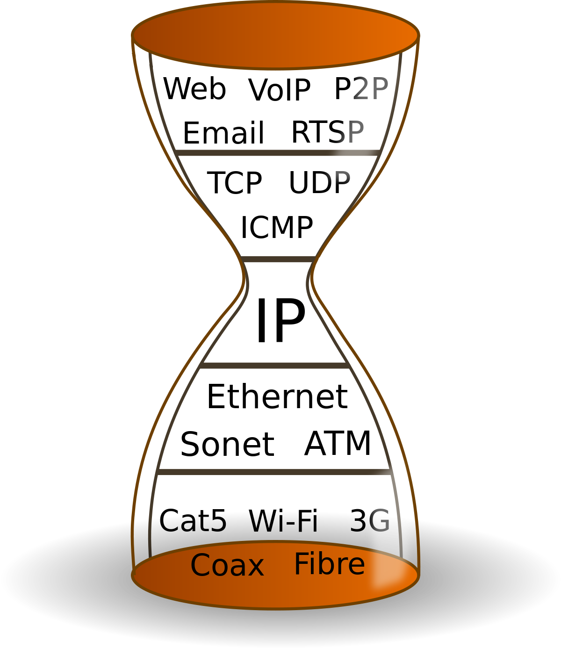
Hourglass Model
Key Principle:
Allows interoperability
Cost of the hourglass model?
10

Slide 11
Best effort
End-to-end argument
Fate Sharing
11

Slide 12
Window-based Congestion Control
TCP Reno
12

Slide 13
Slow Start:
cwnd ← cwnd + MSS
cwnd doubles every RTT
additive
increase
Congestion Avoidance:
cwnd ← cwnd + MSS/cwnd
cwnd + MSS every RTT
multiplicative
decrease
Packet Loss:
cwnd ← cwnd/2
13

Slide 14
Congestion Avoidance
cwnd
Time
Slow start
Congestion avoidance

Slide 15
AIMD ⇒ Convergence to fairness & efficiency
Flow 2
throughput
AIMD
Converge to fairness & efficiency
Flow 1
throughput

Slide 16
Synchronization of TCP Flows
Flows will likely experience packet losses together
cwnd will half at the same time
⇒Synchronization
Can lead to poor utilization!

Slide 17
Explicit Congestion Notification (ECN)
ECN uses last 2 bits in DiffServ field of IP Header.
The latter bit is echoed back by destination host.
TCP responds to ECN bit like dropped packet.
ECT | CT
0 | 0 | Non-ECT
0 | 1 | ECT(1)
1 | 0 | ECT(0)
1 | 1 | CE
}
Nonce

Slide 18
Nonce
A random or non-repeating value that is included in data exchanged by a protocol, usually for the purpose of guaranteeing the transmittal of live data rather than replayed data, thus detecting and protecting against replay attacks.

Slide 19
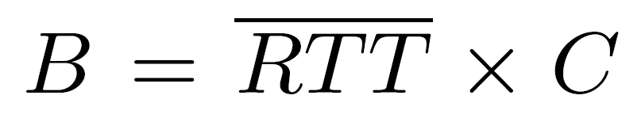
Buffer Sizing Rule of Thumb (1994)
Buffer grows linearly with line rate!
19

Slide 20
Why
?
20

Slide 21
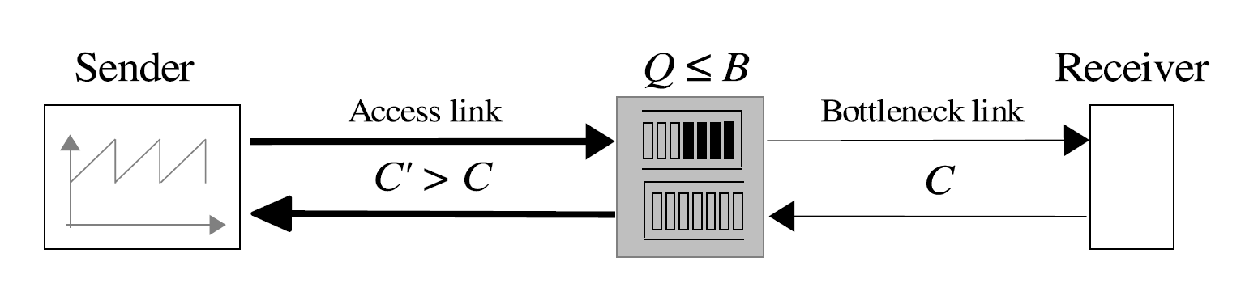
Pause sending
ACK
cwnd
W_{max}
C.RTT+B
How long will buffer take to drain?
W_{max}
B
2
C
Time

Slide 22
cwnd
W_{max}
C.RTT+B
_{cwnd}
Send rate =
RTT
W_{max}
W_{max}
2
Time
=
>= C
2RTT
W_{max} >= 2RTT.C
B
How many packets in buffer when cwnd =W_{max}?
B >=
W_{max} – BDP
“pipe”
>= 2RTT.C – RTT.C
Time
= RTT.C
t₀
t₁
t₂

Slide 23
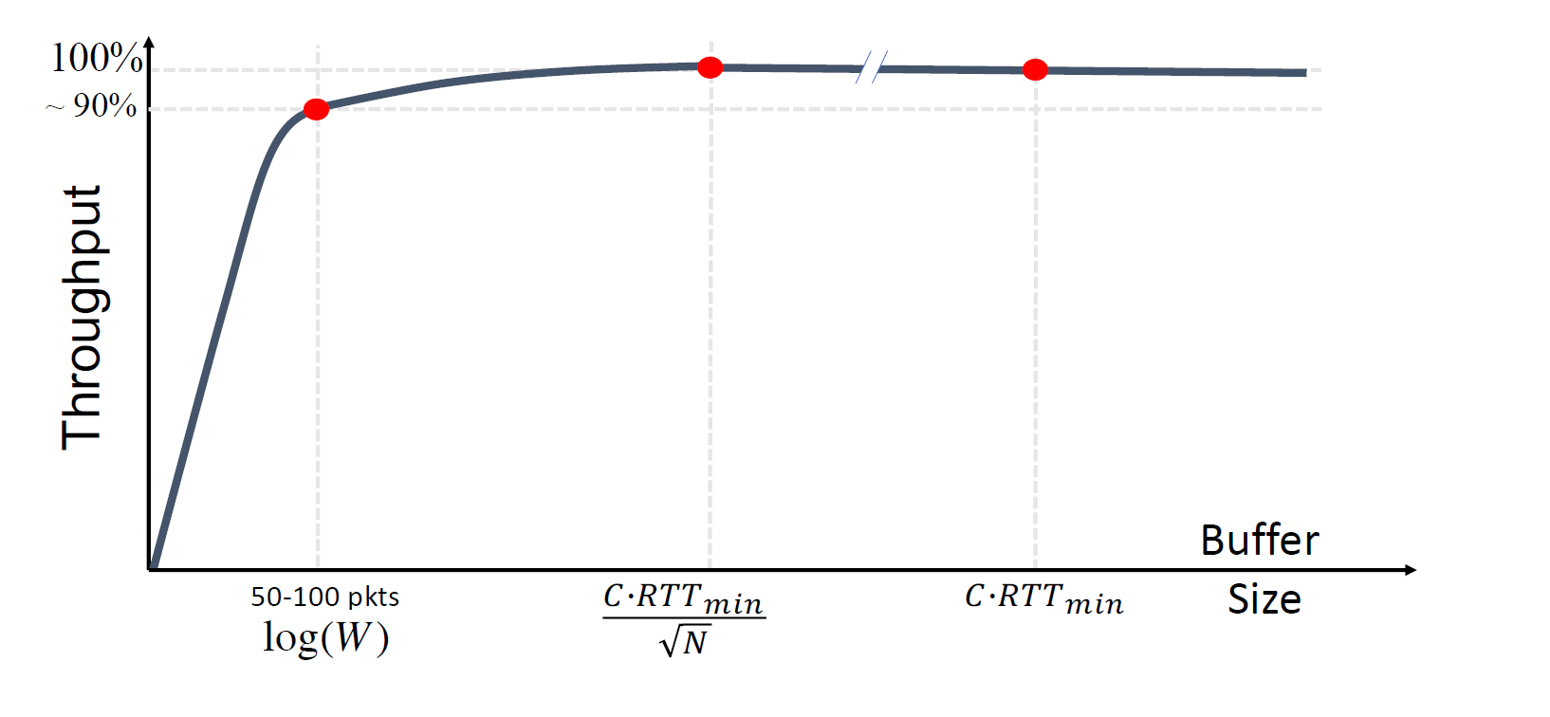
“Tiny buffers”
“Small buffers”
2006
2004
1994
Paced Traffic
Only 20-50 packet buffers

Slide 24
CoDeL
Buffer overflow ⇒ drop packet (as per normal)
Track local minimum queue delay (time)
Start dropping when delay > target
Next drop time is decreased in inverse proportion to the square root of the number of drops since we started dropping
When delay < target, stop dropping

Slide 25
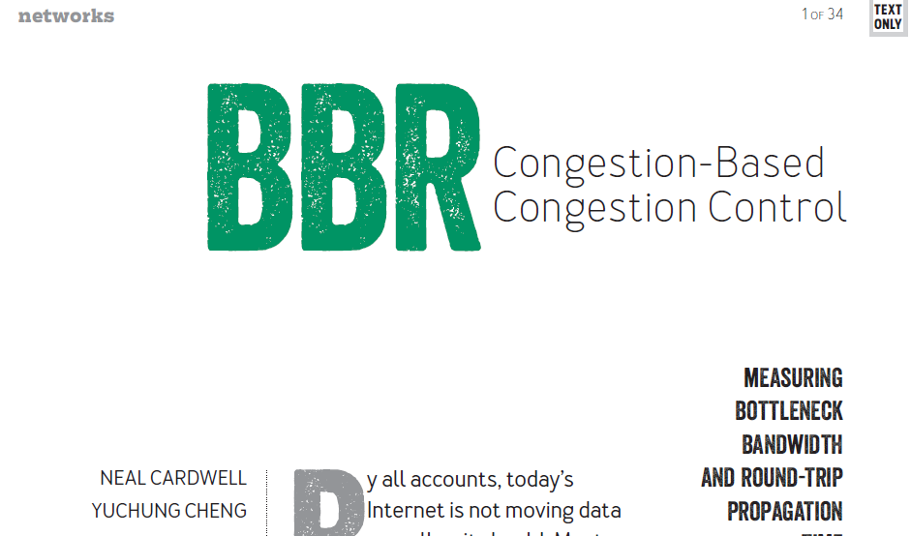

Slide 26
Startup
rate
Increase sending rate by 2.89 times every RTT
When to stop?
BtlBw
3 RTTs where throughput
does not increase > 25%
pkts in
flight
BDP

Slide 27
Drain
rate
Reduce send rate to 4 pkts until in-flight pkts reduced to BDP
BtlBw
Compute
pkts in
flight
BDP

Slide 28
What if more bandwidth becomes available?
PROBE_BW
Drain buffer
RTT_{min}
1.25
0.75
1.00
1.00
1.00
1.00
1.00
1.00
Periodic pattern
Probe for
additional BW

Slide 29
PROBE_RTT
rate
10 s
BtlBw
Synchronize!
pkts in
flight
0.2 s
BDP

Slide 30
Does BBR need a cwnd?
Yes!
cwnd = 2 x BDP!

Slide 31
BBR vs CUBIC
Shallow buffer
Deep buffer
BBR wins!
CUBIC wins!
More BBR flows ⇒ wins less

Slide 32
XCP
Congestion is not binary
Aggressiveness of the sender should be adjusted according to the delay in the feedback-loop.
Robustness to congestion should be independent of unknown and quickly changing parameters, such as the number of flows.
The aggregate rate increases by N packets per RTT, or decreases proportionally to 1/N

Slide 33

XCP Efficiency Controller
RTT
Constants
Aggregate feedback
Can be negative
Spare bandwidth
Persistent queue

Slide 34
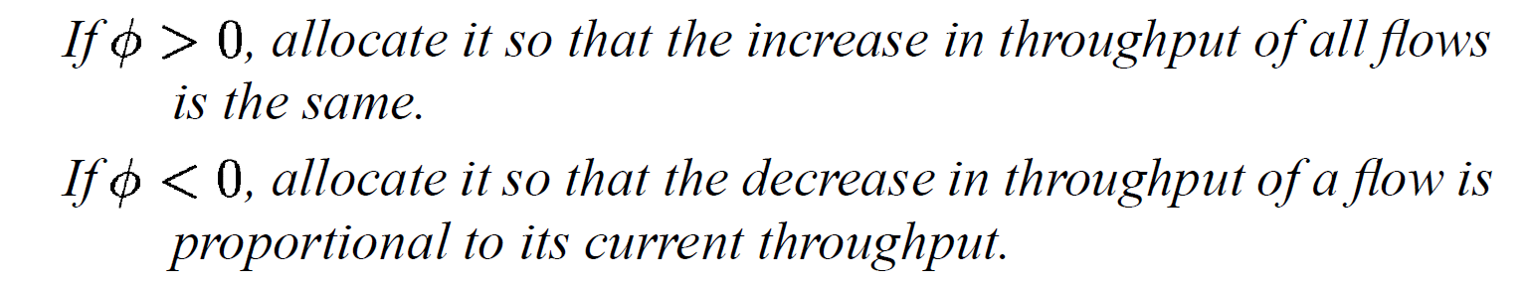
XCP Fairness Controller
Divide aggregate feedback between the flows!
AIMD!

Slide 35
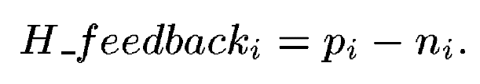




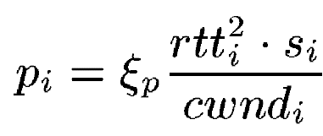
XCP Fairness Controller
:
cwnd
Rate =
⇒
RTT
.
Divide this over the #packets
1
RTT
So,

Slide 36
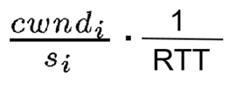
XCP fairness controller (AIMD)
Say XCP wants the ∆cwnd to take effect over some time period t. It would then have the distribute ∆cwnd over K packets, where K is the total number of packets a sender sends during the time period t.
K = (rate in packets per second) x t
same for every flow
packets/cwnd

Slide 37




XCP Fairness Controller
:
.
Divide this over the #packets
1
RTT

Slide 38
Max-min fairness
Max-min fairness does rate allocation over a network, not a single bottleneck
Allocation maximizes the minimum bandwidth allocated to every flow
Key Idea: Every flow must be bottlenecked.

Slide 39
Max-min fairness
An allocation of rate x is “max-min fair” if and only if an increase of any rate within the domain of feasible allocations must be at the cost of a decrease of some already smaller rate.
Depending on the problem, a max-min fair allocation may or may not exist. However, if it exists, it is unique.
Progressive filling

Slide 40
Max-min fairness
5
20
5
15
10
10
20
20
10
10

Slide 41
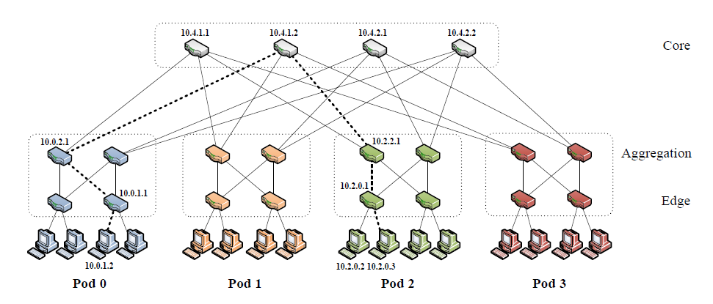
FatTree

Slide 42
Jellyfish
Replace tree with Random
Regular Graph (RRG).
Why should this work better??
Shorter average path lengths!

Slide 43
Part 2 of Final Project

Slide 44
Data Centre Networks
High Throughput
High Burst Tolerance
Low Latency
Deep Buffers (for throughput):
Queuing Delays
Increase Latency
Shallow Buffers:
Bad for Bursts tolerance & Throughput
DCTCP
Reduced RTO_{min} (SIGCOMM ‘09)
Doesn’t Help Latency Still need to ReTx
AQM – RED:
Avg Queue Not Fast
Enough for Incast
Credits: Adapted from Mohammad Alizadeh. DCTCP (SIGCOMM ’10)
Notes:
Deep Buffers for throughput/burst tolerance – bad for latency
Shallow Buffers – bad for bursts & throughput
Reduce RTO_{min} – no good for latency
AQM – Difficult to tune, not fast enough for incast-style micro-bursts, lose throughput in low stat-mux

Slide 45


Data Centres: Buffer Sizing
Bandwidth-delay product rule of thumb:
A single flow needs buffers for 100% Throughput.
Appenzeller rule of thumb (SIGCOMM ‘04):
Large # of flows: is enough.
Can’t rely on statistical multiplexing benefit in the datacenter networks
Measurements show typically 1-2 big flows at each server, at most 4.
Real Rule of Thumb:
Low Variance in Sending Rate → Small Buffers Good Enough!
Credits: Adapted from Mohammad Alizadeh, MIT

Slide 46
DCTCP
Congestion Signal: Use ECN marking (but differently)
Two key ideas
React in proportion to the extent of congestion, not its presence.
Reduces variance in sending rates, lowering queuing requirements.
Mark based on instantaneous queue length.
Fast feedback to better deal with bursts.
ECN Marks | TCP | DCTCP
1 0 1 1 1 1 0 1 1 1 | Cut window by 50% | Cut window by 40%
0 0 0 0 0 0 0 0 0 1 | Cut window by 50% | Cut window by 5%
Credits: Adapted from Mohammad Alizadeh, MIT

Slide 47
TIMELY
Problems we faced while using delay as a congestion signal:
Competing with loss-based flows
Getting an accurate* RTT estimate
We can do this with moderns NICs!

Slide 48
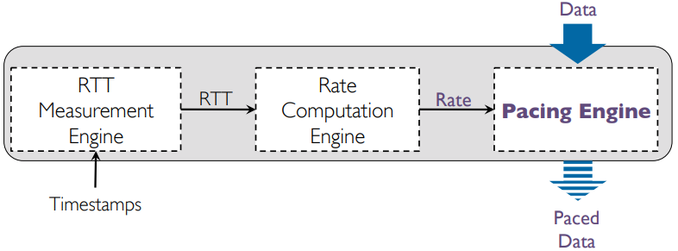

The TIMELY Algorithm
Good ol’ AIMD
Context matters

Slide 49


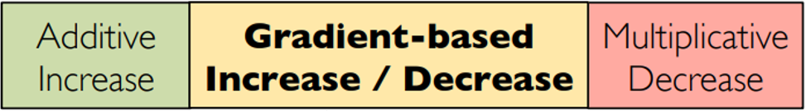


T_low
T_high
normalized_gradient ≤ 0?

Slide 50
Overview: Ad Hoc Routing
Proactive
DSDV
Reactive
DSR
AODV
TORA
Geographic
Nodes know their physical location and their neighbours location (aka GPS)
Notes:
FB Multiget: http://highscalability.com/blog/2009/10/26/facebooks-memcached-multiget-hole-more-machines-more-capacit.html

Slide 51
Geographic Routing
Key idea:
We can use the physical coordinates of the nodes for routing!
Greedy forwarding mostly works!
Notes:
FB Multiget: http://highscalability.com/blog/2009/10/26/facebooks-memcached-multiget-hole-more-machines-more-capacit.html

Slide 52
Face Routing
Destination
Source

Slide 53
Key idea: Planarization
Destination
Source

Slide 54
Key idea: Planarization
Destination
Source
GG
RNG
CLDP
Converting graph to planar graph

Slide 55
GDSTR: Hull Tree Routing
Destination
Source

Slide 56
Geographic Routing
Greedy Forwarding
Recover from Dead End
Back to Greedy Forwarding
Notes:
FB Multiget: http://highscalability.com/blog/2009/10/26/facebooks-memcached-multiget-hole-more-machines-more-capacit.html

Slide 57
Peer-to-Peer Systems
Consistent Hashing
Distributed Hash Tables (DHT)
Recursive vs Iterative Lookup
Rendezvous problem
State “liveness” & Parallel queries
Incentives

Slide 58
Half distance in each step!
O(log n)
steps
Chord
Binary Search

Slide 59
EpiChord
Intrinsically iterative
Additional policies to learn new routing entries:
When a node first joins network, obtains a cache transfer from successor
Nodes gather information by observing lookup traffic

Slide 60
Reactive Cache Management
Traditional (active) approach ⇒ Ping fingers periodically
Reactive approach:
Cache entries have a fixed expiration period
Divide address space into exponentially smaller slices
Periodically check if each slice has sufficient (j) un-expired entries
If not, make a lookup to the midpoint of the offending slice

Slide 61
BitTorrent’s Choking Algorithm
based on Tit-for-tat!
Peers can select who they upload to
Peers often unchoke only the top 4 peers ranked by download rate
With one optimistic unchoke on a random peer
Therefore a selfish peer gets starved because no one will send to him!

Slide 62
BitTorrent’s other practical considerations
Peer selection: BitTorrent selects a finite number of peers randomly from a list of available peers
Rarest first: BitTorrent prioritizes downloading the rare chunks before the common chunks.
Endgame mode: In the end-phase, BitTorrent will open up multiple connections in parallel to get the last few chunks quickly.
Anti-snubbing: When a client is snubbed, peer selection is done based on best upload rate.

Slide 63
Google MapReduce
Map
Reduce
Input
Output
key/value pairs
Intermediate key/value pairs
values (files)
Why is this better?
Simpler, easier to debug
Reuseable components
Easily parallelized
Possible input for another MapReduce operation

Slide 64
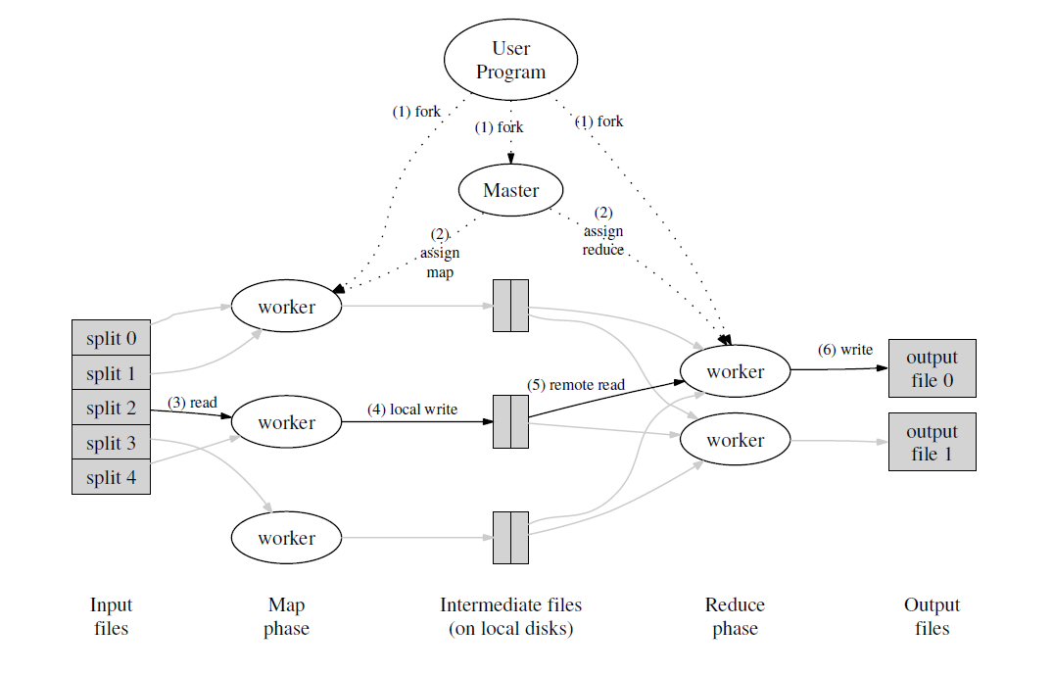
MapReduce
Ideally,
M+R >> n
M pieces
R pieces

Slide 65
Dynamo
Key-Value Store
Consistent Hashing
Vector clocks
Quorum + sloppiness
Merkle Trees
Gossip

Slide 66
Consistent Hashing
successor
6
1
0
7
1
f
6
2
5
3
virtual nodes
4
2

Slide 67
Replication consistency: Quorum
R+W > N
67

Slide 68
Merkle Trees
H(H(H(A)+H(B))+H(H(C)+H(D)))
H(H(H(A)+H(B))+H(H(C’)+H(D)))
H(H(A)+H(B))
H(H(C)+H(D))
H(H(A)+H(B))
H(H(C’)+H(D))
A
B
C
D
A
B
C
D
H(A)
H(B)
H(C)
H(D)
H(A)
H(B)
H(C’)
H(D)
68

Slide 69
Network-Distributed System Co-Design
NOPaxos: Indirection with sequencer
Pegasus: Selective replication with coherence directory
69

Slide 70
Don’t memorize anything
Focus on concepts & understanding!
Exam
open-book!
Open laptop (no internet)!
70

Slide 71
Abstractions
71

Slide 72
Final Admin Notes
Exam instructions forthcoming
Project grading
Questions?
72

Slide 73

Thanks for being great students!
See you in
person next week!
73

