Slide 1
Lecture 5: Network-Assisted Congestion Control
CS5229 Advanced Computer Networks

Slide 2
Quick Admin Notes
Reminder to form teams (12 Sep 23:59)
Venues for end-of-semester assessment confirmed
Questions?
2

Slide 3
Key Lessons for End-to-End Congestion Control
Slow start-Congestion Avoidance
ACK-clocking
Congestion window
Bandwidth-delay product
TCP Friendliness
Signalling congestion + delay-based control loop

Slide 4
Recap: what we need to do
Estimate the available bandwidth
Be “fair” to other flows
Adapt to network changes
Deal with packet loss
“TCP friendliness”
“give way” to new flows
“soak up” available bandwidth
4

Slide 5
Recap: BBR
Packet pacing
From ACKs, measure RTT and BtlBW
Deduce RTT_{min}
Deduce BtlBW_{max}
Regulate send rate around BtlBW_{max}
5

Slide 6
Startup
rate
Increase sending rate by 2.89 times every RTT
When to stop?
BtlBw
3 RTTs where throughput
does not increase > 25%
pkts in
flight
BDP

Slide 7
Drain
rate
Divide sending rate by 2.89
every RTT
Exit when inflight = BDP
BtlBw
How?
Compute
pkts in
flight
BDP

Slide 8
Recap: ECN
ECN uses last 2 bits in DiffServ field of IP Header.
One is set by source to indicate that it is ECN capable. The other bit is set by routers to signal congestion.
The latter bit is echoed back by destination host.
TCP responds to ECN bit like dropped packet.

Slide 9
RFC3168
K Ramakrishnan, Sally Floyd, and D Black. RFC3168: The addition of explicit congestion notification (ECN) to IP, 2001.
9

Slide 10
RFCs
Contain technical recommendations and organizational notes for the Internet
Stands for ‘Request For Comments’
RFCs usually begin as Internet-Drafts (I-Ds) written by an individual or a small group.
In the IETF (Internet Engineering Task Force), these are then usually adopted by a working group, and improved and revised.

Slide 11
Learning Points from RFC3168
Need for incremental deployment ⇒ islands
Attempt to address need for low-latency applications for which packet loss (+retrans) is undesirable
Support active queue management to avoid packet drops
Asymmetric routing is likely to be a normal occurrence in the Internet.

Slide 12
Learning Points from RFC3168
Routers often process the "regular" headers in IP packets more efficiently than IP options.
End-systems should react at most once every RTT
The benefit of lying about participating in new mechanisms such as ECN-capability should be small. ⇒ lack of trust
ECN nonce

Slide 13
Nonce
A random or non-repeating value that is included in data exchanged by a protocol, usually for the purpose of guaranteeing the transmittal of live data rather than replayed data, thus detecting and protecting against replay attacks.

Slide 14
Learning Points from RFC3168
Only knows of RED, but anticipates unknown AQMs
CE codepoint should not be set based on the instantaneous queue size. ⇒ Why?
Fragmentation possible
Middleboxes can cause problems
Dealing with non-compliant flows
1-bit implementation vs 2-bit implementation

Slide 15
eXplicit Control Protocol, XCP
Dina Katabi, Mark Handley, and Charlie Rohrs. Congestion control for high bandwidth-delay product networks. In Proceedings of the 2002 conference on Applications, technologies, architectures, and protocols for computer communications, pages 89–102, 2002
SIGCOMM Test Of Time Paper Award, 2014
15

Slide 16
XCP: Motivation
AQM instability for high bandwidth flows
TCP’s additive increase policy limits its ability to acquire spare bandwidth to one packet per RTT
Short TCP flows cannot acquire the spare bandwidth fast enough
RTT unfairness
eXplicit Control Protocol, XCP, generalizes ECN

Slide 17
Recap: RED
Router knows when congestion is building up!
No need to wait for buffer to overflow before signalling congestion!
⇒propagation delay v queueing delay
Key insight:
Router can tell end-points what bandwidth!

Slide 18
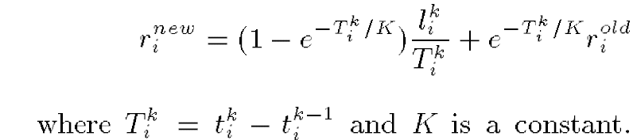
Recap: CSFQ
Edge routers vs core routers
Only edge routers store per flow state
Approximate max-min fairness
Edge routers estimate rate:
Inserted into packet labels
Comms + avoid per-flow state

Slide 19
Key idea: Decouple utilization control from fairness control.
19

Slide 20
Utilization control :
Adjust aggressiveness according to delay feedback
Fairness control :
Reclaim bandwidth from flows with more than fair share
20

Slide 21
XCP: Design Considerations
Congestion is not binary
Aggressiveness of the sender should be adjusted according to the delay in the feedback-loop.
Robustness to congestion should be independent of unknown and quickly changing parameters, such as the number of flows.
The aggregate rate increases by N packets per RTT, or decreases proportionally to 1/N

Slide 22
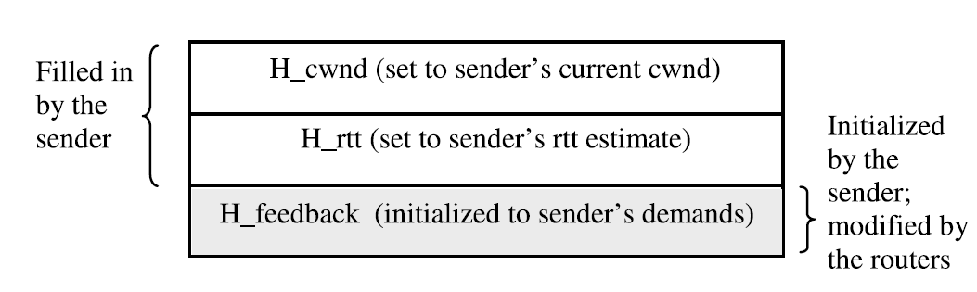
XCP Header
cwnd = max(cwnd + H_feedback, packet size)

Slide 23

XCP Efficiency Controller
RTT
Constants
Aggregate feedback
Can be negative
Spare bandwidth
Persistent queue

Slide 24
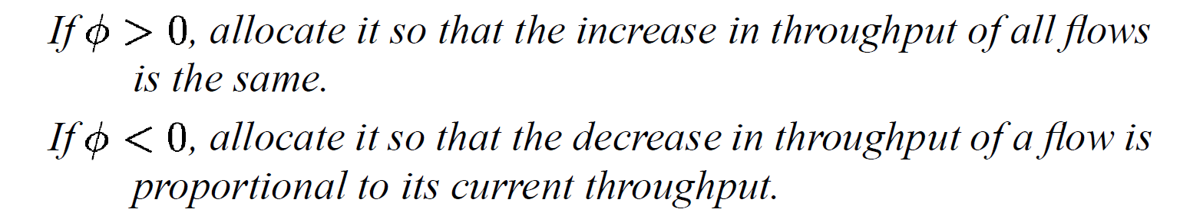
XCP Fairness Controller
Divide aggregate feedback between the flows!
AIMD!
+ Bandwidth shuffling

Slide 25
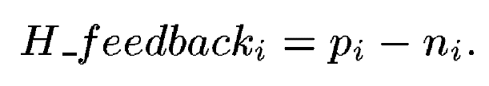




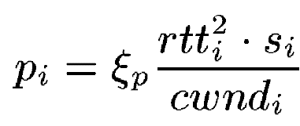
XCP Fairness Controller
:
cwnd
Rate =
⇒
RTT
.
Divide this over the #packets
1
RTT
So,

Slide 26




XCP Fairness Controller
:
.
Divide this over the #packets
1
RTT

Slide 27
XCP: Implementation
Aggregate state, not per-flow state
Can replace AIMD/MIMD with other controllers
Robust to estimation errors
Incremental Deployment
TCP Friendliness
Everything needs to be modified ☹

Slide 28
Rate Control Protocol (RCP)
Nandita Dukkipati, Masayoshi Kobayashi, Rui Zhang-Shen, and Nick McKeown. Processor sharing flows in the internet. In International Workshop on Quality of Service, pages 271–285, 2005.
28

Slide 29
RCP: Motivation
XCP is good for long-lived flows, but many flows are short-lived
Many flows finish before TCP finds the correct rate
Instead of incremental changes every RTT, just set(!) the rate!

Slide 30
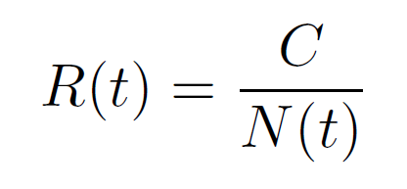
Naïve solution
But, it is hard to estimate N(t)
Also, there is a delay, by the time we sent R(t) to the sender, N(t) would have changed!
Recall CSFQ

Slide 31
RCP: Implementation
Each router maintains R(t)
Packets carry R_{p} in header. Updated by routers with minimal R_{p}
Source sends at R_{p} echoed in ACKs
R(t) is updated every RTT

Slide 32
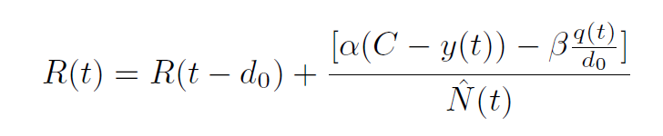

Updating R(t)
RTT
Constants
queue size
Capacity
#flows
input traffic

Slide 33
What if some flows don’t have enough data to send at R(t)?
Recall: max-min fairness
33

Slide 34
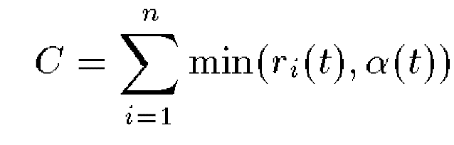
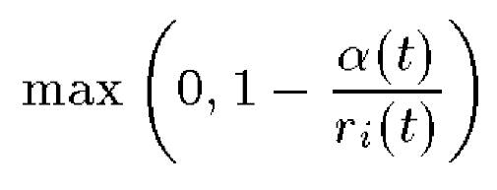
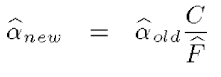
Recall: CSFQ
Fair share α(t):
Drop probability:
Estimate aggregate arrival rate A and accepted traffic F
If A < C, α(t) will be largest r_{i}(t) seen
Else,

Slide 35
S-Perc
Lavanya Jose, Stephen Ibanez, Mohammad Alizadeh, and Nick McKeown. A distributed
algorithm to calculate max-min fair rates without per-flow state. Proceedings of the ACM on Measurement and Analysis of Computing Systems, 3(2):1–42, 2019.
Achieves max-min fairness
35

Slide 36
Max-min fairness
Max-min fairness does rate allocation over a network, not a single bottleneck
Maximize the minimum bandwidth allocated to every flow
Key Idea: Every flow must be bottlenecked.
FQ is not Max-min fair
Fair allocation
Fair allocation
Fair allocation
Which flow here is not bottlenecked?

Slide 37
Max-min fairness
Max-min fairness does rate allocation over a network, not a single bottleneck
Maximize the minimum bandwidth allocated to every flow
Key Idea: Every flow must be bottlenecked.
Actual bandwidth
Actual bandwidth
Actual bandwidth
Which flow here is not bottlenecked?

Slide 38
Max-min fairness
The Yellow flow is not bottlenecked
We can be smarter about our allocation. Locally:
Allocate non-bottlenecked flows their bottleneck bandwidth.
Allocate bottlenecked flows fair share of remaining bandwidth
Actual bandwidth
Actual bandwidth
Actual bandwidth
Which flow here is not bottlenecked?

Slide 39
Max-min fairness
The Yellow flow is not bottlenecked
We can be smarter about our allocation. Locally:
Allocate non-bottlenecked flows their bottleneck bandwidth.
Allocate bottlenecked flows fair share of remaining bandwidth
Fair allocation
Fair allocation
Fair allocation
Bottlenecked flow
Non-bottlenecked flow

Slide 40
Max-min fairness
The Yellow flow is not bottlenecked
We can be smarter about our allocation. Locally:
Allocate non-bottlenecked flows their bottleneck bandwidth.
Allocate bottlenecked flows fair share of remaining bandwidth
Actual bandwidth
Actual bandwidth
Actual bandwidth
All flows are bottlenecked now!

Slide 41
S-Perc
Claim: reactive congestion control algorithms converge too slowly
Extra header
No per-flow state
Bounded convergence time

Slide 42
Summary
Routers know a lot
We can do better CC with network support
Need for incremental deployment
Embedding information in packet headers to avoid per-flow state
Feedback loop can become unstable if delay increases
Convergence & stability matters

Slide 43
Network-Assisted Algorithms not successfully deployed
Why do people think that it’s so?
43

Slide 44
Next week:
What happens in data centres
44

