Slide 1
Lecture 8: Wireless Ad Hoc Networks
CS5229 Advanced Computer Networks

Slide 2
Questions?
Quick Admin Notes
Course consultation sometime next week
Please indicate your preferences on the Google form shared on Coursemology/Teams before this Sunday, 10 PM
Simpler Training questions
2

Slide 3
Recap: Software Defined Networks
Difficult to add new features because switches are closed sourced and proprietary
→SDN 1.0 (Openflow)
Key idea: Indirection
Too many protocols to support
+ advances in programmable archecture
Programming language to specify hardware pipelines
→SDN 2.0 (P4)

Slide 4
What happens the network is not wired and fixed?

Slide 5
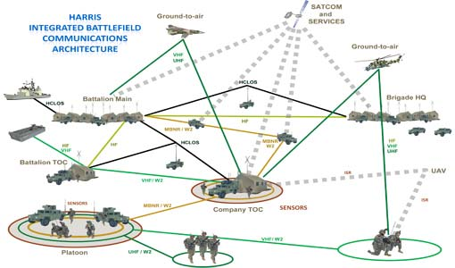
Credit: Kurdziel, Michael. (2014). Cyber Threat Model for Tactical Radio Networks. 910305. 10.1117/12.2047582.

Slide 6
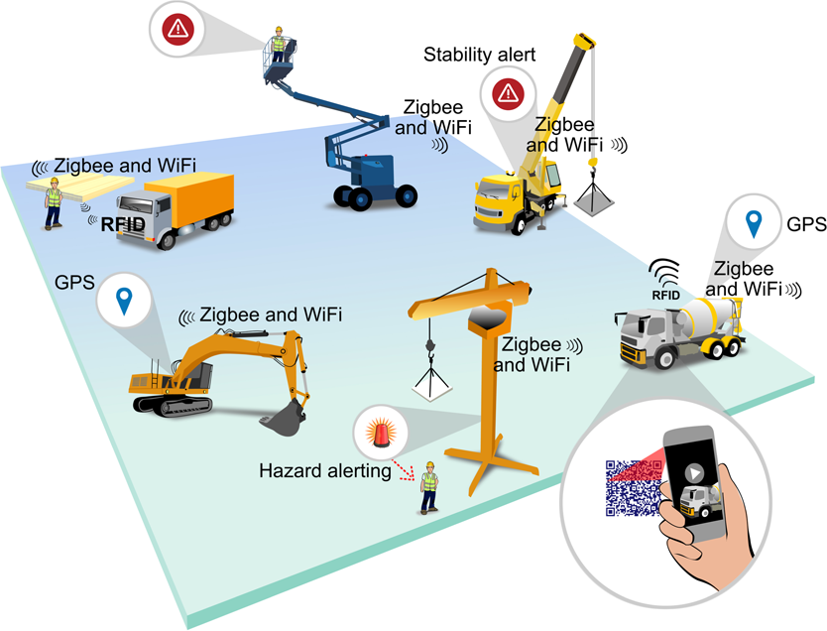
Credit: Emerald Insight

Slide 7
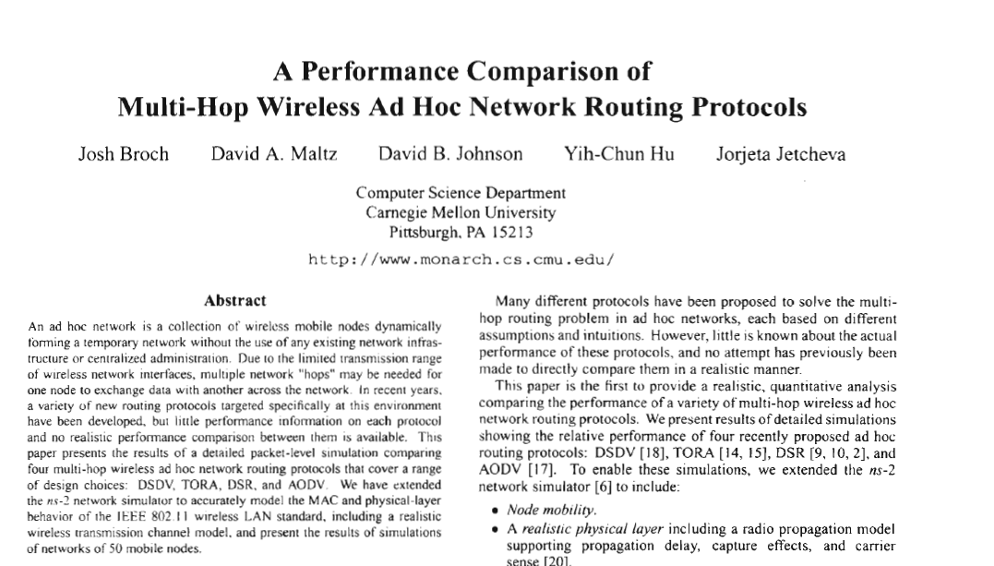
Wireless Ad Hoc Networks (1990’s)

Slide 8
Wireless Ad Hoc Networks
Wireless nodes coming together without centralized infrastructure or administration
Wireless transmissions have limited range
Two different problems:
Naming
Routing
→ Require multiple hops to reach destination
Correctness
Efficiency
Overheads
Notes:
FB Multiget: http://highscalability.com/blog/2009/10/26/facebooks-memcached-multiget-hole-more-machines-more-capacit.html

Slide 9
DSDV (1994)
Destination-Sequenced Distance-Vector Routing (DSDV)
Each node progates a distance vector to neighbours → Take path with fewer hops
Problem: count to infinity
Broadcast periodic updates
~ Bellman-Ford
→ Add a sequence number
Notes:
FB Multiget: http://highscalability.com/blog/2009/10/26/facebooks-memcached-multiget-hole-more-machines-more-capacit.html

Slide 10
DSR (1996)
Dynamic Source Routing(DSR)
Route Discovery
Broadcast Route Request (store route in packet)
Destination sends Route Reply on reverse path
Intermediate nodes cache route with TTL
Route Maintenance: Node sends Route Error if a link fails
Notes:
FB Multiget: http://highscalability.com/blog/2009/10/26/facebooks-memcached-multiget-hole-more-machines-more-capacit.html

Slide 11
AODV (1997)
Ad hoc On-Demand Distance Vector (AODV) Routing
Cross between DSR and DSDV
Instead of source routing, maintain one-hop routing entries at nodes
Periodic HELLO packets to ensure that routing table is still valid
Why is source routing considered nasty?
Notes:
FB Multiget: http://highscalability.com/blog/2009/10/26/facebooks-memcached-multiget-hole-more-machines-more-capacit.html

Slide 12
TORA (1997)
Temporally-Ordered Routing Algorithm (TORA)
Create routes on demand
Routes will be a DAG to the destination
Maintains routes using height data tuple:
(τ_{i}, oid _{i}, r _{i}, δ_{i}, i)
“Timestamp”
Node
created
Reflection Flag
Ref Level
Router
Notes:
FB Multiget: http://highscalability.com/blog/2009/10/26/facebooks-memcached-multiget-hole-more-machines-more-capacit.html

Slide 13
Source
QRY
QRY
QRY
Dest

Slide 14
Source
QRY
QRY
Dest
QRY

Slide 15
Source
QRY
QRY
QRY
QRY
Dest

Slide 16
Source
QRY
QRY
QRY
Dest

Slide 17
Source
UPD
UPD
Dest

Slide 18
Source
UPD
UPD
UPD
Dest

Slide 19
Source
Dest
UPD
UPD
UPD

Slide 20
Source
Many routes to destination
Dest

Slide 21
Source
UPD
Still ok!
UPD
Dest

Slide 22
Source
Dest

Slide 23
Source
Still ok!
Dest

Slide 24
Not ok!
Source
Detects partition
Dest

Slide 25
Key ideas
“Loop free”
→ DAG
(τ_{i}, oid _{i}, r _{i}, δ_{i}, i)
“Timestamp”
Node
created
Reflection Flag
Ref Level
Router
Sequence number
Multiple routes
→ No urgency to repair
25

Slide 26
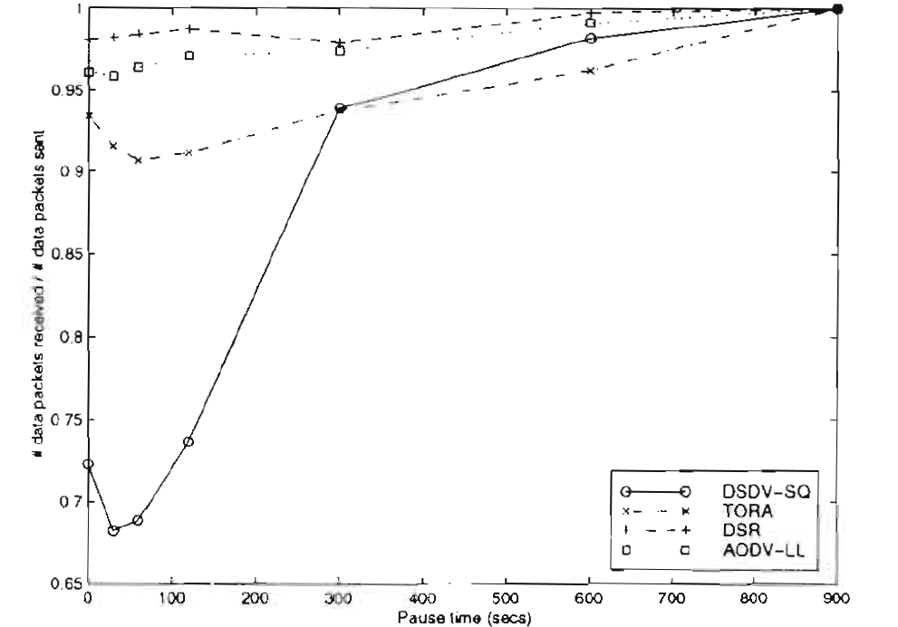
Performance
%received
constantly moving
pause time
Notes:
FB Multiget: http://highscalability.com/blog/2009/10/26/facebooks-memcached-multiget-hole-more-machines-more-capacit.html

Slide 27
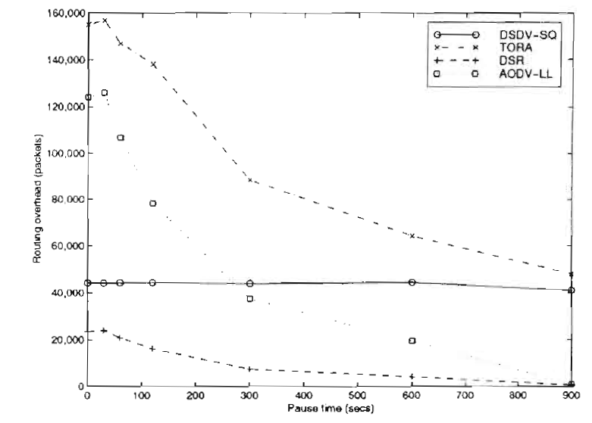
Overheads
Overheads (pkts)
pause time
Notes:
FB Multiget: http://highscalability.com/blog/2009/10/26/facebooks-memcached-multiget-hole-more-machines-more-capacit.html

Slide 28
Which is the best routing algorithm?

Slide 29
The answer to all questions:
It depends

Slide 30
Overview: Ad Hoc Routing
Proactive
DSDV
Reactive
DSR
AODV
TORA
Geographic
Nodes know their physical location and their neighbours location (aka GPS)
Notes:
FB Multiget: http://highscalability.com/blog/2009/10/26/facebooks-memcached-multiget-hole-more-machines-more-capacit.html

Slide 31
Geographic Routing
Source

Slide 32
Geographic Routing
Destination
Source

Slide 33
Geographic Routing
Destination
Source

Slide 34
Greedy Forwarding
Destination
Source

Slide 35
Greedy Forwarding
Destination
Source

Slide 36
Greedy Forwarding
Destination
Source
How?
Whoops. Dead end!

Slide 37
Geographic Routing: Handling dead ends in greedy forwarding

Slide 38
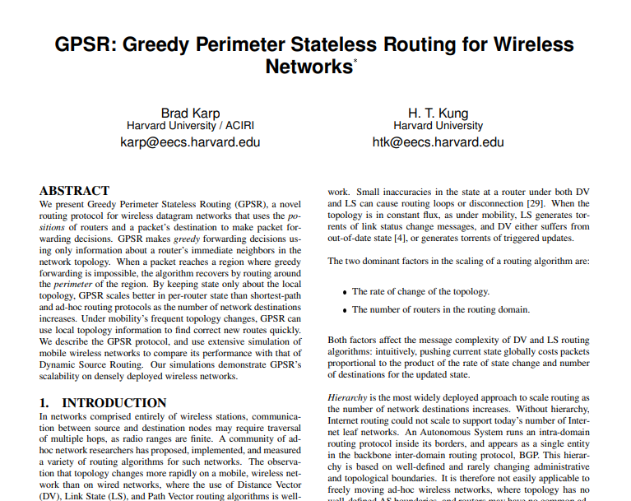
Greedy Perimeter Stateless Routing (2000)

Slide 39
Key idea: Planarization
Destination
Source
Converting graph to planar graph
No overlapping links

Slide 40
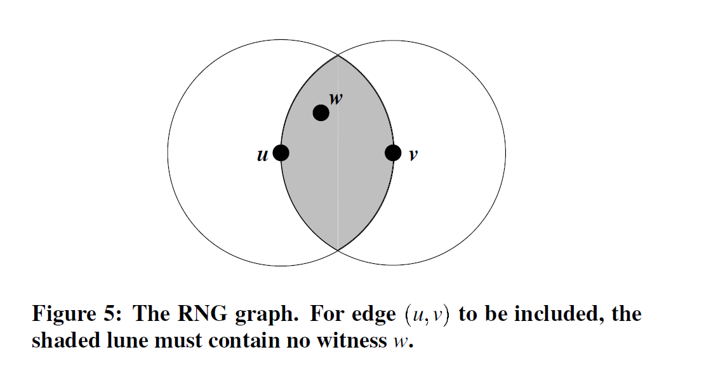

Slide 41
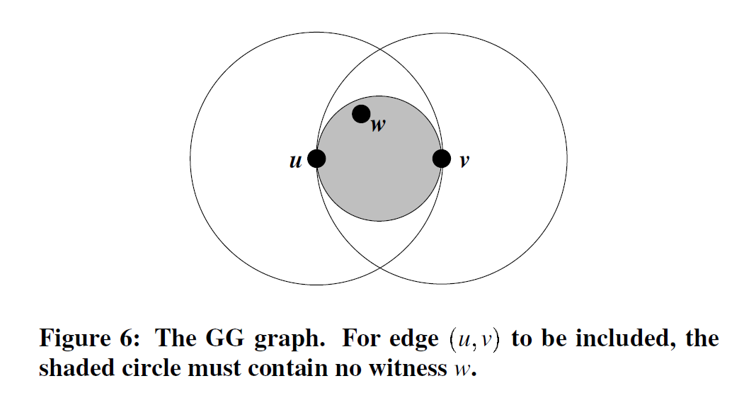

Slide 42
Key idea: Planarization
Destination
Source

Slide 43
Face Routing
Destination
Source

Slide 44
Face Routing
Destination
Source
“Right hand rule”

Slide 45
Face Routing
Destination
Source

Slide 46
Back to Greedy Forwarding
Destination
Source

Slide 47
Back to Greedy Forwarding
Destination
Source

Slide 48
Back to Greedy Forwarding
Destination
Source

Slide 49
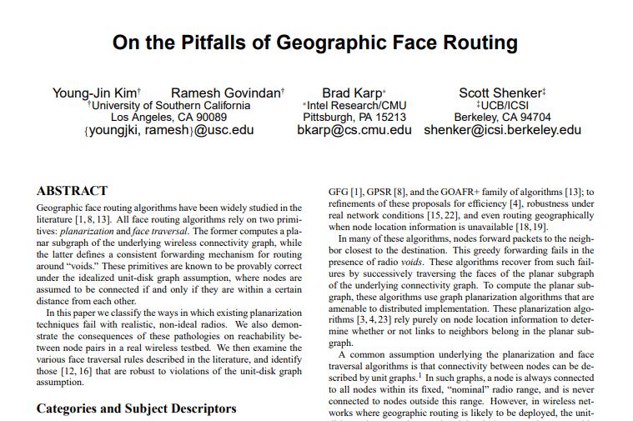
Face Routing is pretty bad

Slide 50
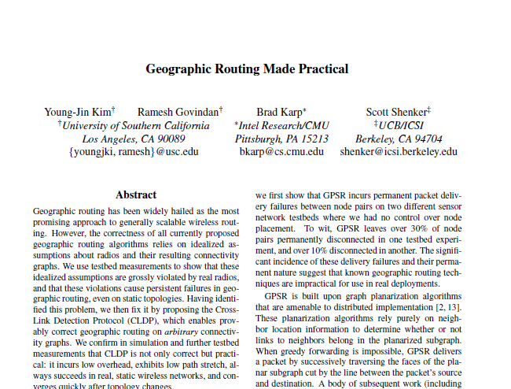
Planarization done right

Slide 51
Planarization is Costly!
Planarization is hard for real networks
GG and RNG (proposed for GPSR) don’t work
Planarization is complicated & costly!
CLDP (Kim et al., 2005)
→ Send probes using “right hand rule” to detect “overlapping” links.

Slide 52
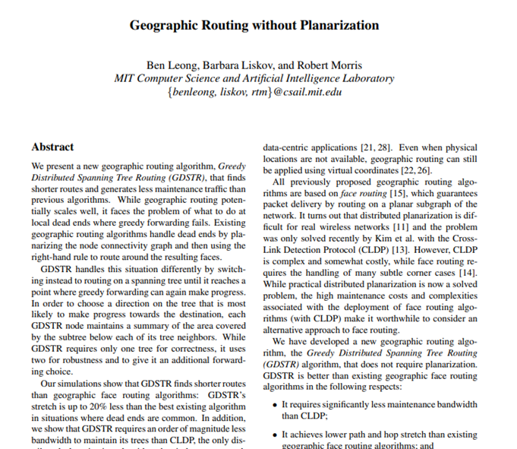
Let’s get rid of Planarization (2006)

Slide 53
Greedy Distributed Spanning Tree Routing (GDSTR)
Route on a spanning tree
Use convex hulls to “summarize” the area covered by a subtree
convex hulls tells us what points are possibly reachable
reduces the subtree that must be traversed (smaller search problem)

Slide 54
Hull Tree

Slide 55
GDSTR Example
Destination
Source

Slide 56
GDSTR Example
Destination
Source

Slide 57
GDSTR Example
Destination
Source

Slide 58
Destination
Source

Slide 59
GDSTR Example
Destination
Source

Slide 60
GDSTR Example
Destination
Source

Slide 61
GDSTR Example
Destination
Source

Slide 62
GDSTR Example
Destination
Source

Slide 63
GDSTR Example
Destination
Source

Slide 64
Revert to Greedy Forwarding
Destination
Source

Slide 65
Revert to Greedy Forwarding
Destination
Source

Slide 66
Revert to Greedy Forwarding
Destination
Source

Slide 67
Issues
Choosing forwarding direction
multiple hull trees
Undeliverable packets
conflict Hulls

Slide 68
Using Multiple Trees
Source
Destination

Slide 69
Using Multiple Trees
Source
Destination
With one tree, may be forced to route in “bad” direction.

Slide 70
Using Multiple Trees
Source
Destination
Two extremal-rooted trees are usually sufficient to “approximate” a void

Slide 71
Using Multiple Trees
Source
Destination
Pick tree with root closest to the destination

Slide 72
Key insight: in a local minimal, there are 2 choices to get around the “void,” hull trees allow us to pick well.

Slide 73
Summary: GDSTR Routing
Try greedy forwarding
Dead end:
choose tree
record start node
traverse subtree
If possible, revert to greedy forwarding
Back to start node: packet undeliverable

Slide 74
Is geographic routing proactive or reactive?

Slide 75
What if we don’t have access to the real physical locations?

Slide 76
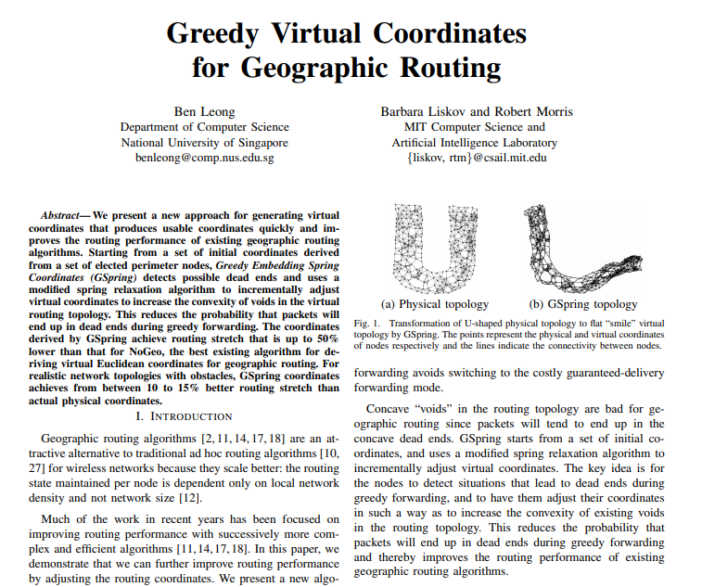
Virtual Coordinates!

Slide 77
Why are we learning about geographic routing?

Slide 78
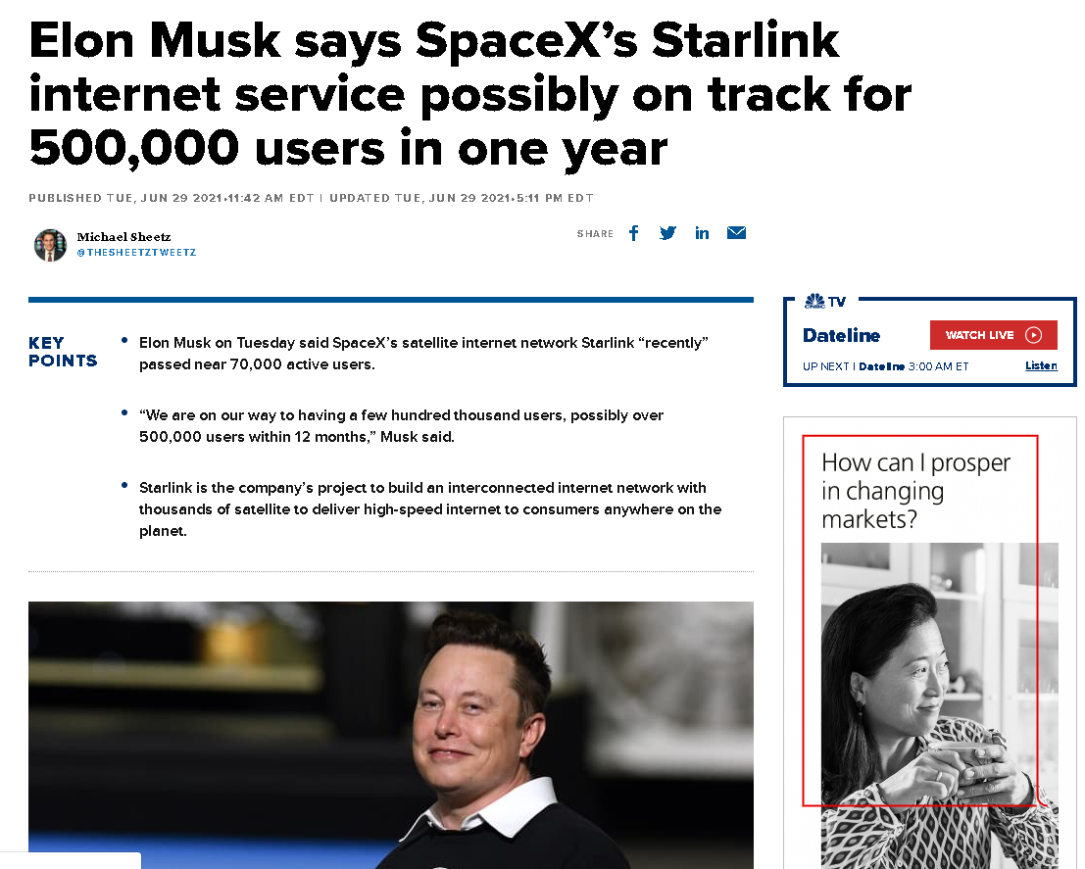
Credit: CNBC

Slide 79
Summary
Context and assumptions matter
Rate of change
Location information
Routing
Correctness
Efficiency
Overheads
Fixing greedy forwarding
Exploit Structure
Tree-based summary

