Slide 1
CPS 590: Software Defined Networking
Theophilus Benson

Slide 2
Welcome!

Slide 3
Administrative Details
Course Format
Student Engagement (30%)
Class Participation (20%)
Paper Reviews (10%)
Course Assignments (20%)
Learning to use SDN environments
Writing Controller Applications
Course Project (60%)
Deep dive into an SDN topic

Slide 4
Outline
Section 1: SDN Ecosystem
SDN Motivation
SDN Primer
Dimensions of SDN Environments
Dimensions of SDN Applications
Section 2: OpenFlow Primer
Section 3: Demo/Use-cases
Network Virtualization
Section 4: SDN Challenges
SDN Challenges

Slide 5
Section 1

Slide 6
Network Today…
Vertical integrated stacks
Similar to PC in 1980s
D.B.
COBOL Apps.
L3 Routing
VLANS
O.S
Switch O.S.
CPU
ASIC
IBM’s Mainframe
Cisco Routers

Slide 7
Implications of Networking…
Restricted to ill defined vendor CLI
Provisioning is slow….
VM provisioning: 1min
Virtual network provisioning: 1-3 weeks

Slide 8
Background: Switch Internals
Logical View of a Switch
Physical Architecture of a Switch
Processor
control plane
data plane
ASIC
Switching
Fabric
AISC
Applications
Applications
Network O.S.
ASIC

Slide 9
Software Defined Networking
Current Switch
Vertical stack
Applications
Applications
Applications
Network O.S.
Applications
Applications
SDN
Network O.S.
Southbound
API
ASIC
SDN Switch
Decoupled stack
Switch Operating System
Switch Hardware
Southbound API: decouples the switch hardware from control function
Data plane from control plane
Switch Operating System: exposes switch hardware primitives

Slide 10
Implications Of SDN
Current Networking
SDN Enabled Environment
Applications
Applications
Applications
Applications
Applications
Applications
Applications
Network O.S.
Network O.S.
Global View
ASIC
ASIC
Controller (N. O.S.)
Applications
Applications
Network O.S.
Programmatic
Control
Southbound
API
ASIC
Switch O.S
Switch HW
Switch O.S
Switch O.S
Switch HW
Switch HW

Slide 11
Implications Of SDN
Current Networking
SDN Enabled Environment
Applications
Applications
Applications
Applications
Applications
Applications
Applications
Network O.S.
Network O.S.
Controller (N. O.S.)
ASIC
ASIC
Southbound
API
Switch O.S
Applications
Switch HW
Applications
Network O.S.
Switch O.S
Switch O.S
Switch HW
Switch HW
ASIC
Distributed protocols
Each switch has a brain
Hard to achieve optimal solution
Network configured indirectly
Configure protocols
Hope protocols converge
Global view of the network
Applications can achieve optimal
Southbound API gives fine grained control over switch
Network configured directly
Allows automation
Allows definition of new interfaces

Slide 12

How SDN Works
Applications
Applications
Applications
Controller (N. O.S.)
Southbound
API
Switch O.S
Switch O.S
Switch H.W
Switch H.W

Slide 13
How to Pick an SDN Environment
Applications
Applications
How easy is it to develop on for the
Controller platform?
Applications
Network O.S.
SDN
What is the Southbound AP!?
Southbound
API
Switch Operating System
Is the switch virtual or physical?
Switch Hardware
Is the switch hardware and OS closed?

Slide 14
The SDN Stack
oftrace
oflops
openseer
Monitoring/ debugging tools
ENVI (GUI)
LAVI
n-Casting
…
Applications
NOX
Beacon
Trema
FloodLight
…
Controller
Slicing
Software
FlowVisor
Console
FlowVisor
Commercial Switches
Software
Ref. Switch
NetFPGA
Broadcom
Ref. Switch
HP, IBM, NEC, Pronto, Juniper.. and many more
OpenFlow
Switches
OpenWRT
PCEngine WiFi AP
Open vSwitch
Source: SDN Tutorial by B. Heller
Open Networking Summit, April 2012
14
Notes:
There are components at different levels that work together in making it work

Slide 15
Dimensions of SDN Environments: Vendor Devices
Vertical Stacks
Whitebox Networking
Vendor bundles switch and switch OS
Restricted to vendor OS and vendor interface
Low operational overhead
One stop shop
Vendor provides hardware with no switch OS
Switch OS provided by third party
Flexibility in picking OS
High operational overhead
Must deal with multiple vendors

Slide 16
Dimensions of SDN Environments: Switch Hardware
Virtual: Overlay
Physical: Underlay
Pure software implementation
Assumes programmable virtual switches
Run in Hypervisor or in the OS
Larger Flow Table entries (more memory and CPU)
Backward compatible
Physical switches run traditional protocols
Traffic sent in tunnels
Lack of visibility into physical network
Fine grained control and visibility into network
Assumes specialized hardware
Limited Flow Table entries

Slide 17
Dimensions of SDN Environments: Southbound Interface
OpenFlow
BGP/XMPP/IS-IS/NetConf
Flexible matching
L2, L3, VLAN, MPLS
Flexible actions
Encapsulation: IP-in-IP
Address rewriting:
IP address
Mac address
Limited matching
IS-IS: L3
BGP+MPLS: L3+MPLS
Limited actions
L3/l2 forwarding
Encapsulation

Slide 18
Dimensions of SDN Environments: Controller Types
Modular Controllers
High Level Controllers
Application code manipulates forwarding rules
E.g. OpenDaylight, Floodlight
Written in imperative languages
Java, C++, Python
Dominant controller style
Application code specifies declarative policies
E.g. Frenetic, McNettle
Application code is verifiable
Amendable to formal verification
Written in functional languages
Nettle, OCamal

Slide 19
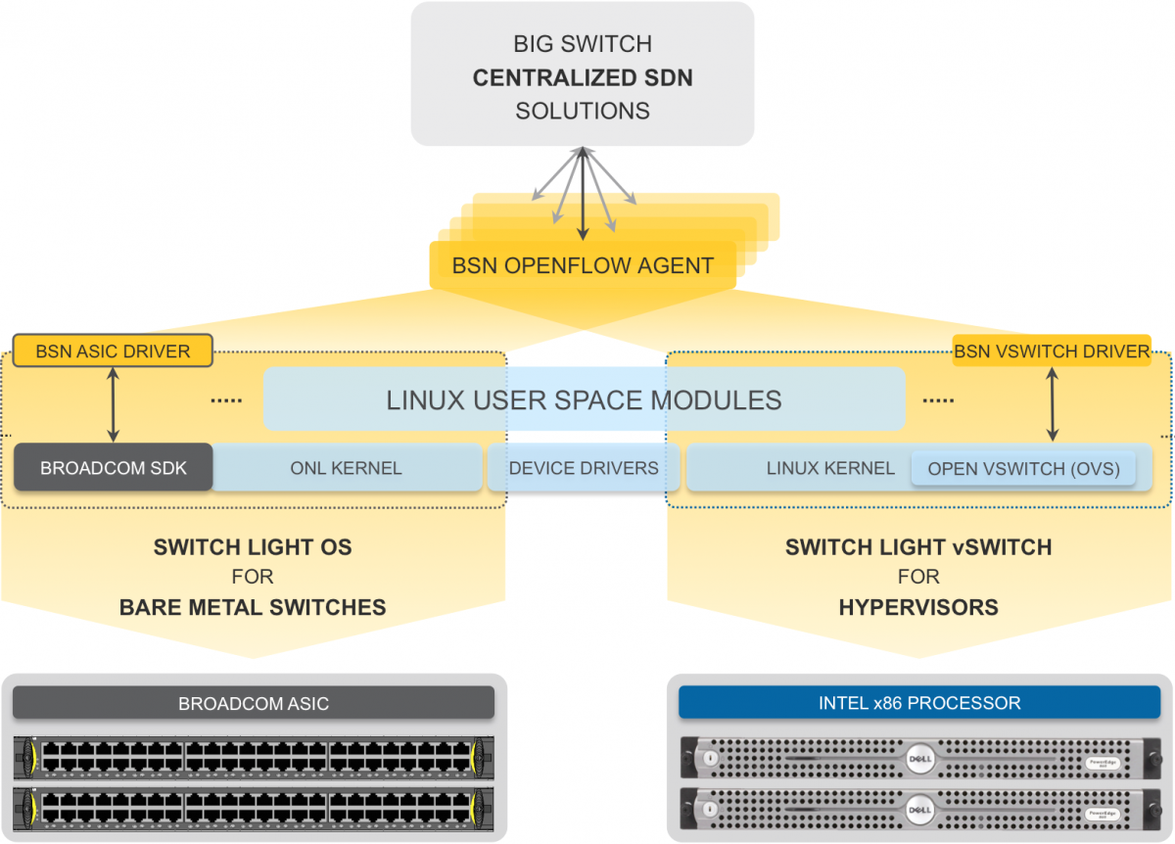
BigSwitch
Controller Type
Modular: Floodlight
Southbound API: OpenFlow
OpenFlow 1.3
SDN Device: Whitebox
(indigo)
SDN Flavor
Underlay+Overlay

Slide 20
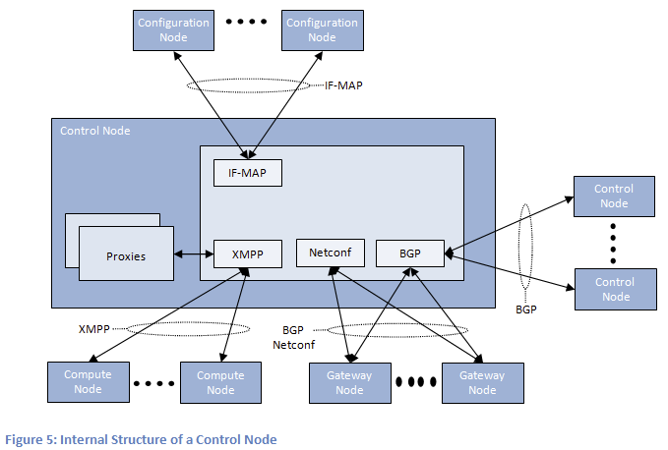
Juniper Contrail
Controller Type
Modular: OpenContrail
Southbound API: XMPP/NetConf
BGP+MPLS
SDN Device: Vertical Stack
Propriety Junos
SDN Flavor
Overlay

Slide 21
SDN EcoSystem
Arista
Broadcom
Cisco
OF + proprietary
OF + proprietary
OF + proprietary
Underlay
Underlay
Underlay+Overlay
Vertical Stack
Vertical Stack
Vertical Stack
HP
Dell
FloodLight
HP
OF
OF
OF
OF
Underlay
Underlay
Underlay+Overlay
Underlay
Vertical Stack
Vertical Stack
Whitebox
Vertical Stack
Juniper
Alcatel
BGP+NetConf
BGP
Overlay
Overlay
Vertical Stack
Vertical Stack

Slide 22
SDN Stack
Applications
Applications
Applications
Controller (Network O.S.)
SDN
Southbound
API
Switch Operating System
Switch Hardware
Southbound API: decouples the switch hardware from control function
Data plane from control plane
Switch Operating System: exposes switch hardware primitives

Slide 23
Section2: Southbound API: OpenFlow

Slide 24

OpenFlow
Developed in Stanford
Standardized by Open Networking Foundation (ONF)
Current Version 1.4
Version implemented by switch vendors: 1.3
Allows control of underlay + overlay
Overlay switches: OpenVSwitch/Indigo-light
PC

Slide 25
How SDN Works: OpenFlow
Applications
Applications
Applications
Controller (N. O.S.)
OpenFlow
OpenFlow
Southbound
API
Switch O.S
Switch O.S
Switch H.W
Switch H.W

Slide 26
OpenFlow: Anatomy of a Flow Table Entry
Match
Action
Counter
Priority
Time-out
When to delete the entry
What order to process the rule
# of Packet/Bytes processed by the rule
Forward packet to zero or more ports
Encapsulate and forward to controller
Send to normal processing pipeline
Modify Fields
Switch
Port
VLAN
ID
VLAN
pcp
MAC
src
MAC
dst
Eth
type
IP
Src
IP
Dst
IP
ToS
IP
Prot
L4
sport
L4
dport

Slide 27
OpenFlow: Types of Messages
Asynchronous (Controller-to-Switch)
Send-packet: to send packet out of a specific port on a switch
Flow-mod: to add/delete/modify flows in the flow table
Asynchronous (initiated by the switch)
Read-state: to collect statistics about flow table, ports and individual flows
Features: sent by controller when a switch connects to find out the features supported by a switch
Configuration: to set and query configuration parameters in the switch
Asynchronous (initiated by the switch)
Packet-in: for all packets that do not have a matching rule, this event is sent to controller
Flow-removed: whenever a flow rule expires, the controller is sent a flow-removed message
Port-status: whenever a port configuration or state changes, a message is sent to controller
Error: error messages
Symmetric (can be sent in either direction without solicitation)
Hello: at connection startup
Echo: to indicate latency, bandwidth or liveliness of a controller-switch connection
Vendor: for extensions (that can be included in later OpenFlow versions)

Slide 28
Dimension of SDN Applications: Rule installation
Proactive Rules
Reactive Rules
Applications
Applications
Applications
Applications
Applications
Applications
Controller (N. O.S.)
Controller (N. O.S.)
O.S
O.S
Switch H.W
Switch H.W

Slide 29
Dimension of SDN Applications: Rule installation
Proactive Rules
Reactive Rules
Controller pre-installs flow table entries
Zero flow setup time
Requires installation of rules for all possible traffic patterns
Requires use of aggregate rules (Wildcards)
Require foreknowledge of traffic patterns
Waste flow table entries
First packet of each flow triggers rule insertion by the controller
Each flow incurs flow setup time
Controller is bottleneck
Efficient use of flow tables

Slide 30
Dimensions of SDN Applications: Granularity of Rules
Microflow
WildCards (aggregated rules)
Applications
Applications
Applications
Applications
Applications
Applications
Controller (N. O.S.)
Controller (N. O.S.)
O.S
O.S
Switch H.W
Switch H.W

Slide 31
Dimensions of SDN Applications: Granularity of Rules
Microflow
WildCards (aggregated rules)
One flow table matches one flow
Uses CAM/hash-table
10-20K per physical switch
Allows precisions
Monitoring: gives counters for individual flows
Access-Control: allow/deny individual flows
One flow table entry matches a group of flow
Uses TCAM
5000~4K per physical switch
Allows scale
Minimizes overhead by grouping flows

Slide 32
Dimensions of SDN Applications: Granularity of Rules
Distributed Controller
Centralized Controller
Applications
Applications
Applications
Applications
Applications
Applications
Controller (N. O.S.)
Controller (N. O.S.)
Applications
Applications
Applications
Applications
Applications
Applications
Switch O.S
Switch HW
Controller (N. O.S.)
Controller (N. O.S.)
Switch O.S
Switch O.S
Switch HW
Switch HW
Switch O.S
Switch HW
Switch O.S
Switch O.S
Switch HW
Switch HW

Slide 33
Google’ B4 Application
Rule installation
Proactive
Rule Granularity
Aggregate
Distributed
Multiple instances

Slide 34
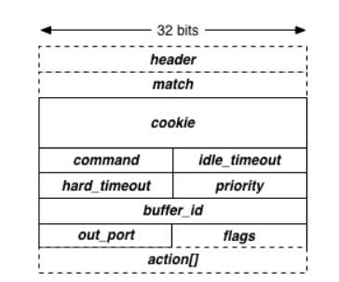
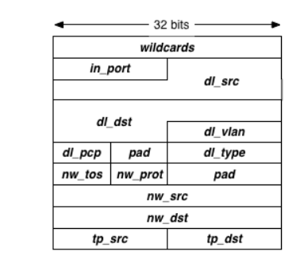
OpenFlow: Message Formats
Controller encapsulates message into an object
Accessor functions to different fields
No need to worry about crafting network packets

Slide 35
OpenFlow Actions (Partial list from OpenFlow 1.0 spec)
Output to switch port (Physical ports & virtual ports). Virtual ports include the following:
ALL (all standard ports excluding the ingress port) - flood
CONTROLLER (encapsulate and send the packet to controller) – PACKET_IN message
LOCAL (switch’s stack) – go through the IP layer, etc (mostly used for vSwitches)
NORMAL (process the packet using traditional non-OpenFlow pipeline of the switch) – traditional L2 forwarding, L3 routing
Drop
Set fields (packet modification/header rewriting)
Ethernet Source address
Ethernet Dest address
IP source & dest addresses, IP ToS, IP ECN, IP TTL, VLAN
TCP/UDP source and destination ports
Strip (pop) the outer VLAN tag
Set queue ID when outputting to a port (Enqueue)
New in OpenFlow 1.1+
Support for matching across mulitple tables
Support for tunneling
Support for Push/Pop mulitple VLAN/MPLS/PBB tags

Slide 36
Section 2: SDN Use Cases

Slide 37
SDN Use Cases
Network Virtualization (VMWare, Azure)
Port tapping (Big Switch’s BigTap)
Access control (Big Switch’s SNAC)
WAN Traffic Engineering (Google B4)
DDoS Detection (Defense4All)
Network Orchestration (OpenStack, VMWare)

Slide 38
SDN Use Cases
WAN-Traffic engineering
Google’s B4 (SIGCOMM 2013)
Microsoft’s SWAN (SIGCOMM 2013)
Network Function Virtualization: Service Chaining
SIMPLIFY/FlowTags (SIGCOMM 2013, NSDI 2014)
Slick (ONS 2013)
Network virtualization
Nicira, Azure, Google,
VL2 & Portland (SIGCOMM 2009)
CloudNaaS (SoCC 2011)
Seamless workload (VM) mobility
(CrossRoads (NOMS 2012))
Data Center Traffic engineering
Routing elephant flows differently (Hedera – NSDI 2010)
Routing predictable traffic (MicroTE – CoNext 2011)
Port-Mirroring
BigTap
OpenSafe (INM/WREN 2011)

Slide 39
SDN Use Case: Network Function Virtualization

Slide 40

Network Policy:
Goals:
Detect attacks
Prevent unauthorized access
Problem:
Traffic takes shortest path
Avoids middleboxes
Servers are unprotected
Web
Firewall
IDS
WEB
Firewall
IDS

Slide 41
Network Policy:
Web
Firewall
IDS
Applications
Applications
Applications
Controller (N. O.S.)
WEB
Firewall
IDS

Slide 42
Network Policy:
Web
Firewall
IDS
Applications
Applications
Applications
Controller (N. O.S.)
WEB
Firewall
IDS

Slide 43
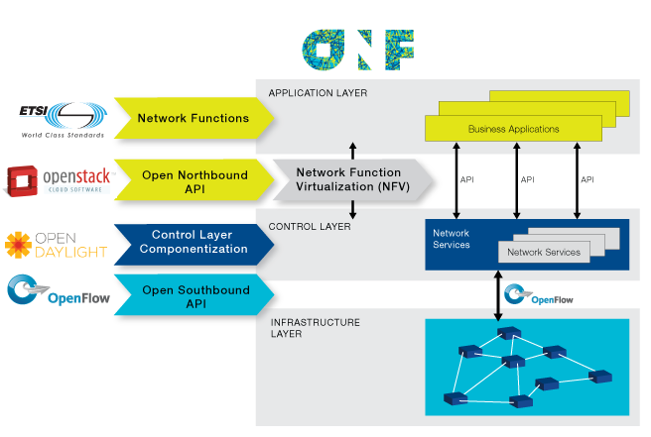
ONF NVF RoadMap

Slide 44
Section 2: SDN Challenges

Slide 45
Controller Availability
Applications
Applications
Applications
Controller (N. O.S.)

Slide 46
Controller Availability
Applications
Applications
Applications
Controller (N. O.S.)

Slide 47
Controller Availability
“control a large force like a small force: divide and conquer”
--Sun Tzu, Art of war
How many controllers?
How do you assign switches to controllers?
More importantly: which assignment reduces processing time
How to ensure consistency between controllers
Applications
Applications
Applications
Controller (N. O.S.)
Applications
Applications
Applications
Applications
Applications
Applications
Controller (N. O.S.)
Controller (N. O.S.)

Slide 48

SDN Reliability/Fault Tolerance
Controller: Single point of control
Bug in controller takes the whole network down
Existing network survives failures or bugs in code for any one devices
Applications
Applications
Applications
Controller (N. O.S.)

Slide 49
SDN Reliability/Fault Tolerance
Controller: Single point of control
Bug in controller takes the whole network down
Single point of failure
Existing network survives failures or bugs in code for any one devices
Applications
Applications
Applications
Controller (N. O.S.)

Slide 50

SDN Security
Controller: Single point of control
Compromise controller
If one device in the current networks are compromised the network may still be safe
Applications
Applications
Applications
Controller (N. O.S.)

Slide 51

SDN Security
Controller: Single point of control
Compromise controller
Denial of Service attack the control channel
Applications
Applications
Applications
Controller (N. O.S.)

Slide 52
Data-Plane Limitations
Limited Number of TCAM entries
Currently only 1K
Networks have more than 1K flows
How to fit network in limited entries?
Limited control channel capacity
All switches use same controller interface
Need to rate limit control messages
Prioritize certain messages
Limited switch CPU
Less power than a smartphone ☹
Limit control messages and actions that use CPU
Applications
Applications
Applications
Controller (N. O.S.)
O.S
Switch H.W

Slide 53
Debugging SDNs
Buggy
App
Problems can occur anywhere in the SDN stack
How do you diagnose each type of problem?
Applications
Applications
Applications
Network O.S.
Buggy
NOS
Buggy
Switch
Buggy
Switch
H/W
Switch Operating System
Switch Operating System
Switch Hardware
Switch Hardware

Slide 54
Section 2: SDN – A Systems Approach to SDN

Slide 55
Conclusion
An overview of SDN technologies
Introduction to OpenFlow
Developing Applications on OpenFlow

