Slide 2

Last Time on 590.04….
Policy
App
App
App
Physical View
Network OS
Veriflow|H.A.S.|Libra
Invariant has been violated!
There’s a bug. What Next?
Device State

Slide 3
Last Time on 590.04….
Policy
App
App
App
Physical View
Network OS
Veriflow|H.A.S.|Libra
Invariant has been violated!
There’s a bug. What Next?
Device State

Slide 4


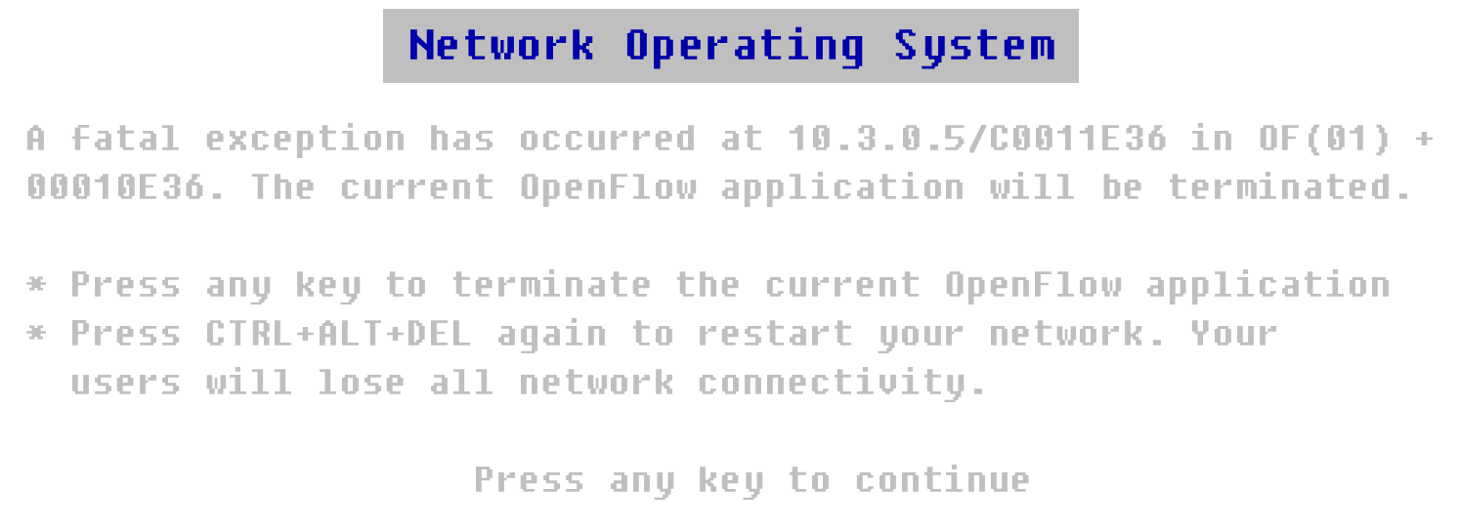
… at the risk of bugs

Slide 5
What are the types of Bugs in a Distributed System?

Slide 6
What are the types of Bugs in a Distributed System?
Distributed correctness faults:
Race conditions
Atomicity violations
Deadlock
Livelock
…
+ Normal software bugs

Slide 7
What is code Debugging?

Slide 8
What is code Debugging?
Some way to figure out
what triggers the bug.
How to reproduce the bug
Where in the source code to search for the bug
What to fix
A trace of the code:
Log files (Best or Common Practice)
Print statements

Slide 9
How are bugs discovered?

Slide 10
How are bugs discovered?
On developer’s local machine
(unit and integration tests)
In production environment
On quality assurance testbed

Slide 11
What is Code?
if(pkt.dst == broadcast){
if(mactable.exists(pkt.dst)){
installrule()
fwdpkt()
}
}
Else{
floodpkt()
}

Slide 12
Programming Languages Approach to Debugging: Take 1
Model Checking: model the program as a state machine
State: all the variables in the system
Transition: Events that change the values of the variables

Slide 13
System State
Controller (global variables)
Environment:
Switches (flow table, OpenFlow agent)
Simplified switch model
State
End-hosts (network stack)
Simple clients/servers
Communication channels (in-flight pkts)
Notes:
Only care about the controller state and not the rest of the system

Slide 14
System State
Controller
State: All global variables
Transitions: pkt-in events, function calls
Endhost
No State
Just Transitions: Send/Receive
Switch
State: forwarding tables
Transitions:
process_pkt: e.g. forward a packet
process_of: e.g. flowmod

Slide 15
State-Space Model
Model Checking
State 0
State 1
State 3
State 2
State 4
State 5
State 6
State 7
State 8
State 9

Slide 16
Transition System
State 0
host send
Data-dependent transitions!
Run actual packet_in handler
switch process_pkt
State 1
State 3
State 2
switch process_of
ctrl packet_in(pkt A)
ctrl packet_in(pkt B)
State 4
State 5
State 6
State 7
State 8
State 9

Slide 17
Systematically Testing OpenFlow Apps
Carefully-crafted streams of packets
Many orderings of packet arrivals and events
State-space exploration via Model Checking (MC)
Target
system
Unmodified OpenFlow program
Environment model
Switch 1
Switch 2
Complex environment
Host A
Host B

Slide 18
Model Checking Scalability Challenges
Data-plane driven
Complex network behavior
Huge space of possible packets
Huge space of possible event orderings
Enumerating all inputs and event orderings is intractable

Slide 19

Quick OpenFlow 101
Controller
Execute packet_in event handler
OpenFlow program
Default: forward to controller
Install rule; forward packet
Host A
Host B
Packet
Switch 1
Switch 2
Flow Table
Rule 1
System is distributed and asynchronous → can misbehave under corner cases
Match
Actions
Counters
Rule 2
Dst: Host B
Fwd: Switch 2
pkts / bytes
Rule N

Slide 20
Bugs in OpenFlow Apps
Drop packet
Controller
?
OpenFlow program
Install rule
Install rule
Delayed!
Inconsistent distributed state!
Host A
Host B
Packet
Goal: systematically test possible behaviors to detect bugs
Switch 1
Switch 2

Slide 21
Input
NICE
Output
No bugs In Controller Execution
Unmodified OpenFlow program
Traces of property violations
State-space search
Network topology
Correctness properties (e.g., no loops)
NICE found 11 bugs in 3 real OpenFlow Apps

Slide 22
What is a Code path?
pkt
Function foobar(pkt)
if(pkt.dst == broadcast){
if(mactable.exists(pkt.dst)){
installrule()
fwdpkt()
}
}
Else{
floodpkt()
}
}
is dst broadcast?
yes
no
dst in mactable?
no
yes
Flood packet
Install rule and forward packet

Slide 23
Programming Languages Approach to Debugging: Take 2
Symbolic Execution
Execute the code with symbolic input
At every branch duplicate the code and run
pkt
is dst broadcast?
yes
no
dst in mactable?
no
yes
Flood packet
Install rule and forward packet

Slide 24
Symbolic Execution Scalability Challenges
With every branch → exponential increase in space and processing requirements.

Slide 25
Drawbacks of Symbolic Execution
pkt
Doesn’t accord for concurrency
Thread ordering
Asynchronous events
is dst broadcast?
yes
no
dst in mactable?
no
yes
Flood packet
Install rule and forward packet

Slide 26
Combating Huge Space of Packets
pkt
is dst broadcast?
Equivalence classes of packets:
Broadcast destination
Unknown unicast destination
Known unicast destination
yes
no
dst in mactable?
Packet arrival handler
no
yes
Flood packet
Install rule and forward packet
Code itself reveals equivalence classes of packets

Slide 27
Code Analysis: Symbolic Execution (SE)
Symbolic packet λ
1 path =
1 equivalence class of packets =
1 packet to inject
is λ.dst broadcast?
Infeasible from initial state
λ .dst ∈ {Broadcast}
λ .dst ∉ {Broadcast}
yes
no
λ.dst in mactable?
Packet arrival handler
no
λ .dst ∉ {Broadcast} ∧ λ .dst ∉ mactable
yes
λ .dst ∉ {Broadcast}
∧ λ .dst ∈ mactable
Flood packet
Install rule and forward packet

Slide 28
Model Checking Scalability Challenges
Data-plane driven
Complex network behavior
Huge space of possible packets
Huge space of possible event orderings
Equivalence classes of packets

Slide 29
Combining SE with Model Checking
host send(pkt A)
host discover_packets
host send(pkt B)
State 0
State 1
State 2
State 3
host send(pkt C)
Controller state changes
State 4
discover_packets transition:
Controller state 1
Symbolic execution of packet_in handler
New packets
Enable new transitions: host / send(pkt B) host / send(pkt C)

Slide 30
Model Checking Scalability Challenges
Data-plane driven
Complex network behavior
Huge space of possible packets
Huge space of possible event orderings
Equivalence classes of packets
Domain-specific search strategies

Slide 31
Our Goal
Allow developers to focus on fixing the underlying bug
Notes:
While this kind of debugging isn’t very visibile to researchers,
This is a real problem in the commercial world
Our intent was to build real techniques that can be integrated into existing commercial testbeds
That would cope with real software

Slide 32
Problem Statement
Identify a minimal sequence of inputs that triggers the bug
in a blackbox fashion
Notes:
TODO: crucial point: want to do this in a blackbox fashion.
TODO: maybe say “approximate”?

Slide 33
Why minimization?
Smaller event traces are easier to understand
G. A. Miller. The Magical Number Seven, Plus or Minus Two: Some Limits on Our Capacity for Processing Information. Psychological Review ’56.

Slide 34
Outline
What are we trying to do?
How do we do it?
Does it work?
Notes:
“I’m going to first try to convince you that there is a real problem with the way troubleshooting is done today.
Then I’m going to describe a system and the techniques we apply within this system to make troubleshooting easier.
Then I’ll end by showing you how well the system works.

Slide 35
How are bugs discovered?
On developer’s local machine
(unit and integration tests)
In production environment
On quality assurance testbed

Slide 36
Approach: Delta Debugging¹ Replay
✔
✗
?
1. A. Zeller et al. Simplifying and Isolating Failure-Inducing Input. IEEE TSE ’02
Notes:
Signpost: how do we do it? Key slide!
Right now the cuts we make are based on time. But you could imagine doing this slicing based on nodes in the topology, or combinations of types of events.
If any of you are aware of the work, this technique is called delta debugging.
When you apply delta debugging to a distributed system rather than a single program, you run into some challenges.

Slide 37
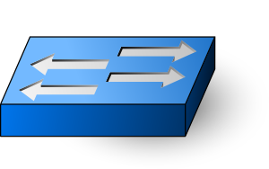
Approach: Modify Testbed
Controller 1
Controller N
Control Software
QA Testbed
Test Coordinator
Notes:
We use the *same*, preexisting QA infrastructure that companies already have in place. We just need to employ our techniques to this infrastucture.

Slide 38
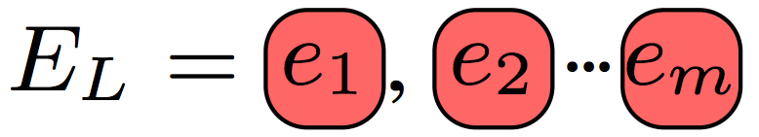
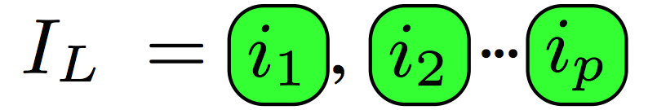
Testbed Observables
Invariant violation detected by testbed
Event Sequence:
External events (link failures, host migrations,..) injected by testbed
Internal events (message deliveries) observed by testbed (incomplete)

Slide 39

Approach: Delta Debugging¹ Replay
Events (link failures, crashes, host migrations) injected by test orchestrator
✔
✗
?
1. A. Zeller et al. Simplifying and Isolating Failure-Inducing Input. IEEE TSE ’02
Notes:
TODO: describe what would happen during interference, in a concise way.
Right now the cuts we make are based on time. But you could imagine doing this slicing based on nodes in the topology, or combinations of types of events.
If any of you are aware of the work, this technique is called delta debugging.
When you apply delta debugging to a distributed system rather than a single program, you run into some challenges.

Slide 40
Key Point
Must Carefully Schedule Replay Events To Achieve Minimization!
Notes:
Verbal: And this is our contribution

Slide 41
Challenges
Asynchrony
Divergent execution
Non-determinism
Notes:
NOTE: as you can probably tell, these are general challenges. Here we develop practical heuristics for dealing with them that are emperically validated. We’re currently working on developing a model to show how to provide provable guarentees on how we cope with them.
TODO: cut these subbullets?

Slide 42
Challenge: Asynchrony
Asynchrony definition:
No fixed upper bound on relative speed of processors
No fixed upper bound on time for messages to be delivered
Dwork & Lynch. Consensus in the Presence of Partial Synchrony. JACM ‘88

Slide 43
Challenge: Asynchrony
Need to maintain original event order
Crash
Master
Ping
Ping
Pong
Timeout
Backup
Master
port_status
port_status
ACK
Blackhole persists!
Switch
Link Failure
Timeout

Slide 44
Challenge: Asynchrony
Need to maintain original event order
Crash
Master
Ping
Ping
Pong
Timeout
Backup
New Routing Table!
Master
port_status
Blackhole avoided!
Switch
Link Failure
Notes:
NOTE: as we replay subsequences, we’re going to try to keep as many of these causal dependencies from the original intact. Next slide:

Slide 45
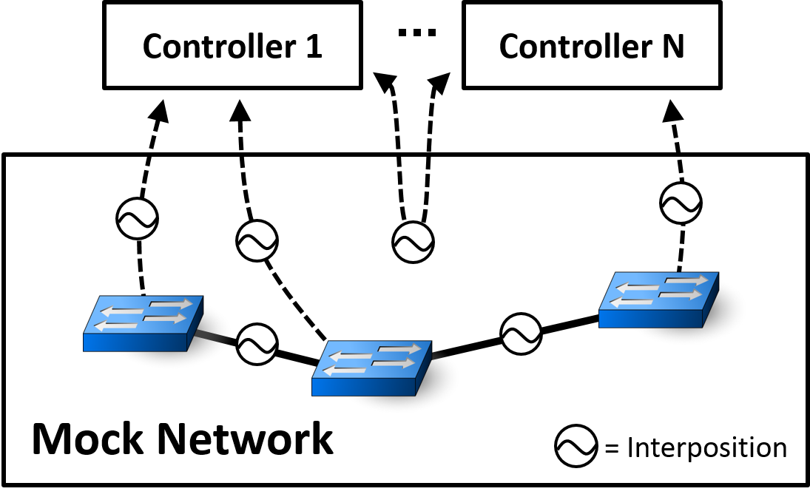
Coping with Asynchrony
Use interposition to maintain causal dependencies
Notes:
NOTE: interposition gives us messages during the *recording* phase.=
And we achieve this by interposing on the internal events. As we observe messages, we allow them through in a way that is consistent with the causal dependencies from the original execution.
If you were a company with a QA testbed, you would just need to add interposition. We built our own, since no open source were available for SDN

Slide 46
Challenge: Divergence
Asynchrony
Divergent execution
Syntactic Changes
Absent Events
Unexpected Events
Non-determinism

Slide 47
Divergence: Absent Internal Events
Prune Earlier Input..
Crash
Master
Ping
Pong
Ping
Backup
Master
Policy change
Notify
Notify
ACK
Switch
Link Failure
Host Migration

Slide 48
Divergence: Absent Internal Events
Some Events No Longer Appear
Crash
Master
Ping
Pong
Ping
Backup
Master
Policy change
Notify
Switch
Link Failure
Host Migration

Slide 49
Solution: Peek Ahead
Infer which internal events will occur
Crash
Master
Ping
Pong
Ping
Backup
Master
Policy change
Notify
Switch
Link Failure
Host Migration
Notes:
TODO: Say: take a snapshot

Slide 50
Challenge: Non-determinism
Asynchrony
Divergent execution
Non-determinism

Slide 51
Coping With Non-Determinism
Replay multiple times per subsequence
Assuming i.i.d., probability of not finding bug modeled by:
If not i.i.d., override gettimeofday(), multiplex sockets, interpose on logging statements
Notes:
Other tricks:
- multiplexed sockets
- override gettimeofday and rand
- interpose on logging library
- interpose on intra-controller messages

Slide 52
Approach Recap
Replay events in QA testbed
Apply delta debugging to inputs
Asynchrony: interpose on messages
Divergence: infer absent events
Non-determinism: replay multiple times

Slide 53
Outline
What are we trying to do?
How do we do it?
Does it work?
Notes:
“I’m going to first try to convince you that there is a real problem with the way troubleshooting is done today.
Then I’m going to describe a system and the techniques we apply within this system to make troubleshooting easier.
Then I’ll end by showing you how well the system works.

