Slide 1
Lecture 2: Window-Based End-to-End Congestion Control
CS5229 Advanced Computer Networks

Slide 2
Quick Admin Notes
Updates to lesson plan
Lecture Slides
Answers
Late comers
Questions?
2

Slide 3
Sending data on the Internet
A
B
What are the issues or considerations?

Slide 4
From last week: “Best effort”
Packets are not blocked
Buffers to temporarily store packets
Packets dropped if buffer is full, w.o. feedback
4

Slide 5
Sending data on the Internet
A
B
buffer
bottleneck link
Why is Distributed Congestion Control Hard?

Slide 6
Why is Distributed Congestion Control Hard?
Utilization
Fairness
Low visibility of the network
Churn
Intrinsic delay
Easy
6

Slide 7
How do we decide how much to send?
Window-based
Rate-based
⇒ This
lecture
7

Slide 8
In Oct 1986, major congestion collapse
⇒TCP Reno
8

Slide 9
TCP Reno
Van Jacobson. Congestion avoidance and control. ACM SIGCOMM computer communication review, 18(4):314–329, 1988.

Slide 10
Congestion Control from first principles
10

Slide 11
Suppose you have a file to send from A to B
A
B
You divide the file into packets
How fast should you send the packets??

Slide 12
Suppose you have a file to send from A to B
A
B
What happens if you send
too many packets too quickly?

Slide 13
Sending data on the Internet
A
B
buffer
Buffer overflow ⇒ packet drop

Slide 14
What is a Congestion Collapse?
14

Slide 15
How do we set the rate?
“cwnd”
Congestion Window
Directly
Why congestion window?
15

Slide 16
What do we need to do
Estimate the available bandwidth
Adapt to network changes
Deal with packet loss
cwnd can address all these problems and was easier to implement in old kernels
16

Slide 17
Congestion Window
“Unacknowledged Packets Sent”
Packets in flight
Packet “in the pipe”
17

Slide 18
Bandwidth-delay Product
Packets in flight
Packet “in the pipe”
18

Slide 19
Sanity Check
What should cwnd be if a flow is in equilibrium?

Slide 20
What do we need to do
Estimate the available bandwidth
Adapt to network changes
Deal with packet loss
20

Slide 21
Conservation of Packets
For a connection 'in equilibrium', i.e., running stably with a full window of data in transit, the packet flow is what a physicist would call 'conservative': A new packet isn’t put into the network until an old packet leaves. The physics of flow predicts that systems with this property should be robust in the face of congestion.

Slide 22
ACK Clocking
Sender decides what to do when it receives an ACK. In equilibrium, it has one of 3 options:
Do nothing (rate will drop)
Send one packet (maintain rate)
Send >1 packet (increase rate)

Slide 23
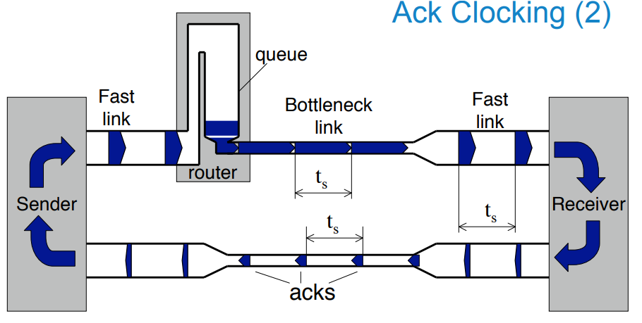
1. Estimating available bandwidth
Sender effectively sends at the bottleneck bandwidth
Credits: Mark Handley, UCL

Slide 24
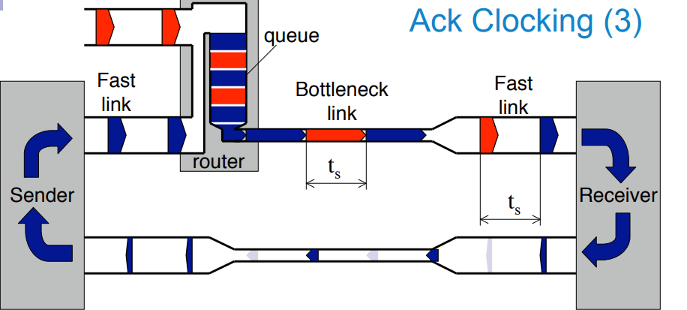
2. Adapt to network changes
Sender automatically slows down when other flows join
Why?
Credits: Mark Handley, UCL

Slide 25
3. Dealing with packet loss
Congestion → too many packets
→ reduce congestion window!

Slide 26
Window-based Congestion Control
Send some packets
Wait for ACKs
Send more packets
26

Slide 27
Fails because….
The connection doesn't get to equilibrium, or
A sender injects a new packet before an old packet has exited, or
The equilibrium can't be reached because of resource limits along the path.
27

Slide 28
Applying packet conservation at the start of the flow doesn’t work.
Why?
How would we try to estimate the available bandwidth efficiently?
28

Slide 29
Slow Start
When sender receives an ACK, increase congestion window by 1, aka send 2 packets.
A
B
What’s the effective
send rate?

Slide 30
Slow Start
When sender receives an ACK, increase congestion window by 1, aka send 2 packets.
A
B

Slide 31
Slow Start
When sender receives an ACK, increase congestion window by 1, aka send 2 packets.
A
B

Slide 32
Slow Start
When sender receives an ACK, increase congestion window by 1, aka send 2 packets.
A
B

Slide 33
Slow Start
When sender receives an ACK, increase congestion window by 1, aka send 2 packets.
A
B
What’s the cwnd
after 10 RTTs?

Slide 34
At some point, *some* buffer will overflow and we will get a packet loss
⇒Congestion!
So half cwnd!
34

Slide 35
Key Idea for sharing without central coordination:
Binary Backoff

Slide 36
Slow Start:
cwnd ← cwnd + MSS
cwnd doubles every RTT
additive
increase
Congestion Control:
cwnd ← cwnd + MSS/cwnd
cwnd + MSS every RTT
multiplicative
decrease
Packet Loss:
cwnd ← cwnd/2
36

Slide 37
Congestion Avoidance
cwnd
Time
Slow start
Congestion avoidance

Slide 38
What do we care about?
Stability
High Utilization
Fairness
We don’t want congestion collapse do we?
Easy
How do we achieve this?
38

Slide 39
Consider 2 flows sharing a bottleneck
Flow 2
throughput
Optimal point
Fairness
line
Overloaded
Efficiency line
Underloaded
Flow 1
throughput
??

Slide 40
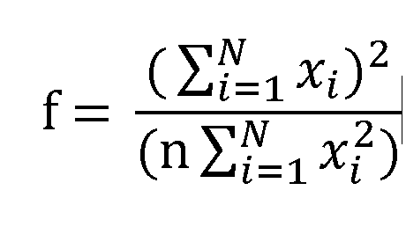
What do we measure fairness?
Jain’s index
40

Slide 41
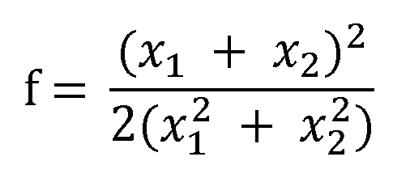
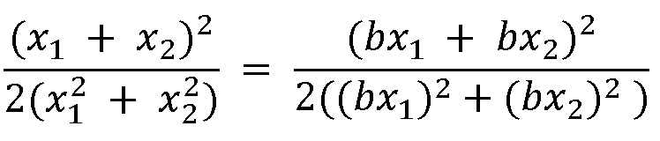
Consider 2 flows sharing a bottleneck
Jain’s Index:
Flow 2
throughput
Equi-fairness
line
Flow 1
throughput

Slide 42
Consider 2 flows sharing a bottleneck
Flow 2
throughput
AIAD
Flow 1
throughput

Slide 43
Consider 2 flows sharing a bottleneck
Flow 2
throughput
MIMD
Flow 1
throughput

Slide 44
Consider 2 flows sharing a bottleneck
Flow 2
throughput
AIMD
Converge to fairness & efficiency
Flow 1
throughput

Slide 45
Let’s talk about losses
“normal”
congestion
Duplicate ACKs
Timeout
cwnd ← cwnd/2
“nasty” congestion
cwnd ← 1
+ back to slow start
45

Slide 46
Isn’t additive increase really slow??
cwnd
Binary
Search!
Time
Slow start
Congestion avoidance

Slide 47
Isn’t additive increase really slow??
cwnd
too much
too little
Time
Slow start
Congestion avoidance

Slide 48
TCP CUBIC
Sangtae Ha, Injong Rhee, and Lisong Xu. Cubic: a new TCP-friendly high-speed TCP variant. ACM SIGOPS operating systems review, 42(5):64–74, 2008.

Slide 49
Issues with window-based and loss-based CC
Bursty traffic when ACKs come quickly or ACK aggregation happens
Under-utilization in lossy networks
Fill deep buffers → high delay
Flows can synchronize

Slide 50
It’s a Zoo!
Ayush Mishra, Xiangpeng Sun, Atishya Jain, Sameer Pande, Raj Joshi, and Ben Leong. The great internet TCP congestion control census. Proceedings of the ACM on Measurement and Analysis of Computing Systems, 3(3):1–24, 2019.

Slide 51
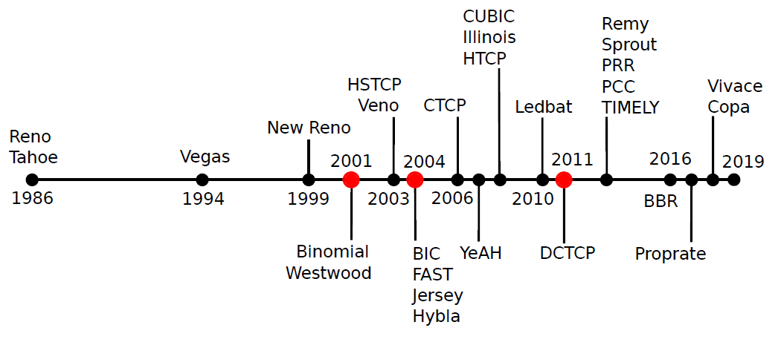

Slide 52
Conducted a Congestion Control Census among the 20,000 most popular websites* on the Internet.
* According to their Alexa 2019 rankings

Slide 53
How do we know which TCP variant is running on a server??
53

Slide 54
Key idea:
Different variants react differently to different network variations!
“Fingerprint”
54

Slide 55
Why is it still hard?
Isolating the Internet’s network dynamics
Extracting a common feature from a variety of congestion control algorithm
Identifying congestion control algorithm behavior within short HTTP page downloads
55

Slide 56
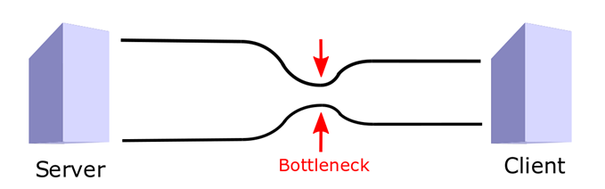
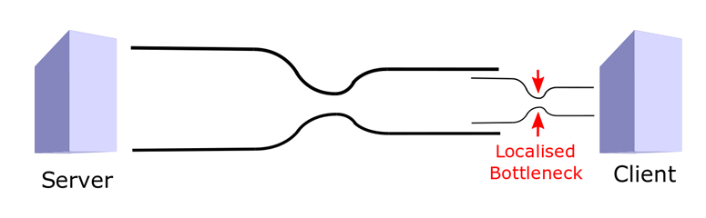

Slide 57
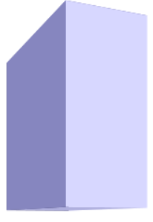
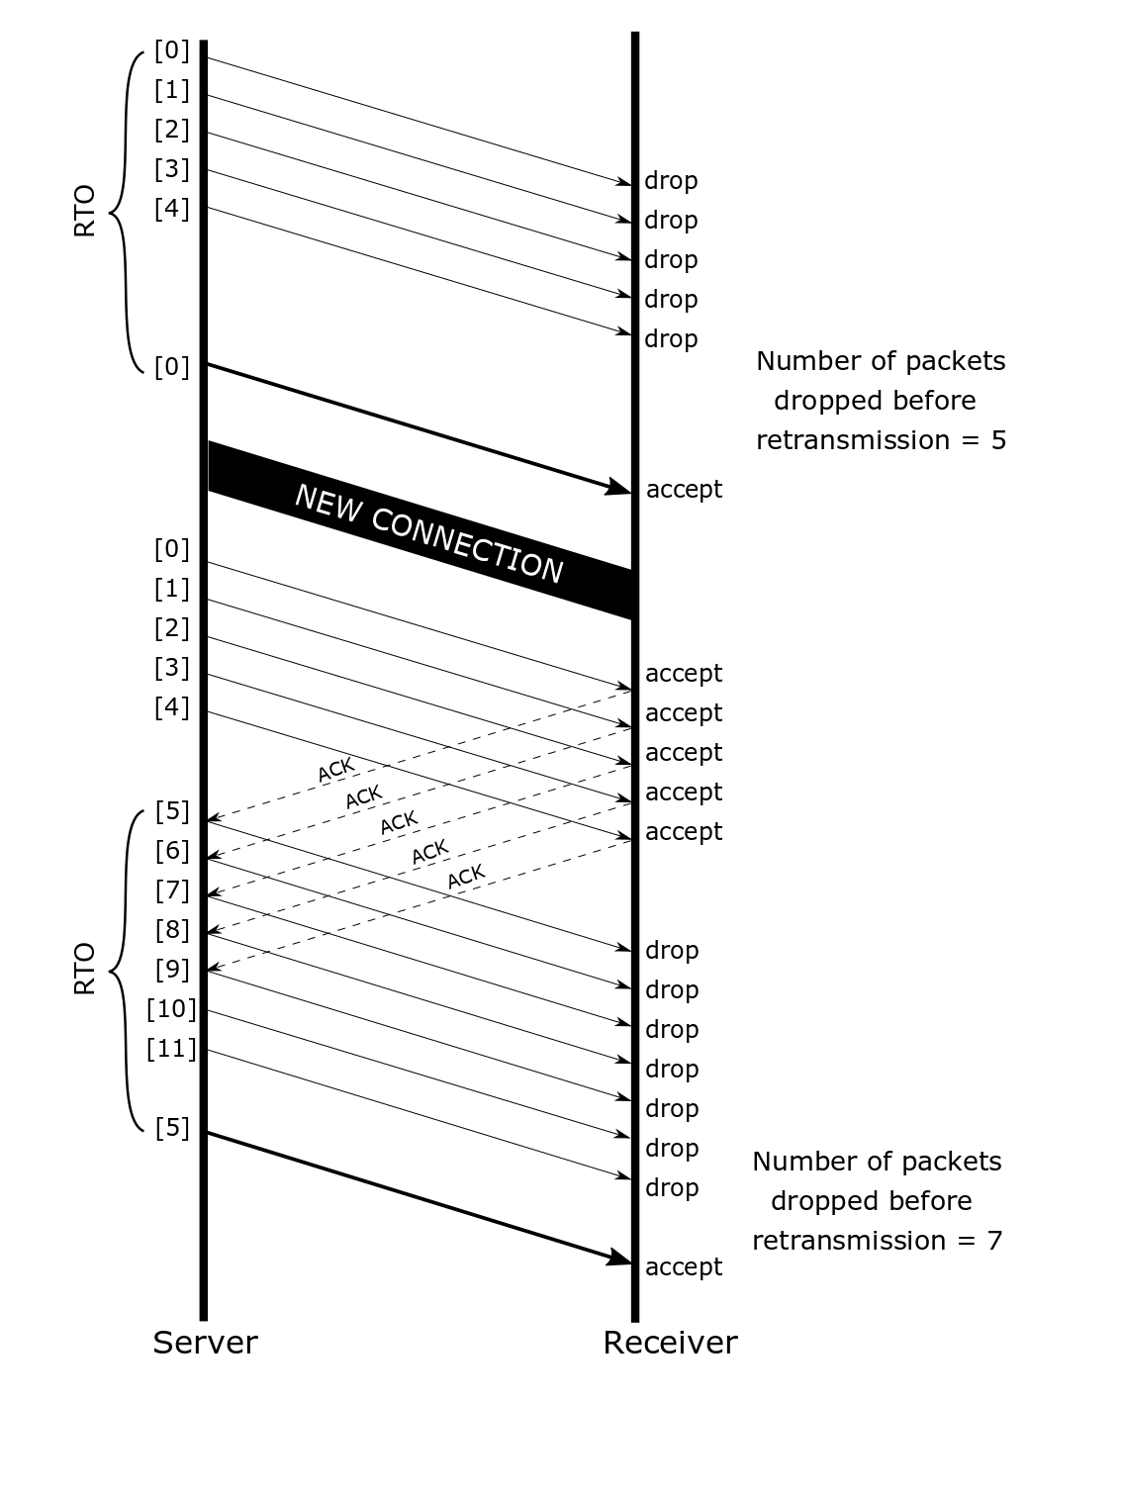

cwnd
Remote
Server
Gordon
RTT
Notes:
First, we needed a feature common to all measurements that would also be indicative of the controller's behaviors, and therefore help us differentiate between them. We settled on measuring the cwnd maintained by the sender every RTT since even though more recent controllers are not specifically window based, they all maintain a cap on the inflight packets that can be considered their effective cwnd.
how we measure the cwnd is as follows: <explain cwnd measurement>

Slide 58
cwnd
Remote
Server
Gordon
RTT
Cwnd evolution graph
Notes:
First, we needed a feature common to all measurements that would also be indicative of the controller's behaviors, and therefore help us differentiate between them. We settled on measuring the cwnd maintained by the sender every RTT since even though more recent controllers are not specifically window based, they all maintain a cap on the inflight packets that can be considered their effective cwnd.
how we measure the cwnd is as follows: <explain cwnd measurement>

Slide 59
Final sequence of network stimuli
“Network profile”:
Packet drop at the first cwnd that exceeds 80 packets
Bandwidth change after receiving 1500 packets
Emulating an RTT of 100 ms
Optimal page size for this network profile: 165 kb
80 -
50 -
BDP
cwnd
34 -
1500 packets
received
RTT
Notes:
With this measurement strategy in place, we wanted to design a common network profile that will help us normalize an algorithms response. Due various reasons discussed in the paper, the final network profile is as follows:
[describe network profile]

Slide 60
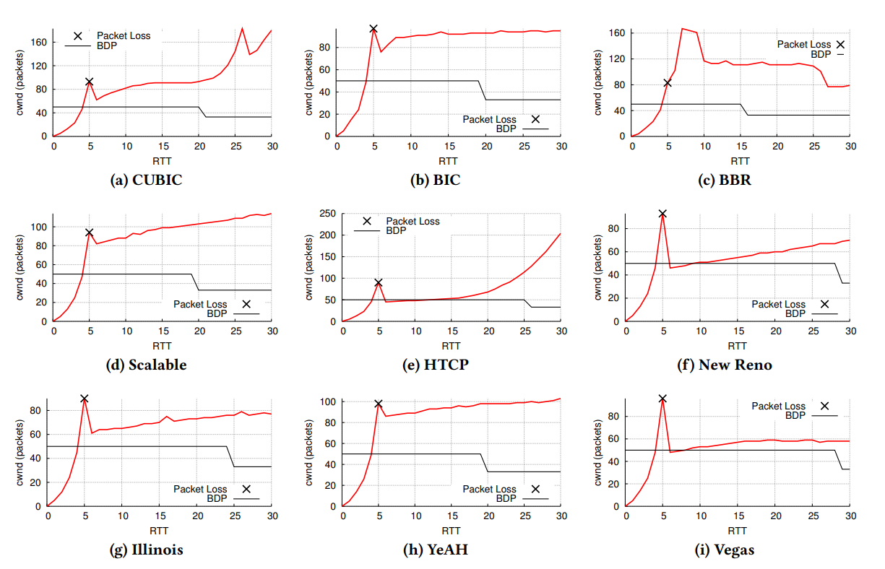
Notes:
Here, we present the measurements produced for some common congestion control algorithms. As is clear from these graphs, we were able to differentiate between most of them based on the shape that they produce.
Our decision-tree-based classifier computes this shape and uses it to differentiate between congestion control algorithms.

Slide 61
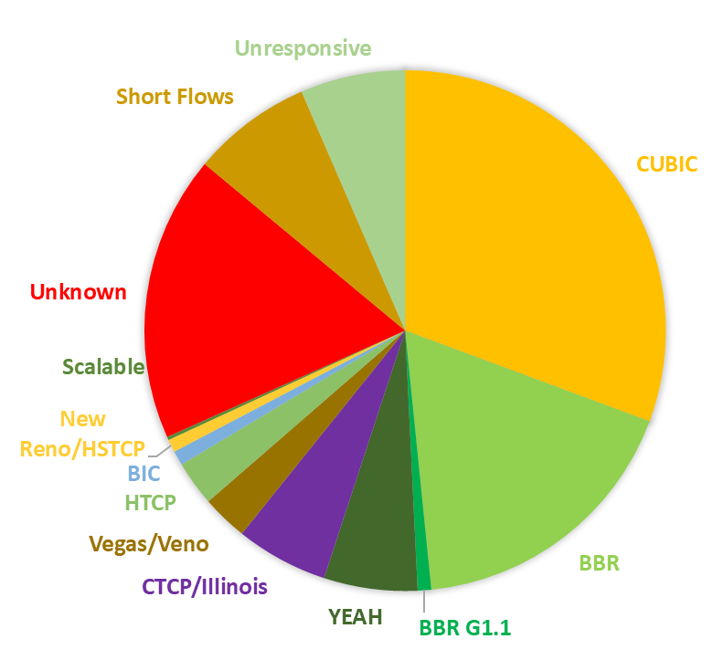
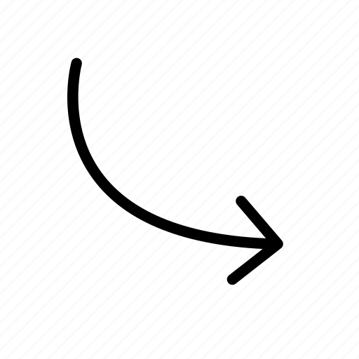
Key Results
BBR
is becoming a dominant CC on the Internet
CUBIC
30.7%
17.7%
Alexa Top 20k
BBR

Slide 62
Key Results
BBR
is becoming a dominant CC on the Internet
CUBIC
22.4%
30.7%
Others
25.2%
17.7%
Alexa Top 250
Even more so among popular websites
BBR

Slide 63
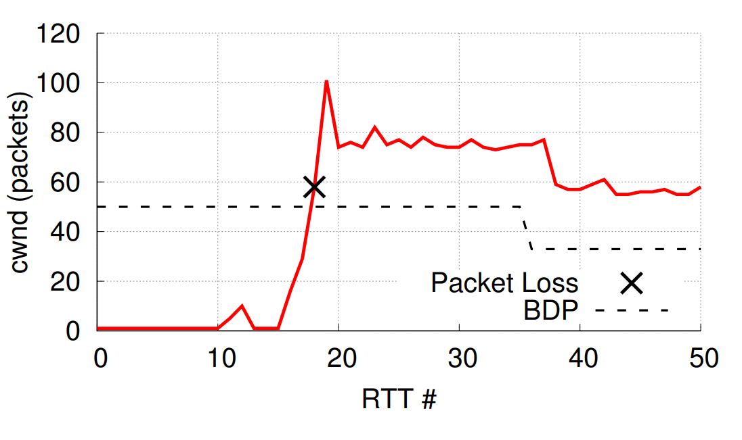

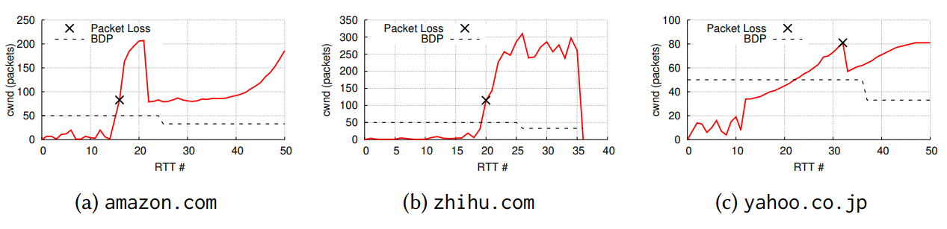
Key Results
The Internet is a Zoo!
CC
(1,103 websites)
Virtually no CC!

Slide 64
Will the Internet collapse?
64

Slide 65
Complications
Link Asymmetry
Wireless losses
Buffer
65

Slide 66
Summary
ACK-clocking
Congestion window
Bandwidth-delay product
Slow start
AIMD congestion avoidance
Binary Backoff
TCP Friendliness
Stability of Future Internet Not Guaranteed

