Slide 1
CS5229 Advanced Computer Networks
Lecture 1: Intro to CS5229 & Internet Architecture
1

Slide 2
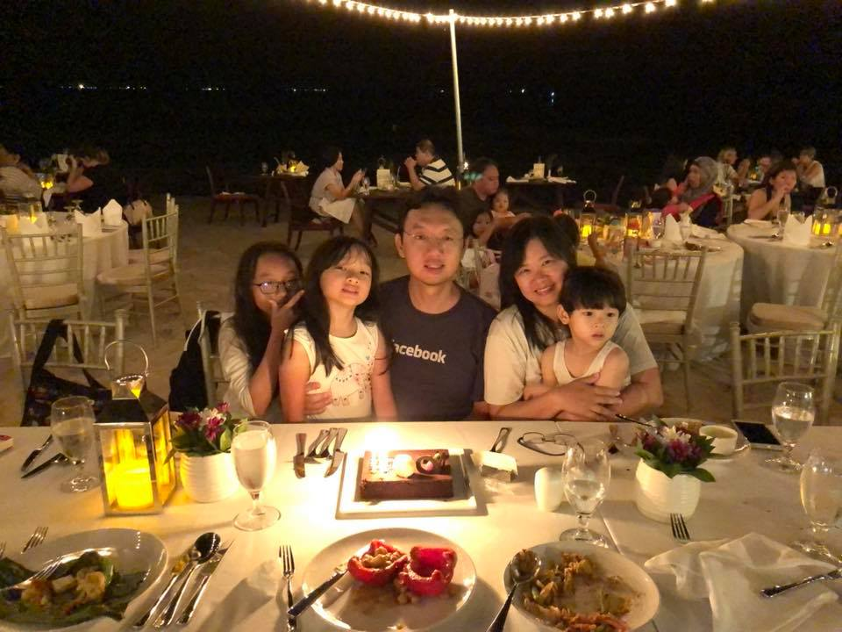
2

Slide 3
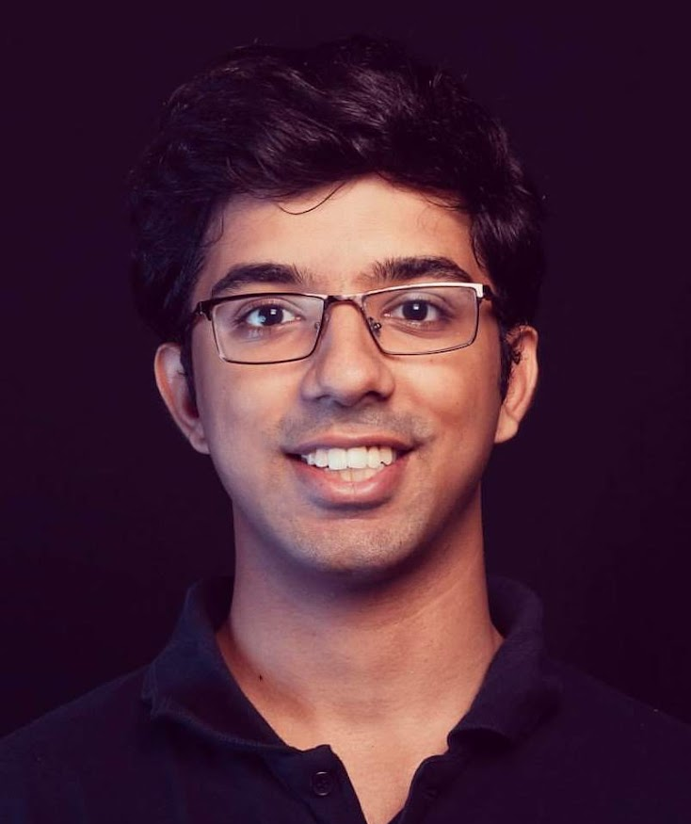
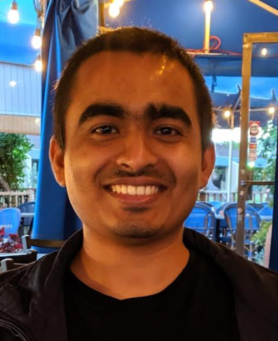
3

Slide 4
Rights Infringements on NUS Course Materials
All course participants (including permitted guest students) who have access to the course materials on LumiNUS or any approved platforms by NUS for delivery of NUS modules are not allowed to re-distribute the contents in any forms to third parties without the explicit consent from the module instructors or authorized NUS officials
4

Slide 5
Why are you here?
5

Slide 6
Computer Networks
Why should
we care?
6

Slide 7







7

Slide 8
Internet
8

Slide 9
Why is Networking Cool?
Relevant
Impactful
Interdisciplinary
Young, relatively immature field
Opportunity for hands-on work
9

Slide 10
Why did I decide to work on networking?
10

Slide 11
Why CS5229?
Undergraduate
networking
State-of-art research
Survey of
important works
Breadth
11

Slide 12
Why CS5229?
Concepts
Undergraduate
networking
State-of-art research
Practical Skills
Generally applicable
12

Slide 13
Course Pre-Requisites
Have taken undergraduate networking classes like CS2105/CS3103
Basic background on probability and algorithms
Know how to program in Java/C/C++ or is comfortable in picking up a new programming language. Homework will be in Python.
13

Slide 14
What you already know….
Router, switches, ISP, AS
IP addressing, DNS, DHCP
protocol stacks, layering, multiplexing
MAC, CSMA/CA, Ethernet
Routing, shortest-path, spanning tree
transport protocols, TCP vs. UDP, congestion control
FTP, HTTP
14

Slide 15
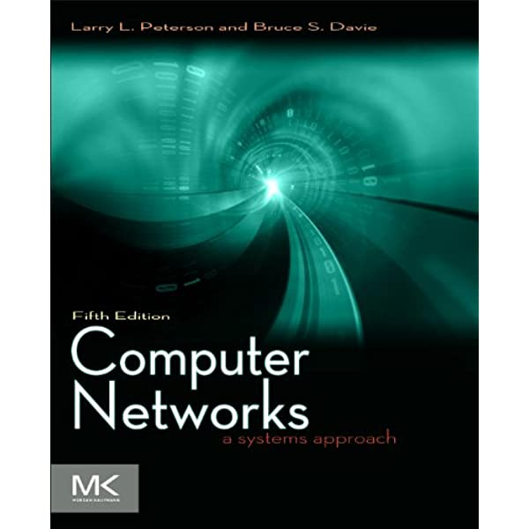
Need a refresher?
Computer Networks: A Systems Approach, 5/e. Peterson, Larry L., Davie, Bruce S
ISBN:9780123850591
https://book.systemsapproach.org
Free!
15

Slide 16
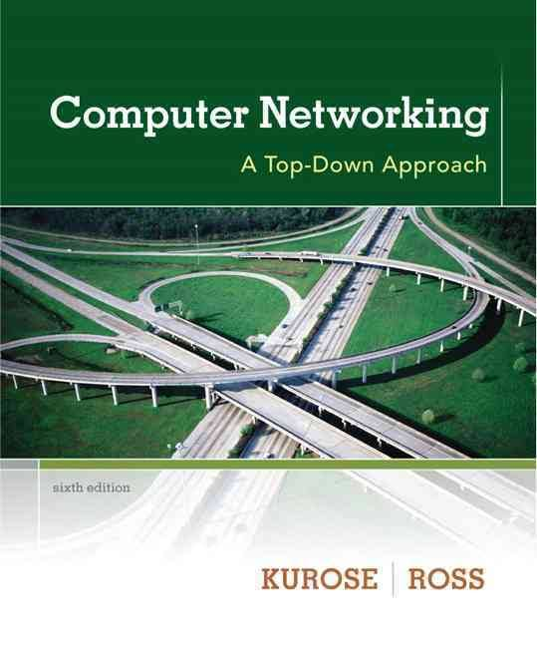
Need a refresher?
Computer Networking: A Top Down Approach, 6/e. James F. Kurose Keith W. Ross .
ISBN: 9780132856201
16

Slide 17
Key Concepts in Networking
Naming
Layering
Protocols
Resource Allocation
17

Slide 18
No textbook!
How cool is that??
Save money!!!
18

Slide 19
Readings
2-4 research papers a week
Slides != notes
19

Slide 20
Topics
Internet Architecture
Congestion Control
Active Queue Management & Buffer Sizing
Software Define Networks
Data Centre Networking
20

Slide 21
Topics
Wireless Networking
Network Security
Peer-to-Peer & Distributed Systems
Subject to change
21

Slide 22
Don’t memorize anything
Focus on concepts & understanding!
Exam
open-book!
22

Slide 23
Grading
Diligence
Online quizzes (CA) – 15%
Programming assignments – 25% (2%+8%+15%)
Term Project – 30%
In-Class Assessment – 30%
Hands on
Understanding/concepts
23

Slide 24
Plagiarism Policy
Okay to discuss, cite them
Cannot share code
Do not publish code on GitHub!!
We will run plagiarism checker
If we catch you, you will fail!
24

Slide 25
Late Policy
Up to 1 hour, no penalty
Up to 24 hours, -20%
Up to 72 hours, -50%
25

Slide 26
Course Assessment
12 Nov 2021 (Friday)
6.30 pm to 8.30 pm
Face-to-face exam
Details TBA
26

Slide 27
Gamified CA (15%)
Sample exam
questions
+70 EXP
+100 EXP
+100 EXP
Readings
Lecture
Trainings
+30 EXP BONUS!
+50 EXP BONUS!
27

Slide 28
Enough EXP?
Level Up!
28

Slide 29
Background Survey
+100 EXP
29

Slide 30
Coursemology not Luminus
30

Slide 31
Please focus on learning, not grades
31

Slide 32
How to read a paper
Srinivasan Keshav. How to read a paper. SIGCOMM Computer Communication Review, 37(3):83–84, 2007.
32

Slide 33
3 Passes
33

Slide 34
1st Pass
Title, Abstract, Intro
Read sections, sub-sections, ignore the content
Conclusion
Check out references
Triage
34

Slide 35
After 1st Pass (5 C’s)
Category: What type of paper is this? A measurement paper? An analysis of an existing system? A description of a research prototype?
Context: Which other papers is it related to? Which theoretical bases were used to analyze the problem?
Correctness: Do the assumptions appear to be valid?
Contributions: What are the paper’s main contributions?
Clarity: Is the paper well written?
5 min
35

Slide 36
2nd Pass
Look at the graphs
Mark references for future reading
Understand the key idea/ content
1 hour
36

Slide 37
3rd Pass
Identify assumptions
Mentally re-implement the paper
Key innovation/novelty, strengths & weaknesses
Can reconstruct paper from memory/teach
~5 hours
37

Slide 38
Questions?
38

Slide 39
Brief History of the Internet
1961- Kleinrock proposes packet switching theory
1967 – Plan for ARPANET (Advanced Research Projects Agency Network)
1969 – First ARPANET node at UCLA, UC Santa Barbara + UUtah
39

Slide 40
Brief History of the Internet
1972 – Public demo of ARPANET at ICCC
1972 – Invention of email
1972 – Proposal for Open Architecture Networking by Kahn
1973 – Ethernet invented (Bob Metcalfe, Xerox PARC)
1974 – TCP/IP (early version) proposed
40

Slide 41
Brief History of the Internet
1982 – DNS deployed
1983 – ARPANET switch from NCP to TCP/IP
1985 – TCP/IP adopted for NSFNET program
1995 – NSFNET Backbone privatized
NSFNET cost US$200 mil between 1986 to 1995
41

Slide 42
Kahn’s Open Architecture Networking
Each distinct network would have to stand on its own and no internal changes could be required to any such network to connect it to the Internet.
Communications would be on a best effort basis. If a packet didn’t make it to the final destination, it would shortly be retransmitted from the source.
42

Slide 43
Kahn’s Open Architecture Networking
Black boxes would be used to connect the networks; these would later be called gateways and routers. There would be no information retained by the gateways about the individual flows of packets passing through them, thereby keeping them simple and avoiding complicated adaptation and recovery from various failure modes.
There would be no global control at the operations level.
43

Slide 44
Implicit Assumptions
End-hosts are machines
Hosts are trustworthy
44

Slide 45
Core Principles & Design Decisions
Provide useful interconnection among heterogeneous machines
Support independent administrative boundaries of control
Multiplexing of expensive resources (hence packet switching)
45

Slide 46
Second Level Goals
Internet Communication must continue despite loss of networks or gateways.
The Internet must support multiple types of communications service.
The Internet architecture must accommodate a variety of networks.
The Internet architecture must permit distributed management of its resources.
46

Slide 47
Second Level Goals
The Internet architecture must be cost effective.
The Internet architecture must permit host attachment with a low level of effort.
The resources used in the Internet architecture must be accountable.
47

Slide 48
Core architectural Design
Packet switching
Effective multiplexing
Ability to operate over a range of networks
Wider range of application
Gateways (routers)
No flow state
tolerate failures
Minimal requirement on gateways
48

Slide 49
Core architectural Design
Co-location of flow state with end-points of flows (fate-sharing)
No mechanism to report network failures
Trust in the end-node
Minimum assumptions about service functions and performance (“best effort”)
49

Slide 50
Computer Science is the study of abstractions
50

Slide 51
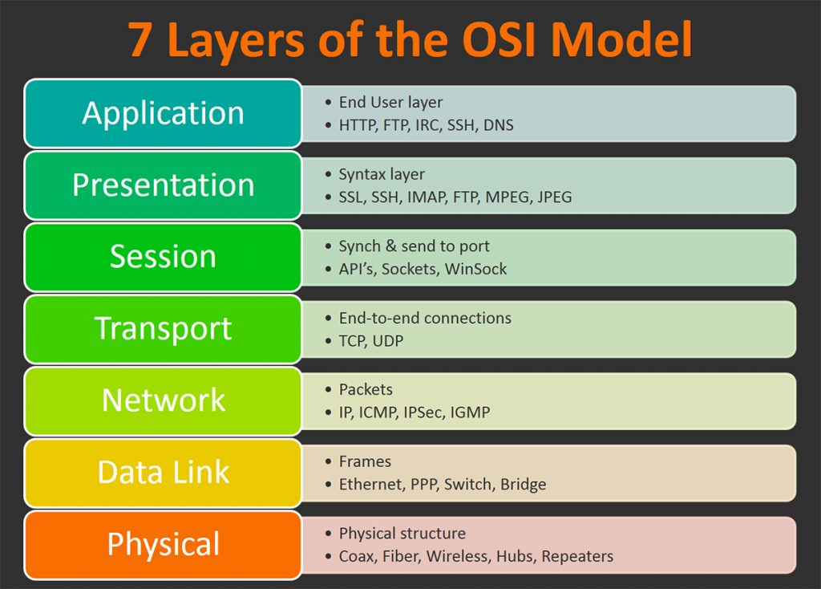
Protocol Layer Abstraction
Application
Transport
Network
Physical
https://www.bmc.com/blogs/osi-model-7-layers/
51

Slide 52
Protocol Layer Abstraction
Key Principle:
Application
Transport
Each layer interacts only with the layer above and below
Network
Physical
Add/strip headers
52

Slide 53
Core Principles & Design Decisions
Provide useful interconnection among heterogeneous machines
Support independent administrative boundaries of control
53

Slide 54
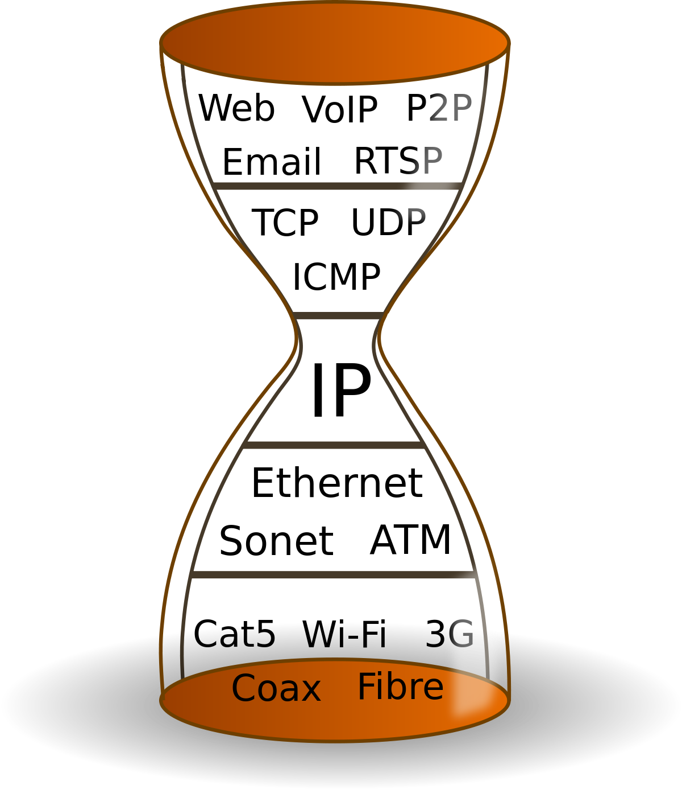
Hourglass Model
Key Principle:
Allows interoperability
Cost of the hourglass model?
54

Slide 55
Core Principles & Design Decisions
3. Multiplexing of expensive resources
Packet Switching vs Circuit Switching
55

Slide 56
Second Level Goals
Internet Communication must continue despite loss of networks or gateways.
Recovery from failures
State
56

Slide 57
Where is the state kept?
In-network
End-hosts
Which one is preferred?
57

Slide 58
Second Level Goals
Internet Communication must continue despite loss of networks or gateways.
Packet Switching vs Circuit Switching
“Dumb” “Best effort”
58

Slide 59
Fate Sharing
Network is stateless
End-points and state will fail at the same time
Advantages:
More robust against intermediate failures
Easier to engineer than replication
59

Slide 60
End-to-end argument in system design
Jerome H Saltzer, David P Reed, and David D Clark. End-to-end arguments in system design. ACM Transactions on Computer Systems (TOCS), 2(4):277–288, 1984.
60

Slide 61
Where should functionality reside in a distributed system?
61

Slide 62
We want to send a message from A to B reliably
A
B
62

Slide 63
We want to send a message from A to B reliably
A
B
63

Slide 64
We want to send a message from A to B reliably
A
B
64

Slide 65
We want to send a message from A to B reliably
A
B
65

Slide 66
2 Options
Option 1: check each link
A
B
66

Slide 67
2 Options
Option 1: check each link
A
B
67

Slide 68
2 Options
Option 1: check each link
A
B
68

Slide 69
2 Options
Option 2: check end-to-end
A
B
69

Slide 70
Which is better?
70

Slide 71
Universal answer to every question:
It depends
71

Slide 72
Second Level Goals
The Internet must support multiple types of communications service.
Is TCP good enough for everything?
72

Slide 73
Beyond TCP
First protocol outside the range of TCP was XNET
A cross-Internet debugger
The network is not working “correctly”, so XNET must work with unreliable delivery
What about voice?
Games?
73

Slide 74
Sometimes we don’t need reliability or retransmissions!
Cannot “bake” reliability into the network!
74

Slide 75
Second Level Goals
Internet Communication must continue despite loss of networks or gateways.
The Internet must support multiple types of communications service.
The Internet architecture must accommodate a variety of networks.
The Internet architecture must permit distributed management of its resources.
75

Slide 76
Second Level Goals
The Internet architecture must be cost effective.
The Internet architecture must permit host attachment with a low level of effort.
The resources used in the Internet architecture must be accountable.
Socket
Abstraction
Failed
76

Slide 77
Other Issues
TCP not suitable for all applications
→Separation of TCPIP into 2 separate layers
Difficult to support multiple types of service without support from underlying network
Lack of tools for distributed management
Large header (40bytes) is large overhead
77

Slide 78
Will the Internet continue to work?
78

Slide 79
Why the internet only just works
Mark Handley. Why the internet only just works. BT Technology Journal, 24(3):119–129, 2006.
79

Slide 80
Modern History of the Internet
1980’s – Congestion collapses
1990’s – BGP (Border Gateway Protocol)
1993 – CIDR (Classless Inter-Domain Routing)
2000’s – NATs (Network Address Translation)
Technologies get deployed in the core of the Internet when they solve an immediate problem or when money can be made.
80

Slide 81
Possible Problems
Spam
Security
Denial of Service Attacks
NATs and Middle-boxes
Congestion Failure?
Inter-domain routing
Mobility
Do we have enough IP addresses?
81

Slide 82
Understanding the Tussle
David D Clark, John Wroclawski, Karen R Sollins, and Robert Braden. Tussle in cyberspace: defining tomorrow’s internet. In Proceedings of the 2002 conference on Applications, technologies, architectures, and protocols for computer communications,
pages 347–356, 2002.
82

Slide 83
Many Stakeholders
Users, who want to run applications and interact over the Internet.
Commercial ISPs, who sell Internet service with the goal of profit.
Private sector network providers who run a part of the Internet to facilitate their business or other undertaking.
Governments, who enforce laws, protect consumers, regulate commerce, and so on.
Intellectual property rights holders, who want to protect their materials on the Internet.
Providers of content and higher level services, offered in search of profit or as a public service.
83

Slide 84
Understanding the Tussle
Design for variation in outcome
Modularize the design along tussle boundaries, so that one tussle does not spill over and distort unrelated issues.
Design for choice, to permit the different players to express their preferences.
84

Slide 85
Design for variation
Expect outcome to be different in different places, and the tussle takes place within the design, not by distorting or violating it. Do not design so as to dictate the outcome. Rigid designs will be broken; designs that permit variation will flex under pressure and survive.
85

Slide 86
Openness
Openness “encourages” competition
Vertical integration, bundling of many services together, requires the removal of certain forms of openness, but may be a useful service to have
The ability to deploy a new protocol without having to modify the inside of the network is important.
86

Slide 87
(Lack of) Trust
Cannot trust anyone
Lost of trust calls for less transparency, and we get firewalls, NAT etc.
Desire by ISP for control and application customization produces application level filtering, connection redirection, etc.
Desire for performance improvement leads to deployment of caches, mirrors, hacks to DNS etc. .
87

Slide 88
Will the end-to-end argument still work?
88

Slide 89
How will the Internet Evolve?
89

Slide 90
Akan Datang
Ayush Mishra, Xiangpeng Sun, Atishya Jain, Sameer Pande, Raj Joshi, and Ben Leong. The great internet TCP congestion control census. Proceedings of the ACM on Measurement and Analysis of Computing Systems, 3(3):1–24, 2019.
90

Slide 91
Summary
Layered Abstraction
Hourglass Abstraction
“Best effort”
End-to-end argument
“Fate sharing”
Big problem with Internet
Misplaced trust, aka no security. ☹
91

