Slide 1
Lecture 10: Introduction to Distributed Systems
CS5229 Advanced Computer Networks

Slide 2
Recap: Peer-to-Peer Networks
Consistent Hashing
Distributed Hash Tables (DHT)
Recursive vs Iterative Lookup
Rendezvous problem
State “liveness” & Parallel queries
Incentives

Slide 3
NAT
Traversal

Slide 4
Quick Admin Notes
Good news: today is more or less the end of the “tested” materials
Next week: guest lecture
Week 13: Class assessment
Sorry, we are a bit just in time.
Part-3: Please start ASAP
Questions?
4

Slide 5
Networks allow us to connect and communicate

Slide 6
Goal: Build cool stuff!

Slide 7


Google MapReduce (2004)
Amazon Dynamo (2007)

Slide 8
Recap:How to Read Papers
What is the problem?
Why is it important?
Why is it not yet well solved?
What is the key idea/insight?
What are the limitations/tradeoffs?

Slide 9
What problem is MapReduce trying to solve?

Slide 10
Computer Science is the study of abstractions
10

Slide 11
Background: Mapping Operation
Often, we want to perform the same operation on every element of a list.
( a b c d )
( f(a) f(b) f(c) f(d) )
This is called mapping.
f

Slide 12
Signal Processing view of Computations
12

Slide 13
Example
Want a list of even Fibonacci numbers fib(k) for all k up to given integer n.

Slide 14
List of Even Fibonacci numbers
def even_fibs(n):
result = []
for k in range(1, n + 1):
f = fib(k)
if f%2==0:
result.append(f)
return result
>>> even_fibs(10)
[2, 8, 34]

Slide 15
Signal Processing View
Enumerate: integers
Map:
fib
Filter:
is_even
Answer
[1, 2, 3, 4, 5, 6, 7, 8, 9, 10]

Slide 16
Signal Processing View
Enumerate: integers
Map:
fib
Filter:
is_even
Answer
[1, 1, 2, 3, 5, 8, 13, 21, 34, 55]

Slide 17
Signal Processing View
Enumerate: integers
Map:
fib
Filter:
is_even
Answer
[ 2, 8, 34 ]

Slide 18
Signal Processing View
Enumerate: integers
Map:
fib
Filter:
is_even
Answer
Why is this better?
Simpler, easier to debug
Reuseable components

Slide 19
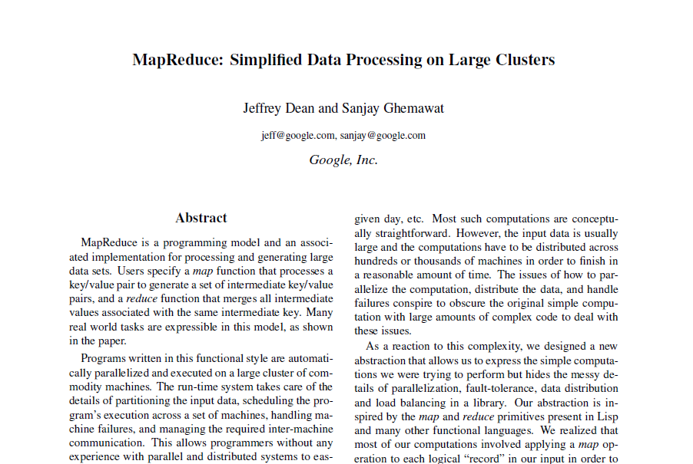
Google MapReduce
19

Slide 20
Google MapReduce
Map
Reduce
Input
Output
key/value pairs
Intermediate key/value pairs
values (files)
Why is this better?
Simpler, easier to debug
Reuseable components
Easily parallelized
Possible input for another MapReduce operation

Slide 21
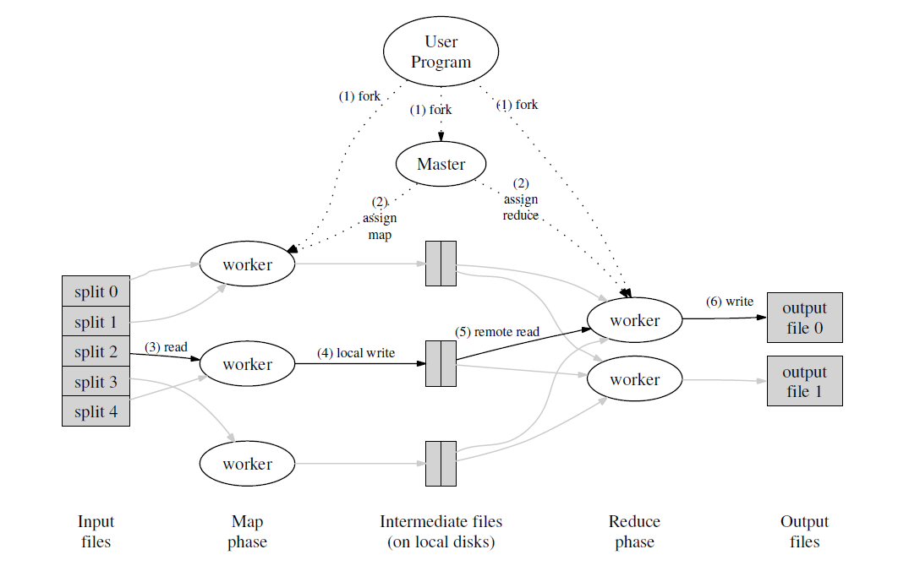
Ideally,
M+R >> n
M pieces
R pieces

Slide 22
Fault Tolerance
Worker Failure
Master Failure
Atomic commits
Skipping Bad Records
Dealing with Stragglers
Parallelization

Slide 23
Optimizations
Partitioning
Ordering Guarantees
Combiner Function
Locality

Slide 24
Selling books online
24

Slide 25
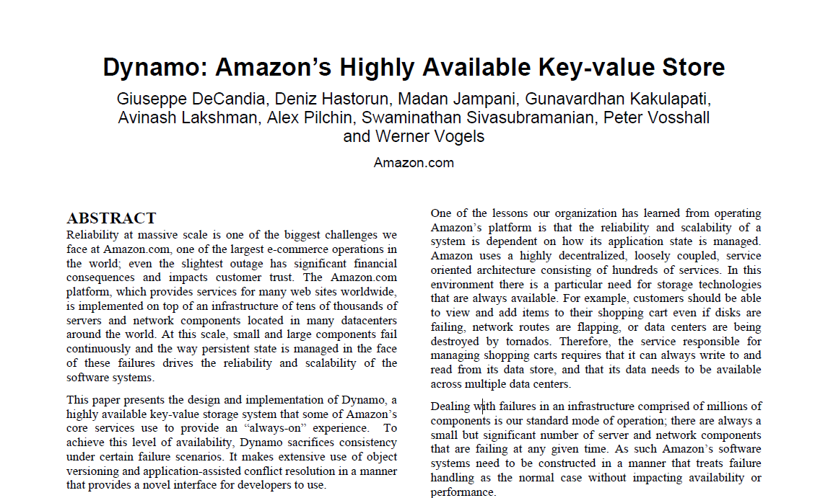
Amazon Dynamo
25

Slide 26
Large Scale Web Applications
Need performance, reliability, efficiency, and scalability.
Key insight: key-value store suffices! No need for RDMS.
Millions of components, so things are failing all the time.
Control performance at the 99.9th percentile.

Slide 27
No novel techniques/algorithms
Really cool how everything is used to make the system work!
27

Slide 28
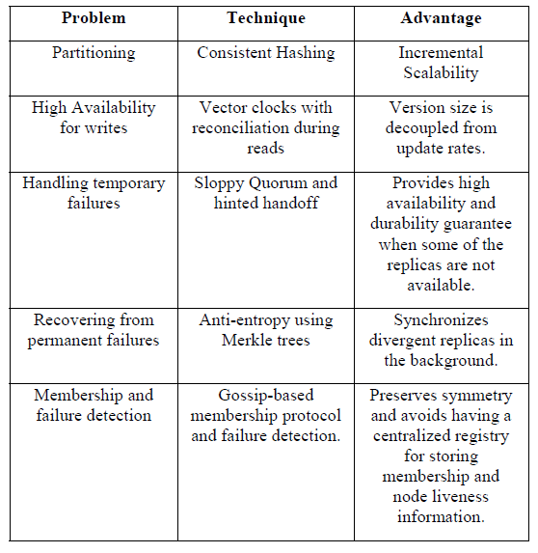

Slide 29
Consistent Hashing
clockwise replication
6
1
0
7
1
f
6
2
5
3
4
2

Slide 31
Consistent Hashing
clockwise replication
6
1
0
7
1
f
6
2
virtual nodes
5
3
4
2
may need to skip nodes!

Slide 32
Why is Consistent Hashing a good idea?
What are the alternatives?
32

Slide 33
Versioning: Vector Clocks
write by Sx
D1 ([Sx,1])
write by Sx
D2 ([Sx,2])
write by Sy
write by Sz
D3 ([Sx,2], [Sy,1])
D4 ([Sx,2], [Sz,1])
reconciled by Sx
D5 ([Sx,3], [Sy,1], [Sz,1])

Slide 34
Replication consistency: Quorum
R+W > N
34

Slide 35

Read/Write Quorum
Suppose R=2, W=4
Read!
Read
successful!

Slide 36
Read/Write Quorum
Suppose R=2, W=4
Write!
Write
completed!

Slide 37
Sloppy Quorum
Why can’t Dynamo use a “normal” quorum?
Hinted handoff
37

Slide 38
What if hinted handoff fails? ☹
Node dies permanently
38

Slide 39
Merkle Trees
H(H(H(A)+H(B))+H(H(C)+H(D)))
H(H(H(A)+H(B))+H(H(C’)+H(D)))
H(H(A)+H(B))
H(H(C)+H(D))
H(H(A)+H(B))
H(H(C’)+H(D))
A
B
C
D
A
B
C
D
H(A)
H(B)
H(C)
H(D)
H(A)
H(B)
H(C’)
H(D)
39

Slide 40
Membership maintenance: Gossip
Gossip-based protocol propagates membership changes to maintain eventually consistent view of membership.
Each node contacts a peer chosen at random every second and the two nodes efficiently reconcile their persisted membership change histories.
Seeds

Slide 41
Summary
Abstractions:
Map-Reduce
Key-Value Store
Parallelization
Recap: Consistent Hashing
Vector clocks
Quorum + sloppiness
Merkle Trees
Gossip

