Slide 1
Lecture 3: Active Queue Management & Buffer Sizing
CS5229 Advanced Computer Networks

Slide 2
Quick Admin Notes
Won’t penalize stragglers
Will release answers once everyone has submitted
Don’t change Zoom username
HW1 to be released this weekend
…until this weekend
Questions?
2

Slide 3
Last call for Lecture 1 Training

Slide 4
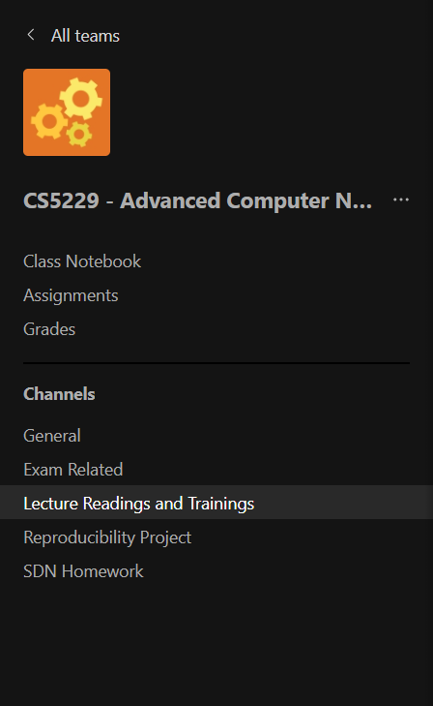
General Etiquette
Please remember to use the correct Teams channels to ask all your questions.
“But I want to check my working, can I ask privately?” → No, it’s not fair to the other students ☹
You can also use the comment section in Coursemology, but ONLY to ask questions regarding the respective Readings, Trainings or Homework.
Comments are NOT for taking notes!

Slide 5
Focus of this class
Survey of important topics
Concepts & Key Ideas
Practical Skills
Application
HWs + Term Project + trainings + attend Lecture
⇒ Will pass CS5229 aka B or C
⇒ Determines A grade
5

Slide 6
cwnd-Based Congestion Control (AIMD)
Slow Start:
cwnd ← cwnd + MSS
Congestion Avoidance:
cwnd ← cwnd + MSS/cwnd
Packet Loss:
cwnd ← cwnd/2
6

Slide 7
Issues with window-based and loss-based Congestion Control
Bursty traffic when ACKs come quickly or ACK aggregation happens
Under-utilization in lossy networks
Fill deep buffers → high delay
Flows can synchronize

Slide 8
AIMD cwnd-based congestion control
buffer
filling
buffer
overflows
cwnd
buffer
drains
sawtooth
Utilization?
Time
Slow start
Congestion avoidance

Slide 9
Synchronization of TCP Flows
Flows will likely experience packet losses together
cwnd will half at the same time
⇒Synchronization
Can lead to poor utilization!

Slide 10
Issues with window-based and loss-based CC
Bursty traffic when ACKs come quickly or ACK aggregation happens
Under-utilization in lossy networks
Fill deep buffers → high delay
Flows can synchronize
BufferBloat

Slide 11
cwnd
Time

Slide 12
Buffer Behaviour
FIFO
What happens when there’s another packet?

Slide 13
Buffer Behaviour
Tail
Head
Droptail

Slide 14
Buffer Behaviour
Tail
Head
Drophead
Why??

Slide 15
Why is FIFO good?
Sharing delay “fairly” among competing flows
Reducing delay during burstiness
Scales well
Easy to implement efficiently.
Simple is good!

Slide 16
Packet Loss Signals Congestion!
Revisit assumption 1:

Slide 17
Can we signal congestion w.o. packet losses?

Slide 18
Explicit Congestion Notification (ECN)
ECN uses last 2 bits in DiffServ field of IP Header.
One is set by source to indicate that it is ECN capable. The other bit is set by routers to signal congestion.
The latter bit is echoed back by destination host.
TCP responds to ECN bit like dropped packet.

Slide 19
Supposedly some ~80% of servers are ECN-capable
Apparently not popular

Slide 20
Need to wait for buffer to overflow
Revisit assumption 2:

Slide 21
Random Early Detection (RED)
Router knows when congestion is building up!
No need to wait for buffer to overflow before signalling congestion!
⇒propagation delay v queueing delay

Slide 22
Implementation
Monitor average queue length
Use randomization to signal congestion
⇒ Can avoid synchronization!
Can either mark or drop

Slide 23
DropTail/DropHead
Drop probability
1
Average queue
Q_{max}

Slide 24
RED Implementation
Mark/drop probability
1
max_{p}
Average queue
min_{th}
max_{th}
Q_{max}

Slide 25
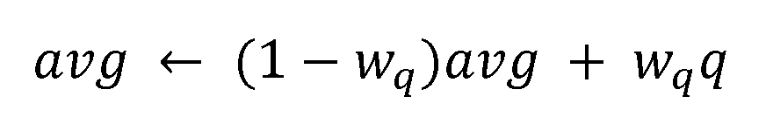
Tracking average queue length
history
instant
Exponentially weighted moving average (EWMA)

Slide 26
Implementation at line rates is difficult?
Why is RED not popular?

Slide 27
AIMD cwnd-based congestion control
cwnd
buffer
fills
Time
Slow start
Congestion avoidance

Slide 28
Should the buffer be large or small?

Slide 29
Buffer Sizing
Guido Appenzeller, Isaac Keslassy, and Nick McKeown. Sizing router buffers. ACM SIGCOMM Computer Communication Review, 34(4):281–292, 2004.
29

Slide 30
Should the buffer be large or small?
Large buffer:
⇒Large delays
Small buffer:
Risk buffer emptying ⇒ low utilization
30

Slide 31
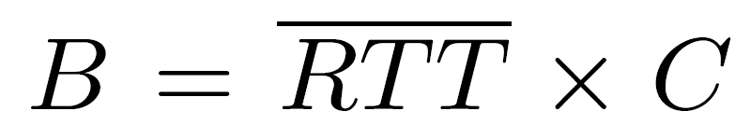
Rule of Thumb (1994)
Buffer grows linearly with line rate!
31

Slide 32
Why
?
Analysis
32

Slide 33
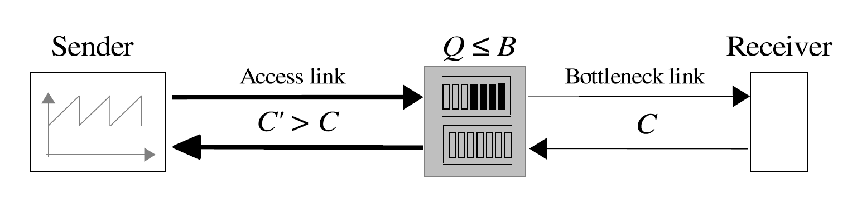
Pause sending
ACK
cwnd
W_{max}
C.RTT+B
How long will buffer take to drain?
W_{max}
B
2
C
Time

Slide 34
cwnd
W_{max}
C.RTT+B
_{cwnd}
Send rate =
RTT
W_{max}
W_{max}
2
Time
=
>= C
2RTT
W_{max} >= 2RTT.C
B
How many packets in buffer when cwnd =W_{max}?
B >=
W_{max} – BDP
“pipe”
>= 2RTT.C – RTT.C
Time
= RTT.C
t₀
t₁
t₂

Slide 35
What happens when there are many flows?
Synchronization common for <100 flows
very rare > 500 concurrent flows
35

Slide 36
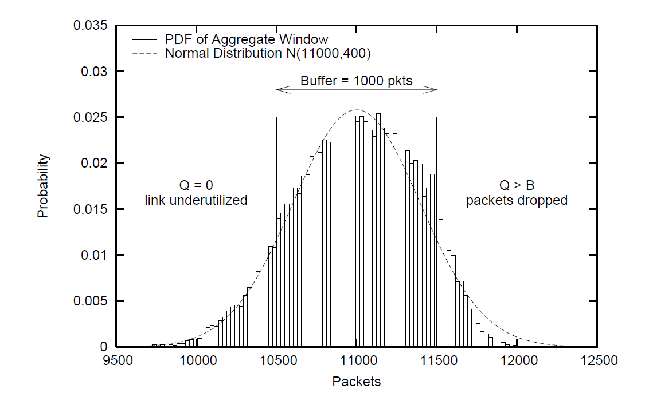
What happens when there are many flows?
36

Slide 37
What happens when there are many flows?
Compute W variance for a long flow
n flows ⇒ n x variance
Short flows don’t matter. Dominated by long flows

Slide 38
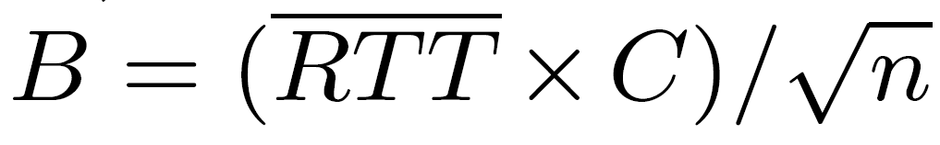
New Proposal (2004)
Counter-intuitive: with more flows, need smaller buffer!
38

Slide 39
1994
2004
40 Mb/s
2.5-10 Gb/s
1 flow
>10,000 flows
BufferBloat!
Change in underlying hardware ⇒ review assumptions/new algorithms

Slide 40
Buffer Sizing (version 2)
Nick McKeown, Guido Appenzeller, and Isaac Keslassy. Sizing router buffers (redux). ACM SIGCOMM Computer Communication Review, 49(5):69–74, 2019
40

Slide 41
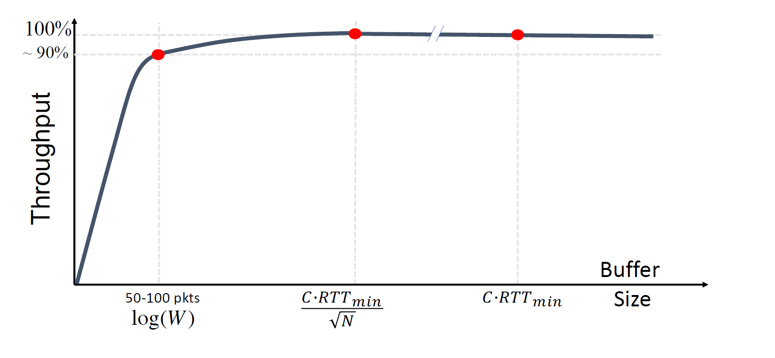
“Tiny buffers”
“Small buffers”
2006
2004
1994
Paced Traffic
Only 20-50 packet buffers

Slide 42
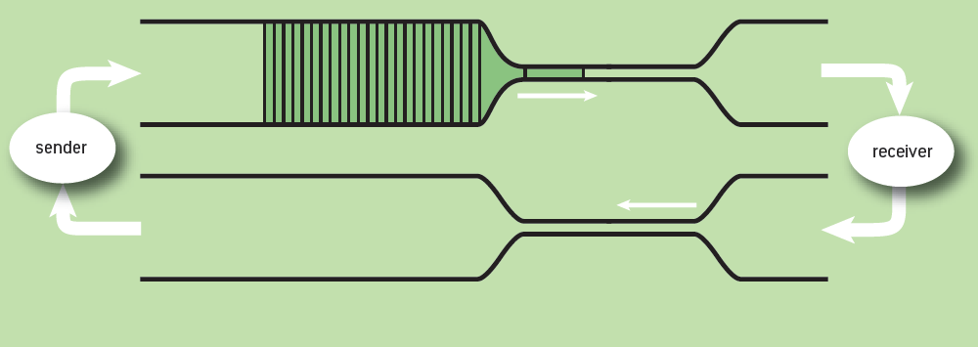
Understanding BufferBloat

Slide 43
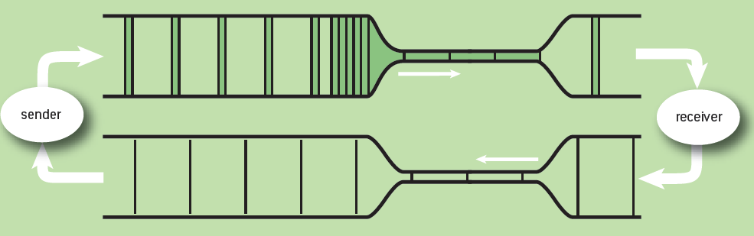
Understanding BufferBloat

Slide 44
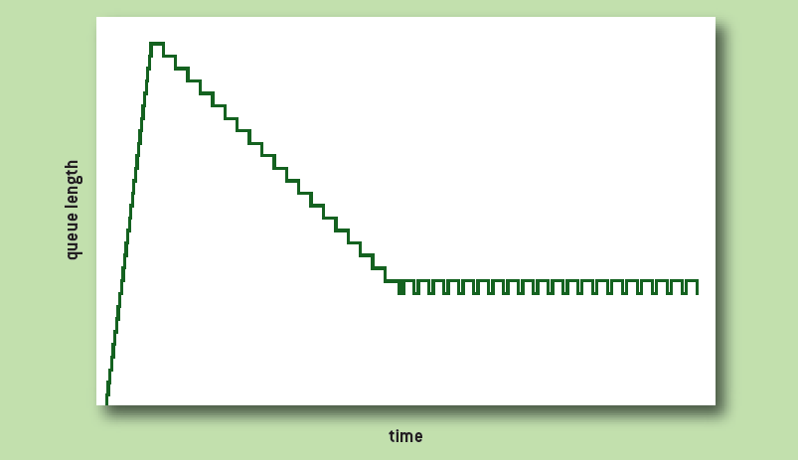
Understanding BufferBloat
Good queue
Bad queue

Slide 45
Why CoDeL?
Mismatch between window and pipe size⇒ BufferBloat
Standing queue that cannot dissipate
Queueing models assume Poisson but TCP packet arrivals are correlated(!)
Queue size is not a good measure of congestion!

Slide 46
Implementing CoDeL (2012)
Buffer overflow ⇒ drop packet (as per normal)
Track local minimum queue delay (time)
Start dropping when delay > target
Next drop time is decreased in inverse proportion to the square root of the number of drops since we started dropping
When delay < target, stop dropping

Slide 47
How do we achieve fairness between flows?

Slide 48
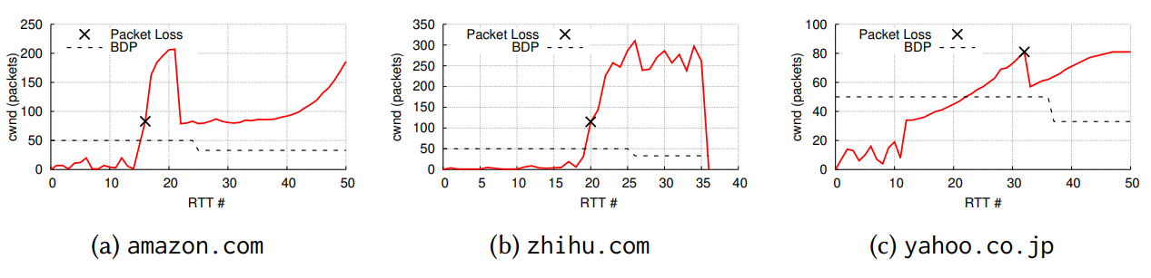
TCP Friendliness
“A unicast-flow is considered TCP-friendly when it does not reduce the long-term throughput of any co-existent TCP flow more than another TCP flow on the same path would do under the same network conditions.[1]”
[1] Widmer, Jörg, Robert Denda, and Martin Mauve. "A survey on TCP-friendly congestion control." IEEE network 15.3 (2001): 28-37.

Slide 49
Wait: what do we mean by fairness??

Slide 50
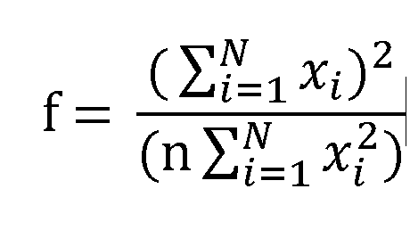
How can we measure fairness?
Jain’s index:
Zero-sum game
Max-min fairness:
Allocation that maximizes the minimum throuhput among all flows
50

Slide 51
Fair queueing
round
robin
Expensive!!

Slide 52
Can we implement fair queueing with FIFO?

Slide 53
Why is it hard to achieve fair queueing?
Per-flow state
Long flows vs short flows
Bursty flows
When does a flow end?
Routing changes
at line rates(!)
Approximate
Drop pkts to reduce rates

Slide 54
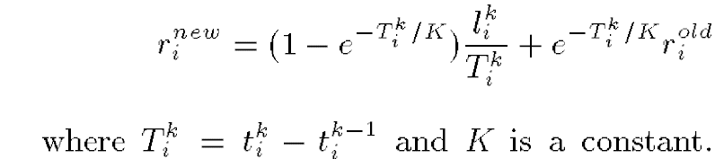
Core-Stateless Fair Queueing (1998)
Edge routers vs core routers
Only edge routers store per flow state
Approximate max-min fairness
Edge routers estimate rate:
Inserted into packet labels

Slide 55
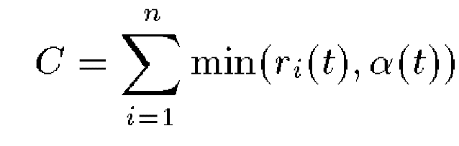
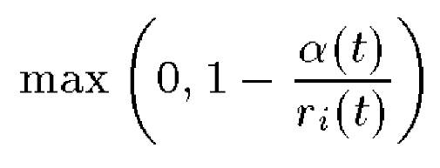
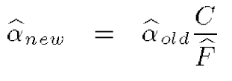
Core-Stateless Fair Queueing (1998)
Fair share α(t):
Drop probability:
Estimate aggregate arrival rate A and accepted traffic F
If A < C, α(t) will be largest r_{i}(t) seen
Else,
EWMA

Slide 56
Modern AQM
Push-In First-Out Queue (PIFO) (2016) -- priority queue data structure that allows packets to be "pushed" (enqueued) into an arbitrary location
Calendar Queues in P4 (2020)
CSFQ in P4 (2021)

Slide 57
References
[1] Anirudh Sivaraman, Suvinay Subramanian, Mohammad Alizadeh, Sharad Chole, Shang-Tse Chuang, Anurag Agrawal, Hari Balakrishnan, Tom Edsall, Sachin Katti, and Nick McKeown. Programmable packet scheduling at line rate. In Proceedings of the 2016 ACM SIGCOMM Conference, pages 44–57, 2016.
[2] Naveen Kr Sharma, Chenxingyu Zhao, Ming Liu, Pravein G Kannan, Changhoon Kim, Arvind Krishnamurthy, and Anirudh Sivaraman. Programmable calendar queues for high-speed packet scheduling. In 17th USENIX Symposium on Networked Systems Design and Implementation (NSDI 20), pages 685–699, 2020.
[3] Zhuolong Yu, Jingfeng Wu, Vladimir Braverman, Ion Stoica, and Xin Jin. Twenty
years after: Hierarchical core-stateless fair queueing. In NSDI, pages 29–45, 2021.

Slide 58
Buffer sizing with modern non-AIMD TCP is still not well understood
Doing research on QUIC as we speak

Slide 59
Summary
BufferBloat
TCP Synchronization is bad
Revisit Assumptions
Need packet loss to signal congestion
Need to wait for buffer to overflow
Exponentially-weighted moving average (EWMA)
Need to change with the times
Why buffer sizing matters
CoDeL
Fair Queueing and Min-max Fairness

