Slide 1
Lecture 4: Rate-based End-to-End Congestion Control
CS5229 Advanced Computer Networks

Slide 2
Quick Admin Notes
Homework 1 issued
Lecture 2 Training Solutions Released
Lecture Trainings end on Sunday
Project – form teams of 3 by 12 Sep 2021 (more details – released tonight)
Questions?
2

Slide 3
Issues with window-based and loss-based CC
Bursty traffic when ACKs come quickly or ACK aggregation happens
Under-utilization in lossy networks
Fill deep buffers → high delay
Flows can synchronize

Slide 4
Recap: what we need to do
Estimate the available bandwidth
Be “fair” to other flows
Adapt to network changes
Deal with packet loss
“TCP friendliness”
“give way” to new flows
“soak up” available bandwidth
4

Slide 5
TCP Vegas
Improved timeout mechanism
Delay-based congestion avoidance instead of loss-based
Modified Slow-Start
5

Slide 6
Modified Timeout Mechanism
Check per packet RTT instead of waiting for dupacks
Don’t reduce cwnd more than once for each RTT interval
6

Slide 7
Bytes in transit is directly proportional to the expected throughput
Key Idea:
window size increases ⇒ throughput should also increase.
Measure and control the amount of extra data in transit

Slide 8
BaseRTT ← minimum of all measured round trip times
Expected Throughput
WindowSize
=
BaseRTT

Slide 9
Diff = Expected - Actual
α<Diff<β, do nothing
Diff<α,
increase cwnd
β <Diff,
decrease cwnd
Why?

Slide 10
Can use delay to infer congestion!
Key Idea:

Slide 11
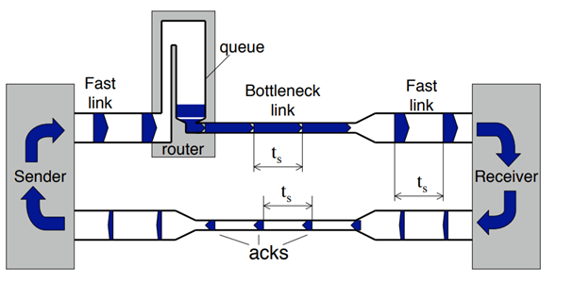
Credits: Mark Handley, UCL

Slide 12
What happens to delay?

Slide 13
Propagation delay
“Pipe”
RTT_{min}
C
BDP = C.RTT_{min}
queueing delay
cwnd
C
BDP = C.(RTT_{min} +d)
~Diff
Expected Throughput
WindowSize
C.d
=
= C +
BaseRTT
RTT_{min}

Slide 14
Modified Slow Start
Exponential growth might be overly aggressive (up to 2x)
Exponential growth only every other RTT
In between, check rate.
14

Slide 15
Vegas is *still* cwnd-based!
Avoid using packet loss to signal congestion and use delay instead!

Slide 16
Non-AIMD CC
Sally Floyd, Mark Handley, Jitendra Padhye, and Jörg Widmer. Equation-based
congestion control for unicast applications. ACM SIGCOMM Computer Communication
Review, 30(4):43–56, 2000.

Slide 17
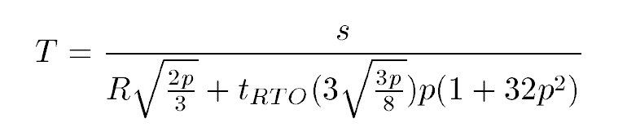
Rate Upperbound for TCP Friendliness
[PFTK98] J. Padhye, V. Firoiu, D. Towsley, and J. Kurose. “Modeling TCP Throughput: A SimpleModel and its Empirical Validation”. SIGCOMM Symposium on Communications Architectures and Protocols, Aug. 1998.

Slide 18
Goals
Primary goal is not to aggressively find and use available bandwidth,
but to maintain steady sending rate while being responsive to congestion

Slide 19

TFRC Overview
delay?
s is the packet size
Loss event rate p must be calculated at the receiver,while the roundtrip time R could be measured at either the sender or the receiver.
The receiver sends either the parameter p or the calculated value of the allowed sending rate T back to the sender.
The sender increases or decreases its transmission rate based on its calculation of T.
19

Slide 20
Is TCP Vegas or TFRC any good?
No!

Slide 21
Why?

Slide 22
TCP Friendliness
“A unicast-flow is considered TCP-friendly when it does not reduce the long-term throughput of any co-existent TCP flow more than another TCP flow on the same path would do under the same network conditions.[1]”
[1] Widmer, Jörg, Robert Denda, and Martin Mauve. "A survey on TCP-friendly congestion control." IEEE network 15.3 (2001): 28-37.

Slide 23
Making Rate-based TCP work

Slide 24
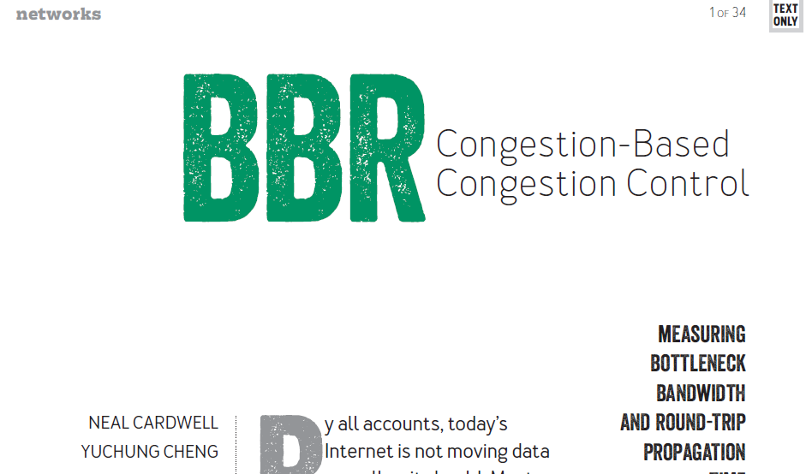

Slide 25
loss-based TCP
RTT
app
limited
BW
limited
d + RTT_{min}
RTT_{min}
pkts in
flight
Kleinrock “optimal”
rate
BtlBw
pkts in
flight
BDP
BDP+buffer

Slide 26
Sanity Check
If the total packets in flight is BDP, does it mean that we will never have any queueing?
False!

Slide 27
Overview: BBR
Packet pacing
From ACKs, measure RTT and BtlBW
Deduce RTT_{min}
Deduce BtlBW_{max}
Regulate send rate around BtlBW_{max}
27

Slide 28
Startup
rate
When to stop?
BtlBw
Exponential
increase
pkts in
flight
BDP

Slide 29
Drain
rate
BtlBw
How?
Compute
pkts in
flight
BDP

Slide 30
Can we just send at BtlBw?
Why or Why Not?

Slide 31
What if more bandwidth becomes available?
PROBE_BW
??
RTT_{min}
1.25
0.75
1.00
1.00
1.00
1.00
1.00
1.00
Periodic pattern
Probe for
additional BW

Slide 32
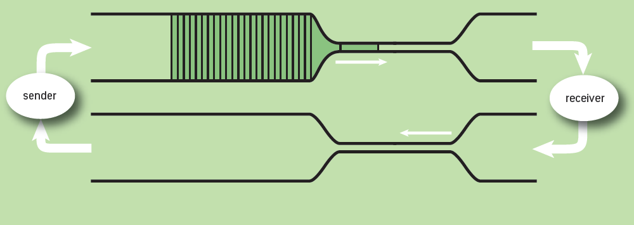
Understanding BufferBloat

Slide 33
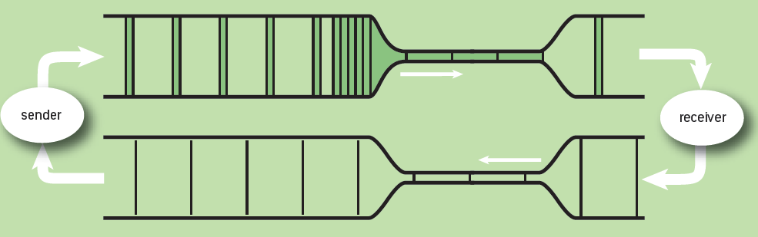
Understanding BufferBloat

Slide 34
How do we estimate RTT_{min}?

Slide 35
PROBE_RTT
rate
10 s
BtlBw
Synchronize!
pkts in
flight
0.2 s
BDP

Slide 36
Is BBR any good?

Slide 37
Does BBR need a cwnd?
Yes!
cwnd = 2 x BDP!

Slide 38
Is BBR TCP friendly?

Slide 39
It depends!

Slide 40
BBR vs CUBIC
Shallow buffer
Deep buffer
BBR wins!
CUBIC wins!
More BBR flows ⇒ wins less

Slide 41
BBR vs CUBIC
Ayush Mishra, Jingzhi Zhang, Melodies Sim, Sean Ng, Raj Joshi,and Ben Leong. Conjecture: Existence of Nash Equilibria in Modern Internet Congestion Control. Proceedings of the Asia-Pacific Workshop on Networking (APNet). June 2021.

Slide 42
Not cast in stone that BBR will be the only TCP

Slide 43
Known Issues: BBR
Not friendly with Reno/CUBIC
Impossible to estimate RTTmin ⇒ cwnd = 2 x BDP ⇒ High delay
Loss rate can be quite high for small buffers
PROBE_RTT causes significant throughput reduction
BBR v2!
43

Slide 44
How else can we do rate-based congestion control?

Slide 45
Rate-based control loop
Wai Kay Leong, Zixiao Wang, and Ben Leong. TCP congestion control beyond bandwidth-delay product for mobile cellular networks. In Proceedings of the 13th International Conference on emerging Networking EXperiments and Technologies, pages 167–179, 2017.
PropRate

Slide 46
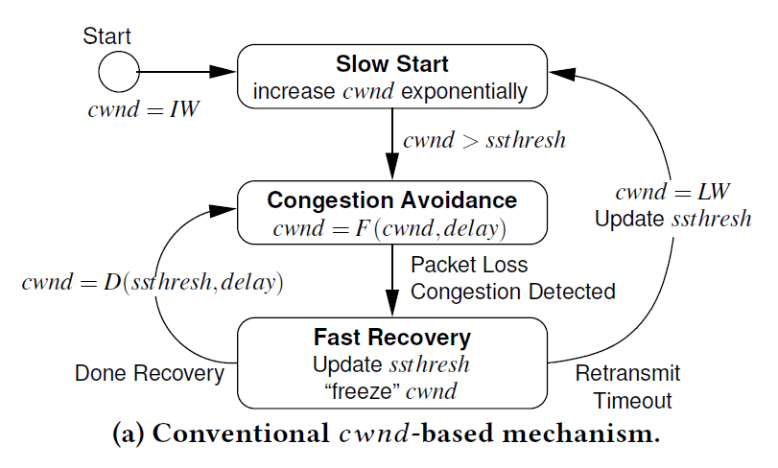

Slide 47
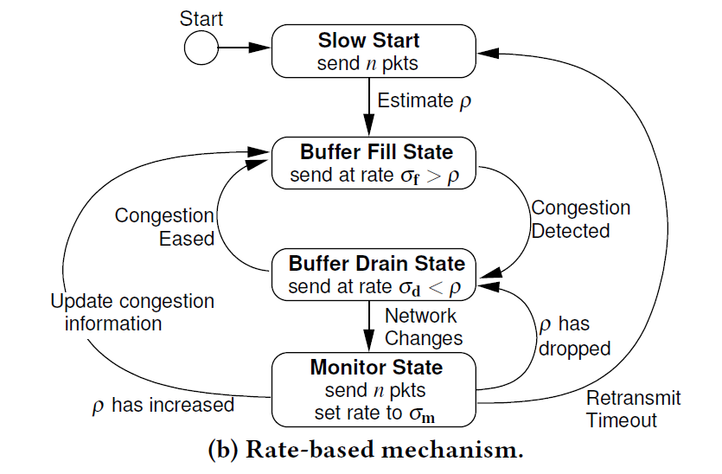

Slide 48
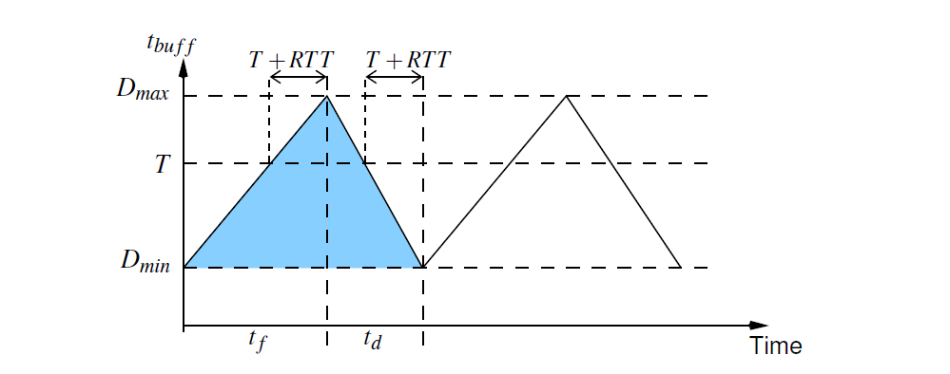
Maximizing Throughput
RTT - RTT_{min}

Slide 49
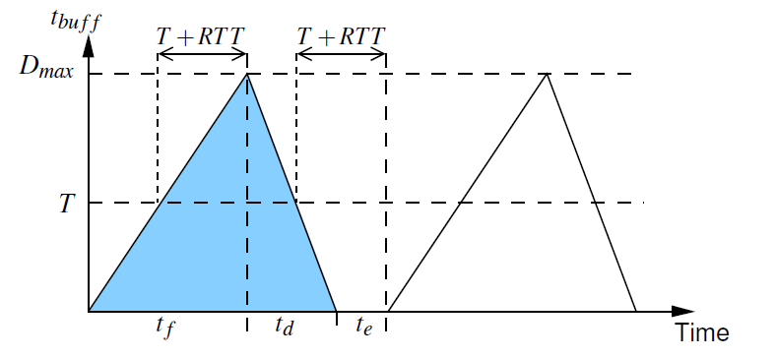
Minimizing delay
Why not a constant rate?

Slide 50
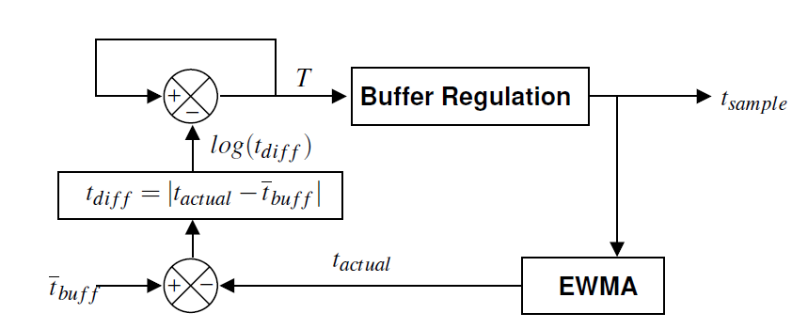
target delay
t_{buff} = RTT – RTT_{min}

Slide 51
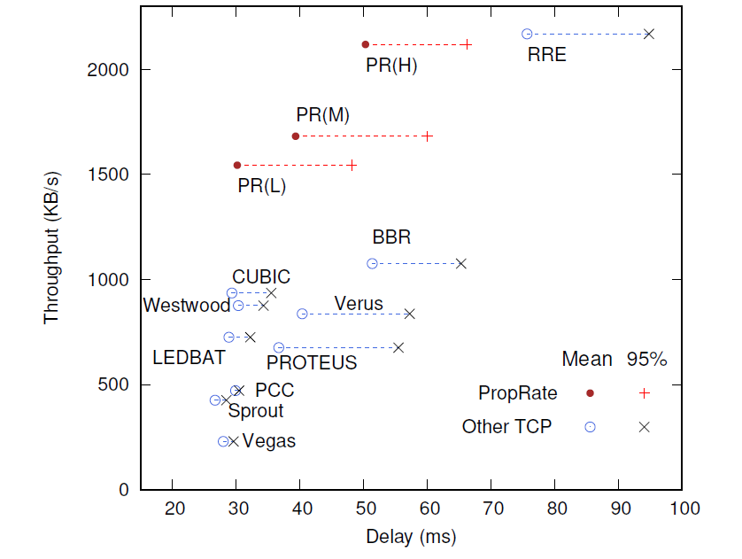
Performance for Real LTE Network

Slide 52
Rate-based control loop
Venkat Arun and Hari Balakrishnan. Copa: Practical delay-based congestion control
for the internet. In 15th USENIX Symposium on Networked Systems Design and Implementation (NSDI 18), pages 329–342, 2018.

Slide 53
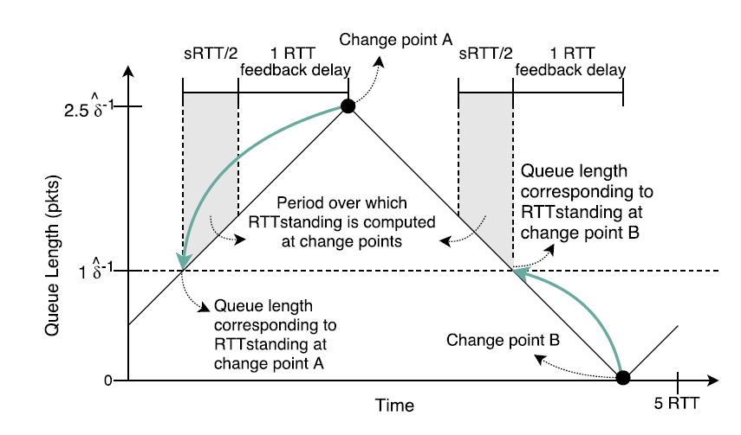
2 modes: “normal” vs buffer fillers
cwnd-based + ACK clocked

Slide 54
PropRate vs Copa
regulates delay
regulates delay
not cwnd-based
cwnd-first rate-based
not ACK-clocked!
ACK-clocked
2 modes
Why does ACK-clocked or not matter?

Slide 55


4G/LTE Mobile Example
choked!
watching video
ACK
stuck behind
file packets!
upload file
What happens?

Slide 56
What if we are not ACK-clocked?
disconnection!
Still need
cwnd!
2 x BDP works well!
What happens?

Slide 57
Summary
Kleinrock “Optimality” Point
TCP Friendliness
BDP = RTT_{min} x Btlbw
Hard to probe RTT_{min}
Need to probe BW
Rate-based TCP ⇒ Control loop
ACK-clocking vs disconnected operation

