Slide 1
Lecture 6: Data Centre Networking
CS5229 Advanced Computer Networks

Slide 2
Quick Admin Notes
Sorry we messed up. ☹
Deadline for Homework 1 has been extended to this Sunday (19th September, 23:59)
Questions?
2

Slide 3

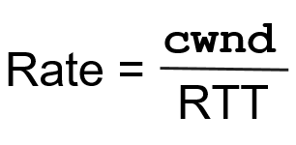
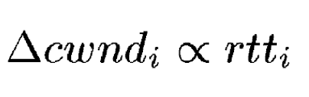

XCP fairness controller (AIMD)
Φ > 0 : Additive Increase on rate
Φ < 0 : Multiplicative Decrease on rate
Reflected as ∆cwnd
AI: Everyone increases by the same ∆Rate.
MD: Everyone decreases by some ∆Rate proportional to their current rate

Slide 4
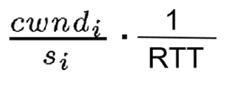
XCP fairness controller (AIMD)
Say XCP wants the ∆cwnd to take effect over some time period t. It would then have the distribute ∆cwnd over K packets, where K is the total number of packets a sender sends during the time period t.
K = (rate in packets per second) x t
same for every flow
packets/cwnd

Slide 5
Recap: Last Week
Routers know a lot
We can do better CC with network support
Need for incremental deployment
Embedding information in packet headers to avoid per-flow state
Feedback loop can become unstable if delay increases
Convergence & stability matters
Difficult to deploy ECN & in-network protocols
lack of control

Slide 6
What about data centres?

Slide 7
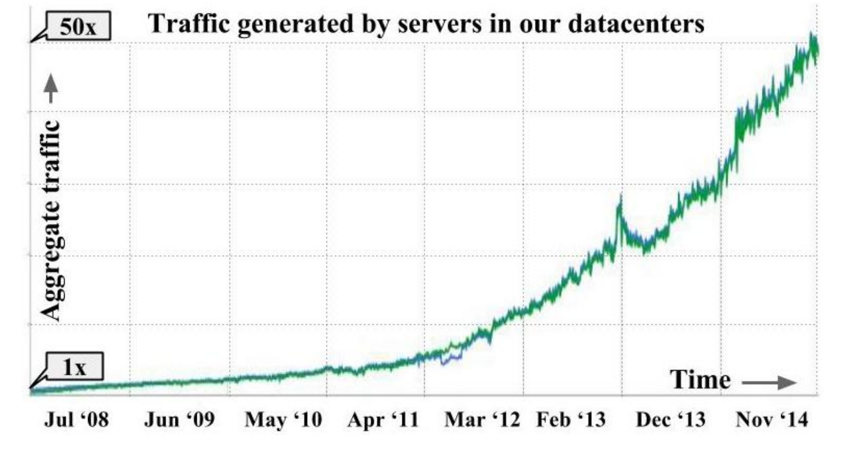
Singh et al. Jupiter rising: A decade of clos topologies and centralized control in google's datacenter network. ACM SIGCOMM computer communication review, 45(4), 183-197. 2015

Slide 8
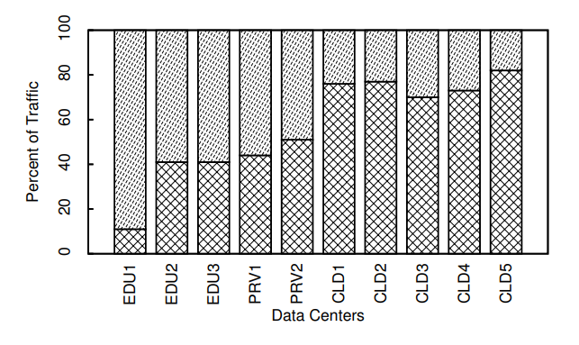
Outgoing
Intra-DC
Benson et al. "Network traffic characteristics of data centers in the wild." Proceedings of the 10th ACM SIGCOMM conference on Internet measurement. 2010.

Slide 9
Key Trends
Huge(!) traffic + growing
Traffic patterns in DCs fundamentally different from Internet at large
Intra-DC traffic!

Slide 10
What is different?
Larger volume of traffic, huge number of flows
Tight deadlines for network I/O
machine-to-machine traffic
Hadoop, MapReduce
~1 s (Internet) vs ~10 ms (DC)

Slide 11
What is different?
Congestion and TCP incast
Need for isolation across applications
Centralized control at the flow level may be difficult but we have a lot more control(!)
Regular TCP doesn’t work well

Slide 12
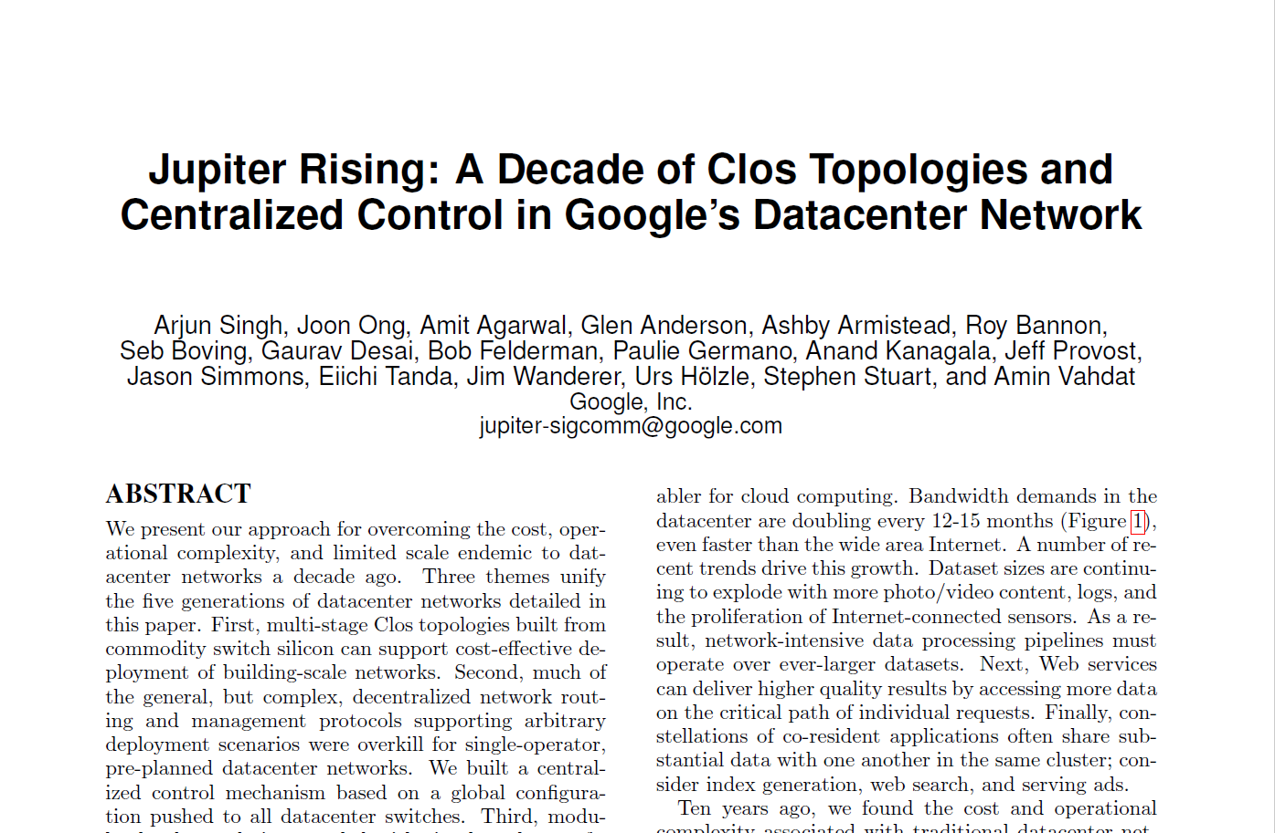
Challenges of DC Comms

Slide 13
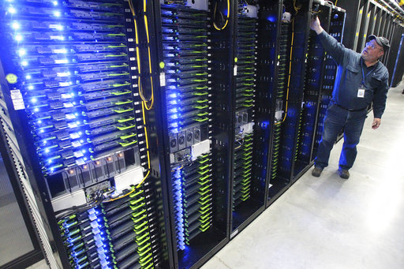
Source: phys.org

Slide 14
How do we build a data centre?
Top-of-rack switch
Server

Slide 15
How do we build a data centre?
Simple
right??

Slide 16
Why not simple?
Scalability
$$$$

Slide 17
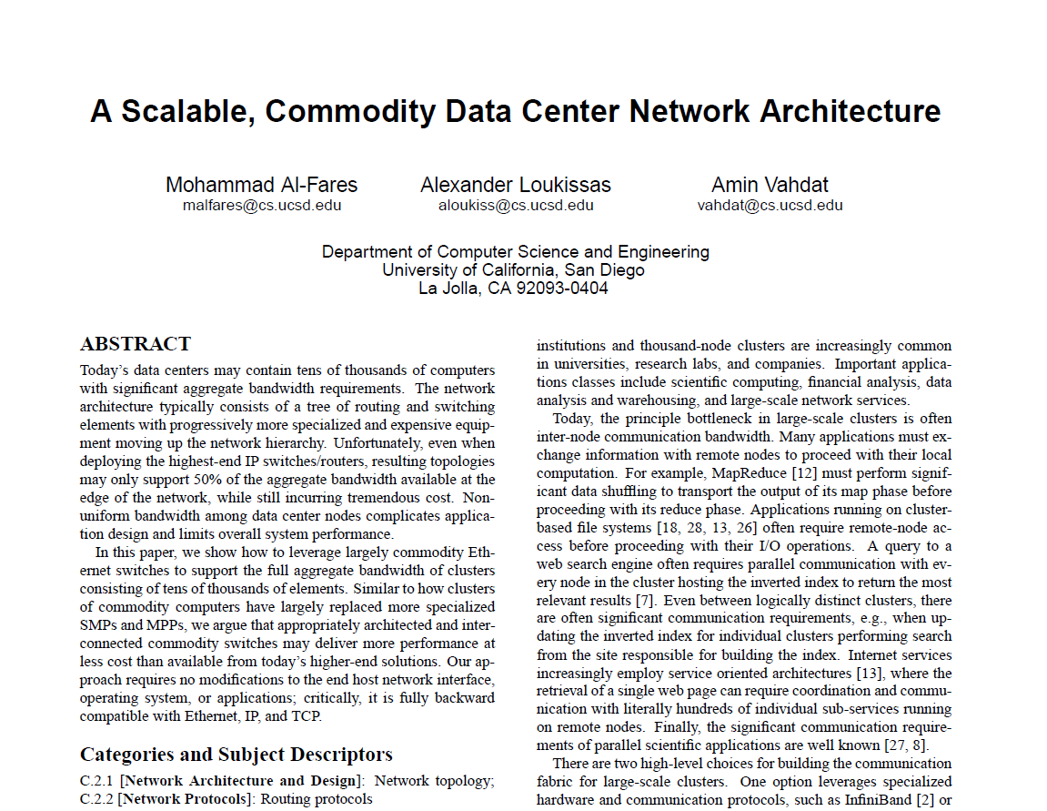
FatTree

Slide 18
Key Idea
$$$
“big” switch

Slide 19
Key Idea
$$$$
“bigger” switch

Slide 20
Key Idea
Even bigger
how?
$$$
$$$

Slide 21
Clos (Tree) Network
$$$$
$$$
$$$
$$$
$$$

Slide 22
Clos (Tree) Network
$$$
$$$
$$$
$$$
$$$
$$$

Slide 23
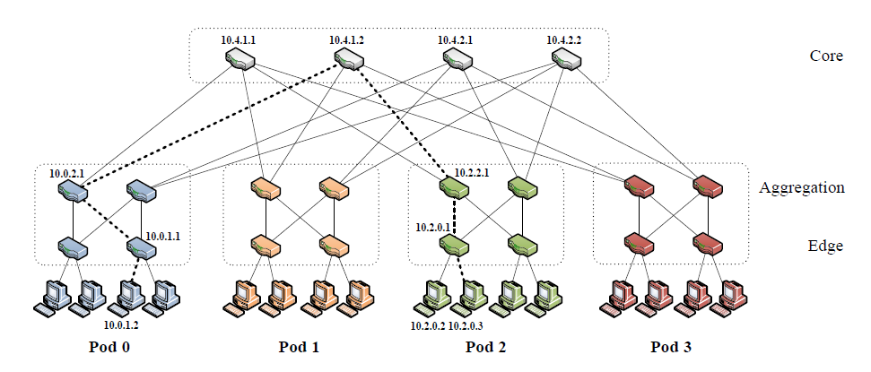
FatTree

Slide 24
FatTree (2008)
C. E. Leiserson (1985)
All switching elements are equivalent!
Replace large expensive switches ($$$$) with smaller commodity switches ($$$)
Tradeoff some latency to save money and increase scalability
Load balancing + multipath routing (ECMP)
Failure resilience
Learning by doing in
the Final Project!

Slide 25
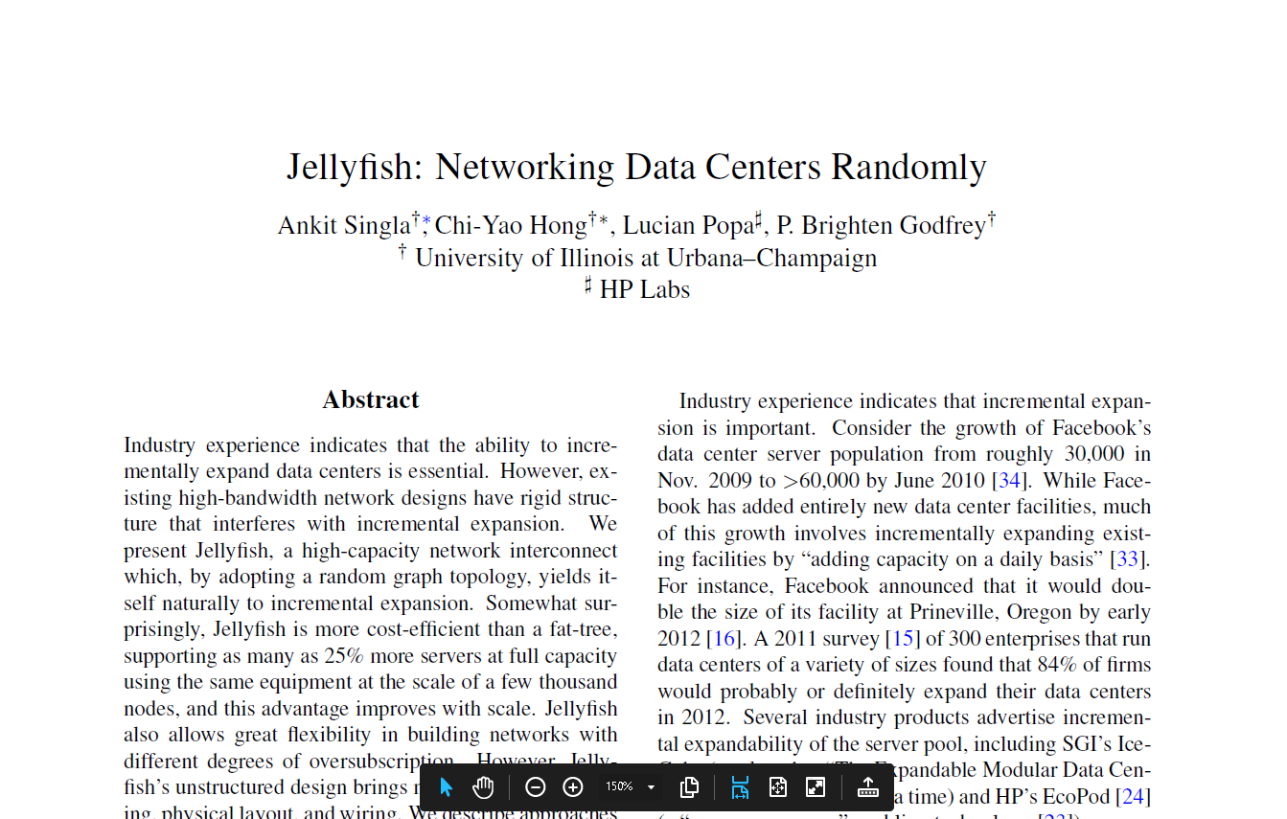
Do we really need trees?

Slide 26
Motivation: Jellyfish (2012)
FatTee design space very coarse: can only be built at sizes 3,456, 8,192, 27,648, and 65,536 corresponding to available port counts of 24, 32, 48, and 64
Fixed structure is a problem!

Slide 27
Key idea: Jellyfish (2012)
Replace tree with Random
Regular Graph (RRG).
Why should this work better??
Shorter average path lengths!
Cable hell
Final Project

Slide 28
Having a scalable topology solves the problem of large traffic volume

Slide 29
Does it also mean that applications can meet their tight deadlines?

Slide 30
What are these deadlines?
DC apps are not
the same as end-user apps

Slide 31

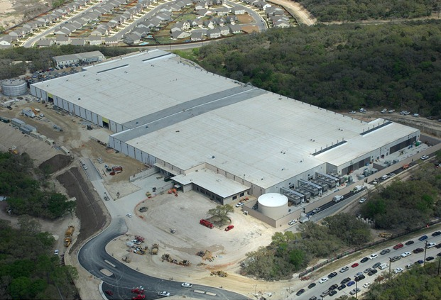

Example: Web Search
Internet

Slide 32
Example: Web Search (inside DC)
Query
Top-level aggregator (deadline: 250ms)
Middle-level aggregators (deadline: 50ms)
Workers (deadline: 10ms)
Notes:
Logical Topology

Slide 33
Example: Web Search (inside DC)
Top-level aggregator (deadline: 250ms)
Response
Middle-level aggregators (deadline: 50ms)
Workers (deadline: 10ms)
Deadlines necessary: response cannot be too late (affects user experience)

Slide 34
Example: Web Search (inside DC)
Scatter-Gather OR Partition-Aggregate Application Traffic Pattern
Top-level aggregator (deadline: 250ms)
Response
Middle-level aggregators (deadline: 50ms)
Workers (deadline: 10ms)
Missed deadline: corresponding response skipped (lower quality result)
Hurts revenue!

Slide 35
Partition-Aggregate is general!
Several large-scale web applications:
Web Search
Ad Selection
Social Network data composition e.g. FB Multiget
Notes:
FB Multiget: http://highscalability.com/blog/2009/10/26/facebooks-memcached-multiget-hole-more-machines-more-capacit.html

Slide 36
Why can’t we meet deadlines simply with better topologies?

Slide 37
Synchronized mice flow collision caused by the partition-aggregate traffic pattern
Incast

Slide 38
Incast
Top-of-rack switch
Congestion on the link to the aggregator
Aggregator
Notes:
One of the server in the rack is an aggregator

Slide 39
Incast
Not a normal TCP congestion
TCP flow sizes are very small: as small as 2 packets
Workers can either lose both packets or the last packet
No way for a worker to know that response packet(s) were lost ➔ rely TCP retransmission timeout (RTO) ➔ worker misses the deadline!
Notes:
One of the server in the rack is an aggregator

Slide 40
Mitigating Incast
If Incast is the only problem we need to solve, what is the most obvious solution?
Notes:
One of the server in the rack is an aggregator

Slide 41
Deep Buffers!

Slide 42
Incast is not the only problem!

Slide 43
Datacenter workloads are mixed
Partition/Aggregate (query)
➔ Need high burst tolerance
Short messages [50KB-1MB] (coordination, control)
➔ Need low-latency
Large flows [1MB-50MB] (data updates, batch processing)
➔ Need high-throughput
Notes:
One of the server in the rack is an aggregator

Slide 44
Other problem: large flows cause queue build-up that increase delays for latency-sensitive flows

Slide 45
Conflicting Requirements
High Throughput
High Burst Tolerance
Low Latency
Deep Buffers (for throughput):
Queuing Delays
Increase Latency
Shallow Buffers:
Bad for Bursts tolerance & Throughput
DCTCP
Reduced RTO_{min} (SIGCOMM ‘09)
Doesn’t Help Latency Still need to ReTx
AQM – RED:
Avg Queue Not Fast
Enough for Incast
Credits: Adapted from Mohammad Alizadeh. DCTCP (SIGCOMM ’10)
Notes:
Deep Buffers for throughput/burst tolerance – bad for latency
Shallow Buffers – bad for bursts & throughput
Reduce RTO_{min} – no good for latency
AQM – Difficult to tune, not fast enough for incast-style micro-bursts, lose throughput in low stat-mux

Slide 46
Key Objective: Low Queue Occupancy & High Throughput

Slide 47
Datacenter TCP (DCTCP)

Slide 48
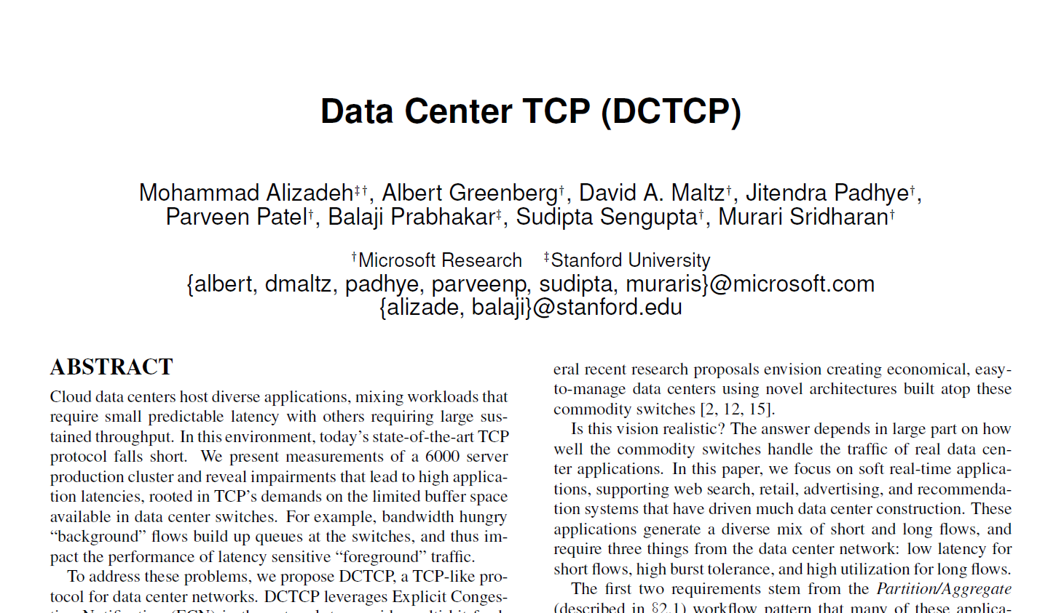
Key idea: React early and proportionately to congestion and don’t wait till packet loss

Slide 49


The Buffer Sizing Story
Bandwidth-delay product rule of thumb:
A single flow needs buffers for 100% Throughput.
Appenzeller rule of thumb (SIGCOMM ‘04):
Large # of flows: is enough.
Can’t rely on statistical multiplexing benefit in the datacenter networks
Measurements show typically 1-2 big flows at each server, at most 4.
Real Rule of Thumb:
Low Variance in Sending Rate → Small Buffers Good Enough!
Credits: Adapted from Mohammad Alizadeh, MIT

Slide 50
DCTCP
Congestion Signal: Use ECN marking (but differently)
Two key ideas
React in proportion to the extent of congestion, not its presence.
Reduces variance in sending rates, lowering queuing requirements.
Mark based on instantaneous queue length.
Fast feedback to better deal with bursts.
ECN Marks | TCP | DCTCP
1 0 1 1 1 1 0 1 1 1 | Cut window by 50% | Cut window by 40%
0 0 0 0 0 0 0 0 0 1 | Cut window by 50% | Cut window by 5%
Credits: Adapted from Mohammad Alizadeh, MIT

Slide 51
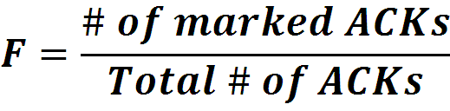

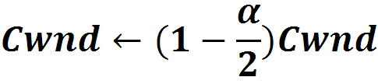
Data Center TCP Algorithm
Switch side:
Mark packets when Queue Length > K.
B
K
Don’t
Mark
Mark
Sender side:
Maintain running average of fraction of packets marked (α).
In each RTT:
Adaptive window decreases:
Note: decrease factor between 1 and 2.
EWMA
Credits: Adapted from Mohammad Alizadeh, MIT
Notes:
very simple marking mechanism
not all the tunings other aqms have
on the source side, the source is tryign to estimate the fraction of packets getting marked
using the obs that there is a stream of ecn marks coming back – more info in the stream than in any single bit
trying to maintain smooth rate variations to operate well even when using shallow buffers, and only a few flows (no stat mux)
F over the last RTT. In TCP there is always a way to get the next RTT from the window size. Comes from the self-clocking of TCP.
Only changing the decrease. Simplest version – makes a lot of sense. So generic could apply it to any algorithm – CTCP, CUBIC – how to cut its window leaving increase part to what it already does. Have to be careful here.

Slide 52
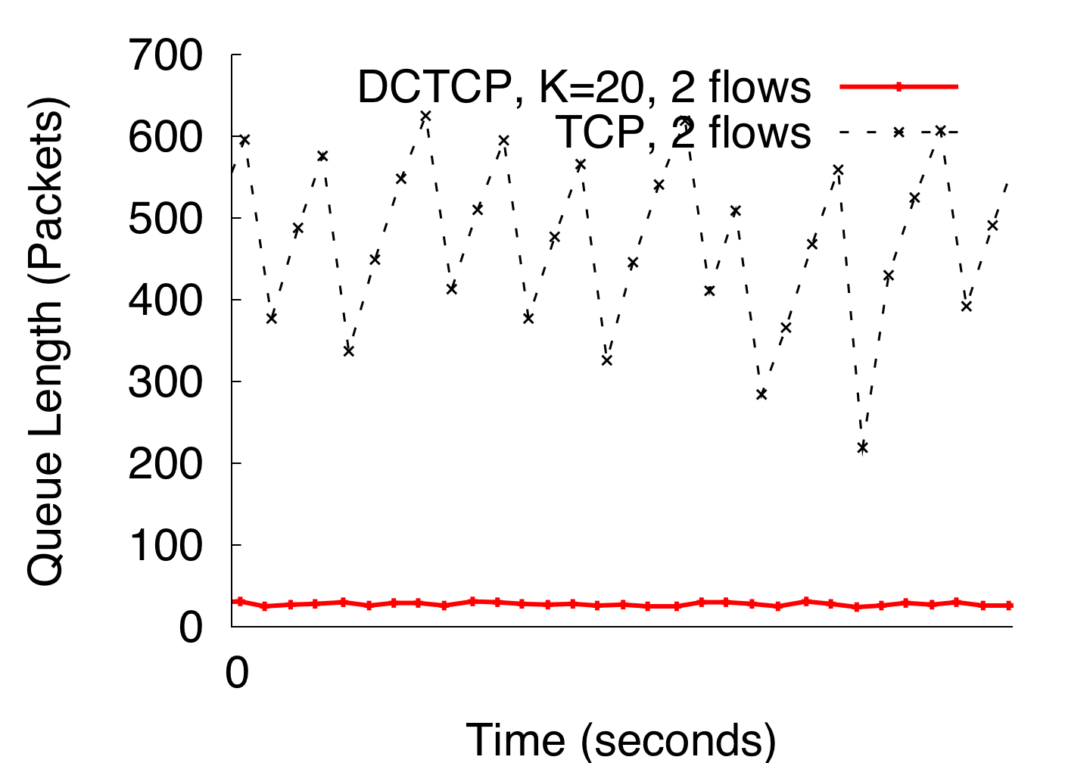
DCTCP in Action
(Kbytes)
Setup: Win 7, Broadcom 1Gbps Switch
Scenario: 2 long-lived flows, K = 30KB
Credits: Adapted from Mohammad Alizadeh, MIT
Notes:
Not ns2.

Slide 53
Meeting the conflicting requirements
High Burst Tolerance
Large buffer headroom → bursts fit.
Aggressive marking → sources react before packets are dropped.
Low Latency
Small buffer occupancies → low queuing delay.
3. High Throughput
ECN averaging → smooth rate adjustments, low variance.
Credits: Adapted from Mohammad Alizadeh, MIT

Slide 54
DCTCP Analysis
Packets sent (from the queue) in this period (1 RTT) are marked
Amplitude
Lecture training: Use Q_{max} and Amplitude for estimating Query Completion Time
Credits: Adapted from Mohammad Alizadeh, MIT
Notes:
Section 3.3 in the paper has more detailed analysis

Slide 55


Wait a minute, wasn’t RTT a great congestion signal?
It was fine grained, responsive, and didn’t require switch support.
Sure, but remember Vegas? There’s no way a delay-based algorithm will last when competing with a loss-based algorithm.
But that’s not a problem in data centers!
RIP Vegas
Gone but not forgotten
The ECN Camp
The Delay Camp

Slide 56
Why did DCTCP NOT use delay as a congestion signal?

Slide 57
Measuring RTT variations in datacenter networks
Datacenter networks
Small RTTs: 10’s-100’s microseconds
High-speed links (10+ Gbps)
Shallow-buffered switches
RTT variations are very small
10 packet queue build-up on a 10Gbps link ➔ extra delay of 12µs
DCTCP published in 2010
In 2010, no reliable way to measure such small RTT variations
Even with high-resolution software timestamps on the servers, the measurements could be extremely noisy

Slide 58
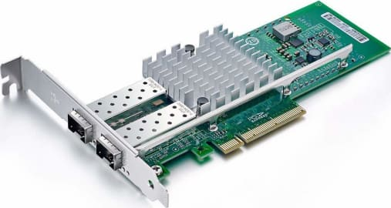
Fast-forward to 2015
High-speed NICs with hardware timestamping

Slide 59
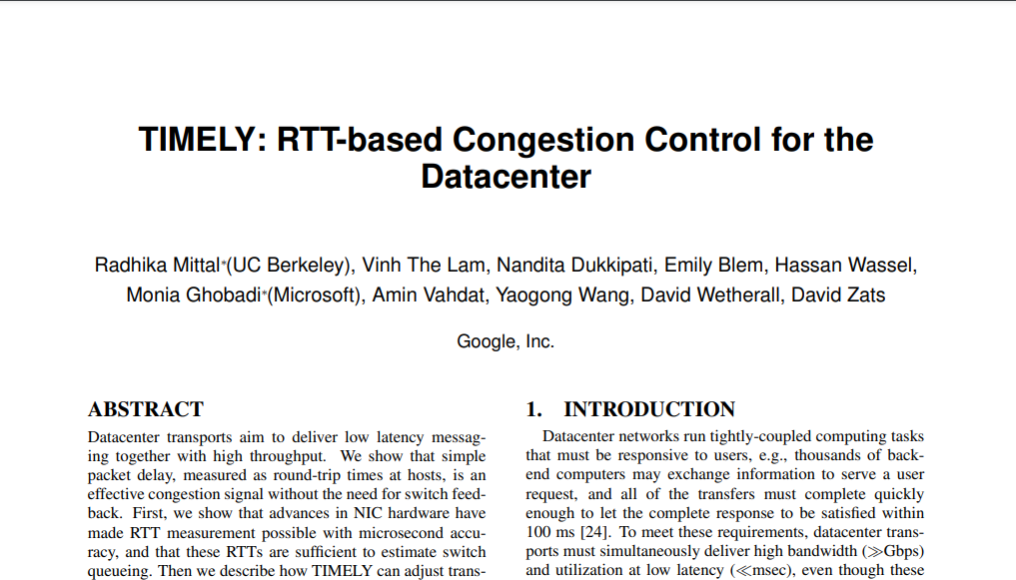
Key idea: Let’s use delay as a congestion signal in data centers
Tadaa!

Slide 60
What were the problems we faced while using delay as a congestion signal the last time?
Competing with loss-based flows
Getting an accurate* RTT estimate
*within few µs
Let’s use NIC timestamps!

Slide 61
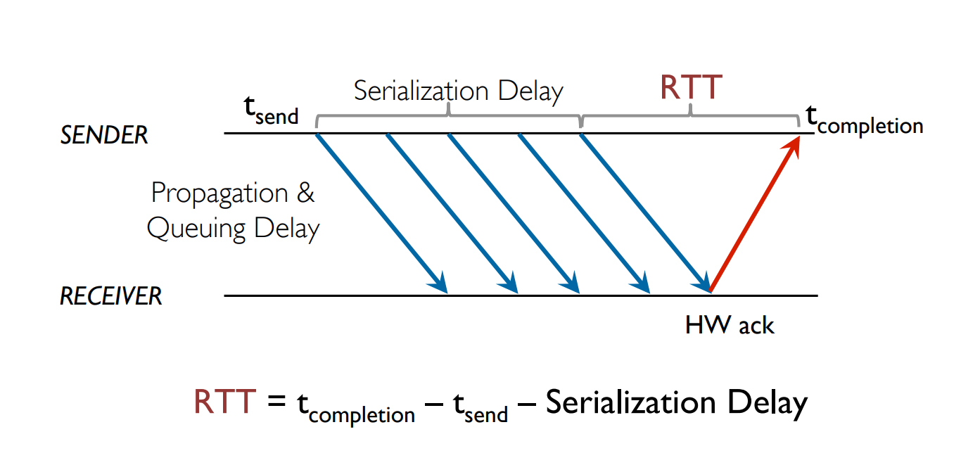
How TIMELY measures the RTT
Credits: Radhika Mittal, UIUC

Slide 62
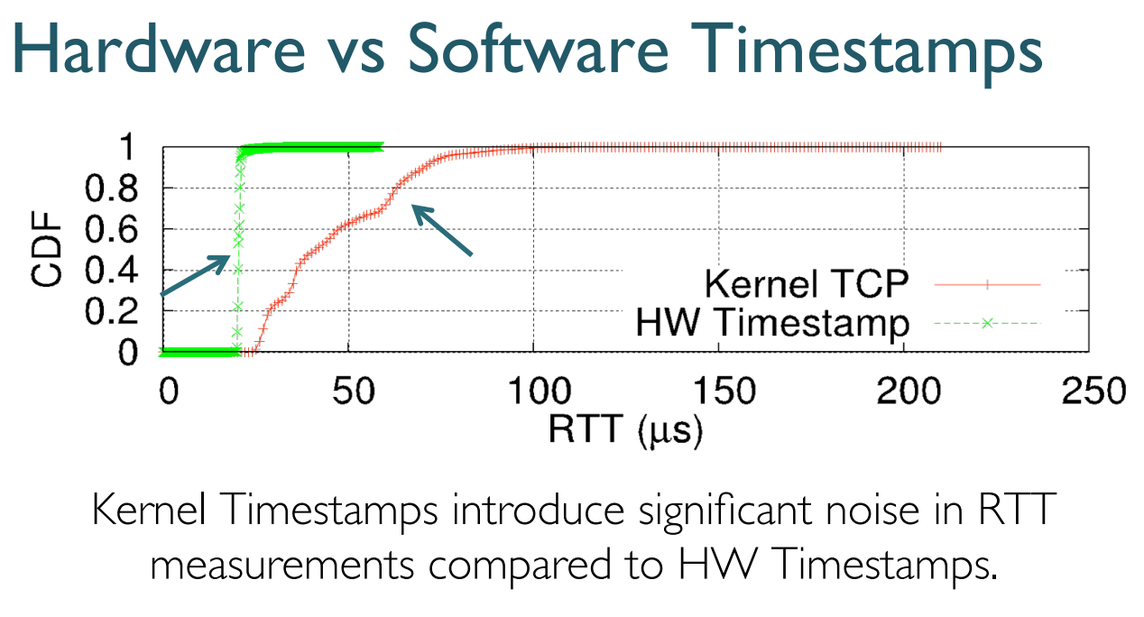
How TIMELY measures the RTT
Credits: Radhika Mittal, UIUC

Slide 63
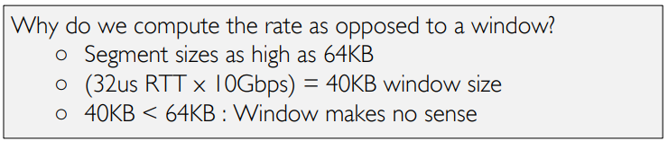
The TIMELY Algorithm
TIMELY is rate-based, and not window based. Why?
Segments need to be paced, because in DC, segments can be larger than the BDP!

Slide 64
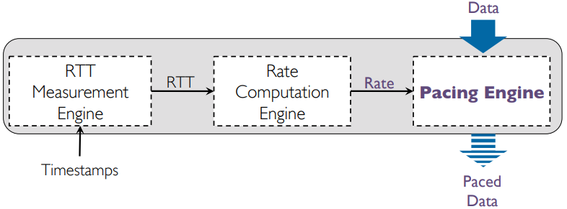

The TIMELY Algorithm
Good ol’ AIMD

Slide 65
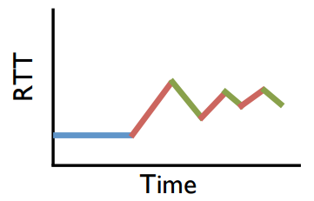
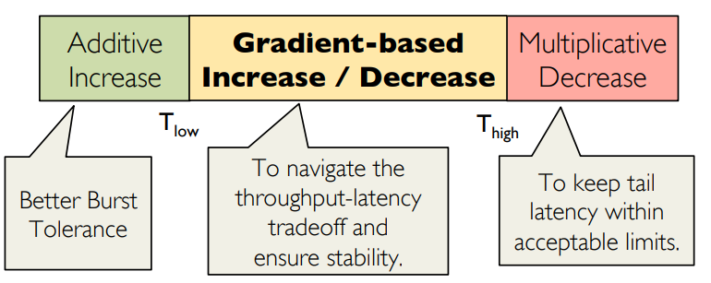
The TIMELY Algorithm
RTT Gradient-based AIMD
RTT
Queue is draining
Queue is building

Slide 66


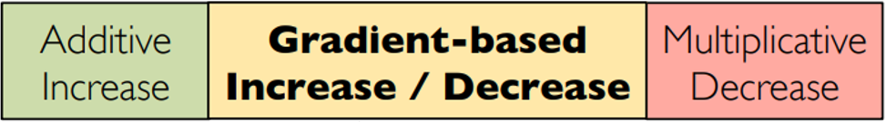


T_low
T_high
normalized_gradient ≤ 0?

Slide 67
The TIMELY Algorithm
RTT Gradient-based AIMD
RTT
Queue is draining
Queue is building

Slide 68
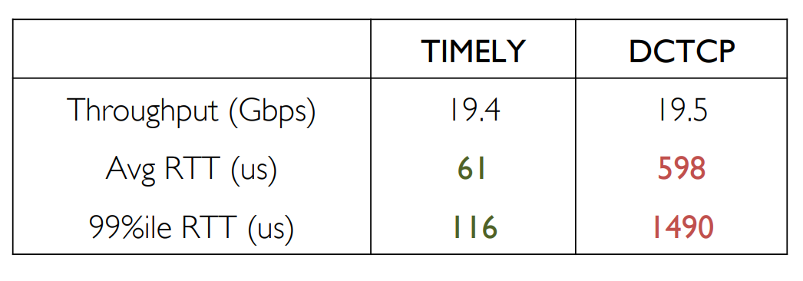
TIMELY’s performance
…
Yay!
Why is TIMELY’s performance so much better than DCTCP?

Slide 69
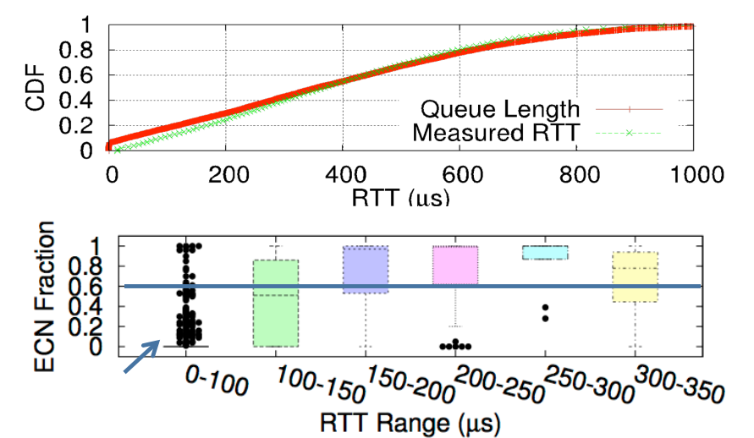
TIMELY’s performance
TIMELY
DCTCP
RTT changes is more correlatd to congestion than ECN!

Slide 70
Summary
Data Centres have different traffic patterns
Topology Matters
DC Congestion control & Incast
Having full controls helps a lot
DCTCP (ECN-based)
TIMELY (delay-based)

Slide 71
Midterm Survey!
+100 EXP

Slide 72
Have a Recess Week!

