Slide 1
Lecture 9: Peer-to-Peer Networks
CS5229 Advanced Computer Networks

Slide 2
Questions?
Quick Admin Notes
Project:
Do NOT procrastinate. Only 5 weeks to go!
Part-3: Start ASAP. More details this weekend.
Evaluation: live demo w/ TAs in exam weeks (more details TBA)
2

Slide 3


Slide 4
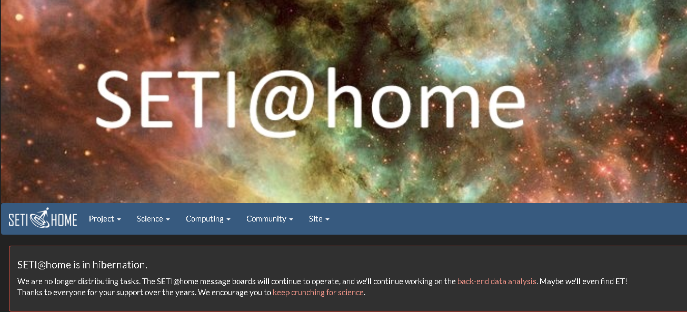

Slide 5
Why Peer-to-Peer (P2P) Networks?
Computers are commonplace.
Can we use the resources contribute to a common pool to do more?
Public cloud is cheap + reliable
P2P has since fallen out of fashion
Algorithms & techniques are still potentially useful/helpful

Slide 6
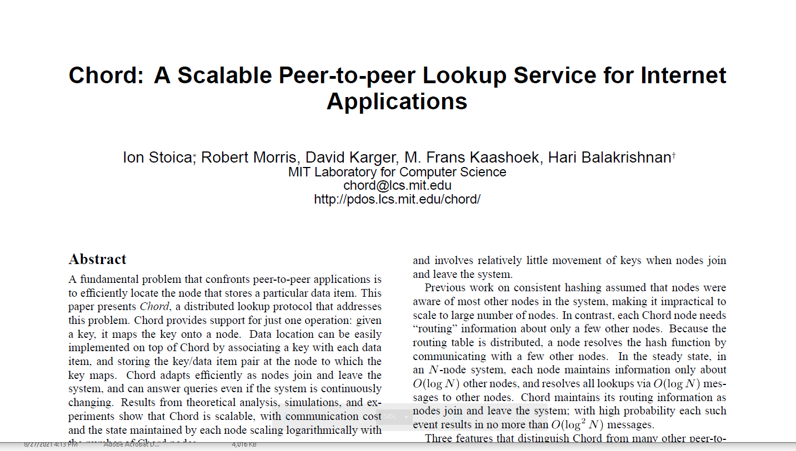
Distributed Hash Tables (DHTs)

Slide 7
Operating Context for Peer-to-Peer Applications
No central authority
Network churn
Cannot completely trust the peers
Need the right incentives
Scalability
Load balancing

Slide 8
Structured Peer-to-Peer Systems
Large scale dynamic network
Self configuring
Fault tolerant
Every node responsible for some objects
Find node having desired object
Challenge: Efficient Routing at Low Cost

Slide 9
What are distributed hash tables?
Rendezvous problem: look up service
How can we build a system that can allow us to do look up reliably without central coordination?

Slide 10
Distributed Hash Tables (DHTs)
A Distributed Hash Table (DHT) is a distributed data structure that supports a put/get interface.
Store and retrieve {key, value} pairs efficiently over a network of (generally unreliable) nodes
Keep state stored per node small because of network churn ) minimize book-keeping & maintenance traffic

Slide 11
Recap: Hashing
f
n
0
5
buckets

Slide 12
Consistent Hashing
successor
6
1
0
7
1
f
6
2
5
3
virtual nodes
4
2

Slide 13
How do we know which node should store what data w.o. a centralized view?

Slide 14
Chord
Identifiers are ordered in an identifier circle modulo 2^{m}
Nodes maintain:
Predecessor
Finger table

Slide 15
Fingers
start | int | succ
1
2
4
m=3
[1,2)
1
[2,4)
3
[4,0)
0
start | int | succ
2
3
5
0
[2,3)
3
7
1
[3,5)
3
[5,1)
0
6
2
5
3
start | int | succ
4
5
7
[4,5)
0
4
[5,7)
0
[7,3)
0

Slide 16
Fingers
start | int | succ
1
2
4
Know predecessors
[1,2)
1
[2,4)
3
owns(3,0]
[4,0)
0
start | int | succ
2
3
5
0
[2,3)
3
7
1
[3,5)
3
owns(0,1]
[5,1)
0
6
2
Why?
owns(1,3]
5
3
start | int | succ
4
5
7
[4,5)
0
4
[5,7)
0
[7,3)
0

Slide 17
start | int | succ
1
2
4
[1,2)
1
lookup
[2,4)
3
1
[4,0)
0
start | int | succ
2
3
5
0
(3,0]
[2,3)
3
7
1
(0,1]
[3,5)
3
[5,1)
0
6
2
5
3
start | int | succ
4
5
7
[4,5)
0
4
(1,3]
[5,7)
0
[7,3)
0

Slide 18
start | int | succ
1
2
4
[1,2)
1
lookup
[2,4)
3
2
[4,0)
0
start | int | succ
2
3
5
0
(3,0]
[2,3)
3
7
1
(0,1]
[3,5)
3
[5,1)
0
6
2
5
3
start | int | succ
4
5
7
[4,5)
0
4
(1,3]
[5,7)
0
[7,3)
0

Slide 19
start | int | succ
1
2
4
[1,2)
1
lookup
[2,4)
3
6
[4,0)
0
start | int | succ
2
3
5
0
(3,0]
[2,3)
3
7
1
(0,1]
[3,5)
3
[5,1)
0
6
2
5
3
start | int | succ
4
5
7
[4,5)
0
4
(1,3]
[5,7)
0
[7,3)
0

Slide 20
start | int | succ
1
2
4
[1,2)
1
lookup
at 3
[2,4)
3
1
[4,0)
0
start | int | succ
2
3
5
0
(3,0]
[2,3)
3
7
1
(0,1]
[3,5)
3
[5,1)
0
6
2
5
3
start | int | succ
4
5
7
[4,5)
0
4
(1,3]
[5,7)
0
Recursive lookup
[7,3)
0

Slide 21
start | int | succ
1
2
4
[1,2)
1
[2,4)
3
[4,0)
0
start | int | succ
2
3
5
0
(3,0]
[2,3)
3
7
1
lookup
at 3
[3,5)
3
1
(0,1]
[5,1)
0
6
2
5
3
start | int | succ
4
5
7
[4,5)
0
4
(1,3]
[5,7)
0
Iterative lookup
[7,3)
0

Slide 22
Node Join
Initialize the predecessor and fingers of node
Update the fingers and predecessors of existing nodes to reflect the addition of
Notify the higher layer software so that it can transfer state (e.g. values) associated with keys that node is now responsible for.

Slide 23
start | int | succ
1
2
4
[1,2)
1
Node 6 joins
[2,4)
3
6
[4,0)
0
1
start | int | succ
2
3
5
0
(3,0]
[2,3)
3
7
1
(0,1]
[3,5)
3
predecessor?
[5,1)
0
6
2
start | int | succ
7
0
2
[7,0)
0
[0,2)
0
5
3
start | int | succ
4
5
7
2
[2,7)
3
[4,5)
0
4
(1,3]
[5,7)
0
[7,4)
0

Slide 24
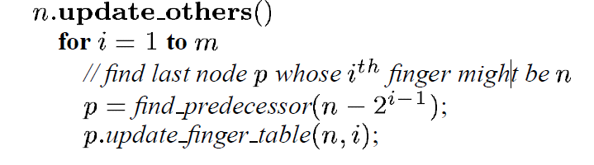
start | int | succ
1
2
4
[1,2)
1
[2,4)
3
6
[4,0)
0
Notify update
fingers
1
start | int | succ
2
3
5
0
(3,0]
[2,3)
3
7
1
(0,1]
[3,5)
3
[5,1)
6
0
6
2
start | int | succ
7
0
2
(3,6]
[7,0)
0
[0,2)
0
5
3
start | int | succ
4
5
7
2
[2,7)
3
[4,5)
0
4
[5,7)
0
(1,3]
6
[7,4)
0

Slide 25
start | int | succ
1
2
4
[1,2)
1
[2,4)
3
Transfer state
6
[4,0)
0
1
start | int | succ
2
3
5
0
(3,0]
[2,3)
3
7
(6,0]
1
(0,1]
[3,5)
3
6
[5,1)
6
6
2
start | int | succ
7
0
2
(3,6]
[7,0)
0
[0,2)
0
5
3
start | int | succ
4
5
7
2
[2,7)
3
[4,5)
0
4
(1,3]
[5,7)
6
[7,4)
0

Slide 26
How do we deal with node departures?
Maintain list of r successors

Slide 27
Data replication
k replicas

Slide 28
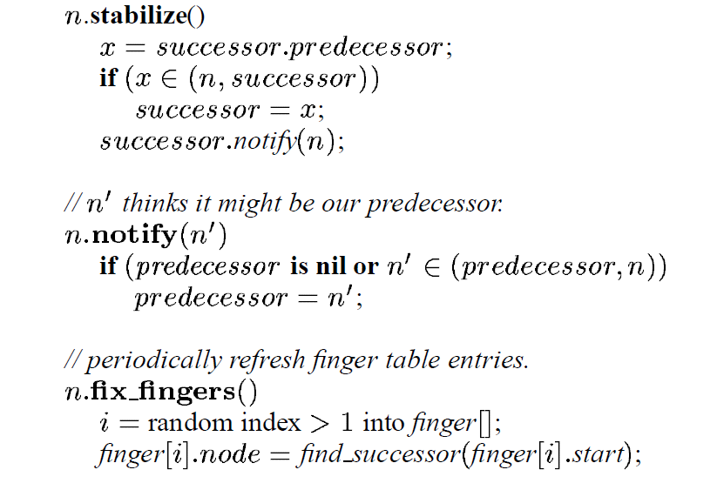
Stabilization

Slide 29
Are you confused? ☺

Slide 30
Let’s take a step back

Slide 31
What if there are no fingers? Only successor & predecessor?

Slide 32
Does it work?

Slide 33
Half distance in each step!
O(log n)
steps
Chord
Binary Search

Slide 34
Can we do better than O(log n) with minima extra overhead?

Slide 35
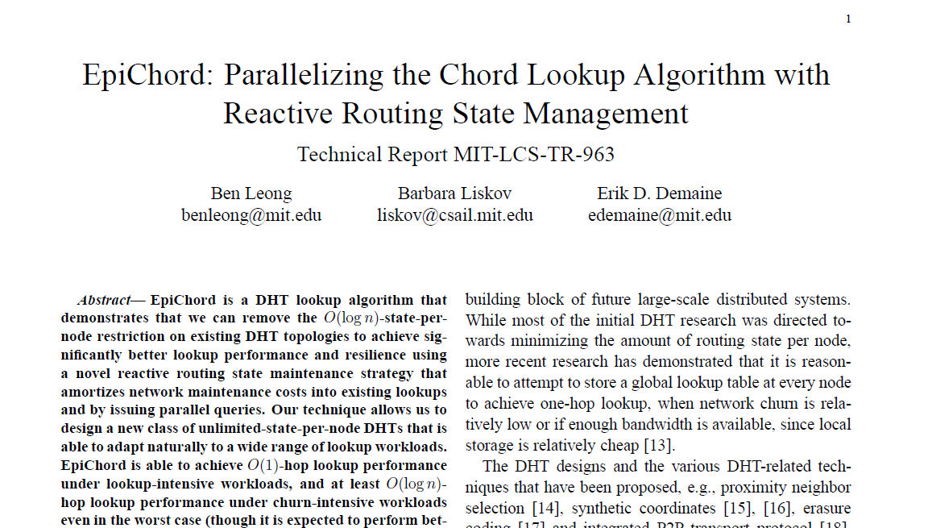
EpiChord

Slide 36
Key Ideas
Use a combination of techiques:
Piggyback information on lookup messages
Allow cache to store more than O(log n) routing state
Issue parallel queries during lookup

Slide 37
K2
p-1 queries
want K2
Known node
Unknown node

Slide 38
K2
Known node
Unknown node

Slide 39
K2
Known node
Unknown node

Slide 40
K2
Known node
Unknown node

Slide 41
K2
Known node
Unknown node

Slide 42
EpiChord
Intrinsically iterative
Additional policies to learn new routing entries:
When a node first joins network, obtains a cache transfer from successor
Nodes gather information by observing lookup traffic

Slide 43
Reactive Cache Management
Traditional (active) approach ⇒ Ping fingers periodically
Reactive approach:
Cache entries have a fixed expiration period
Divide address space into exponentially smaller slices
Periodically check if each slice has sufficient (j) un-expired entries
If not, make a lookup to the midpoint of the offending slice

Slide 44
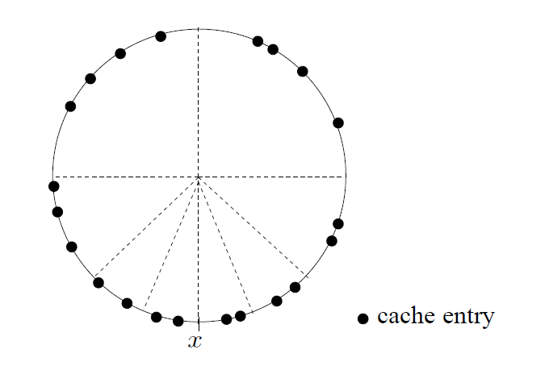
Reactive Cache Management

Slide 45
Can we do O(1)?

Slide 46
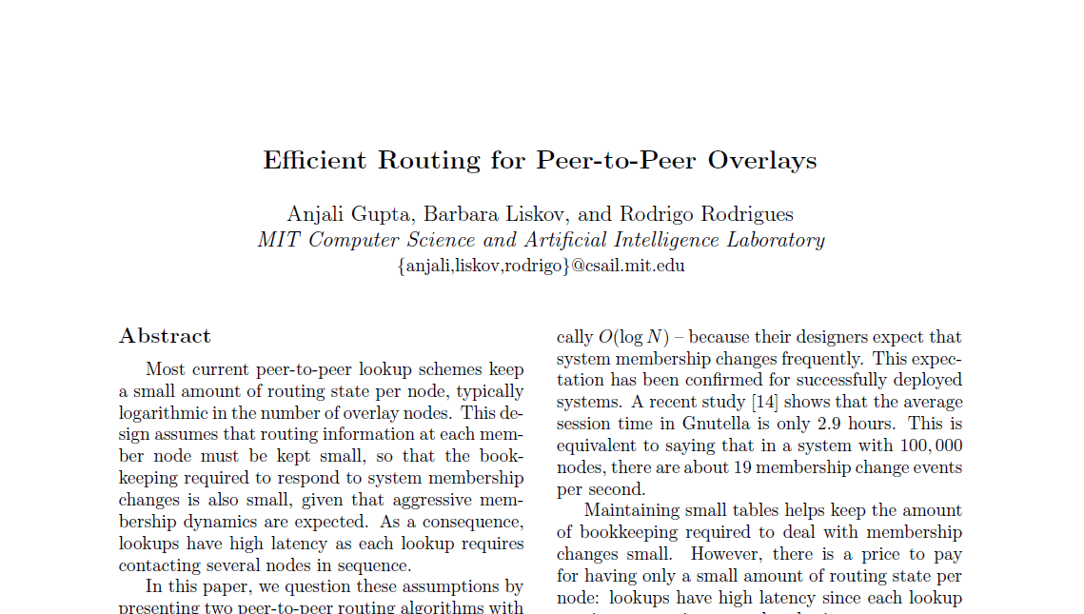
One-hop DHT

Slide 47
Key Ideas from DHTs
Consistent Hashing
Binary Search (Fingers)
Recursive vs Iterative Lookup
Stabilization
Reactive Cache Management
Parallelization

Slide 48
BitTorrent
Understanding P2P File Sharing

Slide 49





The traditional file download model

Slide 50


The traditional file download model

Slide 51
The traditional file download model
$$$

Slide 52
The traditional file download model
Share!

Slide 53
The BitTorrent file download model

Slide 54

The BitTorrent file download model

Slide 55

The BitTorrent file download model
132.17.29.1
87.64.101.7
72.55.2.133
123.122.0.12
11.22.9.176

Slide 56
The BitTorrent file download model
132.17.29.1
The torrent file:
Ask 87.64.101.7 how to get
Tracker
Client
87.64.101.7
72.55.2.133
123.122.0.12
11.22.9.176

Slide 57
The BitTorrent file download model
132.17.29.1
72.55.2.133
11.22.9.176
123.122.0.12
have the file
Seed
132.17.29.1
Tracker
Client
87.64.101.7
72.55.2.133
Seed
123.122.0.12
Original Seed
11.22.9.176
Seed

Slide 58
The BitTorrent file download model
Seed
132.17.29.1
Tracker
Client
87.64.101.7
72.55.2.133
Seed
123.122.0.12
Original Seed
11.22.9.176
Seed

Slide 59
The BitTorrent file download model
Seed
132.17.29.1
Tracker
Seed
87.64.101.7
72.55.2.133
Seed
123.122.0.12
Original Seed
11.22.9.176
Seed

Slide 60
The BitTorrent file download model
Seed
132.17.29.1
Tracker
Seed
87.64.101.7
Can still work!
72.55.2.133
Seed
123.122.0.12
Original Seed
11.22.9.176
Seed

Slide 61
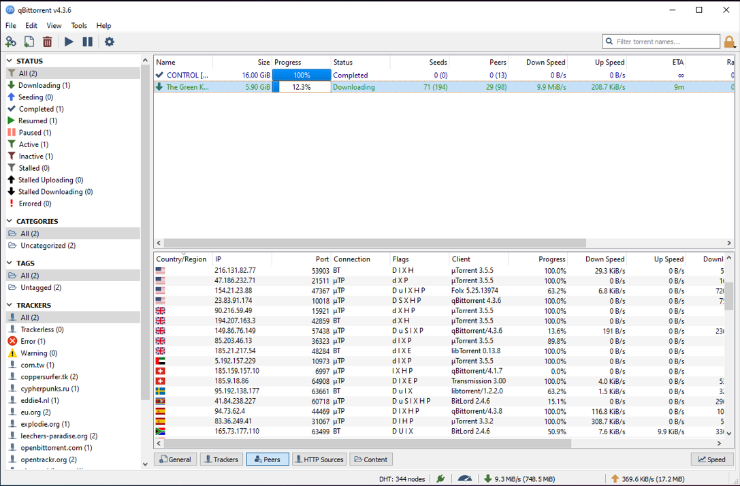
The practical details:
BitTorrent in action
Seeds
Only upload
Peers
Both download and upload
When you start downloading something, you become a Peer by default
Multiple trackers

Slide 62
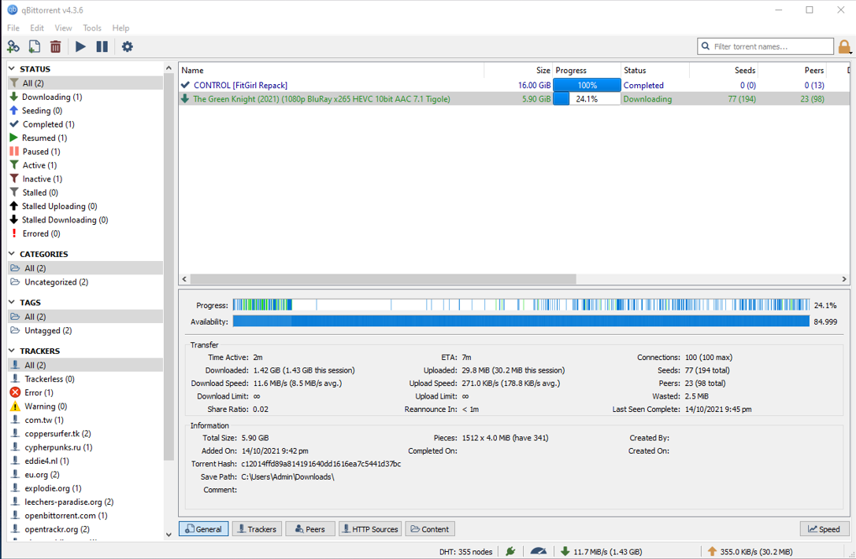
The practical details:
BitTorrent in action
To make the most of multiple Peers/Seeds, BitTorrent downloads different file pieces from different Peers in parallel.
Since all peers might not have all the file chunks, the tracker keeps track of which peers have which file chunks and updates the peers accordingly.

Slide 63
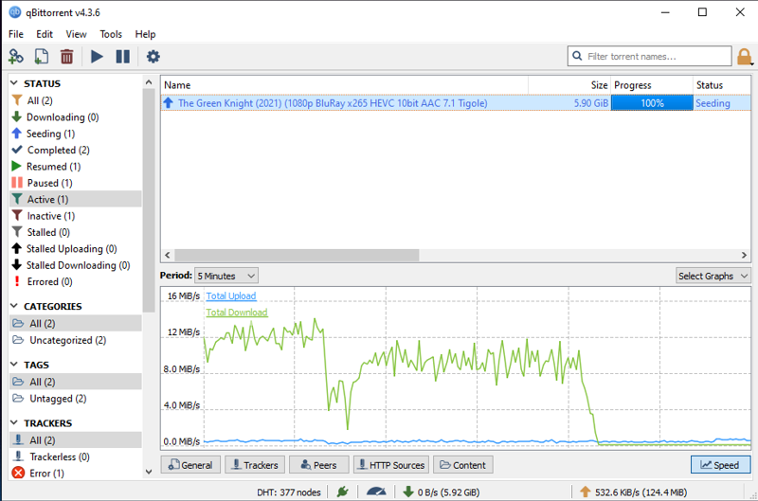
The practical details:
BitTorrent in action
Once the download is complete, the Peer becomes a Seed, helping other people download the file!
This happens as long as your torrent client is active and the torrent has not been deleted

Slide 64
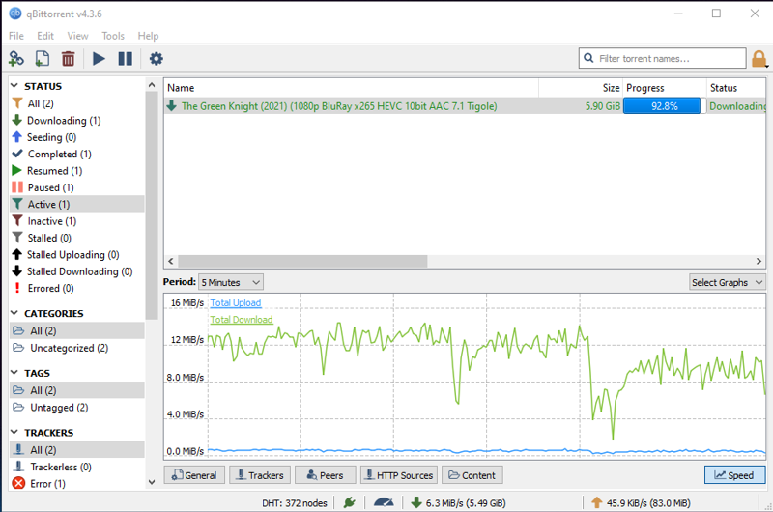
And here lies the Problem.
Why would someone be a Seed?
Peers went down
most probably finished download and didn’t remain Seeds

Slide 65
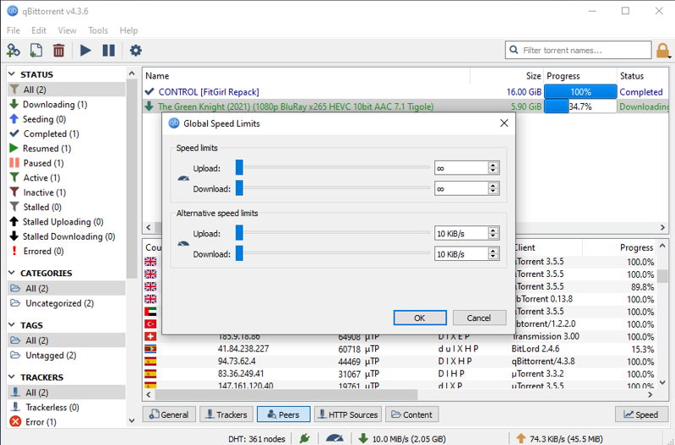
And here lies the Problem.
Even as Peers, people can be selfish!
Most BitTorrent clients have the option to choke the uplink.

Slide 66
BitTorrent’s Choking Algorithm
based on Tit-for-tat!
Peer
132.17.29.1
(Leachers)
Selfish Peer
Tracker
87.64.101.7
72.55.2.133
Peer
123.122.0.12
Peer
11.22.9.176
Peer

Slide 67
BitTorrent’s Choking Algorithm
based on Tit-for-tat!
Peer
Peers can select who they upload to
Peers often unchoke only the top 4 peers ranked by download rate
With one optimistic unchoke on a random peer
Therefore a selfish peer gets starved because no one will send to him!
132.17.29.1
(Leachers)
Selfish Peer
Tracker
87.64.101.7
72.55.2.133
Peer
123.122.0.12
Peer
11.22.9.176
Peer

Slide 68
BitTorrent’s Choking Algorithm
based on Tit-for-tat!
Peer
The selfish peer gets choked
132.17.29.1
(Leachers)
Selfish Peer
Tracker
87.64.101.7
72.55.2.133
Peer
The selfless peers help each other
123.122.0.12
Peer
11.22.9.176
Peer

Slide 69
BitTorrent’s other practical considerations
Peer selection: BitTorrent selects a finite number of peers randomly from a list of available peers
Rarest first: BitTorrent prioritizes downloading the rare chunks before the common chunks.
Endgame mode: In the end-phase, BitTorrent will open up multiple connections in parallel to get the last few chunks quickly.
Anti-snubbing: When a client is snubbed, peer selection is done based on best upload rate.

Slide 70
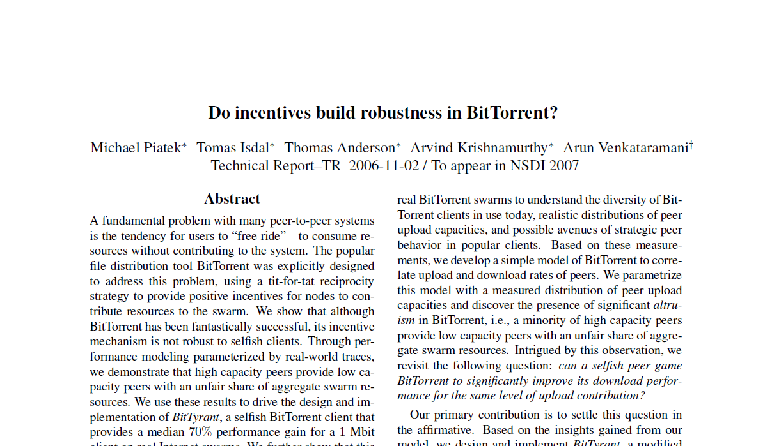
Still not the perfect solution.
Because of the choking algorithm’s tit-for-tat nature,
high capacity peers can starve low capacity peers.
BitTyrant can gain 70% median improvement in download speeds by being selfish.

Slide 71
Sybil Attack
Cooperative behaviour is good
Malicious peers can collude to cause damage
Attackers can create multiple identities

Slide 72
NAT
Traversal

Slide 73
Summary
Consistent Hashing
Distributed Hash Tables (DHT)
Recursive vs Iterative Lookup
Rendezvous problem
State “liveness” & Parallel queries
Incentives

