Slide 1
Dream
Slides Courtesy of Minlan Yu (USC)

Slide 2
Challenges in Flow-based Measurement
Many Management tasks
Controller
Heavy Hitter detection
Change detection
Heavy Hitter detection
Heavy Hitter detection
H
Dynamic Resource Allocator
1
(Re)Configure resources
1
Configure resources
2
Fetch statistics
Limited resources (<4K TCAM)
Notes:
Many measurement tasks
Task types: Heavy hitter, Change detection
Header fields: Source IP, Destination port
Traffic aggregate: To drill down
Per-tenant tasks
Limited measurement resources
Limited CPU for measurement
Cheap switches with limited memory
We focus on hardware switches with TCAM

Slide 3
Last Class: OpenSketch
Use sketch to perform measurements
Sketches are very efficient (space wise)
Requites a combination of TCAM and SRAM
Requires the same flow to go through multiple stages
Sketches have 3 phases.
Many OpenFlow 1.0 switches don’t support multi-stage matching
OpenFlow 1.3> supports some multi-stage matching

Slide 4
Flow-based Measurement
Flow-based counters
Match on multiple packet header fields
Report #bytes/#packets
Heavy hitters, change detection, etc.
Monitor nodes in IP prefix tree
E.g., Identify source IPs over 10
Divide to increase accuracy
Merge to save TCAM entries
31
26
5
-
-
2
3
Divide
Merge
31
26
5
13
13
2
3
Notes:
Cause of error: Monitor ancestors of large leaves

Slide 5
Recall
To make accuracy gurantees
You need to know traffic matrix
You need to know for given algorithm what is the space to accuracy trade-off

Slide 6
Diminishing return of resources
Tradeoff accuracy for more resources
More resources make smaller accuracy gains
Operators can accept an accuracy bound <100%
Recall=
detected true HH/all
Challenge: No ground truth of resource-accuracy
Notes:
Finding 8Mbps heavy hitters on CAIDA trace
This curve is the same for different traffic, different measurement tasks, and has been observed papers
More resources find less significant outputs

Slide 7
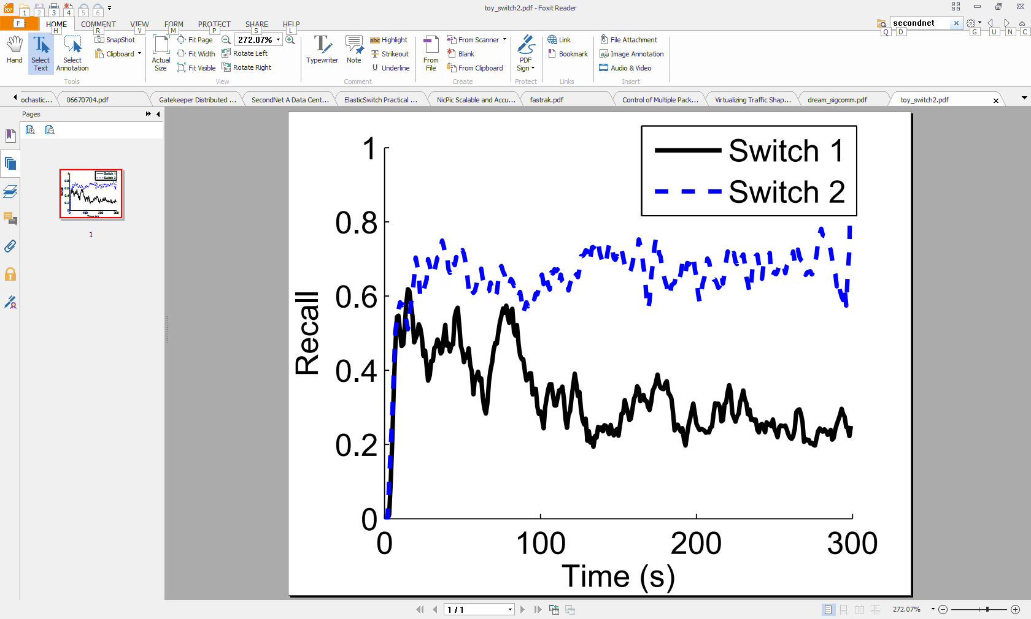
Spatial/Temporal Resource Multiplexing
Temporal multiplexing across tasks
Traffic varies over time, and accuracy depends on traffic
Spatial multiplexing across switches
A task needs different resources across switches
1
1
2
Recall=
detected true HH/all
2
Switch 1
Switch 2
Challenge: Handle traffic and task dynamics across switches
Notes:
Accuracy changes with traffic and traffic changes overtime
To reach an accuracy, we need to dynamically change its resources
Switch 1 needs more resources

Slide 8
Multiplexing Resources Among Tasks
A task may need more resources
At a specific time
At a specific switch
But we can multiplex
1
1
1
1
2
2
2
2
Time=0
Time=1
Switch 1
Switch 2
Temporal multiplex
Spatial multiplex

Slide 9
DREAM Framework
Controller
TCAM-based Measurement Framework
Estimated accuracy
Estimated accuracy
Allocated resource
Allocated resource
Dynamic Resource Allocator
1
(Re)Configure resources
1
Configure resources
2
Fetch statistics

Slide 10
TCAM-based Measurement Framework
General support for different types of tasks
Heavy hitters, Hierarchical HHs, change detection
Resource aware
Maximize accuracy given limited resources
Network-wide
Measuring traffic from multiple switches
Assume each flow is seen at one switch (e.g., at sources)
Notes:
Stress that each flow is at each source
Multiple switches: e.g., HHs from different switches
Assume: Each flow is seen at one switch (e.g., at sources)

Slide 11
Challenges
No ground truth of resource-accuracy
Hard to do traditional convex optimization
We propose new ways to estimate accuracy on the fly
Adaptively increase/decrease resources accordingly
Spatial & temporal changes
Task and traffic dynamics across switches
Temporal: Adjust resources based on traffic changes
Spatial: Dynamically allocate resources across switches

Slide 12
Divide & Merge at Multiple Switches
Divide: Monitor children to increase accuracy
Requires more resources on a set of switches
E.g., needs an additional entry on switch B
Merge: Monitor parent to free resources
Each node keeps the switch set it frees after merge
Finding the least important prefixes to merge is the minimum set cover problem
26
0**
5
1**
{A,B,C}
{B}
{A,B}
{B,C}
{B}
{B}
13
00*
01*
13
2
10*
11*
3
Notes:
Change the example to original ones

Slide 13
Task Implementation
Controller
Heavy Hitter detection
Change detection
Heavy Hitter detection
Heavy Hitter detection
H
Estimated accuracy
Estimated accuracy
Allocated resource
Allocated resource
Dynamic Resource Allocator
1
(Re)Configure resources
1
Configure resources
2
Fetch statistics

Slide 14
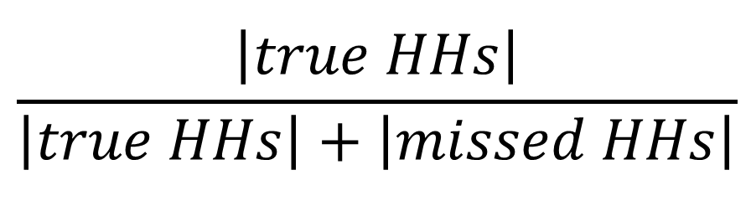
Accuracy Estimation
Leverage all the monitored counters
Precision: every detected HH is a true HH
Recall:
Estimate missing HHs using counter and level
Threshold=10
At level 2 missed <=2 HH
With size 26 missed <=2 HHs
76
***
26
0**
1**
50
The error for our accuracy estimator for Heavy hitters is below 5% for real traffic traces
13
00*
01*
13
15
10*
11*
35
001
011
101
111
4
9
12
1
0
15
20
15
000
010
100
110
Notes:
How to estimate missed HHs?
HHH: challenge:
Describe what is HHH
reported ones are the true ones
Dependent on each other
The average error for accuracy estimation is 5% in general and its error reduces as the accuracy increases. For example if the accuracy is above 80%, then the average error is about 1% in our experiments. This is because for higher accuracies, we need more resources. More resources also help to have lower error for accuracy estimation: With lower error we monitor more nodes close to leaves with smaller volume

Slide 15
Dynamic Resource Allocator
Controller
Heavy Hitter detection
Change detection
Heavy Hitter detection
Heavy Hitter detection
H
Estimated accuracy
Estimated accuracy
Allocated resource
Allocated resource
Dynamic Resource Allocator
Decompose the resource allocator to each switch
Each switch separately increase/decrease resources
When and how to change resources?

Slide 16
Per-switch Resource Allocator: When?
When a task on a switch needs more resources?
Global accuracy is important
if bound is 40%, no need to increase A’s resources
Local accuracy is important
if bound is 80%, increasing B’s resources is not helpful
Conclusion: when max(local, global) < accuracy bound
Controller
Detected HH: 14 out of 30
Global accuracy=47%
Heavy Hitter detection
Detected HH:5 out of 20
Local accuracy=25%
Detected HH:9 out of 10
Local accuracy=90%
A
B

Slide 17
Per-Switch Resource Allocator: How?
How to adapt resources?
Take from rich tasks (r=r-s), give to poor tasks (r=r+s)
How much resource to take/give?
Approach: Adaptive change step (s) for fast convergence
Intuition: Small steps close to bound, large steps otherwise
Additive increase in both AA and AM methods converges slowly when the goal changes
Multiplicative increase and Multiplicative decrease has converges fast
Additive decrease cannot decrease the step size fast to converge to a fixed value
Notes:
If status changed → close to bound
increase if status is same
decrease if status changes
We see higher rejection for HH than HHH, because we over estimate miss HH, underestimate accuracy, use more resources than necessary
For HHH, we use precision, we don’t have such problem.
For change detection, we have this problem too.
We can improve the accuracy of recall, if we assume a model of traffic. If we know the traffic is skewed.
The results show that

Slide 18
DREAM Overview
Task type (Heavy hitter, Hierarchical heavy hitter, Change detection)
Task specific parameters (HH threshold)
Packet header field (source IP)
Filter (src IP=10/24, dst IP=10.2/16)
Accuracy bound (80%)
Prototype Implementation with DREAM algorithms on Floodlight and Open vSwitches
2) Accept/Reject
1) Instantiate task
5) Report
Resource Allocator
Task object 1
Task object n
7) Allocate / Drop
6) Estimate accuracy
DREAM
SDN Controller
4) Fetch counters
3) Configure counters

Slide 19
Prototype Evaluation
DREAM prototype
DREAM algorithms in Floodlight controller
8 Open vSwitches
Prototype evaluation
256 tasks (HH, HHH, CD, combination)
5 min tasks arriving in 20 mins
Replaying 5 hours CAIDA trace
Validate simulation using prototype
Notes:
Large scale simulation (4096 tasks on 32 switches)
accuracy bounds
task loads (arrival rate, duration, switch size)
tasks (task types, task parameters ex. Threshold)
# switches per tasks

Slide 20
DREAM Conclusion
Challenges with software-defined measurement
Diverse and dynamic measurement tasks
Limited resources at switches
Dynamic resource allocation across tasks
Accuracy estimators for TCAM-based algorithms
Spatial and temporal resource multiplexing
Notes:
Future work
Apply DREAM on the hash-based primitive (Sketches)
Time-slicing measurement
Other service interfaces to tasks

Slide 21
Summary
Software-defined measurement
Measurement is important, yet underexplored
SDN brings new opportunities to measurement
Time to rebuild the entire measurement stack
Our work
OpenSketch:Generic, efficient measurement on sketches
DREAM: Dynamic resource allocation for many tasks

Slide 22
Thanks!

