Slide 1
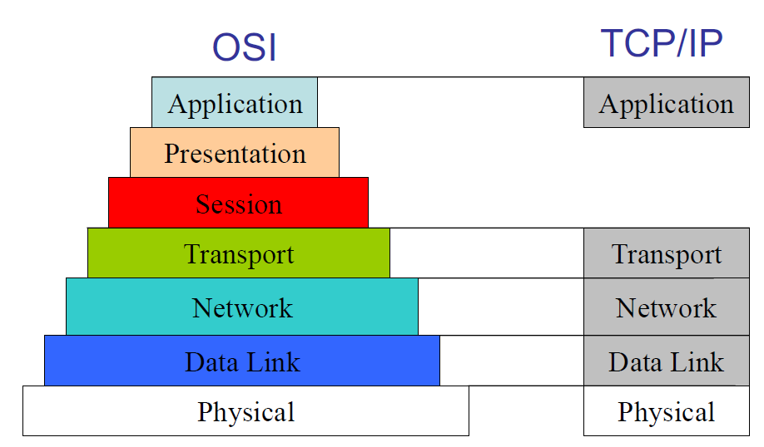
Why need Cross-Layer: 1.the unique problems created by wireless links, the possibility of opportunistic communication on wireless links, and the new modalities of communication offered by the wireless medium. The key is to self-adaptive.
pros and cons of cross layer design
Communication system design is basically a tradeoff of performance versus complexity. Cross layer design leads to performance gains at the cost of complexity. This complexity can be at run-time or at the design stage. Since cross layer design violates the layered architecture, it could also lead to stifling of innovation and difficult maintenance.
The TCP/IP Model
Application Layer – concerned with how data at both ends is handled, user interface
Transport Layer – manages end-to-end flow of data, reliability, congestion control
Network Layer – which performs routing and provides hierarchical addressing
Data Link Layer – manages transmission of data on a link-by-link basis, link-level reliability
Physical Layer – used for transmitting data on the physical medium
OSI Model
Application Layer – It is concerned with how data at both ends is handled, user interface. The application layer establishes the availability of intended communication partners, synchronizes and establishes agreement on procedures for error recovery and control of data integrity.
Presentation Layer – It converts the data into a format compatible with the receiver's system format and suitable for transmission. Translates between multiple data formats by using a common format. Provides encryption and compression of data. Examples :- JPEG, MPEG, ASCII. Session Layer – The session layer defines how to start, control and end conversations (called sessions) between applications. It also synchronizes dialogue between two hosts’ presentation layers and manages their data exchange. It offers provisions for efficient data transfer. SSL, SQL
Transport Layer – It manages end-to-end flow of data, reliability, congestion control. It contains TCP/UDP. The transport layer segments data from the sending host's system and reassembles the data into a data stream on the receiving host's system. It ensure end-to-end reliability.
Network Layer – Defines end-to-end delivery of packets. Defines logical addressing so that any endpoint can be identified. Defines how routing works and how routes are learned. Routers operate at Layer 3. Find a set of reliable links which form a path from source to destination, routing.
Data Link Layer – It manages transmission of data on a link-by-link basis, link-level reliability. The data link layer provides reliable transit of data
across a physical link by using the Media Access Control (MAC) addresses. It create a reliable link.
Physical Layer: The physical layer deals with the physical characteristics of the transmission medium. It learns how to use the medium of communication, and create a link.

Slide 2
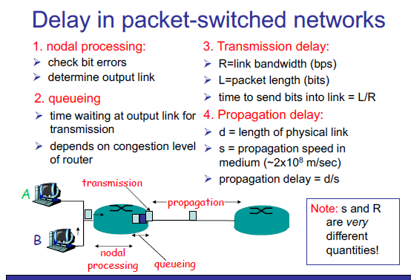
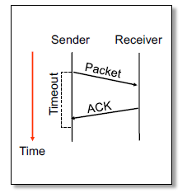

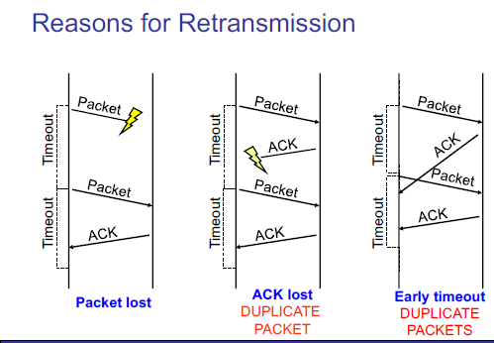
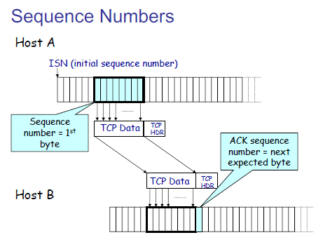
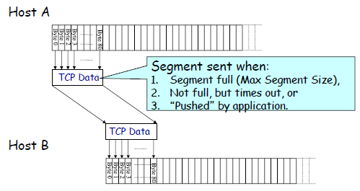
Circuit switching VS Packet Switching
Circuit switching: dedicated circuit per call: telephone net – call setup required
Packet switching: data sent through net in discrete “chrunks”– each end-to-end stream divided into
packets - each packet uses full link bandwidth resource contention – aggregate resource demand
can exceed amount available. Congestion- packets queue, wait for link use.
store and forward: packets move one hop at a time. Node receives complete packet before forwarding.
ARQ: Automatic Repeat Request
ARQ provides link layer reliability at the hop-by-hop level. TCP is at the transport layer and
provides end-to-end reliability. Receiver sends acknowledgment(ACK) when it receives packet.
Sender waits for ACK and timeout if it does not arrive within some time period.
Multiplexing and Demultiplexing
UDP
UDP applications: 1. multimedia streaming: telephone calls, video conferencing
Gaming. 2. Simple query protocols like Domain Name System.
TCP properties:
1. connection oriented – explicit set-up and tear down of TCP session
2. stream-of-bytes service – a stream of bytes, not messages
3. Reliable, in-order delivery – checksums to detect corrupted data. Ack & retransmission for
reliable delivery. Sequence numbers to detect losses and record data.
4. Flow control – prevent overflow of the receiver’s buffer space
5. Congestion control. – Adapt to network congestion for the greater good.
TCP segment: TCP header is 20 bytes long, IP header is 20 bytes long.
ISN – Intial Sequence Number

Slide 3
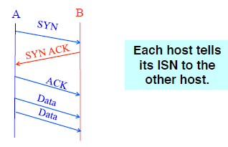
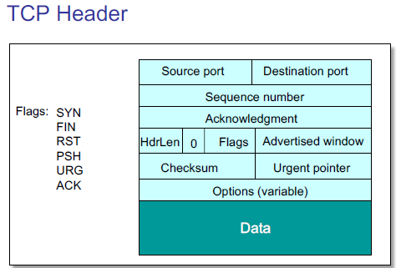
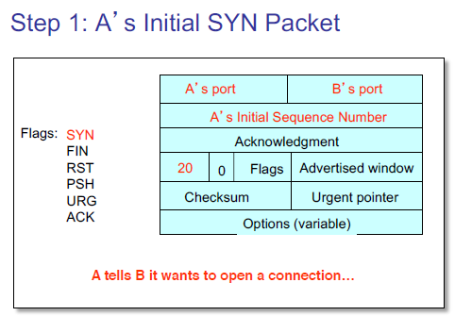
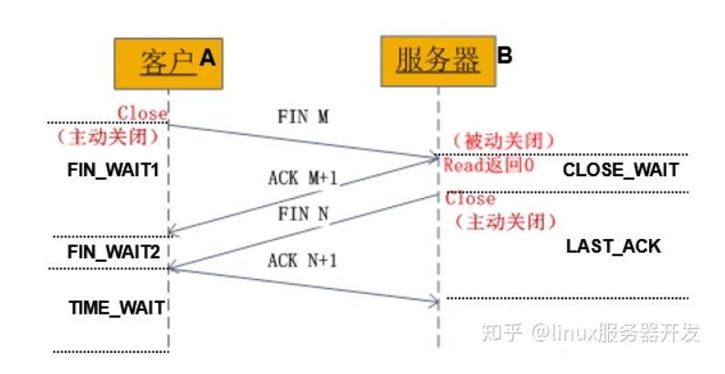
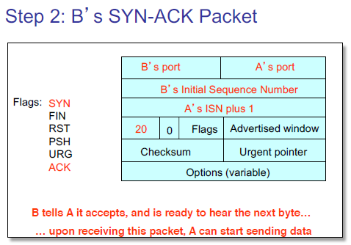
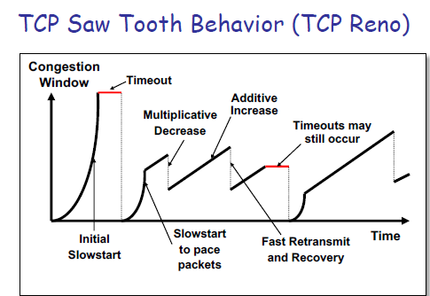
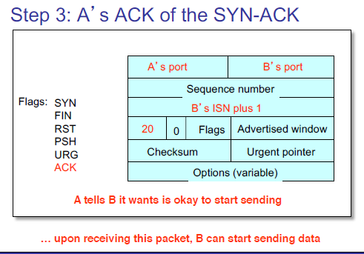
TCP Three-Way Handshake
How to establishing a TCP Connection:
Host A sends a SYN (open) to the host B
Host B returns a SYN acknowledgment (SYN ACK)
Host A sends an ACK to acknowledge the SYN ACK
How to close a TCP connection:
1. Host A send a Finish (FIN) to close and receive remaining bytes
2. Host B sends a FIN ACK to acknowledge
3. Host B sends a Finish(FIN) to close and send remaining bytes
4. Host A receive remaining bytes from Host A and send ACK

Slide 4
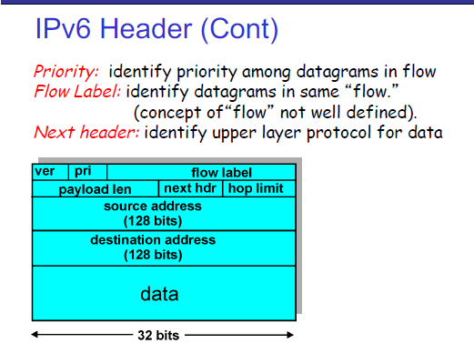
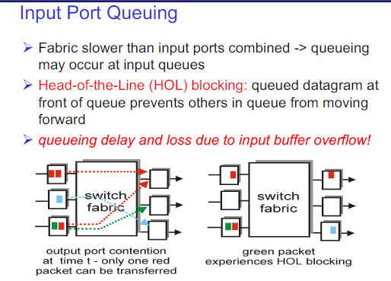
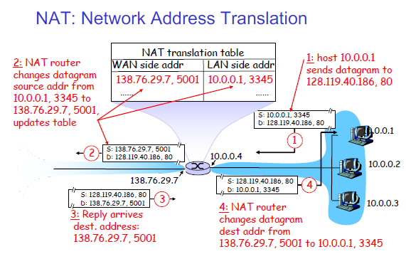
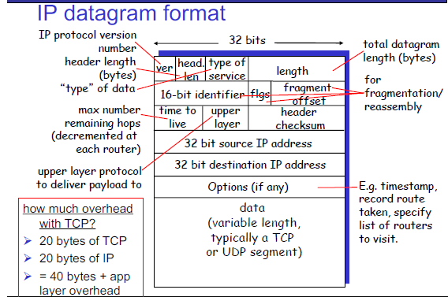
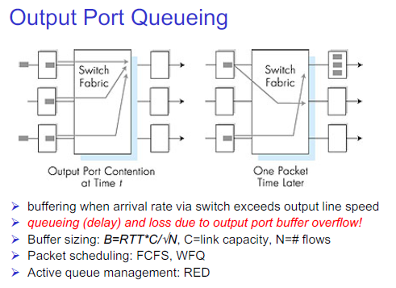
Network-Layer Functions
Forwarding: move packet from router’s input to appropriate router output. Process of planning trip from source to destination.
Routing: determine route taken by packets from source to destination. Process of getting through single interchange
Routing algorithms: RIP, OSPF, BGP.
CIDR: Classless Inter Domain Routing
DHCP: Dynamic Host Configuration Protocol
1. host broadcasts “DHCP discover” msg
2. DHCP server responds with “DHCP offer” msg
3. host requests IP address: “DHCP request” msg
4. DHCP server sends address: “DHCP ack” msg
ICANN: Internet Corporation for Assigned
NAT: Network Address Translation

Slide 5
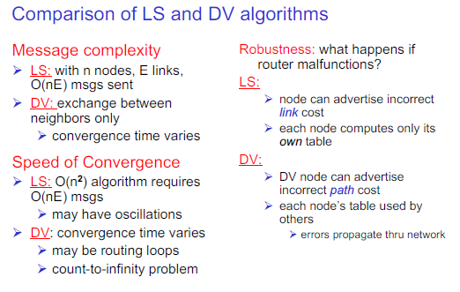
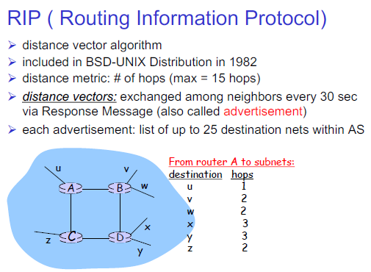
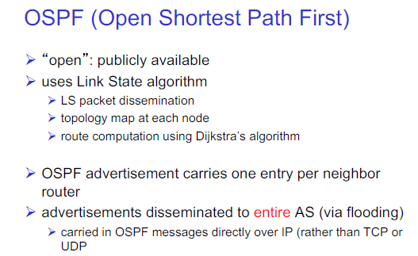
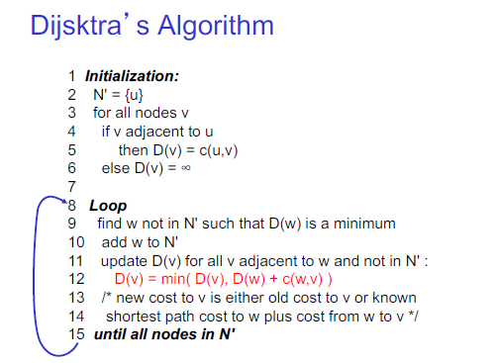
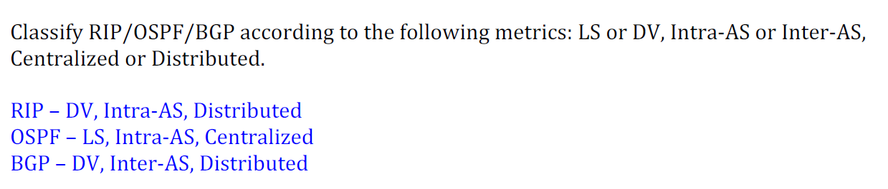
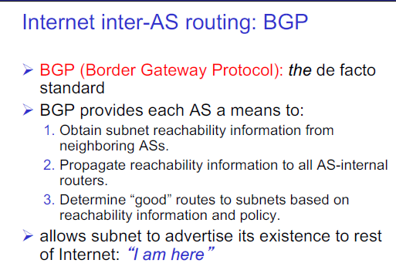
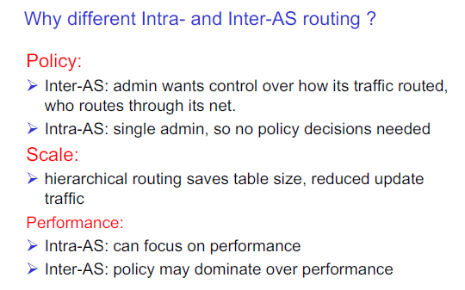
A Link-State Routing Algorithm
Dijkstra’s algorithm
Distance Vector Algorithm
Bellman-Ford Equation(dynamic programming)
Intra-AS Routing
Also known as Interior Gateway Protocols(IGP)
RIP: Routing Information Protocol (Distance Vector)
OSPF: Open Shortest Path First (Link State)
IGRP: Interior Gateway Routing Protocol (Cisco proprietary)

Slide 6
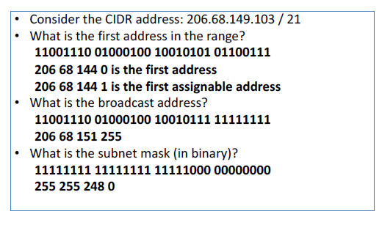
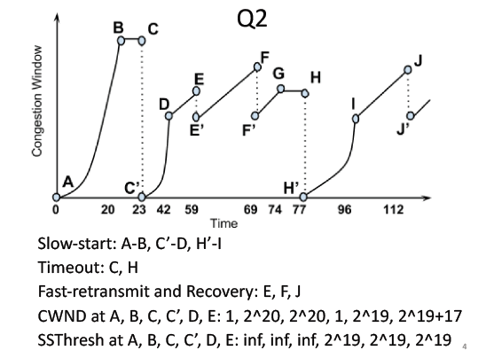
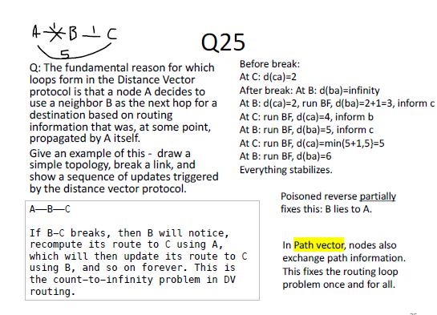
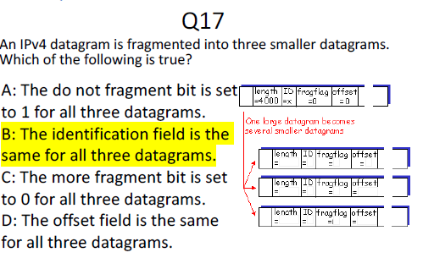
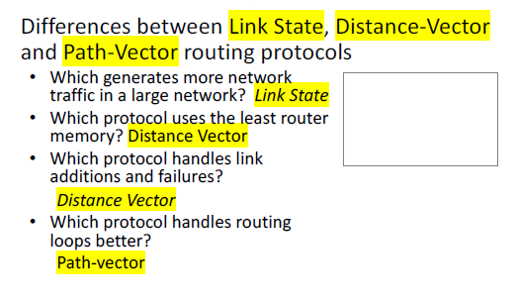
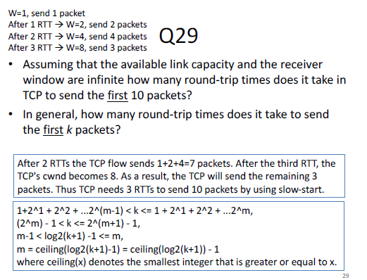
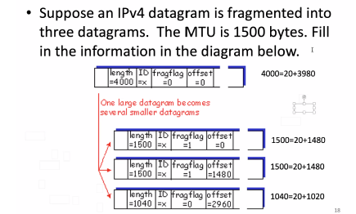
Path vector

Slide 7
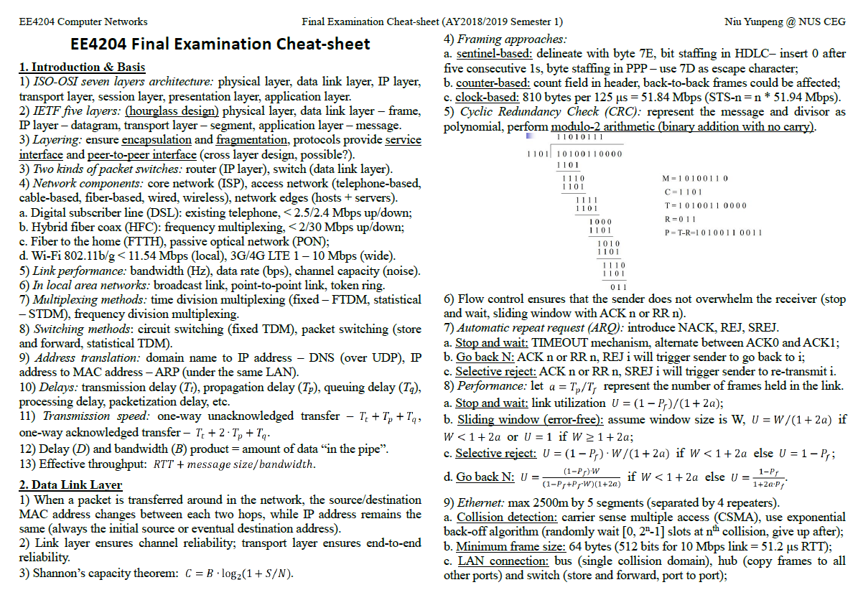

Slide 8
