Slide 1
CS252
Graduate Computer Architecture
Lecture 19
Memory Systems Continued
November 5th, 2003
Prof. John Kubiatowicz
http://www.cs.berkeley.edu/~kubitron/courses/cs252-F03

Slide 2

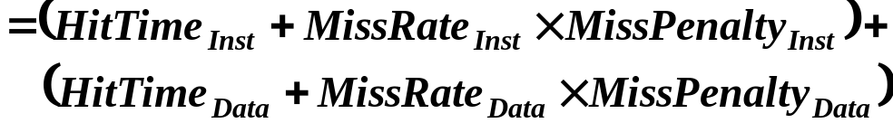
Review: Cache performance
Miss-oriented Approach to Memory Access:
Separating out Memory component entirely
  AMAT = Average Memory Access Time

Slide 3
Review: Where can a block be placed in the upper level?
Block 12 placed in 8 block cache:
  Fully associative, direct mapped, 2-way set associative
  S.A. Mapping = Block Number Modulo Number Sets
Fully associative:
block 12 can go anywhere
Direct mapped:
block 12 can go only into block 4 (12 mod 8)
Set associative:
block 12 can go anywhere in set 0 (12 mod 4)
Block
no.
0 1 2 3 4 5 6 7
Block
no.
0 1 2 3 4 5 6 7
Block
no.
0 1 2 3 4 5 6 7
Set
0
Set
1
Set
2
Set
3
Block-frame address
Block
no.
1 1 1 1 1 1 1 1 1 1 2 2 2 2 2 2 2 2 2 2 3 3
0 1 2 3 4 5 6 7 8 9 0 1 2 3 4 5 6 7 8 9 0 1 2 3 4 5 6 7 8 9 0 1

Slide 4
Review: Cache Update Policies
Write Through
  Data updates cache and underlying system
  Tag State: Tags, Valid Bits
  Cache Data: “Read-only” can always be discarded
  Primary Advantage:
    Simplicity of Mechanism
  Primary Disadvantages:
    Speed limited by memory
    Updates to memory are single words
Write Back
  Data updates cache
  Tag State: Tags, Valid Bits/Dirty Bits
  Cache Data: “Read-Write” may need to be written back to memory
  Primary Advantages:
    Speed limited by cache only
    Bandwidth Reduction
    Only Cache-line-sized elements trans
  Primary Disadvantage: Complexity, Timing
Proc
Cache I
Memory
Proc
Cache I
Memory

Slide 5
Review: Reducing Misses via a
“Victim Cache”
How to combine fast hit time of direct mapped
yet still avoid conflict misses?
Add buffer to place data discarded from cache
Jouppi [1990]: 4-entry victim cache removed 20% to 95% of conflicts for a 4 KB direct mapped data cache
Used in Alpha, HP machines
TAGS
DATA
Tag and Comparator
One Cache line of Data
Tag and Comparator
One Cache line of Data
Tag and Comparator
One Cache line of Data
Tag and Comparator
One Cache line of Data
To Next Lower Level In
Hierarchy

Slide 6
Review: Cache allocation policies
Write Allocate:
  On cache miss during store, must allocate cache line
  This means that Writes become like Reads+store
  Write-Back caches usually use this
Write Non-Allocate:
  On cache miss, simply write around cache
  Underlying memory must handle single-word writes!
  Often used by Write-Through Caches

Slide 7
Review: Reducing Penalty: Read Priority over Write on Miss
Cache
Processor
DRAM
Write Buffer
Write Buffer is needed between the Cache and Memory
  Processor: writes data into the cache and the write buffer
  Memory controller: write contents of the buffer to memory
Write buffer is just a FIFO:
  Typical number of entries: 4
  Works fine if:Store frequency (w.r.t. time) << 1 / DRAM write cycle
  Must handle burst behavior as well!
Notes:
You are right, memory is too slow. We really didn't writ e to the memory directly. We are writing to a write buffer.
Once the data is written into the write buffer and assuming a cache hit, the CPU is done with the write. The memory controller will then move the write buffer’s contents to the real memory behind the scene.
The write buffer works as long as the frequency of store is not too high. Notice here, I am referring to the frequency with respect to time, not with respect to number of instructions.
Remember the DRAM cycle time we talked about last time. It sets the upper limit on how frequent you can write to the main memory.
If the store are too close together or the CPU time is so much faster than the DRAM cycle time, you can end up overflowing the write buffer and the CPU must stop and wait.
+2 = 60 min. (Y:40)

Slide 8
RAW Hazards from Write Buffer!
Write-Buffer Issues: Could introduce RAW Hazard with memory!
  Write buffer may contain only copy of valid data ⇒
  Reads to memory may get wrong result if we ignore write buffer
Solutions:
  Simply wait for write buffer to empty before servicing reads:
    Might increase read miss penalty (old MIPS 1000 by 50% )
  Check write buffer contents before read (“fully associative”);
    If no conflicts, let the memory access continue
    Else grab data from buffer
Can Write Buffer help with Write Back?
  Read miss replacing dirty block
    Copy dirty block to write buffer while starting read to memory
3
8
3
8
3
8
3
8
DRAM
RAS/
CAS
Write
DATA
RAS/
CAS
Read
DATA
RAS/
CAS
Read
DATA
RAS/
CAS
Write
DATA
8
8
Processor + DRAM
Proc
Write
DATA
Read
DATA

Slide 9
Review: Second level cache
L2 Equations
AMAT = Hit Time_{L1} + Miss Rate_{L1} x Miss Penalty_{L1}
Miss Penalty_{L1} = Hit Time_{L2} + Miss Rate_{L2} x Miss Penalty_{L2}
AMAT = Hit Time_{L1} +
Miss Rate_{L1} x (Hit Time_{L2} + Miss Rate_{L2} + Miss Penalty_{L2})
Definitions:
  Local miss rate— misses in this cache divided by the total number of memory accesses to this cache (Miss rate_{L2})
  Global miss rate—misses in this cache divided by the total number of memory accesses generated by the CPU
  (Miss Rate_{L1} x Miss Rate_{L2})
  Global Miss Rate is what matters

Slide 10
Review:1-T Memory Cell (DRAM)
row select
Write:
  1. Drive bit line
  2.. Select row
Read:
  1. Precharge bit line to Vdd/2
  2.. Select row
  3. Cell and bit line share charges
    Very small voltage changes on the bit line
  4. Sense (fancy sense amp)
    Can detect changes of ~1 million electrons
  5. Write: restore the value
Refresh
  1. Just do a dummy read to every cell.
bit
Notes:
The state of the art DRAM cell only has one transistor. The bit is stored in a tiny transistor.
The write operation is very simple. Just drive the bit line and select the row by turning on this pass transistor.
For read, we will need to precharge this bit line to high and then turn on the pass transistor.
This will cause a small voltage change on the bit line and a very sensitive amplifier will be used to measure this small voltage change with respect to a reference bit line.
Once again, the value we stored will be destroyed by the read operation so an automatic write back has to be performed at the end of every read.
+ 2 = 48 min. (Y:28)

Slide 11
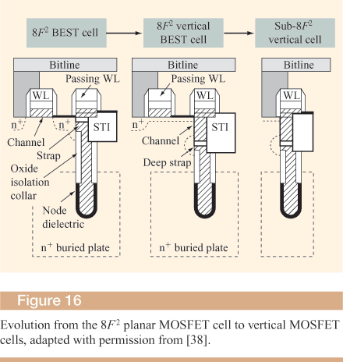
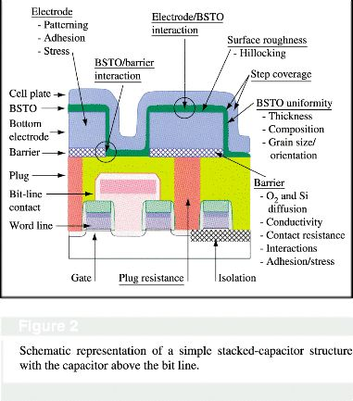
DRAM Capacitors: more capacitance in a small area
Trench capacitors:
  Logic ABOVE capacitor
  Gain in surface area of capacitor
  Better Scaling properties
  Better Planarization
Stacked capacitors
  Logic BELOW capacitor
  Gain in surface area of capacitor
  2-dim cross-section quite small

Slide 12
Classical DRAM Organization (square)
bit (data) lines
r
o
w
d
e
c
o
d
e
r
Each intersection represents
a 1-T DRAM Cell
RAM Cell
Array
word (row) select
row
address
Column Selector &
I/O Circuits
Column
Address
Row and Column Address together:
  Select 1 bit a time
data
Notes:
Similar to SRAM, DRAM is organized into rows and columns.
But unlike SRAM, which allows you to read an entire row out at a time at a word, classical DRAM only allows you read out one-bit at time time.
The reason for this is to save power as well as area. Remember now the DRAM cell is very small we have a lot of them across horizontally.
So it will be very difficult to build a Sense Amplifier for each column due to the area constraint not to mention having a sense amplifier per column will consume a lot of power.
You select the bit you want to read or write by supplying a Row and then a Column address.
Similar to SRAM, each row control line is referred to as the word line and each vertical data line is referred to as the bit line.
+2 = 57 min. (Y:37)

Slide 13
DRAM Read Timing
Every DRAM access begins at:
  The assertion of the RAS_L
  2 ways to read:
  early or late v. CAS
RAS_L
CAS_L
WE_L
OE_L
A
256K x 8
DRAM
D
9
8
DRAM Read Cycle Time
RAS_L
CAS_L
A
Row Address
Col Address
Junk
Row Address
Col Address
Junk
WE_L
OE_L
D
High Z
Junk
Data Out
High Z
Data Out
Read Access
Time
Output Enable
Delay
Early Read Cycle: OE_L asserted before CAS_L
Late Read Cycle: OE_L asserted after CAS_L
Notes:
Similar to DRAM write, DRAM read can also be a Early read or a Late read.
In the Early Read Cycle, Output Enable is asserted before CAS is asserted so the data lines will contain valid data one Read access time after the CAS line has gone low.
In the Late Read cycle, Output Enable is asserted after CAS is asserted so the data will not be available on the data lines until one read access time after OE is asserted.
Once again, notice that the RAS line has to remain asserted during the entire time. The DRAM read cycle time is defined as the time between the two RAS pulse.
Notice that the DRAM read cycle time is much longer than the read access time.
Q: RAS & CAS at same time? Yes, both must be low
+2 = 65 min. (Y:45)

Slide 14
4 Key DRAM Timing Parameters
t_{RAC}: minimum time from RAS line falling to the valid data output.
  Quoted as the speed of a DRAM when buy
  A typical 4Mb DRAM t_{RAC} = 60 ns
  Speed of DRAM since on purchase sheet?
t_{RC}: minimum time from the start of one row access to the start of the next.
  t_{RC} = 110 ns for a 4Mbit DRAM with a t_{RAC} of 60 ns
t_{CAC}: minimum time from CAS line falling to valid data output.
  15 ns for a 4Mbit DRAM with a t_{RAC} of 60 ns
t_{PC}: minimum time from the start of one column access to the start of the next.
  35 ns for a 4Mbit DRAM with a t_{RAC} of 60 ns

Slide 15
Main Memory Performance
Cycle Time
Access Time
Time
DRAM (Read/Write) Cycle Time >> DRAM (Read/Write) Access Time
  ­ 2:1; why?
DRAM (Read/Write) Cycle Time :
  How frequent can you initiate an access?
  Analogy: A little kid can only ask his father for money on Saturday
DRAM (Read/Write) Access Time:
  How quickly will you get what you want once you initiate an access?
  Analogy: As soon as he asks, his father will give him the money
DRAM Bandwidth Limitation analogy:
  What happens if he runs out of money on Wednesday?
Notes:
In the previous two slides, I have shown you that for both read and write operation, the access time is much shorter than the DRAM cycle time (use the time line)..
The DRAM cycle time puts a limit on how frequent can you initiate an access. Using an analogy, this is like a little kid can only ask his father for money on Saturday--the cycle time of accessing his father’s money is 1 week.
The access time tells us how quickly will you get what you want once you start your access. Using our analogy again, the little kid probably will get the money as soon as he ask so the access time to his father’s money is several minutes, much shorter than the cycle time.
Now what happens if the little kid runs out money on Wednesday and he knows he can not ask dad for money for 3 more day, what can he do?
What would you do if you are the little kid? Well, I know what I will do. I will ask Mom.
So if he is smart, he can ask Mom for money every Wednesday and ask Dad on weekend.
He ends up having twice the money to spend without making either parents angry.
The scheme he just invented is memory interleaving.
+2 = 67 min. (Y:47)

Slide 16
Increasing Bandwidth - Interleaving
Access Pattern without Interleaving:
CPU
Memory
D1 available
Start Access for D1
Start Access for D2
Memory
Bank 0
Access Pattern with 4-way Interleaving:
Memory
Bank 1
CPU
Memory
Bank 2
Memory
Bank 3
Access Bank 1
Access Bank 0
Access Bank 2
Access Bank 3
We can Access Bank 0 again
Notes:
Without interleaving, the frequency of our access will be limited by the DRAM cycle time.
With interleaving, that is having multiple banks of memory, we can access the memory much more frequently by accessing another bank while the last bank is finishing up its cycle.
For example, first we will access memory bank 0. Once we get the data from Bank 0, we will access Bank 1 while Bank 0 is still finishing up the rest of its DRAM cycle.
Ideally, with interleaving, how quickly we can perform memory access will be limited by the memory access time only.
Memory interleaving is one common techniques to improve memory performance.
+ 1 = 68 min. (Y:48)

Slide 17
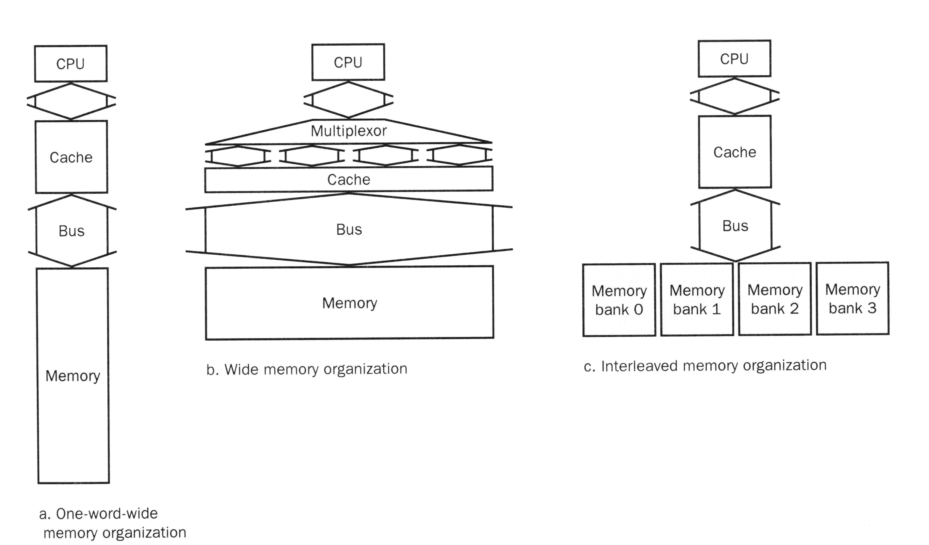
Main Memory Performance
Wide:
  CPU/Mux 1 word; Mux/Cache, Bus, Memory N words (Alpha: 64 bits & 256 bits)
Interleaved:
  CPU, Cache, Bus 1 word: Memory N Modules
  (4 Modules); example is word interleaved
Simple:
  CPU, Cache, Bus, Memory same width
  (32 bits)

Slide 18
Main Memory Performance
Timing model
  1 to send address,
  4 for access time, 10 cycle time, 1 to send data
  Cache Block is 4 words
Simple M.P. = 4 x (1+10+1) = 48
Wide M.P. = 1 + 10 + 1 = 12
Interleaved M.P. = 1+10+1 + 3 =15
address
address
address
address
0
1
2
3
4
5
6
7
8
9
10
11
12
13
14
15
Bank 0
Bank 1
Bank 2
Bank 3

Slide 19
Avoiding Bank Conflicts
Lots of banks
int x[256][512];
for (j = 0; j < 512; j = j+1)
for (i = 0; i < 256; i = i+1)
x[i][j] = 2 * x[i][j];
Even with 128 banks, since 512 is multiple of 128, conflict on word accesses
SW: loop interchange or declaring array not power of 2 (“array padding”)
HW: Prime number of banks
  bank number = address mod number of banks
  address within bank = address / number of words in bank
  modulo & divide per memory access with prime no. banks?
  address within bank = address mod number words in bank
  bank number? easy if 2^{N} words per bank

Slide 20
Fast Bank Number
Chinese Remainder Theorem
As long as two sets of integers ai and bi follow these rules
and that ai and aj are co-prime if i ≠ j, then the integer x has only one solution (unambiguous mapping):
  bank number = b₀, number of banks = a₀ (= 3 in example)
  address within bank = b₁, number of words in bank = a₁
  (= 8 in example)
  N word address 0 to N-1, prime no. banks, words power of 2
Seq. Interleaved Modulo Interleaved
Bank Number: 0 1 2 0 1 2 Address within Bank: 0 0 1 2 0 16 8 1 3 4 5 9 1 17
2 6 7 8 18 10 2 3 9 10 11 3 19 11 4 12 13 14 12 4 20 5 15 16 17 21 13 5 6 18 19 20 6 22 14 7 21 22 23 15 7 23

Slide 21
Fast Memory Systems: DRAM specific
Multiple CAS accesses: several names (page mode)
  Extended Data Out (EDO): 30% faster in page mode
New DRAMs to address gap;
what will they cost, will they survive?
  RAMBUS: startup company; reinvent DRAM interface
    Each Chip a module vs. slice of memory
    Short bus between CPU and chips
    Does own refresh
    Variable amount of data returned
    1 byte / 2 ns (500 MB/s per chip)
  Synchronous DRAM: 2 banks on chip, a clock signal to DRAM, transfer synchronous to system clock (66 - 150 MHz)
  Intel claims RAMBUS Direct (16 b wide) is future PC memory
Niche memory or main memory?
  e.g., Video RAM for frame buffers, DRAM + fast serial output

Slide 22
Fast Page Mode Operation
Regular DRAM Organization:
  N rows x N column x M-bit
  Read & Write M-bit at a time
  Each M-bit access requires
  a RAS / CAS cycle
Fast Page Mode DRAM
  N x M “SRAM” to save a row
After a row is read into the register
  Only CAS is needed to access other M-bit blocks on that row
  RAS_L remains asserted while CAS_L is toggled
Column
Address
N cols
DRAM
Row
Address
N rows
N x M “SRAM”
M bits
M-bit Output
1st M-bit Access
2nd M-bit
3rd M-bit
4th M-bit
RAS_L
CAS_L
A
Row Address
Col Address
Col Address
Col Address
Col Address
Notes:
So with this register in place, all we need to do is assert the RAS to latch in the row address, then entire row is read out and save into this register.
After that, you only need to provide the column address and assert the CAS needs to access other M-bit within this same row.
I like to point out that even I use the word “SRAM” here but this is no ordinary sram. It has to be very small but the good thing is that it is internal to the DRAM and does not have to drive any external load.
Anyway, this type of operation where RAS remains asserted while CAS is toggled to bring in a new column address is called Page Mode operation.
Strore orw so don’t have to repeat: SRAM
It will become clearer why this is called Page Mode operation when we look into the operation of the SPARCstation 20 memory system.
+ 2 = 71 min. (Y:51)

Slide 23
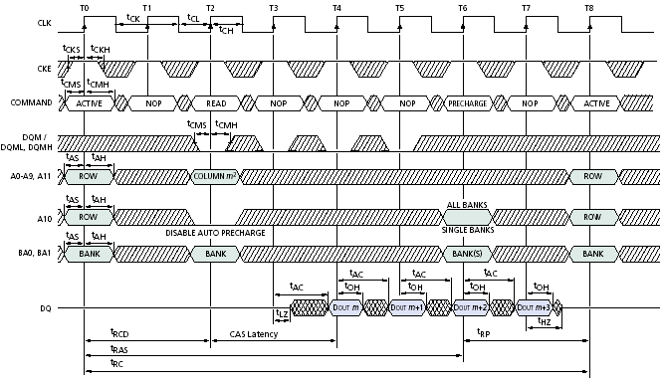
SDRAM timing
CAS
End RAS
x
RAS
(New Bank)
Burst
READ
CAS Latency
Micron 128M-bit dram (using 2Meg×16bit×4bank ver)
  Row (12 bits), bank (2 bits), column (9 bits)

Slide 24
DRAM History
DRAMs: capacity +60%/yr, cost –30%/yr
  2.5X cells/area, 1.5X die size in ­3 years
‘98 DRAM fab line costs $2B
  DRAM only: density, leakage v. speed
Rely on increasing no. of computers & memory per computer (60% market)
  SIMM or DIMM is replaceable unit
  => computers use any generation DRAM
Commodity, second source industry
=> high volume, low profit, conservative
  Little organization innovation in 20 years
Order of importance: 1) Cost/bit 2) Capacity
  First RAMBUS: 10X BW, +30% cost => little impact

Slide 25
DRAM Future: 1 Gbit+ DRAM
Mitsubishi Samsung
Blocks 512 x 2 Mbit 1024 x 1 Mbit
Clock 200 MHz 250 MHz
Data Pins 64 16
Die Size 24 x 24 mm 31 x 21 mm
  Sizes will be much smaller in production
Metal Layers 3 4
Technology 0.15 micron 0.16 micron

Slide 26
DRAMs per PC over Time
DRAM Generation
‘86 ‘89 ‘92 ‘96 ‘99 ‘02
1 Mb 4 Mb 16 Mb 64 Mb 256 Mb 1 Gb
4 MB
8 MB
16 MB
32 MB
64 MB
128 MB
256 MB
32
8
16
4
8
2
Minimum Memory Size
4
1
8
2
4
1
8
2

Slide 27
Potential
DRAM Crossroads?
After 20 years of 4X every 3 years, running into wall? (64Mb - 1 Gb)
How can keep $1B fab lines full if buy fewer DRAMs per computer?
Cost/bit –30%/yr if stop 4X/3 yr?
What will happen to $40B/yr DRAM industry?

Slide 28
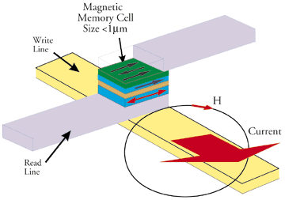
Something new: Structure of Tunneling Magnetic Junction
Tunneling Magnetic Junction RAM (TMJ-RAM)
  Speed of SRAM, density of DRAM, non-volatile (no refresh)
  “Spintronics”: combination quantum spin and electronics
  Same technology used in high-density disk-drives

Slide 29
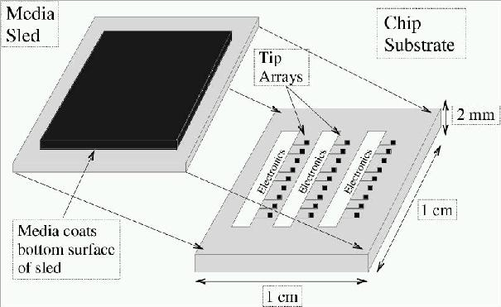
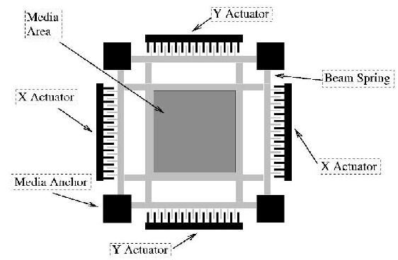
MEMS-based Storage
Magnetic “sled” floats
on array of read/write heads
  Approx 250 Gbit/in²
  Data rates:
  IBM: 250 MB/s w 1000 heads
  CMU: 3.1 MB/s w 400 heads
Electrostatic actuators move media around to
align it with heads
  Sweep sled ±50μm in < 0.5μs
Capacity estimated to be in the 1-10GB in 10cm²
See Ganger et all: http://www.lcs.ece.cmu.edu/research/MEMS

Slide 30
Big storage (such as DRAM/DISK):
Potential for Errors!
Motivation:
  DRAM is dense ⇒Signals are easily disturbed
  High Capacity ⇒ higher probability of failure
Approach: Redundancy
  Add extra information so that we can recover from errors
  Can we do better than just create complete copies?
Block Codes: Data Coded in blocks
  k data bits coded into n encoded bits
  Measure of overhead: Rate of Code: K/N
  Often called an (n,k) code
  Consider data as vectors in GF(2) [ i.e. vectors of bits ]
Code Space is set of all 2^{n} vectors,
Data space set of 2^{k} vectors
  Encoding function: C=f(d)
  Decoding function: d=f(C’)
  Not all possible code vectors, C, are valid!

Slide 31
General Idea:
Code Vector Space
Code Space
C₀=f(d₀)
Code Distance
(Hamming Distance)
d₀
Not every vector in the code space is valid
Hamming Distance (d):
  Minimum number of bit flips to turn one code word into another
Number of errors that we can detect: (d-1)
Number of errors that we can fix: ½(d-1)

Slide 32
Main Memory Summary
Main memory is Dense, Slow
Cycle time > Access time!
Techniques to optimize memory
  Wider Memory
  Interleaved Memory: for sequential or independent accesses
  Avoiding bank conflicts: SW & HW
  DRAM specific optimizations: page mode & Specialty DRAM
DRAM has errors: Need error correction codes!
  Topic for next lecture

