Slide 1


Advisor : Hoon Sung Chwa
Weekly Meeting
2022.12.02
Dept of Information & Communication Engineering, DGIST
Real-Time Computing Lab
Kang Young Eun ( kye0520 @dgist.ac.kr)

Slide 2
Contents
Motivation
Main Idea
Methodology
Light weight detector
Consecutive frame
2

Slide 3
Motivation
Problem in real-time object detection
The tradeoff of execution time and detection accuracy in object detection networks
Current real-time object detection networks are not applicable for multi camera object detection.
3

Slide 4
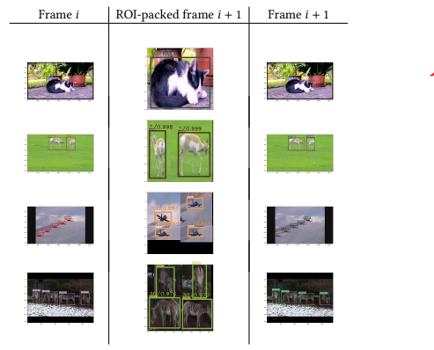
Motivation
Problem Statement
Solve the tradeoff between detection accuracy and execution time in object detection with multiple cameras.
Main Idea : Patching
Example of Image Patching
Frame t
Patched image
Frame t+1
4

Slide 5
Main Idea
Patching
Assumptions
Patching increases detection accuracy.
Patching lowers detection latency of object detection.
[1] Kumar, Athindran Ramesh, Balaraman Ravindran, and Anand Raghunathan. "Pack and detect: Fast object detection in videos using region-of-interest packing." Proceedings of the ACM India Joint International Conference on Data Science and Management of Data. 2019.
5

Slide 6
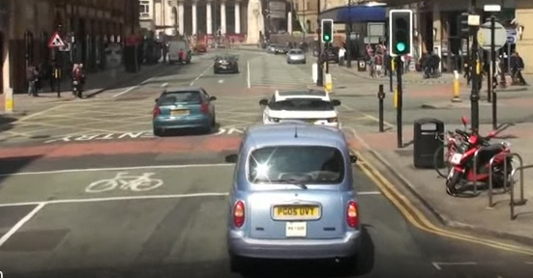


Motivation
Related Work
Mechanism of canvas
Key Frame
Tracker
Detection
New Object Detection
Selected Region
Detection Update
Canvas scheduling
Not applicable for multi camera object detection!!
6

Slide 7
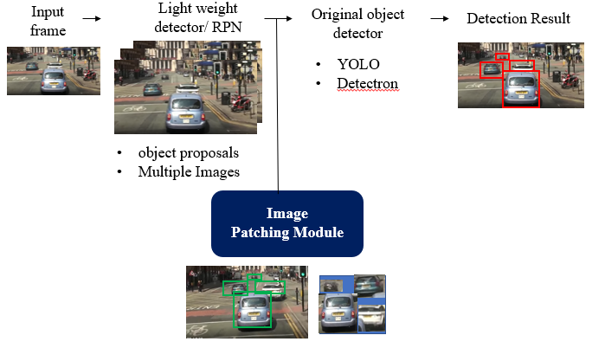
Methodology
Light weight Region Proposal Method
mmDetection RPN backbone
detectron2 ResNet50-FPN
ResNet18 , ResNet32, ResNet50 pytorch
Exploit consecutive frames
7

Slide 8
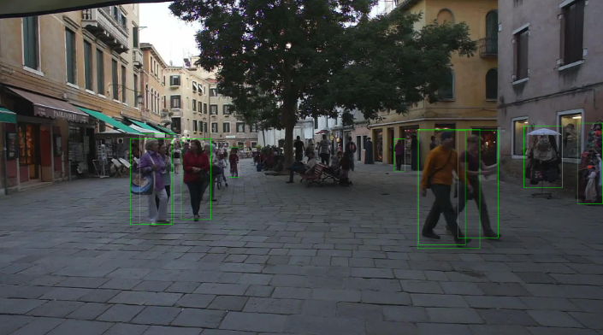
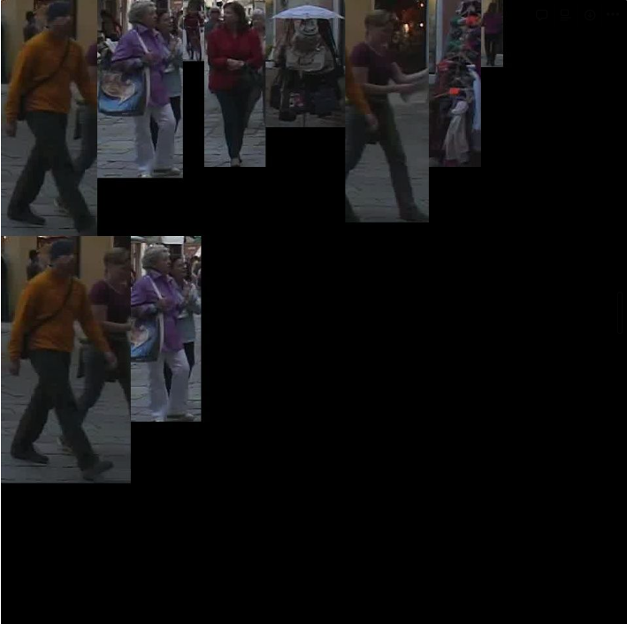
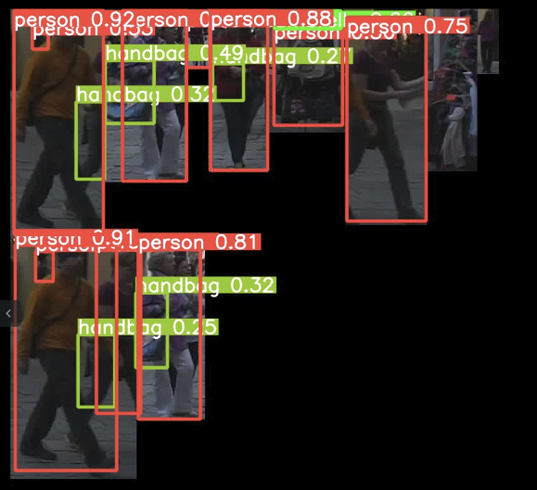
Methodology
Light weight Region Proposal Method
1920x1080 RPN Detected Original Image
960x960 Patched Image
YOLO detection of Patched Image
Patched Image & Original Image bbox coordinate mapping
8

Slide 9
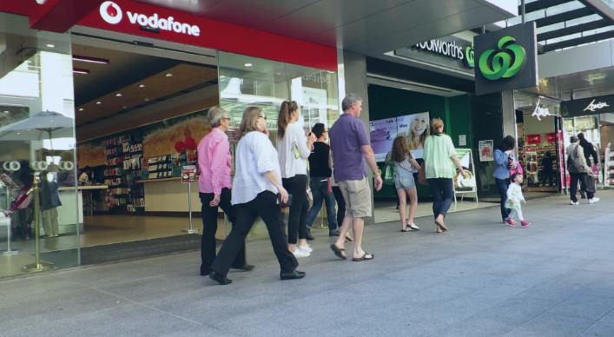
Detection Accuracy
Experimental Results
Dataset: MOT16-09
mmDetection RPN
Number of ground-truth detected objects: [12,21]
Average of 16.8 objects per frame
Detection Accuracy on class Person with MOT16-09 dataset
9

Slide 10
Execution Time breakdown
Execution time of Patching
1290x1290 image to 960x960 image with no object scale change
10
Notes:
다음은 Execution time 측정 결과입니다.
Rpn이 같은 크기의 yolo detection 결과랑만 비교 했을 때 절반 가량 detection 시간을 줄일 수 있는 것으로 확인되었습니다.
이 detection latency 부분이 deadline에 따라서 dynamic하게 조절할 수 있는 부분이고 지금 비교적 큰 size의 이미지로 detection 진행했기 때문에 이보다 작게 줄이면
Total 실행시간을 크게 줄일 수 있을 것으로 보입니다.

Slide 11
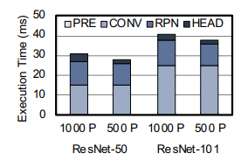
Execution Time breakdown
Execution time of Patching
1290x1290 image to 960x960 image with no object scale change
Execution time
11
Notes:
다음은 Execution time 측정 결과입니다.
지난번 rpn 측정 값이 누락.
Rpn이 같은 크기의 yolo detection 결과랑만 비교 했을 때 절반 가량 detection 시간을 줄일 수 있는 것으로 확인되었습니다.
이 detection latency 부분이 deadline에 따라서 dynamic하게 조절할 수 있는 부분이고 지금 비교적 큰 size의 이미지로 detection 진행했기 때문에 이보다 작게 줄이면
Total 실행시간을 크게 줄일 수 있을 것으로 보입니다.

Slide 12
Methodology
Light weight Region Proposal Method
mmDetection RPN backbone
detectron2 ResNet50-FPN
ResNet18 , ResNet32, ResNet50 pytorch
Exploit consecutive frames
12

Slide 13
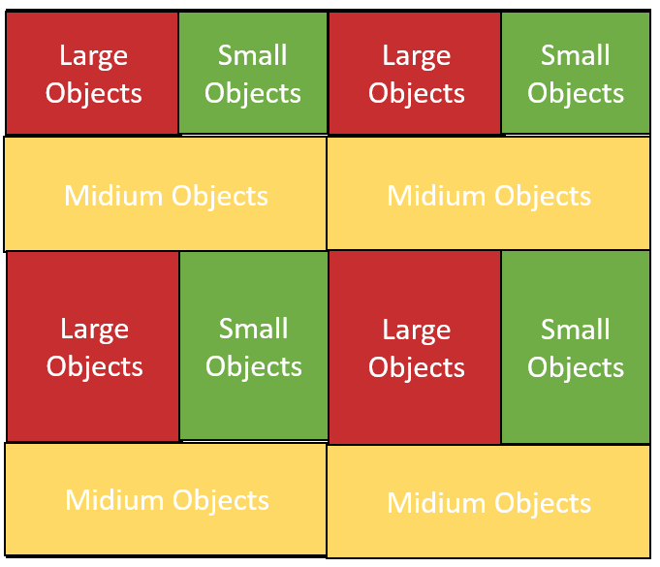






Overview
Overview of exploiting consecutive frames
$$F_{1}$$
$$F_{1}$$
Detection
(Yolo)
$$F_{2}$$
Frame Ordering Module
.
.
.
.
.
.
$$F_{2}$$
.
.
.
.
.
$$F_{n}$$
Multiple Input Images
update
$$F_{n}$$
Patching Module
New Object Detection
Tracker
13
Notes:
Key frame

Slide 14



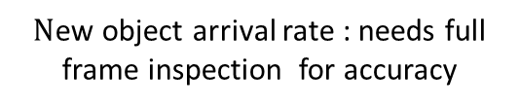

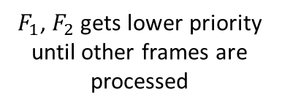

Frame Selection Module
Frame Selection Mechanism
Output : order of frames or window size per frame
Decides number of possible number of images for full frame inspection according to deadline
Exploits consecutive frame info
1. Available full frame inspection until deadline: 2
Detection
(Yolo)
$$F_{1}$$
$$F_{1}$$
$$F_{2}$$
Frame Priority Ordering Module
.
.
.
$$F_{2}$$
$$F_{n}$$
$F_{1}$, $F_{2}$ gets lower priority until other frames are processed
Selected Frames
Multiple Input Images
$N$ew object arrival rate : needs full frame inspection for accuracy
14
Notes:
Full frame inspection을 frame당 얼마나 자주 누구 frame 부터 하는 것이 적당한지

Slide 15
To Do
Implementation
Patching for consecutive frames
Patching Mechanism for multiple cameras
Assumption Verification
Patching increases detection accuracy.
Patching lowers detection latency of object detection.
15
15
15

Slide 16

Advisor : Hoon Sung Chwa
Thank you
Dept of Information & Communication Engineering, DGIST
Real-Time Computing Lab
Kang Young Eun (kye0520@dgist.ac.kr)

