Slide 1


Advisor : Hoon Sung Chwa
Weekly Meeting
2023.01.06
Dept of Information & Communication Engineering, DGIST
Real-Time Computing Lab
Kang Young Eun ( kye0520 @dgist.ac.kr)

Slide 2
Contents
Motivation
Motivational Experiment
To Do
2

Slide 3
Motivation
Real Time Object Detection
The trend of object detection systems with multiple cameras.
Solve the tradeoff between detection accuracy and execution time in object detection with multiple cameras.
Problem with multi camera object detection
Deadline miss may lead to severe accidents.
Solve the tradeoff between detection accuracy and execution time in object detection with multiple cameras.
3

Slide 4
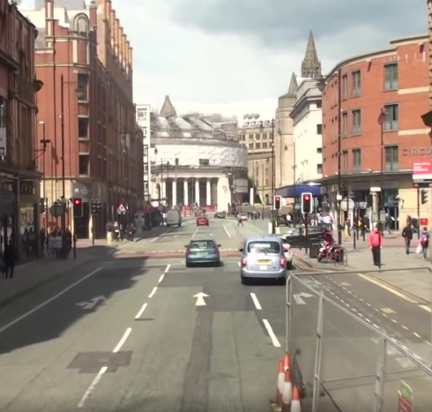
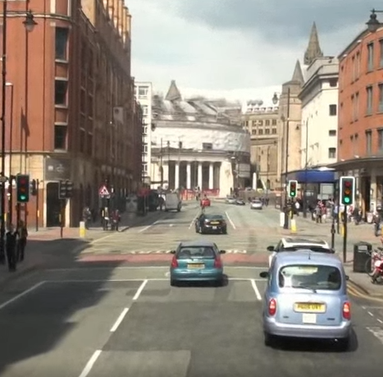
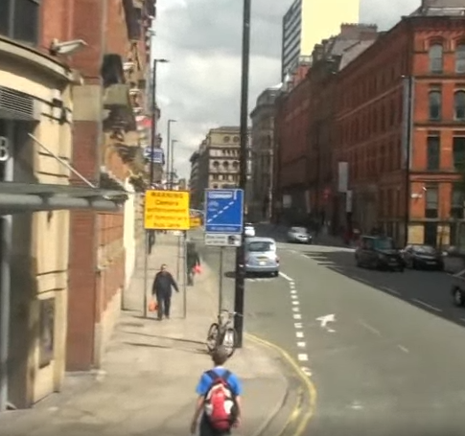
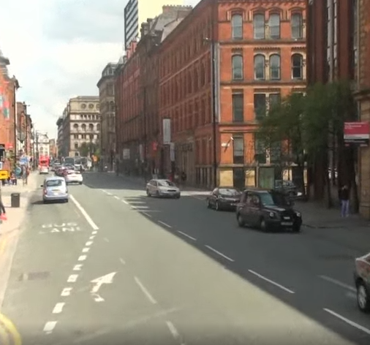
Motivation
Question
Is patching multiple images and executing them at once efficient than executing them separately?
Single image execution
Patched image execution
Detection
Network
Detection
Network
Result
Result
4

Slide 5
Motivation
Motivation Experiment
Single Execution vs Patched Image execution
Average Execution Time Comparison with YOLOv5
Image Size
1: 384x640
2: 728x640
4: 728x1280
6: 1256x1280
1.49x
1.46x
1.4x
Patched Image has 1.4x faster execution time than single image execution.
5
Notes:
Yolov5
1: 384x640
2: 728x640
4: 728x1280
6: 1256x1280

Slide 6
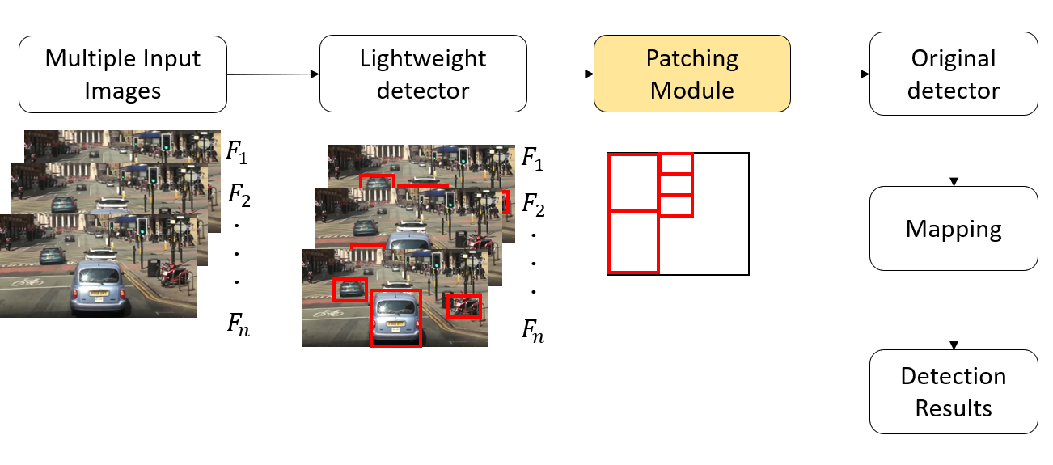
Patching Overview
6

Slide 7
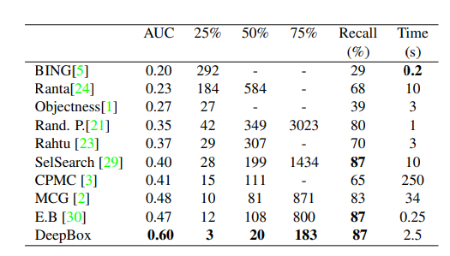
Model Selection
Light weight detector
Select region that has of high possibility of having an object in the certain area with Objectness score
Execution time comparison with objectness works
[1] Kuo, Weicheng, Bharath Hariharan, and Jitendra Malik. "Deepbox: Learning objectness with convolutional networks." Proceedings of the IEEE international conference on computer vision. 2015.
7

Slide 8
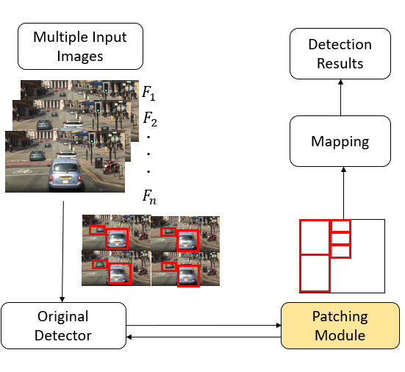
Patching Overview
8

Slide 9
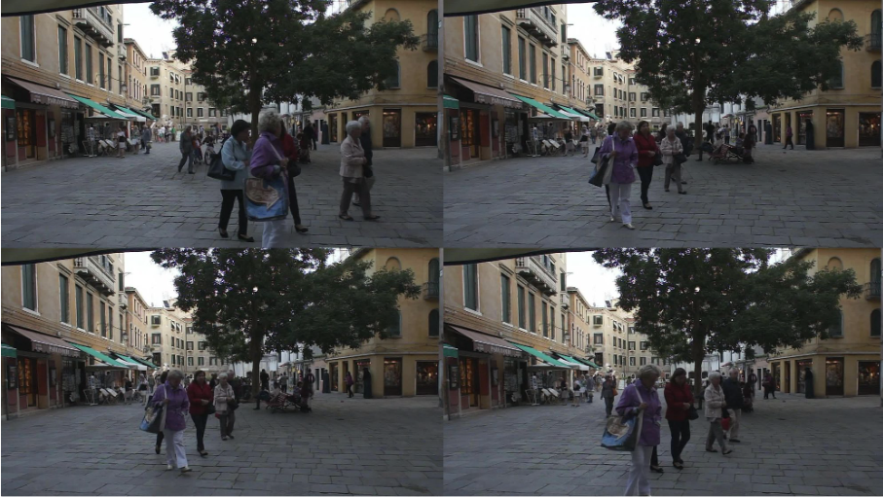
Experiment Setup
Experiment
Execution time of patched image sizes
Accuracy of patched images
Experimental Setup
Detection model : YOLOv5
Dataset : MOT16-09
Patching
4 images patched
Different image size
9

Slide 10
Motivation Experiment
Motivation Experiment
Accuracy per patched image resolution
Execution Time of 4 patched image
Detection Accuracy
10
Notes:
Distractor occlude reflection

Slide 11
To Do
Lightweight detector selection
Yolo resizing
Objectness model
Additional Experiments for selection
IoU without classification score (localization score)
Execution time breakdown of Yolo resizing
11
11
11

Slide 12

Advisor : Hoon Sung Chwa
Thank you
Dept of Information & Communication Engineering, DGIST
Real-Time Computing Lab
Kang Young Eun (kye0520@dgist.ac.kr)

Slide 13
Motivation
Motivation Experiment
Single Execution vs Patched Image execution
Average Execution Time Comparison
13
Notes:
384x640
Merged 4 : 736x1280(YOLOV5) , 768x1280(Faster R-CNN)

Slide 14
Assumptions
Execution time
Patching helps lower total execution time compared to the original model.
Accuracy
Patching has low accuracy loss.
14

