Slide 1


Advisor : Hoon Sung Chwa
Weekly Meeting
2023.01.27
Dept of Information & Communication Engineering, DGIST
Real-Time Computing Lab
Kang Young Eun ( kye0520 @dgist.ac.kr)

Slide 2
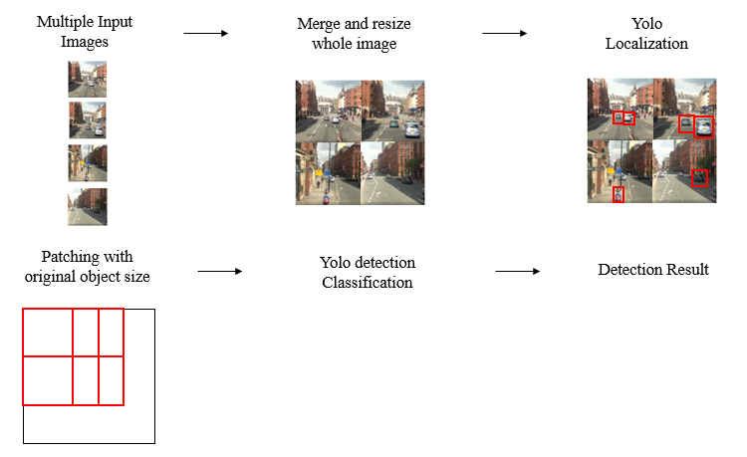
Motivation Experiment
Questions
Does localization have correlation with image size?
Execution time and Accuracy
Does object patching maintain detection accuracy while minimizing execution time?
2

Slide 3
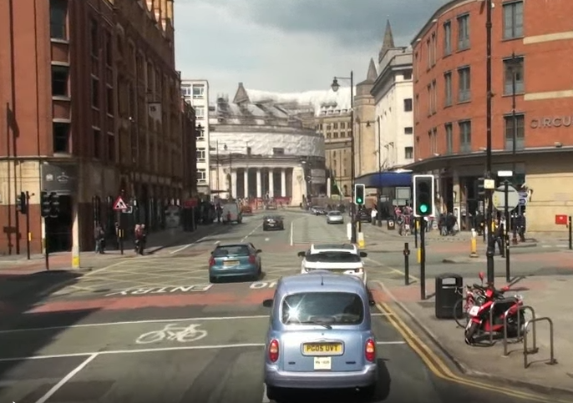
Motivation Experiment
Difference comparison of Localization mAP and Classification mAP
1920x1080
Detection
Network
Classification Results
960x1664
448x640
The accuracy of the classification task may be heavily dependent localization results.
3
Notes:
Classification mAP와 비교해본 결과, classification은 상당히 유사한 추세로 떨어지는 것 확인
떨어지지 않기를 기대했으나, 보다 더 sensitive한 것으로 보인다.

Slide 4
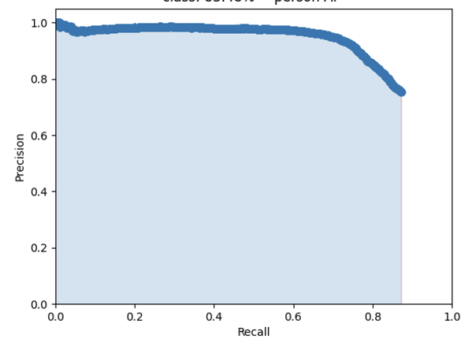
Localization mAP vs Classification mAP
Experiment Method 2
1. Localization at 1080x1920
2. Crop Localization results at size 1080x1920
3. Yolo detection with different resolution
4. mAP calculation
1920x1080
960x1664
448x640
4
Notes:
Classification mAP와 비교해본 결과, classification은 상당히 유사한 추세로 떨어지는 것 확인
떨어지지 않기를 기대했으나, 보다 더 sensitive한 것으로 보인다.

Slide 5
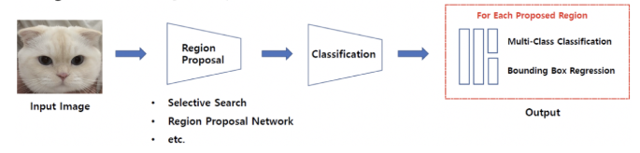
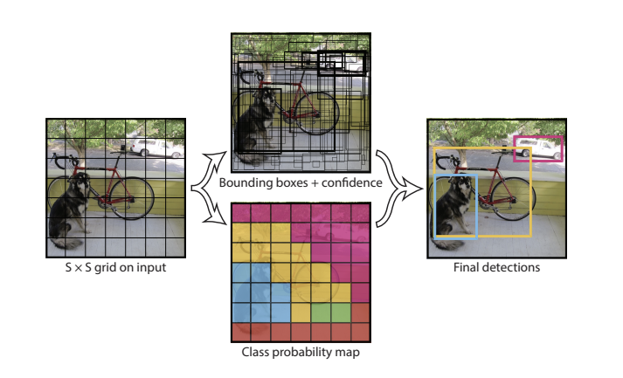
Motivation Experiment
Types of object detector
Two stage object detector
One stage object detector : YOLO
5

Slide 6
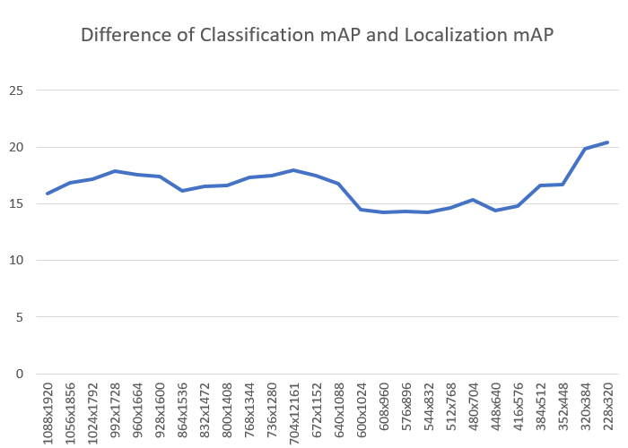
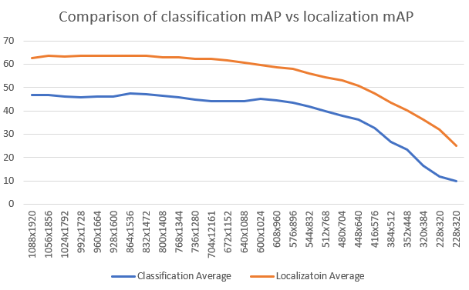
Motivation Experiment
Comparison of Localization mAP and Classification mAP
Therefore, localization is less sensitive to downsizing compared to classification.
6
Notes:
Classification mAP와 비교해본 결과, classification은

Slide 7
To Do
Motivation Experiments
Does localization have correlation with image resolution?
Does patching maintain detection accuracy while minimizing execution time?
Expansion to Multi camera ideas
AdaScale
Multiple Input Images
Merge and resize whole image
Localization
Patching with original object size
Yolo detection
Detection Result
7
7
7

Slide 8

Advisor : Hoon Sung Chwa
Thank you
Dept of Information & Communication Engineering, DGIST
Real-Time Computing Lab
Kang Young Eun (kye0520@dgist.ac.kr)

Slide 9
Motivation Experiment
Execution time of localization per different image resolution
Merging images for localization is effective in terms of execution time.
9

Slide 10
Adaptive scaling
Adascale
Execution time of adascale determining the best scale for an image
10
Notes:
(MOT16-09)

Slide 11
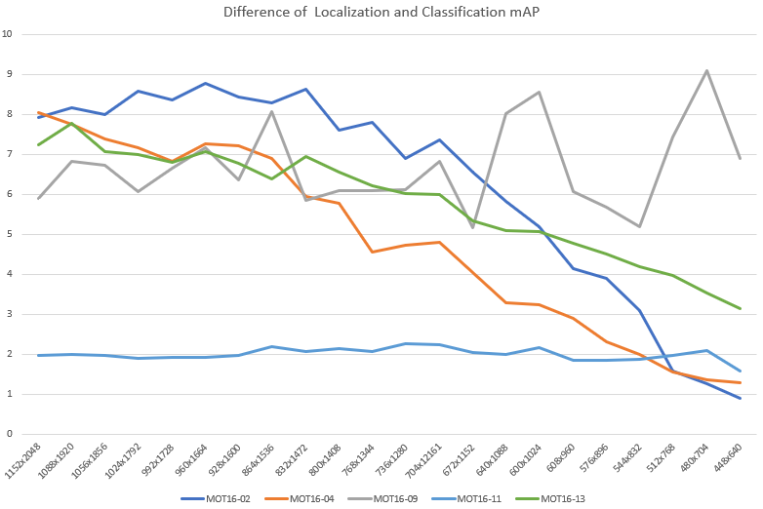
Motivation Experiment
Motivation Experiment
Difference comparison of Localization mAP and Classification mAP
11
Notes:
특정 data에 따라서 이러한 차이를 보이는 것인지를 확인해보았더니,
Localization은 이미지의 density에 따라 좀 차이를 보이는 것 같아서 살펴보니 localization이 dense한 이미지에 대해서는

Slide 12
Motivation
Real Time Object Detection
The trend of object detection systems with multiple cameras.
Solve the tradeoff between detection accuracy and execution time in object detection with multiple cameras.
Problem with multi camera object detection
Deadline miss may lead to severe accidents.
Solve the tradeoff between detection accuracy and execution time in object detection with multiple cameras.
12

Slide 13
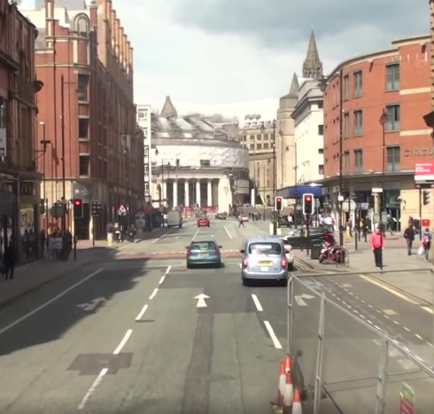
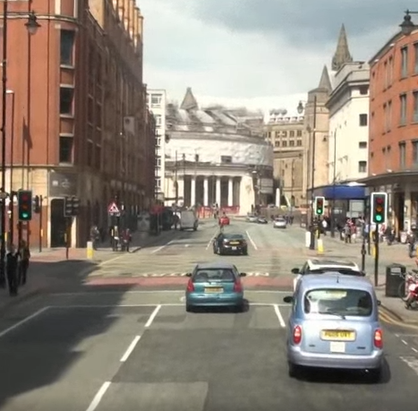
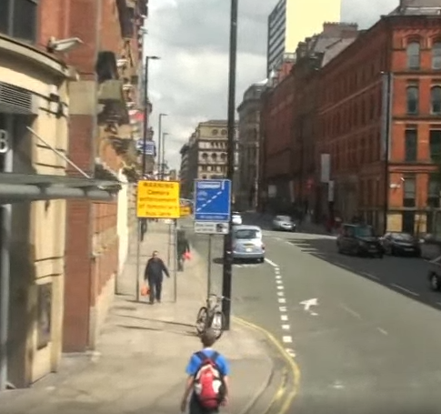
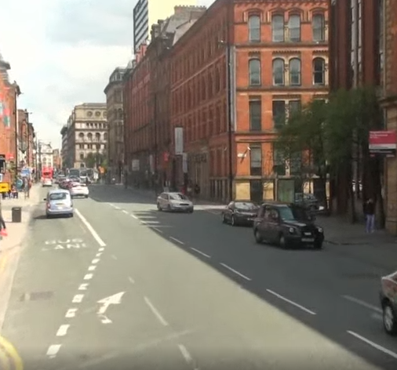
Motivation
Approach 2
Is patching multiple images and executing them at once efficient than executing them separately?
Single image execution
Merged image execution
Detection
Network
Detection
Network
Result
Result

Slide 14
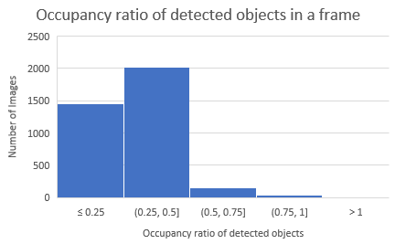
Review
Approach
Occupancy ratio of detected objects
Detected objects in a frame has less than 50% of the frame in most of the cases.
14

Slide 15
Review
Approach
Single Execution vs Merged Image execution
Average Execution Time Comparison with YOLOv5
Image Size
1: 384x640
2: 728x640
4: 728x1280
6: 1256x1280
1.49x
1.46x
1.4x
Patched Image has 1.4x faster execution time than single image execution.
15
Notes:
Yolov5
1: 384x640
2: 728x640
4: 728x1280
6: 1256x1280

