Slide 1


Advisor : Hoon Sung Chwa
Weekly Meeting
2023.02.03
Dept of Information & Communication Engineering, DGIST
Real-Time Computing Lab
Kang Young Eun ( kye0520 @dgist.ac.kr)

Slide 2
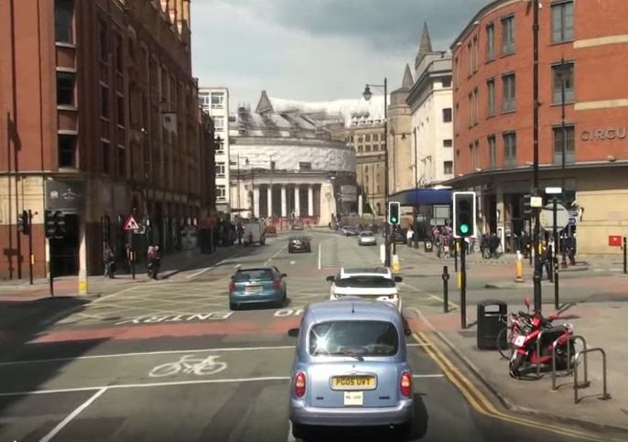
Motivation Experiment
Difference comparison of Localization mAP and Classification mAP
1920x1080
Detection
Network
Classification Results
960x1664
448x640
The accuracy of the classification task may be heavily dependent localization results.
2

Slide 3
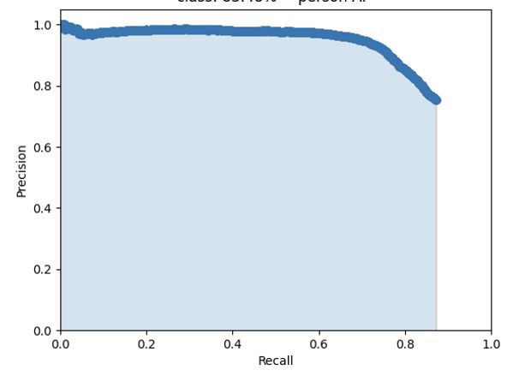
Localization mAP vs Classification mAP
Experiment Method 2
1. Localization at 1080x1920
2. Crop Localization results at size 1080x1920
3. Yolo detection with different resolution
4. mAP calculation
1920x1080
960x1664
448x640
3

Slide 4
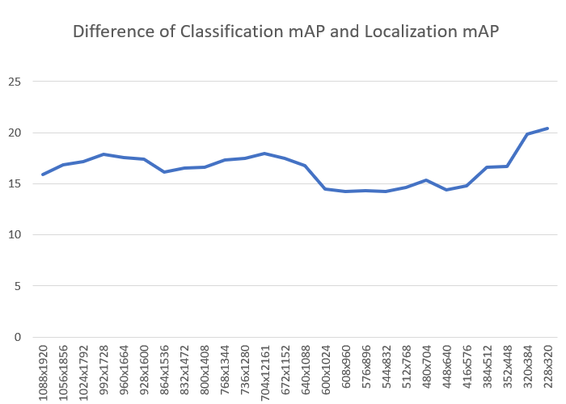
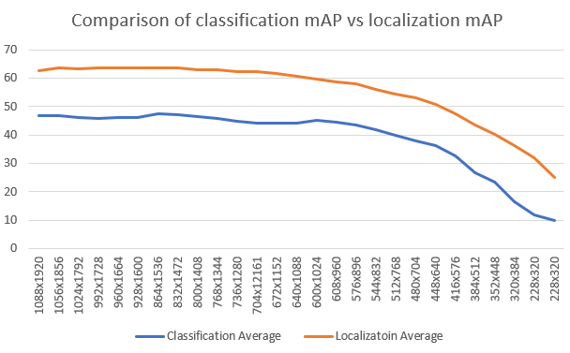
Motivation Experiment
Comparison of Localization mAP and Classification mAP
Classification accuracy with localization 100% hit ratio.
→ No meaningful experimental results
4

Slide 5
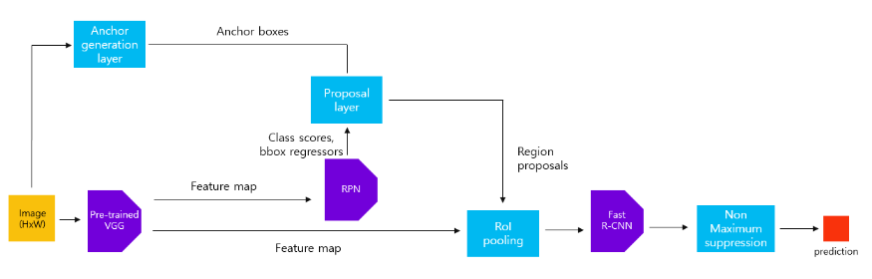
Motivation Experiment
2-stage object detector Faster R-CNN
Structure of Faster R-CNN
5

Slide 6
Motivation Experiment
2-stage object detector Faster R-CNN
  Scale sensitivity comparison of localization and classification
Structure of Faster R-CNN
Localization
Classification
6

Slide 7
Patching Model
RoI Extraction
  RPN : high execution time than yolo(original detector)
  Merged image downsized YOLO :
    Localization merge + downsizing reasoning
  Exploit consecutive frame data
    Tracking : SORT Algorithm
    New object detection module : Background subtraction etc.
7

Slide 8
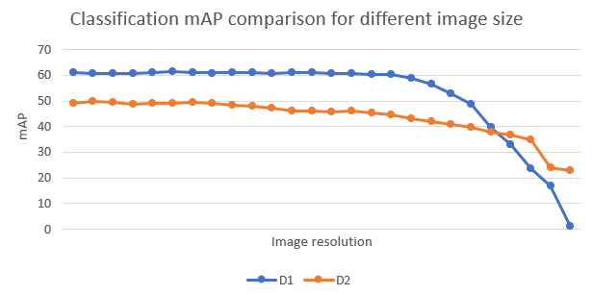


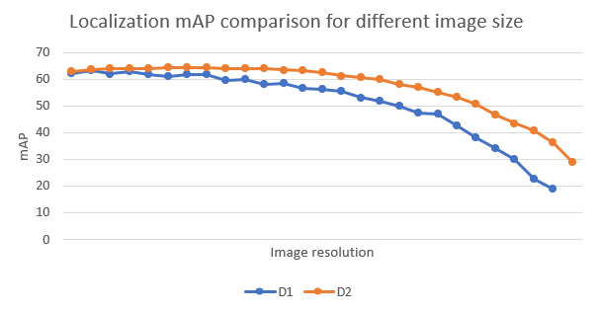
Density of Image
Density comparison of sensitivity on image size
D1
D2
→ Dense images are more sensitive to downsizing in both localization and classification.
8

Slide 9
To Do
Motivation Experiments
  Localization Accuracy comparison with Classification Accuracy
  Does patching maintain detection accuracy while minimizing execution time?
Expansion to Multi camera ideas
AdaScale application
Multiple Input Images
Merge and resize whole image
Localization
Patching with original object size
Yolo detection
Detection Result
9
9
9

Slide 10

Advisor : Hoon Sung Chwa
Thank you
Dept of Information & Communication Engineering, DGIST
Real-Time Computing Lab
Kang Young Eun (kye0520@dgist.ac.kr)

Slide 11
Motivation Experiment
Execution time of localization per different image resolution
Merging images for localization is effective in terms of execution time.
11

Slide 12
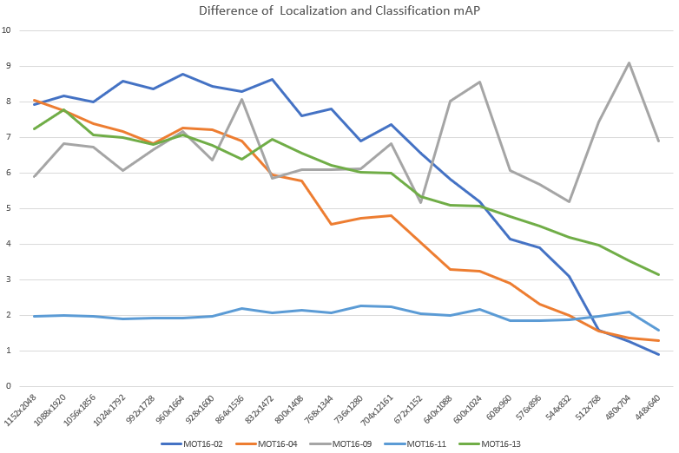
Motivation Experiment
Motivation Experiment
  Difference comparison of Localization mAP and Classification mAP
12
Notes:
특정 data에 따라서 이러한 차이를 보이는 것인지를 확인해보았더니,
Localization은 이미지의 density에 따라 좀 차이를 보이는 것 같아서 살펴보니 localization이 dense한 이미지에 대해서는

Slide 13
Motivation
Real Time Object Detection
  The trend of object detection systems with multiple cameras.
  Solve the tradeoff between detection accuracy and execution time in object detection with multiple cameras.
Problem with multi camera object detection
  Deadline miss may lead to severe accidents.
  Solve the tradeoff between detection accuracy and execution time in object detection with multiple cameras.
13

Slide 14
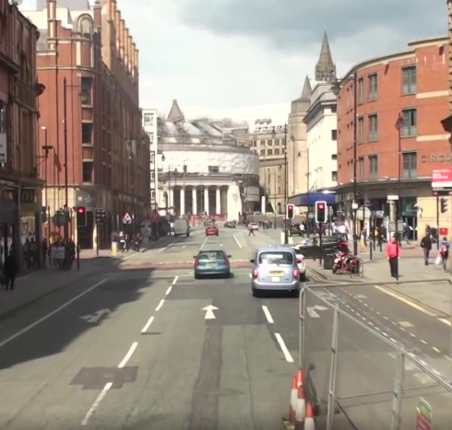
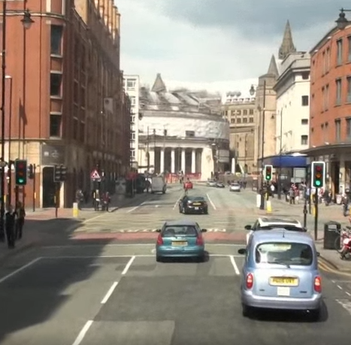
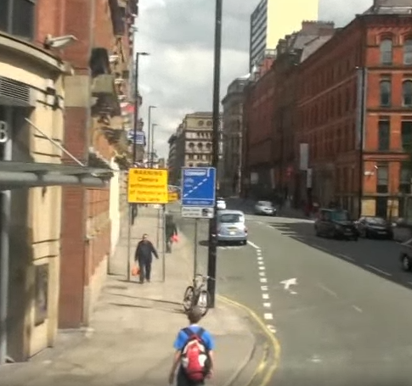

Motivation
Approach 2
  Is patching multiple images and executing them at once efficient than executing them separately?
Single image execution
Merged image execution
Detection
Network
Detection
Network
Result
Result

Slide 15
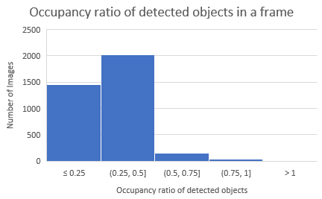
Review
Approach
  Occupancy ratio of detected objects
Detected objects in a frame has less than 50% of the frame in most of the cases.
15

Slide 16
Review
Approach
  Single Execution vs Merged Image execution
Average Execution Time Comparison with YOLOv5
Image Size
1: 384x640
2: 728x640
4: 728x1280
6: 1256x1280
1.49x
1.46x
1.4x
Patched Image has 1.4x faster execution time than single image execution.
16
Notes:
Yolov5
1: 384x640
2: 728x640
4: 728x1280
6: 1256x1280

Slide 17
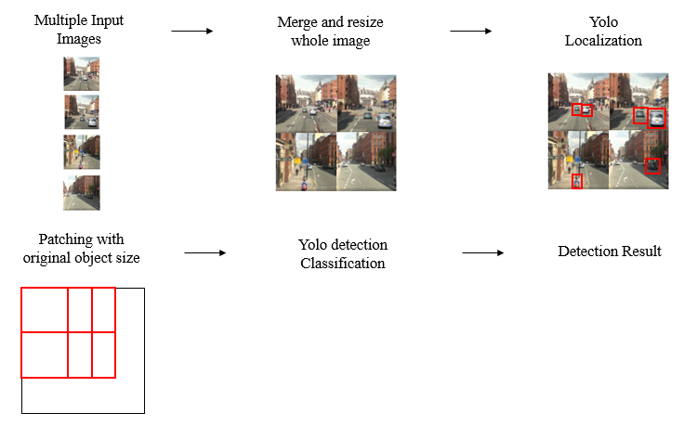
Motivation Experiment
Questions
  Does localization have correlation with image size?
    Execution time and Accuracy
  Does object patching maintain detection accuracy while minimizing execution time?
17

