Slide 1
MU-MIMO
Satellite Precoding Techniques

Slide 2
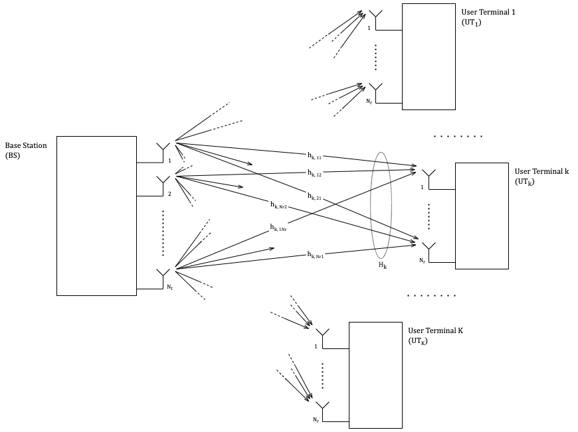
Introduction

Slide 3


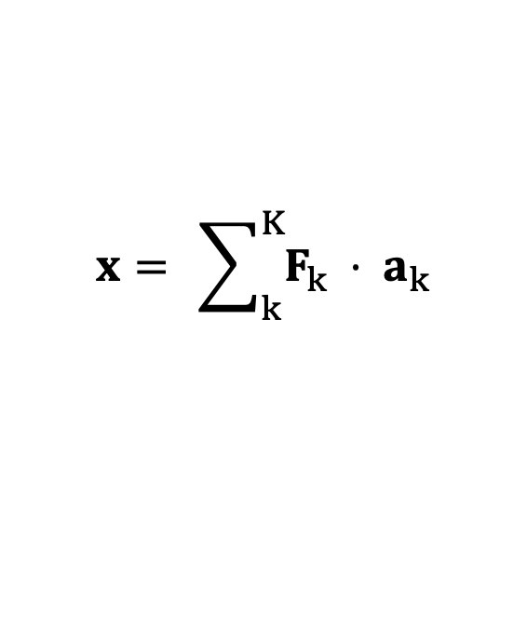

System Model
The transmitted signal $x$ is constructed at the BS by precoding the data streams:
$$x= \sum_{k}^{K}{F_{k} ⋅ a_{k}}$$
The received signal $y_{k}$ at UT_{k} can be written in terms of the transmitted signal $x$ as:
$$y_{k}= H_{k}⋅x + n_{k}$$
The received signal $y_{k}$ at UT_{k} is combined to obtain the scaled decision variable $z_{k}$:
$$z_{k}= G_{k}⋅y_{k}$$
$$z= GHF⋅a +G n$$

Slide 4
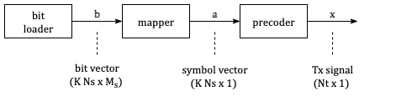
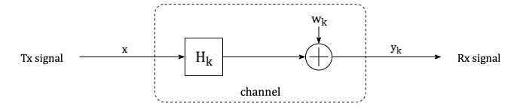
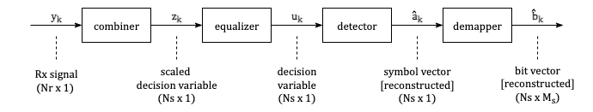
System Model

Slide 5
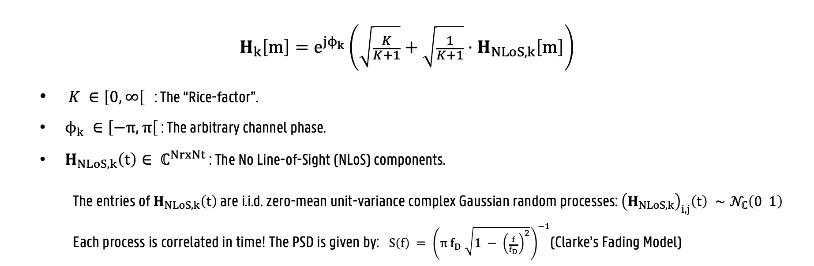
Satellite Channel Model
$$H_{k}\left[m\right]=e^{jϕ_{k}}\left(\sqrt{\frac{K}{K+1}}+\sqrt{\frac{1}{K+1}}⋅H_{NLoS, k}\left[m\right]\right)$$
$K ∈\left[0, ∞\right[$ : The “Rice-factor”.
$ϕ_{k} ∈\left[−π, π\right[$ : The arbitrary channel phase.
$H_{NLoS, k}\left(t\right)∈ ℂ^{NrxNt}$ : The No Line-of-Sight (NLoS) components.
The entries of $H_{NLoS, k}\left(t\right)$ are i.i.d. zero-mean unit-variance complex Gaussian random processes: ${\left(H_{NLoS, k}\right)}_{i,j}\left(t\right) ∼𝒩_{ℂ}\left(0 1\right)$
Each process is correlated in time! The PSD is given by: $S\left(f\right) = {\left(π{ f}_{D} \sqrt{1 − {\left(\frac{f}{f_{D}}\right)}^{2}}\right)}^{−1}$(Clarke’s Fading Model)
Notes:
The Rice factor K quantifies the strength of the deterministic LoS component relative to the scattered multipath.
f_D is the Doppler Frequency limit.

Slide 6
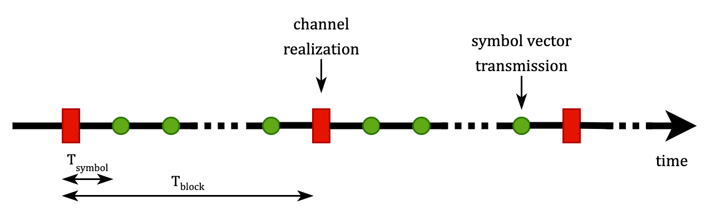
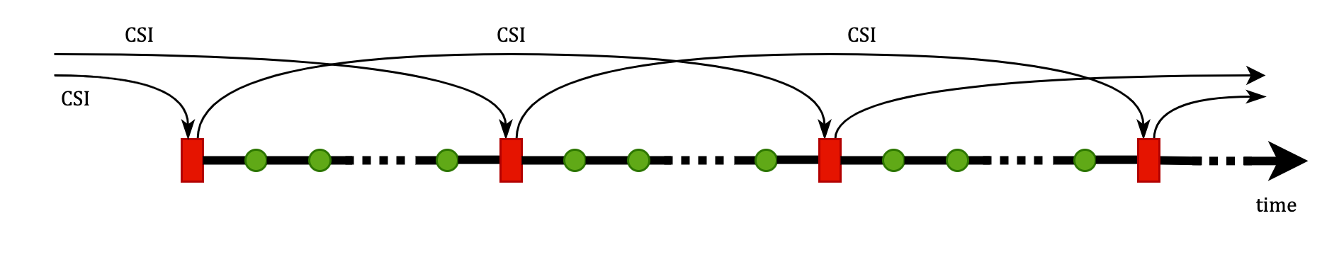
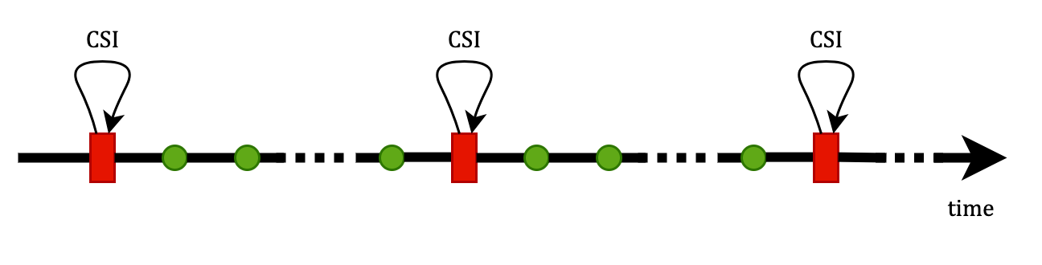
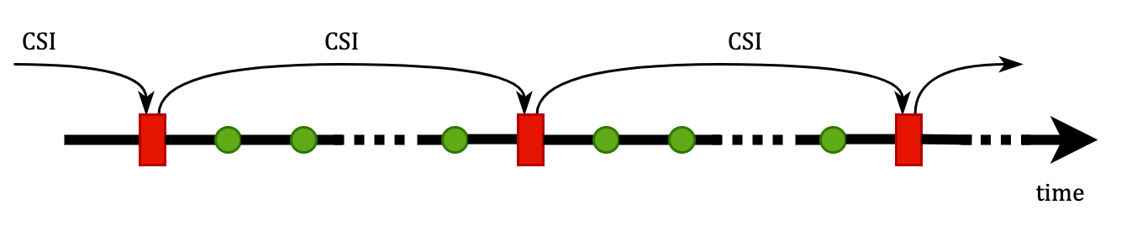
Satellite Channel Model
Outdated CSI
Notes:
T_RTT: the round-trip time. This is how long it takes for a signal to go from BS to UT and back (twice the propagation delay).
T_c: the coherence time. The channel is assumed to be constant during this period.
T_block: the block period. Also, the sample period T_sample of the channel realization. Tb <= Tc, so the channel is assumed to be constant during the transmission of one block (block fading).
T_symbol: the symbol period.
CSI_delay: the delay on the CSI expressed in block periods.

Slide 7
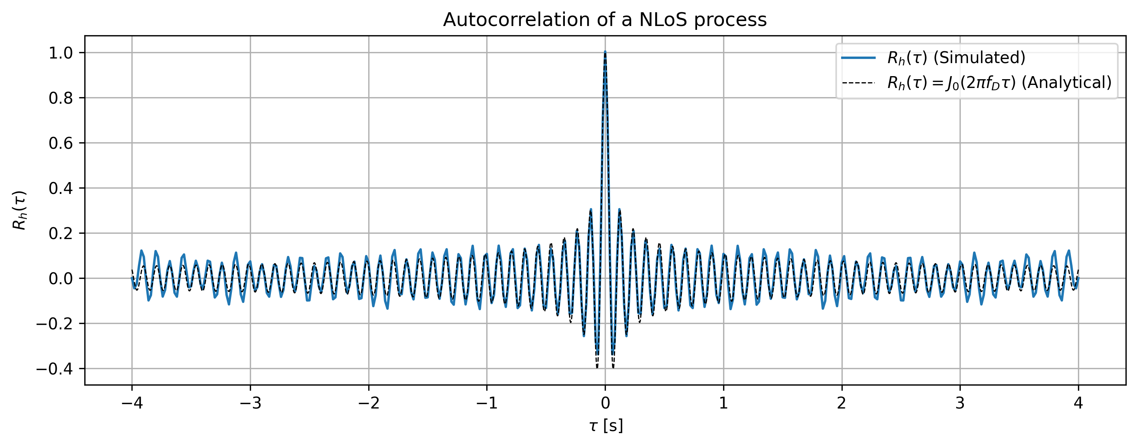
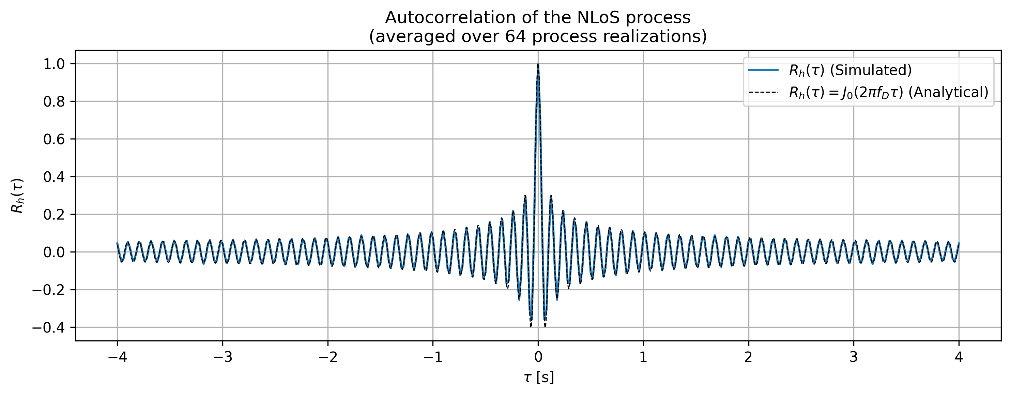
Satellite Channel Model
Time Correlation

Slide 8
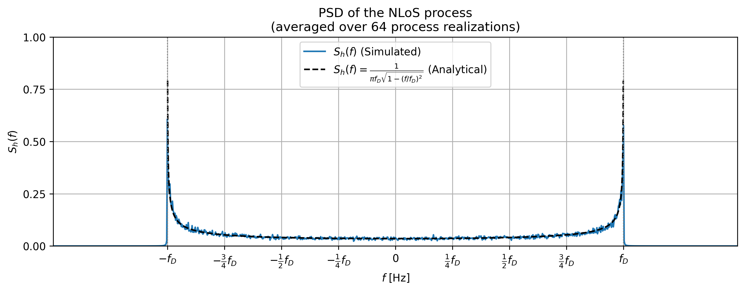
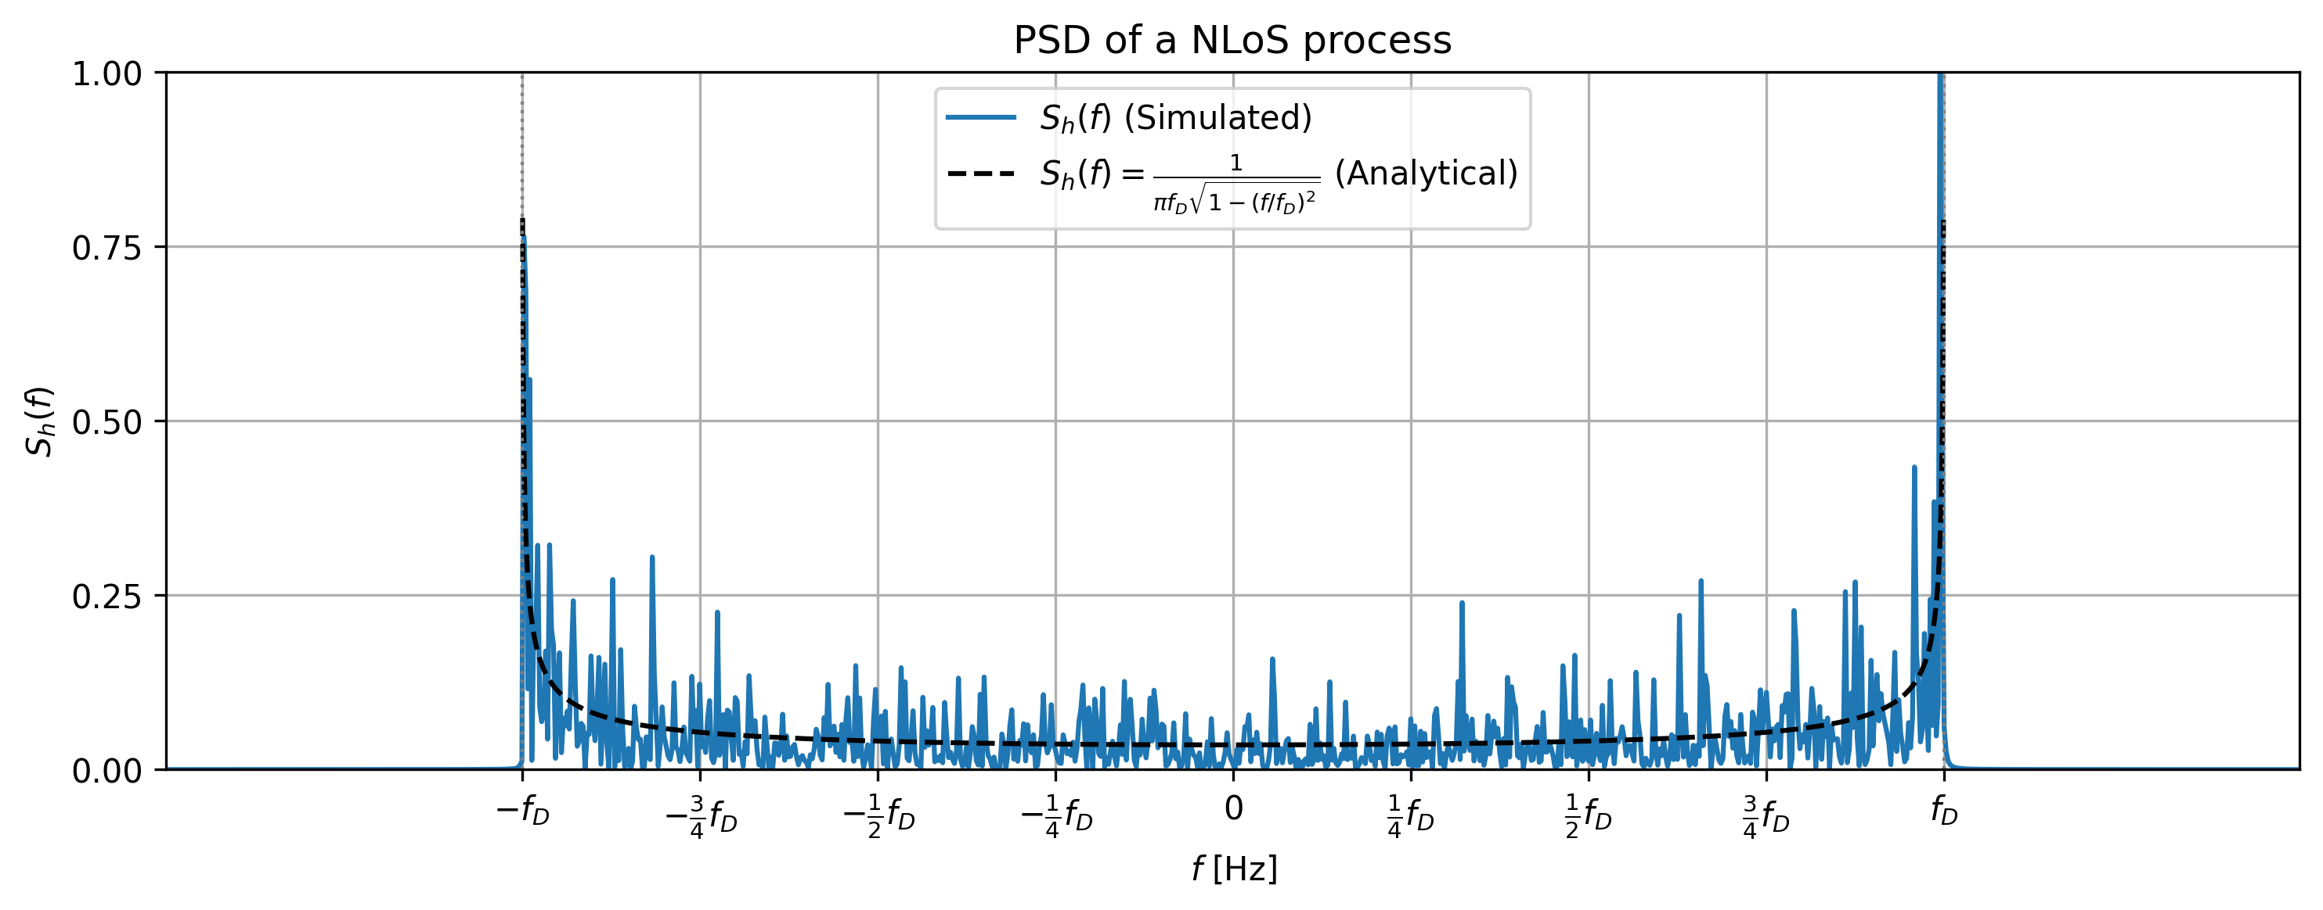
Satellite Channel Model
Time Correlation

Slide 10
Wannes Baes
Supervisors: Prof. Dr. Ir. Nele Noels, Dr. Ir. Rodrigo Moreas
Universiteit Gent
@ugent
@ugent
Ghent University
wannes.baes@ugent.be
youtube.com/ugent
www.ugent.be

Slide 11




Channel Estimation
Rayleigh Fading Channel
pilots
feedback ($H_{k}$)
feedforward ($W_{k}$)
Compute Compound Precoder $F$ & Compound Combiner $W$
Estimate Channel $H_{k}$

Slide 12




Channel Estimation
Proposal
1. Initial Channel Estimation
pilots
feedback ($H_{k}$)
feedforward ($W_{k}$)
Estimate Channel $H_{k}$
Compute Compound Precoder $F$ & Compound Combiner $W$

Slide 13
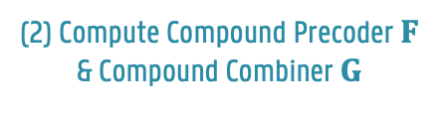

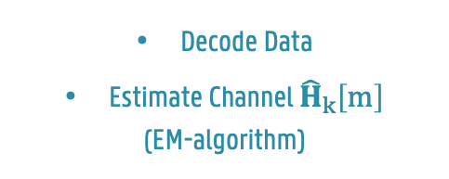

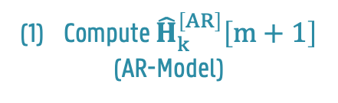
Channel Estimation
Proposal
2. Data Transmission
pilots + data
feedback: ${\hat{H}}_{k}\left[m\right]$
feedforward: $G_{k}$
Decode Data
Estimate Channel ${\hat{H}}_{k}\left[m\right]$
(EM-algorithm)
Compute ${\hat{H}}_{k}^{\left[AR\right]}\left[m+1\right]$
(AR-Model)
(2) Compute Compound Precoder $F$ & Compound Combiner $G$

