Slide 1
MU-MIMO
Satellite Precoding Techniques

Slide 2
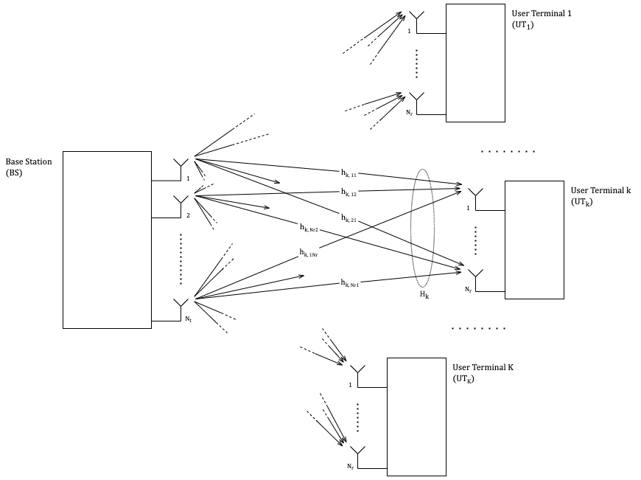
Introduction

Slide 3
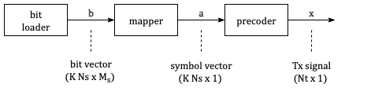
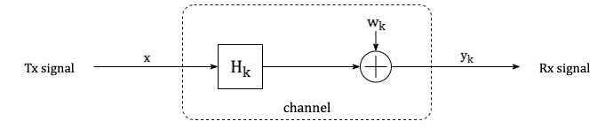
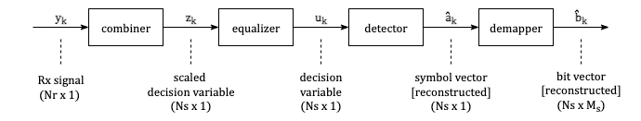
System Model

Slide 4


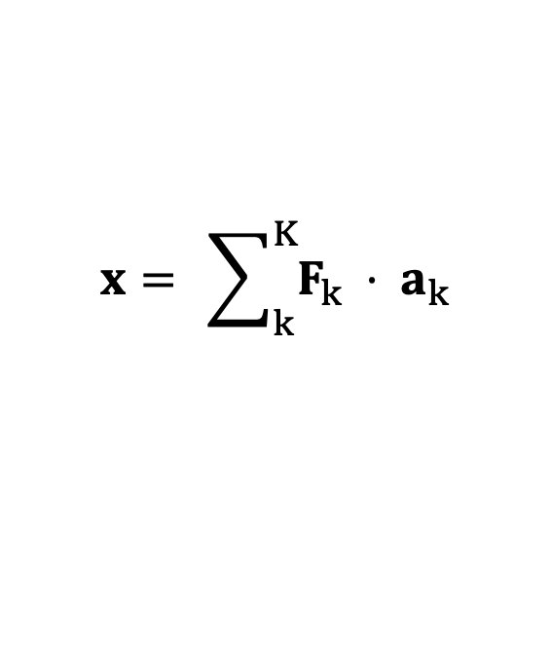

System Model
The transmitted signal $x$ is constructed at the BS by precoding the data streams:
$$x= \sum_{k}^{K}{F_{k} ⋅ a_{k}}$$
The received signal $y_{k}$ at UT_{k} can be written in terms of the transmitted signal $x$ as:
$$y_{k}= H_{k}⋅x + n_{k}$$
The received signal $y_{k}$ at UT_{k} is combined to obtain the scaled decision variable $z_{k}$:
$$z_{k}= G_{k}⋅y_{k}$$
$$z= GHF⋅a +G n$$

Slide 5
Satellite
Channel Model

Slide 6
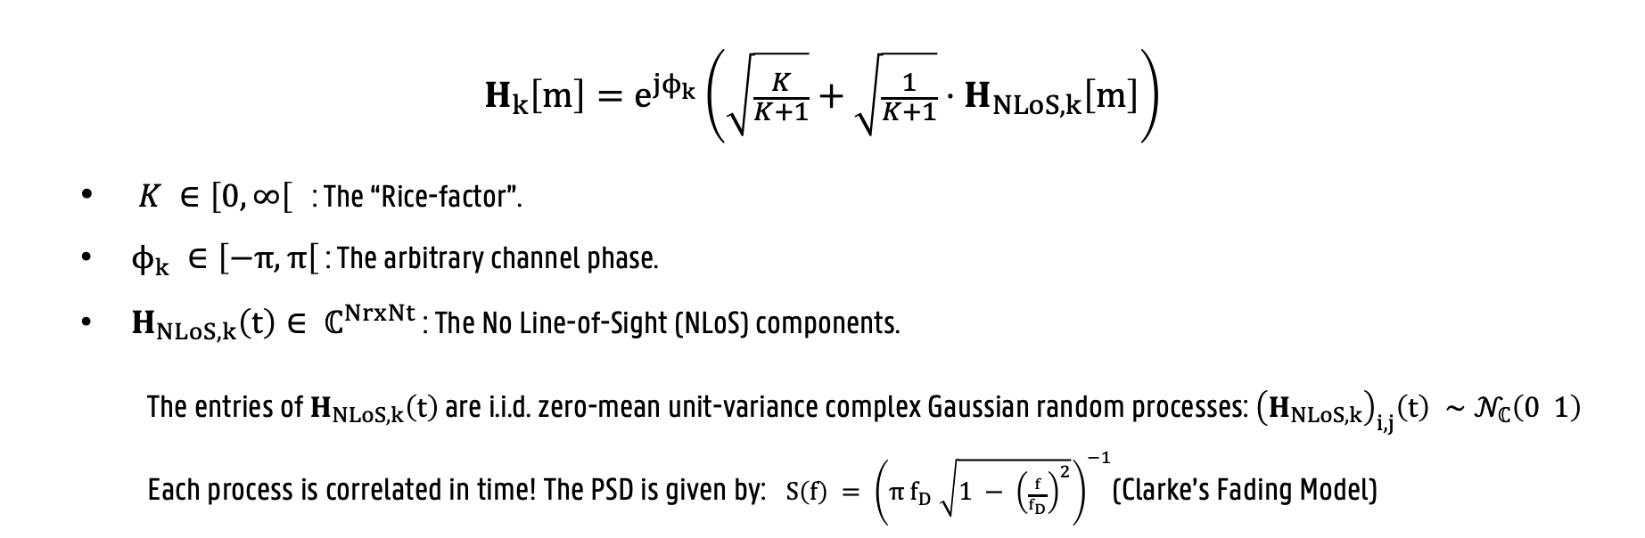
Satellite Channel Model
$$H_{k}\left[m\right]=e^{jϕ_{k}}\left(\sqrt{\frac{K}{K+1}}+\sqrt{\frac{1}{K+1}}⋅H_{NLoS, k}\left[m\right]\right)$$
$K ∈\left[0, ∞\right[$ : The “Rice-factor”.
$ϕ_{k} ∈\left[−π, π\right[$ : The arbitrary channel phase.
$H_{NLoS, k}\left(t\right)∈ ℂ^{NrxNt}$ : The No Line-of-Sight (NLoS) components.
The entries of $H_{NLoS, k}\left(t\right)$ are i.i.d. zero-mean unit-variance complex Gaussian random processes: ${\left(H_{NLoS, k}\right)}_{i,j}\left(t\right) ∼𝒩_{ℂ}\left(0 1\right)$
Each process is correlated in time! The PSD is given by: $S\left(f\right) = {\left(π{ f}_{D} \sqrt{1 − {\left(\frac{f}{f_{D}}\right)}^{2}}\right)}^{−1}$(Clarke’s Fading Model)
Notes:
The Rice factor K quantifies the strength of the deterministic LoS component relative to the scattered multipath.
f_D is the Doppler Frequency limit.

Slide 7
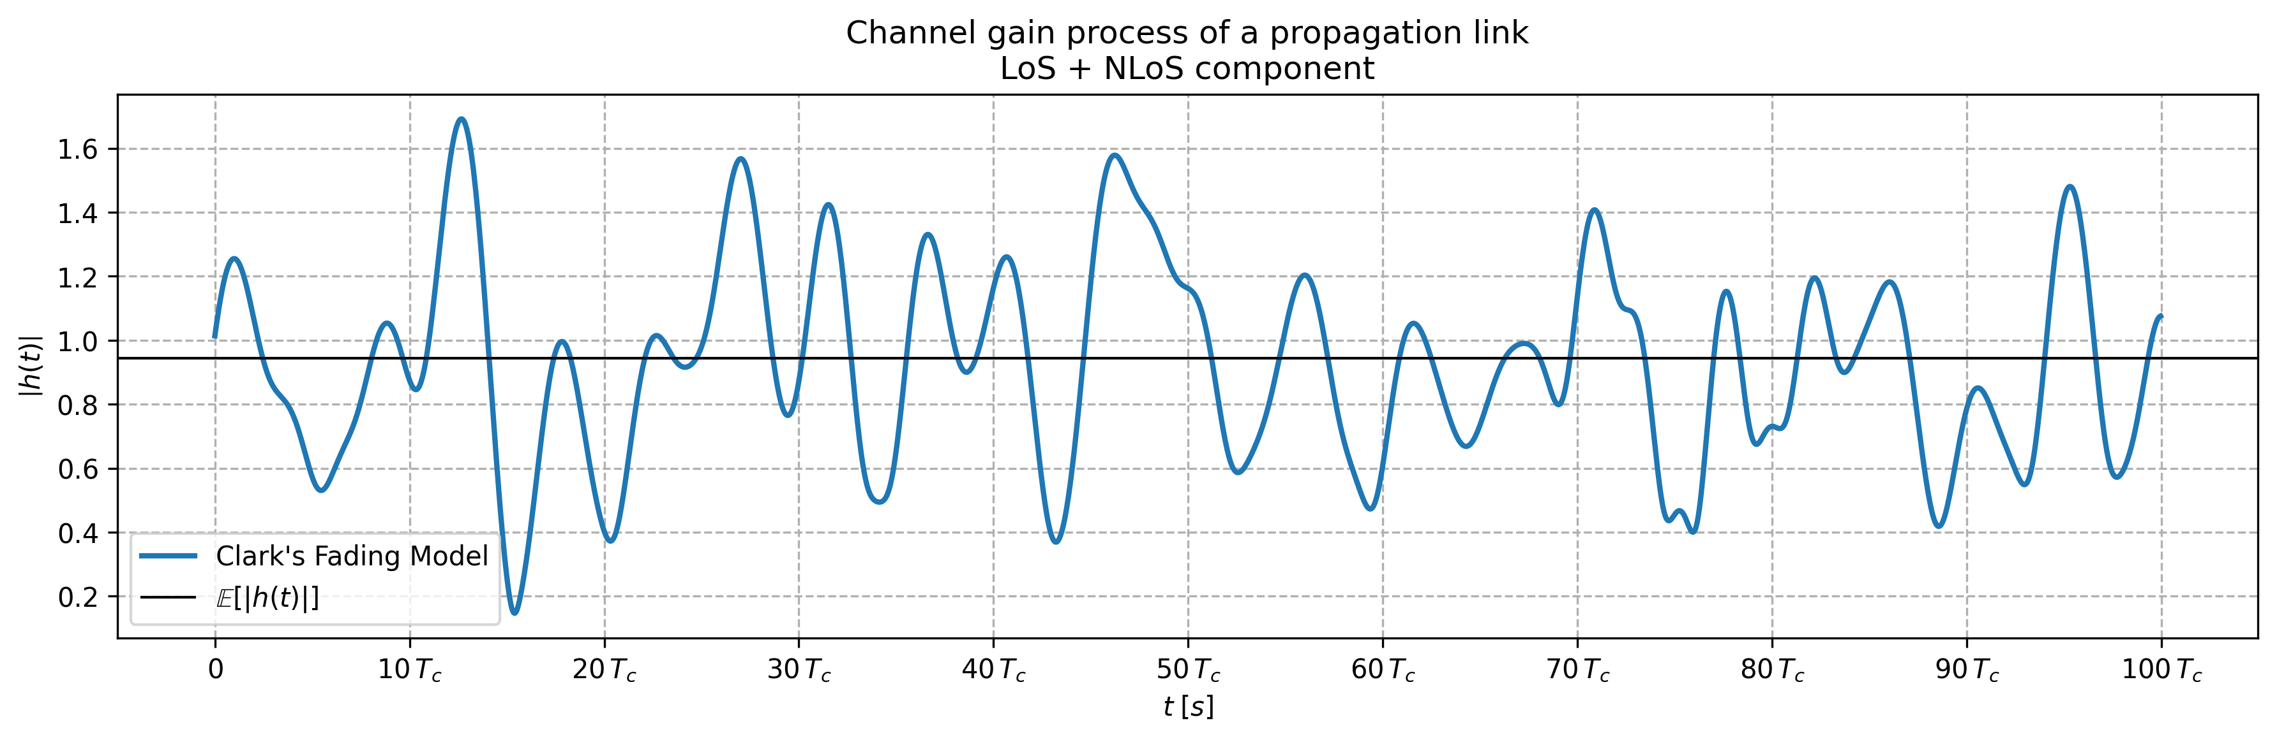
Satellite Channel Model
Time Correlation

Slide 8
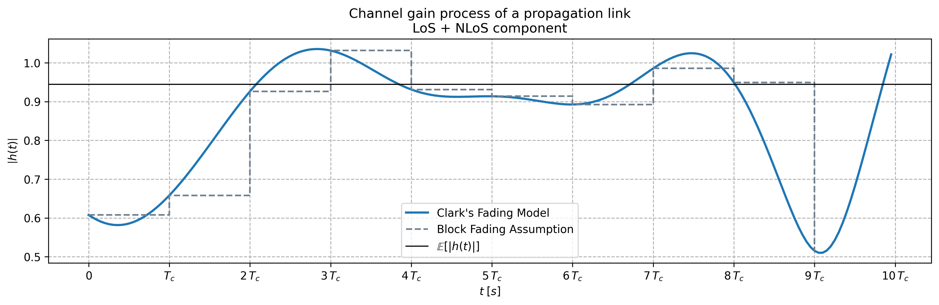
Satellite Channel Model
Time Correlation

Slide 9
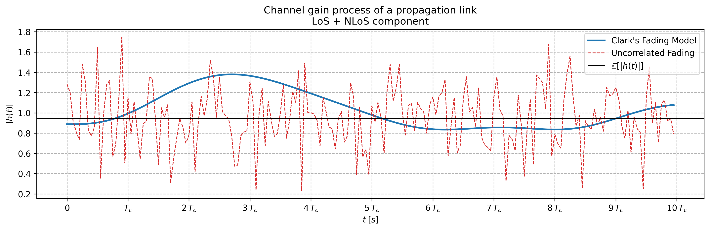
Satellite Channel Model
Time Correlation

Slide 10
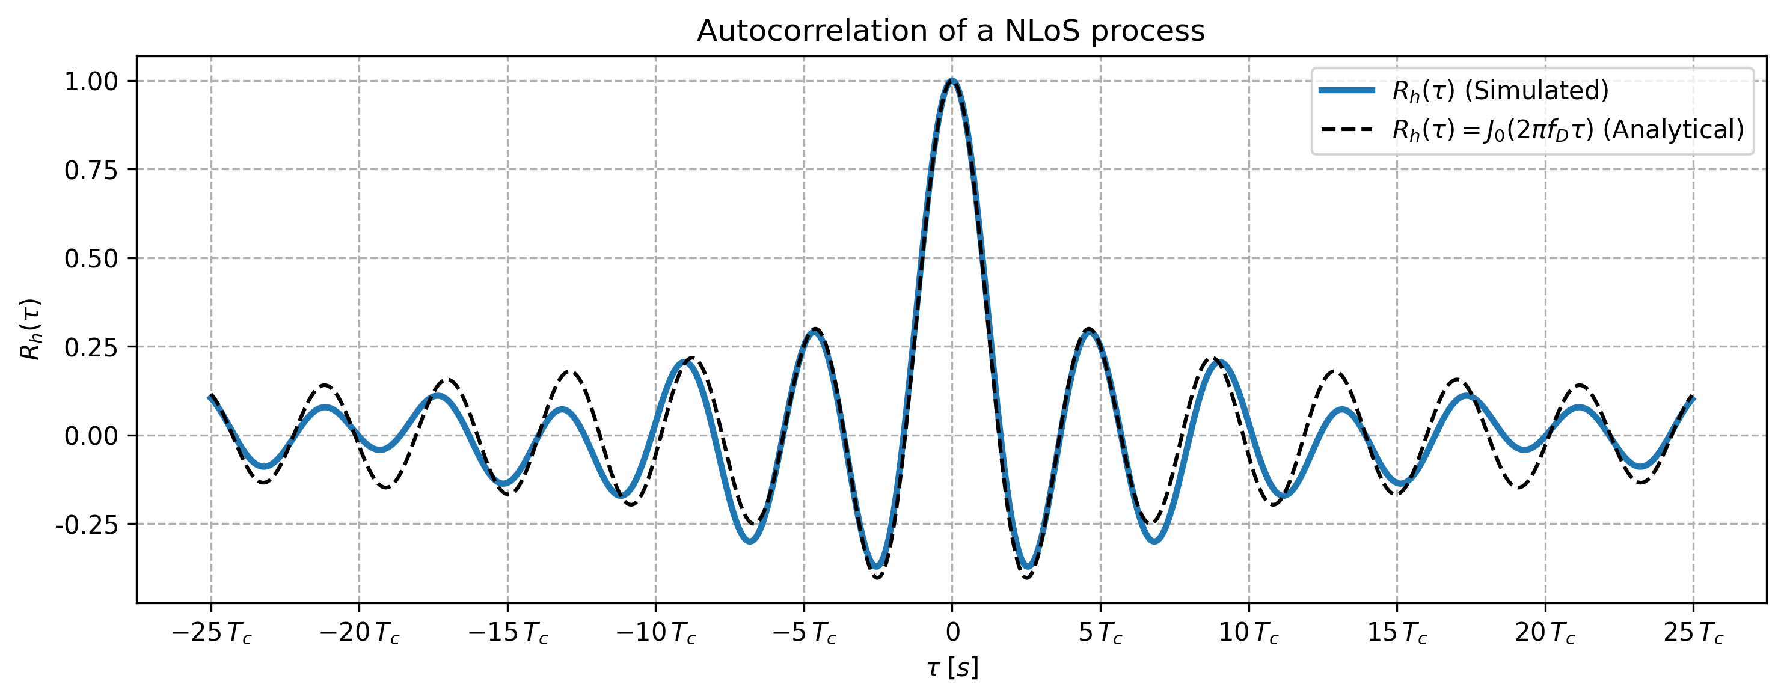
Satellite Channel Model
Time Correlation – autocorrelation of the NLoS component

Slide 11
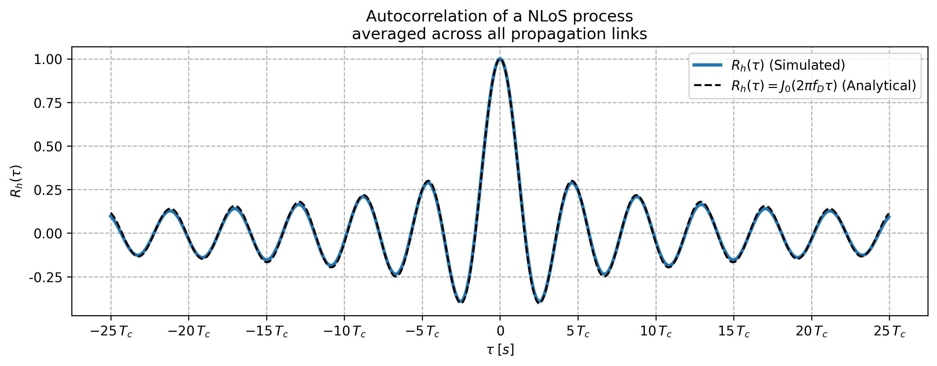
Satellite Channel Model
Time Correlation – autocorrelation of the NLoS component

Slide 12
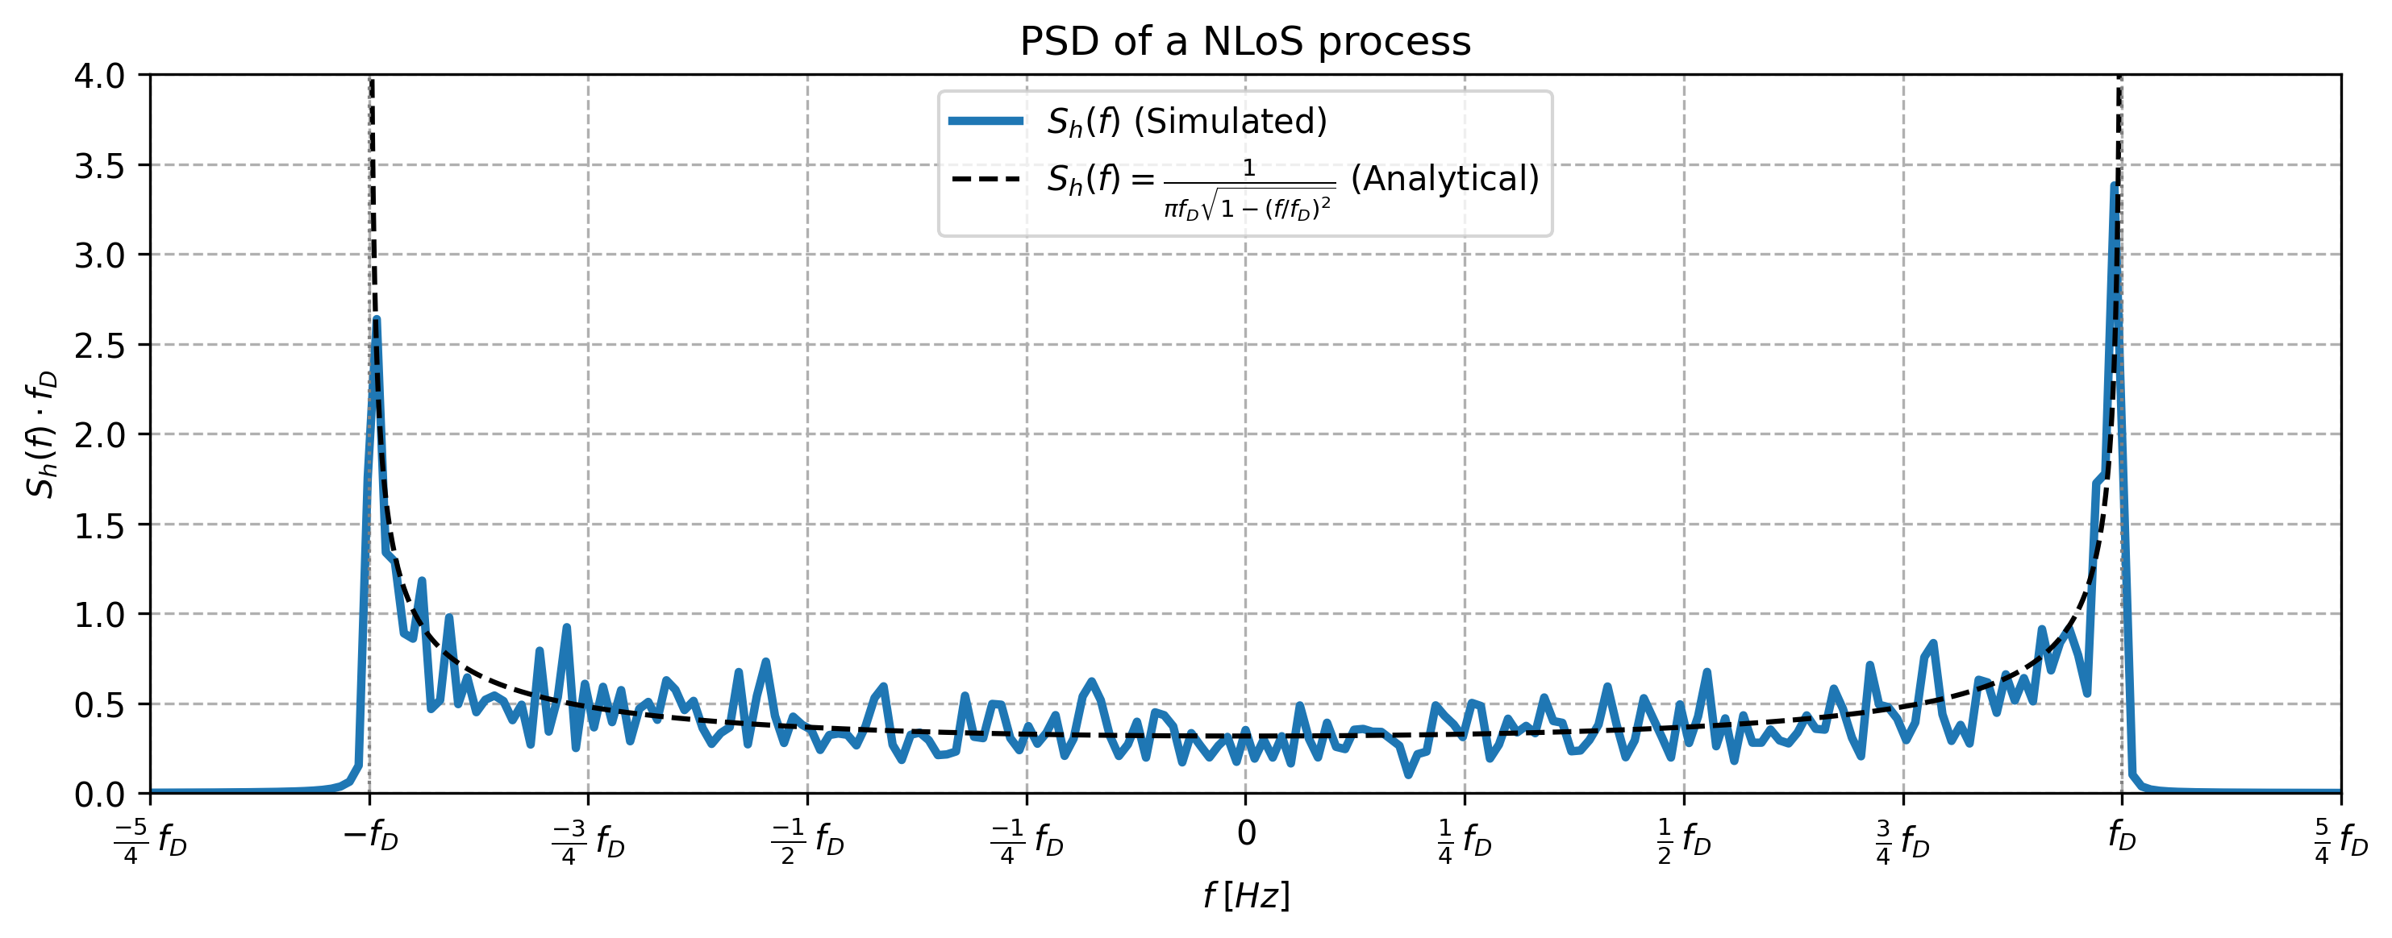
Satellite Channel Model
Time Correlation – PSD of the NLoS component

Slide 13
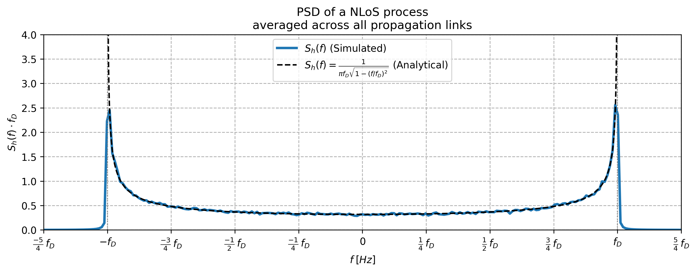
Satellite Channel Model
Time Correlation – PSD of the NLoS component

Slide 14
Precoding Techniques

Slide 15
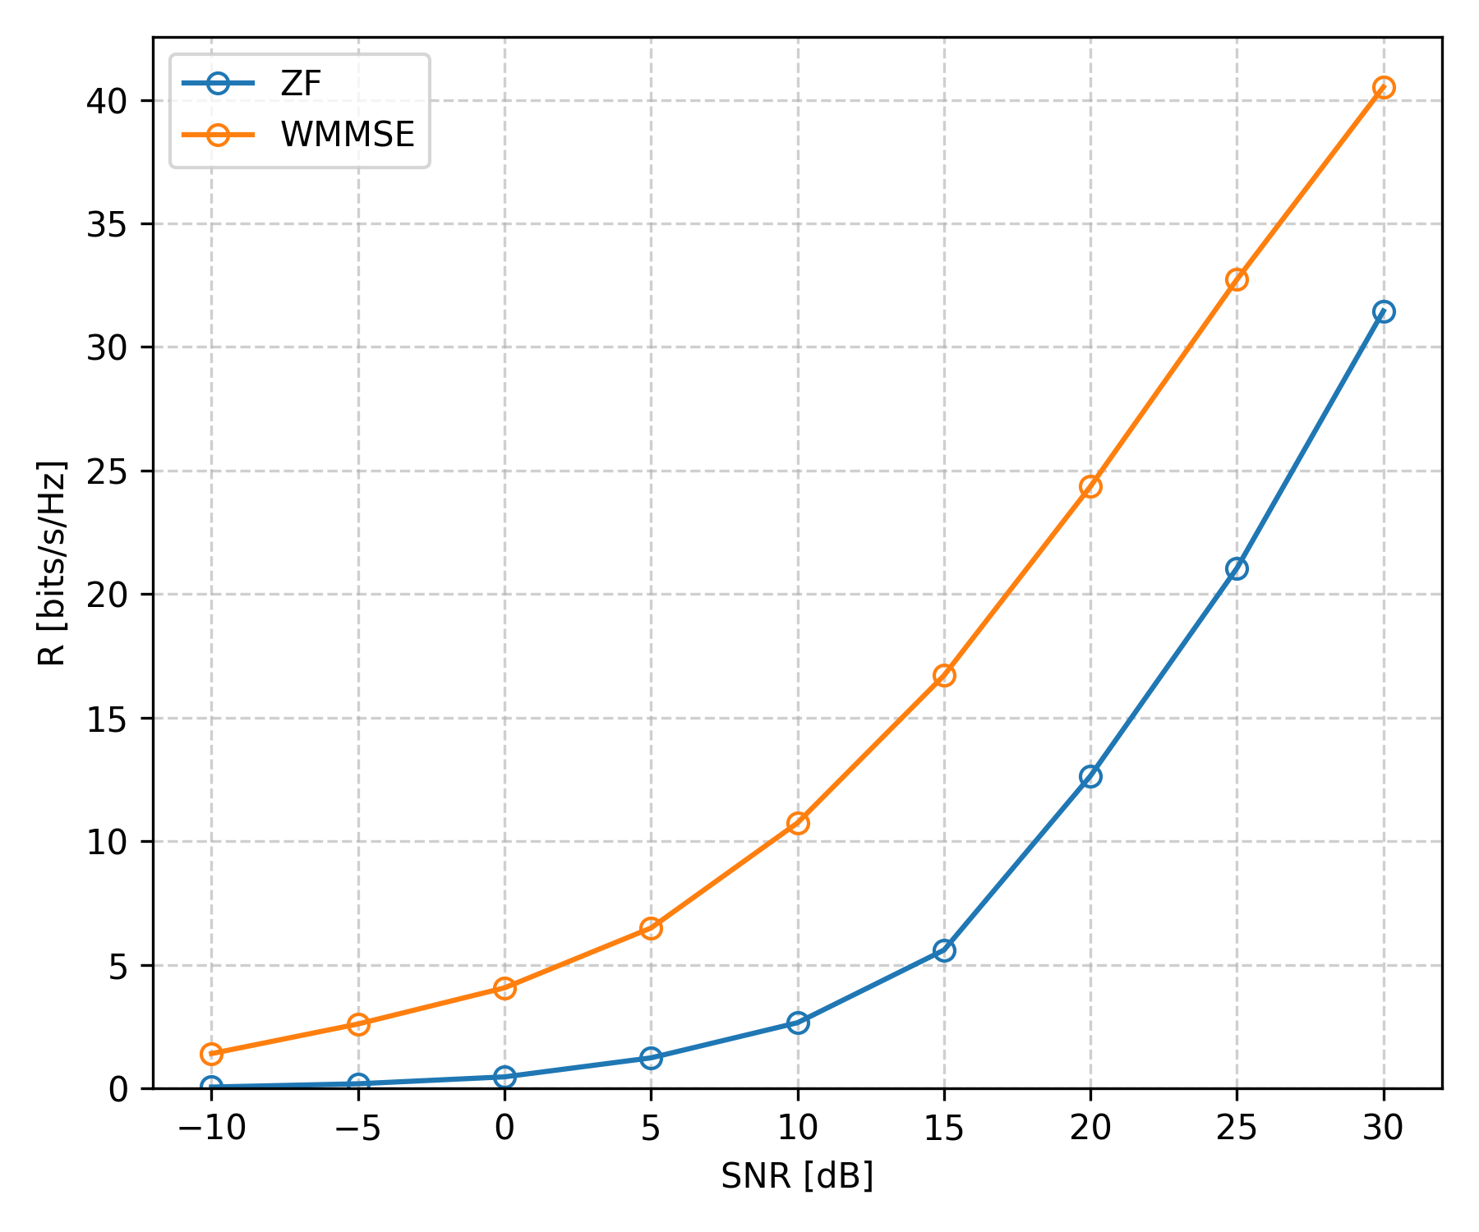
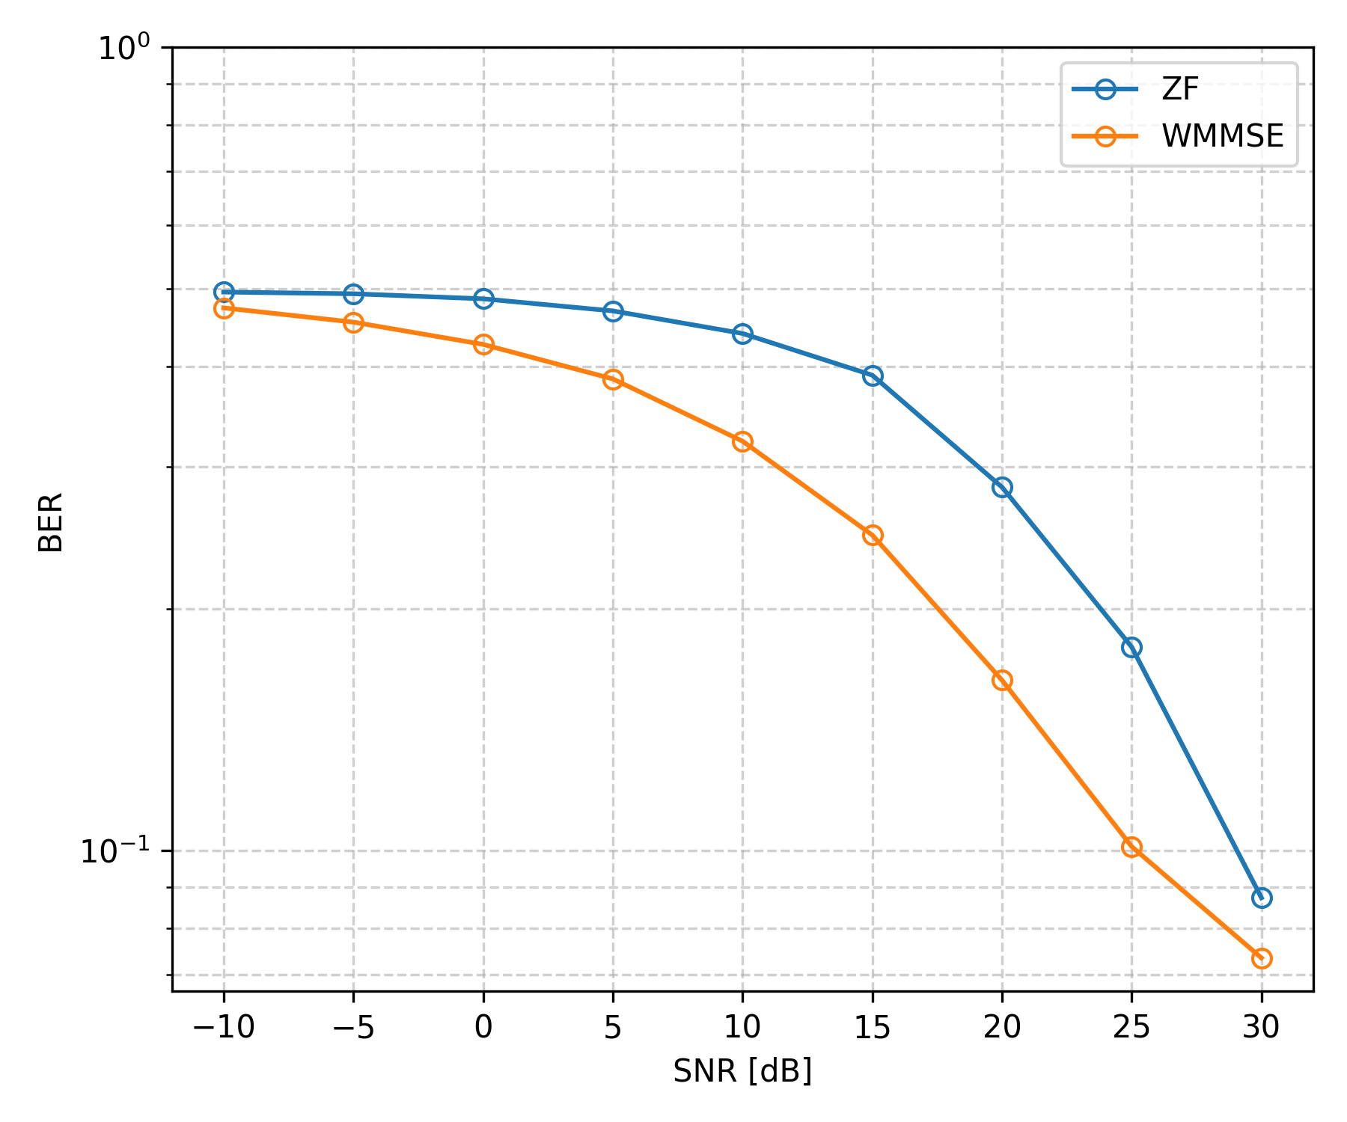
Performance
Fixed Bit Loader (16-QAM), Fully Loaded System (4 UTs)
Notes:
sys_ref_numbers = ["2_sl_0.1.5.3", "2_sl_0.4.5.3"]

Slide 16
Performance with
Outdated CSI

Slide 17
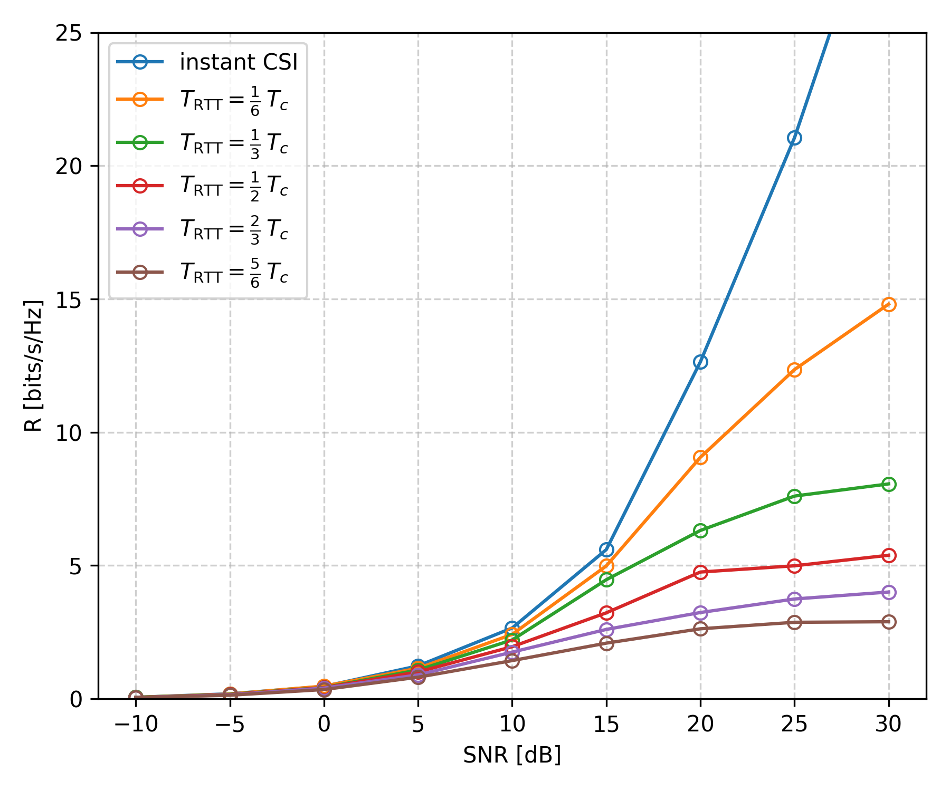
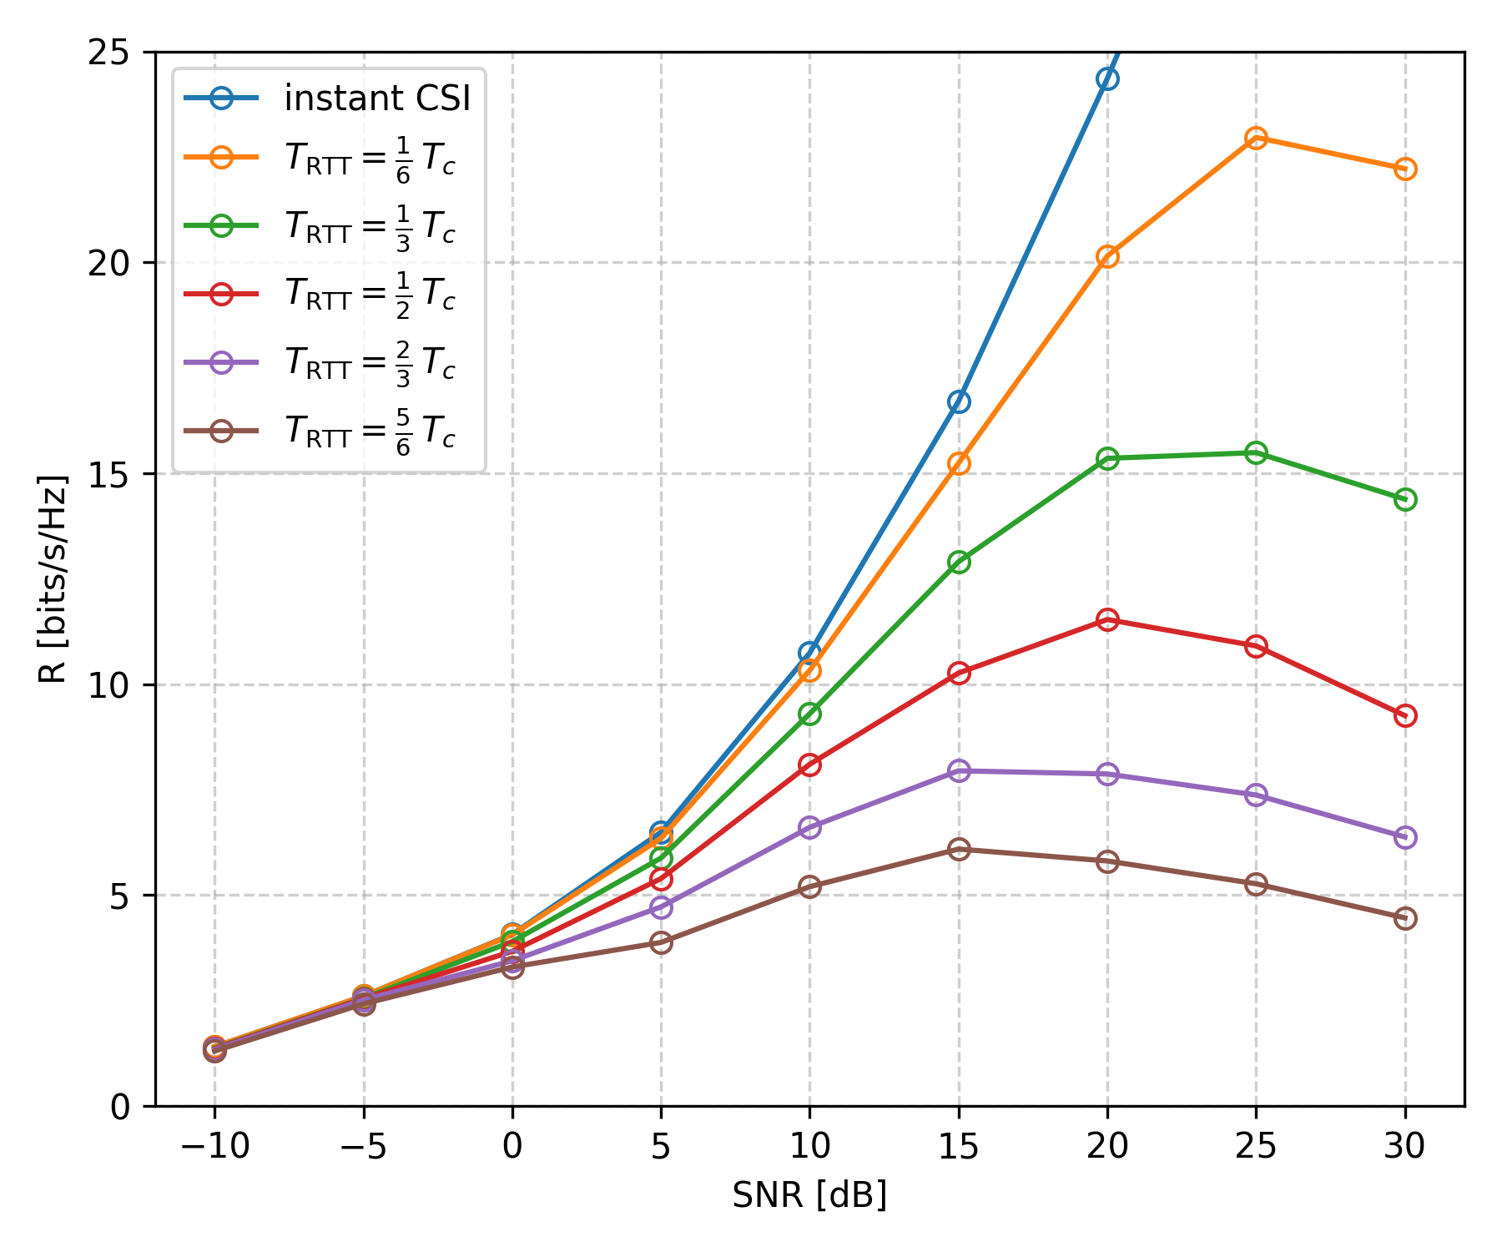
Impact of Outdated CSI
ZF
WMMSE
Notes:
ZF: sys_ref_numbers = ["2_sl_0.1.5.3", "2_sl_1.1.5.3", "2_sl_2.1.5.3", "2_sl_3.1.5.3", "2_sl_4.1.5.3", "2_sl_5.1.5.3"] WMMSE: sys_ref_numbers = ["2_sl_0.4.5.3", "2_sl_1.4.5.3", "2_sl_2.4.5.3", "2_sl_3.4.5.3", "2_sl_4.4.5.3", "2_sl_5.4.5.3"]

Slide 18
Performance with
Outdated CSI & Channel Prediction

Slide 19
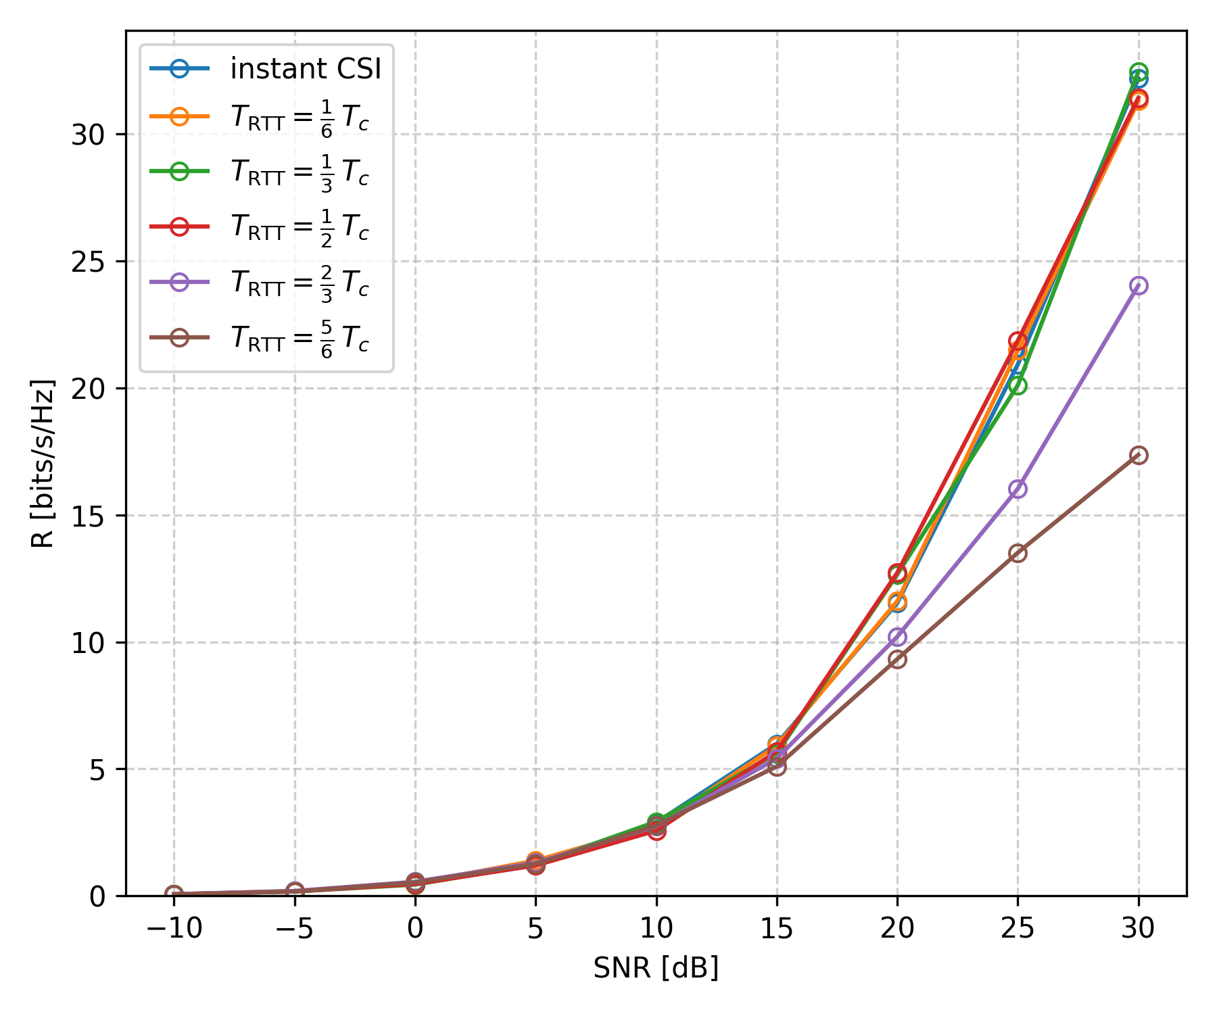
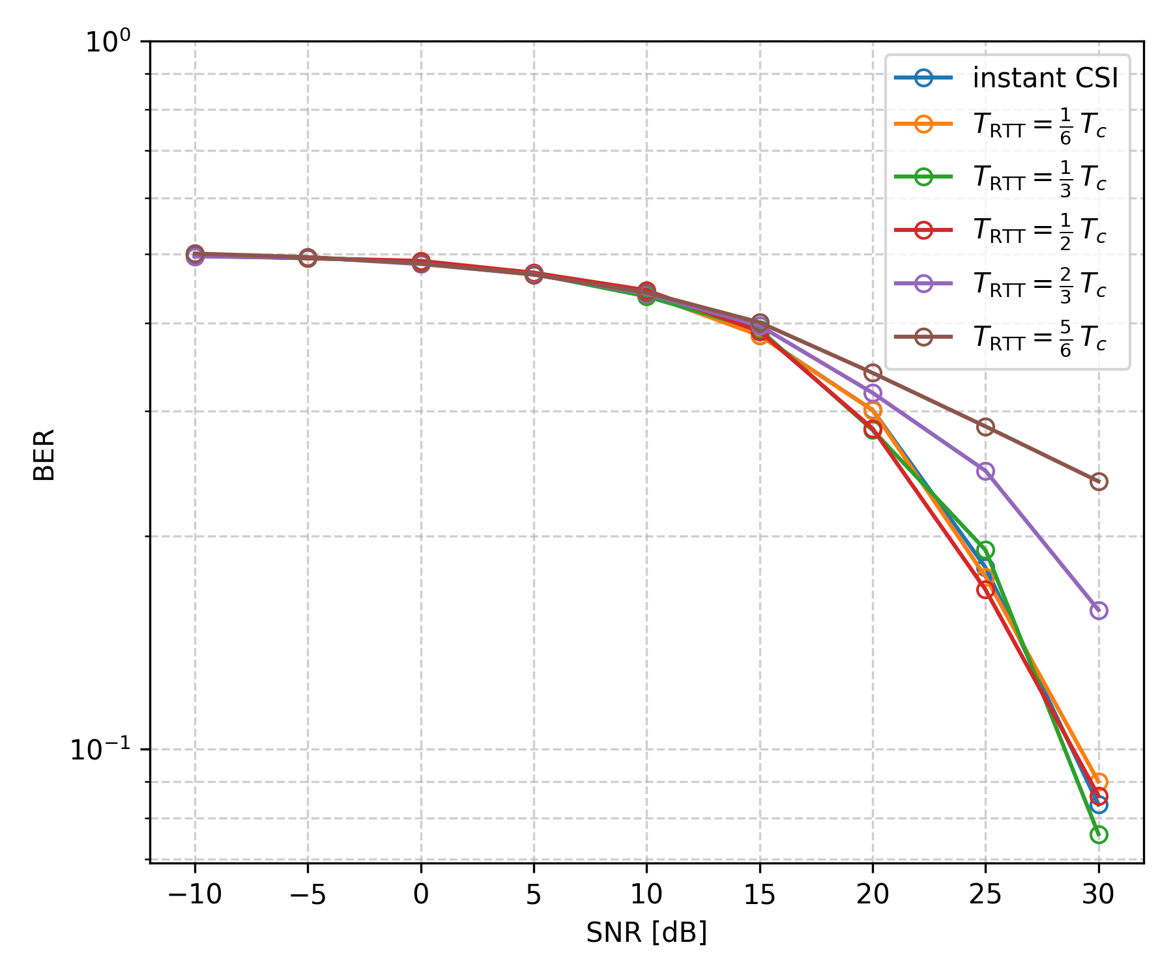
Impact of Outdated CSI & Channel Prediction (ZF)
Notes:
sys_ref_numbers = ["3_sl_0.1.5.3", "3_sl_1.1.5.3", "3_sl_2.1.5.3", "3_sl_3.1.5.3", "3_sl_4.1.5.3", "3_sl_5.1.5.3"]

Slide 20
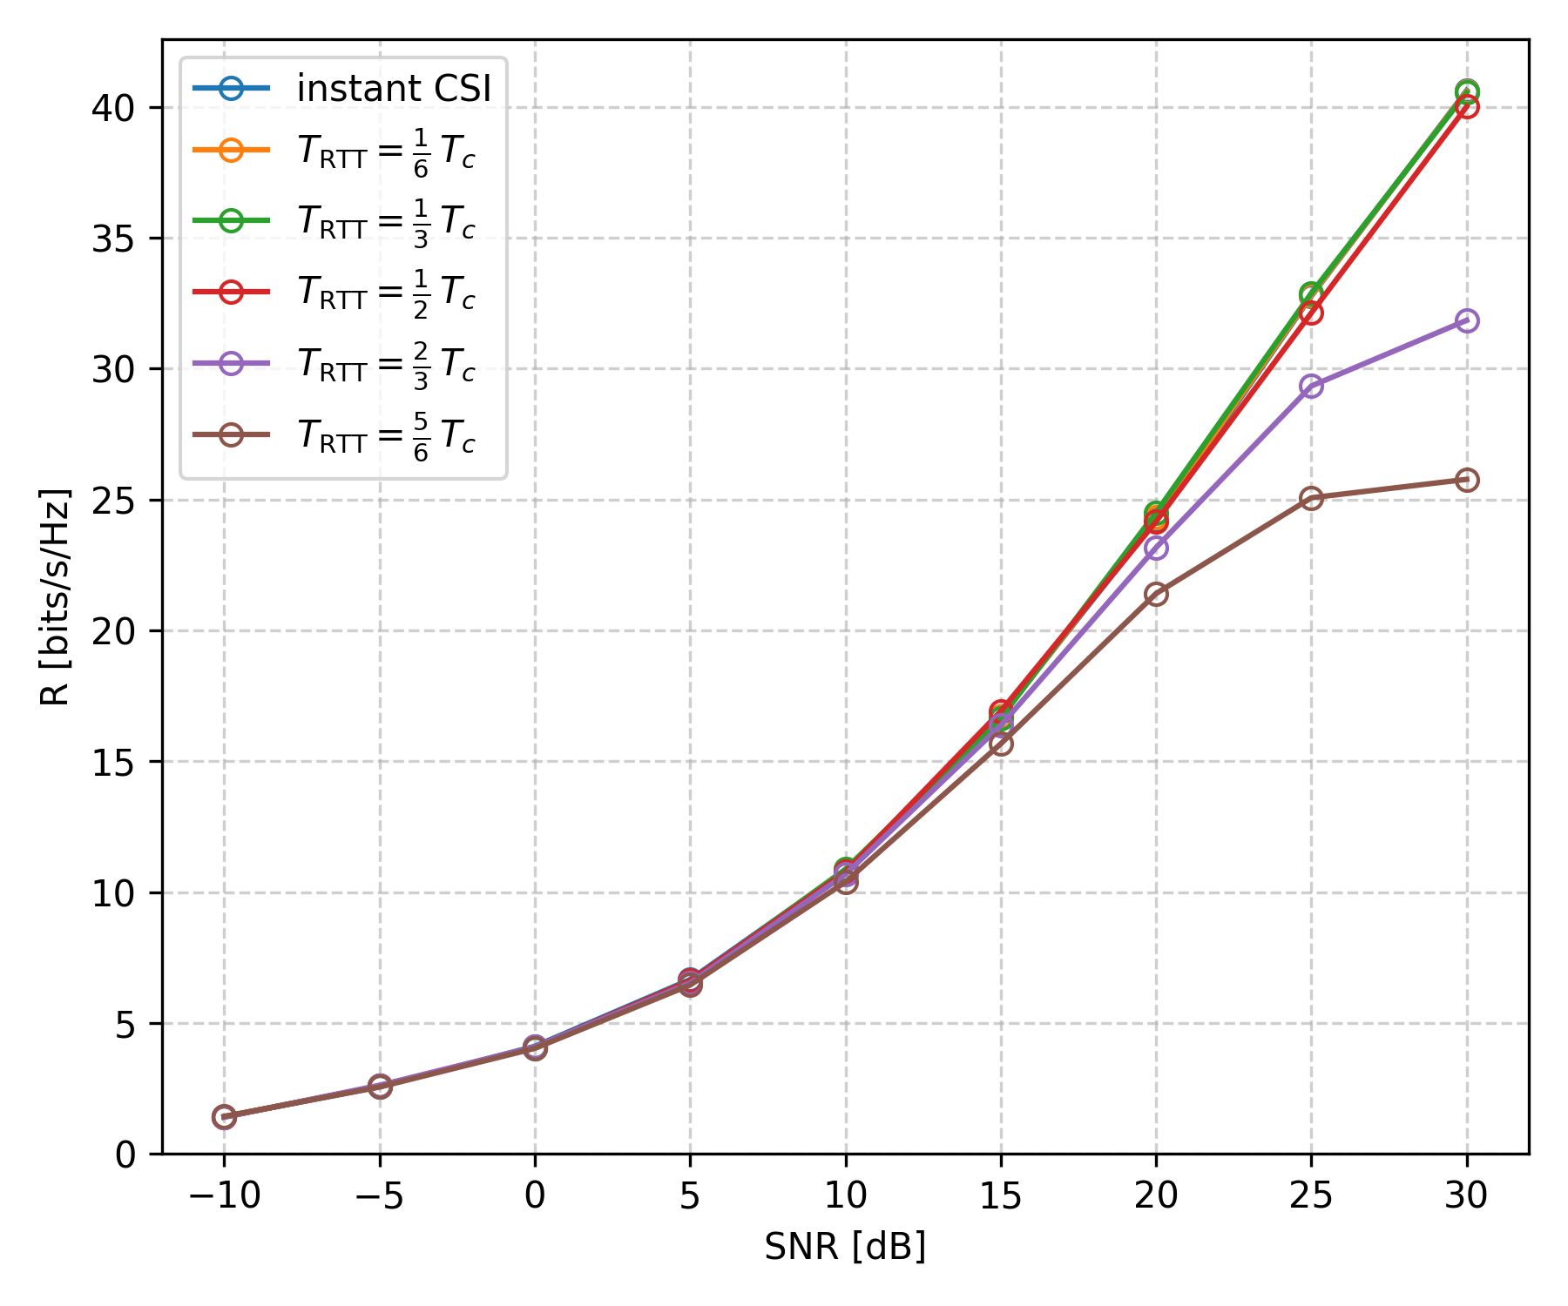
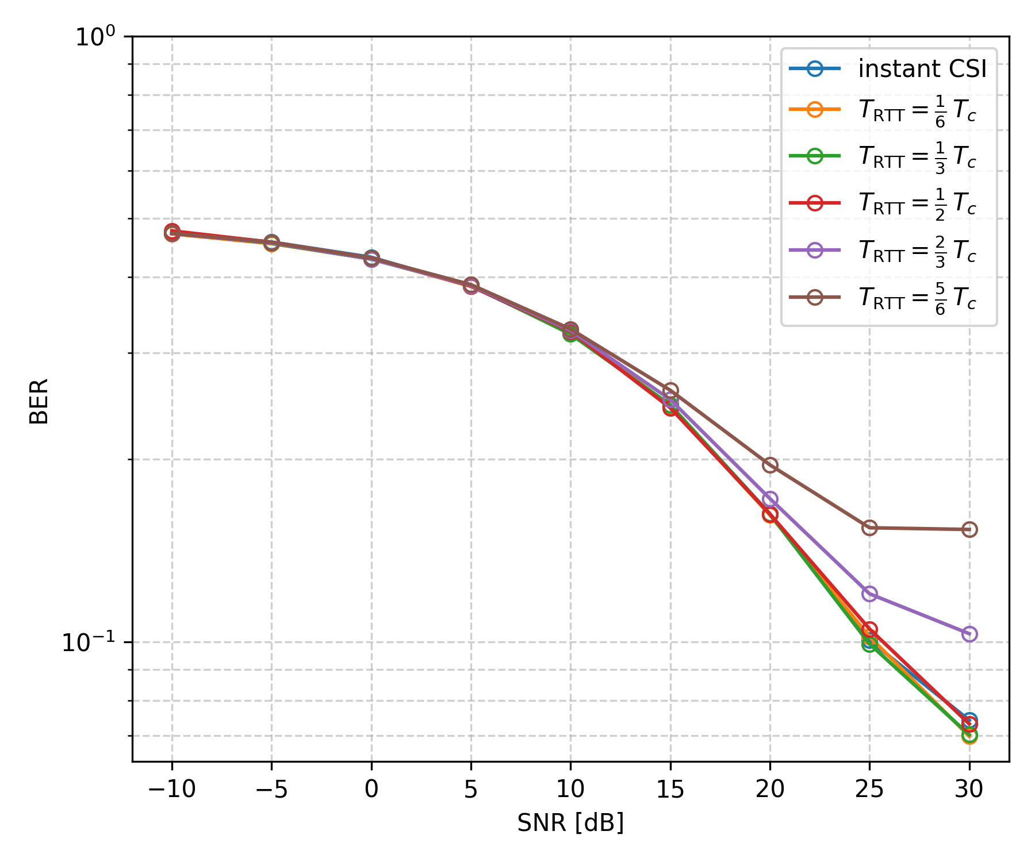
Impact of Outdated CSI & Channel Prediction (WMMSE)
Notes:
sys_ref_numbers = ["3_sl_0.4.5.3", "3_sl_1.4.5.3", "3_sl_2.4.5.3", "3_sl_3.4.5.3", "3_sl_4.4.5.3", "3_sl_5.4.5.3"]

Slide 21
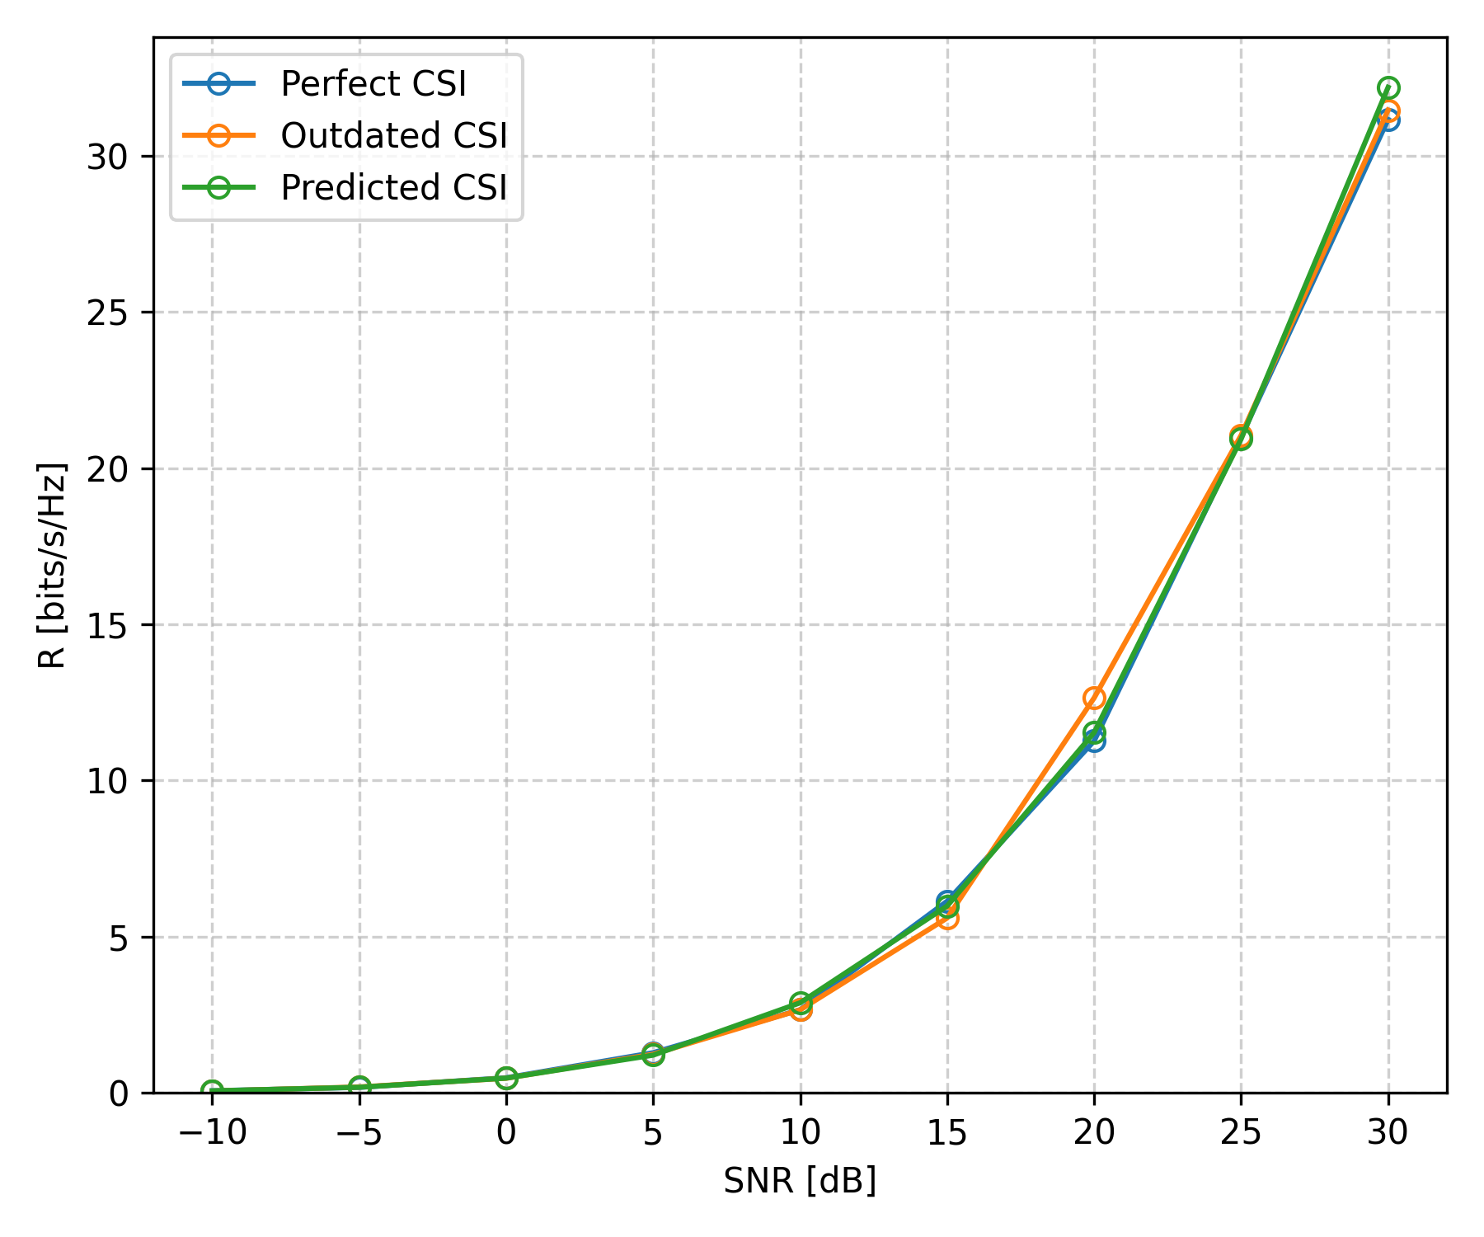
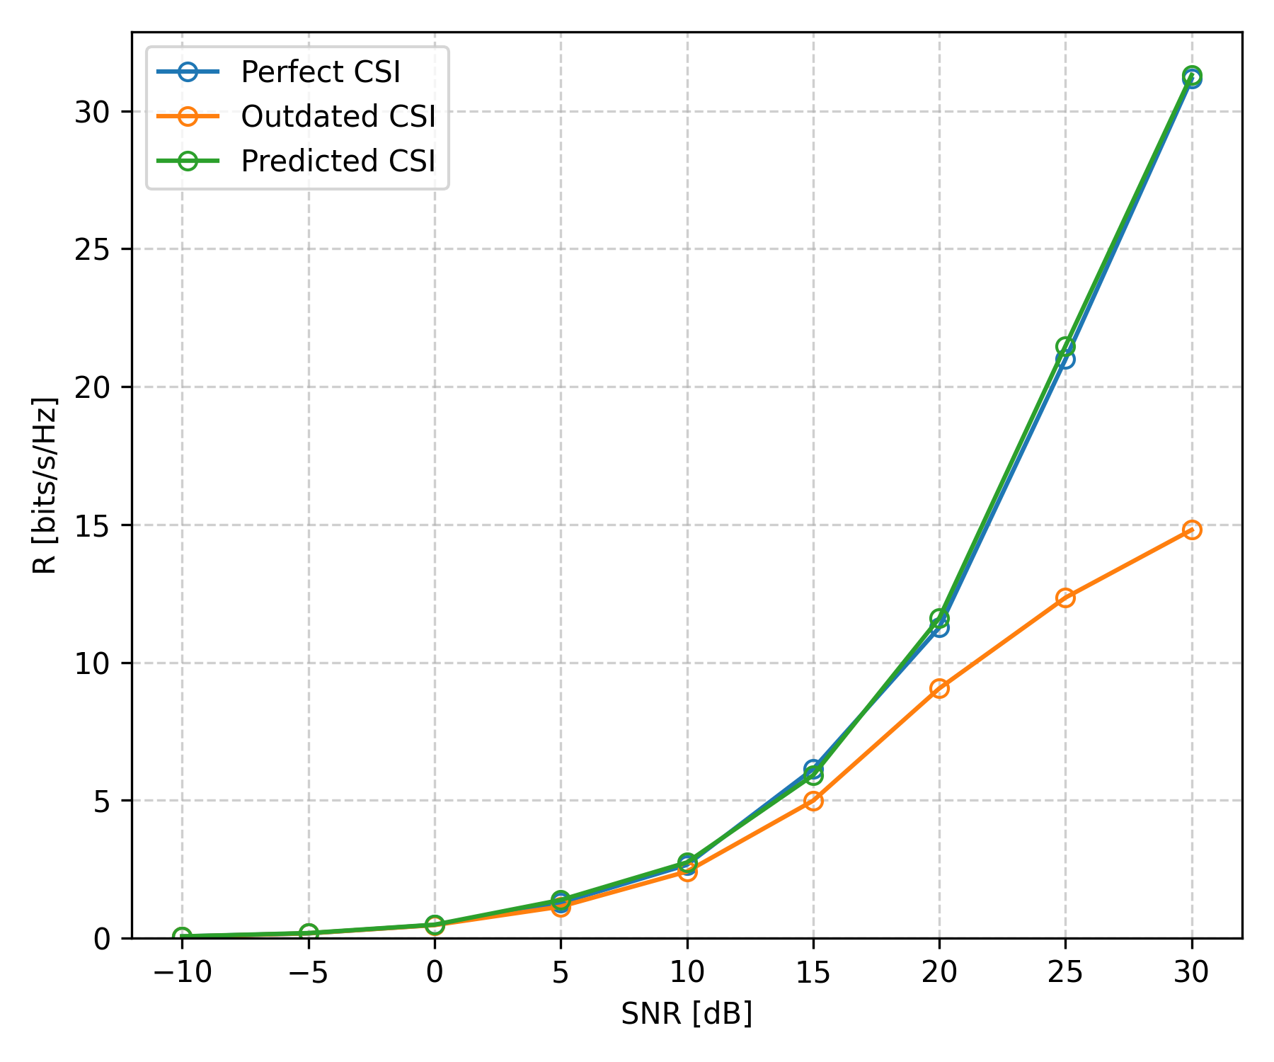
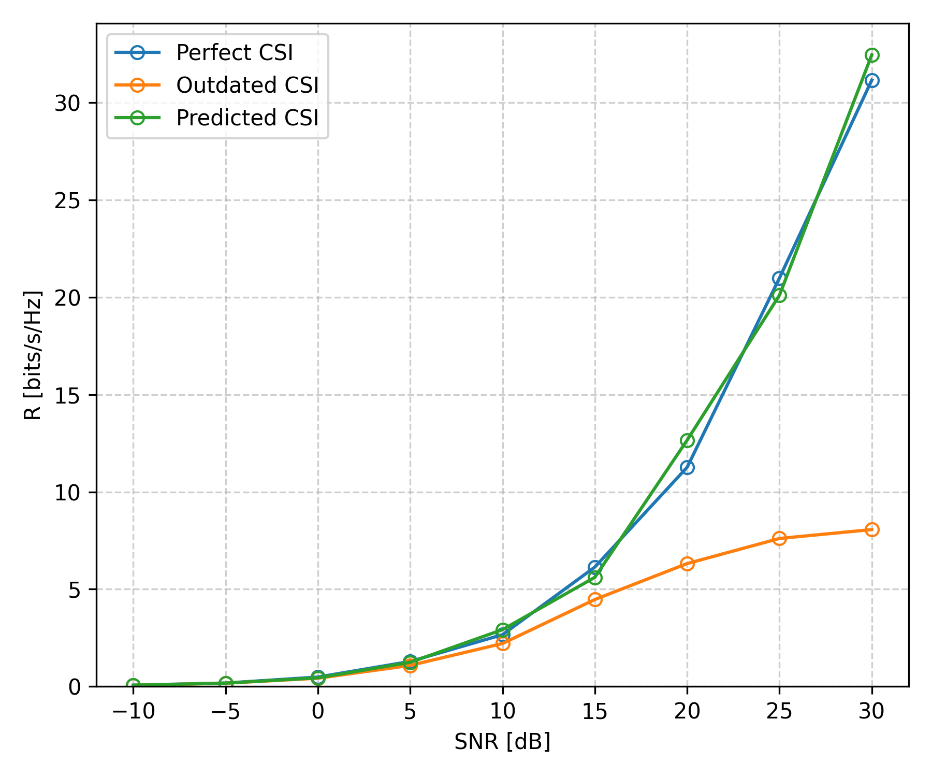
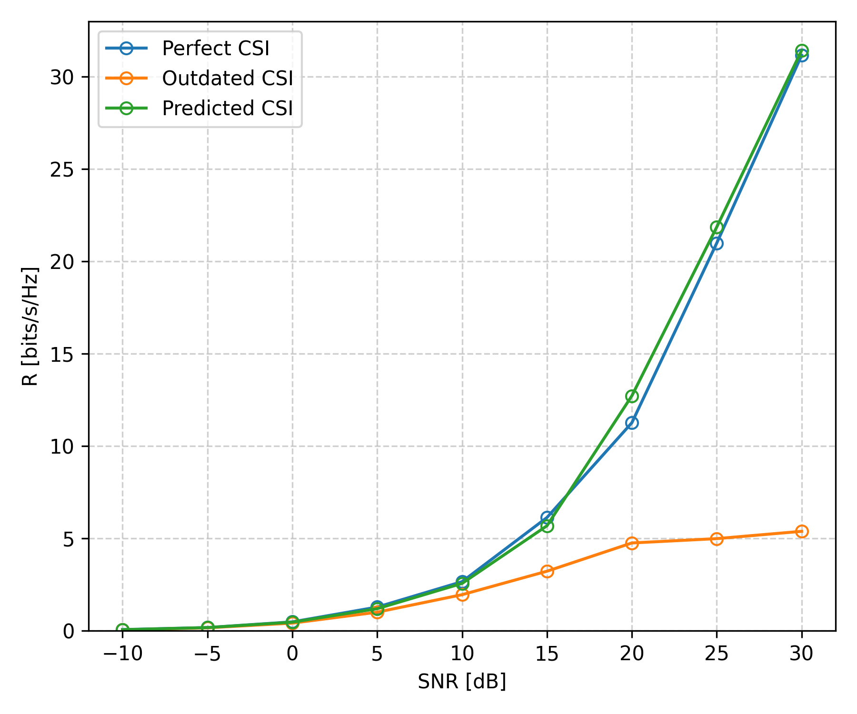
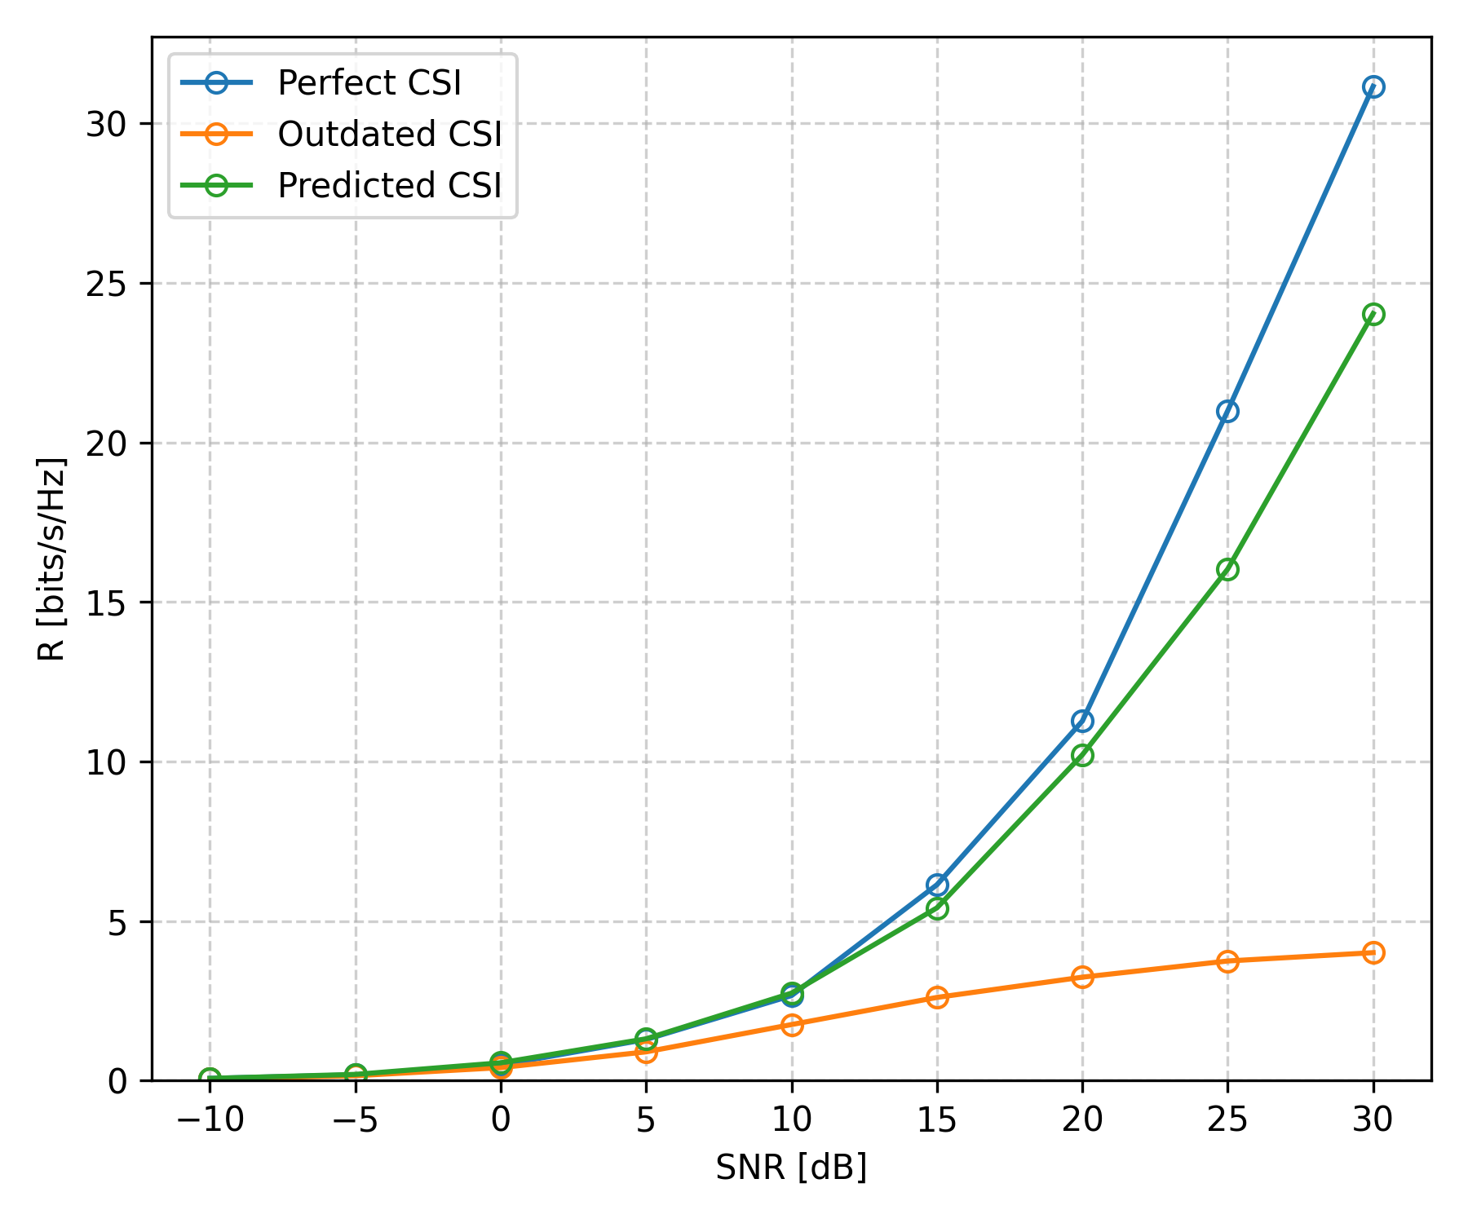
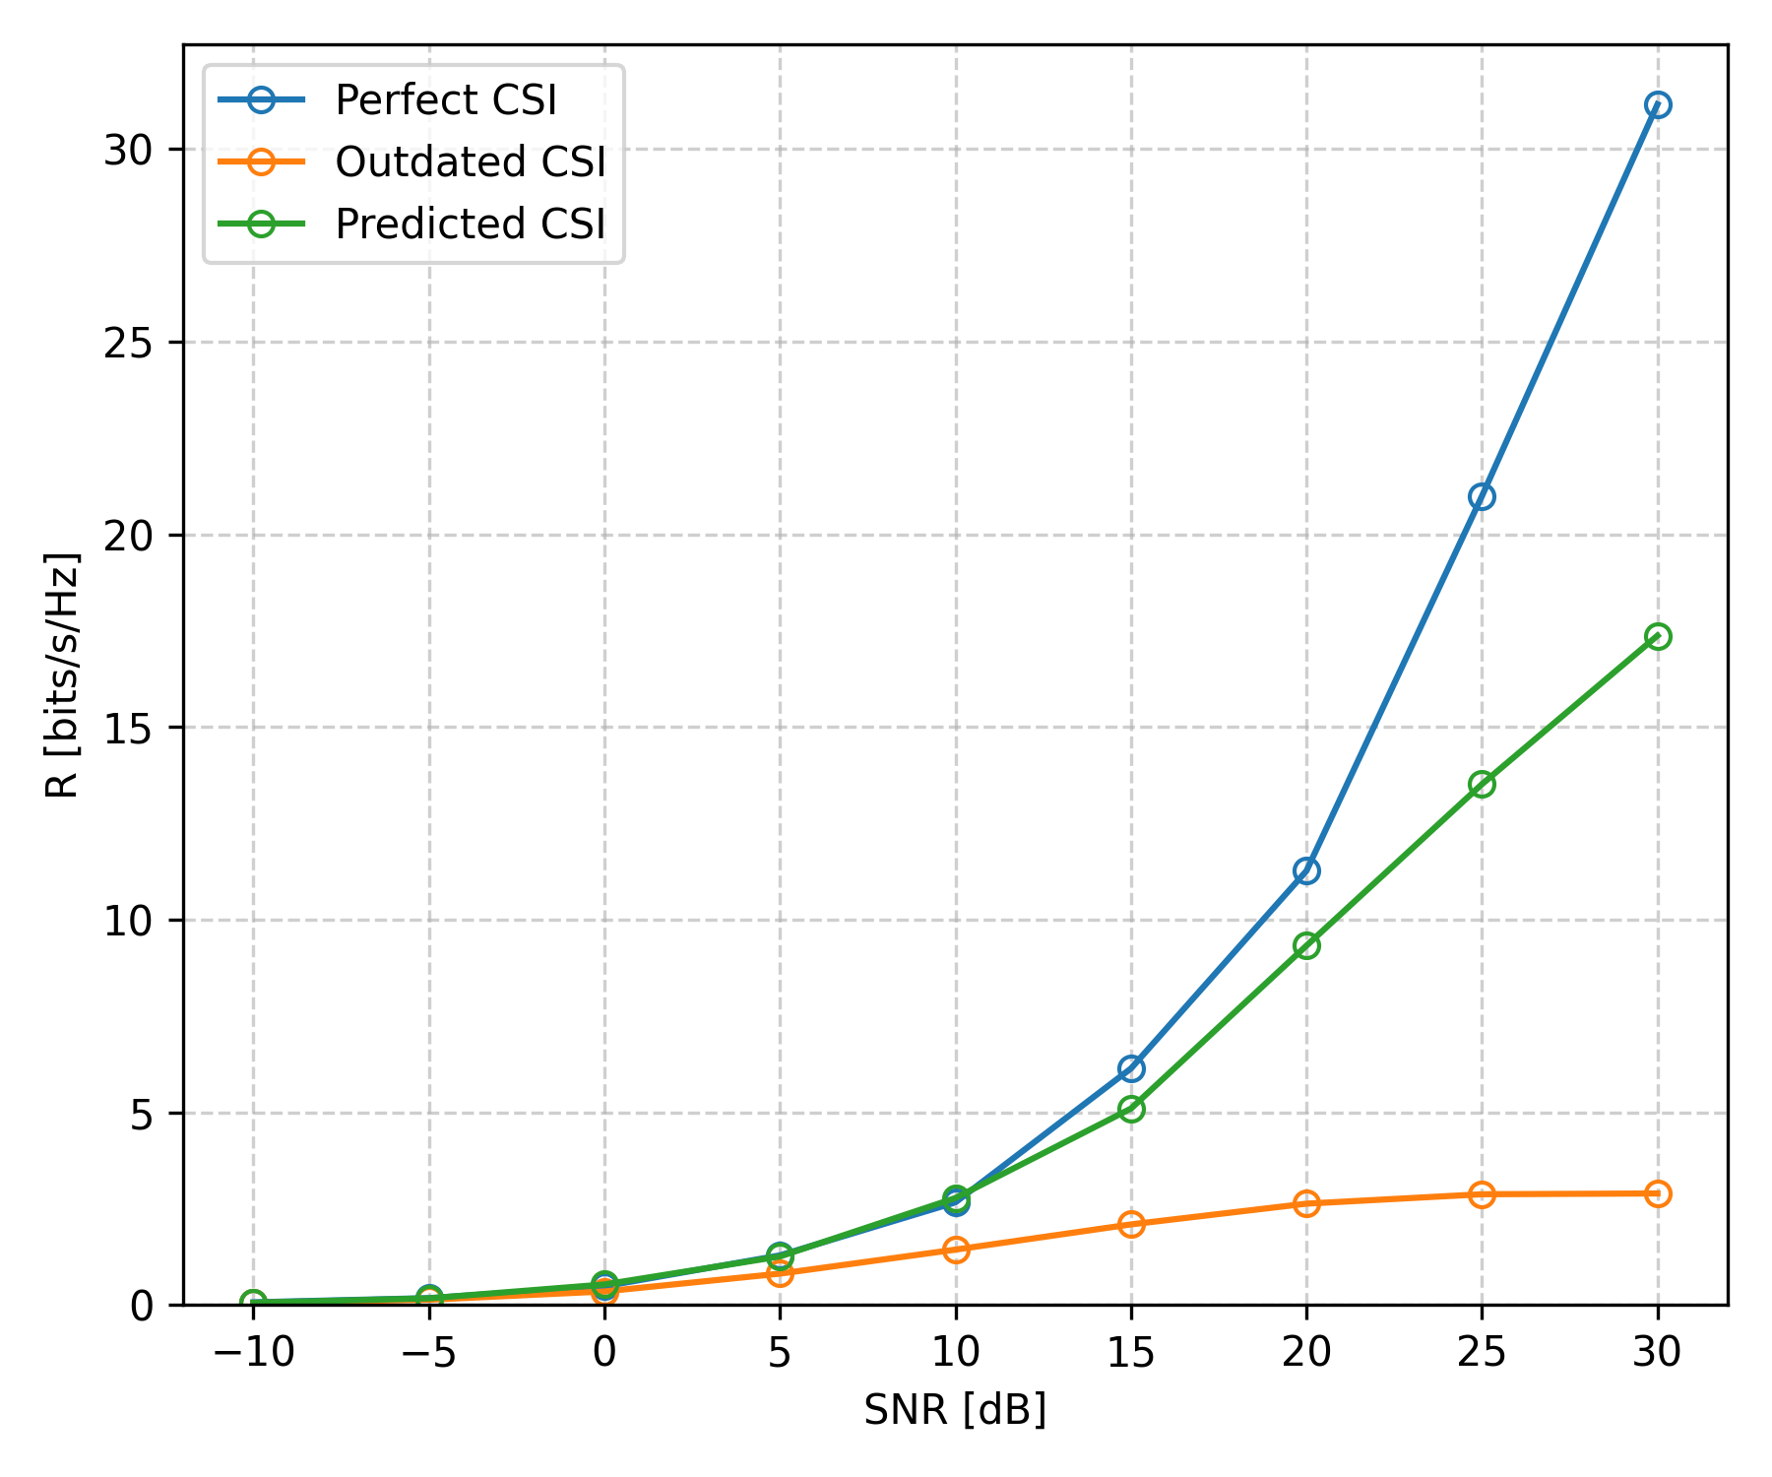






Impact of Outdated CSI & Channel Prediction (ZF)
$$T_{RTT}=0$$
$$T_{RTT}=\frac{1}{6} T_{c}$$
$$T_{RTT}=\frac{2}{6} T_{c}$$
$$T_{RTT}=\frac{3}{6} T_{c}$$
$$T_{RTT}=\frac{4}{6} T_{c}$$
$$T_{RTT}=\frac{5}{6} T_{c}$$
Notes:
sys_ref_numbers = [["1_sl_0.1.5.3", "2_sl_0.1.5.3", "3_sl_0.1.5.3"], ["1_sl_0.1.5.3", "2_sl_1.1.5.3", "3_sl_1.1.5.3"], ["1_sl_0.1.5.3", "2_sl_2.1.5.3", "3_sl_2.1.5.3"], ["1_sl_0.1.5.3", "2_sl_3.1.5.3", "3_sl_3.1.5.3"], ["1_sl_0.1.5.3", "2_sl_4.1.5.3", "3_sl_4.1.5.3"], ["1_sl_0.1.5.3", "2_sl_5.1.5.3", "3_sl_5.1.5.3"]]

Slide 22
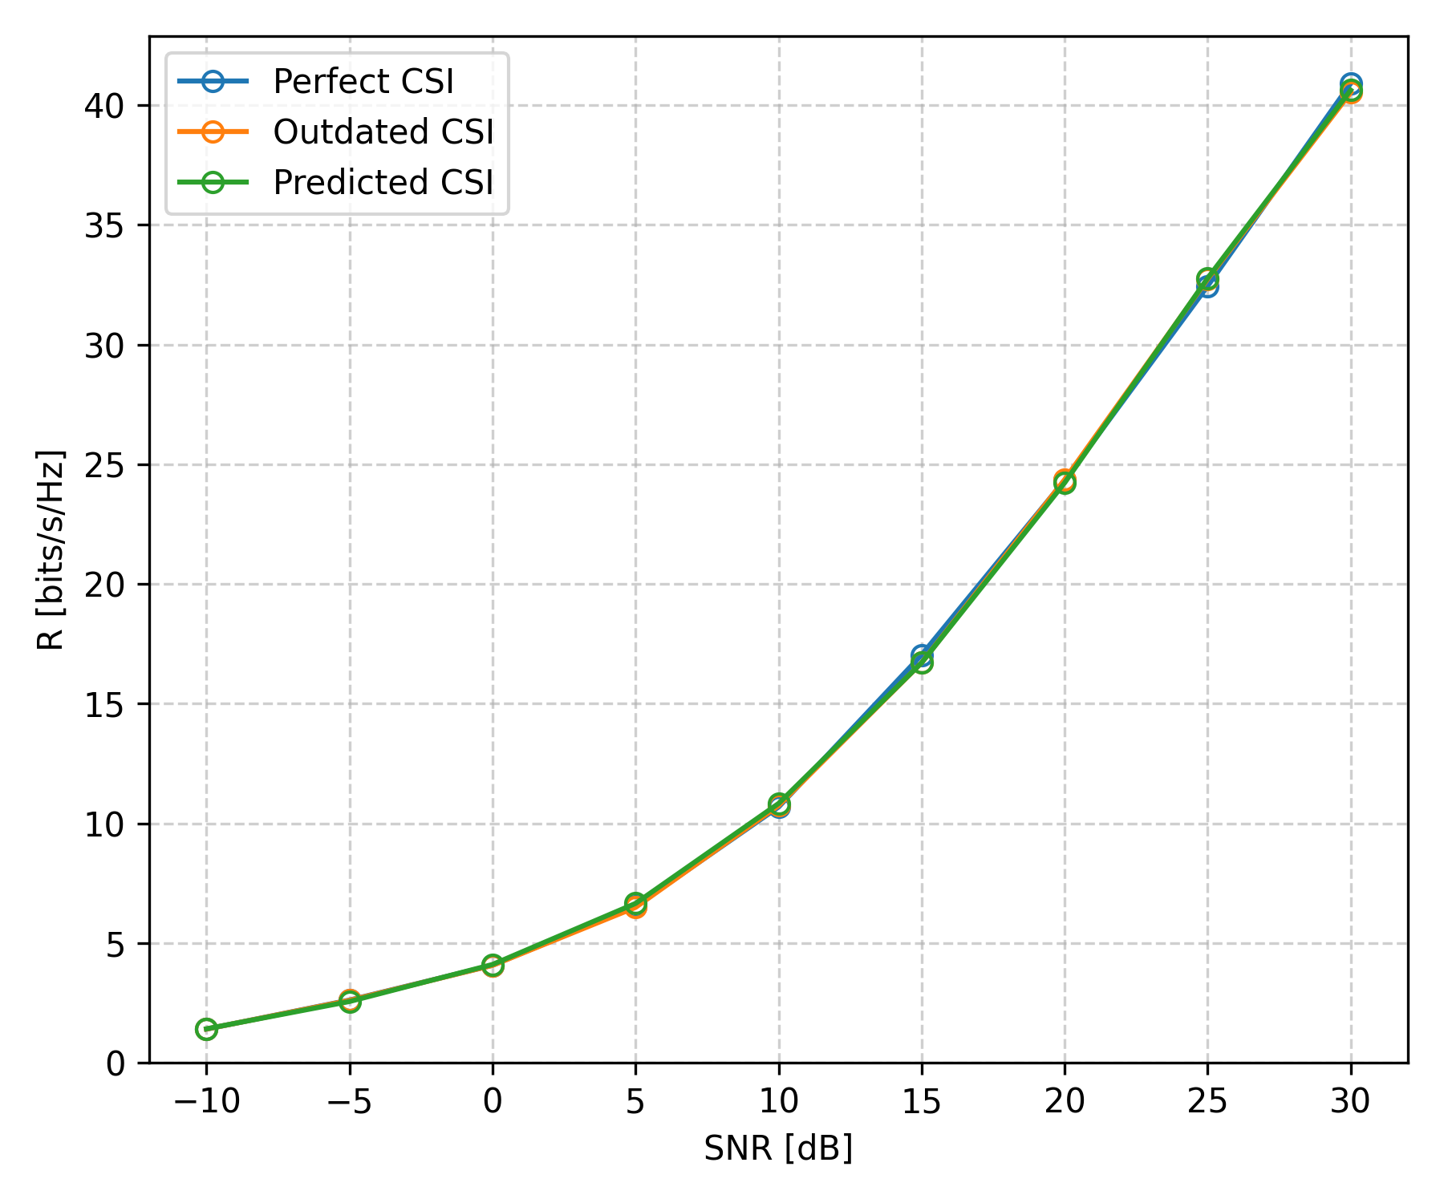
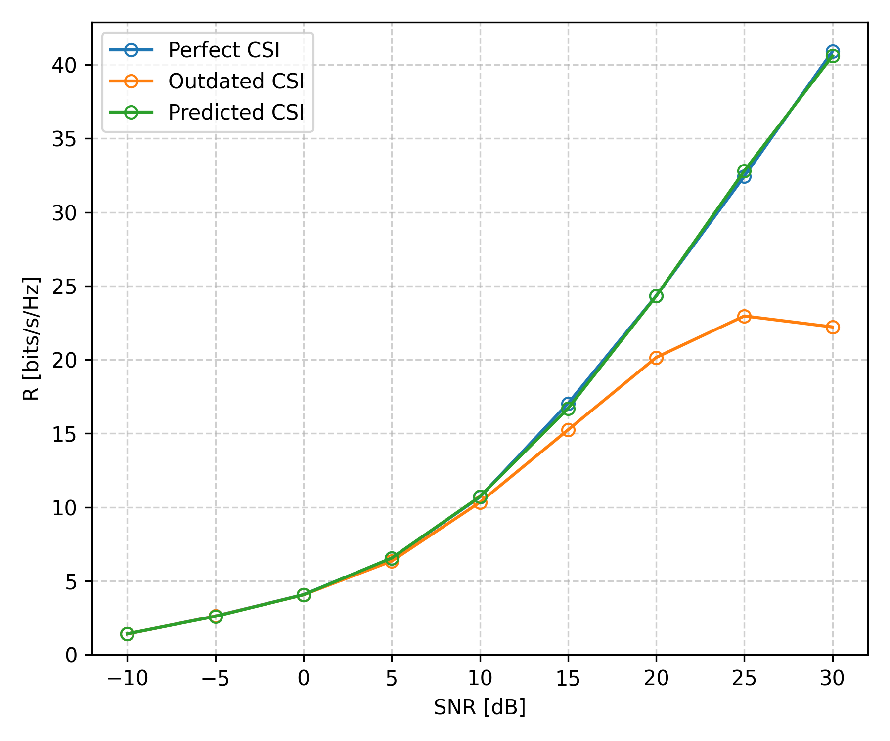
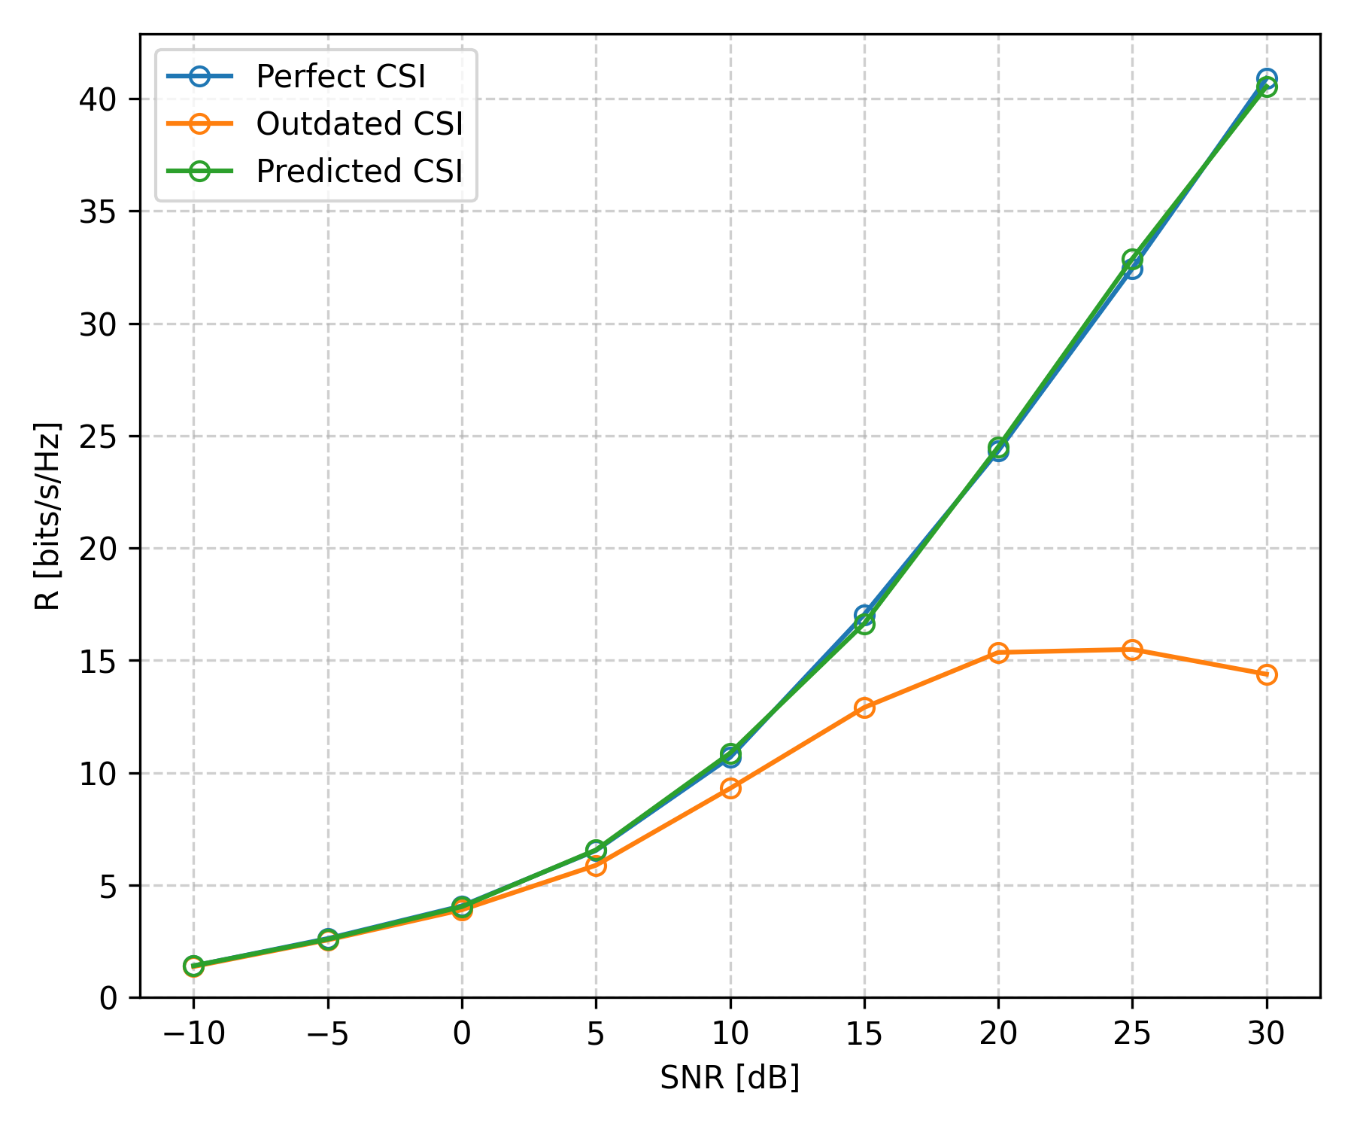
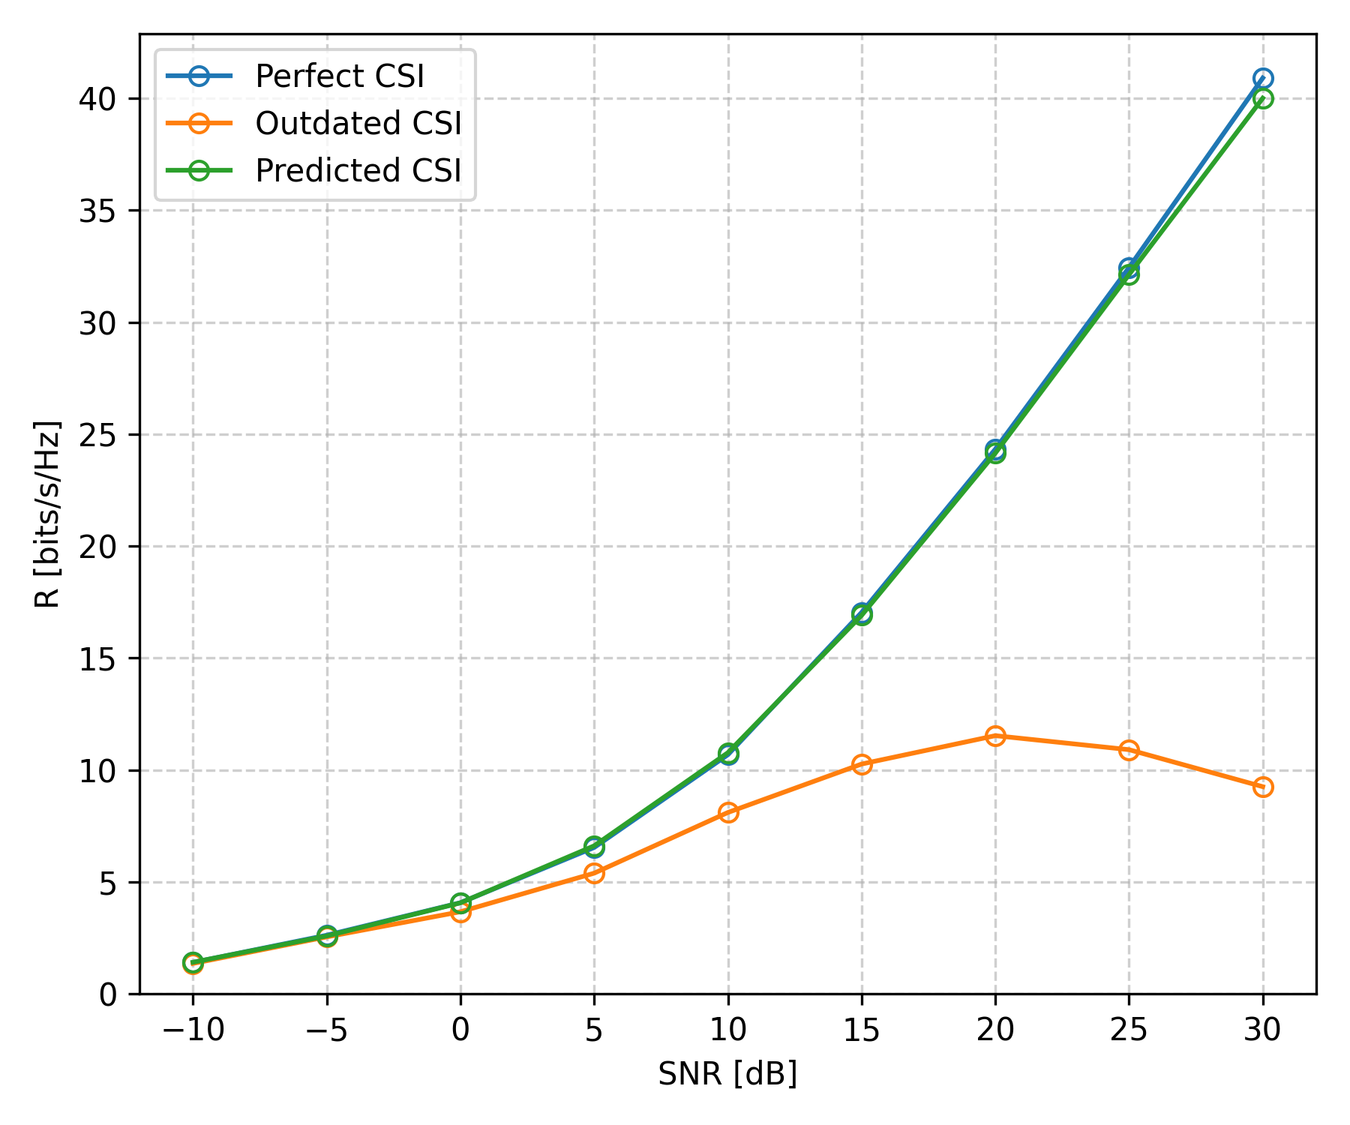
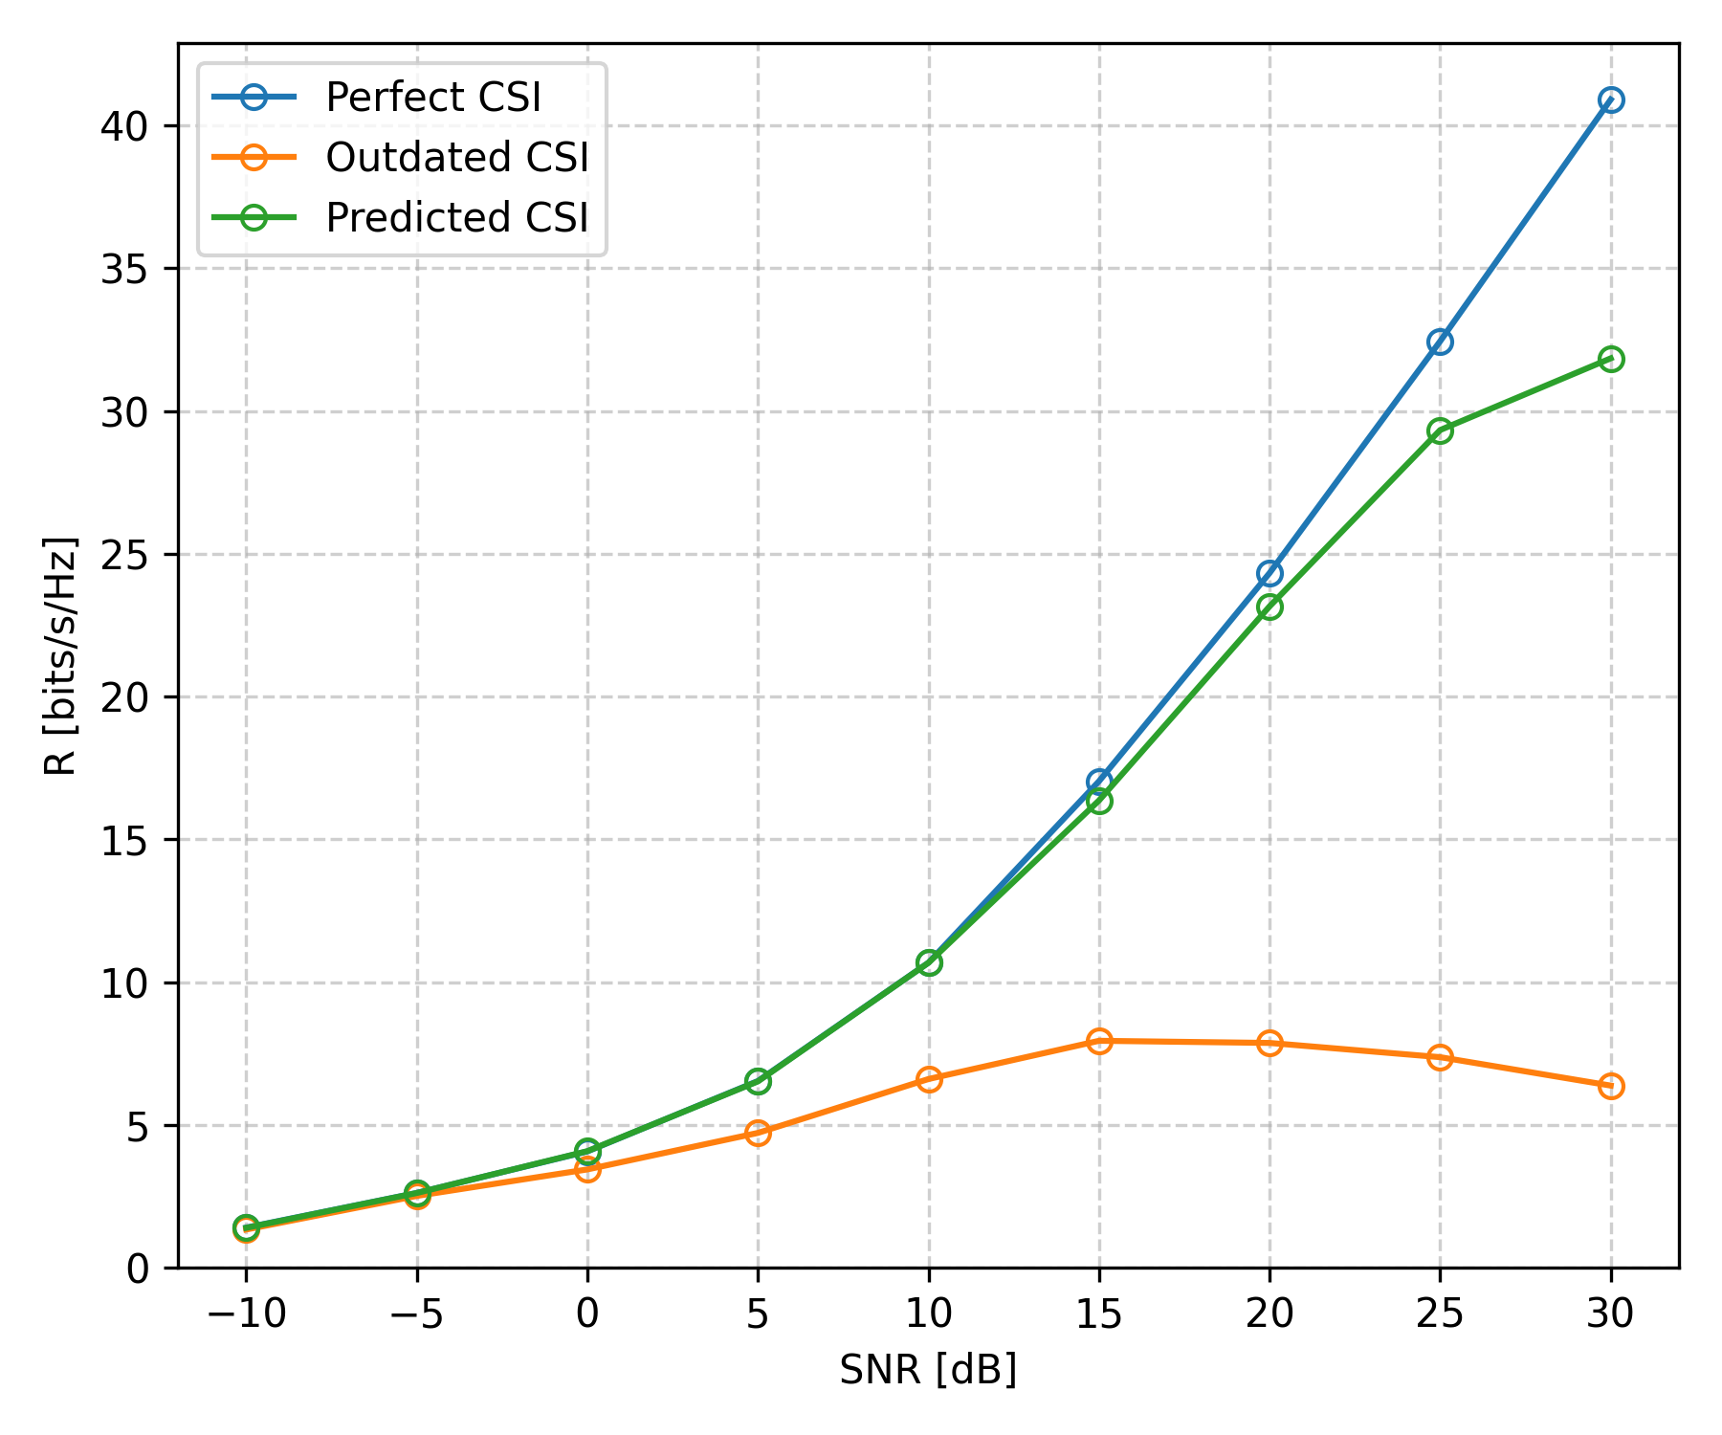
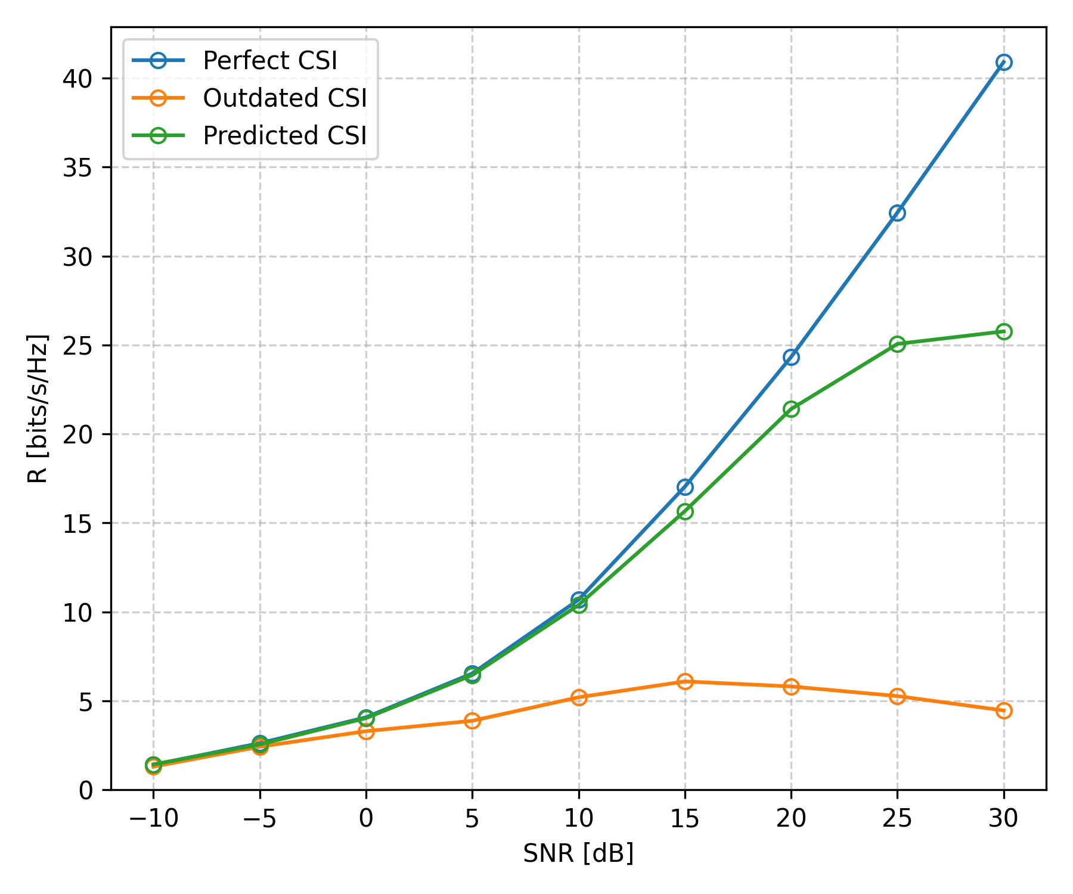






Impact of Outdated CSI & Channel Prediction (WMMSE)
$$T_{RTT}=0$$
$$T_{RTT}=\frac{1}{6} T_{c}$$
$$T_{RTT}=\frac{2}{6} T_{c}$$
$$T_{RTT}=\frac{3}{6} T_{c}$$
$$T_{RTT}=\frac{4}{6} T_{c}$$
$$T_{RTT}=\frac{5}{6} T_{c}$$
Notes:
sys_ref_numbers = [["1_sl_0.4.5.3", "2_sl_0.4.5.3", "3_sl_0.4.5.3"], ["1_sl_0.4.5.3", "2_sl_1.4.5.3", "3_sl_1.4.5.3"], ["1_sl_0.4.5.3", "2_sl_2.4.5.3", "3_sl_2.4.5.3"], ["1_sl_0.4.5.3", "2_sl_3.4.5.3", "3_sl_3.4.5.3"], ["1_sl_0.4.5.3", "2_sl_4.4.5.3", "3_sl_4.4.5.3"], ["1_sl_0.4.5.3", "2_sl_5.4.5.3", "3_sl_5.4.5.3"]]

Slide 23
Wannes Baes
Supervisors: Prof. Dr. Ir. Nele Noels, Dr. Ir. Rodrigo Moreas
Universiteit Gent
@ugent
@ugent
Ghent University
wannes.baes@ugent.be
youtube.com/ugent
www.ugent.be

