Slide 1
MU-MIMO
Precoding Techniques

Slide 2
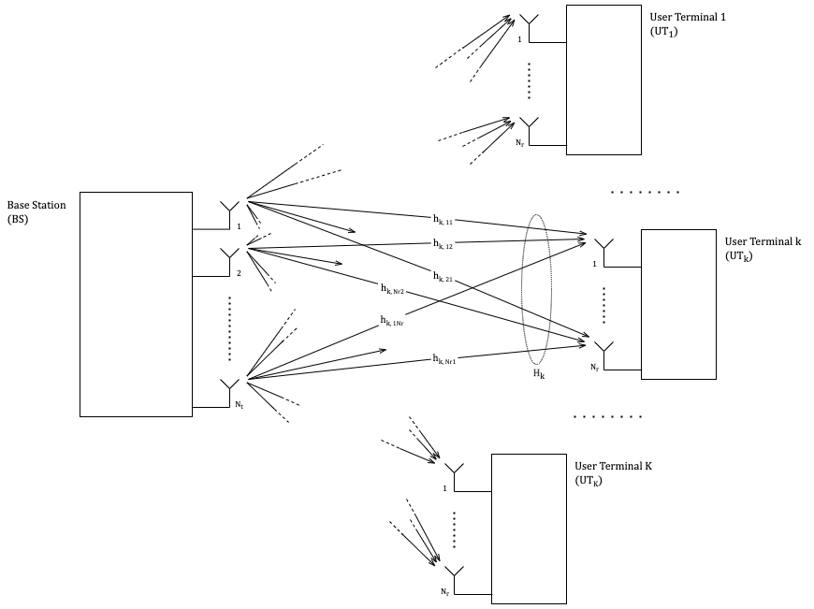
Introduction

Slide 3
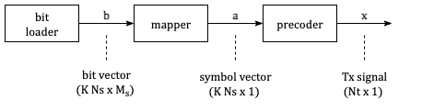
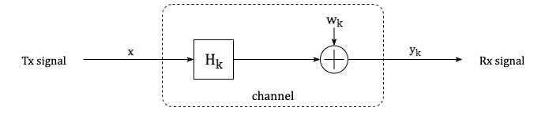
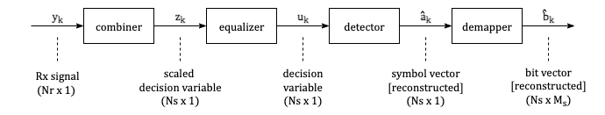
System Model

Slide 4


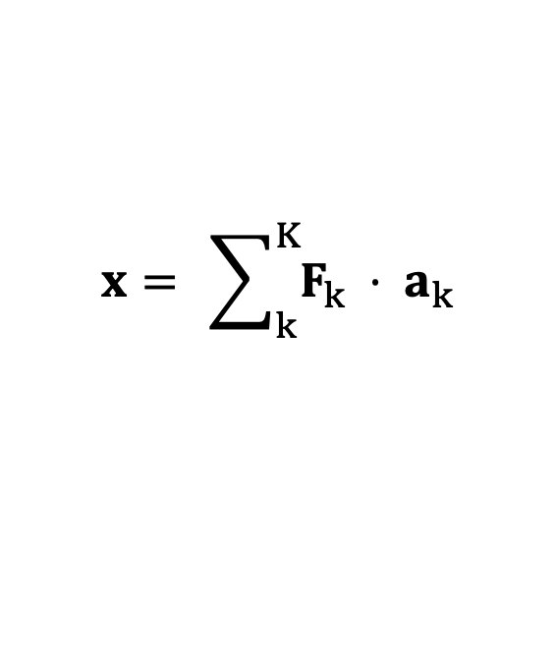

System Model
The transmitted signal $x$ is constructed at the BS by precoding the data streams:
$$x= \sum_{k}^{K}{F_{k} ⋅ a_{k}}$$
The received signal $y_{k}$ at UT_{k} can be written in terms of the transmitted signal $x$ as:
$$y_{k}= H_{k}⋅x + n_{k}$$
The received signal $y_{k}$ at UT_{k} is combined to obtain the scaled decision variable $z_{k}$:
$$z_{k}= G_{k}⋅y_{k}$$
$$z= GHF⋅a +G n$$

Slide 5
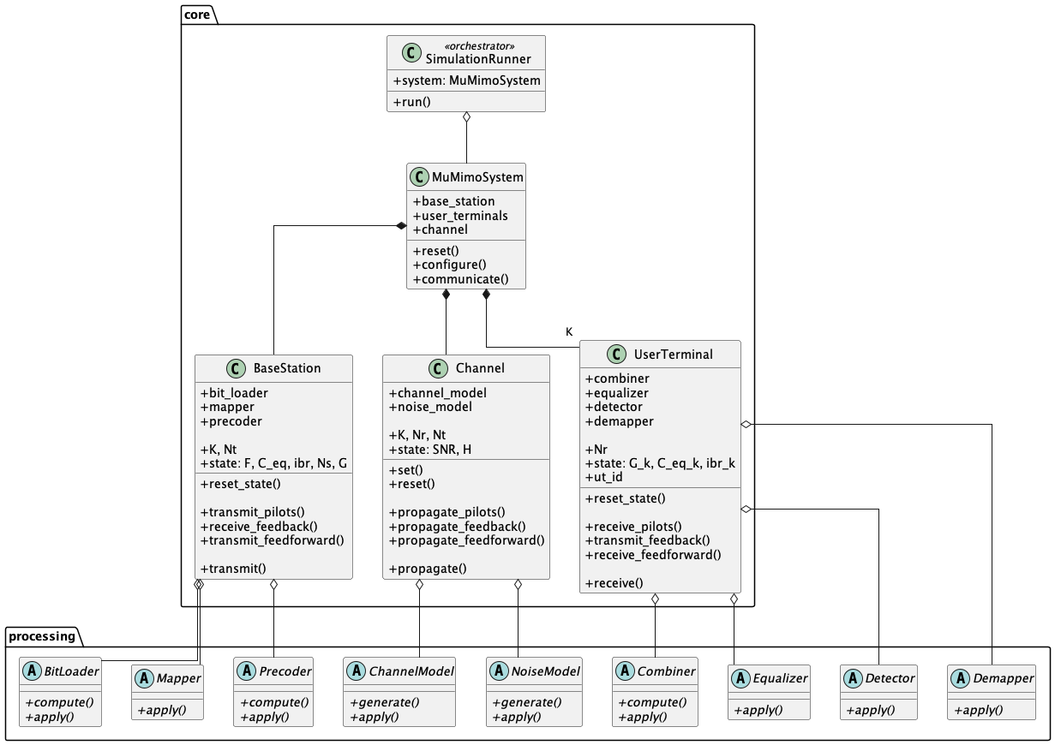
Simulation Framework
Class Diagram

Slide 6
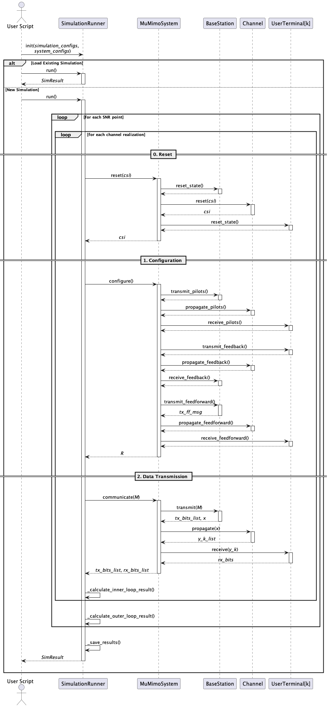
Simulation Framework
Sequence Diagram

Slide 7
Precoding Techniques
Zero-Forcing (ZF)
Zero-Forcing (ZF) + Heuristic LSV Combiner
Block-Diagonalization (BD)
Weighted Minimum Mean Squared Error (WMMSE)

Slide 8
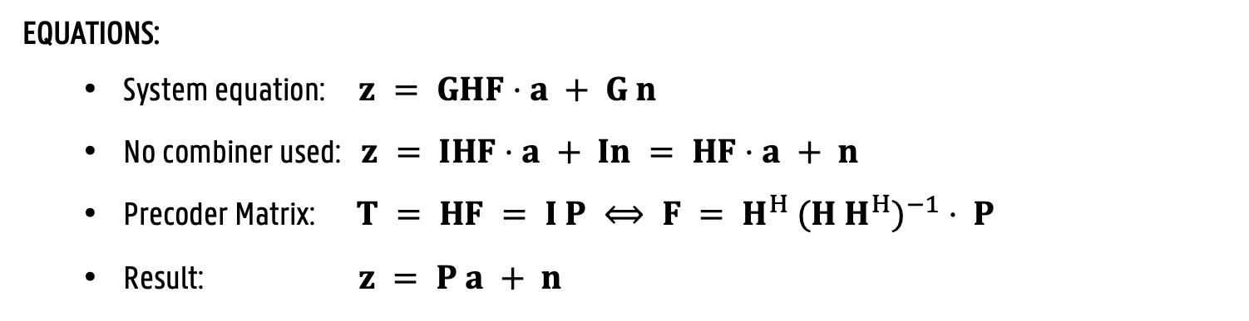
Precoding Techniques – ZF
GOAL:
Cancel all interference (stream and user)
HOW:
Choose the precoder equal to the psuedo-inverse of the channel
Waterfilling for power allocation
EQUATIONS:
System equation: $z = GHF⋅a + G n$
No combiner used: $z = IHF⋅a + In = HF⋅a + n$
Precoder Matrix: $T = HF = I P ⟺ F = H^{H} {(H H^{H})}^{−1} ⋅ P$
Result: $z = P a + n$

Slide 9
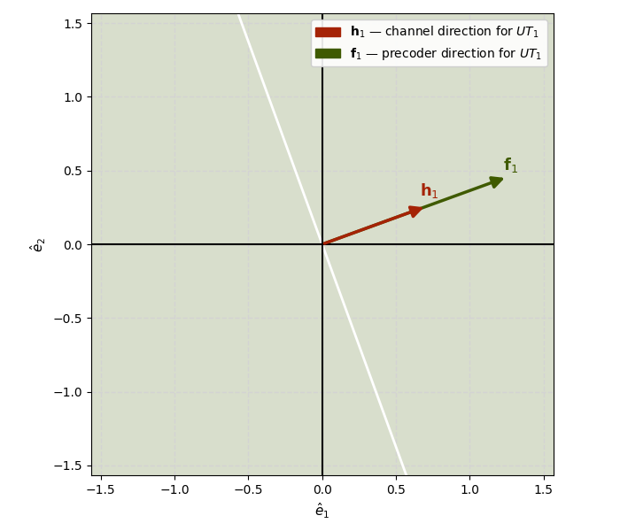
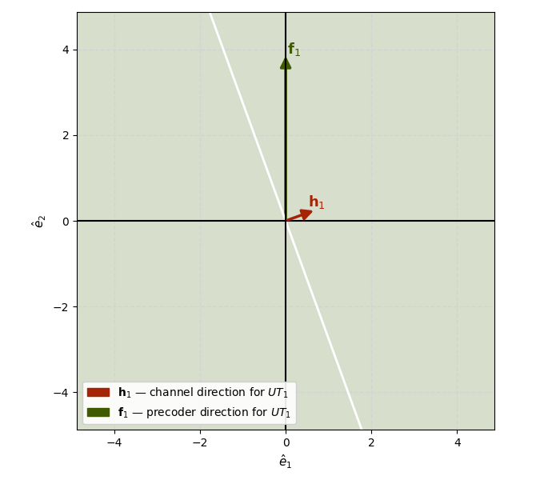
Precoding Techniques – ZF
$$Nt=2, Nr=1, K=1$$
Notes:
Because there is only one UT in the system, there is no interference to cancel. The precoder matrix can be chosen freely in the 2D transmit signal space, as long as it is not perpendicular to the channel vector.
Choosing the precoder direction to be parallel to the channel direction results in the highest possible signal-to-noise ratio (SNR) at the UT, and thus the best performance. This is the same precoder direction as the maximum ratio transmission (MRT) precoder.

Slide 10
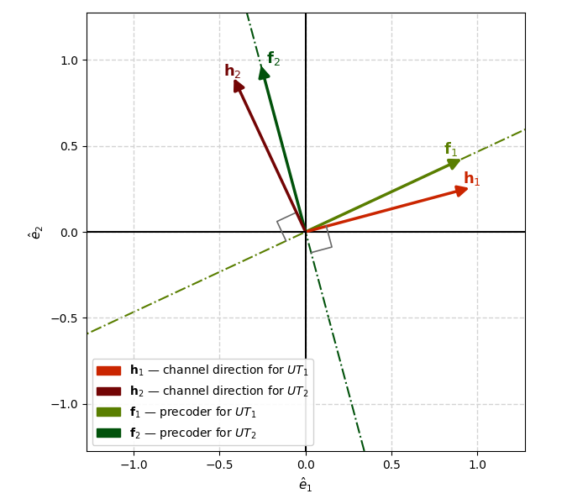
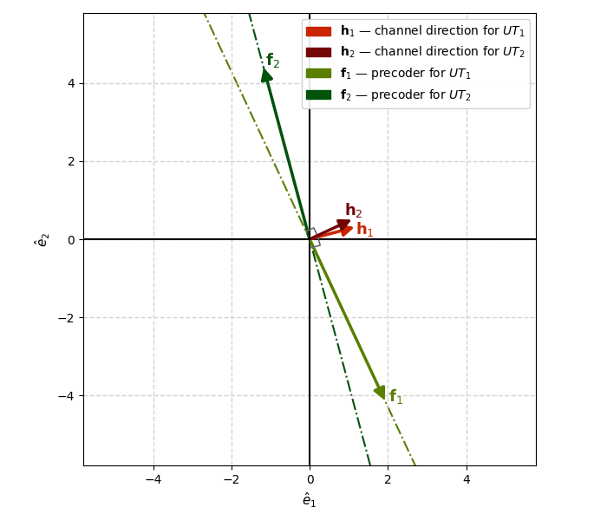
Precoding Techniques – ZF
$$Nt=2, Nr=1, K=2$$
Favourable Channel Conditions
Unfavourable Channel Conditions

Slide 11
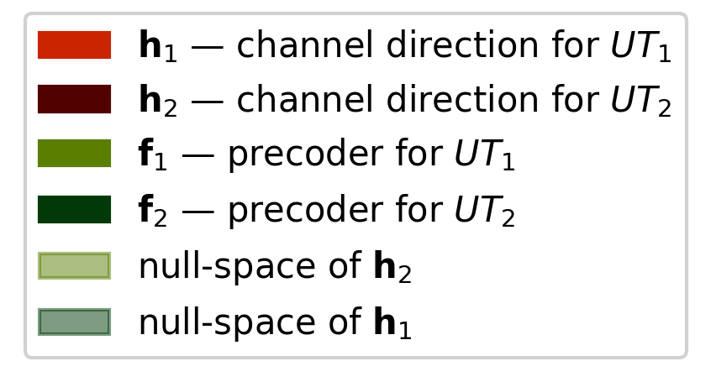
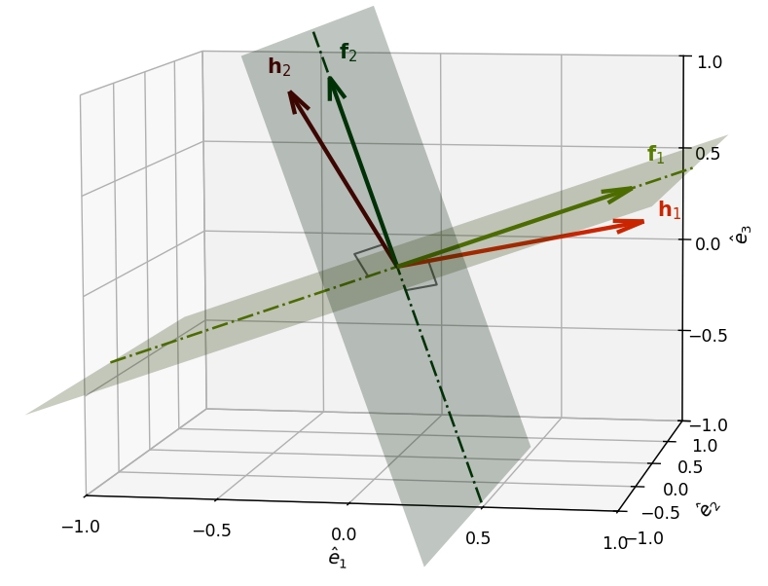
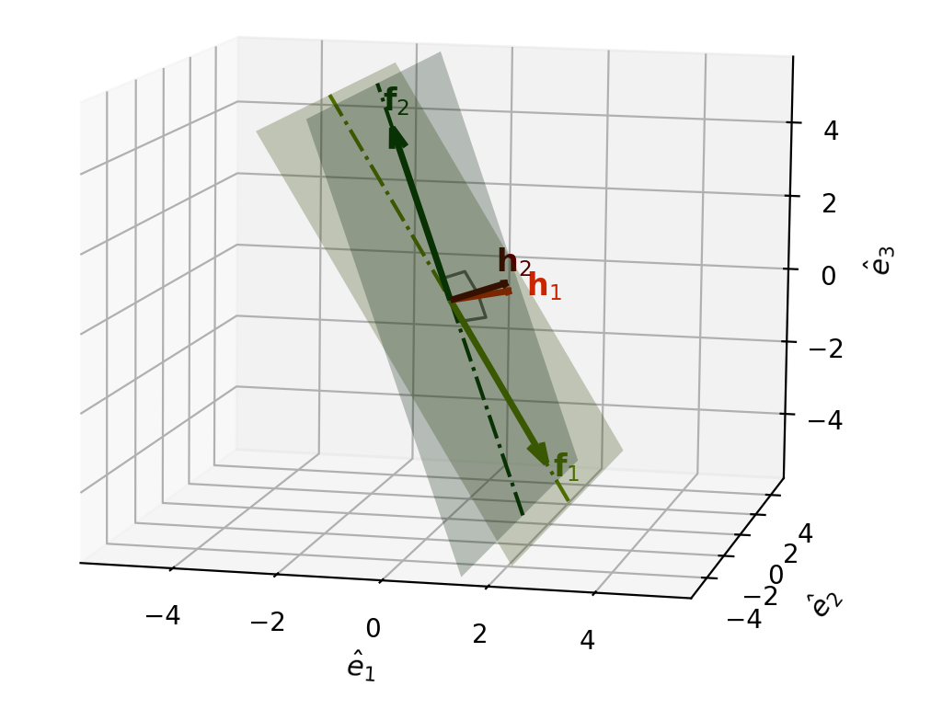
Precoding Techniques – ZF
$$Nt=3, Nr=1, K=2$$
Favourable Channel Conditions
Unfavourable Channel Conditions

Slide 12
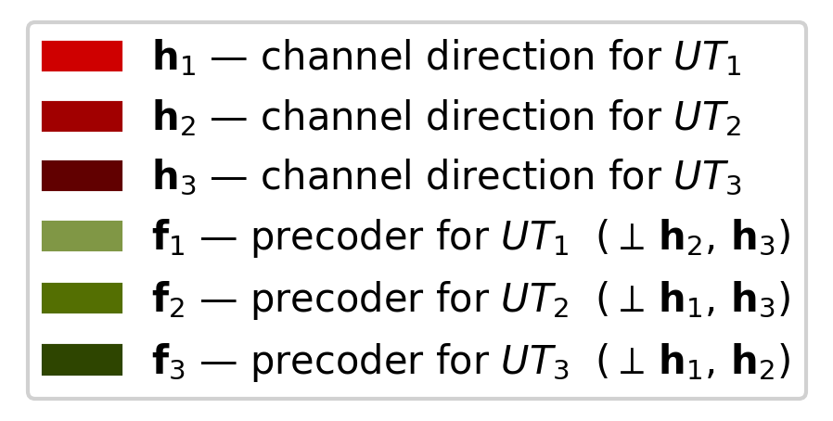
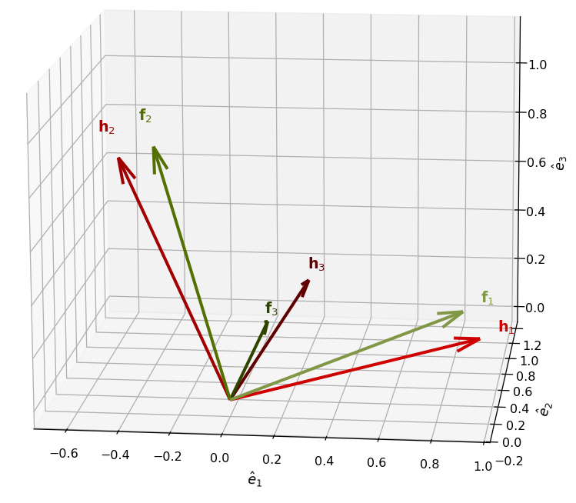
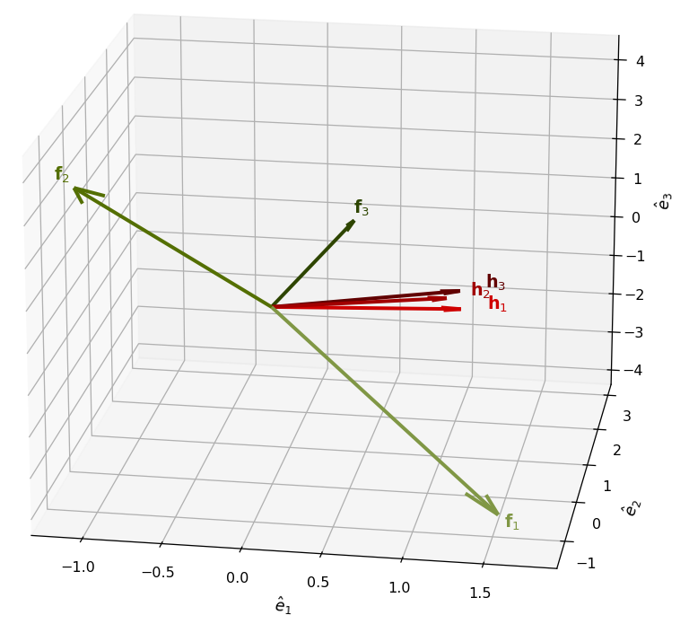
Precoding Techniques – ZF
$$Nt=3, Nr=1, K=3$$
Favourable Channel Conditions
Unfavoxurable Channel Conditions

Slide 13
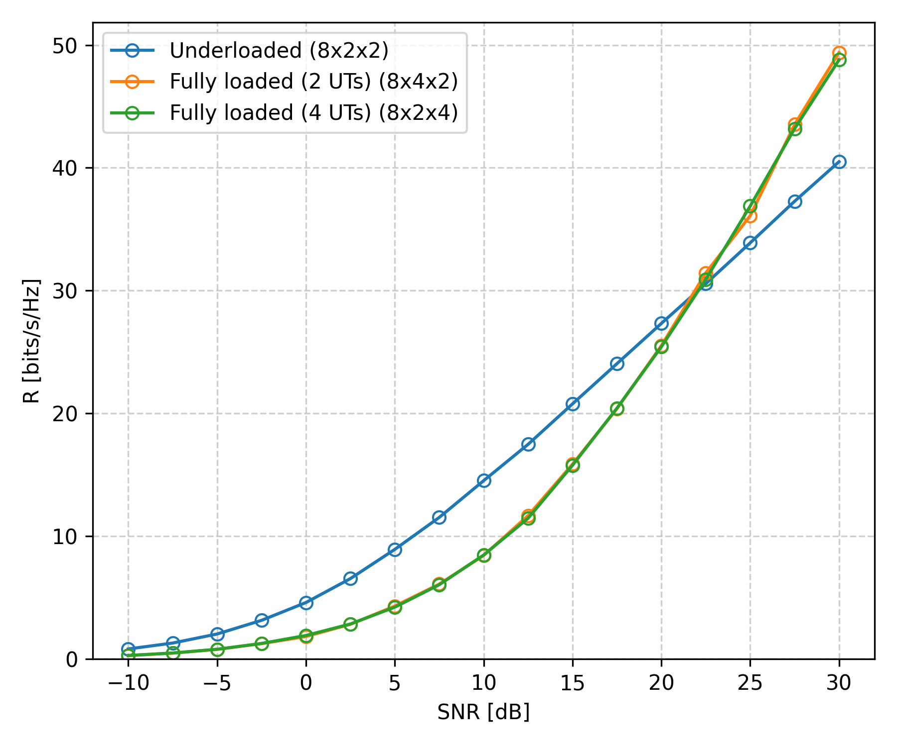
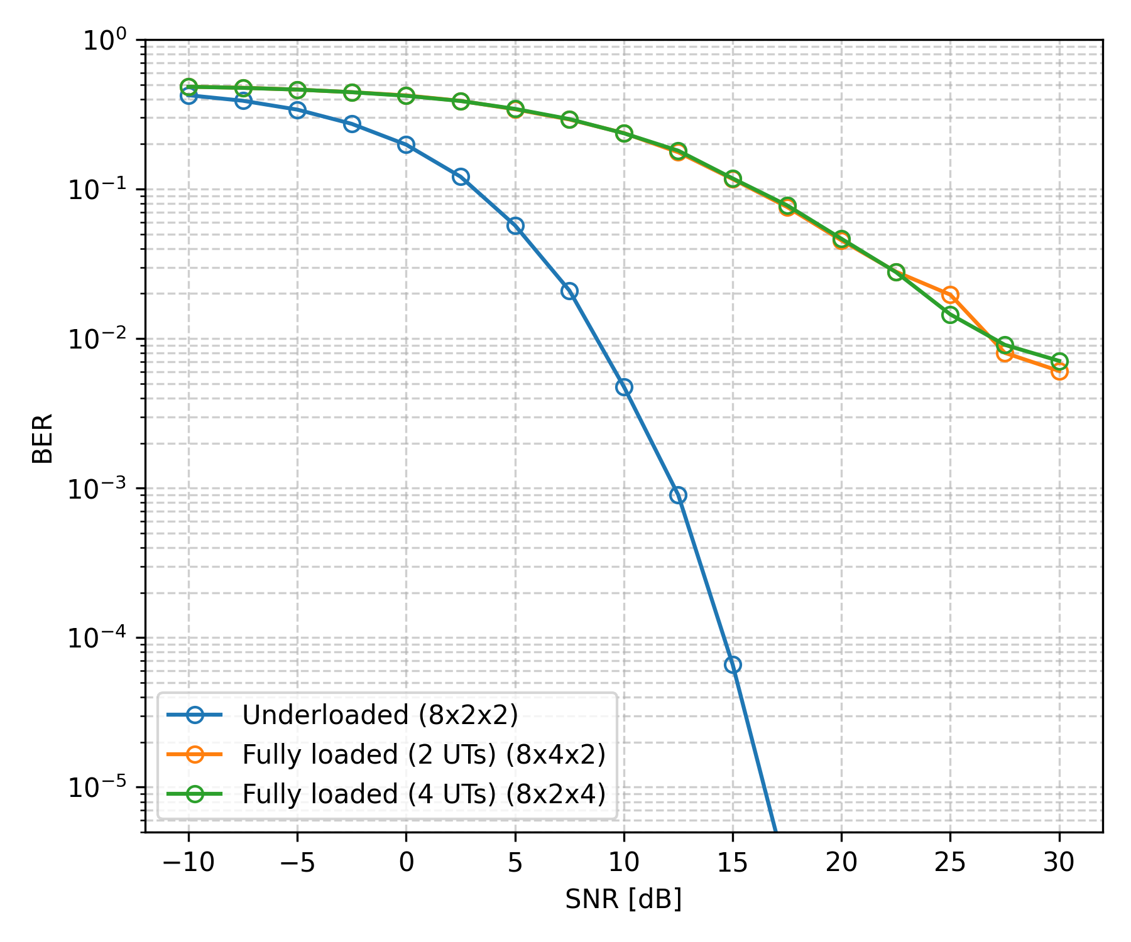
Simulation Results – ZF
Fixed Bit Loader (4-QAM)
R vs SNR
BER vs SNR
Notes:
Distribution of the rx antennas across the UTs DOES NOT impact the system-wide performance, only the total number of receive antennas K*Nr !
Achievable rate increases faster in function of the SNR with more receive antennas in the system.
BER decreases faster in function of the SNR when difference between total number of receive antennas (K*Nr) and total number of transmit antannes (Nt) grows.
Conclusion: The “denser” the system, the higher the achievable rate but the lower the BER at each SNR value.

Slide 14
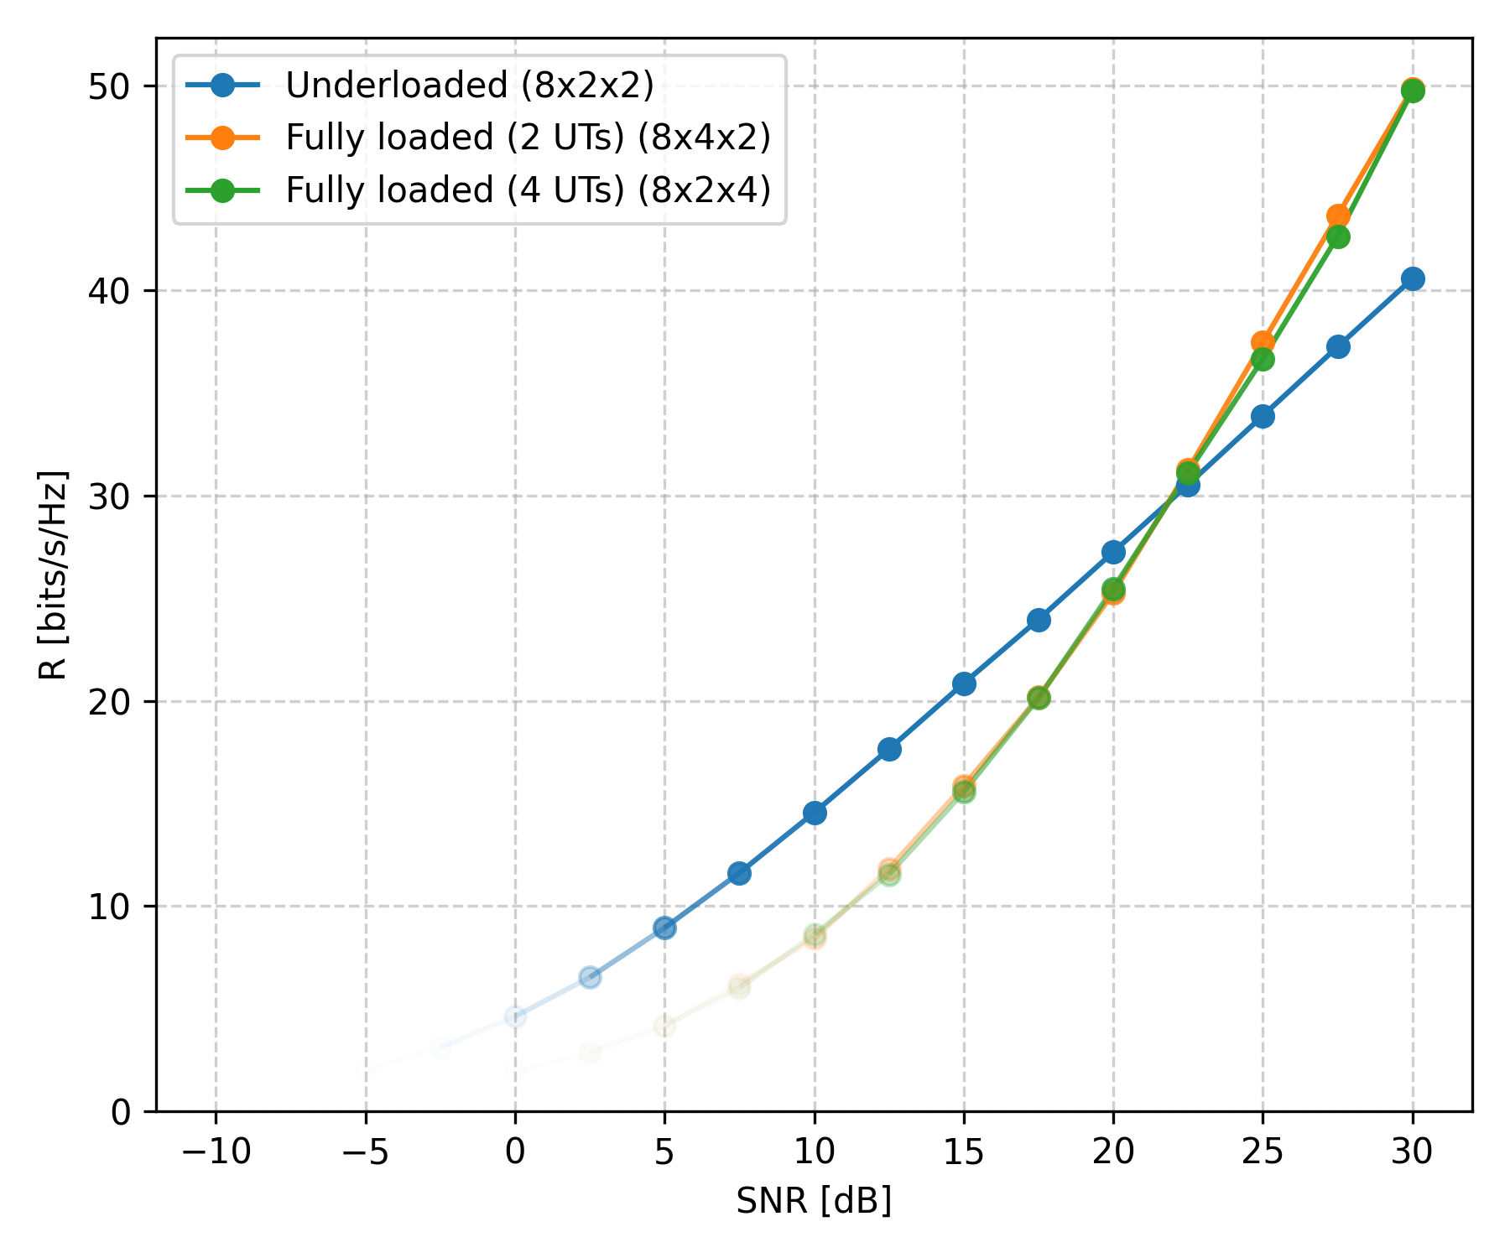
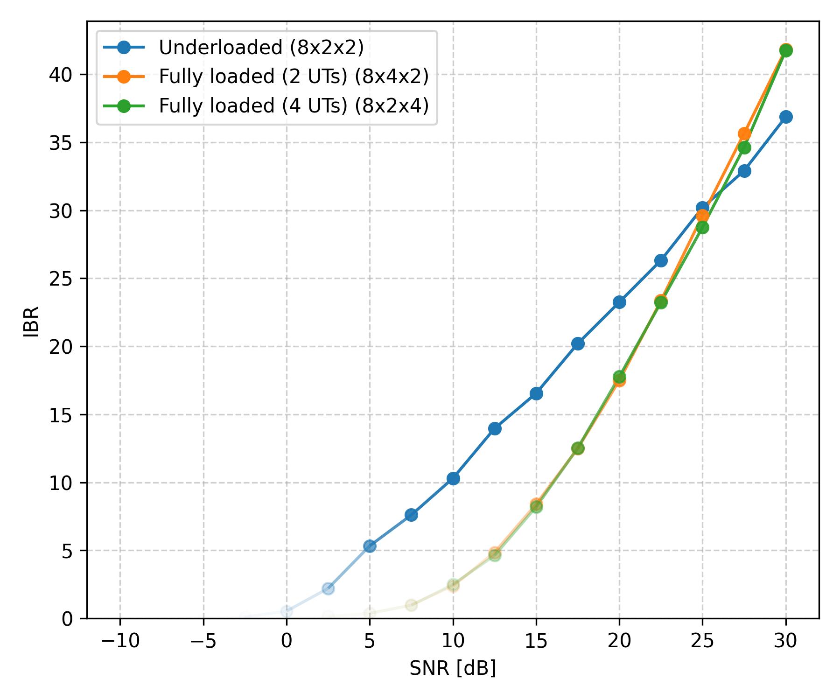
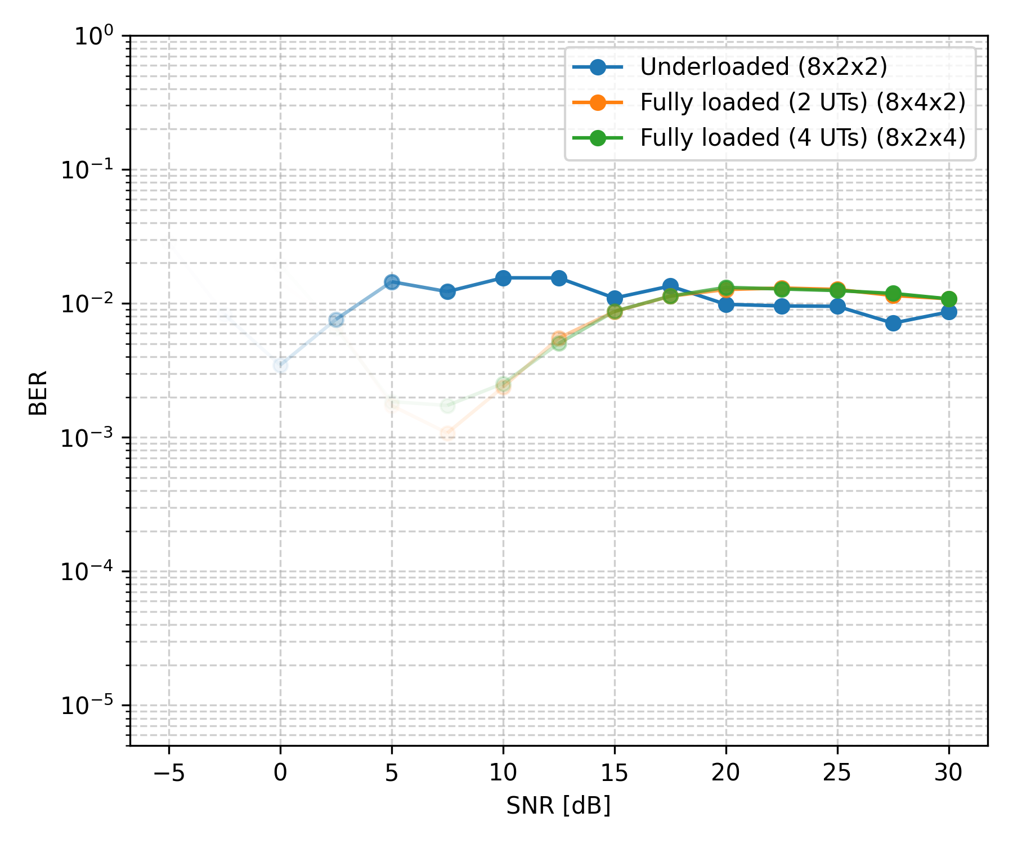
Simulation Results – ZF
Adaptive Bit Loader ($R$-QAM)
R vs SNR
IBR vs SNR
BER vs SNR
Notes:
The achievable rate stays the same. This makes sense: the achievable rate is independent of the bit loader!
The IBR follows the achievable rate in discrete steps. This makes sense: the constellation size (in bits) has to be an (even) integer!
The higher the SNR, the more data we transmit. The BER stays approximately constant!

Slide 15
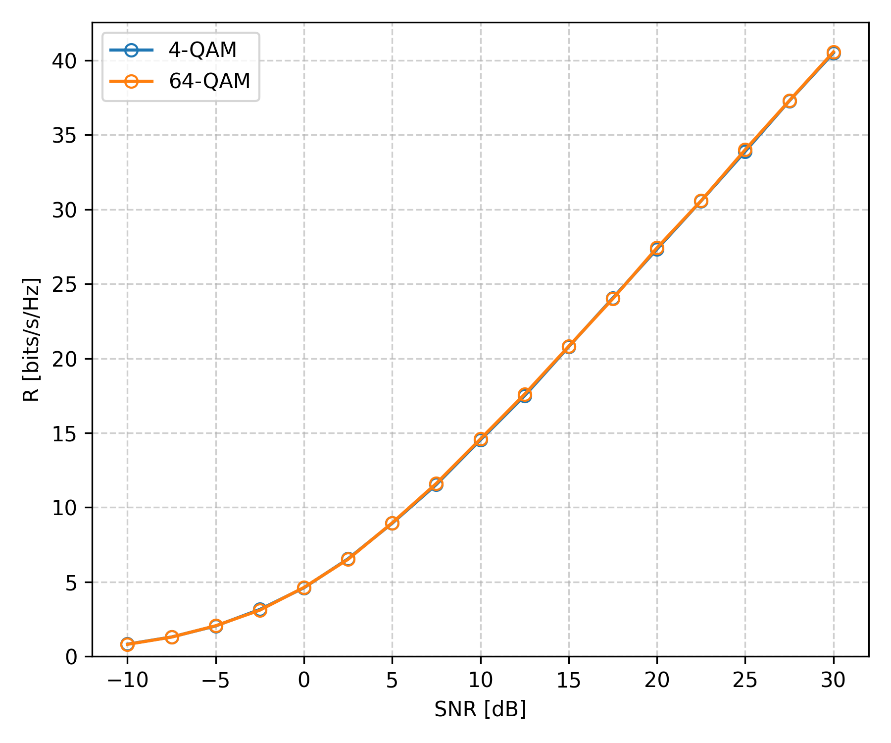
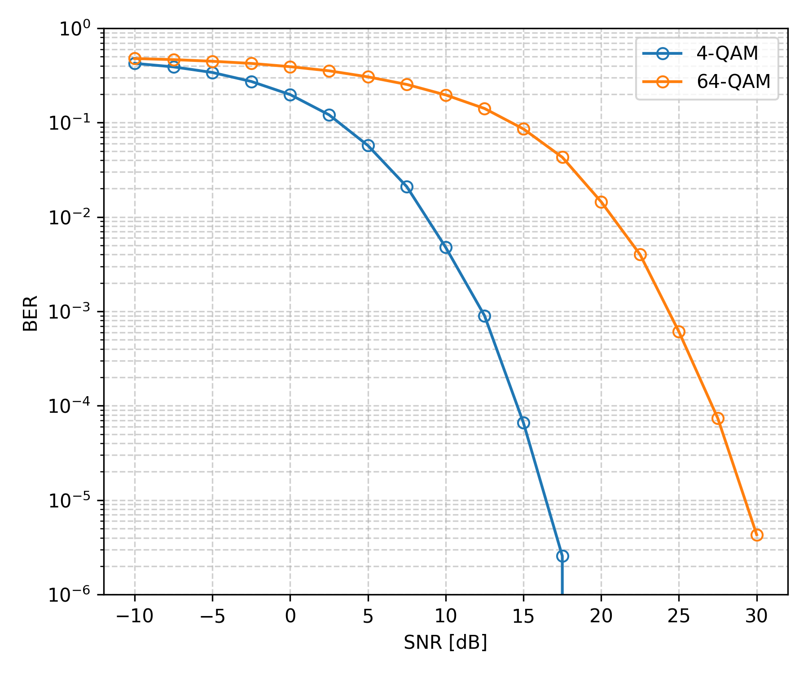
Simulation Results – ZF
Fixed Bit Loader (QAM), Underloaded System
R vs SNR
BER vs SNR
Notes:
The achievable rate stays the same. This makes sense: the achievable rate is independent of the bit loader!
Using a smaller constellation size corresponds to a SNR gain (here approx 12.5 dB). It does not influence to slope of the curve.

Slide 16
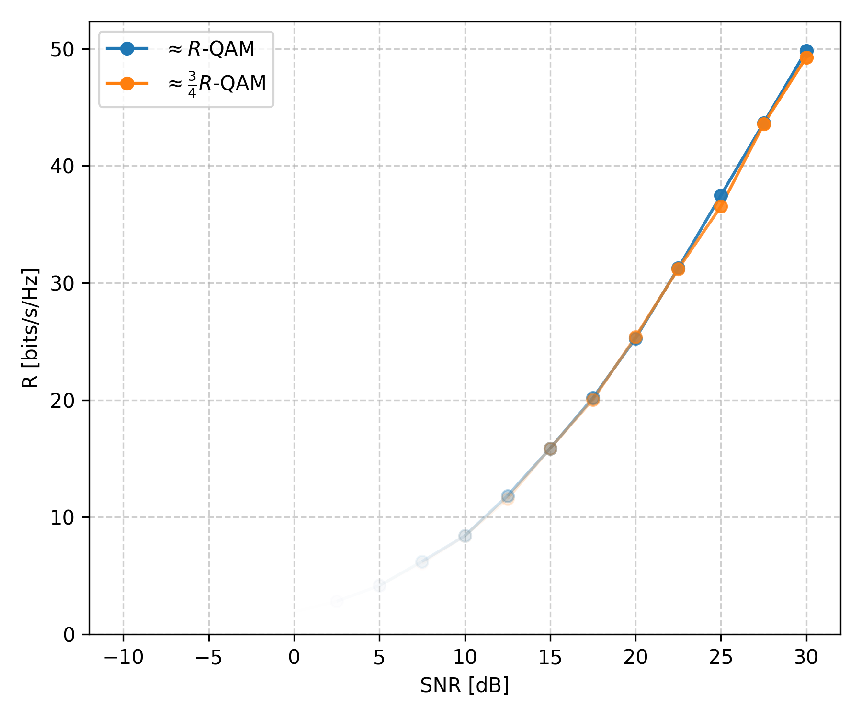
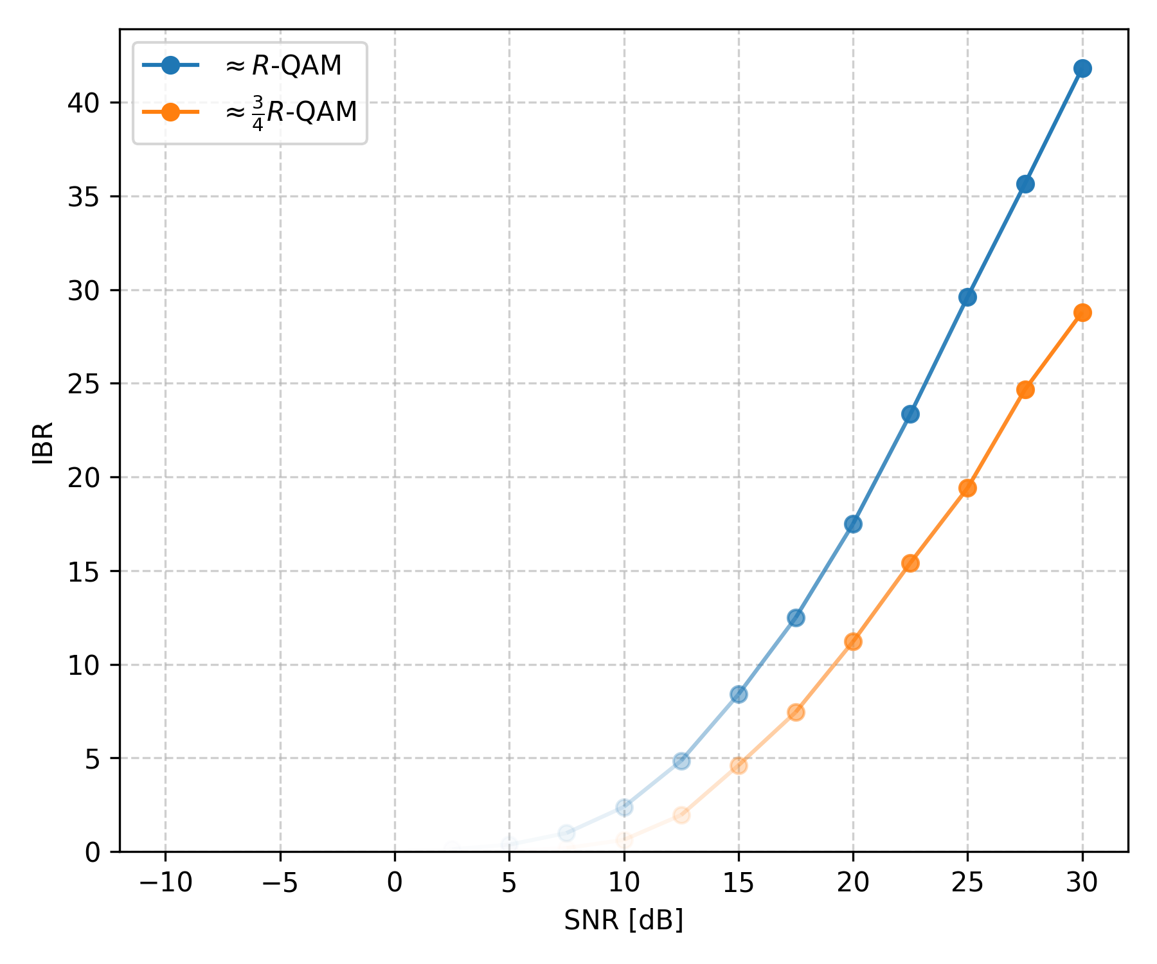
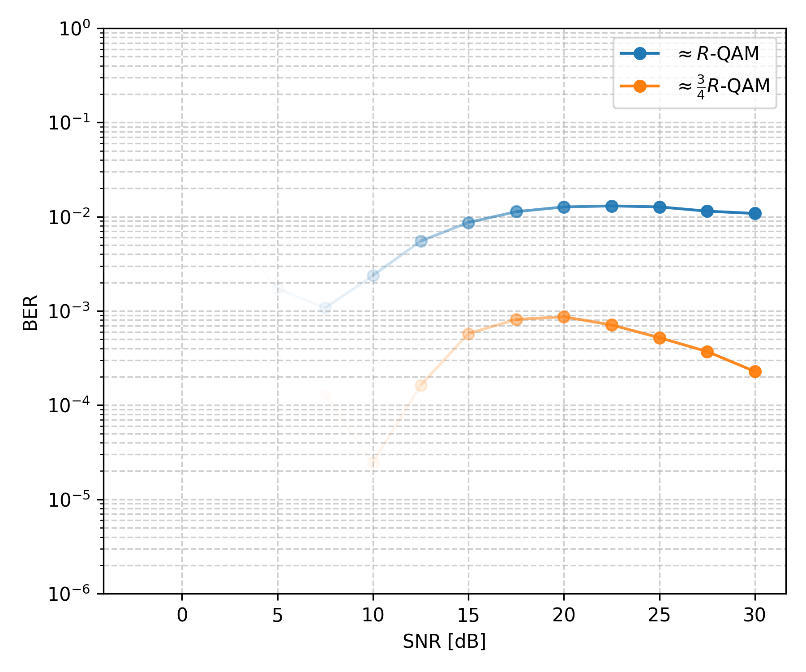
Simulation Results – ZF
Adaptive Bit Loader (QAM), Fully Loaded System (4 UTs)
R vs SNR
IBR vs SNR
BER vs SNR
Notes:
The achievable rate stays the same. This makes sense: the achievable rate is independent of the bit loader!
The IBR follows the achievable rate in discrete steps. This makes sense: the constellation size (in bits) has to be an (even) integer!
The smaller the fraction of the achievable rate at which you send data, the lower the BER.

Slide 17
Simulation Results – ZF
Conclusion: same performance trade-offs for each UT as for a SU-MIMO system!

Slide 18
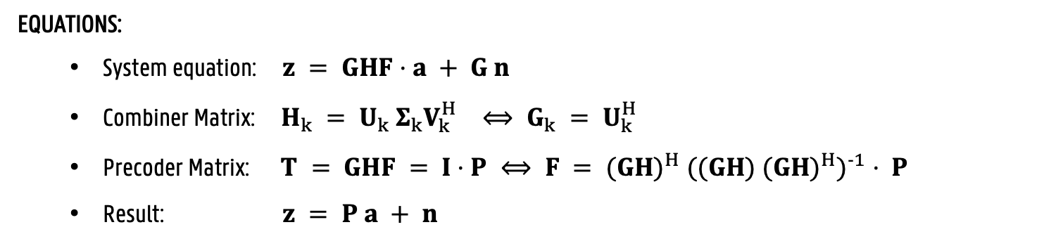
Precoding Techniques – ZF + LSV
GOAL:
Cancel all interference (stream and user) and create more favourable circumstances for optimal power allocation
HOW:
Choose the heuristic combiners equal to the LSV of the UT channels
Choose the precoder equal to the psuedo-inverse of the effective channel
Waterfilling for power allocation
EQUATIONS:
System equation: $z = GHF⋅a + G n$
Combiner Matrix: $H_{k} = U_{k} Σ_{k}V_{k}^{H} ⟺ G_{k} = U_{k}^{H}$
Precoder Matrix: $T = GHF = I⋅P ⟺ F = {(GH)}^{H} {((GH) {(GH)}^{H})}^{−1} ⋅ P$
Result: $z = P a + n$

Slide 19
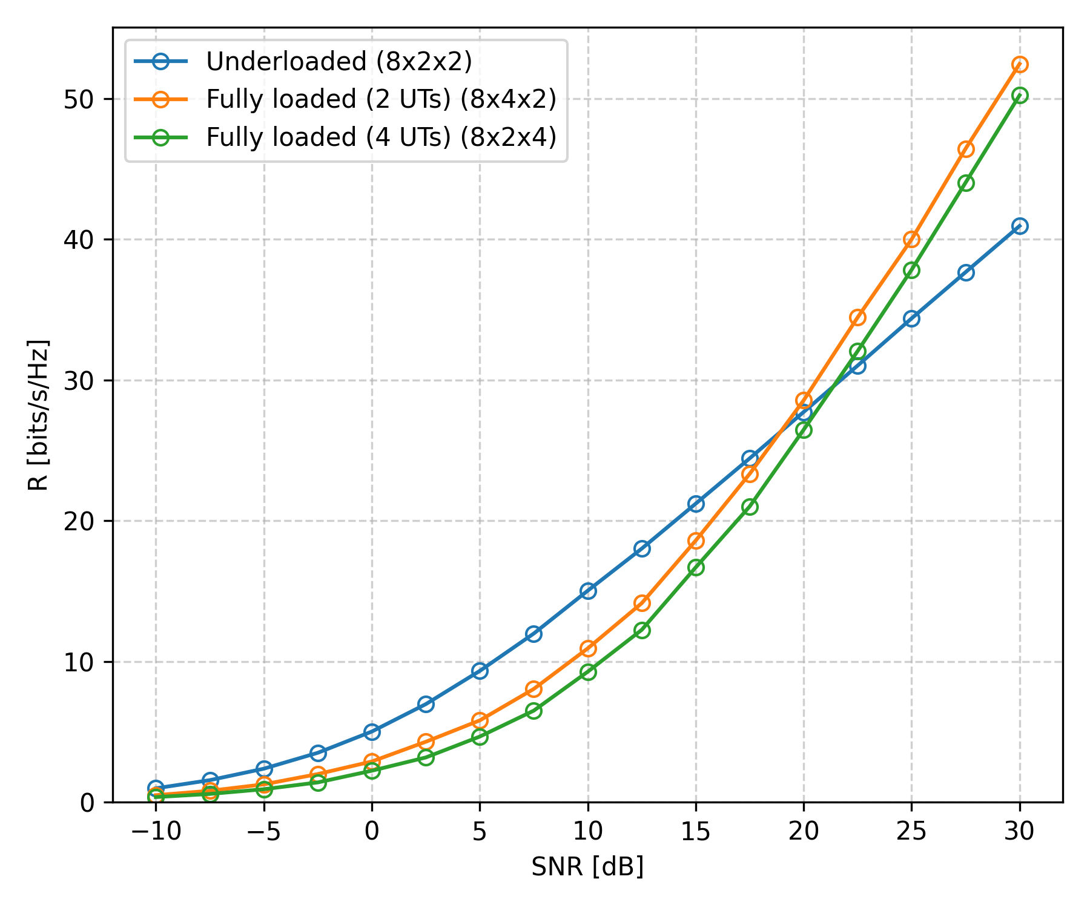
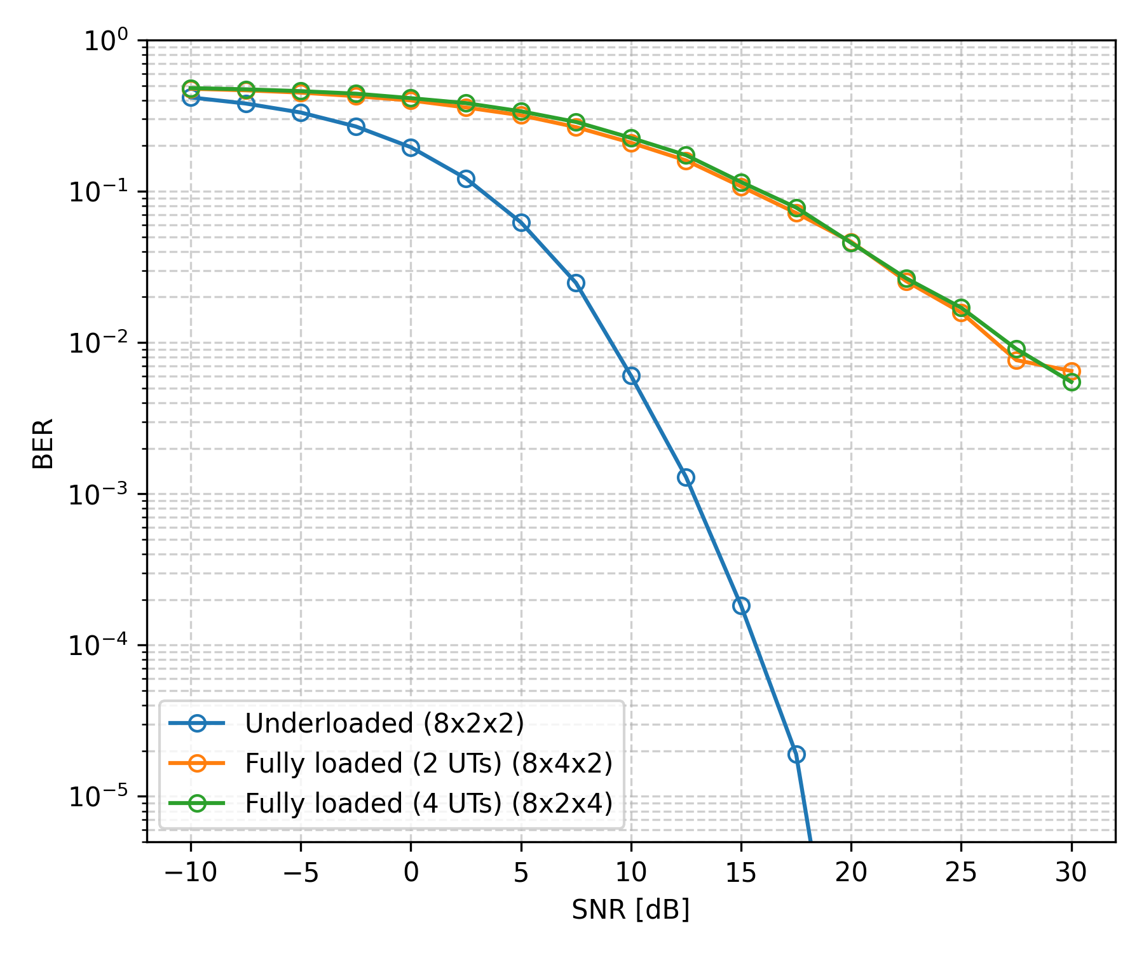
Simulation Results – ZF + LSV
Fixed Bit Loader (4-QAM)
R vs SNR
BER vs SNR

Slide 20
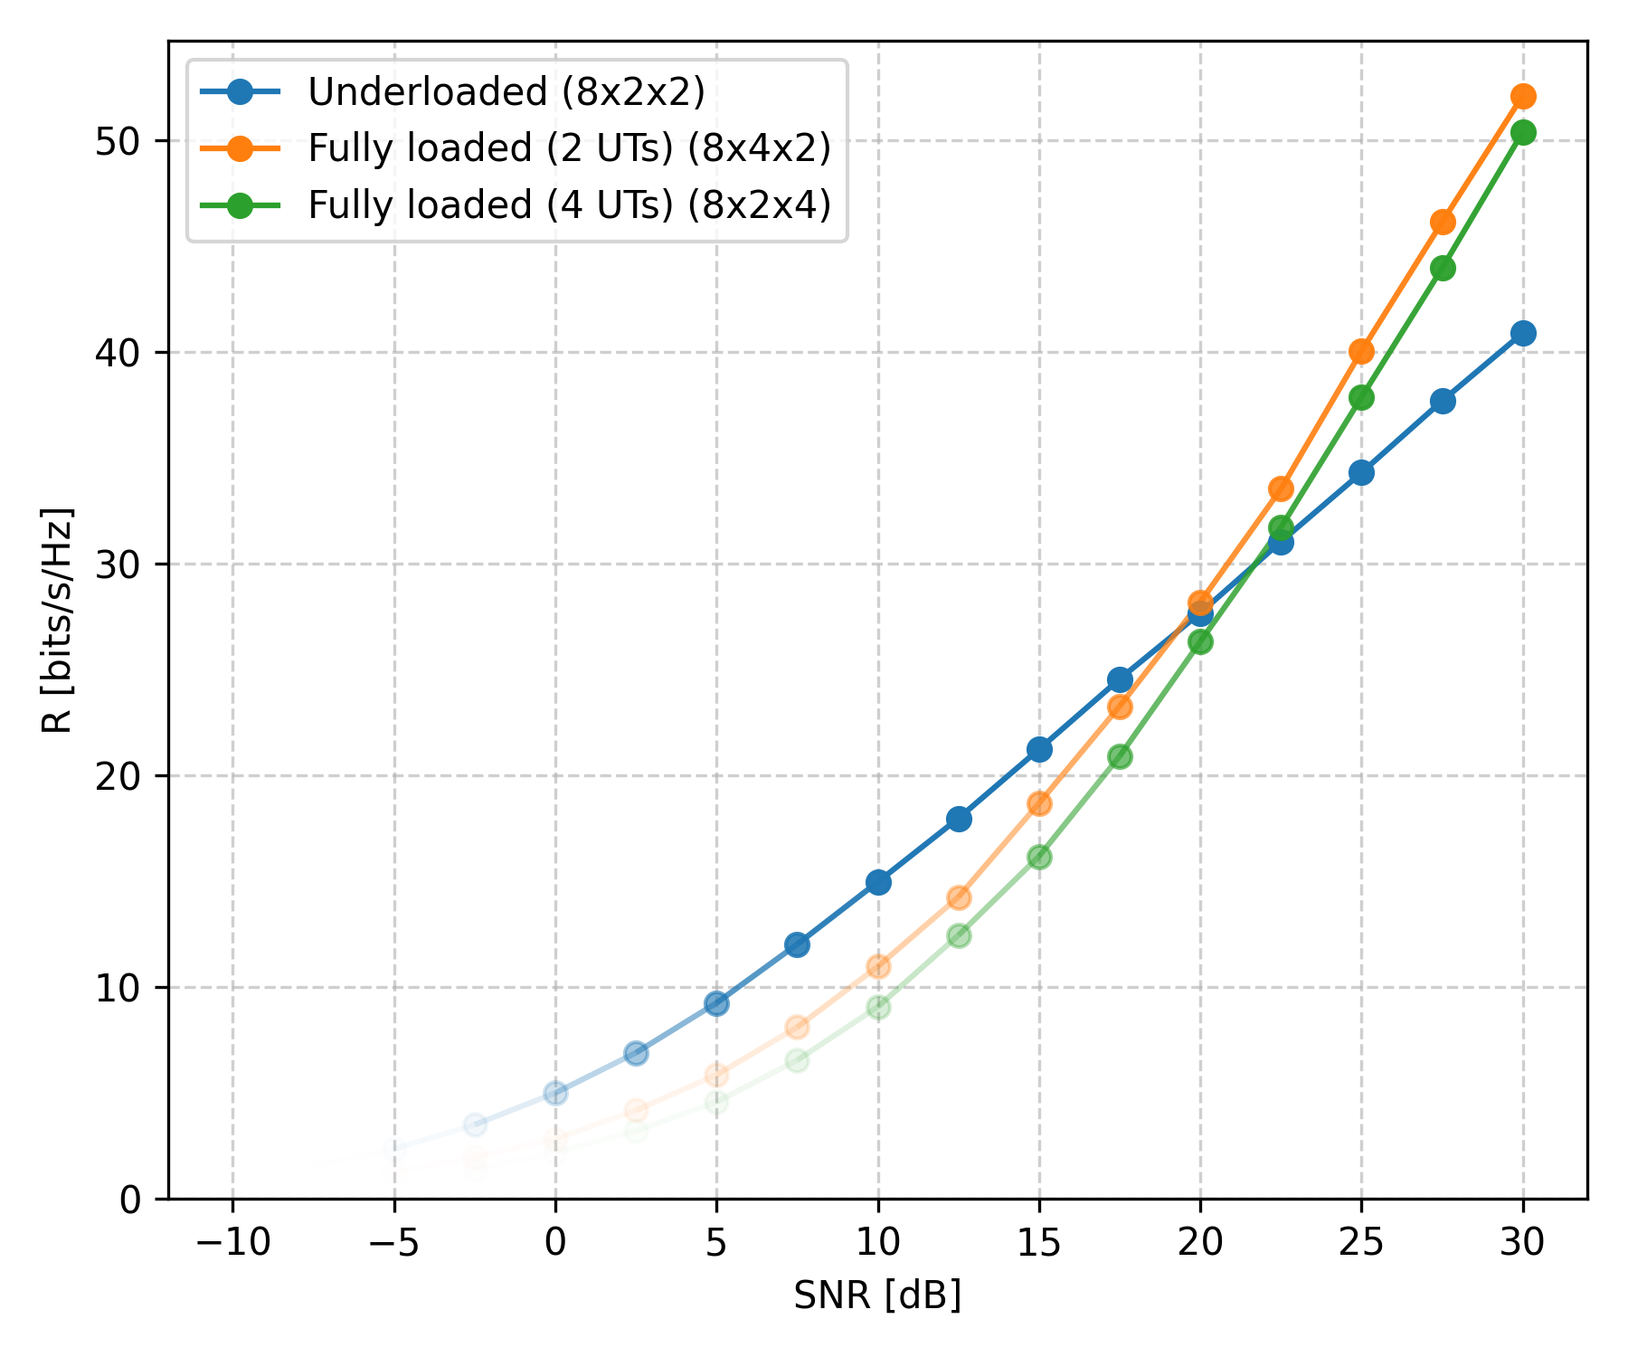
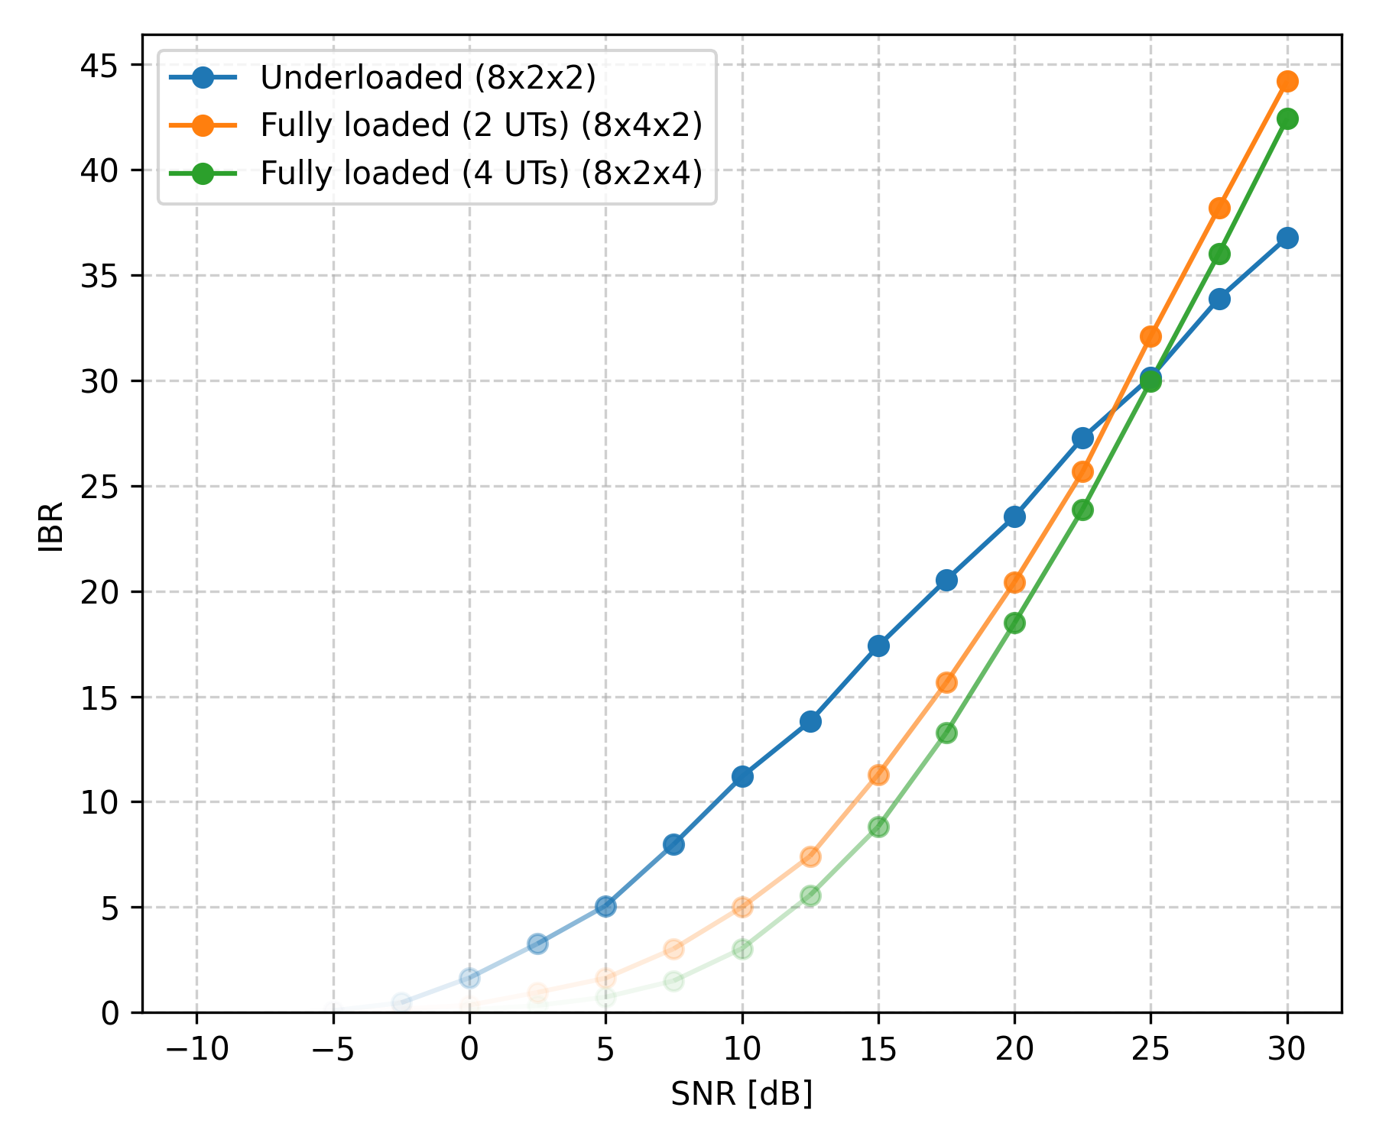
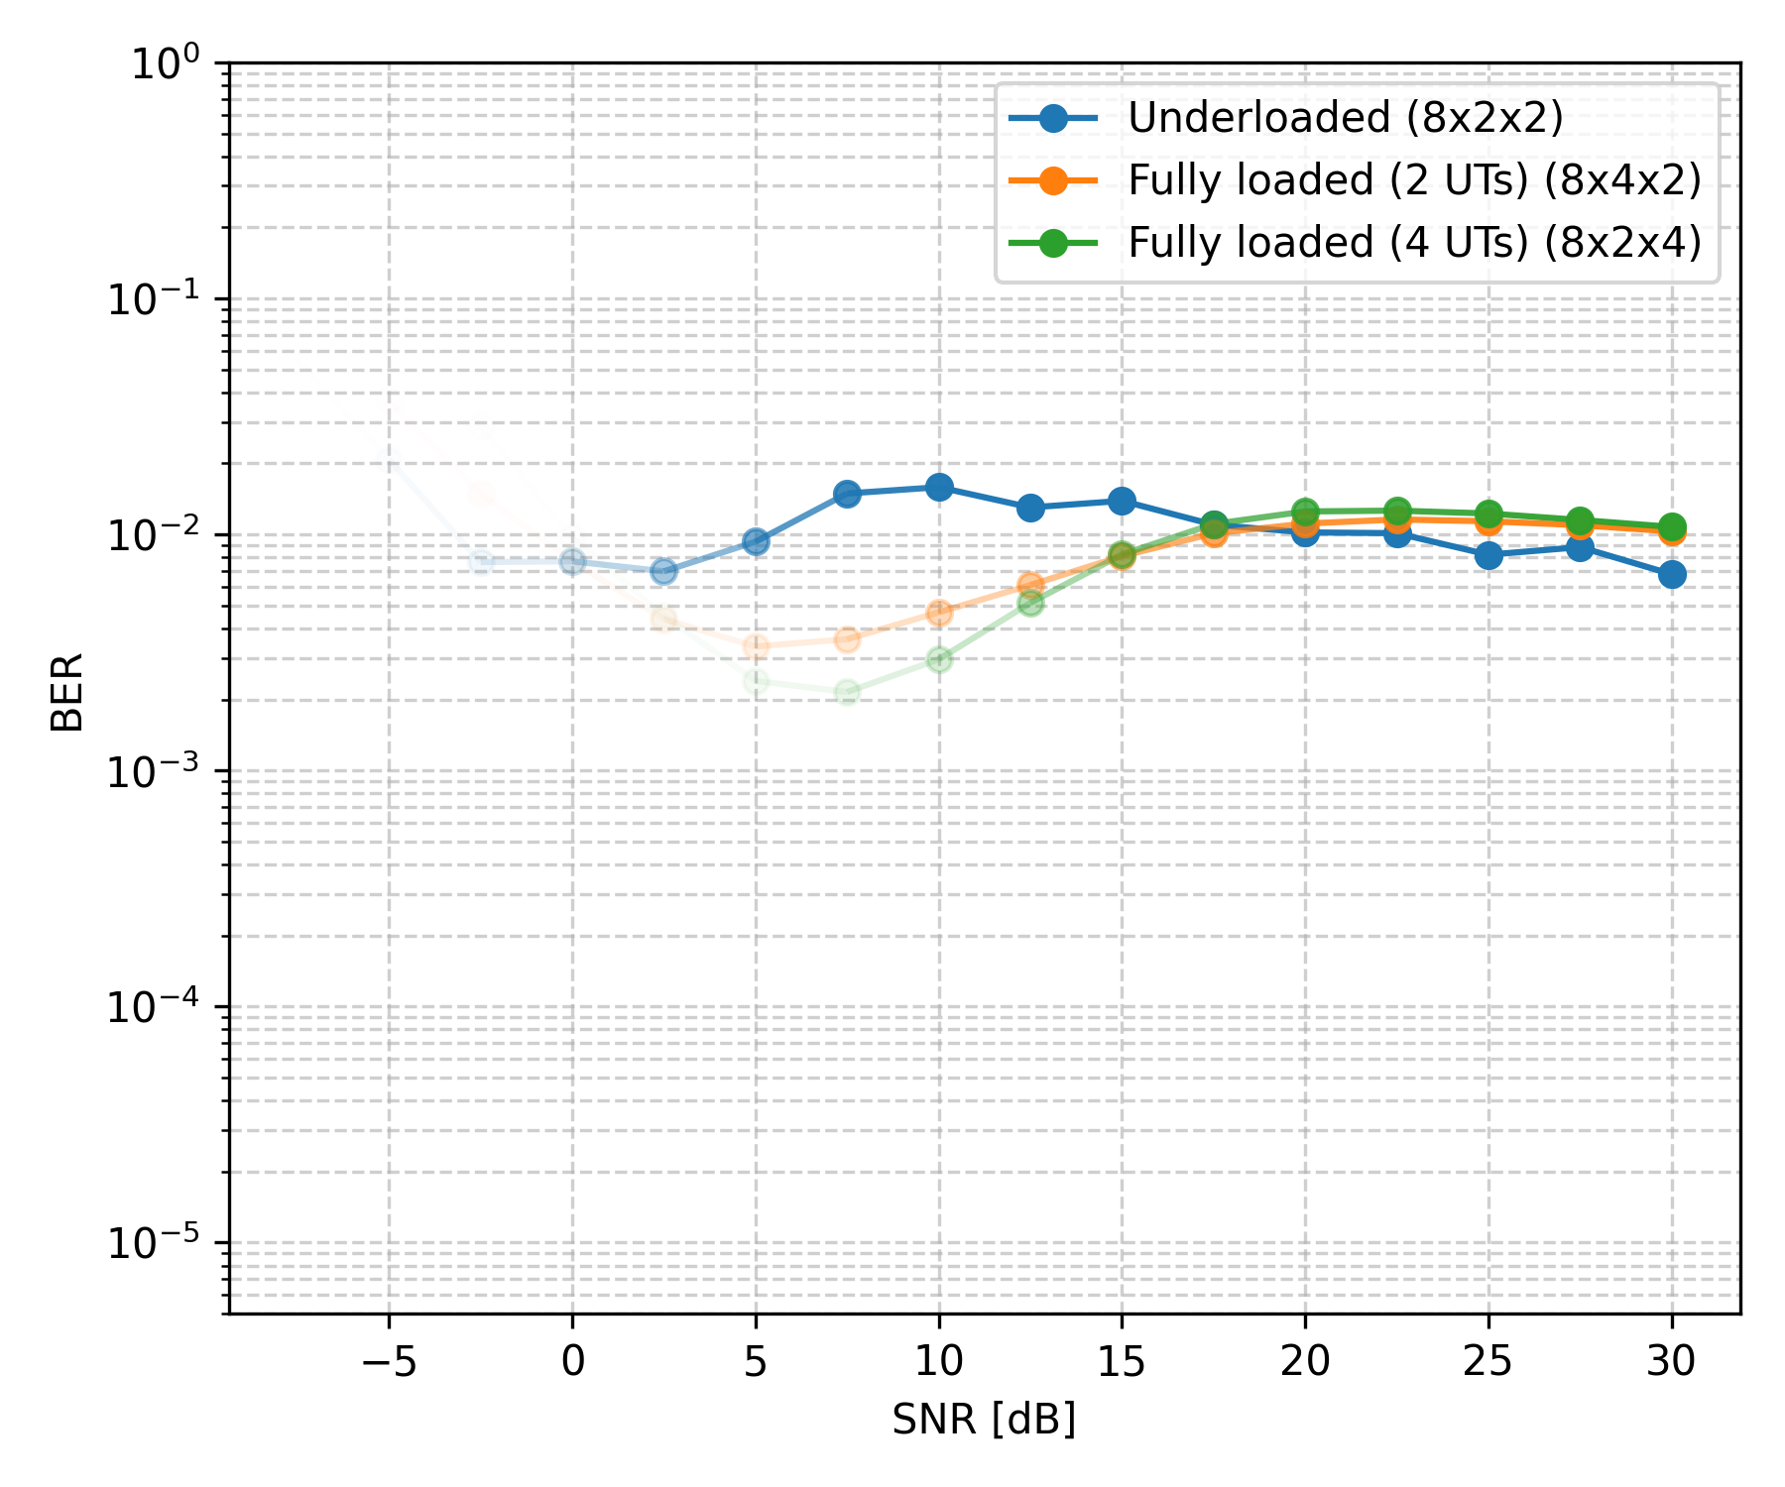
Simulation Results – ZF + LSV
Adaptive Bit Loader ($R$-QAM)
R vs SNR
IBR vs SNR
BER vs SNR

Slide 21
Simulation Results – ZF + LSV
Fixed Bit Loader (QAM ), Underloaded System
R vs SNR
BER vs SNR

Slide 22
Simulation Results – ZF + LSV
Adaptive Bit Loader (QAM), Fully loaded System (4 UTs)
R vs SNR
IBR vs SNR
BER vs SNR

Slide 23
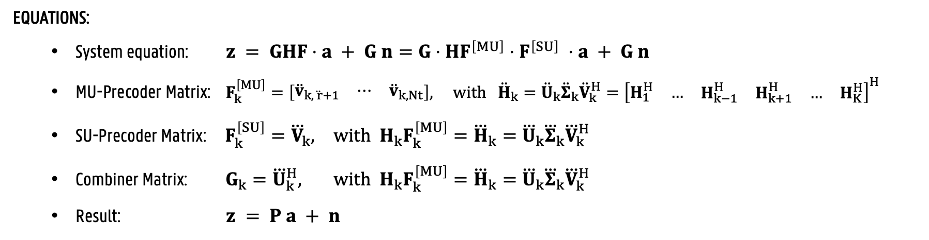
Precoding Techniques – BD
GOAL:
Cancel all inter-user interference
HOW:
Choose the MU-precoder of each UT such that it spans the null space of the the interfering channel
SVD Beamforming for each resulting SU-MIMO system.
EQUATIONS:
System equation: $z = GHF⋅a + G n=G⋅HF^{\left[MU\right]}⋅{ F}^{\left[SU\right]} ⋅a + G n$
MU-Precoder Matrix: $F_{k}^{\left[MU\right]}=\left[\begin{matrix}{\ddot{v}}_{k, \ddot{ r}+1} & ⋯ & {\ddot{v}}_{k, Nt}\end{matrix}\right], with {\ddot{H}}_{k}={\ddot{U}}_{k}{\ddot{Σ}}_{k}{\ddot{V}}_{k}^{H}={\left[\begin{matrix}\begin{matrix}H_{1}^{H} & \begin{matrix}… & \begin{matrix}H_{k−1}^{H} & H_{k+1}^{H}\end{matrix}\end{matrix}\end{matrix} & \begin{matrix}… & H_{K}^{H}\end{matrix}\end{matrix}\right]}^{H}$
SU-Precoder Matrix: $F_{k}^{\left[SU\right]}={\overset{⃛}{V}}_{k}, with H_{k}F_{k}^{\left[MU\right]}={\overset{⃛}{H}}_{k}={\overset{⃛}{U}}_{k}{\overset{⃛}{Σ}}_{k}{\overset{⃛}{V}}_{k}^{H}$
Combiner Matrix: $G_{k}={\overset{⃛}{U}}_{k}^{H}, with H_{k}F_{k}^{\left[MU\right]}={\overset{⃛}{H}}_{k}={\overset{⃛}{U}}_{k}{\overset{⃛}{Σ}}_{k}{\overset{⃛}{V}}_{k}^{H}$
Result: $z = P a + n$

Slide 24
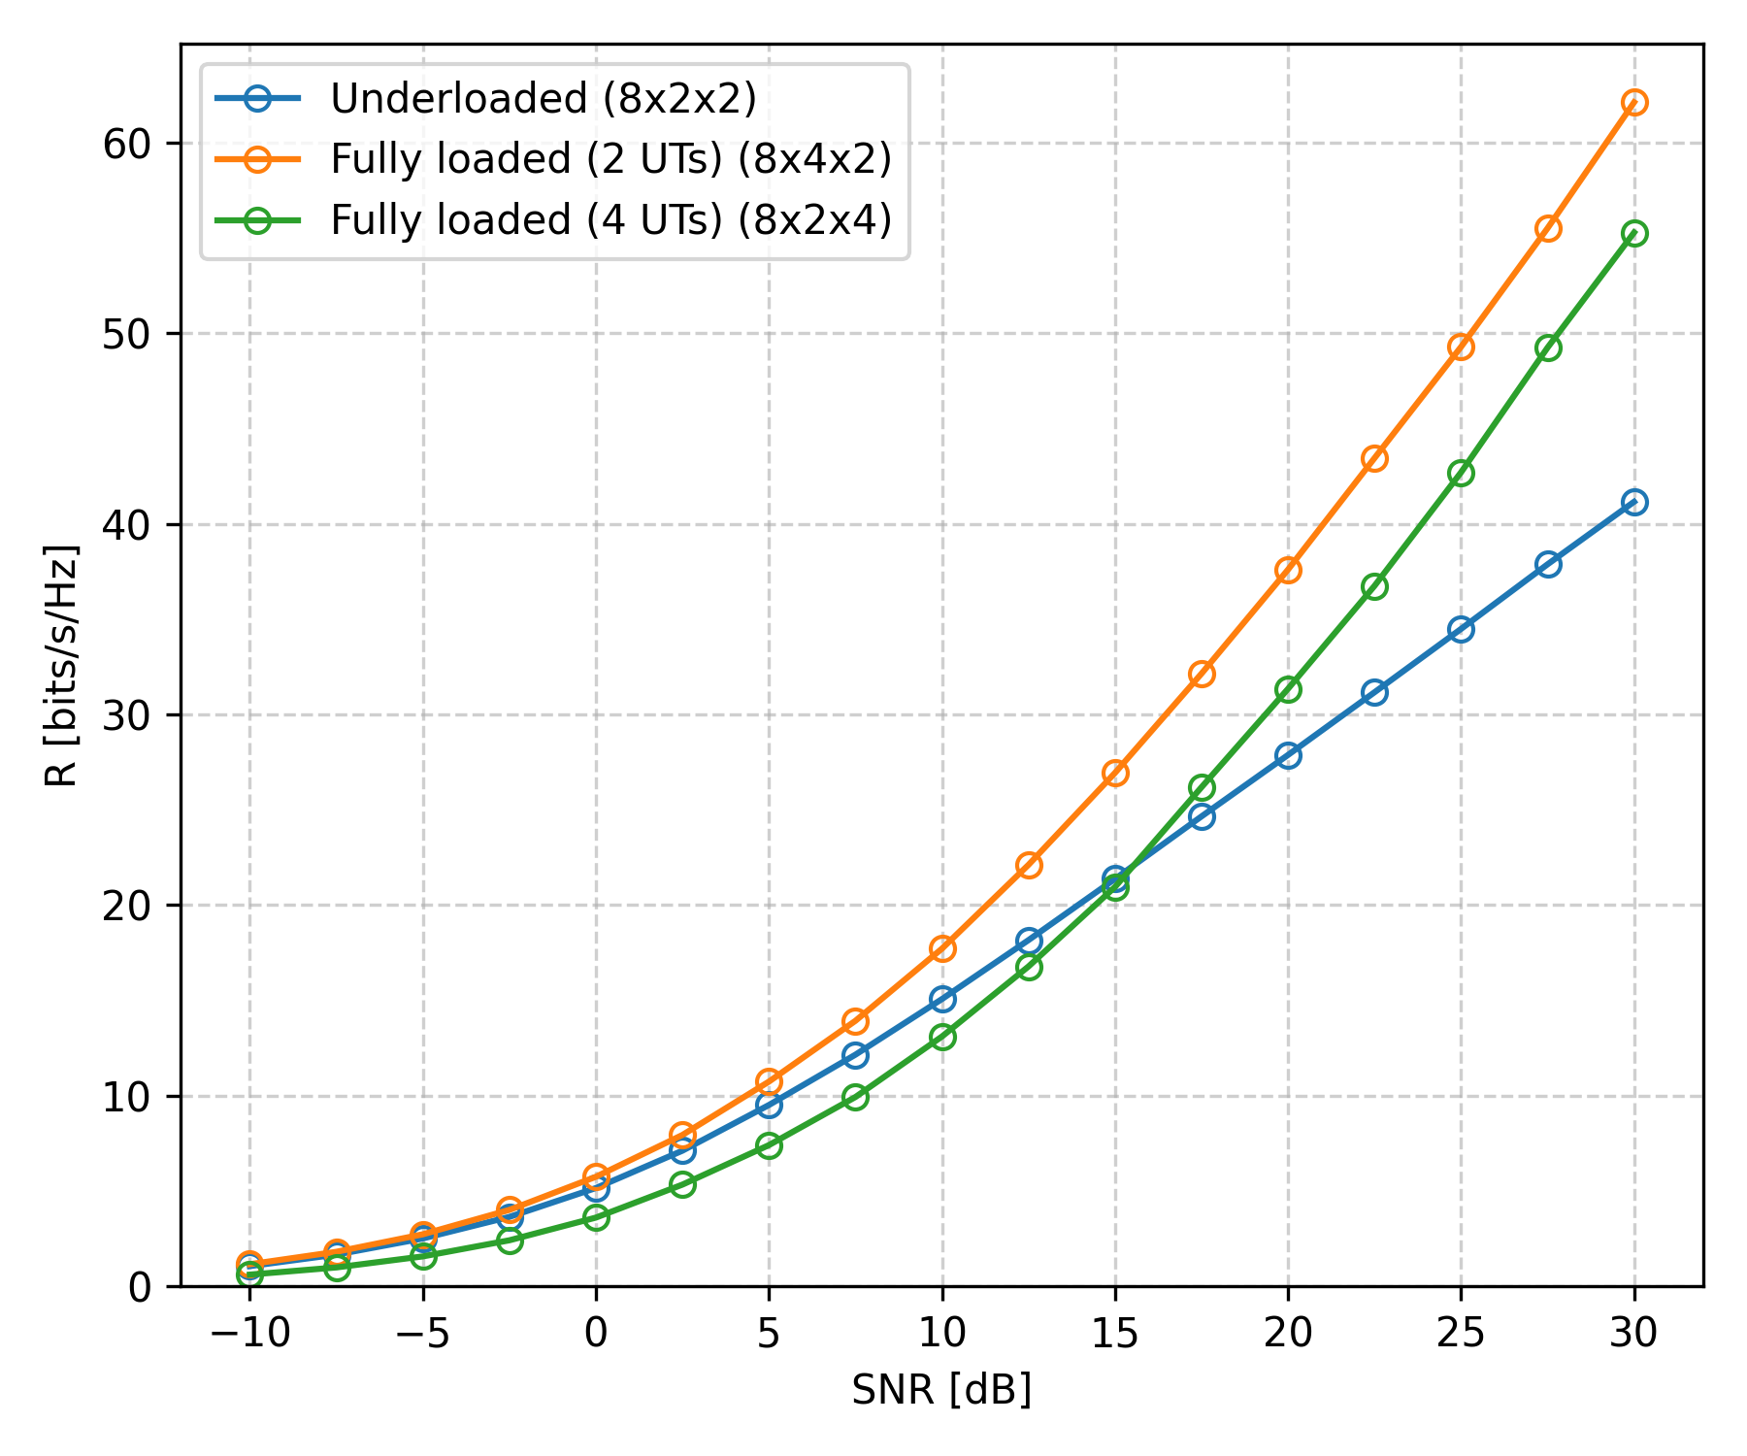
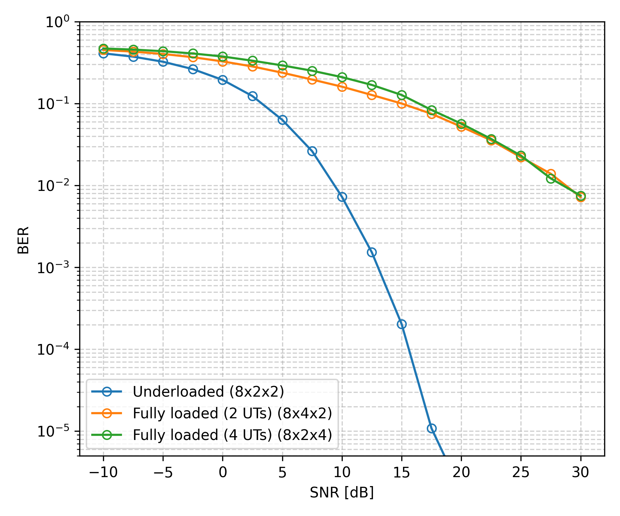
Simulation Results – BD
Fixed Bit Loader (4-QAM)
R vs SNR
BER vs SNR
Notes:
Important: The achievable rate DOES depend on how the rx antennas are distributed across the Uts. This makes sense: the more the antennas are concentrated on fewer Uts, the better we con exploit the combining process.
The slope of the achievable rate depends on the total number of receive antennas, only! There is an SNR gain when the receive antennas are concentrated on fewer Uts.

Slide 25
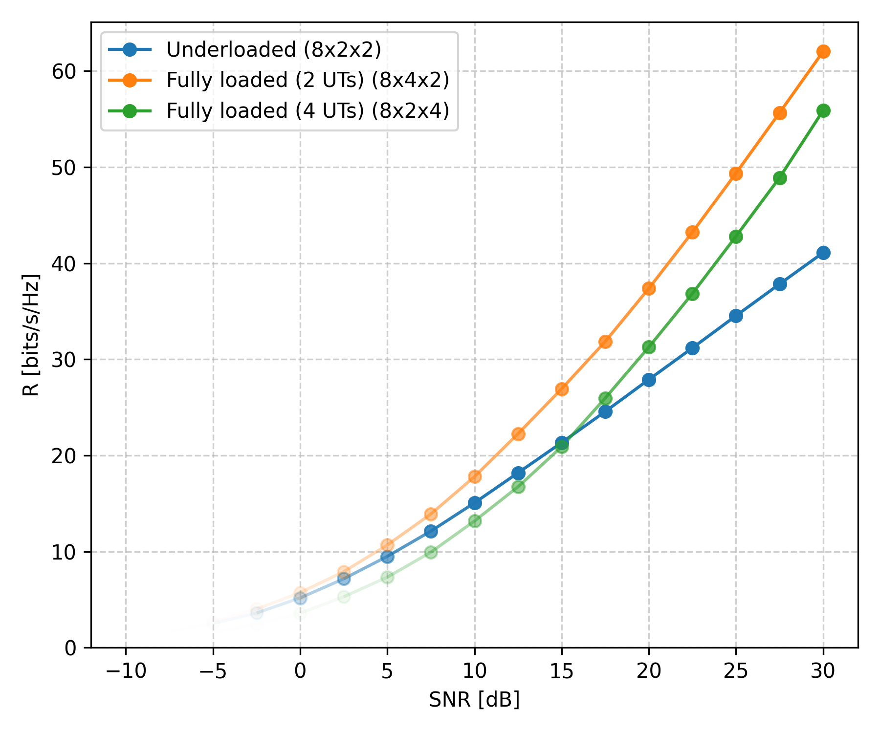
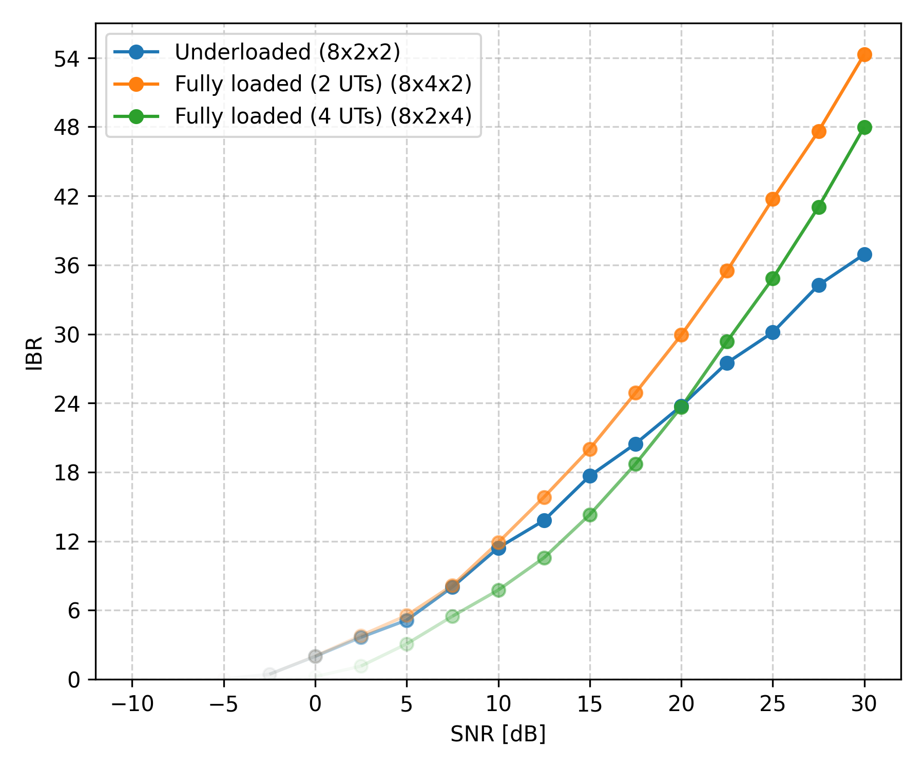
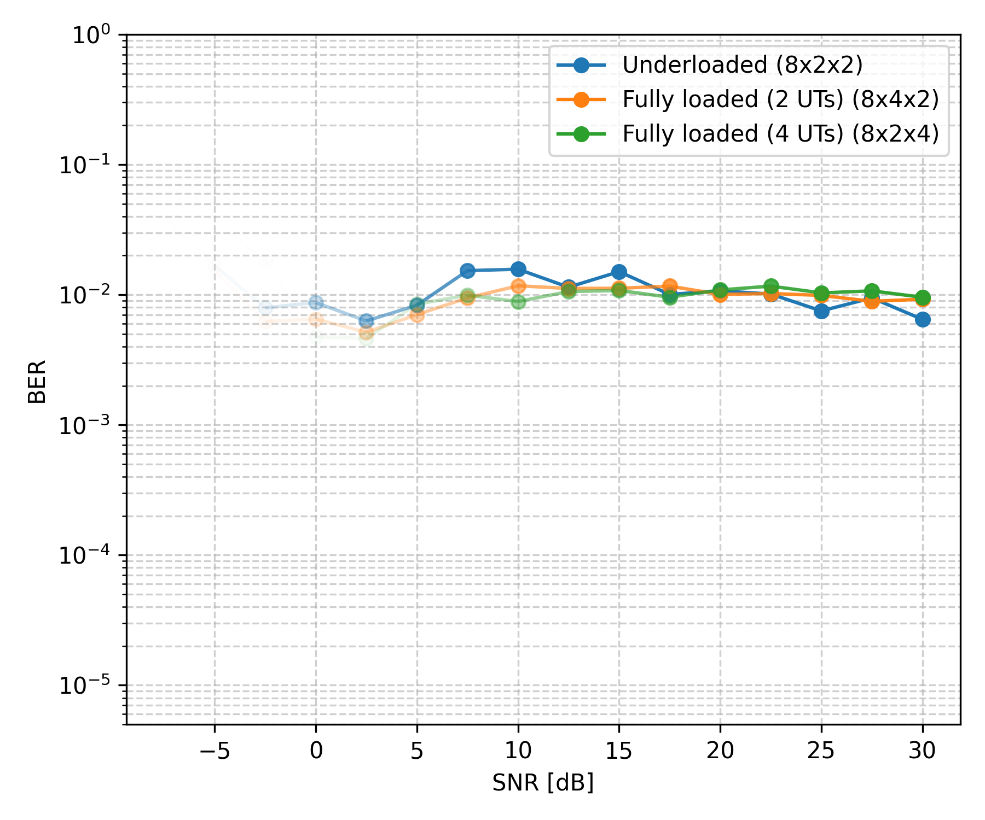
Simulation Results – BD
Adaptive Bit Loader ($R$-QAM)
R vs SNR
IBR vs SNR
BER vs SNR

Slide 26
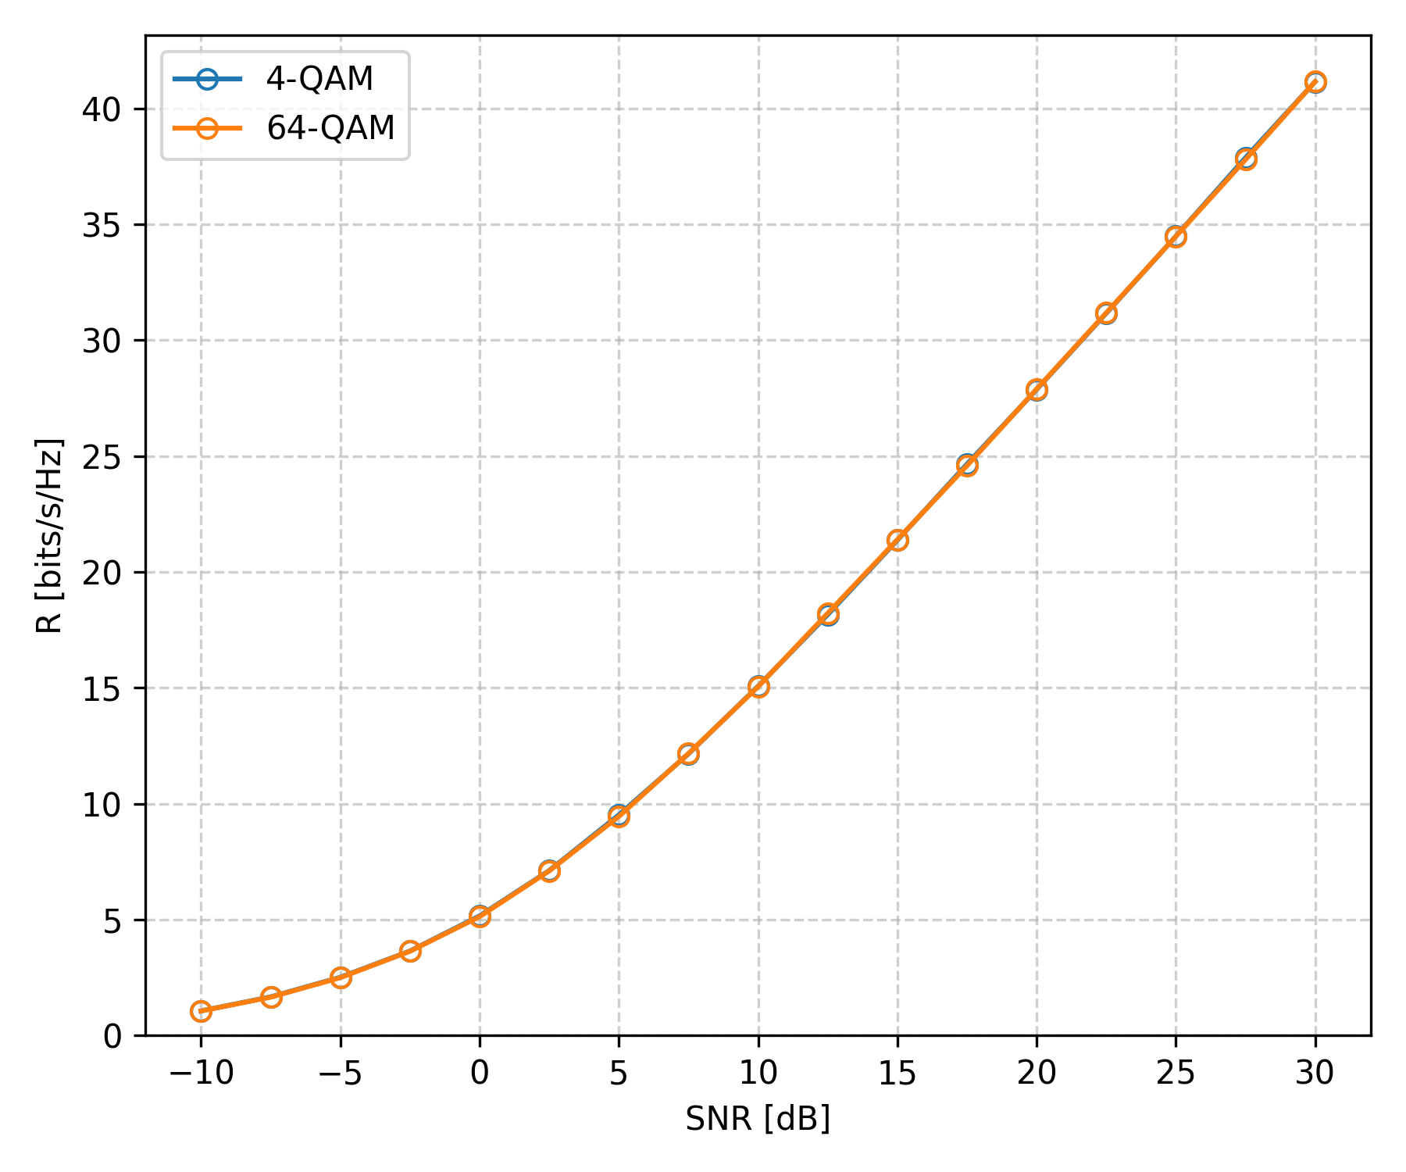
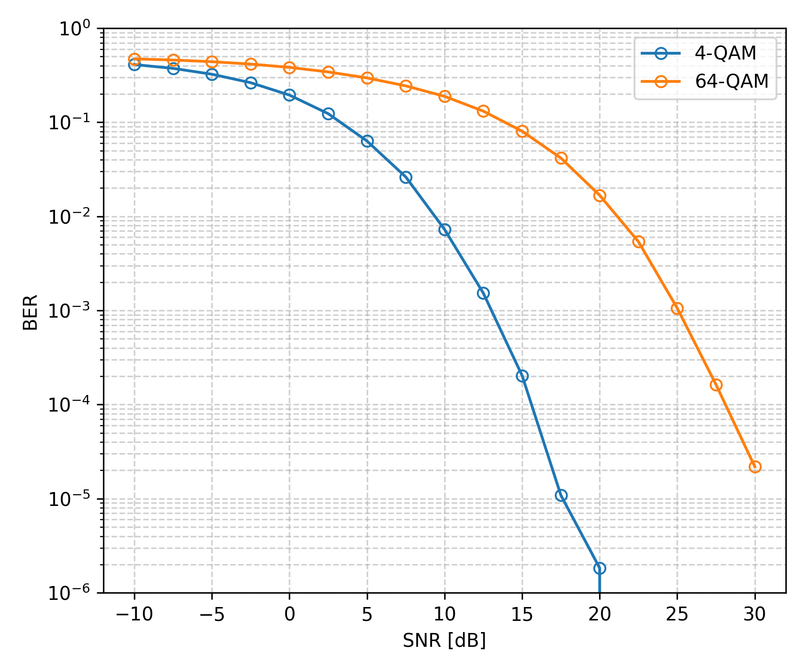
Simulation Results – BD
Fixed Bit Loader (QAM ), Underloaded System
R vs SNR
BER vs SNR

Slide 27
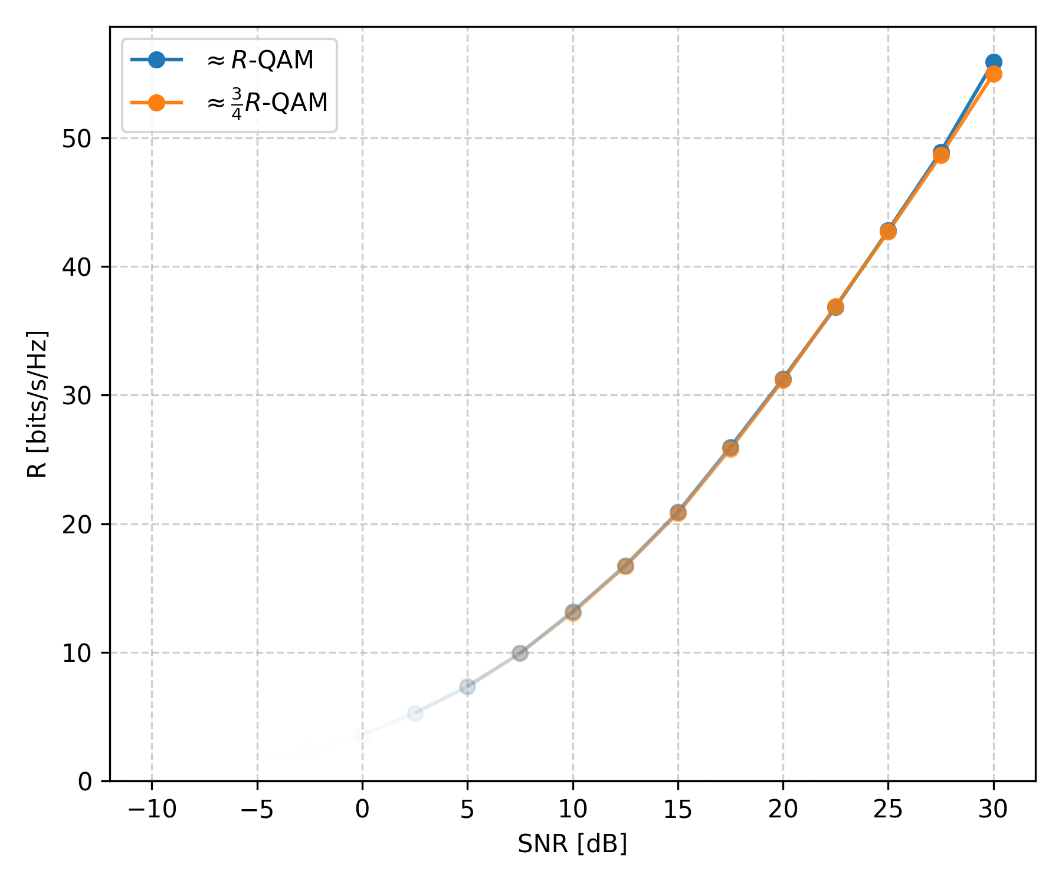
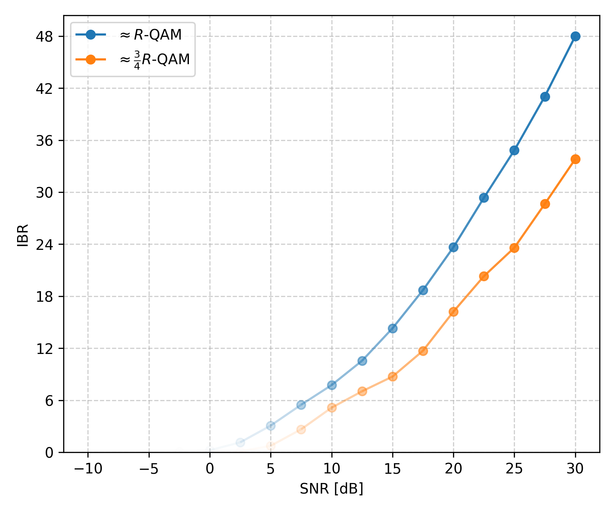
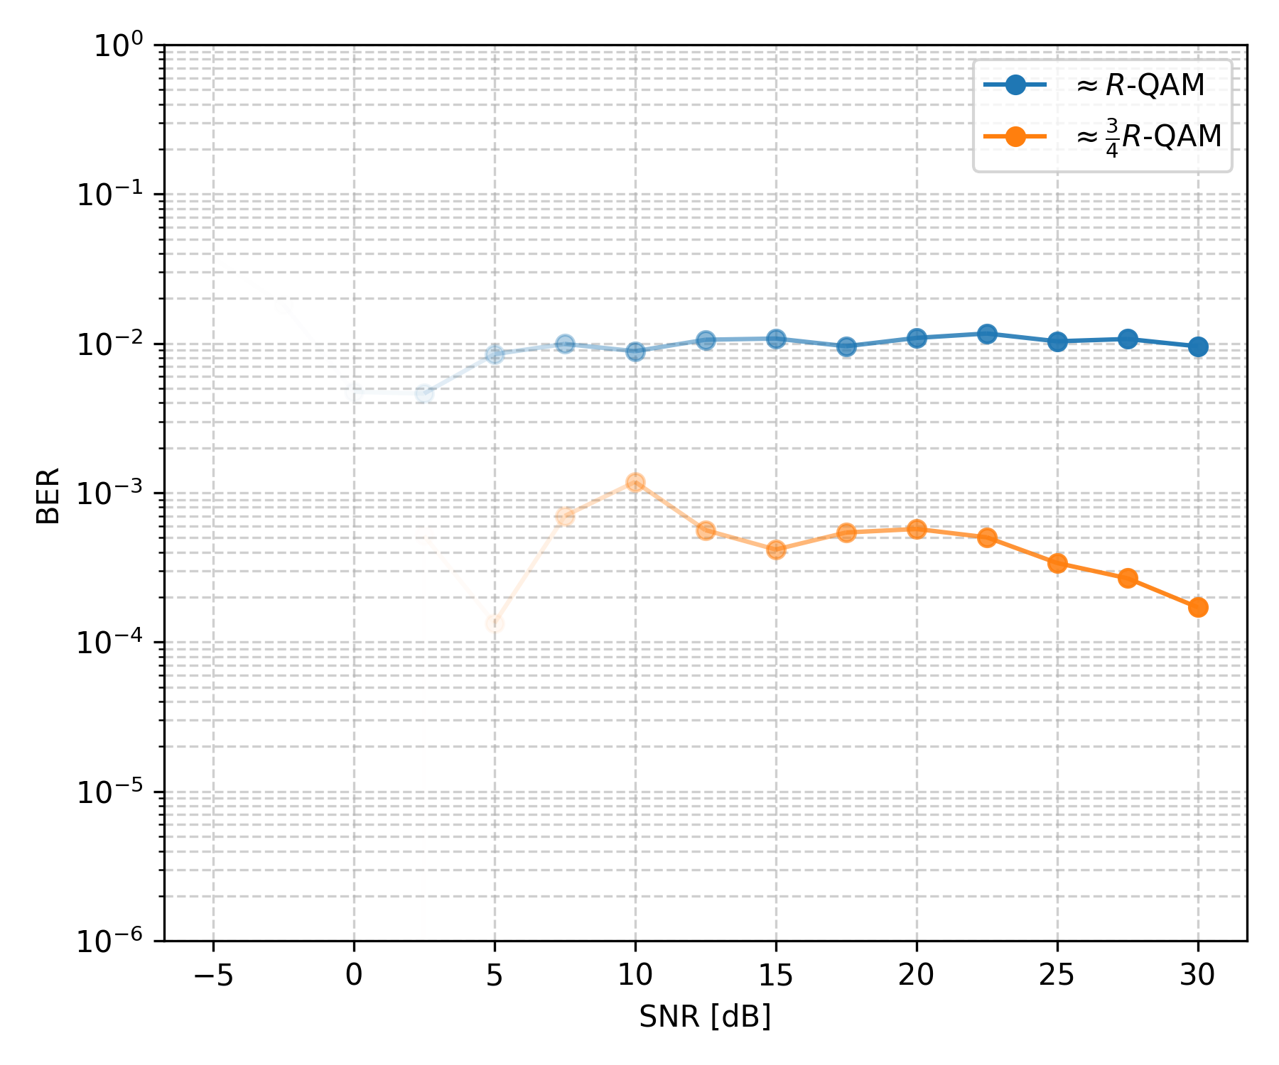
Simulation Results – BD
Adaptive Bit Loader (QAM), Fully Loaded System (4 UTs)
R vs SNR
IBR vs SNR
BER vs SNR

Slide 28
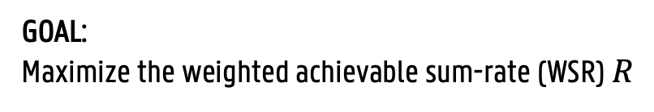
Precoding Techniques – WMMSE
GOAL:
Maximize the weighted achievable sum-rate (WSR) $R$
HOW:
Establish a relationship between the WSR and the WMMSE
Algorithm that alternates between WMMSE optimization of the precoders and the MSE-weight update.
EQUATIONS:
See paper.

Slide 29
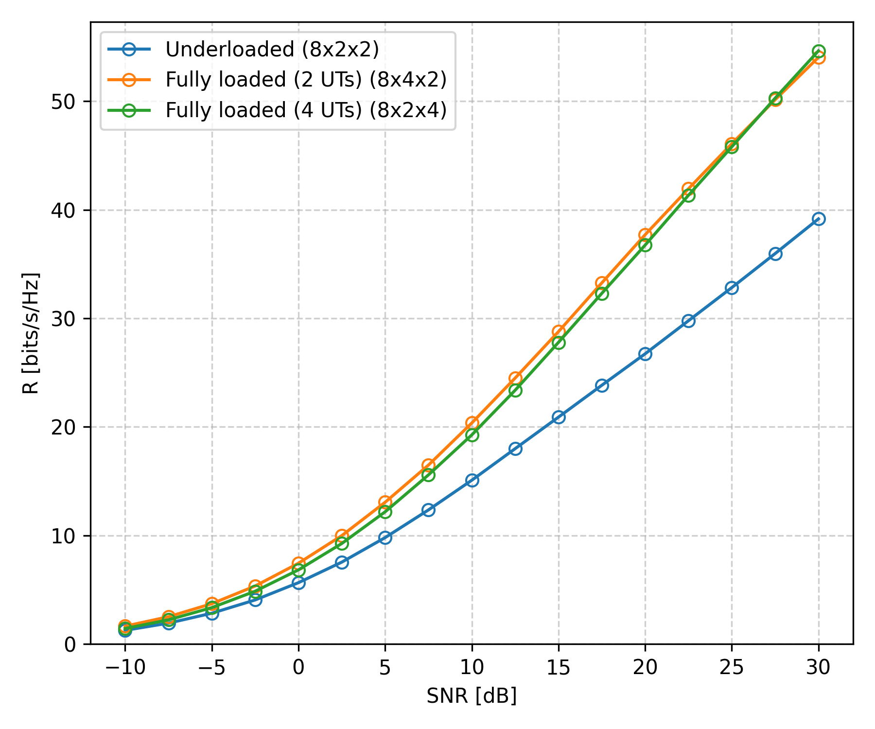
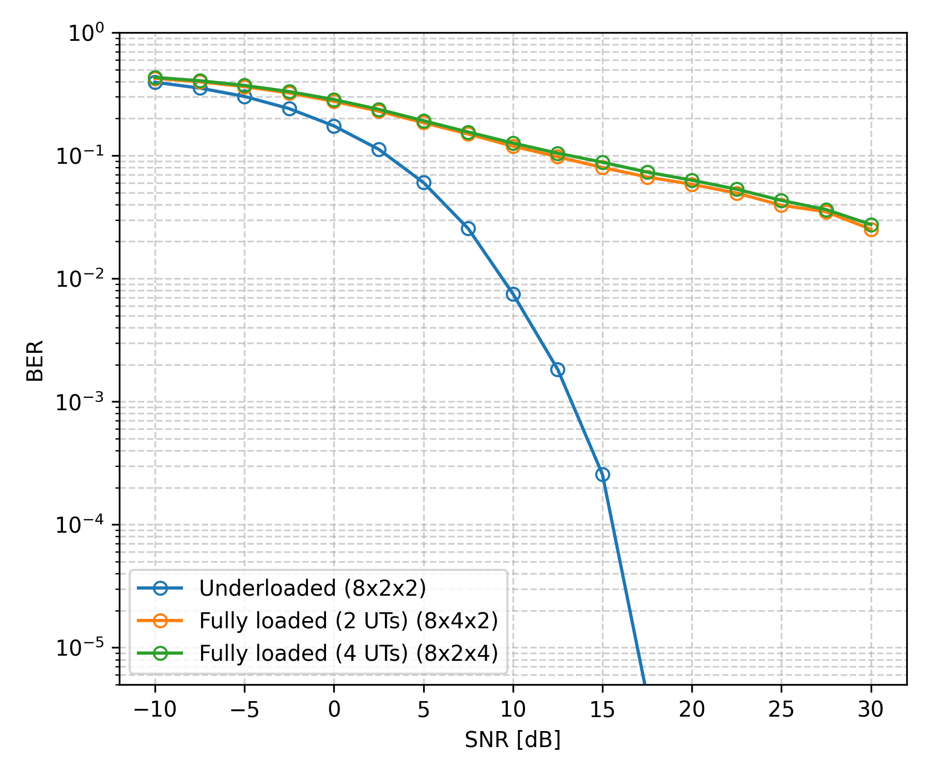
Simulation Results – WMMSE
Fixed Bit Loader (4-QAM)
R vs SNR
BER vs SNR

Slide 30
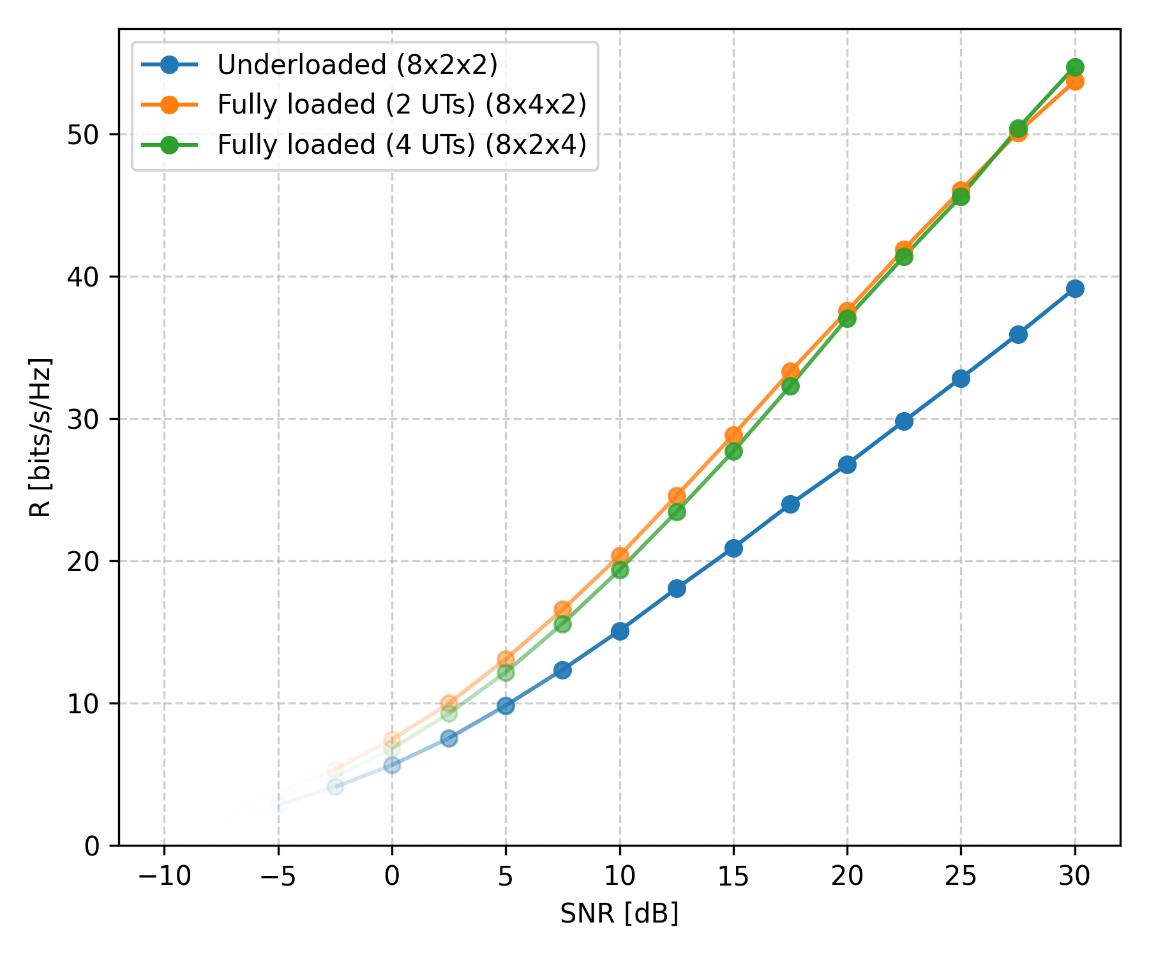
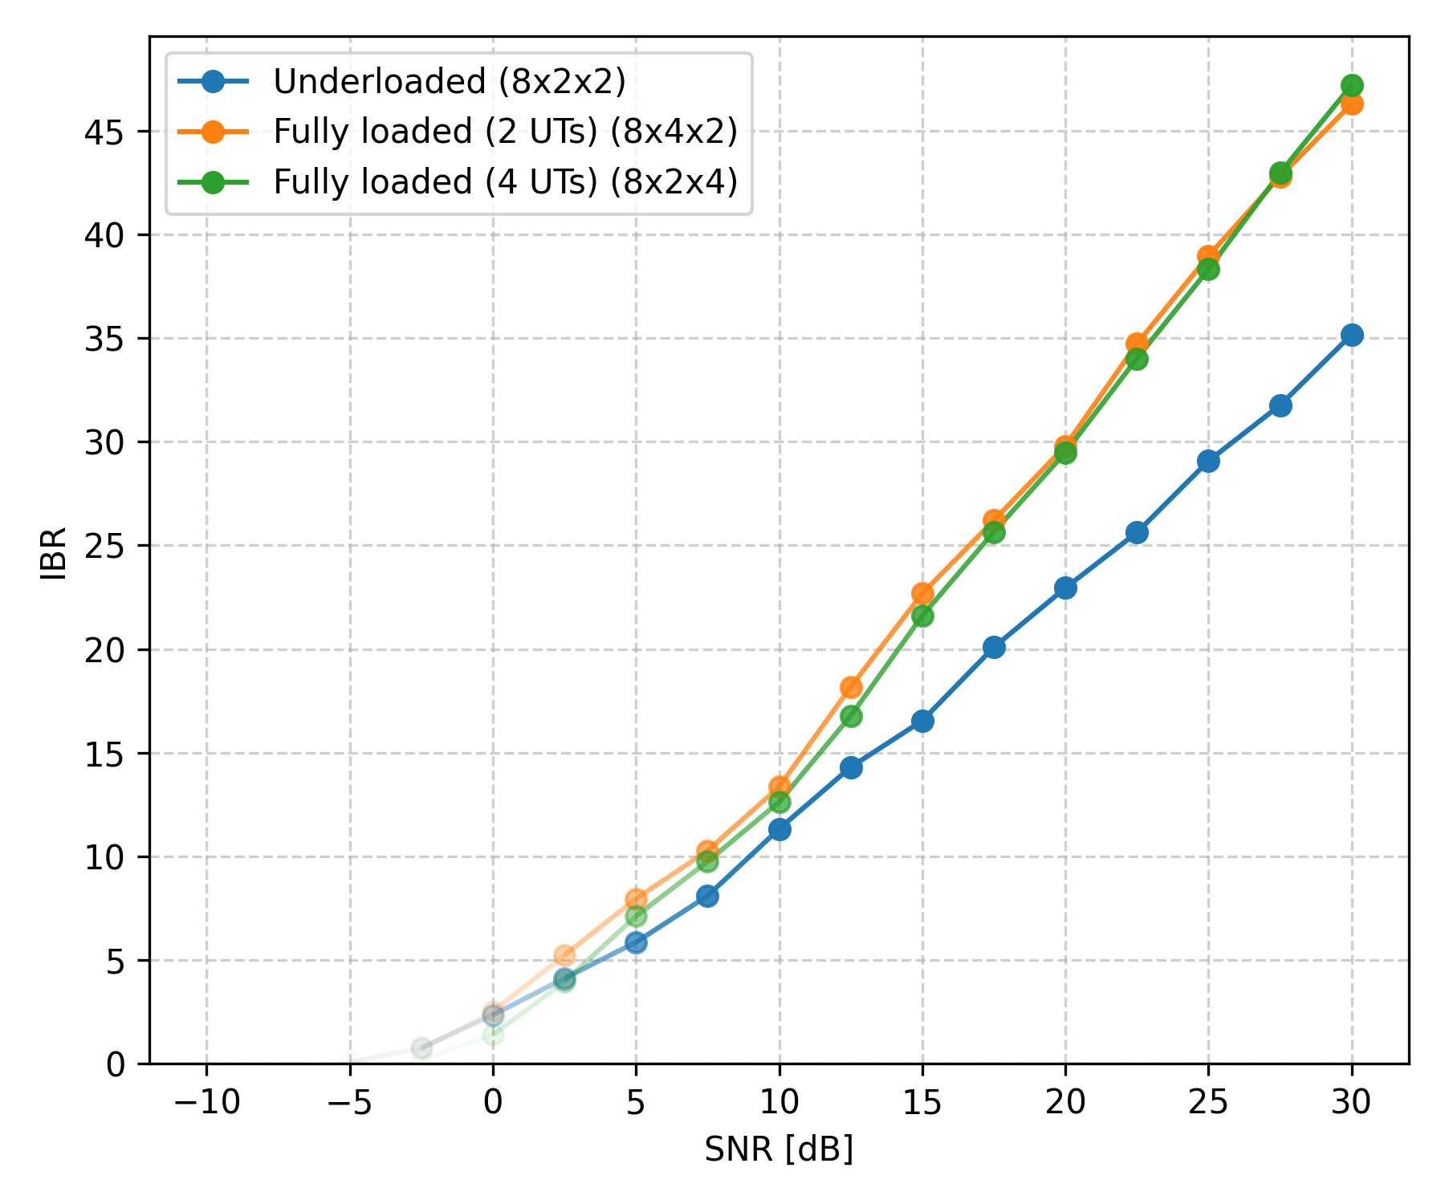

Simulation Results – WMMSE
Adaptive Bit Loader ($R$-QAM)
R vs SNR
IBR vs SNR
BER vs SNR

Slide 31


Simulation Results – WMMSE
Fixed Bit Loader (QAM), Underloaded System
R vs SNR
BER vs SNR

Slide 32



Simulation Results – WMMSE
Adaptive Bit Loader (QAM), Fully Loaded System (2 UTs)
R vs SNR
IBR vs SNR
BER vs SNR

Slide 33


Precoding Techniques – Comparison
ACHIEVABLE RATE:
$$R = 2B \sum_{k=1}^{K}{\sum_{nr = 1}^{Nr}{\log_{2}\left(1 + \frac{g_{k,nr}p_{k,nr}}{N_{0}}\right)}}$$
VIRTUAL PARALLEL CHANNEL GAINS:
Zero-Forcing: $\frac{1}{g_{k,nr}} = {\left({\left(H H^{H}\right)}^{−1}\right)}_{\left(\left(k−1\right)Nr+nr, \left(k−1\right)Nr+nr\right)}$
Zero-Forcing + LSV: $\frac{1}{g_{k,nr}} = {\left({\left(GH {\left(GH\right)}^{H}\right)}^{−1}\right)}_{\left(\left(k−1\right)Nr+nr, \left(k−1\right)Nr+nr\right)}$
Block Diagonalization: $g_{k,nr}= Σ_{\left(nr, nr\right)}^{2}, with H = UΣV^{H} ∈ ℂ^{\ddot{r} x Nr} and h_{\left(r, nr\right)}∼𝒩_{ℂ}\left(0, 1\right) \left(\ddot{r} = Nt − \left(K−1\right)Nr \right)$

Slide 34



Precoding Techniques – Comparison (Fully Loaded System 2 UTs)
Virtual Parallel Channel Gain Distributions $g_{k,nr}$
Zero-Forcing
Zero-Forcing + LSV Combiner
Block Diagonalization

Slide 35


Precoding Techniques – Comparison (Fully Loaded System 2 UTs)
Fixed Bit Loader (64-QAM)
R vs SNR
BER vs SNR

Slide 36



Precoding Techniques – Comparison (Fully Loaded System 2 UTs)
Adaptive Bit Loader
R vs SNR
IBR vs SNR
BER vs SNR

Slide 37



Precoding Techniques – Comparison (Fully Loaded System 4 UTs)
Virtual Parallel Channel Gain Distributions $g_{k,nr}$
Zero-Forcing
Zero-Forcing + LSV Combiner
Block Diagonalization

Slide 38


Precoding Techniques – Comparison (Fully Loaded System 4 UTs)
Fixed Bit Loader (64-QAM)
R vs SNR
BER vs SNR

Slide 39



Precoding Techniques – Comparison (Fully Loaded System 4 UTs)
Adaptive Bit Loader
R vs SNR
IBR vs SNR
BER vs SNR

Slide 40



Precoding Techniques – Comparison (Underloaded System)
Virtual Parallel Channel Gain Distributions $g_{k,nr}$
Zero-Forcing
Zero-Forcing + LSV Combiner
Block Diagonalization

Slide 41


Precoding Techniques – Comparison (Underloaded System)
Fixed Bit Loader (64-QAM)
R vs SNR
BER vs SNR

Slide 42



Precoding Techniques – Comparison (Underloaded System)
Adaptive Bit Loader
R vs SNR
IBR vs SNR
BER vs SNR

Slide 43






Precoding Techniques – Comparison
BD vs SVD
MU-MIMO:
BD
SU-MIMO: SVD

Slide 44


Precoding Techniques – Comparison
BD vs SVD
R vs SNR
BER vs SNR

Slide 45



Precoding Techniques – Comparison
BD vs SVD
R vs SNR
IBR vs SNR
BER vs SNR

Slide 46
Wannes Baes
Supervisors: Prof. Dr. Ir. Nele Noels, Dr. Ir. Rodrigo Moreas
Universiteit Gent
@ugent
@ugent
Ghent University
wannes.baes@ugent.be
youtube.com/ugent
www.ugent.be

