Slide 1
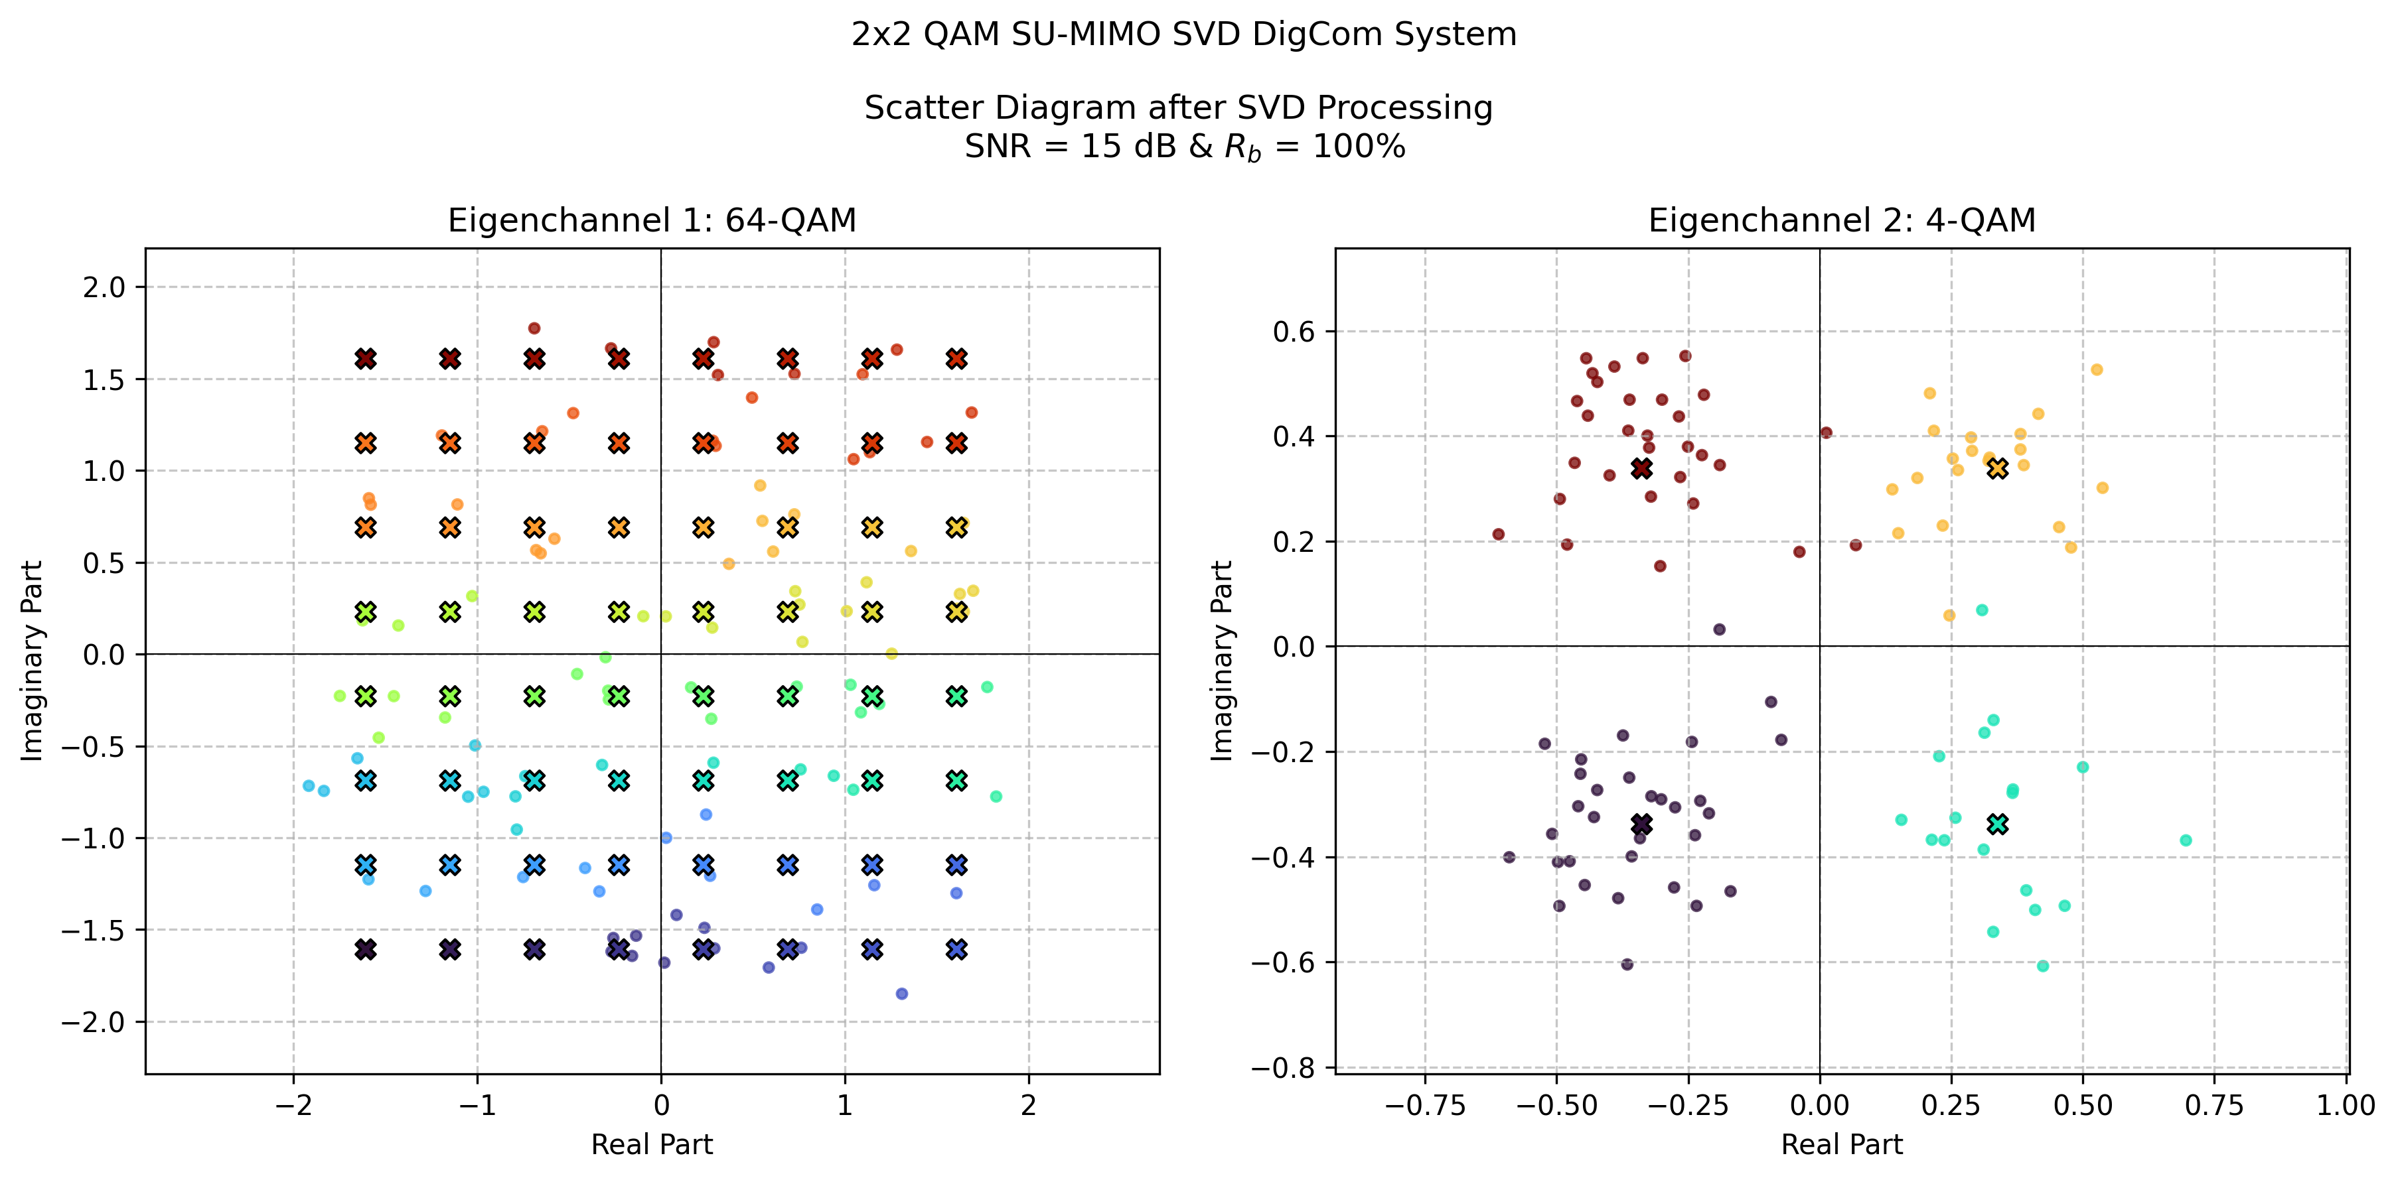
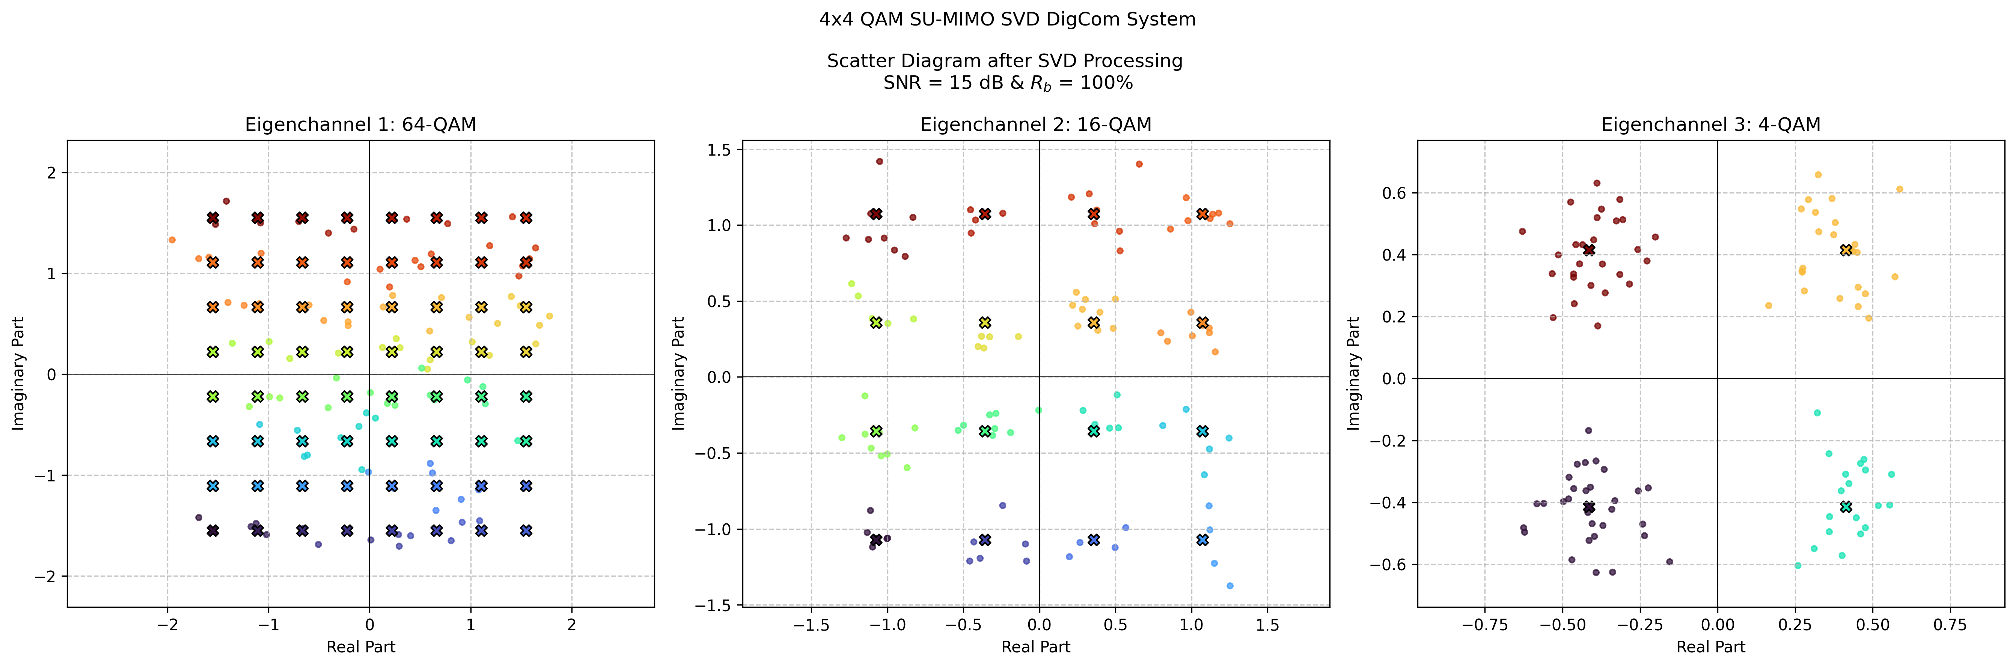
different SU-MIMO systems!
2x2 vs 4x4
same SNR
same information bit rate

Slide 2
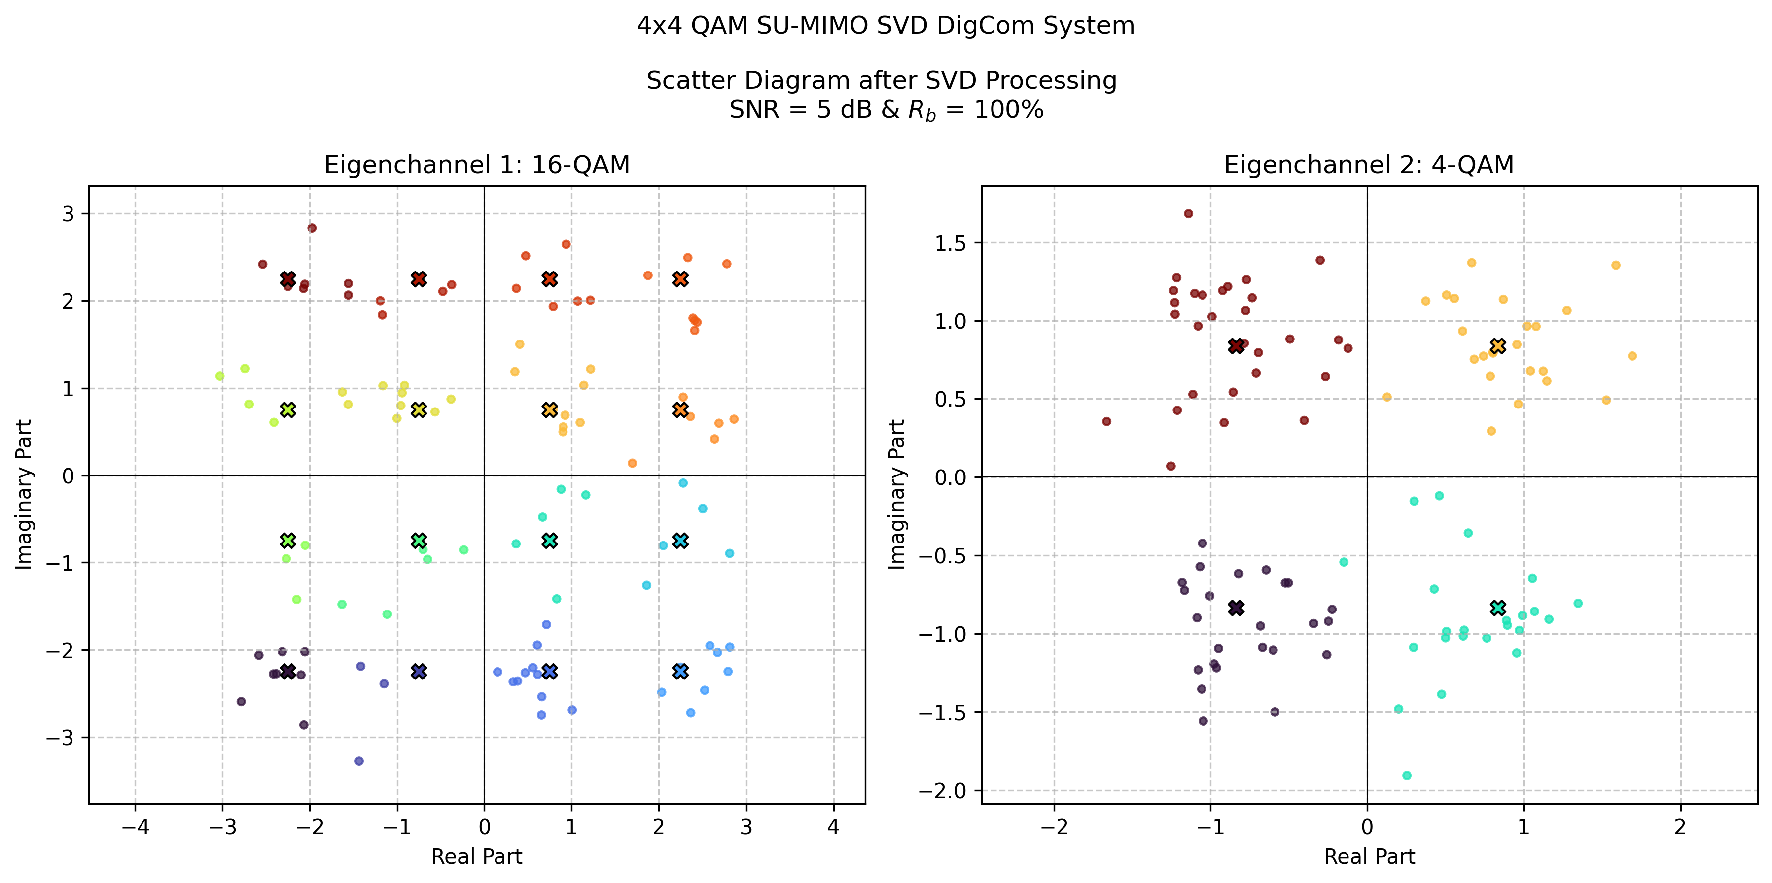
different SNR values
5 vs 15
same systems
same information bit rate

Slide 3
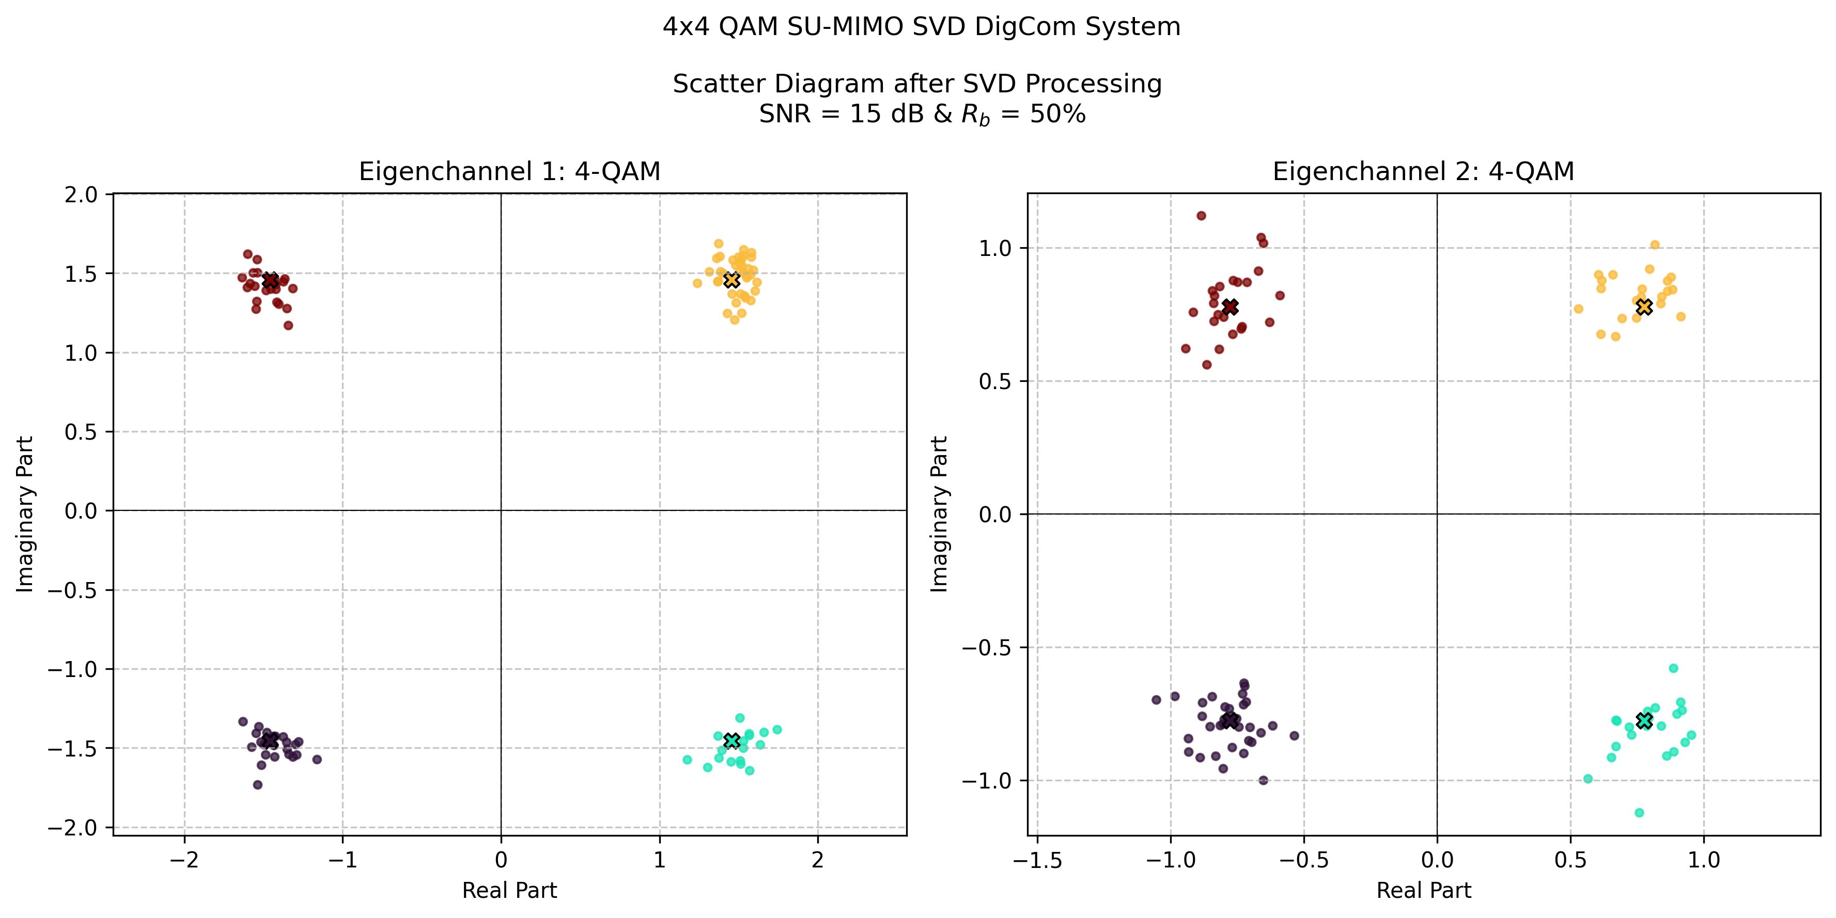
different information bit rate
50% vs 100%
same systems
same information bit rate

Slide 4
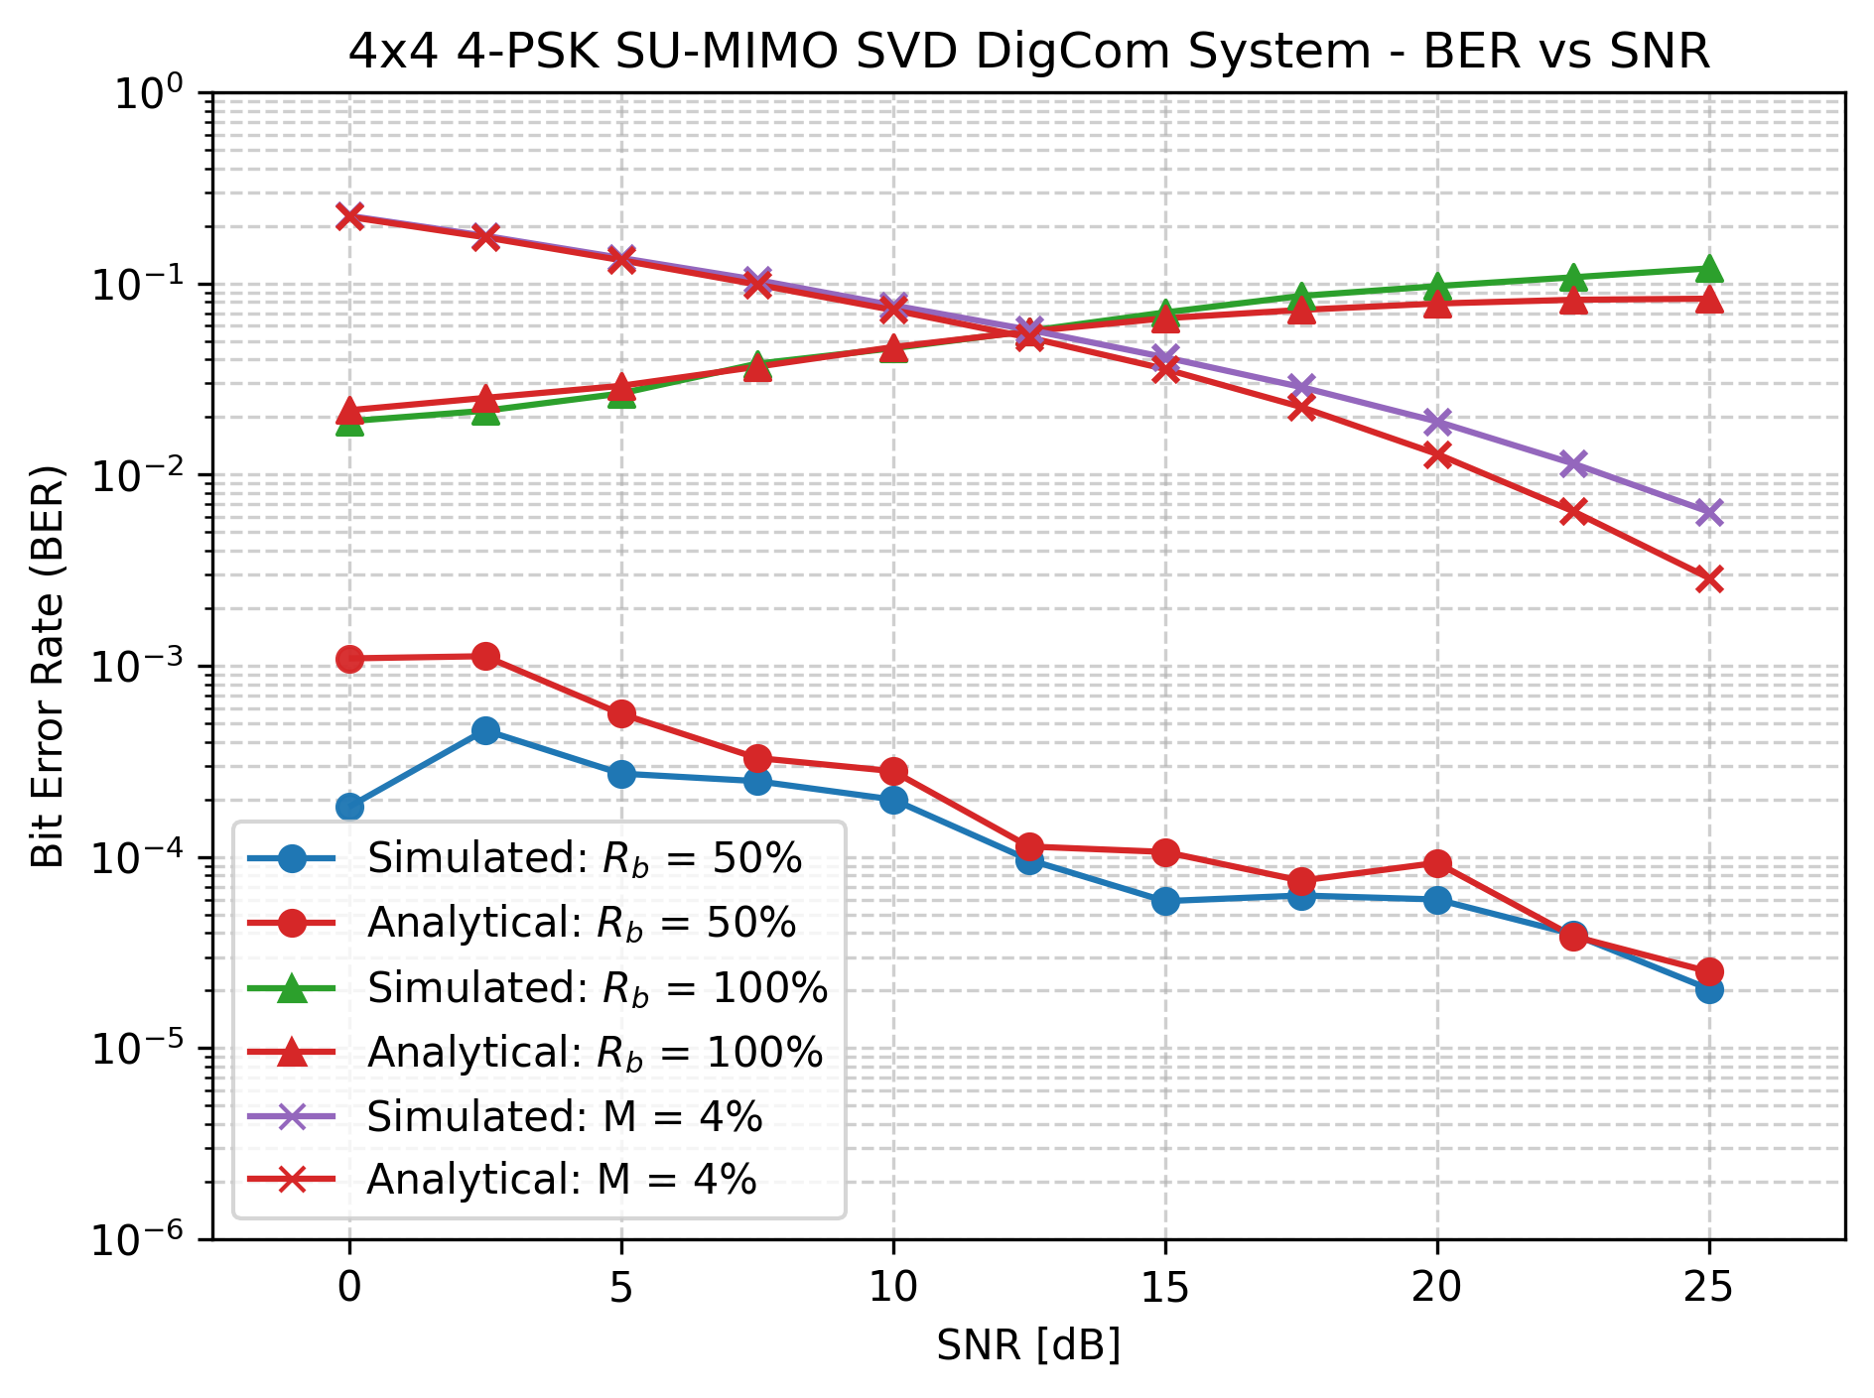
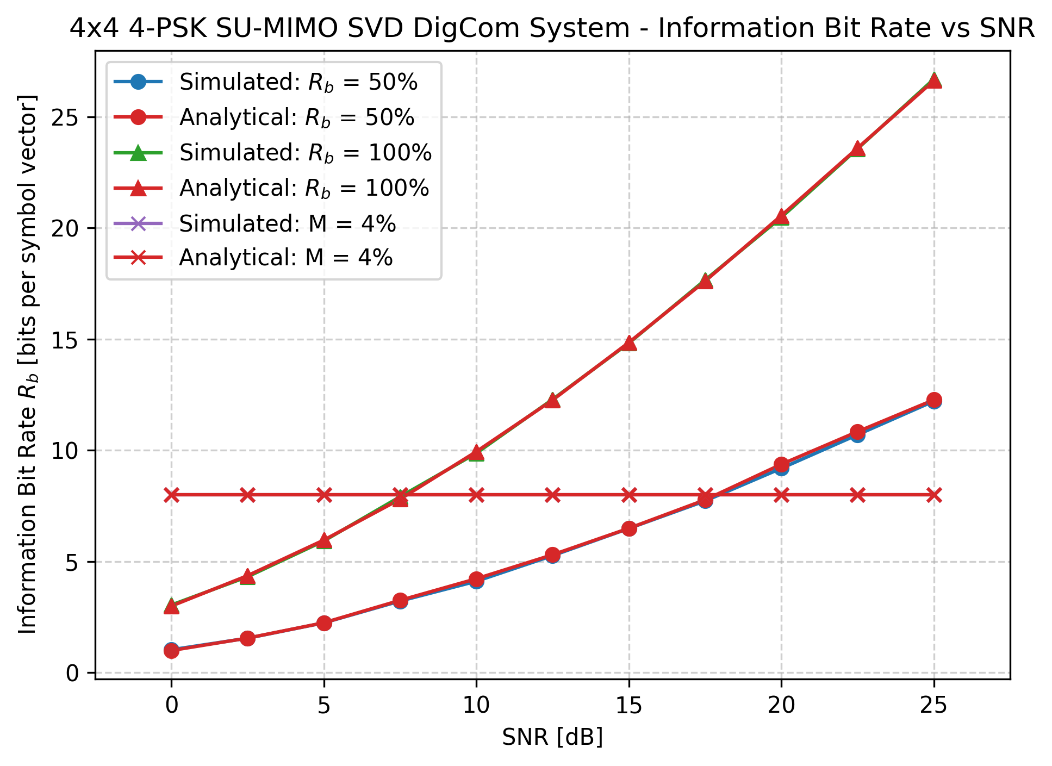
Analytical Bit Error Rate

