Slide 1
HIV INFECTION ANALYSIS
IN CENTRAL AFRICA
GROUP PRESENTATION – ITC 6000
CHENGWEI JIANG
JARSHANA SHRESTHA
JUNAID IFTIKHAR
WANNIDA KRUAYATIDEE

Slide 2




DATA SOURCES
WHERE WE RETRIEVED ALL THE DATA FROM
These are the sources of data we retrieved from: World Health Organization (WHO), The World Bank, UNICEF, and theGlobalEconomy.com

Slide 3

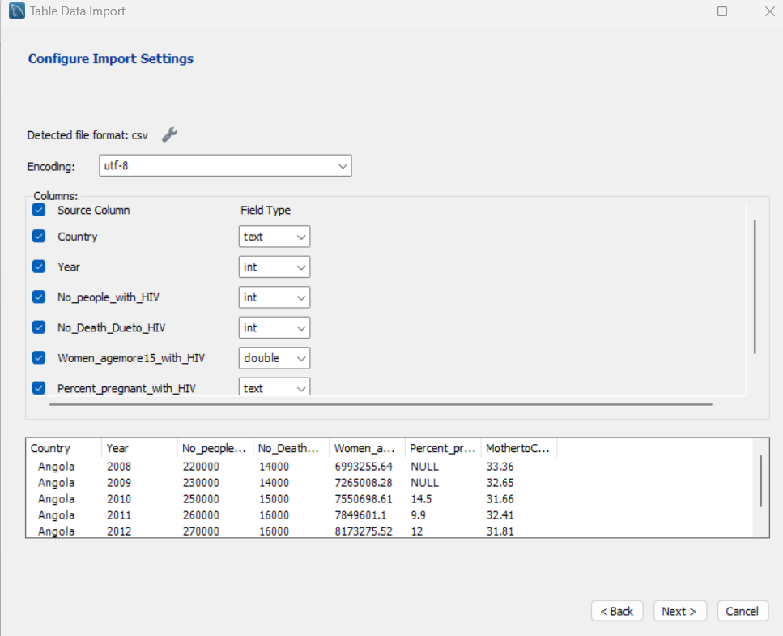
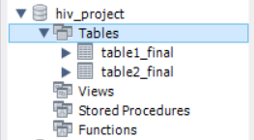
CREATE SCHEMA AND IMPORT TABLES
PROCESS TO IMPORT DATA INTO MYSQL
CREATE A SCHEMA
IMPORT DATA

Slide 4
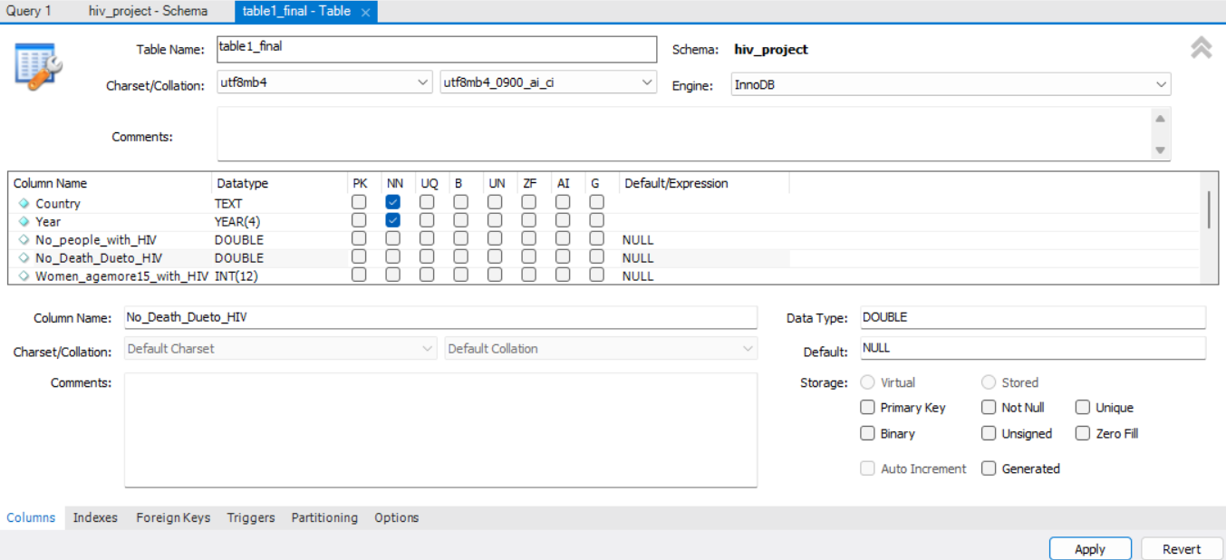
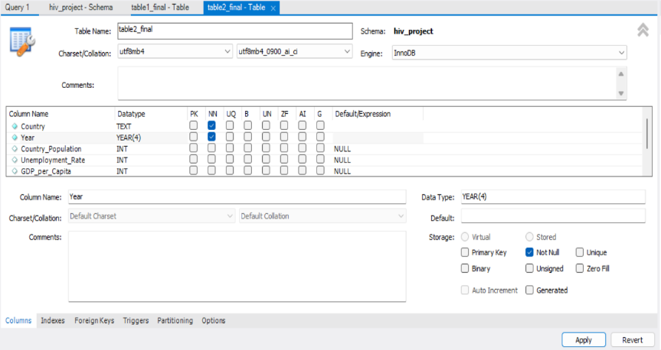
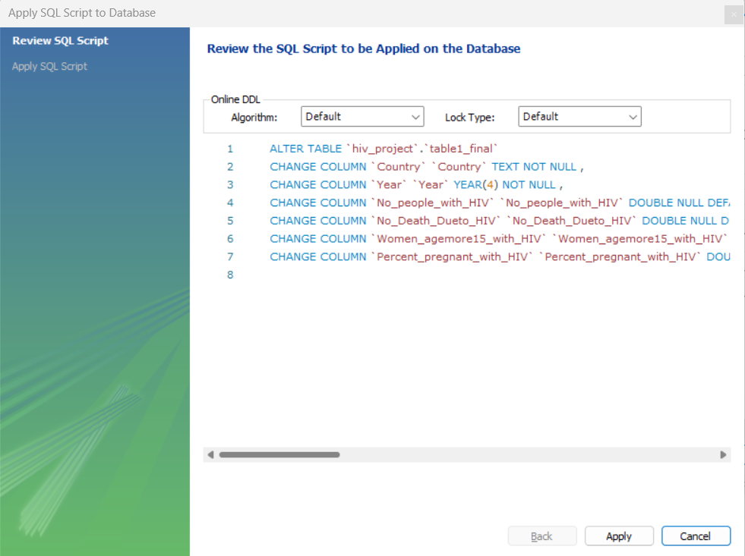
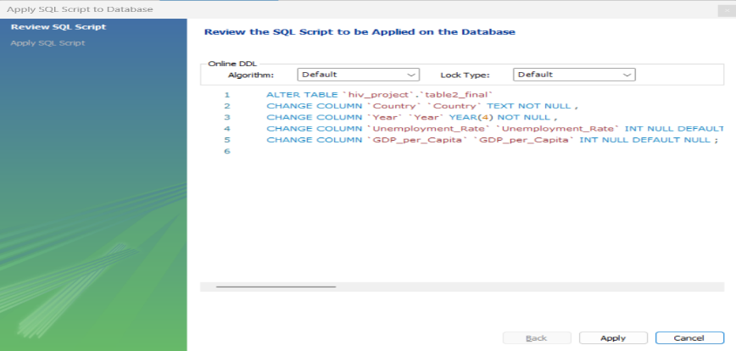
CHANGE IN DATATYPE
SELECT APPROPRIATE DATATYPE AND PROPERTIES
EDIT DATA TYPE – TABLE 1
EDIT DATA TYPE – TABLE 2
1
1
2
2

Slide 5
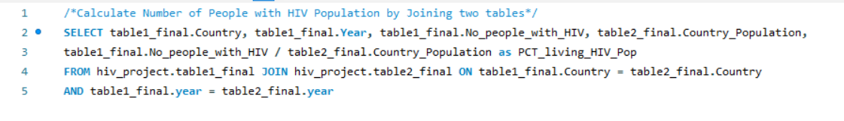
QUERY NO.1
CALCULATE PERCENTAGE THE NUMBER OF PEOPLE WITH HIV COMPARE WITH COUNTRY POPULATION
QUERY 1.A
RESULT 1.A
EXPLANATION
This query was computed to see the percentage of people who live with HIV. However, this cannot illustrate enough how much percentage each country hold during the year 2008-2017; therefore, we began to analyze next query.

Slide 6
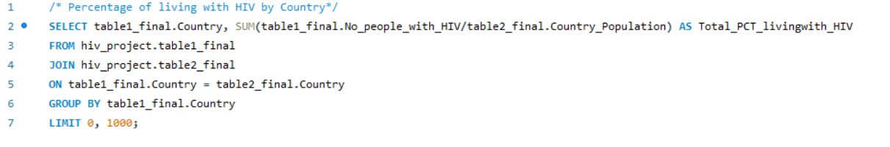
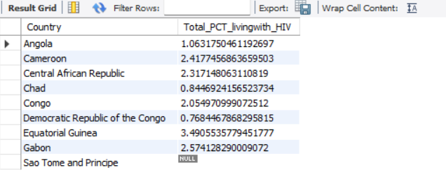
QUERY NO.1
CALCULATE PERCENTAGE THE NUMBER OF PEOPLE WITH HIV COMPARE WITH COUNTRY POPULATION
QUERY 1.B
RESULT 1.B
This is the result from the statements above where we done by joining both table 1 and table 2 then use “Group by” function to see the result during the past 10 years

Slide 7
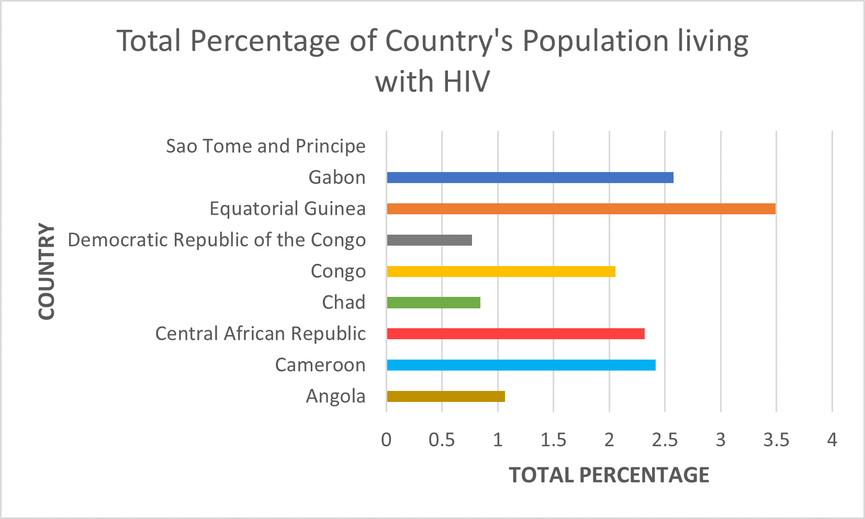

QUERY NO.1
CALCULATE PERCENTAGE THE NUMBER OF PEOPLE WITH HIV COMPARE WITH COUNTRY POPULATION
VISUALIZATION 1
Analysis:
Equatorial Guinea has the highest percentage of country’s population living with HIV at approximately 3.5where the lowest is Democratic Republic of the Congo at around 0.75.

Slide 8
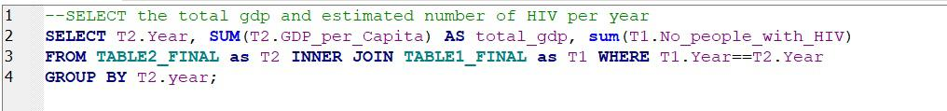
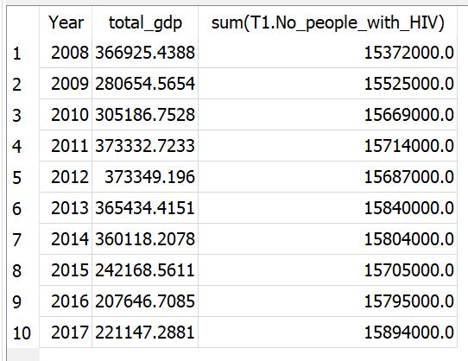
QUERY NO.2
FIND RELATIONSHIP BETWEEN TOTAL GDP AND ESTIMATED NUMBER OF HIV PER YEAR
QUERY 2
These are the statements and result of query no.2
RESULT 2

Slide 9
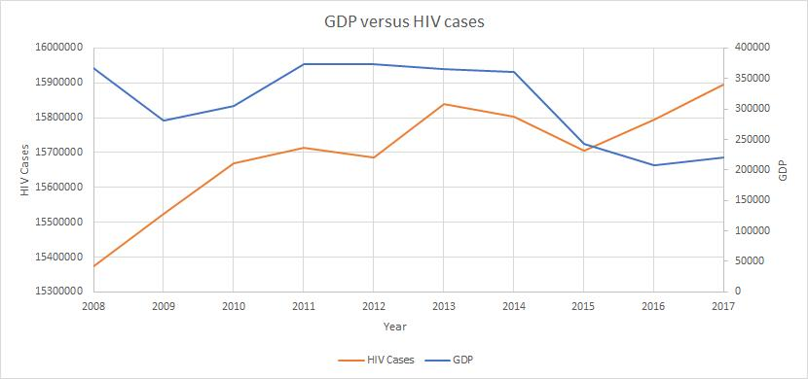
QUERY NO.2
FIND RELATIONSHIP BETWEEN TOTAL GDP AND ESTIMATED NUMBER OF HIV PER YEAR
VISUALIZATION 2
Analysis:
We can conclude that in the year 2008 to 2010, there is a negative relationship in these variables since when there was an increase in HIV cases, the GDP decreased. However, in the year 2012 to 2013, there was another significant increased in HIV cases, but GDP slightly decreased. Moreover, in the year 2014, although there was a decrease in HIV cases, GDP dramatically dropped around 33% which is the greatest drop during 2008 to 2017.

Slide 10
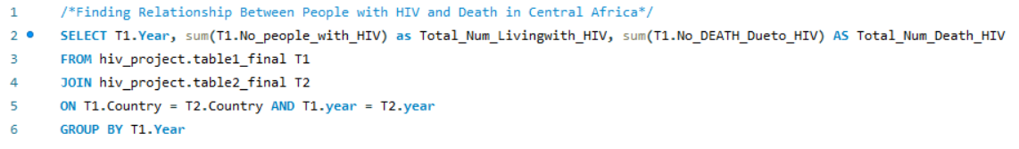
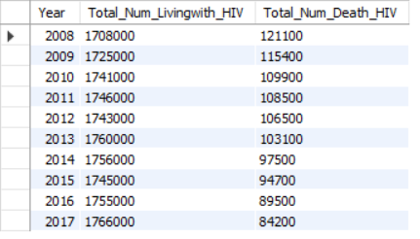
QUERY NO.3
FINDING A RELATIONSHIP BETWEEN PEOPLE LIVE WITH HIV AND DIE FROM HIV IN CENTRAL AMERICA
QUERY 3
RESULT 3
These are the codes and result for query no.2

Slide 11
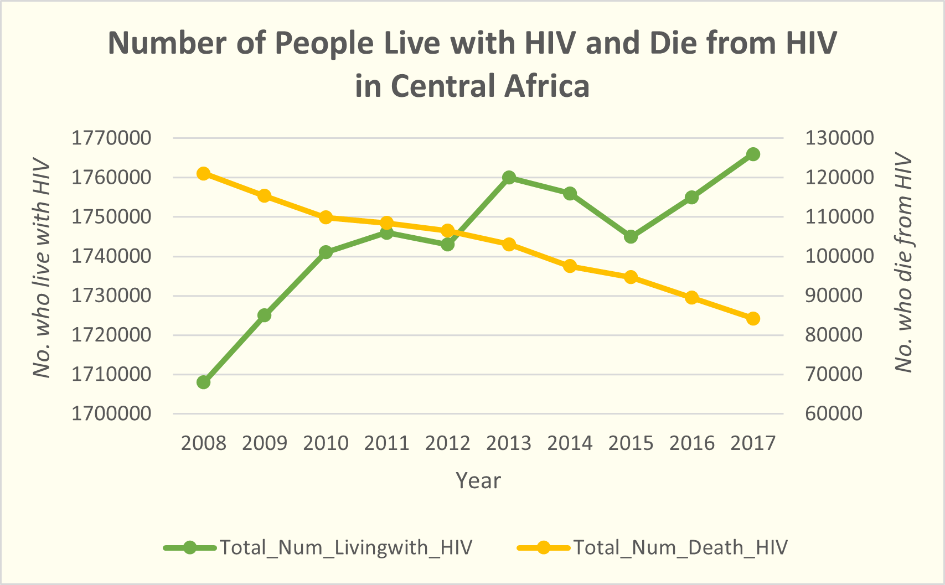

QUERY NO.3
FINDING A RELATIONSHIP BETWEEN PEOPLE LIVE WITH HIV AND DIE FROM HIV IN CENTRAL AMERICA
VISUALIZATION 3
Analysis:
We concluded that the number who died from HIV decreased in each year while the number who live with HIV increased.

Slide 12
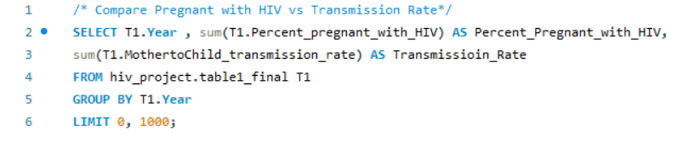
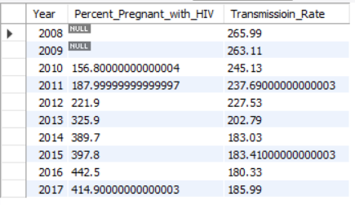
QUERY NO.4
COMPARE PREGNANT WITH HIV VERSUS TRANSMISSION RATE IN CENTRAL AFRICA
QUERY 4
This statement selected the percentage of pregnant with HIV and transmission Rate in Chad from the year 2008-2017
RESULT 4
These are the findings

Slide 13
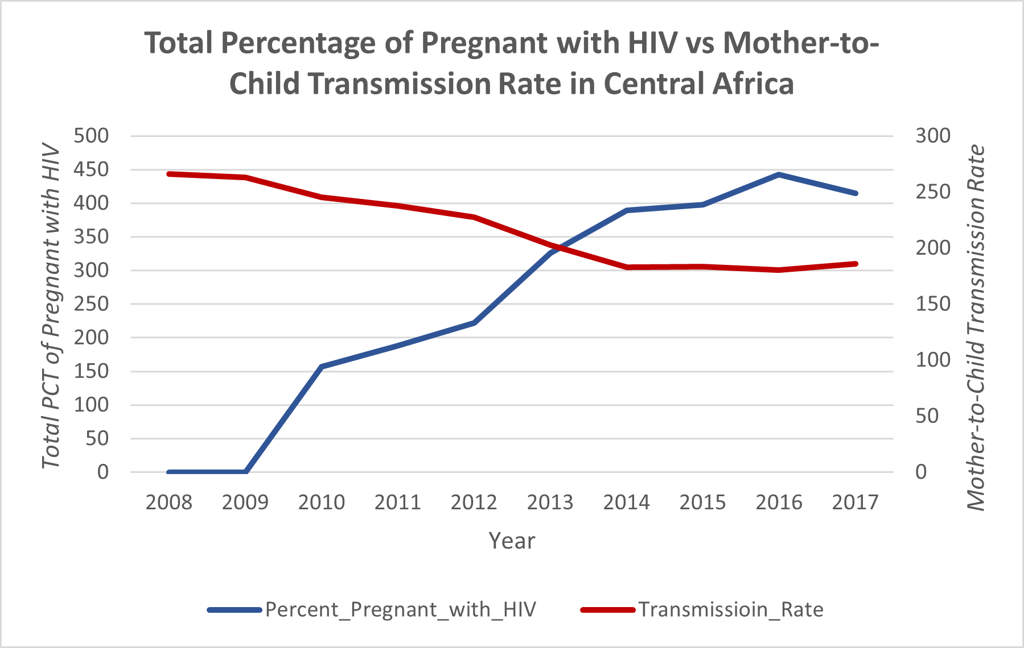
QUERY NO.4
COMPARE PREGNANT WITH HIV VERSUS TRANSMISSION RATE IN CENTRAL AFRICA
VISUALIZATION 4
Analysis:
Apparently, we can conclude that in the year 2008 to 2013, transmission rate was significantly difference from percentage of pregnant with HIV in Central Africa. Moreover, it was a negative relationship as when there was a decrease in transmission rate, percentage of pregnant increased. Eventually, throughout the period, transmission rate in in negative trends while percentage of pregnant kept on increased.

Slide 14
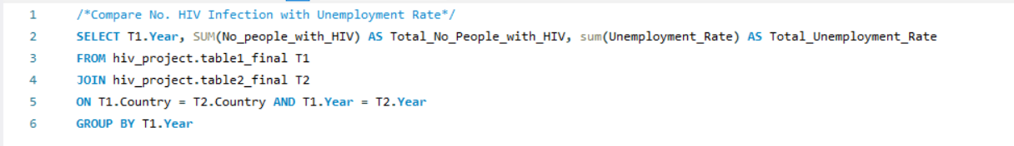
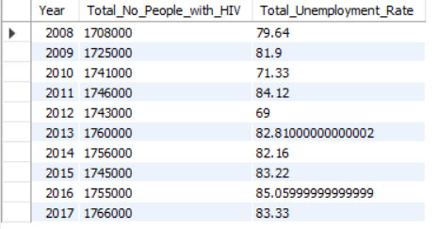
QUERY NO.5
COMPARE NUMBER OF HIV INFECTION WITH UNEMPLOYMENT RATE
QUERY 5
These are the statements and result of query no.5
RESULT 5

Slide 15
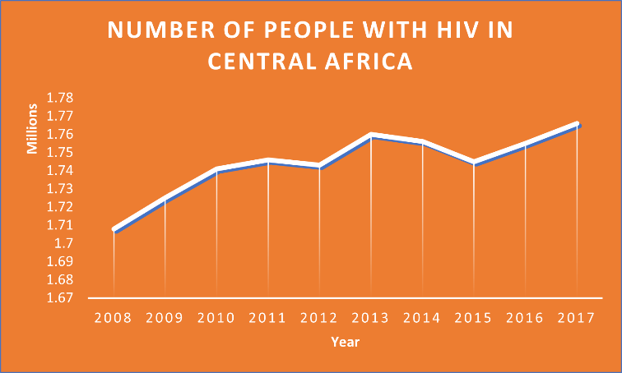
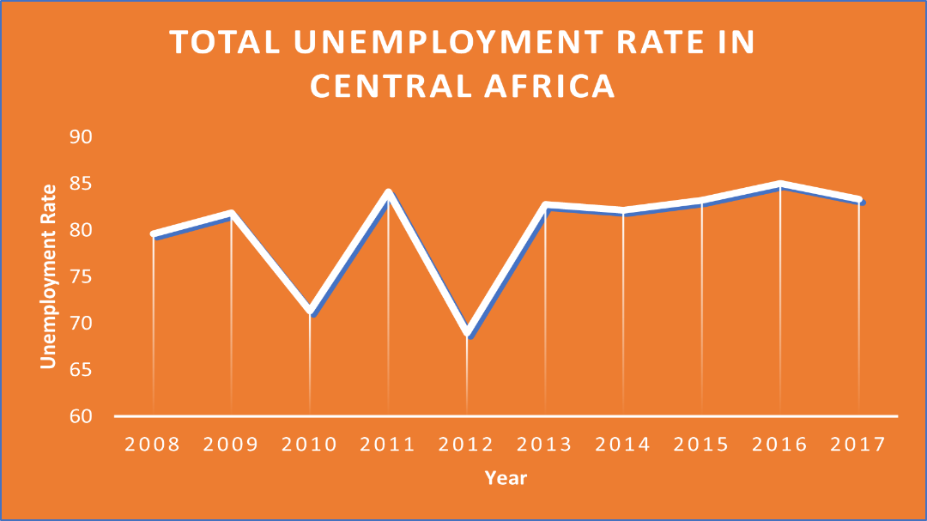
QUERY NO.5
COMPARE NUMBER OF HIV INFECTION WITH UNEMPLOYMENT RATE
VISUALIZATION 5.A
VISUALIZATION 5.B
Analysis: Apparently, the unemployment rate in Central Africa is very fluctuated with the lowest in 2012 at 69. On the other hand, the number of people with HIV in Central Africa increased in each year. We can conclude that, although the unemployment rate was slightly different on each year, still the number of people with HIV in Central Africa increased during year 2008-2017.

Slide 16
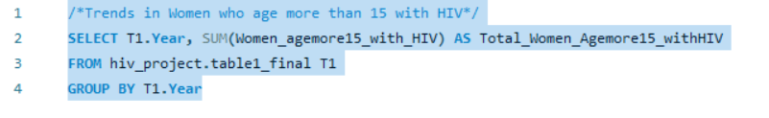
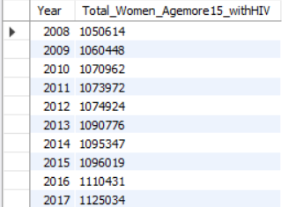
QUERY NO.6
TRENDS IN WOMEN WHO AGE MORE THAN 15 WITH HIV
QUERY 6
These are the statements and result of query no.6
RESULT 6

Slide 17
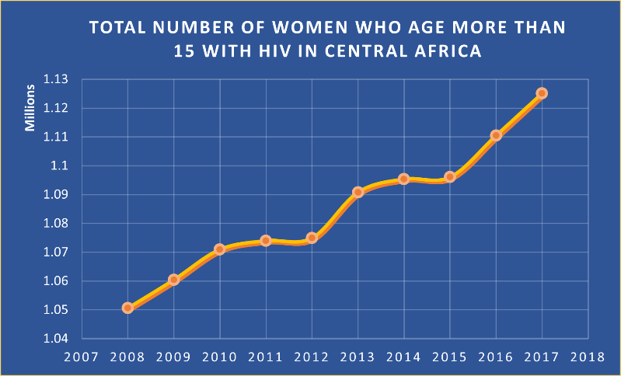
QUERY NO.6
TRENDS IN WOMEN WHO AGE MORE THAN 15 WITH HIV
VISUALIZATION 6
Analysis:
We can conclude that the number of women who age more than 15 with HIV in Central Africa dramatically increased around 12.5% from the year 2008 to 2017

Slide 18
CONCLUSION
WRITE YOUR SUBTITLE
1.
The overall percentage of people living with HIV in Central Africa from 2008 to 2017 requires further analysis to accurately assess the situation.
HIV prevalence varies significantly across countries in the region, with Equatorial Guinea having the highest prevalence at approximately 3.5% and the Democratic Republic of the Congo the lowest at around 0.75%.
2.
The relationship between HIV cases and GDP is complex, with different patterns observed over the years, indicating the need for further investigation.
3.
HIV mortality rates have decreased over time, suggesting improvements in treatment and care, but factors contributing to the increasing number of people living with HIV should be addressed.
4.
A negative relationship exists between the transmission rate and the percentage of pregnant women with HIV, emphasizing the importance of prevention strategies and access to prenatal care.
5.
Despite fluctuations, the overall trend shows a rise in the number of people living with HIV alongside varying unemployment rates, highlighting the need to consider socio-economic factors in prevention efforts.
6.
7.
HIV prevalence among women aged 15 and above in Central Africa has significantly increased by approximately 12.5% from 2008 to 2017, necessitating targeted interventions and support for women.

Slide 19
RECOMMENDATION
01
02
03
STRENGTHEN
HIV PREVENTION
STRATEGIES
ADDRESS
SOCIO-ECONOMIC
FACTORS
FOCUS ON
WOMEN AND
MATERNAL HEALTH
Implement comprehensive HIV prevention programs addressing sexual transmission, mother-to-child transmission, and transmission among key populations to effectively combat the spread of the virus.
The analysis indicates that higher GDP is associated with lower HIV cases, suggesting the need for government focus on strengthening GDP to control and reduce HIV cases.
Governments should prioritize interventions targeting women, particularly in maternal health, as the number of pregnant women with HIV is significantly increasing over time; enhancing access to HIV testing, prevention, and treatment services is crucial.

Slide 20
REFERENCES
UNICEF. (2022). Global and regional trends - UNICEF DATA. UNICEF DATA. https://data.unicef.org/topic/hivaids/global-regional-trends/
Hiv/Aids | Data | DataBank. (n.d.). Databank.worldbank.org. Retrieved June 23, 2023, from https://databank.worldbank.org/databases/hiv/aids
The Global Economy. (2023). Global economy, world economy | TheGlobalEconomy.com. TheGlobalEconomy.com. https://www.theglobaleconomy.com/
GHO | By category | Number of people (all ages) living with HIV - Estimates by country. (n.d.). WHO. https://apps.who.int/gho/data/view.main.22100?lang=en

Slide 21

THANK YOU!
Q & A
TIME!!

