Slide 1
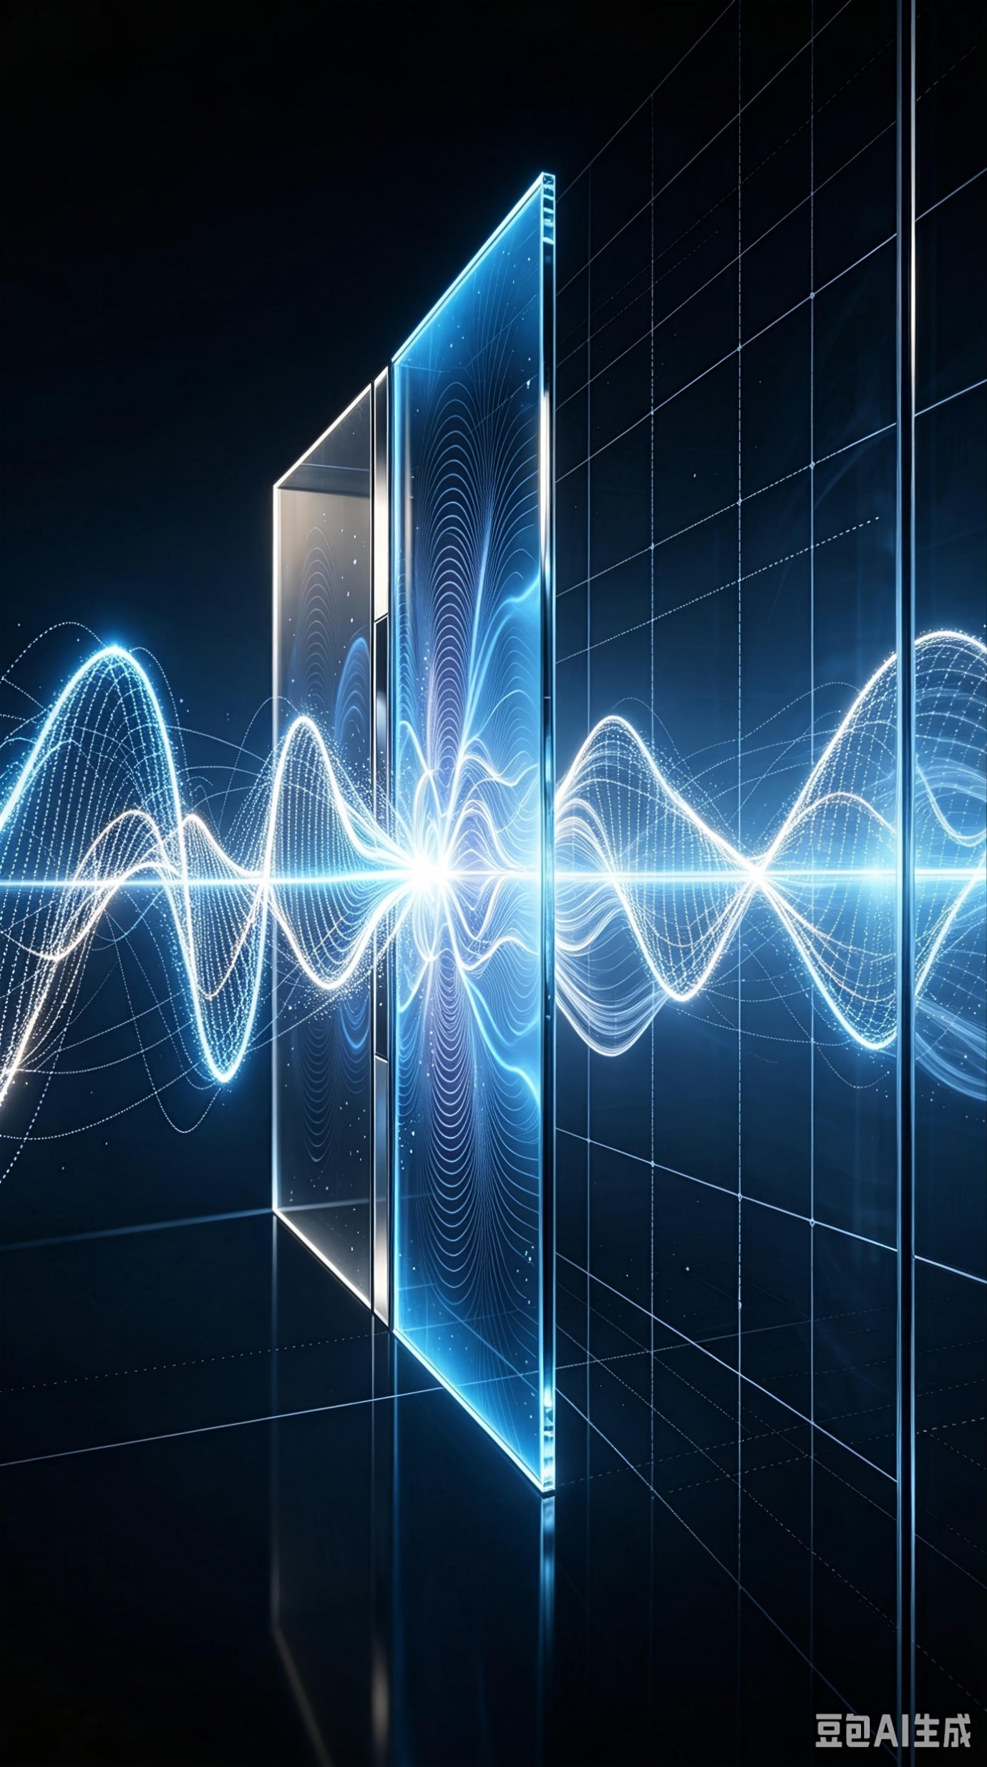
Quantum Tunneling
The Mathematical and Physical Nature of Quantum Tunneling and Frontier Challenges

