Slide 1
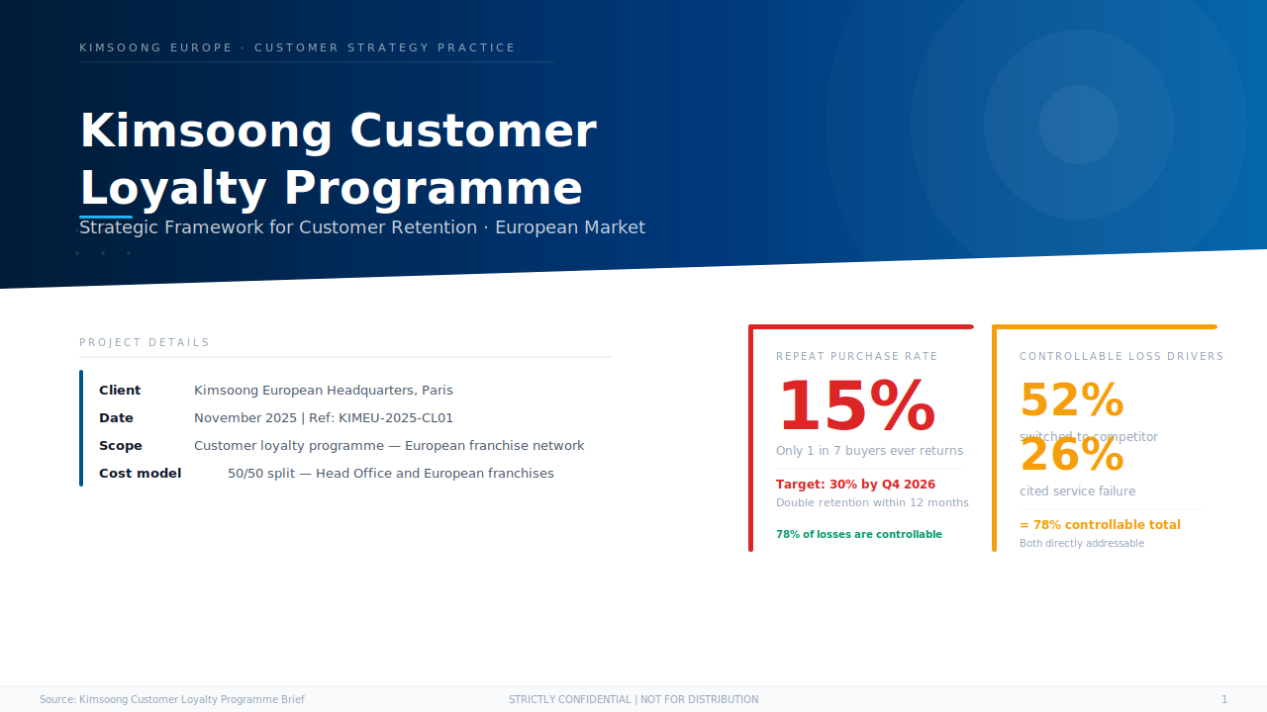
Notes:
Welcome. Today we'll present a strategic framework for transforming Kimsoong's customer loyalty performance in Europe. [Pause]
The headline challenge — and opportunity — sits on this cover. Kimsoong currently retains only 15% of its buyers. That means 85% of customers who purchase a Kimsoong vehicle never return for a second one.
[Data] 15% — that's fewer than 1 in 7. The programme we're presenting today targets 30% within 12 months. And critically, 78% of the losses are driven by factors entirely within our control.
Key points: ① 15% repeat rate is the central problem to solve ② Programme target: 30% by Q4 2026 ③ 78% of losses are controllable — this is the strategic opportunity
Duration: 1 minute
Flex: [If time is tight, state the 15%/30% number and move directly to slide 2]

Slide 2
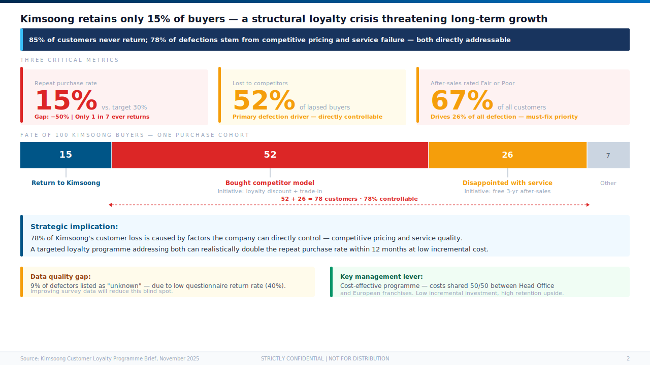
Notes:
[Transition] Let's start with the situation — the full scale of the loyalty challenge.
Three numbers define the crisis. [Pause]
First: 15% repeat rate. Only 1 in 7 buyers comes back. Second: 52% of those who don't return bought a competitor's model. Third: 67% of all customers rate Kimsoong's after-sales service as "fair" or "poor."
[Data] Together, competitive switching at 52% and service disappointment at 26% account for 78% of all customer loss. [Benchmark] Both of these are addressable through the loyalty programme — at low incremental cost.
[Scan Room] The strategic implication is clear: this is not a product problem. It is a retention and service problem — and it is solvable.
Key points: ① 15% repeat rate is structurally below acceptable ② 78% of defection is controllable ③ Service and competitive pricing are the two root causes to target
Duration: 2 minutes
Flex: [Skip the bar chart breakdown and go straight to the strategic implication]

Slide 3
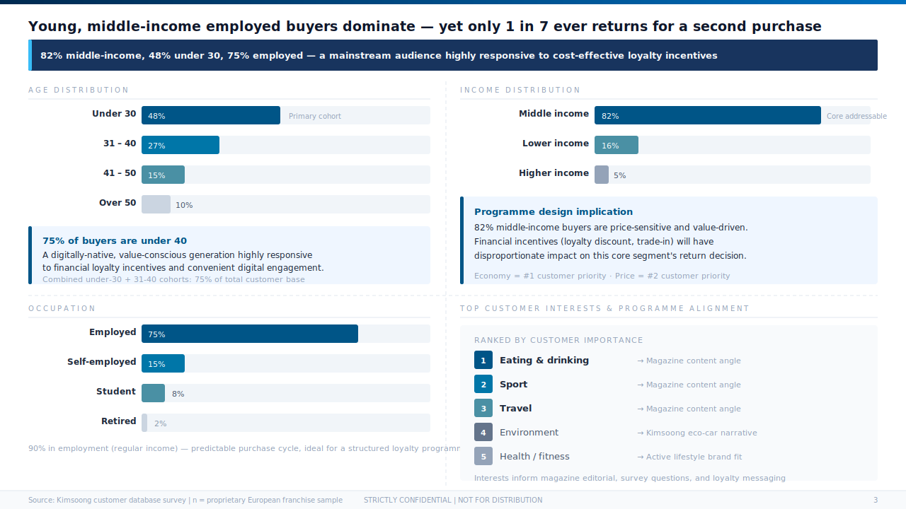
Notes:
[Transition] To design an effective programme, we need to understand who our buyer is.
The picture is remarkably clear. [Pause]
[Data] 48% of Kimsoong buyers are under 30 years old. 82% are middle income. 75% are in employment. This is a mainstream, digitally-active segment — exactly the audience most responsive to loyalty incentives, digital engagement, and value-driven rewards.
[Benchmark] Compared to the difficulty of reaching premium or older demographics, this segment is low-cost to retain: they respond to clear financial value, convenience, and brand trust.
The implication for programme design: keep it simple, keep it financial, make it easy to claim. Economy and price are their top two priorities — our loyalty initiatives must speak directly to that.
Key points: ① Core buyer = young, middle-income, employed ② Highly responsive audience for cost-effective loyalty incentives ③ Programme design should emphasise economy and financial value
Duration: 2 minutes

Slide 4
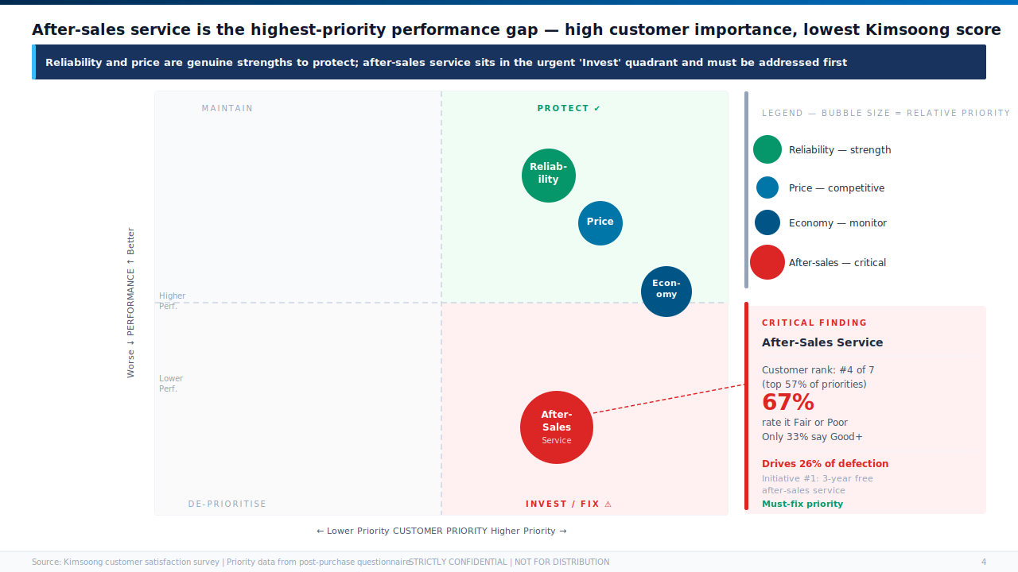
Notes:
[Transition] Now let's look at where the gap between customer expectations and Kimsoong's performance is most severe.
This matrix plots four key attributes against two dimensions: how much customers prioritise it, and how well Kimsoong currently performs. [Pause]
The top-right quadrant is where we want to be: high priority, high performance. And Kimsoong does well there — reliability and price are genuine strengths.
But look at the bottom-right. [Scan Room] After-sales service. High customer priority — ranked #4 globally. Yet 67% rate it as "fair" or "poor." This is not a minor issue. This is the largest performance gap in the entire customer experience.
[Data] Closing this gap is initiative #1 — the free 3-year after-sales service programme — and it directly addresses the 26% of defectors who cite service dissatisfaction.
Key points: ① Reliability and price are strengths to protect ② After-sales service is THE critical gap — high priority, very low satisfaction ③ This single gap drives 26% of all customer defection
Duration: 2 minutes
Flex: [Can skip the quadrant label walkthrough and focus directly on after-sales service finding]

Slide 5
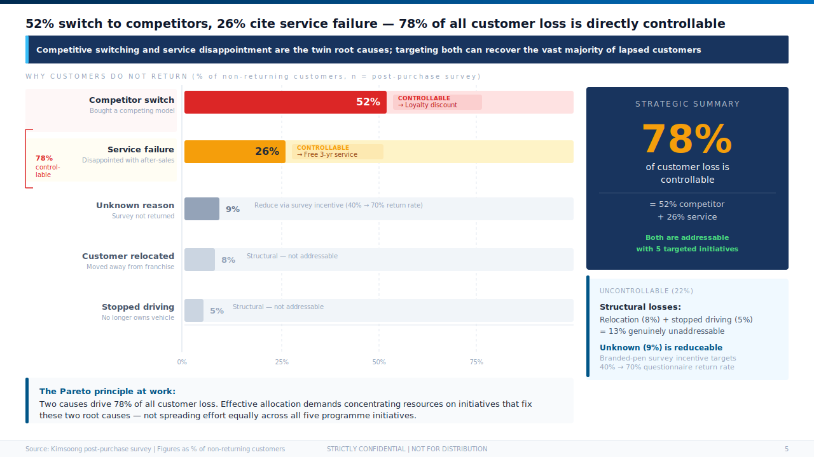
Notes:
[Transition] The matrix showed us the gap. This slide quantifies the root causes of actual defection.
The Pareto principle is at work here. [Pause]
[Data] Two causes — bought a competitor's model at 52%, and disappointment with service at 26% — account for 78% of all customer loss. Add in the 9% "unknown" that we can partially recover through better survey data, and the controllable portion rises further.
[Benchmark] The remaining 22% — relocation and stopping driving — are genuinely uncontrollable. But 78%? That is a solvable problem, not an unavoidable one.
The critical insight for management is this: we do not need to solve everything. We need to solve two things exceptionally well — price competitiveness at repurchase, and service quality. [Pause]
Key points: ① 52% + 26% = 78% controllable loss ② Only two levers needed: price and service ③ 9% unknown is reduceable with better survey data
Duration: 2 minutes

Slide 6
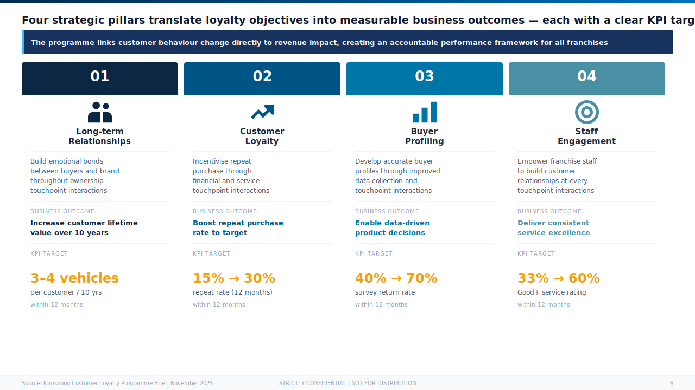
Notes:
[Transition] With the root causes established, we can build the strategic framework. Four pillars. Four measurable outcomes.
Each pillar translates a behavioural objective into a business metric. [Pause]
Pillar one: build long-term relationships. Outcome: customers who buy three to four vehicles over ten years, not just one.
Pillar two: drive loyalty directly. Outcome: repeat rate from 15% to 30% within 12 months.
Pillar three: improve data quality. [Data] We currently have only 40% survey return rate. The target is 70% — enabling better buyer profiling and smarter product decisions.
Pillar four: staff engagement. Outcome: service rating from 33% "good or above" to 60%. [Benchmark] This is nearly double the current satisfaction level.
[Scan Room] Each pillar has a clear owner and a clear KPI. This is an accountable framework — not aspirational language.
Key points: ① Four pillars, four measurable KPIs ② 15% → 30% repeat rate is the primary commercial target ③ Staff engagement and data quality are the enablers
Duration: 3 minutes
Flex: [If time is tight, read out KPI targets only, skip individual pillar descriptions]

Slide 7
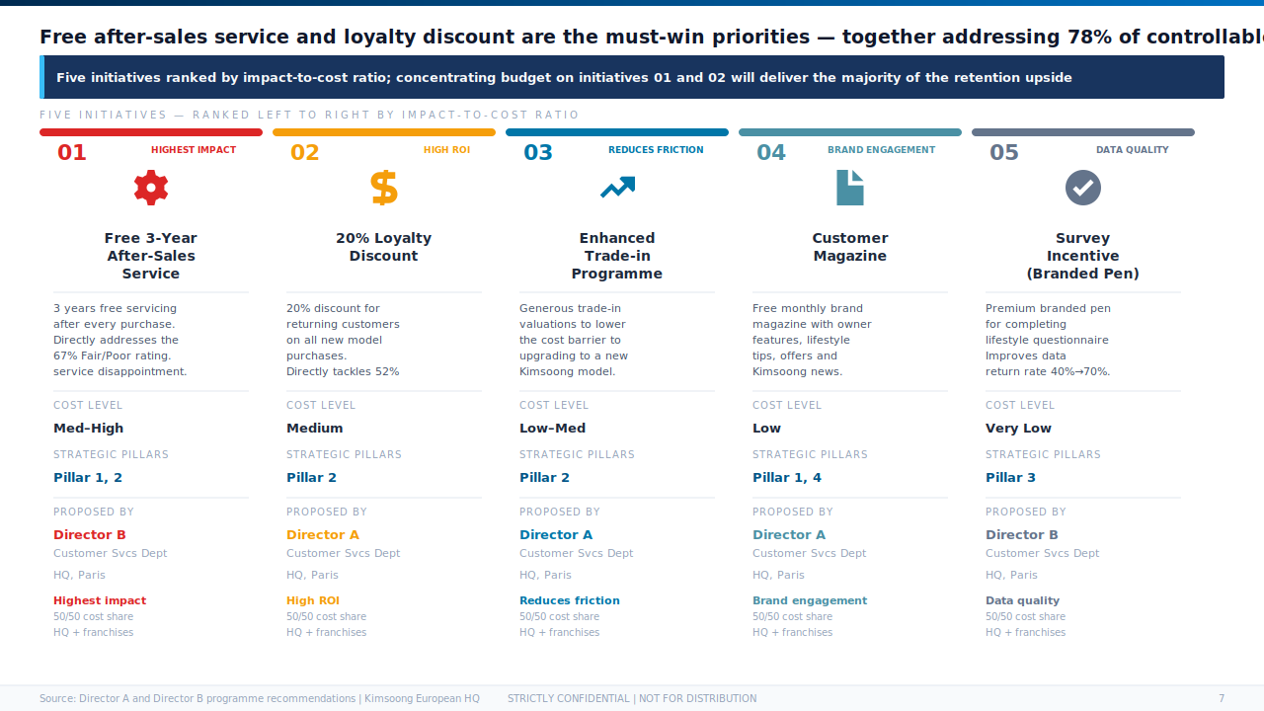
Notes:
[Transition] Four pillars. Five initiatives to deliver them. Prioritised by impact-to-cost ratio.
Initiatives one and two are the must-win battles. [Pause]
[Data] Initiative one: three years free after-sales service after every purchase. This directly targets the 26% of defectors who cited service disappointment. It also signals a fundamental shift in Kimsoong's customer commitment.
Initiative two: 20% loyalty discount for returning customers. This addresses the competitive switching problem — the 52% who bought a competitor's model. At a 20% price advantage, the calculus changes.
[Benchmark] Together, these two initiatives address 78% of the controllable defection. The remaining three — trade-in programme, customer magazine, and survey incentive — are low-cost complements at high ROI.
The resource allocation message is simple: concentrate budget on initiatives one and two. Don't dilute the programme across all five equally.
Key points: ① Initiatives 01 and 02 are the core — together they address 78% of losses ② Initiatives 03–05 are high-ROI, low-cost complements ③ Cost shared 50/50 across HQ and franchises
Duration: 3 minutes

Slide 8
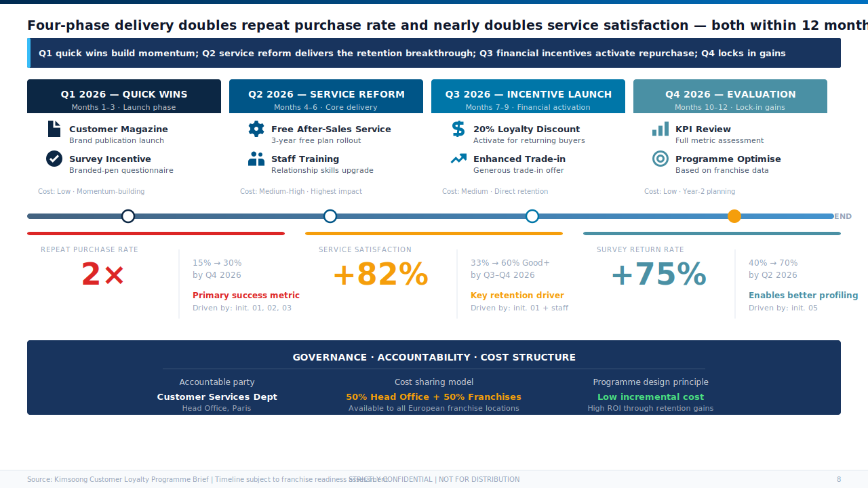
Notes:
[Transition] Finally — how do we deliver this in 12 months?
The roadmap follows a phased logic: prove it works, then scale it. [Pause]
Q1 is about quick wins — magazine and the survey incentive. Low cost, fast to launch, builds brand presence and starts improving our data quality.
Q2 is the core structural reform: the free after-sales service programme. This is the hardest to deliver but the highest impact. [Data] Getting this right is what moves service satisfaction from 33% to 60%.
Q3 activates the financial incentives — loyalty discount and trade-in. This is when we start converting returning customer intent into actual sales.
Q4 measures everything and plans year two.
[Data] The headline targets: repeat purchase rate doubles from 15% to 30%. Service satisfaction rises from 33% to 60%. Survey return rate rises from 40% to 70%. [Scan Room] All three are achievable within 12 months.
Cost structure: 50/50 split between head office and franchises — keeping this affordable at both levels.
Key points: ① Four-phase delivery paced for momentum and manageability ② Q2 delivery of free after-sales is the critical path item ③ Three KPI targets achievable within 12 months at low incremental cost
Duration: 3 minutes
Flex: [If time permits, discuss Q4 evaluation plan and year-2 programme expansion opportunity]

