Slide 1
CAD’24
Eger, Hungary
A Lightweight Representation of Products: Annotated CAD Model Images in PPT Slides
Qiujiao Wang
Southwest Jiaotong University Hope College, China
Zhijie Xie
Shanghai Tecwin Software Technology Co., Ltd, China

Slide 2
Limitations of CAD models
There are usually multiple reporting phases within a product design cycle.
However, typically, CAD models are not used directly as carriers for reporting because the following reasons.
Product model has a large amount of data
  It maybe hundreds of GB
  It requires high-performance computers
Engineers often work with different CAD systems
  CAD system may require a dedicated server
  CAD model can not be share directly between different CAD systems (such as 3dxml)
CAD software requires professional skills
  The reported person need technical personnel assistance
  It is inconvenient to directly annotate on a three-dimension model
CAD’24 Eger

Slide 3
PPT in report
PPT (Microsoft PowerPoint) is widely used during presentations or reports, because it is
Widely installed in computers
With built-in trigger actions
With multiple styles of presentation
CAD’24 Eger

Slide 4
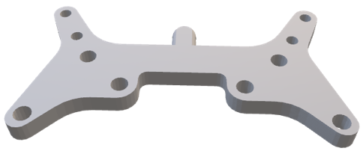
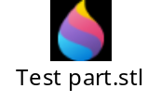
The detailed abilities of PPT
The following styles are using PPT to present CAD model information
Build-in shapes
Pictures
Tables
Three dimension models
  .stl
  .obj
  ...
…
X | Y | Z
1.0 | 2.0 | 3.0
CAD’24 Eger

Slide 5
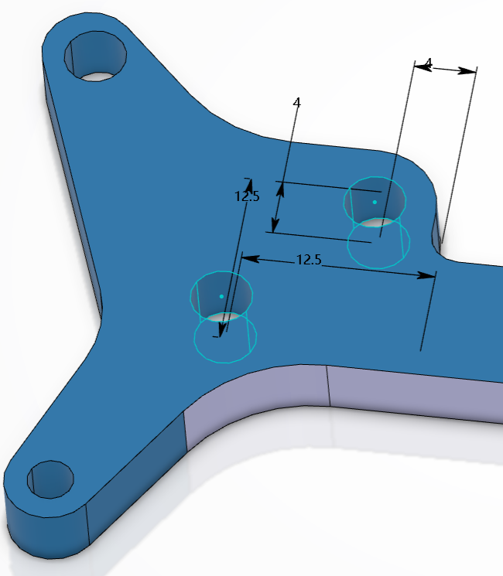
Our idea
We propose using PPT to present CAD model information, the main steps are as follows.
Adjust the model in the graphic window
Take screenshots of the graphic window
Put pictures to PPT slides
Add additional annotations
Hole.1
CAD’24 Eger

Slide 6
Why not use STL (or other formats) in PPT ?
The existing lightweight formats have been supported by many software(such as PDF and PPT), but they have the following limitations (We take STL as the example).
STL cannot contain annotation information
  Three dimension annotation is becoming more and more widespread
  STL can only express the model structure, not the annotations
Product details cannot be easily displayed
  In CAD software, it is easy to adjust the models, and then take screenshot
  STL need to be operated in the special viewing software, which may not easy to adjust the model automatically, or the APIs may not provided
The size of the PPT file is unpredictable
  The size of STL is still related to the size of the original CAD model
  The size of the PPT file with hundreds of slides is still large and unpredictable if the STL model is placed on each slide of the PPT file
  But, the size of a fixed-size screenshot is stable, so the size of the final PPT file with images is predictable
Now, we decide to choose PPT to represent CAD model information.
CAD’24 Eger

Slide 7
Related fundamentals
Model Elements
  It indicates individual or groups of graphic objects, a model element refers to
  Points
  Lines
  Surfaces
  Solids
  Collections
Window Equivalent Size
  It is the smaller value between the height and width of the graphic window
Height
Equivalent Size = the smaller one
Width
CAD’24 Eger

Slide 8
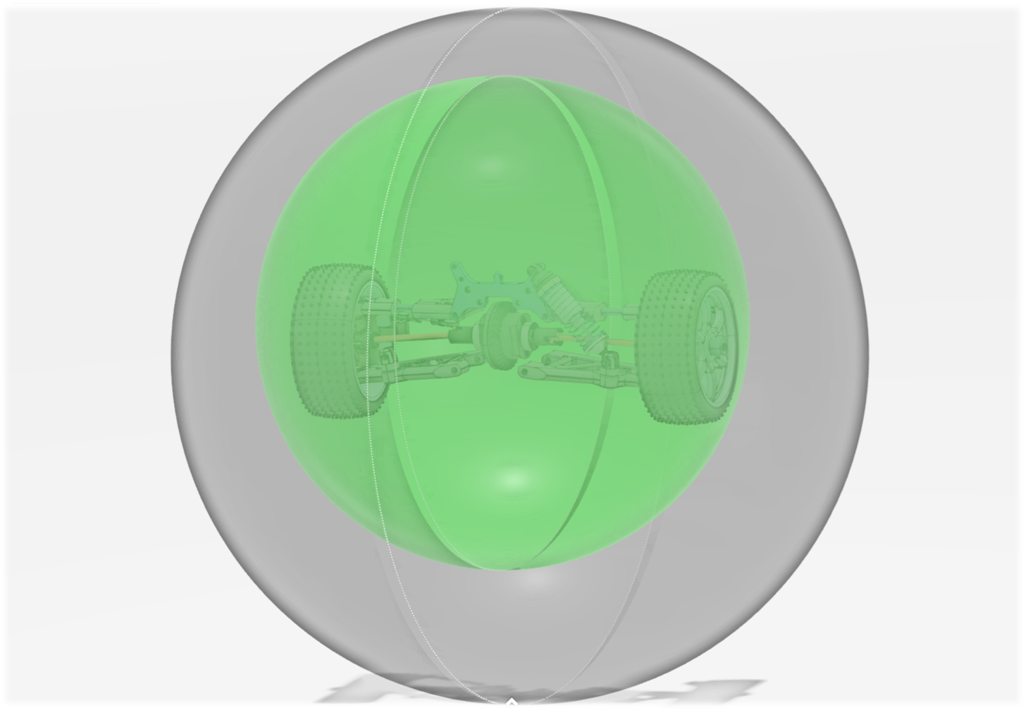
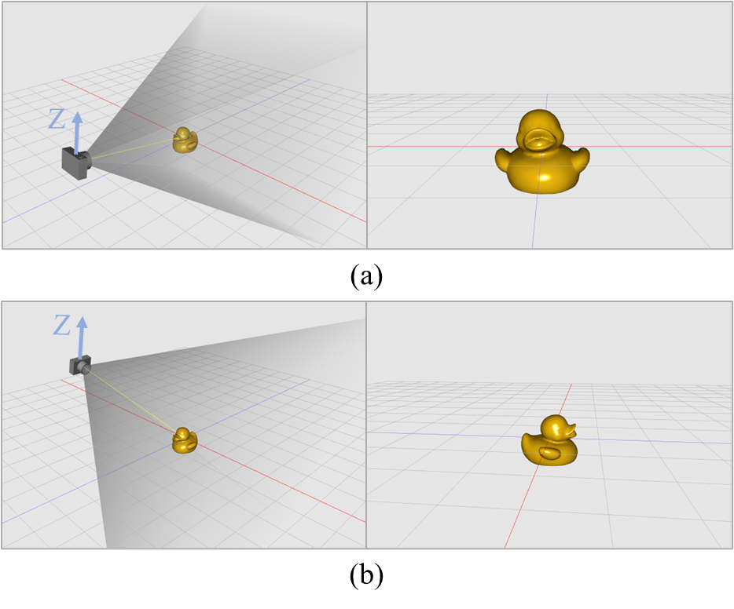
Related fundamentals
Bounding Sphere
  It is a mathematical object consisting a center and a radius
  There are two types of bounding sphere:
    window bounding sphere: the largest sphere that can be fully displayed within the window (the bigger one)
    model bounding sphere: the smallest sphere that can encompass the entire model (the smaller one. It is also called minimum zone sphere)
Camera Parameters
  The camera parameters refer to the parameter set defining the pose for observing the model. It comprises several parameters as follows:
  (1) Camera position
  (2) Target position
  (3) Target direction
  (4) Sight distance
  (5) Up direction
  (6) Near plane
  (7) Far plane
CAD’24 Eger

Slide 9
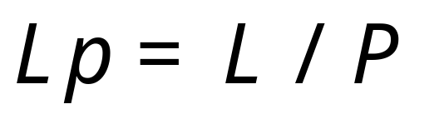
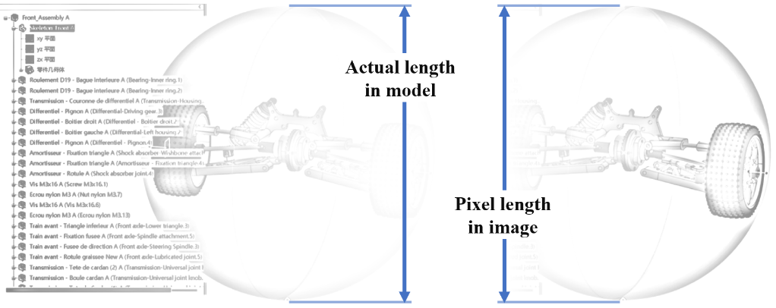
LP Relationship
Length-Pixel or LP relationship, represents the actual length of the model corresponding to each unit of pixels. As the formula
L, is the spatial length in model
P, is the pixel length corresponding to the L
CAD’24 Eger

Slide 10
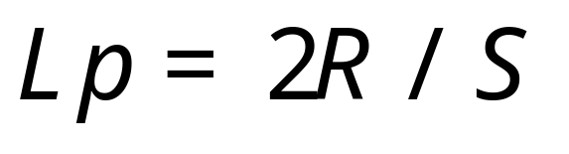
LP Relationship
When centering the model and filling the model bounding sphere into the entire graphic window, the parameters of the window bounding sphere and the model bounding sphere are the same.
  So the diameter of the window bounding sphere (actual length) corresponds to the equivalent size of the graphic window (pixel length). As the formula
R, the radius of the model bounding sphere
S, the equivalent size of the graphic window
Length in real: 2R
Length in pixel: S
R and S all can be easily obtained through CAD APIs.
CAD’24 Eger

Slide 11
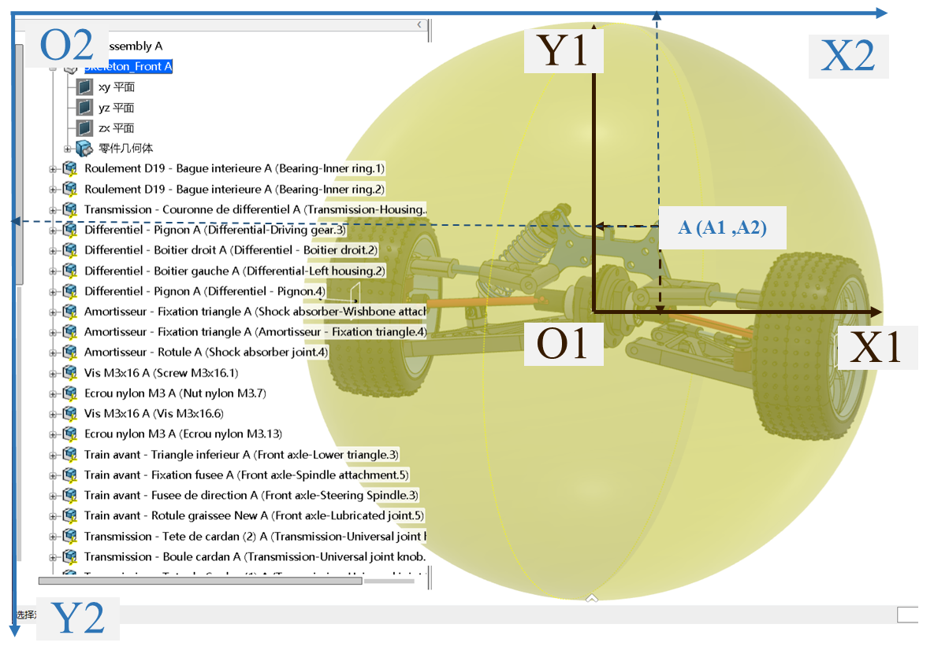
Calculation of Image Coordinates
Assuming we want to calculate the pixel coordinates in the screenshot image of spatial position A (it may be the centroid of a part)
Calculate LP value
  Center the model, obtain the bounding sphere and the equivalent size of the graphic window, and calculate the LP value
Take screenshot
  Capture a screenshot of the graphic window to obtain a 2D image
Construct projection plane
  Construct a plane P parallel to the screen with the center O of the window bounding sphere as the origin
CAD’24 Eger

Slide 12
Calculation of Image Coordinates
Get 2D point A1 from three dimension point A
  Project the three dimension point A onto the plane P to obtain the projected 2D point A1
Convert A1 from Length Coordinate System to Pixels Coordinate System (by LP)
Transform the point A1 into the image coordinate system A2
  A1: with the origin at the center, X-axis pointing right , Y-axis pointing upper
  A2: with the origin at the upper left corner, X-axis pointing right , Y-axis pointing down
CAD’24 Eger

Slide 13
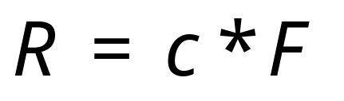
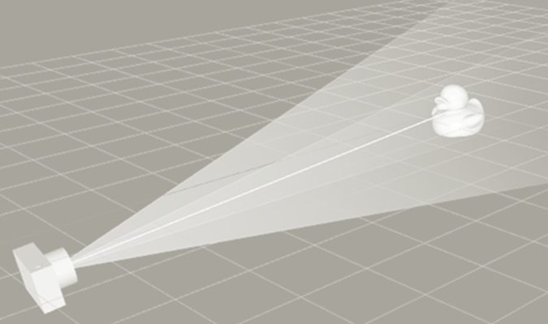
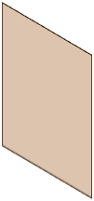
Automatic adjusting of camera parameters
If the model position has been adjusted, the image coordinates of spatial points can be calculated using the above approach.
But, how to automatically adjust the models?
First of all, there is a relationship between the camera Focus distance F and the radius R of the window bounding sphere. As the formula
c is the coefficient between the two parameters. For the default main viewpoint of the graphic window in CATIA, c= 0.268
We also call this formula FR relationship.
R
F
CAD’24 Eger

Slide 14
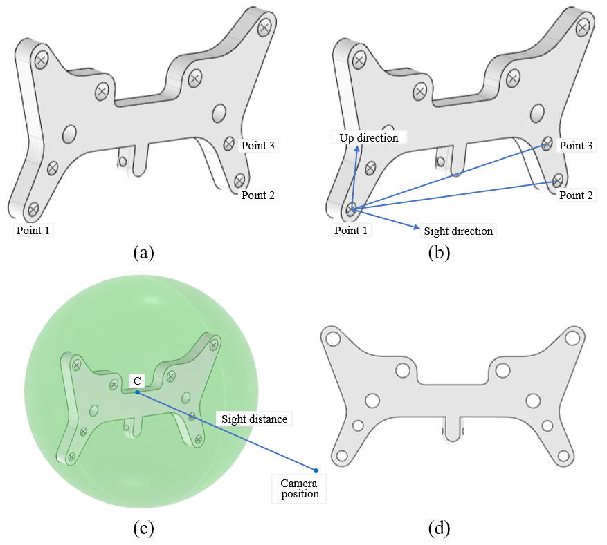
Automatic adjusting of camera parameters
Adjusting the model is actually adjusting four camera parameters
  Sight direction
  Up direction
  Camera position
  Focus distance
The detailed steps were overlooked (See the conference paper)
In short, the final aim is to implement the model pose result, as shown in Fig (d) by the following sub states.
  All points are included and centered within the graphic window
  The camera should be facing the plane formed by the points 1, 2, and 3
  Line12 formed by the points 1 and 2 is horizontal, with point 2 to the right of point 1
  Point3 is above line12
Then, in fact, the Sight direction, Sight distance, Camera position, and the Up direction are determined.
CAD’24 Eger

Slide 15
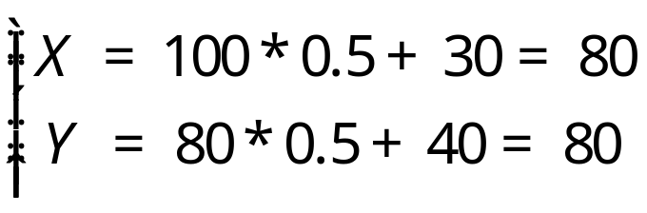
Annotations in PPT
The size of a PPT slide is measured in pixels.
The three dimension point's coordinates in the PPT slide is as the formula
For example, if
  the 2D coordinates of a point in image is (100, 80)
  the original image size is 600 in width and 600 in height
  the image is inserted into the PPT at position (30, 40)
  the inserted size is 300 in width and 300 in height
then
  the scaling factor is 0.5
  The coordinates of the three dimension point in the PPT slide is
CAD’24 Eger

Slide 16
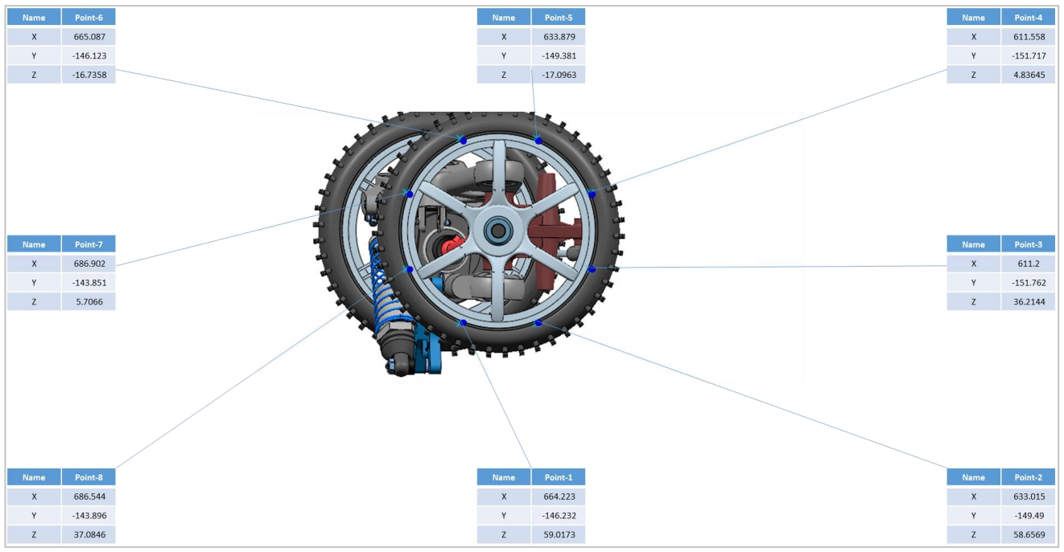
Annotations in PPT
Finally, the pixel coordinates in PPT corresponding to three dimension points can be pinpointed.
CAD’24 Eger

Slide 17
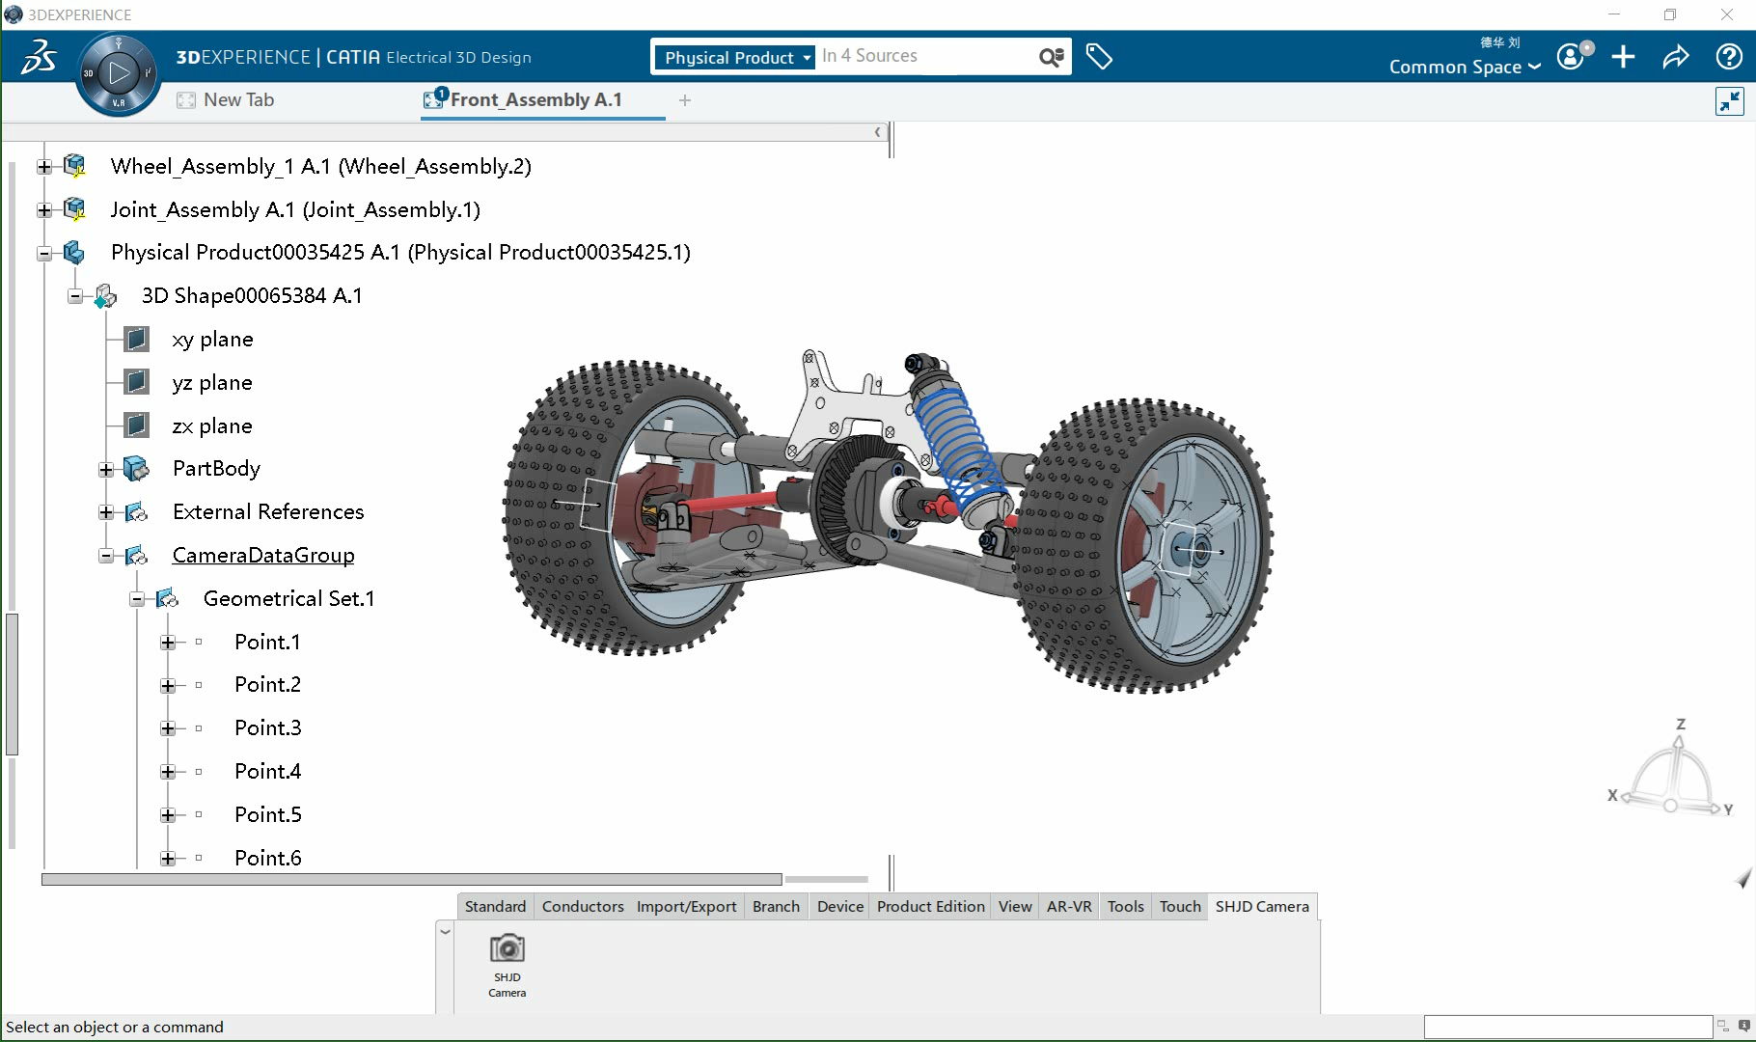
Results
We have already applied the approach in the automotive industry, we re-implemented its core functions and uploaded the operation video to https://github.com/wantchoosejoy/CAD-Camera
CAD’24 Eger

Slide 18
Conclusion
PPT files with model images and annotations can detailed express a product.
There are three main steps to complete this task.
Calculate the camera parameters
  Calculate the Sight direction, Up direction, and Focus distance
  Center the model and get the window bounding sphere
  Calculate the camera position according to the FR relationship
  Set the camera parameters
Calculate the image coordinates
  Take screenshot of the graphic window
  Calculate LP value
  Construct the projection plane (Use the sphere center as the origin)
  Project the 3D point to the plane, get the 2D coordinates of the projected point
  Convert 2D coordinates of the projected point to pixel coordinates (with the center of the image as the origin)
  Convert the pixel coordinates to image coordinates with the upper left corner as the origin
Create PPT slides
  Create a PPT file
  Insert the images into PPT slides
  Calculate the coordinates of the 3D points in the PPT slides
  Annotate information in PPT slides
CAD’24 Eger

Slide 19
CAD’24
Eger, Hungary
Thanks to the conference organization
Qiujiao Wang
Southwest Jiaotong University Hope College, China
Zhijie Xie
Shanghai Tecwin Software Technology Co., Ltd, China

