Slide 1

AGC
ACCELERATE 3.0 HACKATHON
Architecture
Governance Copilot
Traceable evidence. Human-controlled decisions.
Two Tokens One Brain
Zhang1, Yang — Team Lead
Wang, Ted — Team Member
Internal hackathon proof of concept

Slide 2
CURRENT GOVERNANCE PROCESS
Architecture review spans documents, meetings, and tracked work
The Domain Architect remains the formal decision authority across review rounds.
1
Project Team
2
Solution Intent in Confluence
3
Domain Review in Teams
→
→
Prepare the SI using the required template
Official document and design baseline
Review meeting with transcription when enabled
4
Findings and Changes
5
SI Revision
6
Further Review → Approval
→
→
Communicate required updates and evidence
Project team updates the official SI
Repeat until Domain Architect approval
ADO governance ticket · tracked actions · manual handoffs
PoC normalization
Confluence content → normalized SI content
Teams transcript → normalized review transcript
Synthetic inputs in this PoC · future approved connectors are not implemented
ARCHITECTURE GOVERNANCE COPILOT · ACCELERATE 3.0
02

Slide 3
PROPOSED SOLUTION
Draft the SI, structure the review, keep humans accountable
Project Context
Package
DRAFT + GOVERNANCE REVIEW
HUMAN CONTROL
OUTPUTS
+
→
Solution Intent · Outcome · Findings
Decisions · Actions · Evidence
→
Review
Edit
Include / Exclude
→
Review Record
+
ADO Item Previews
Review Transcript +
Metadata
Evidence Traceability
Structured Findings and Actions
Human Accountability
NO AUTOMATIC APPROVAL
ARCHITECTURE GOVERNANCE COPILOT · ACCELERATE 3.0
03

Slide 4
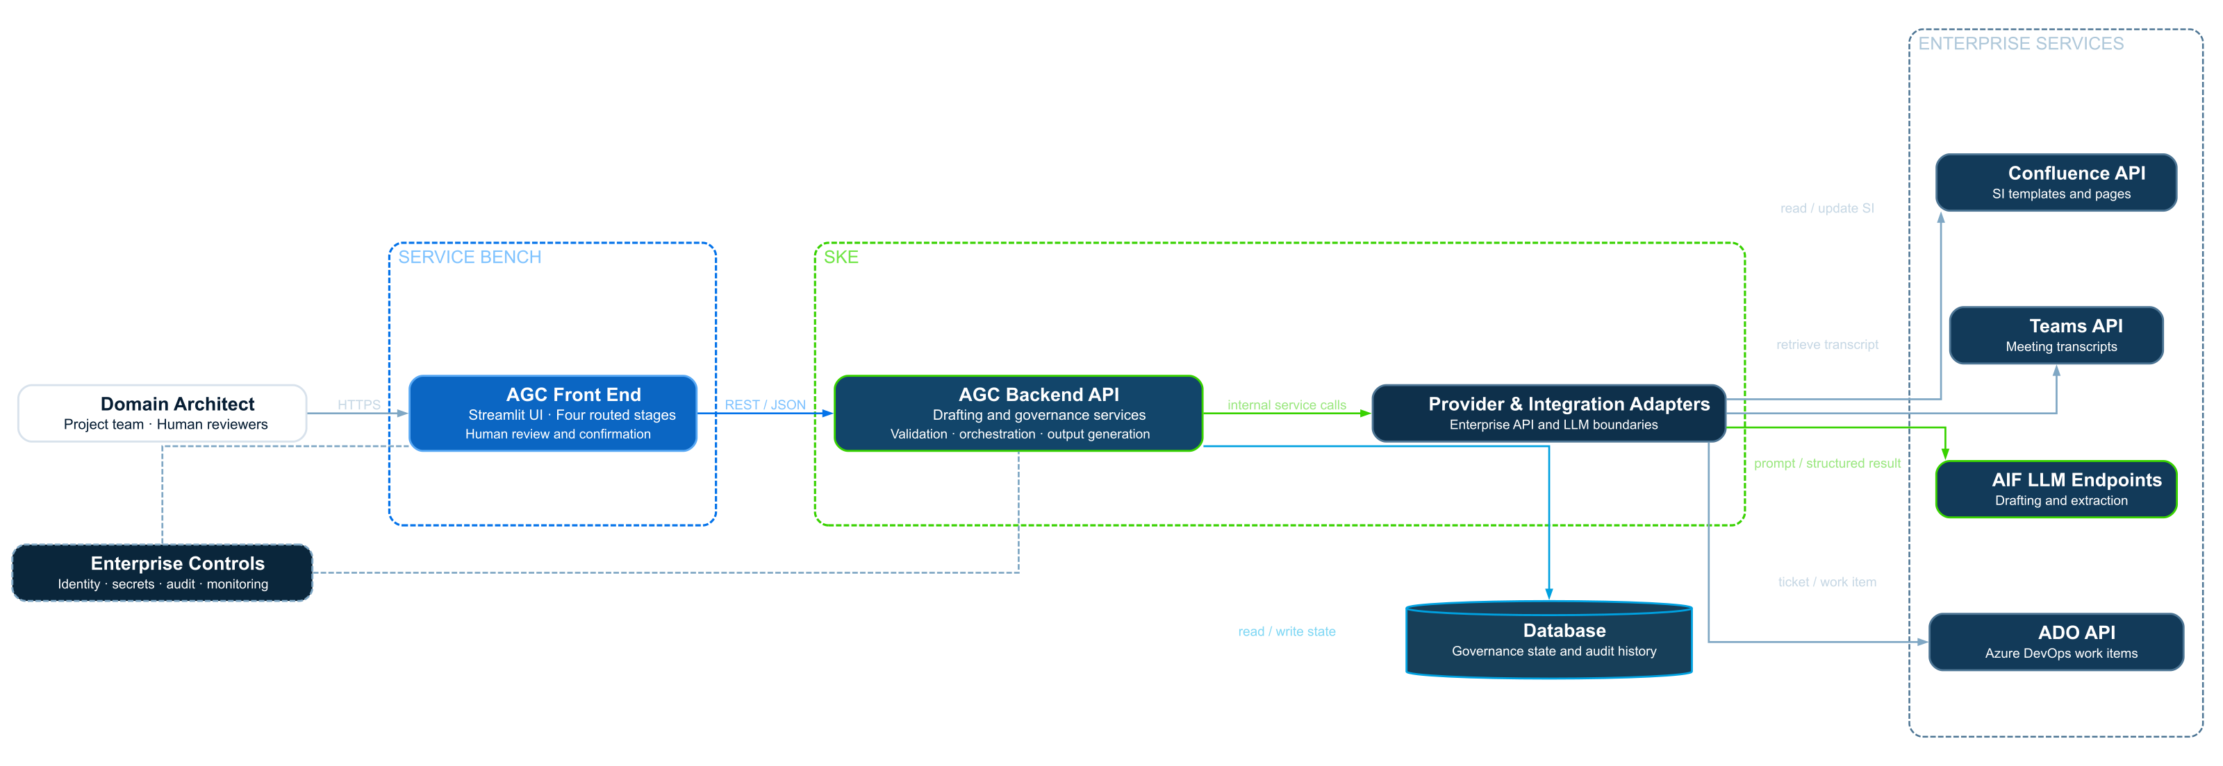
SYSTEM ARCHITECTURE
Target architecture connects governed context to AI-assisted review
Proposed production integration view · Current PoC uses local deterministic providers.
SKE
INTEGRATION ADAPTERS
ENTERPRISE SERVICES
SERVICE BENCH
Confluence API
Confluence Connector
↔
SI content
Retrieve SI content · publish confirmed record
AGC Front End
AGC Backend API
Domain Architect
HTTPS
Four routed stages
Human review and confirmation
REST / JSON
Drafting · governance
Validation · output generation
Teams Connector
↔
Teams API
Project team · Human reviewer
↔
↔
Review transcripts
Retrieve permitted review transcript
AIF LLM Provider
↔
AI Factory (AIF)
Structured AI requests
Send scoped context · receive structured result
read / write state + audit
Database
AZURE DEVOPS
Governance state
and audit history
Azure DevOps
↔
Azure Repos API
Selected repository + branch context
Repos + Boards connector
↔
Azure Boards API
Governance metadata + approved work items
Enterprise Controls
Cross-cutting identity · secrets · audit · monitoring · data policy
ARCHITECTURE GOVERNANCE COPILOT · ACCELERATE 3.0
04

Slide 5
Architecture Governance Copilot
Traceable evidence. Human-controlled decisions.
Two Tokens One Brain
Zhang1, Yang — Team Lead
Wang, Ted — Team Member
ACCELERATE 3.0 HACKATHON
Synthetic data · Hackathon proof of concept

