Slide 1

AGC
ACCELERATE 3.0 HACKATHON
Architecture
Governance Copilot
Traceable evidence. Human-controlled decisions.
Two Tokens One Brain
Zhang1, Yang — Team Lead
Wang, Ted — Team Member
Internal hackathon proof of concept

Slide 2
CURRENT GOVERNANCE PROCESS
Architecture review spans documents, meetings, and tracked work
The Domain Architect remains the formal decision authority across review rounds.
1
Project Team
2
Solution Intent in Confluence
3
Domain Review in Teams
→
→
Prepare the SI using the required template
Official document and design baseline
Review meeting with transcription when enabled
4
Findings and Changes
5
SI Revision
6
Further Review → Approval
→
→
Communicate required updates and evidence
Project team updates the official SI
Repeat until Domain Architect approval
ADO governance ticket · tracked actions · manual handoffs
PoC normalization
Confluence content → normalized SI content
Teams transcript → normalized review transcript
Synthetic inputs in this PoC · future approved connectors are not implemented
ARCHITECTURE GOVERNANCE COPILOT · ACCELERATE 3.0
02

Slide 3
PROPOSED SOLUTION
Draft the SI, structure the review, keep humans accountable
SI Template +
Source Context
DRAFT + GOVERNANCE REVIEW
HUMAN CONTROL
OUTPUTS
+
→
Solution Intent · Outcome · Findings
Decisions · Actions · Evidence
→
Review
Edit
Include / Exclude
→
Review Record
+
ADO Item Previews
Review Transcript +
Metadata
Evidence Traceability
Structured Findings and Actions
Human Accountability
NO AUTOMATIC APPROVAL
ARCHITECTURE GOVERNANCE COPILOT · ACCELERATE 3.0
03

Slide 4
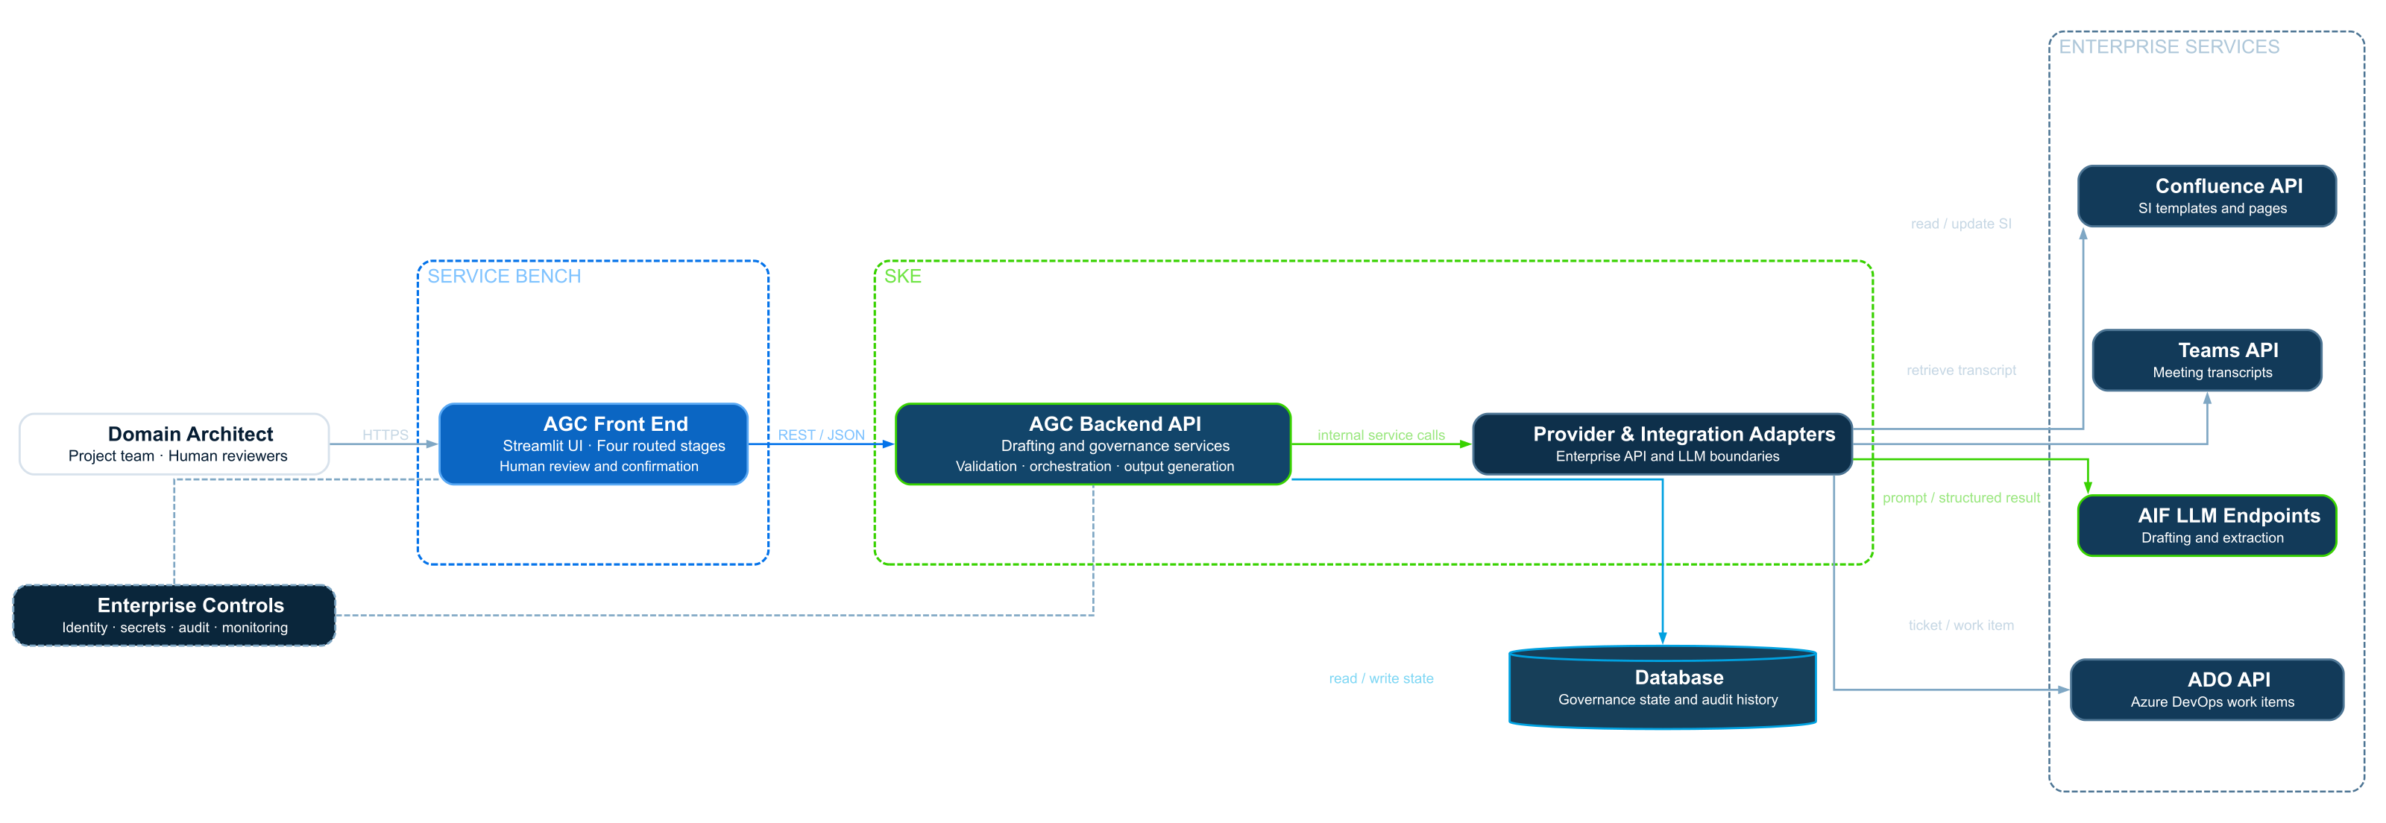
SYSTEM ARCHITECTURE
Target architecture separates experience, services, AI, and data
Proposed deployment and integration view · Current PoC uses local deterministic providers.
ARCHITECTURE GOVERNANCE COPILOT · ACCELERATE 3.0
04

Slide 5
Architecture Governance Copilot
Traceable evidence. Human-controlled decisions.
Two Tokens One Brain
Zhang1, Yang — Team Lead
Wang, Ted — Team Member
ACCELERATE 3.0 HACKATHON
Synthetic data · Hackathon proof of concept

