Slide 1
ISRAEL MVP · AWS SERVERLESS · IL-CENTRAL-1 (TEL AVIV)
wanthat
Earn cashback by sharing what you love.
Product & architecture overview · Dennis Potashnik · July 2026
1 · the business
2 · the product
3 · the architecture
backup · deep dives
Notes:
One sentence: "Wanthat turns the product links people already send to friends into cashback — I'll show the product in two minutes, then spend the rest on how it's built."

Slide 2




02
BUSINESS
Every everyday shopper becomes an affiliate — automatically
THE GAP
THE PRODUCT
Shoppers
share product links every day — "where did you get that?" — and earn nothing for the purchases they drive.
Wanthat turns the link you already send into a tracked affiliate link.
Wanthat is the single registered affiliate across AliExpress / Shein / Amazon and others — when a friend buys, the commission flows in and is split between the recommender and the buyer.
It monetizes a behavior that already exists.
Cashback platforms
Rakuten and Honey reward passive shopping through their own portal; the social recommendation goes unpaid and unmeasured.
Organic word-of-mouth
brands keep growing influencer budgets while organic word-of-mouth — which converts better — stays invisible
wanthat
2
Notes:
word-of-mouth drives 20-50% of purchases and nobody pays for it. We are not building an influencer platform — the persona is a regular person in four family WhatsApp groups.

Slide 3






03
BUSINESS
Why Israel, why now
66%
#1
$17B+
of Israeli online orders are AliExpress — the MVP integration
WhatsApp penetration among the highest globally — group sharing is a daily habit
global affiliate market — a proven commercial model
3 days
₪20+
Month 3
AliExpress attribution window — sharing must be instant
payout via bank / card / Bit / PayBox
go/no-go gates: 500 active sharers · >20% CTR · >6% conversion · >50% 30-day return
wanthat
3
Notes:
the gates decide Phase 2 (group sharing, two-sided rewards) and a pre-seed raise.

Slide 4
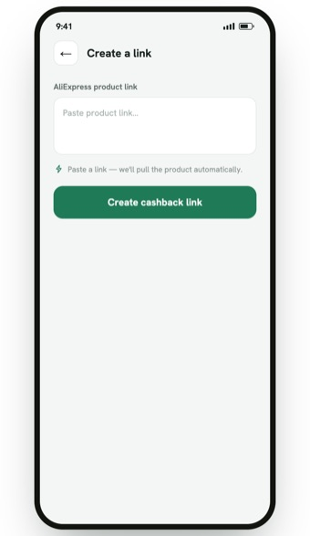
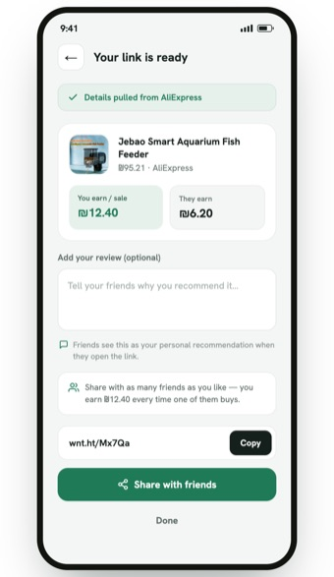
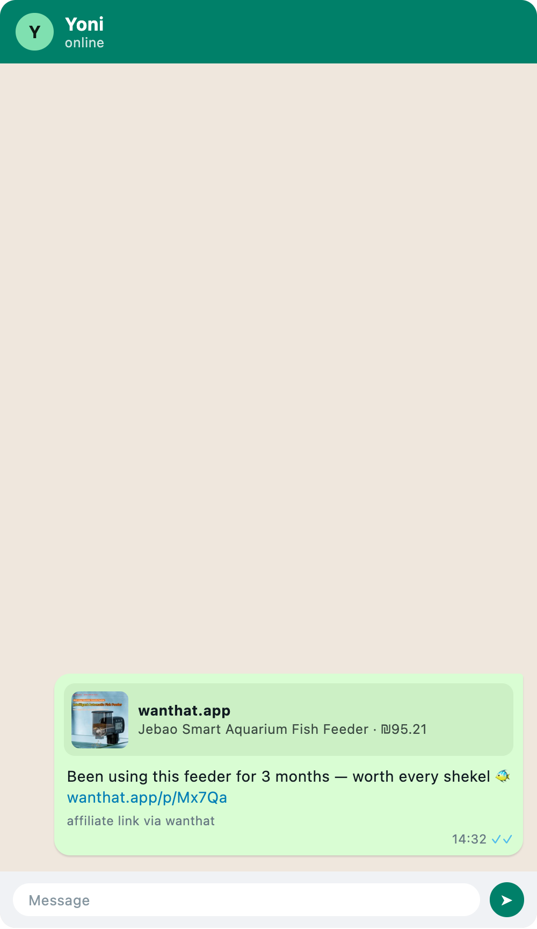
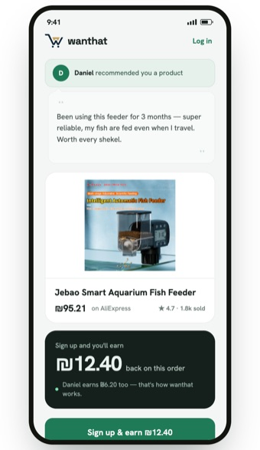
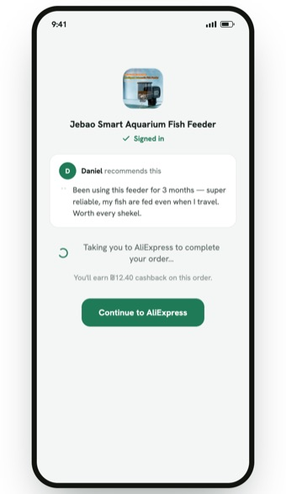
04
PRODUCT
How it works — share a recommendation
wanthat.app/create
wanthat.app/create
WhatsApp — off-platform
wanthat.app/p/Mx7Qa
→ aliexpress.com — attributed
→
→
→
→
1 Member pastes a product link
2 Link ready — product pulled, cashback split shown
3 Shared on WhatsApp — disclosure included
4 Friend opens the branded landing — with the review
5 Signed in, sent to the store — purchase attributed
wanthat
4
Notes:
the whole loop is two taps for the member; the friend's landing carries the personal review, which is the trust mechanic. Screens are the design-handoff mocks.

Slide 5
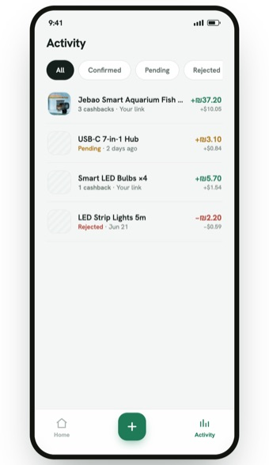
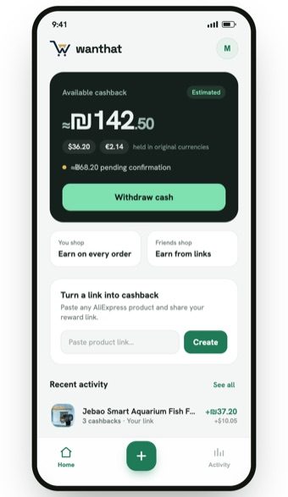
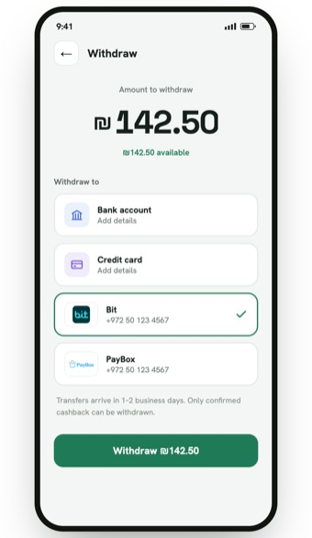
05
PRODUCT
How it works — the cashback comes back
wanthat.app/activity
wanthat.app/home
wanthat.app/withdraw
→
→
1 Conversion tracked — pending until the store confirms
2 Wallet credited — estimated ILS over real currencies
3 Withdraw from ₪20 — bank, card, Bit or PayBox
wanthat
5
Notes:
note the "Estimated" chip — cashback is held in the settlement currency and the ILS headline is a display estimate (ADR-0017); conversion happens at withdrawal.

Slide 6






06
ENGINEERING
Engineering principles
Optimize for cost
Zero to scale
Security by design
Avoid constant costs: zero interface endpoints, scale-to-zero, on-demand DBs.
A link going viral in a WhatsApp group is the potential spike.
The entire framework is about money movement. Apply least privilege access, MFA, data integrity provability, isolation of concerns, strict auditing and other security principles.
Monorepo, schema-first
Everything as code
Decisions on record
pnpm + Turborepo, TypeScript everywhere (Node 24, arm64). Zod contracts in one package: inferred types + runtime validation at every boundary.
AWS CDK v2; per-env stacks; zero console changes. PRs run CI + cdk diff; merge deploys dev; SQL migrations run in-deploy; verify no orphaned resources after deploys.
ADRs beside the code. Locked: change is a new superseding ADR, never an edit.
wanthat
6
Notes:
these five drove every decision that follows; when two conflicted, cost and money-safety won.

Slide 7
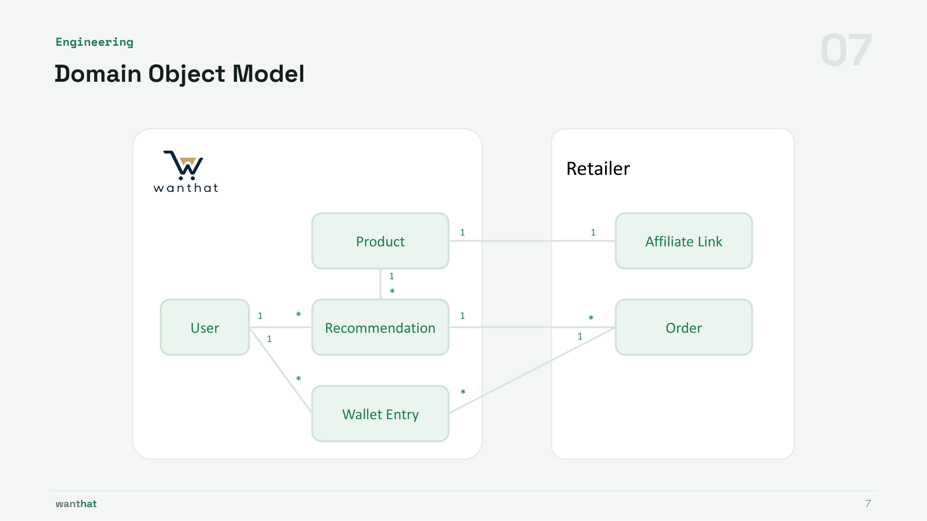
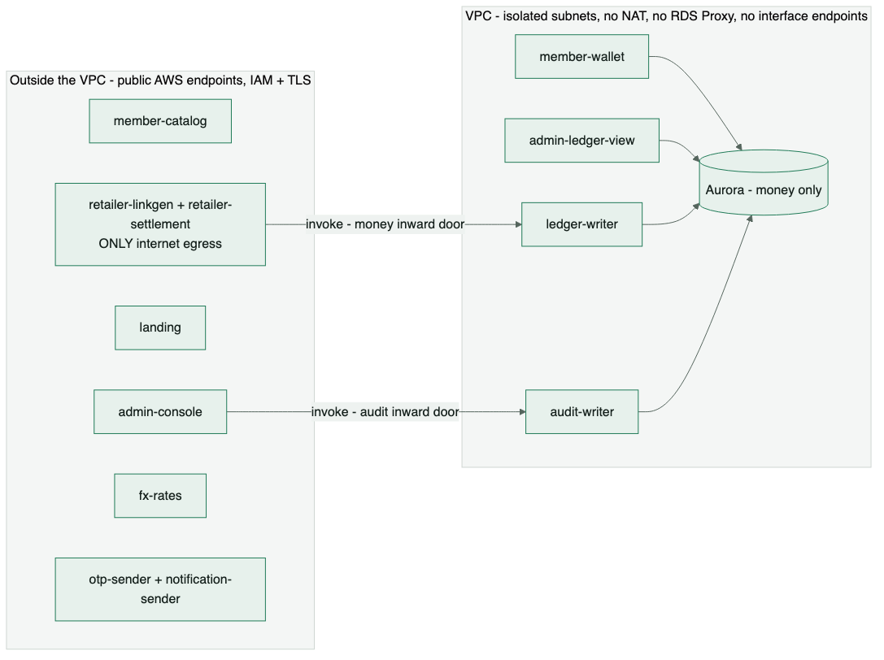
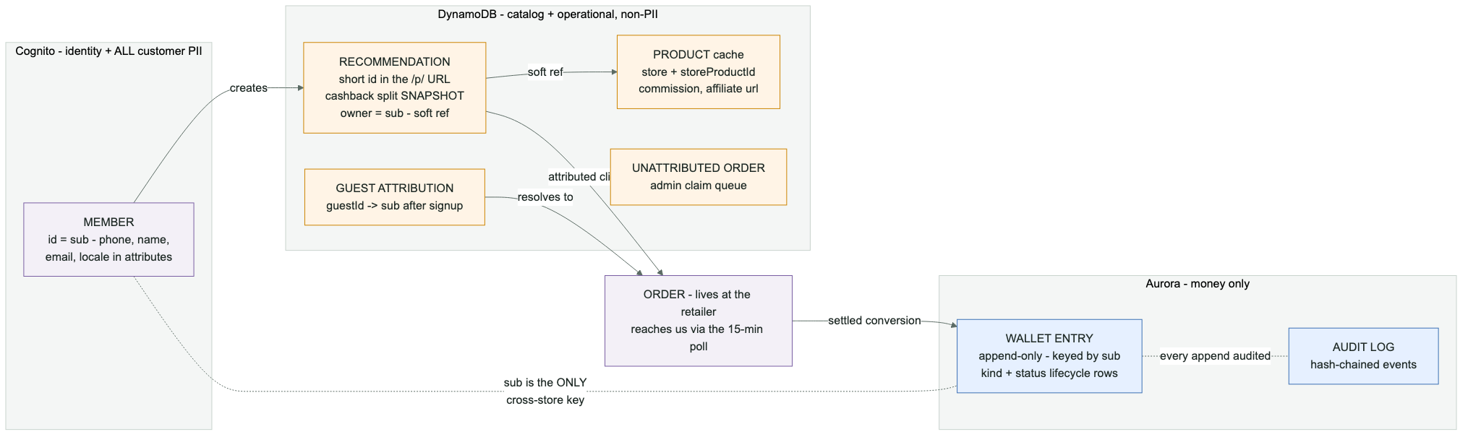
Notes:
The split-by-guarantee is the next slide's architecture in miniature — PII never leaves Cognito, the viral read path never leaves DynamoDB, and money only ever APPENDS in Aurora. Per-column schemas are in backup B10/B11.

Slide 8
08
DECISIONS
Data stores and cost
Data | Decision | Why | Trade-off accepted
Money + Audit Log | Aurora Serverless v2 (0-2 ACU, IAM auth, no proxy) | ACID; permissions enforced on DB level (GRANTs); storing the audit log with hashed chains | Scale-to-zero cold resume ~20 s (60 s connect timeout + SPA warm-up probe); 50-connection cap. Possible simple workaround — cached last known totals (display while reloading) per user on SPA or backend
Customer PII | Cognito user attributes are the system of record | Auth path touches zero databases; GDPR delete = one call; the only backup carrying PII is the Cognito backup | ListUsers-only queries (no joins, one filter); no PITR; no attribute history
Operational | DynamoDB on-demand (9 tables) | Viral bursts absorbed at $0 idle; access patterns modeled as projections (byOwner, byState GSIs) | No joins, no ad-hoc queries; counters kept exact via same-table transactions
Deliberate constraint: no cross-STORE transactions exist anywhere — counter rows live inside the counted table (single-table TransactWriteItems); each ledger append commits with its audit witness in ONE Aurora transaction (the single intra-store exception), and replays stay no-ops via the unique (order_id, kind, status) index. Cross-store consistency is by keys and idempotency, not coordination.
wanthat
8
Notes:
if asked why not one Postgres for everything — the redirect hot path must absorb viral spikes at zero idle cost, and the auth path must not depend on a relational database resume. (The data-homes diagram is in backup B6.)

Slide 9
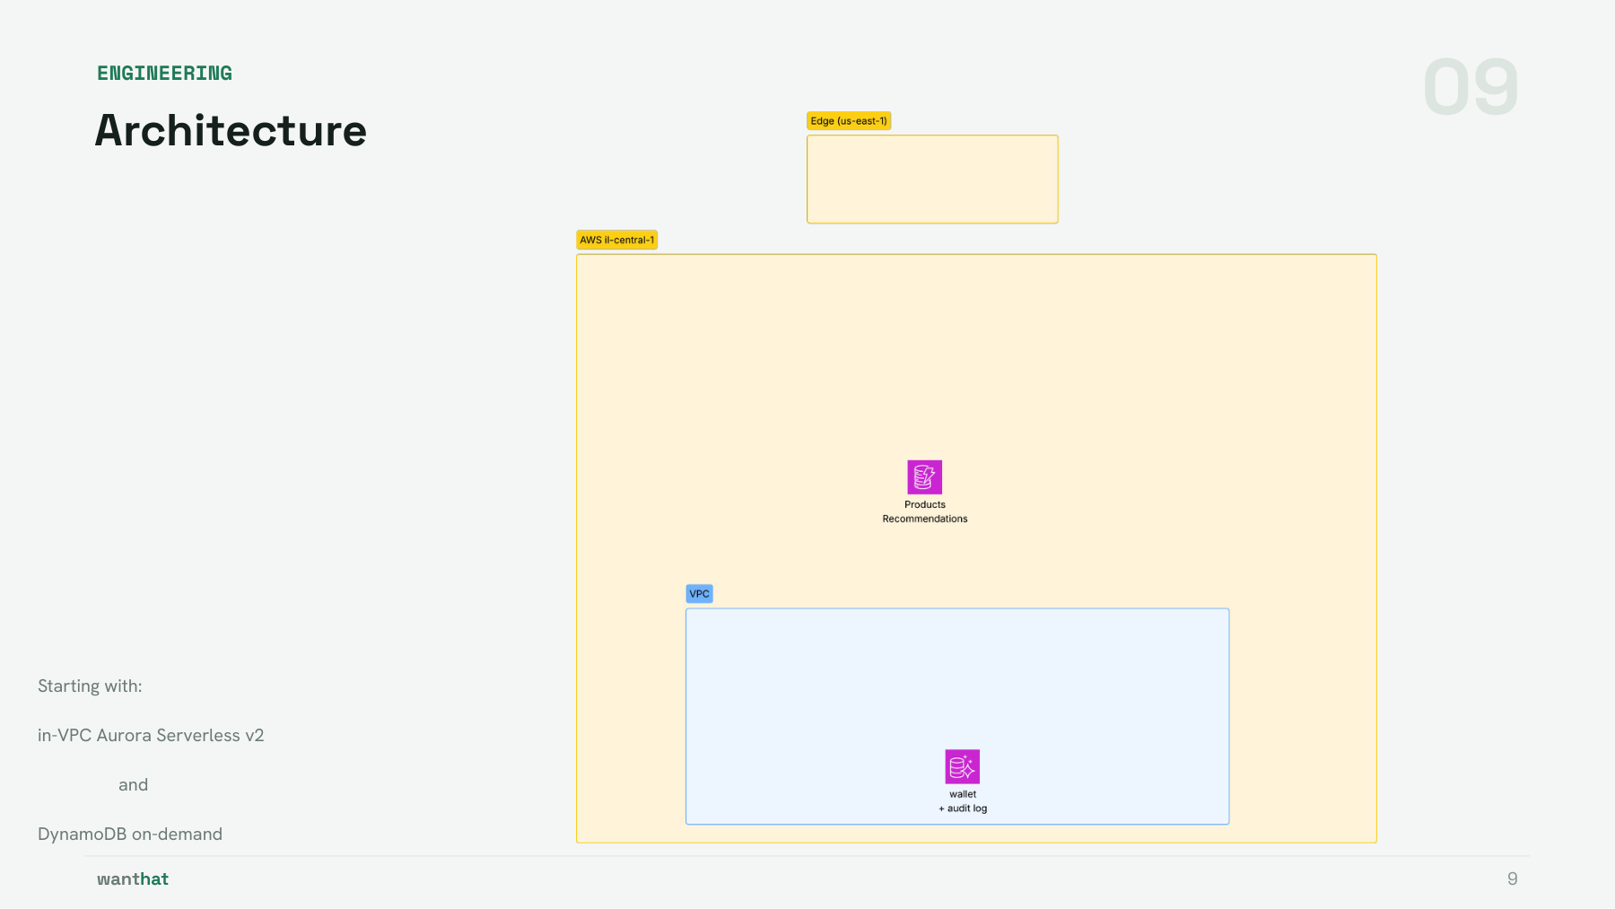
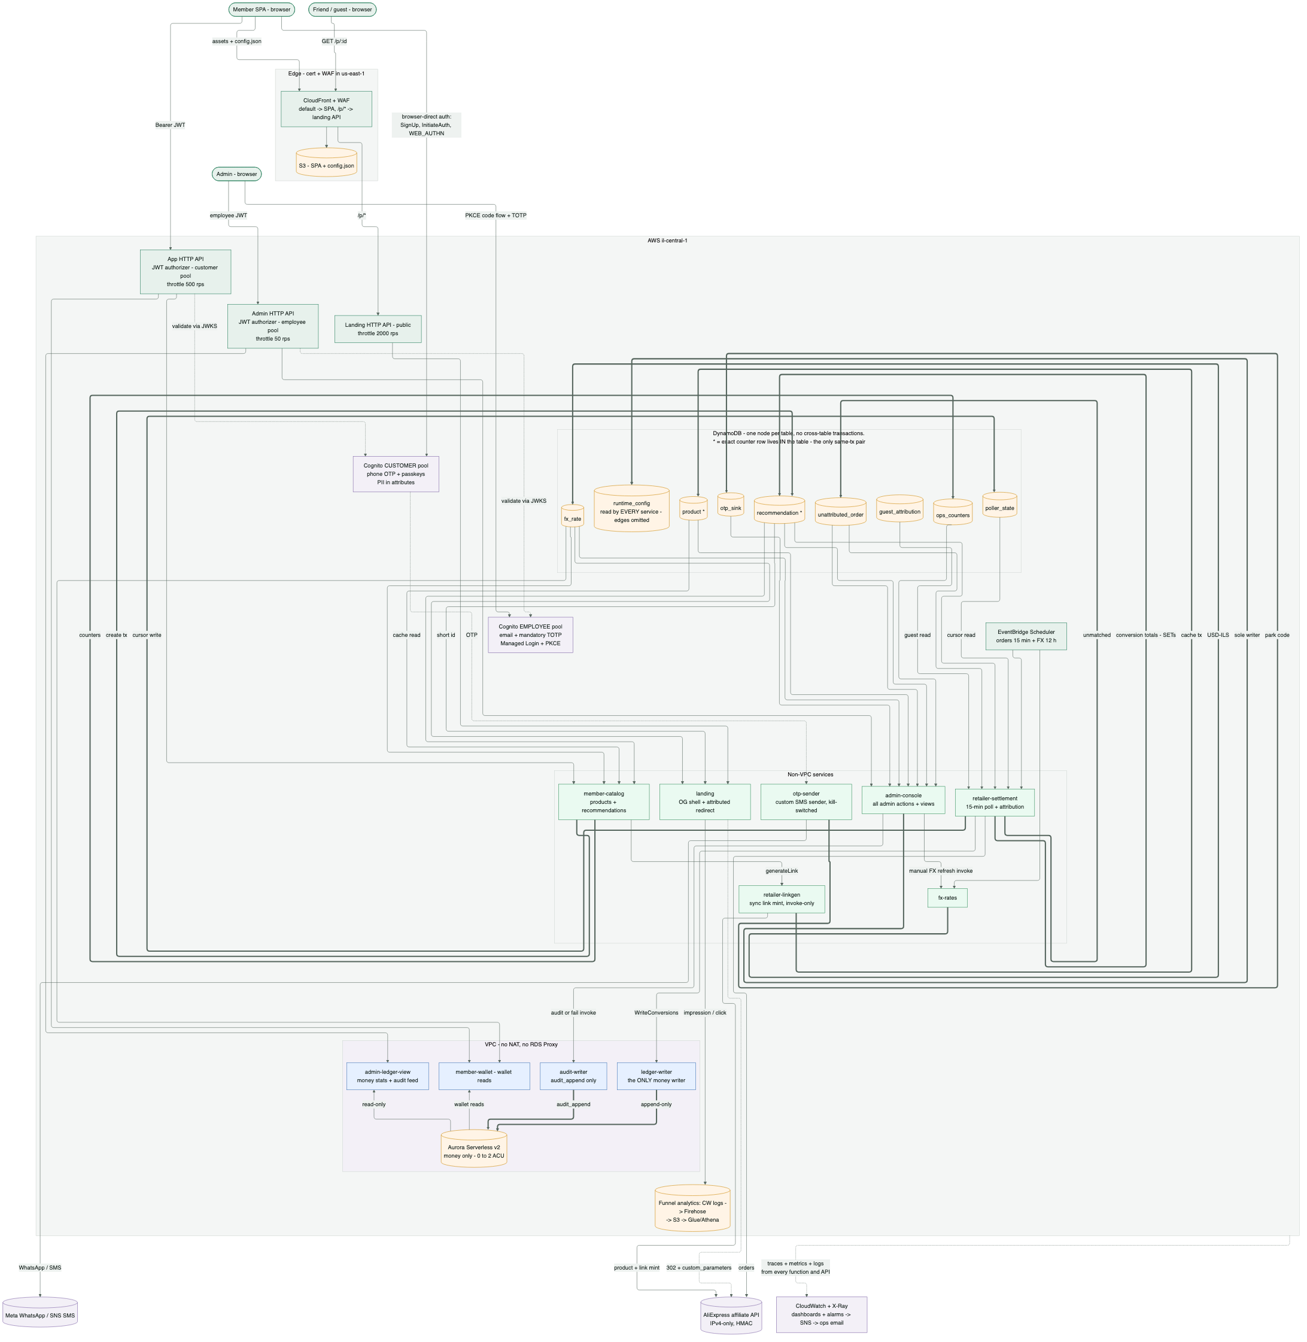
Notes:
Diagram maintained by Dennis in the working deck - the card is reserved space.

Slide 10
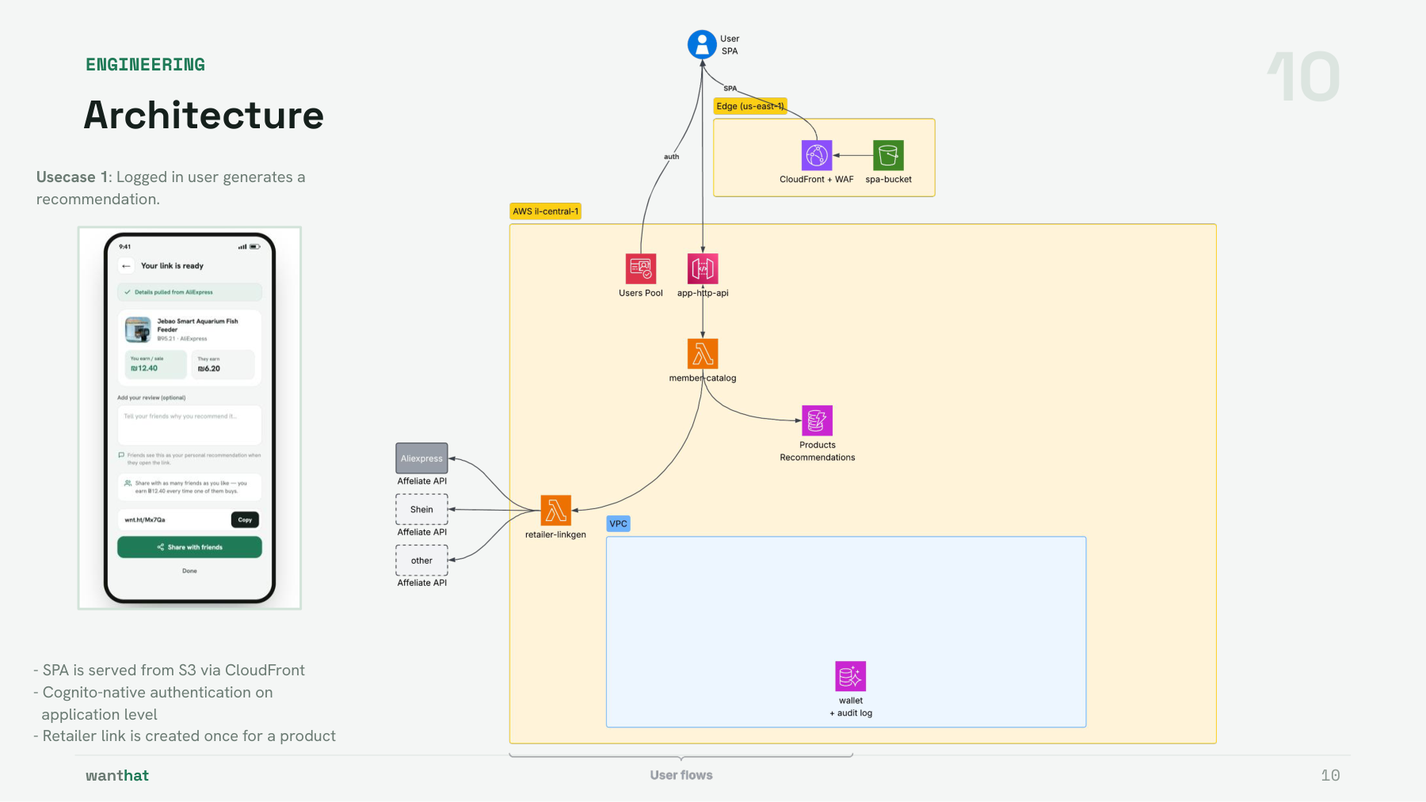
Notes:
Diagram maintained by Dennis in the working deck - the card is reserved space.

Slide 11
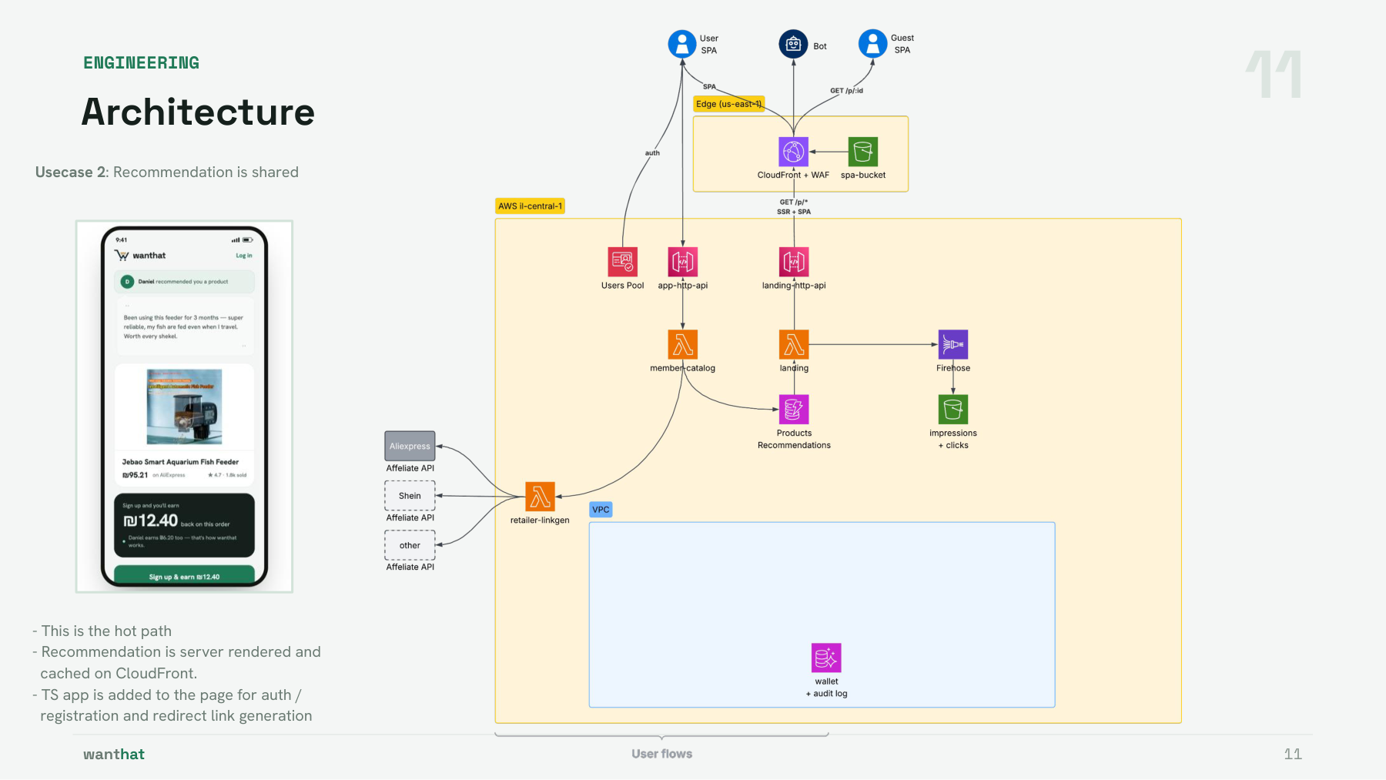
Notes:
Diagram maintained by Dennis in the working deck - the card is reserved space.

Slide 12
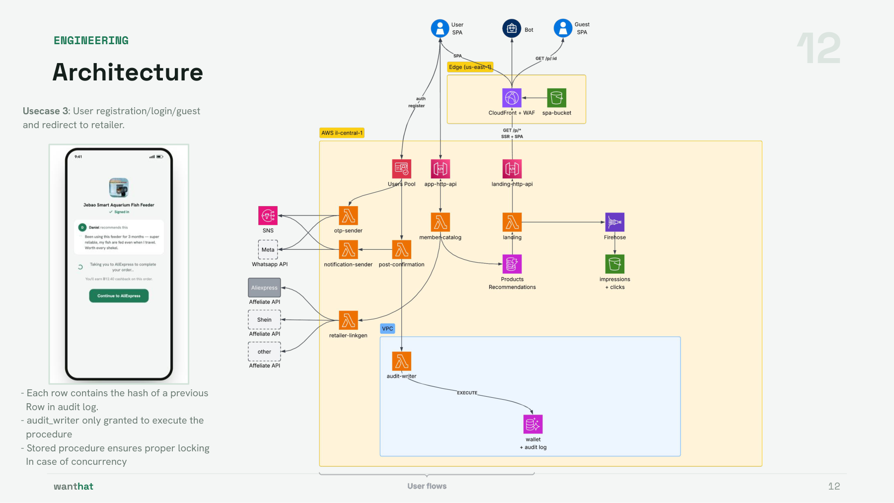
Notes:
Diagram maintained by Dennis in the working deck - the card is reserved space.

Slide 13
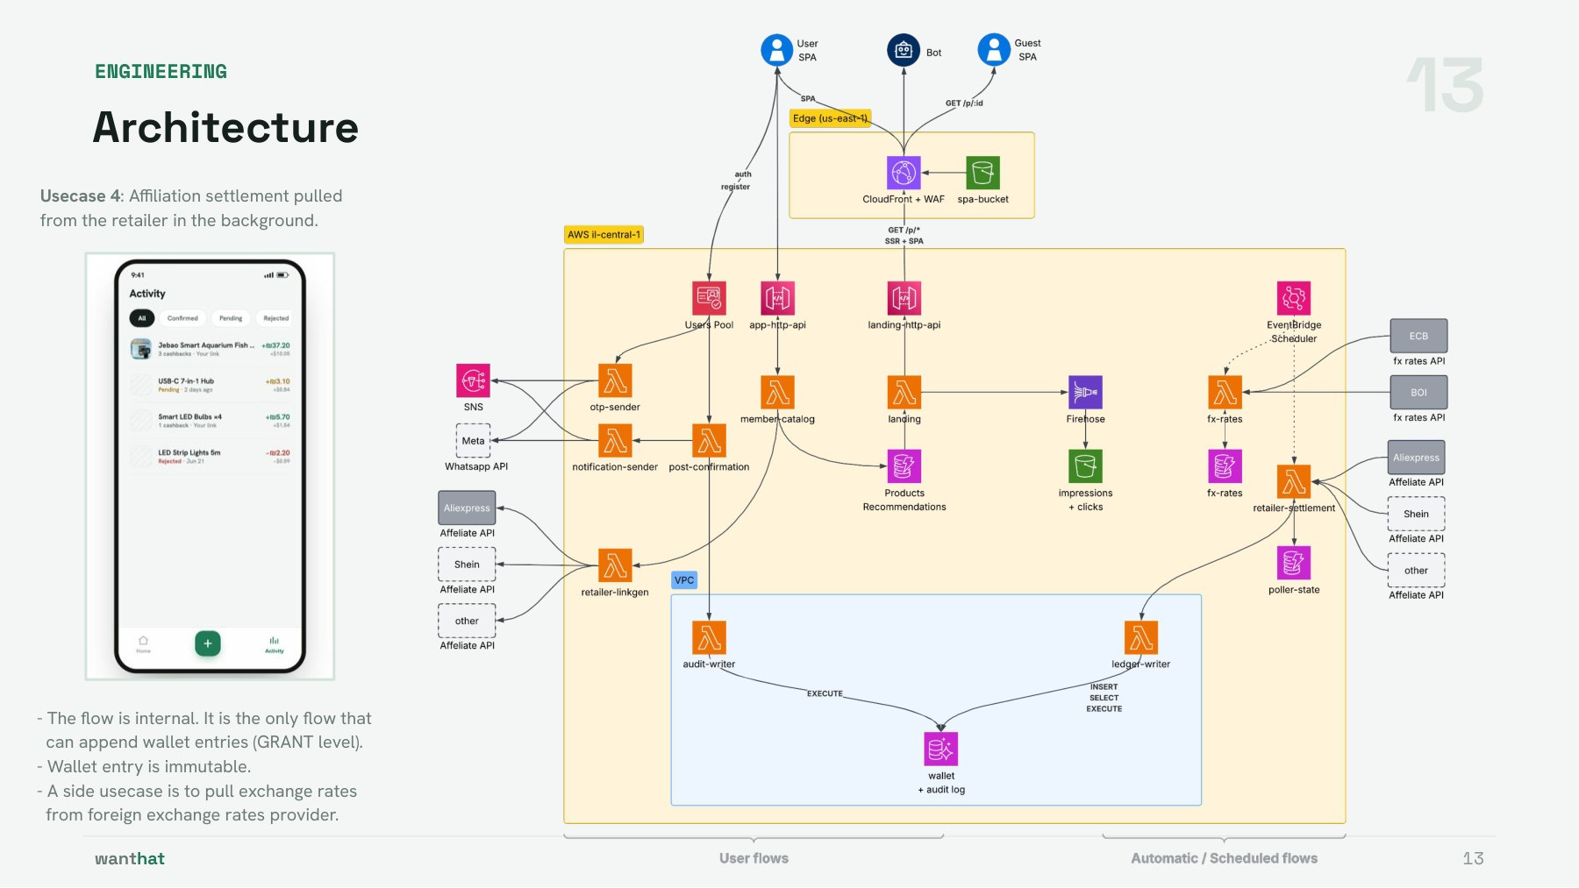
Notes:
Diagram maintained by Dennis in the working deck - the card is reserved space.

Slide 14
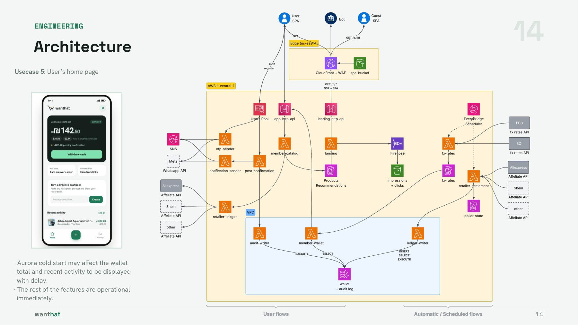
Notes:
Diagram maintained by Dennis in the working deck - the card is reserved space.

Slide 15
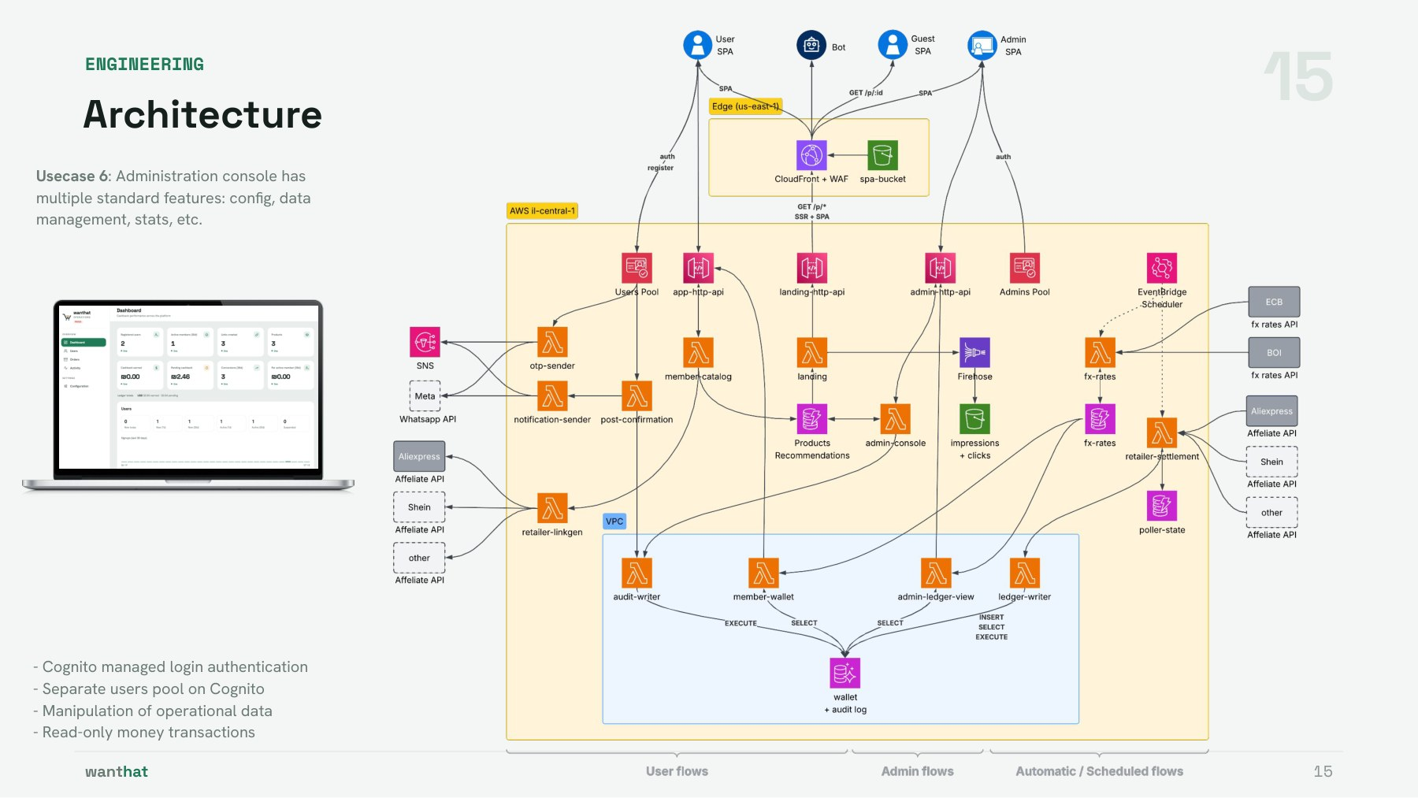
Notes:
Diagram maintained by Dennis in the working deck - the card is reserved space.

Slide 16
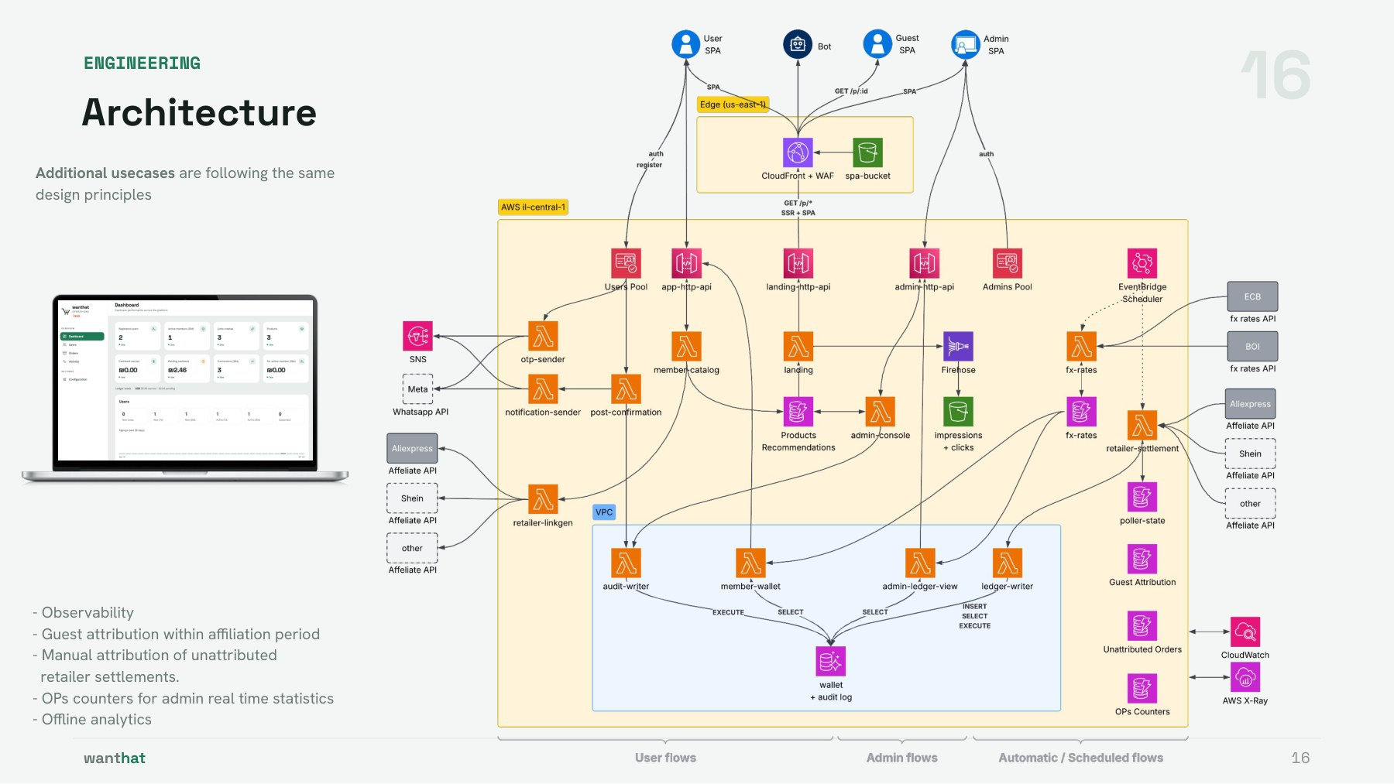
Notes:
Diagram maintained by Dennis in the working deck - the card is reserved space.

Slide 17
17
DECISIONS
Cost model — a measured floor, then linear
Line item | Monthly | Note
Compute + APIs + DynamoDB idle | $0 | Everything scales from zero; Aurora paused = storage only (~$2)
WAF (2 web ACLs + rules) | ~$15 | The deliberate fixed floor: CloudFront ACL + Cognito-pool ACL
Secrets, Route 53, misc | ~$2 | 2 retailer secrets, hosted zone
OTP delivery | capped $1 | SNS hard cap (SMS sandbox); WhatsApp ~10x cheaper per message at scale — hence WhatsApp-default
NAT / proxies / endpoints | $0 | Architecturally eliminated (backup B2)
Costs accepted knowingly: cold-resume UX risk on first wallet read (mitigated by warm-up probe); one AWS account for dev+prod shares SMS caps and quotas — flagged for split.
Unit economics guardrail: the redirect hot path costs micro-cents per thousand clicks and cannot touch Aurora — cost scales with revenue-bearing traffic, not with virality.
Scale projection (10 → 100k users): next slide.
wanthat
17
Notes:
numbers are il-central-1 approximations; the point is the shape — a ~$20 measured floor, then linear with usage.

Slide 18
18
DECISIONS
Cost projection by user count
Monthly (prod) | 10 | 100 | 1,000 | 10,000 | 100,000
WAF (2 ACLs, fixed + $0.60/M req) | $14 | $14 | $14 | $15 | $27
API Gateway (~$1.2/M) | ~$0 | ~$0 | $0.40 | $4 | $36
Lambda (256MB arm64) | ~$0 | ~$0 | $0.20 | $2 | $18
DynamoDB on-demand | ~$0 | ~$0 | $0.40 | $4 | $40
Aurora (compute + storage) | ~$3 | ~$8 | ~$45 | ~$80 | ~$220
RDS Proxy (8-ACU minimum) | — | — | — | ~$100 | ~$100
Cognito ($0.015/MAU after 10k free) | $0 | $0 | $0 | $0 | $1,350
CloudFront + misc | ~$3 | ~$3 | ~$5 | ~$12 | ~$42
Total | ~$20 | ~$25 | ~$65 | ~$215 | ~$1,835
Assumptions: 10 operations/user/day, ~70/30 read-write, il-central-1 approximate prices, prod only; every active user = 1 Cognito MAU; RDS Proxy included from 10k users.
Two step functions, then linear: Aurora stops sleeping (~1k users); the Cognito free tier ends at exactly 10k MAU. Per-user at 100k: ~$0.018/month.
wanthat
18
Notes:
WAF stays flat at every scale - member API operations bypass CloudFront entirely. Breaks BEFORE the bill: account concurrency 10 (~10k users, peaks) - AliExpress rate limits (ADR-0021) - Aurora's 50-connection cap post-quota-raise (only THEN does the proxy earn its cost) - the 2-ACU max.

Slide 19
19
DECISIONS
Known limits — and their revisit triggers
Limitation | Current stance | Revisit trigger
Single active region | Cross-region backups only; RTO = hours (ADR-0005) | Revenue SLA or user base that prices an active-standby
Cognito PII: no PITR, weak queries | Accepted for MVP; profile is thin | Compliance/BI needs → dual-write projection to SQL
Account concurrency = 10 | No reserved concurrency anywhere (deliberate) | Quota raise, then per-function caps return
dev + prod in one account | Shared SMS cap and service quotas | Before marketing push: account split
Retailer throttling interim | Sequential + one ban-window retry (ADR-0021) | Poller volume growth or AliExpress app approval
Questions? backup: sequence diagrams · failure modes · the rejected-alternatives list
wanthat
19
Notes:
every row is documented in an ADR or docs/AWS_Architecture.md — none of these are surprises.

Slide 20
Q&A MATERIAL
Backup
Decisions and trade-offs · sequence diagrams · schemas · operations · the ADR map

Slide 21
B1
BACKUP
Auth — three options
A Cognito Managed Login
B Cognito-native, own UI
C App-owned ceremonies
Hosted pages, PKCE — zero auth code to own
Browser calls SignUp / InitiateAuth / WEB_AUTHN directly; profile = ID-token claims
Proxy every OTP step, own WebAuthn store, Ed25519 ticket bridge, AdminSetUserPassword exchange
REJECTED: no Hebrew/RTL (12 locales, text not editable); passkey RP-ID forced to the auth subdomain — credentials siloed off wanthat.app.
CHOSEN: zero backend calls to authenticate; full RTL UI; pool WAF + quotas as abuse control.
ALTERNATIVE — NOT PURSUED: 2 Lambdas + 3 tables + a crypto path buy exactly ONE feature — userless Face ID; the requirement was waived, so that cost buys nothing.
Trade-offs signed off with B: userless Face ID waived (remembered-phone one-prompt kept); phone enumeration accepted (preventUserExistenceErrors LEGACY) — mitigated by pool WAF rate rules; JWT revocation lags up to 15 min on our APIs (stateless authorizer, 15-minute access tokens) — acceptable for the current member surface.
Measured effect: login requires zero backend calls; the Aurora cold-resume login stall (~20 s) is structurally impossible.
wanthat
B1
Notes:
Full sequence diagram in backup B4.

Slide 22
B2
BACKUP
Network — pay for nothing that idles
Component avoided | Fixed cost avoided | Replaced by
NAT Gateway | ~$33/mo + $0.045/GB | Non-VPC functions call public AWS endpoints (IAM + TLS); the only true internet egress is the retailer tier
VPC interface endpoints | ~$7-15/mo each | Zero needed: nothing in-VPC calls Cognito, Secrets Manager, or the internet — by design, not by exception
RDS Proxy | per-ACU hourly | Direct IAM DB auth; 50-connection cap + no reserved concurrency keeps pressure bounded
DynamoDB access from VPC | — | Free gateway endpoint
Structural consequence: in-VPC functions cannot initiate outward calls — the conversion chain is always proxy → writer (invoke), and admin claim intents settle asynchronously on the next poll heartbeat.
Blast-radius bonus: the retailer credential is readable by exactly one non-VPC function; a compromised in-VPC function has no path to it or to the internet.
Revisit trigger: sustained Aurora connection pressure (alarm at 80% of 50) → RDS Proxy; steady traffic → reserved concurrency once the account quota (10) is raised.
wanthat
B2
Notes:
il-central-1 gaps shaped this too — no RDS Data API (killed the no-VPC data path), no Lambda Function URLs (landing sits behind an HTTP API).

Slide 23
B3
BACKUP
Money — poll over webhook, append over update
Ingestion: scheduled reconciliation
Storage: append-only + GRANT-enforced
- Webhooks rejected: an inbound money-bearing endpoint is a spoofing surface, needs ordering and retry semantics, and the retailer offers no reliable one anyway (ADR-0009).
- Poll = a cursor in poller_state + listOrdersByIndex every 15 min: replayable from any point, idempotent by the ledger unique index, nothing to authenticate inbound.
- Accepted latency: minutes to surface, 24-48 h to confirm (retailer settlement dominates — the product promise is days, not seconds).
- Interim throttling (ADR-0021): sequential calls + one ban-window retry; revisit at volume.
- Lifecycle is data, not mutation: pending → confirmed → clawback are separate immutable rows; balances are always derived.
- The invariant lives in Postgres, not app code: UPDATE/DELETE revoked from every role; only ledger_writer can INSERT; audit_append is SECURITY DEFINER and the only door into the audit log.
- Hash-chained audit log makes tampering evident; admin config changes audit the same way.
- Blast radius: a bug or compromise in any read path has zero write capability on money.
wanthat
B3
Notes:
sequence in backup B3. Unmatched orders are not dropped — they park in unattributed_order and an admin claim settles on the next heartbeat.

Slide 24
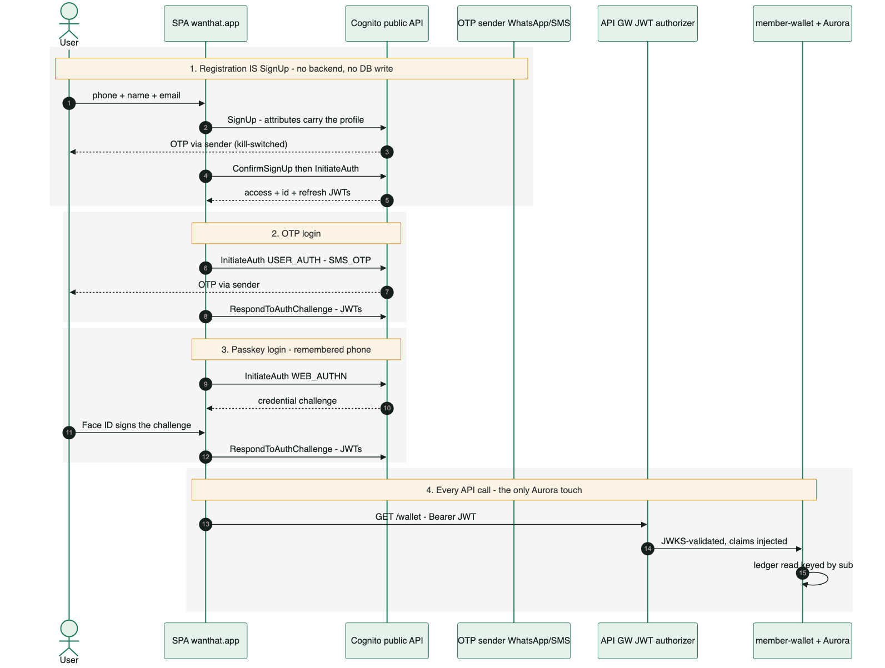
B4
BACKUP
Sequence — customer auth, all four flows
wanthat
B4
Notes:
Registration IS SignUp; OTP and passkey logins; the only Aurora touch is the wallet read.

Slide 25
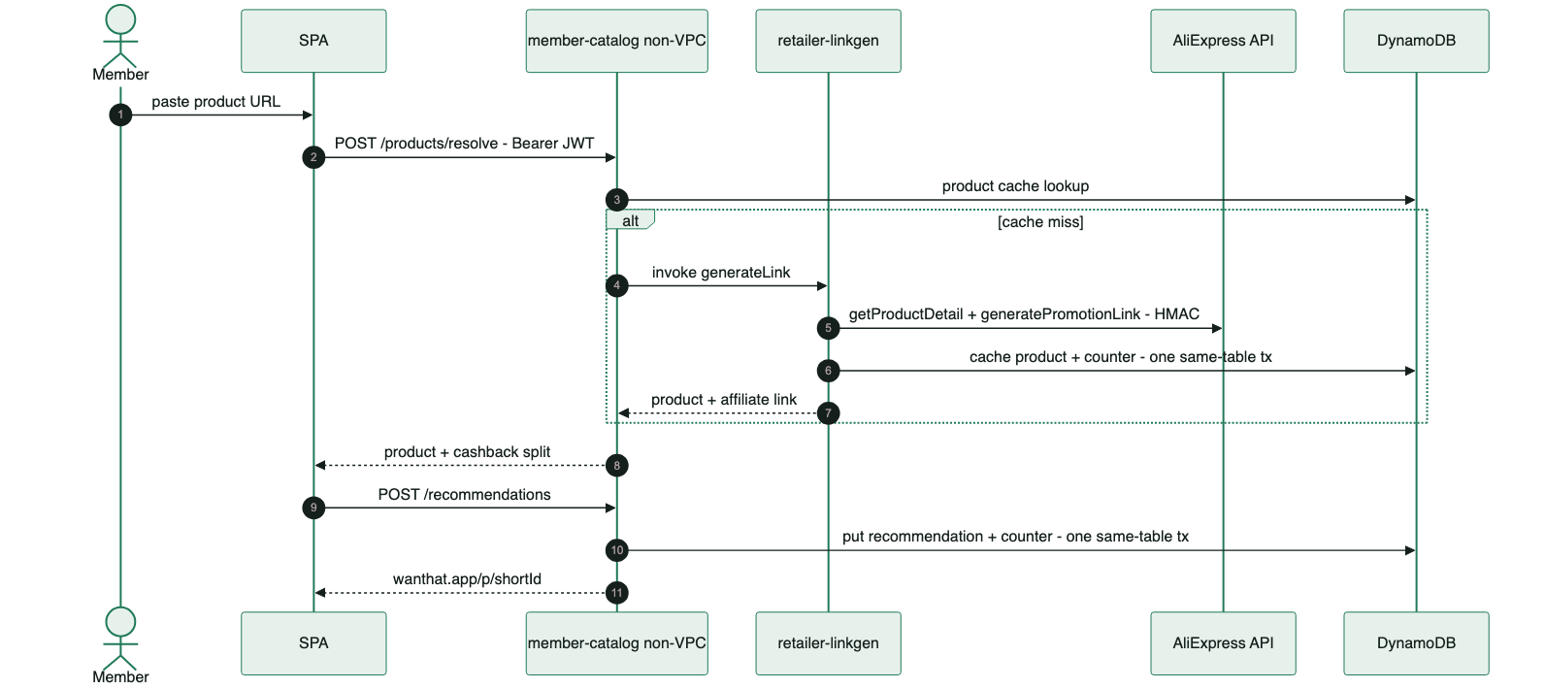
B5
BACKUP
Sequence — create a link
wanthat
B5
Notes:
Cache-first product resolve; on a miss member-catalog invokes retailer-linkgen, which calls AliExpress; both writes are same-table transactions.

Slide 26
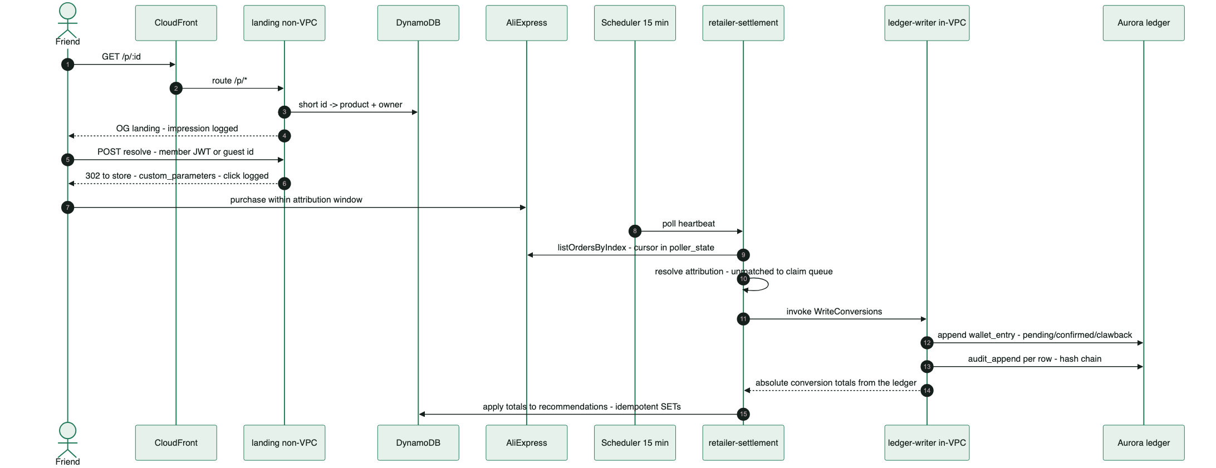
B6
BACKUP
Sequence — click to ledger
wanthat
B6
Notes:
Impression, click, purchase, 15-min poll, attribution resolve, append-only ledger + audit chain.

Slide 27
B7
BACKUP
Trade-off — HA vs single region (ADR-0005)
Chosen: single active region
Rejected, and when to revisit
- Target: 99.5% availability (~3.6 h/month) — lenient by design for an MVP.
- il-central-1 active; eu-central-1 is a RESTORE target, not a standby.
- RPO ~minutes (PITR); RTO ~hours (region-loss rebuild from cross-region copies).
- Hard constraint: Cognito has NO multi-region replication in il-central-1 — hot identity failover is not natively possible at any spend.
- Active-passive multi-region now: not required for 99.5%; identity failover would be non-native anyway; unjustified cost + complexity at MVP.
- In-region backups only: a region incident would lose a money ledger — unacceptable at any SLA.
- Revisit: an SLA beyond 99.5%, or identity region-loss recovery becoming a hard requirement.
wanthat
B7
Notes:
ADR-0005. The Cognito constraint means a hot multi-region identity tier is off the table regardless of budget - the SLA argument and the platform constraint point the same way.

Slide 28
B8
BACKUP
Backup strategy (ADR-0005)
Data | In-region | Cross-region (eu-central-1)
Aurora ledger + audit | PITR, continuous — RPO ~minutes | Automated-snapshot copy
DynamoDB (9 tables) | PITR on every table | Export / copy for the redirect projection + attribution map
Funnel + audit events (S3) | Versioning | Cross-region replication
Secrets | — | Secrets Manager replication
Cognito (identity + ALL PII) | Managed by the pool | NONE — no cross-region recovery in MVP (accepted, documented)
The hash-chained audit log complements backups: restores are tamper-evident, not just recoverable.
Status honesty: PITR is live everywhere; the cross-region copy jobs are the one deferred item of ADR-0005 — tracked, not yet deployed.
wanthat
B8
Notes:
RPO minutes in-region via PITR; cross-region protects against region loss with RTO hours. Cognito PII has no cross-region recovery - a documented, accepted MVP limitation.

Slide 29
B9
BACKUP
Observability
See
Alert
Analyze
Per-surface CloudWatch dashboards: API count / 5xx / p95, Lambda errors / throttles / p95, Aurora ACU + connections, SMS spend. Edge dashboard (CloudFront + WAF) in us-east-1.
SNS -> ops email: per-Lambda errors (13 steady-state functions), per-API 5xx, Aurora connections at 80% of the 50 cap, month-to-date SMS spend at 80% of the cap.
Funnel pipeline: CloudWatch Logs subscription filters on landing / retailer-settlement / ledger-writer pick impression, click, conversion, order_untracked.
X-Ray tracing on every function; structured logs with retention bounds — dev 1 month, prod 6 months.
The two deploy-time triggers are excluded BY DESIGN — their failure fails the deploy itself.
-> Firehose -> date-partitioned S3 -> Glue -> Athena with partition projection.
The alarm list is deliberately short — every alarm is actionable; funnel events are business analytics, not ops noise, which is why they leave CloudWatch.
wanthat
B9
Notes:
Alarm list is deliberately short - every alarm is actionable. Funnel events are business analytics, not ops noise.

Slide 30
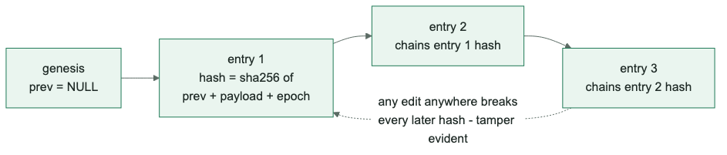
B10
BACKUP
Aurora schema + the hash chain — conceptual
wallet_entry — the append-only ledger
audit_log — hash-chained events
- id, cognito_sub, kind, amount_minor, currency, order_id, recommendation_id, status, created_at — no FK anywhere (the user store is Cognito).
- Lifecycle is rows, not updates: pending -> confirmed -> clawback are separate immutable appends; balances are always derived.
- Unique (order_id, kind, status) = poll idempotency; UPDATE / DELETE revoked from every role.
- Every append commits with its audit_append witness in ONE transaction (2026-07-18) — no ledger row can exist unwitnessed.
- id, prev_hash, entry_hash, payload jsonb, created_at.
- SECURITY DEFINER audit_append is the ONLY door in — an advisory lock serializes writers so the chain can never fork.
- entry_hash = sha256(prev_hash | payload | epoch(created_at)) — any edit anywhere breaks every later hash.
wanthat
B10
Notes:
The chain is verifiable end-to-end with one SQL window query. When we scrubbed PII from historical payloads (2026-07), the migration recomputed the whole chain and it still verifies - an auditable rewrite, not a silent one.

Slide 31
B11
BACKUP
DynamoDB schemas + GSIs
Table | Keys | GSI / extras | Purpose
product | storeId + storeProductId | counter row in-table | retailer product cache (linkgen sole writer)
recommendation | recommendationId | byOwner (ownerId, createdAt) + counter row | short-link projection + per-link stats
guest_attribution | guestId | — | guest -> member carry-over at signup
poller_state | stateKey | — | order-poll cursor
unattributed_order | orderId | byState (state, firstSeenAt) | admin claim queue
runtime_config | configKey | — | kill switches (admin-console sole writer)
ops_counters | counterKey | — | exact counters + daily stats
fx_rate | pair (USD#ILS) | — | FX display-estimate cache
otp_sink | phone | TTL 5 min | parked OTP codes (admin view)
All on-demand + PITR. Exact counters: the #counter sentinel row lives INSIDE the counted table — create/delete + ADD itemCount ride ONE same-table TransactWriteItems (sparse: no ownerId, so GSIs exclude it).
No cross-table transaction exists anywhere — cross-entity consistency is keys + idempotent writes, by design.
wanthat
B11
Notes:
Nine tables, all on-demand with PITR. The counter-in-table pattern keeps exact counts transactional without cross-table transactions.

Slide 32


B12
BACKUP
ADR map — locked: supersede, never edit
Architecture · 0001-0009
Stack · 0010-0016
Extensions · 0017-0021
0001 monorepo + Zod contracts
0002 compute seams
0003 polyglot data, no RDS Proxy
0004 NAT-free network
0005 single region + backups
0006 Cognito-native auth + PII
0007 landing path + latency
0008 attribution: custom_parameters
0009 poller, not webhook
0010 ESM / Node 24
0011 Hono + Powertools
0012 Kysely + SQL migrations
0013 Vitest + Testcontainers
0014 Biome
0015 GitHub Actions OIDC
0016 Vite SPA
0017 currency + FX
0018 CloudFront front door
0019 WhatsApp messaging
0020 sub = canonical id
0021 retailer throttling (interim)
wanthat
B12

Slide 33
B13
BACKUP
ADR-0002 + 0004 — compute seams and the NAT-free bet
wanthat
B13
Notes:
Only what touches Aurora enters the VPC; in-VPC functions cannot call out — every invoke arrow starts outside the VPC and the conversion chain is always settlement -> writer; a NAT Gateway would be the single biggest fixed cost in the account.

Slide 34
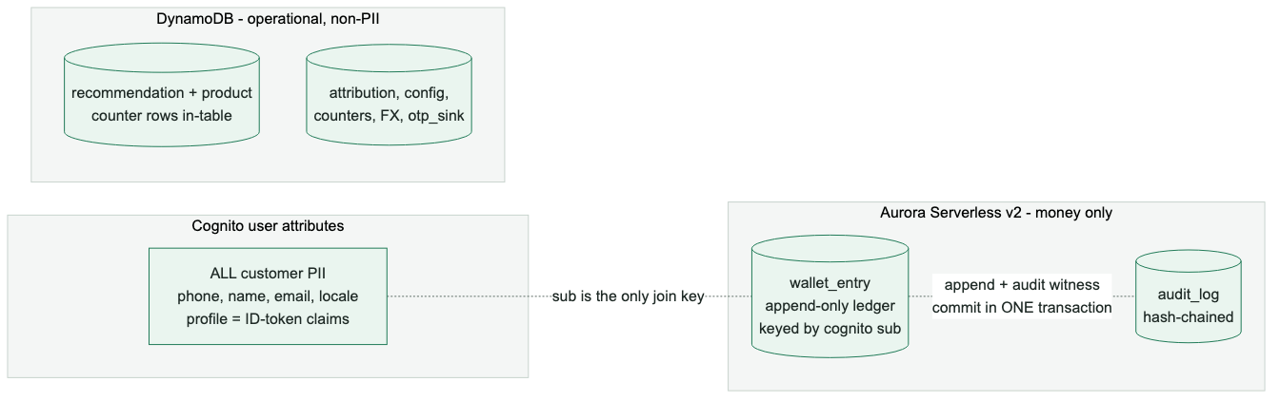

B14
BACKUP
ADR-0003 + 0006 — where data lives
— The customer table was dropped when PII moved to Cognito (migration 0006_money_only) — the ledger is keyed by the Cognito sub directly.
— Admin user search runs on ListUsers (one-attribute filters); fine at MVP scale — dual-write projection is the escape hatch.
— Trade-offs accepted: no SQL over PII, no PITR for the user pool, attribute changes have no built-in history.
wanthat
B14

Slide 35
B15
BACKUP
Failure modes and recovery
Failure | Behavior | Recovery
Aurora cold resume (~20 s) | First wallet read after idle stalls | SPA fires /healthz/db warm-up probe on auth screens; 60 s connect timeout rides it out
AliExpress ApiCallLimit ban window | Poll heartbeat calls rejected | Sequential calls + one ban-window retry (ADR-0021); cursor unmoved → next beat replays
WhatsApp delivery down | OTP channel unavailable | Sticky-preference fallback to SMS; runtime-config kill switches; SNS spend cap bounds abuse
Settlement poll crash mid-batch | Partial writes | Cursor advances only after batch; ledger unique index + absolute stat SETs make replays no-ops
Notification invoke keeps failing | Welcome message undelivered | Lambda async retry x2 → real-payload SQS DLQ (redrivable); kill-switched skips return success and never DLQ
Cognito outage | No new logins | Static SPA still serves; landing redirect works for guests (DynamoDB-only path)
wanthat
B15

Slide 36
B16
BACKUP
Rejected alternatives — the graveyard
Alternative | Why not
RDS Data API (no-VPC SQL) | Not available in il-central-1 — verified, killed the design branch
Lambda Function URLs for landing | Not available in il-central-1 → HTTP API behind CloudFront /p/*
NAT + interface endpoints | Fixed monthly cost for idle capability; non-VPC chaining is $0 and least-privilege by construction
RDS Proxy | Cost + unneeded at 50-connection scale; revisit on connection-pressure alarm
Managed Login for customers | No Hebrew/RTL; passkey RP-ID silo on the auth subdomain (kept for the admin console, where it fits)
Conversion webhooks | Spoofable inbound money surface + no reliable retailer support; reconciliation poll is replayable and auditable
Self-minted session JWTs | A second token validation path across every API; Cognito stays the only issuer
Aurora customer table (PII in SQL) | Kept Aurora on the auth path and PII in two stores; moved to Cognito attributes (ADR-0006)
wanthat
B16

