Slide 1

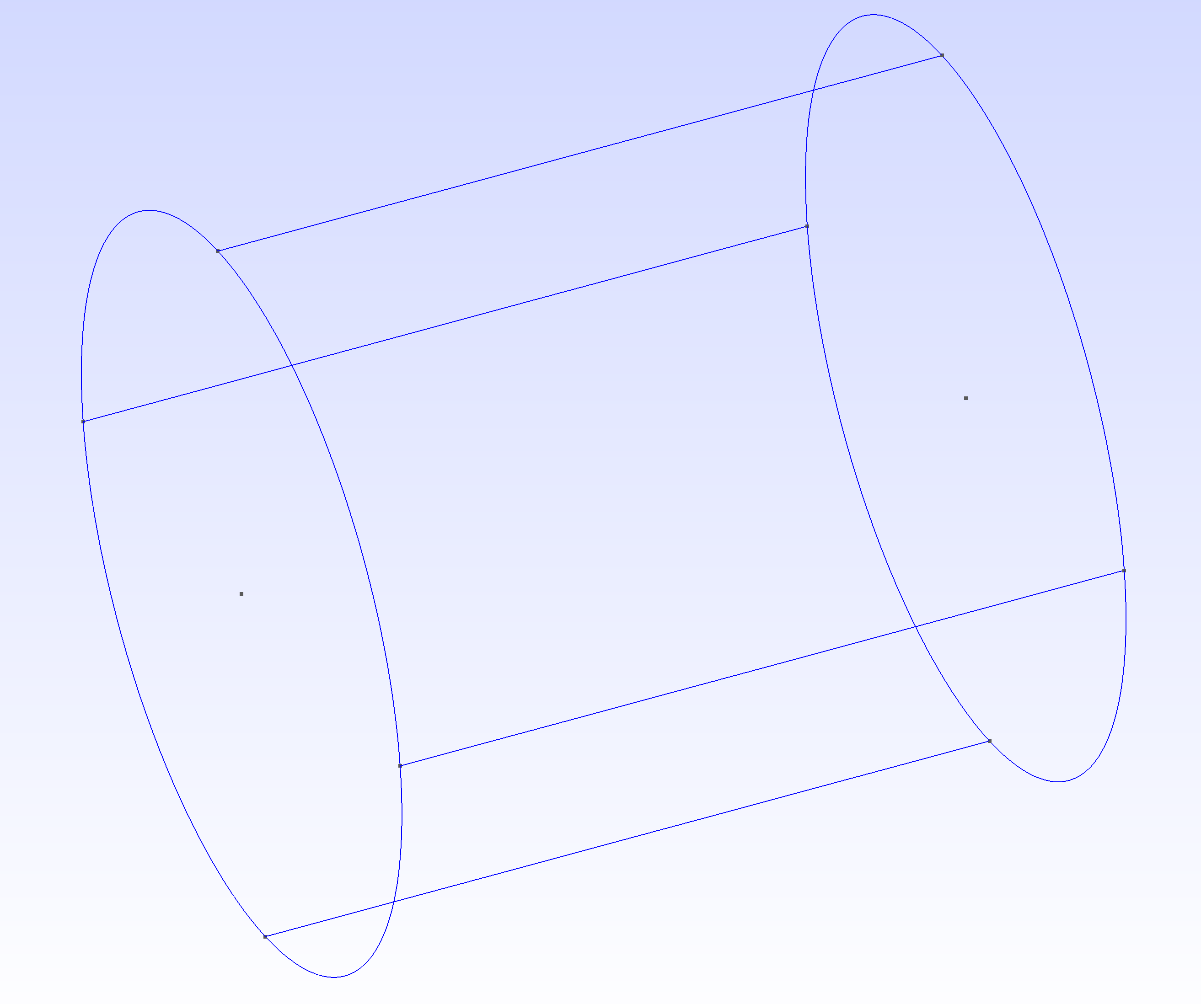
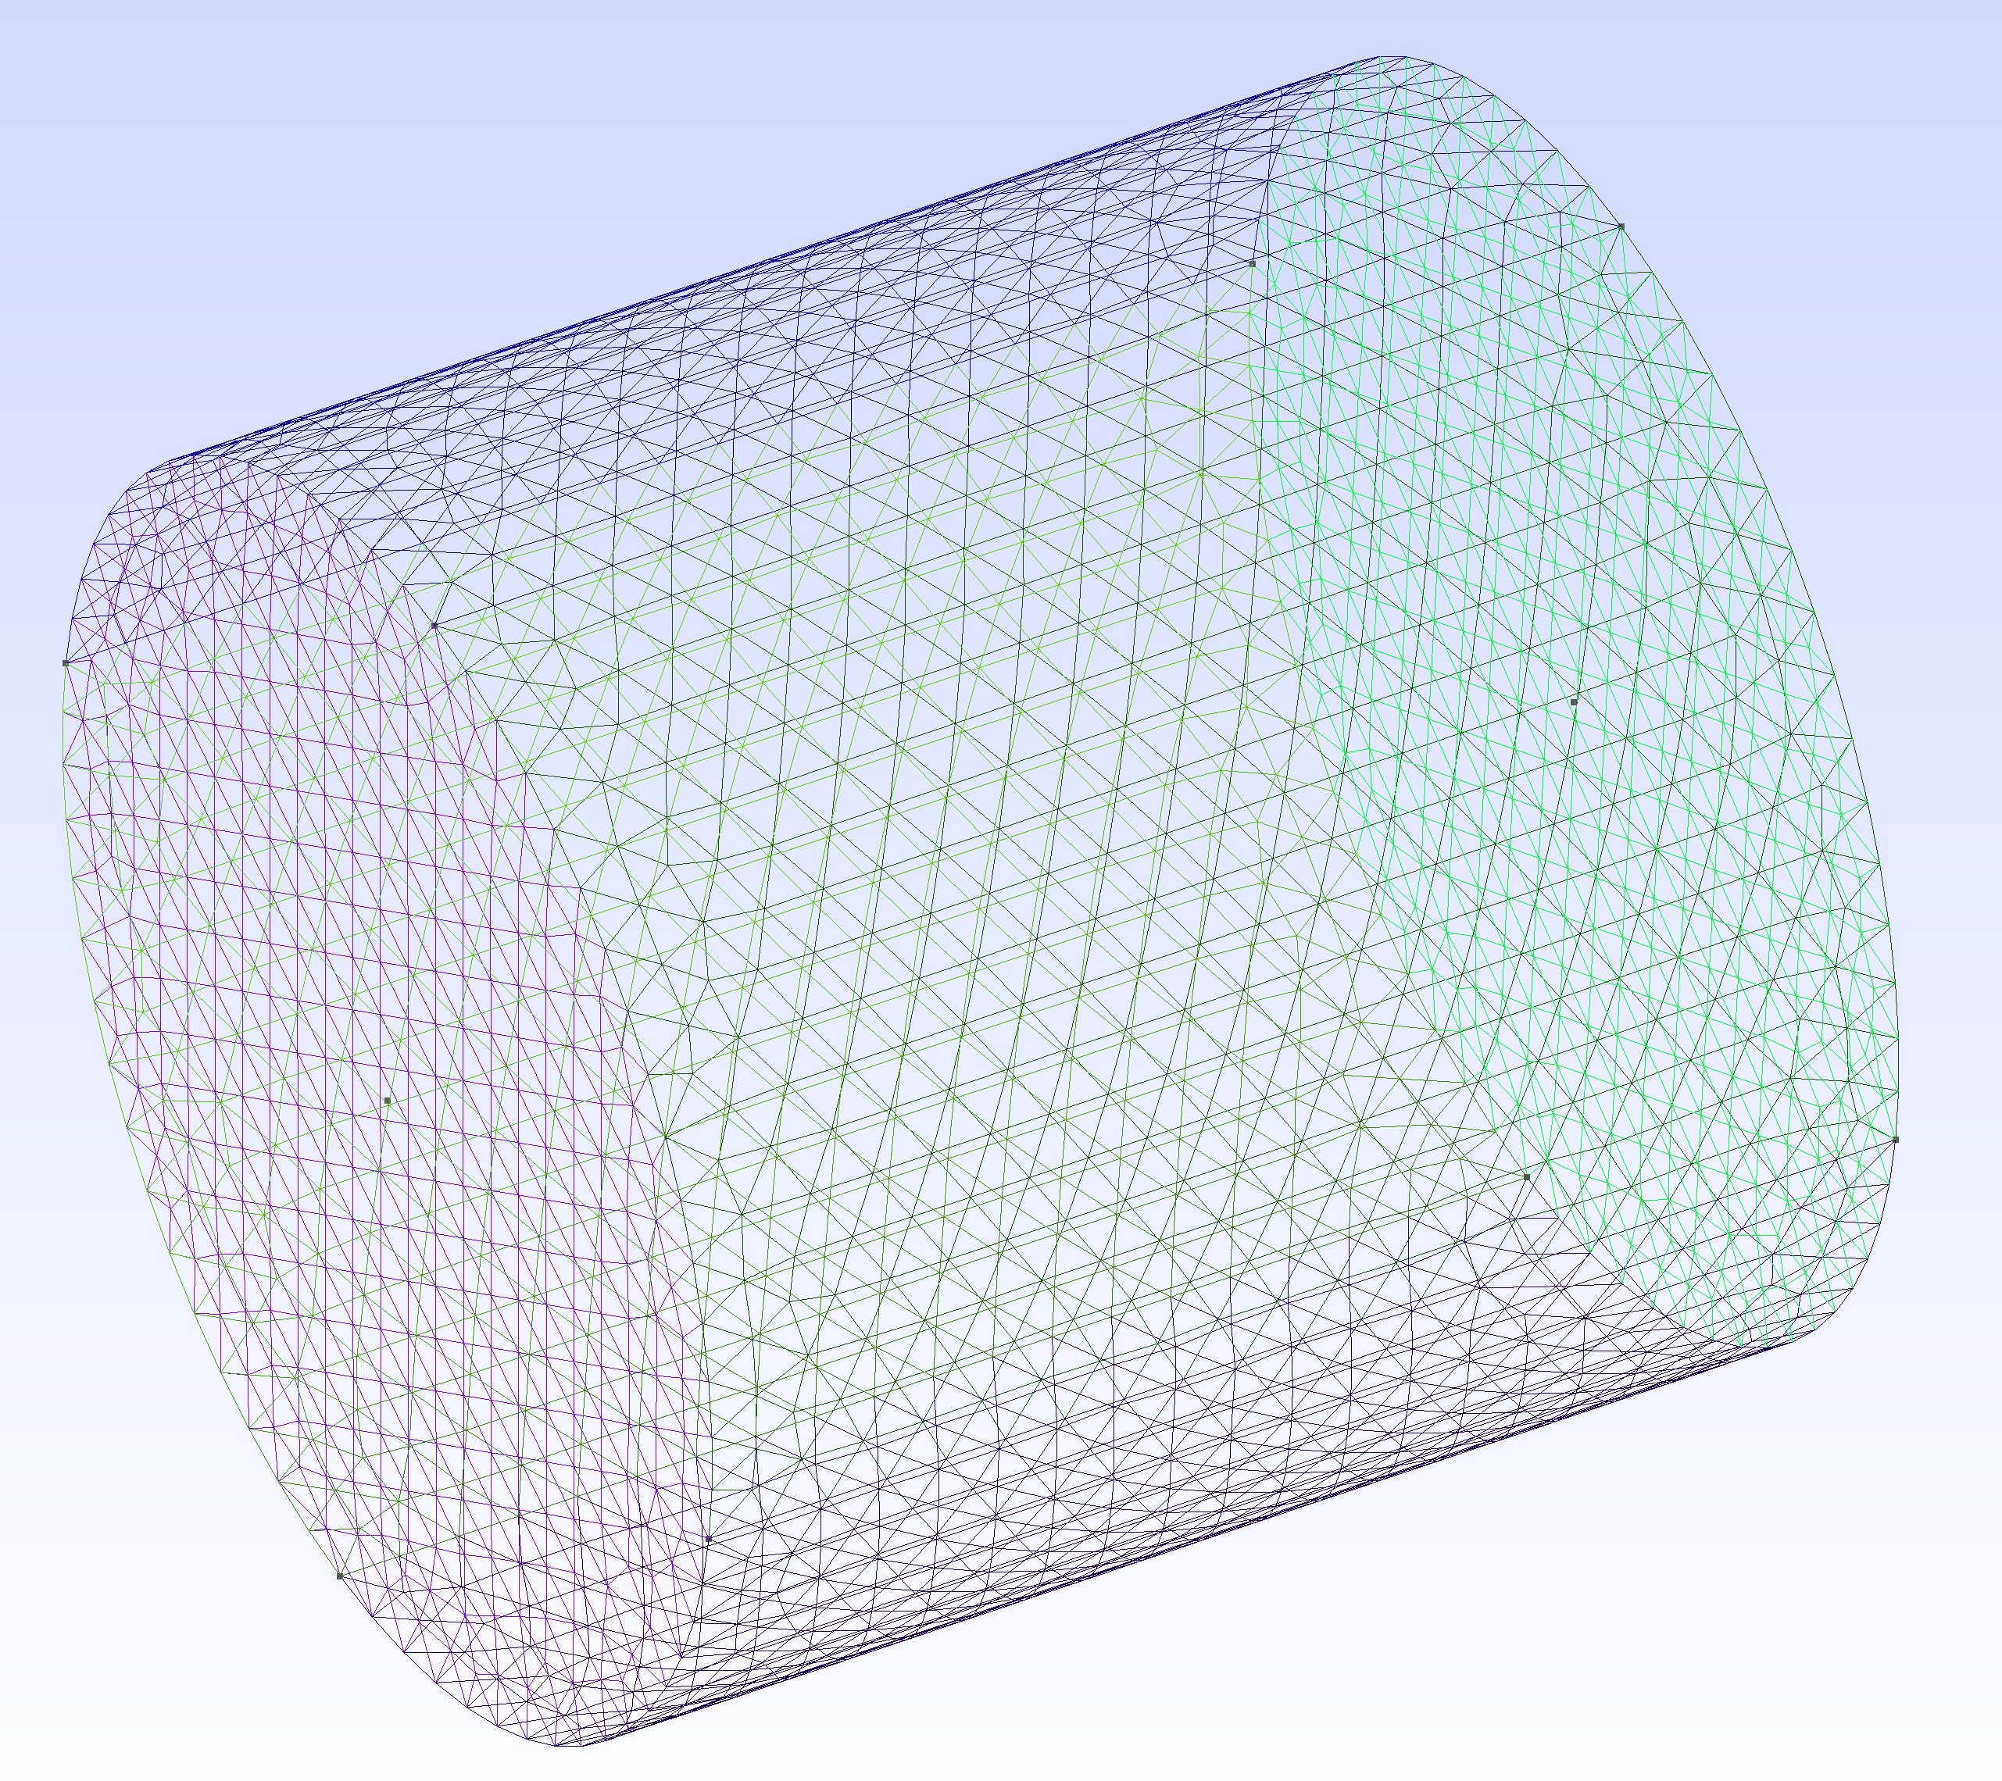
Step 1: Define Vertices of two circles
Step 2: Connect Lines and Arcs
Step 3: Mesh the Surface of Cylinder

