Slide 1
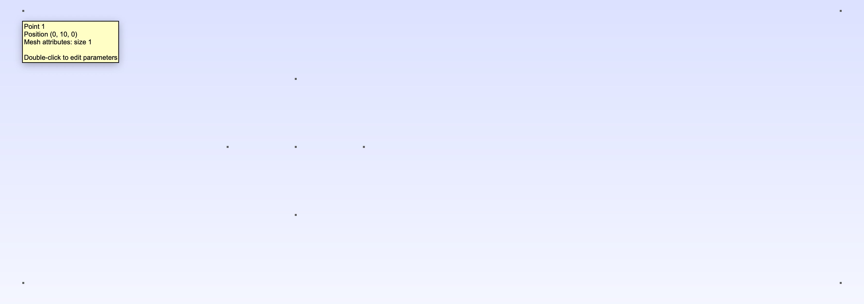
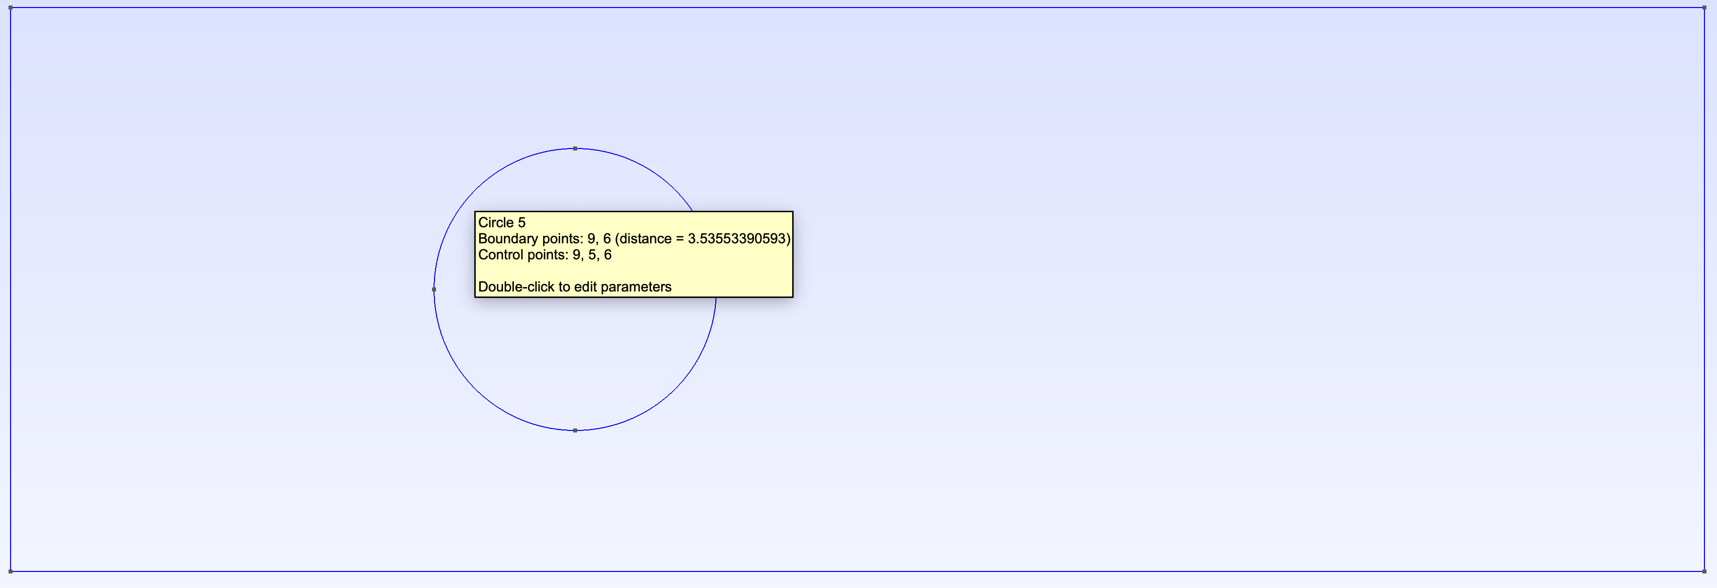
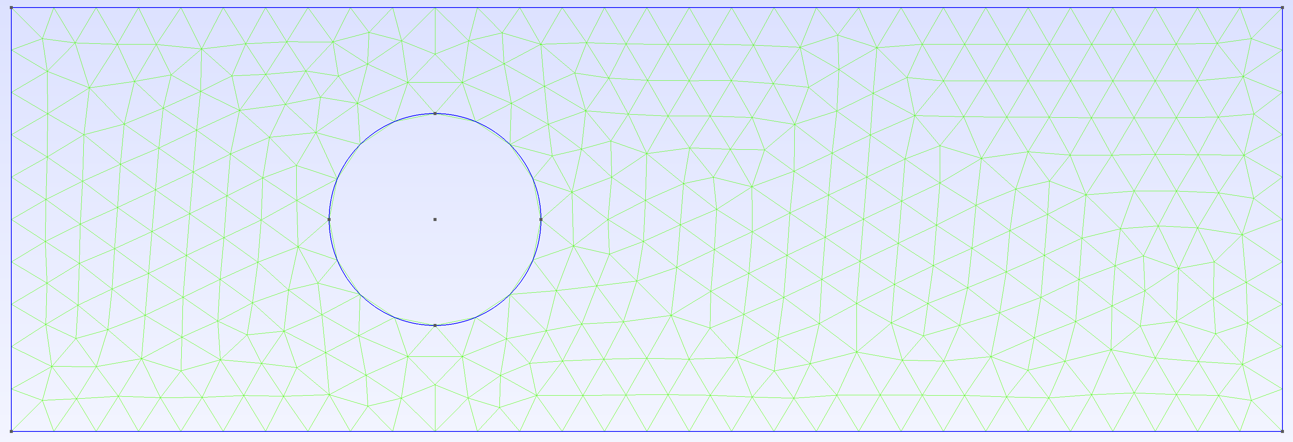
Step 1: Define Vertices
Step 2: Define Lines and Circles
Step 3: Define Surface and Mesh

