Slide 1

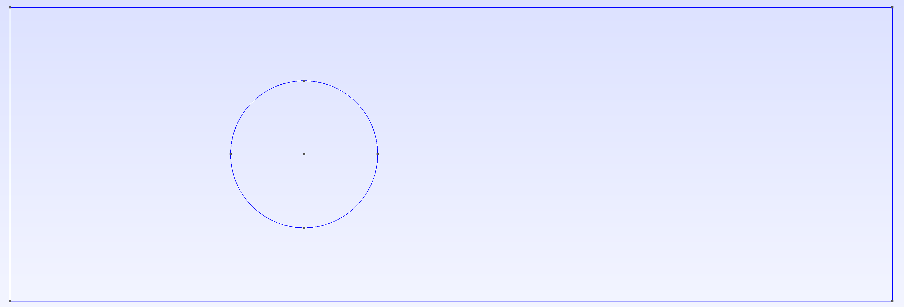
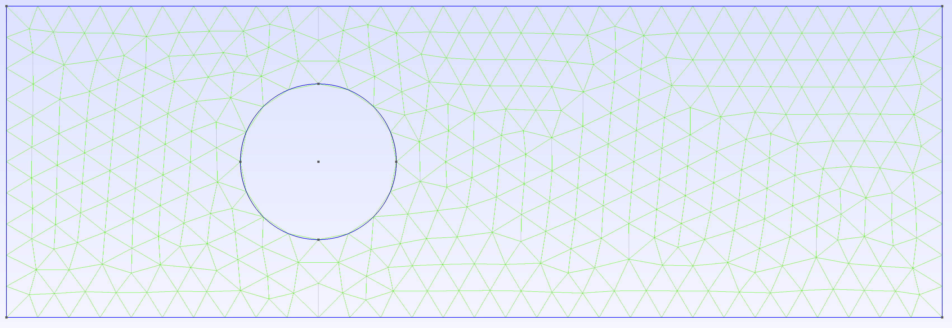
Step 1: Define Vertices
Step 2: Define Lines and Circles
Step 3: Define Surface and Mesh

Slide 2

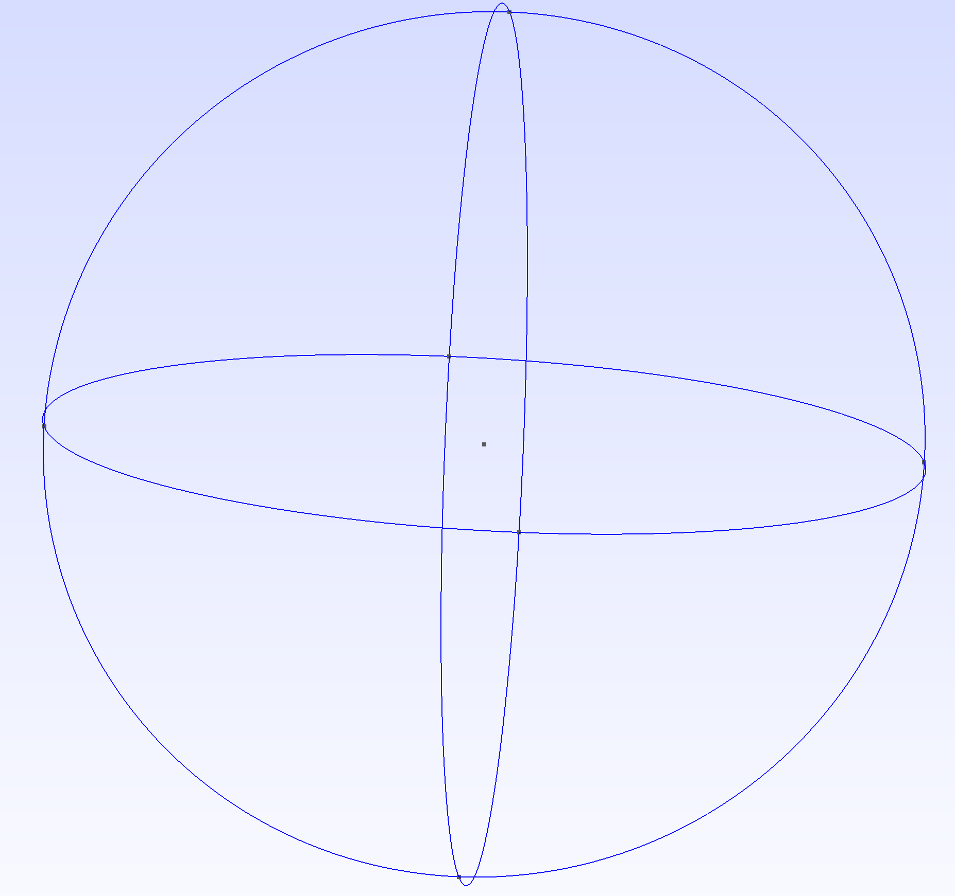
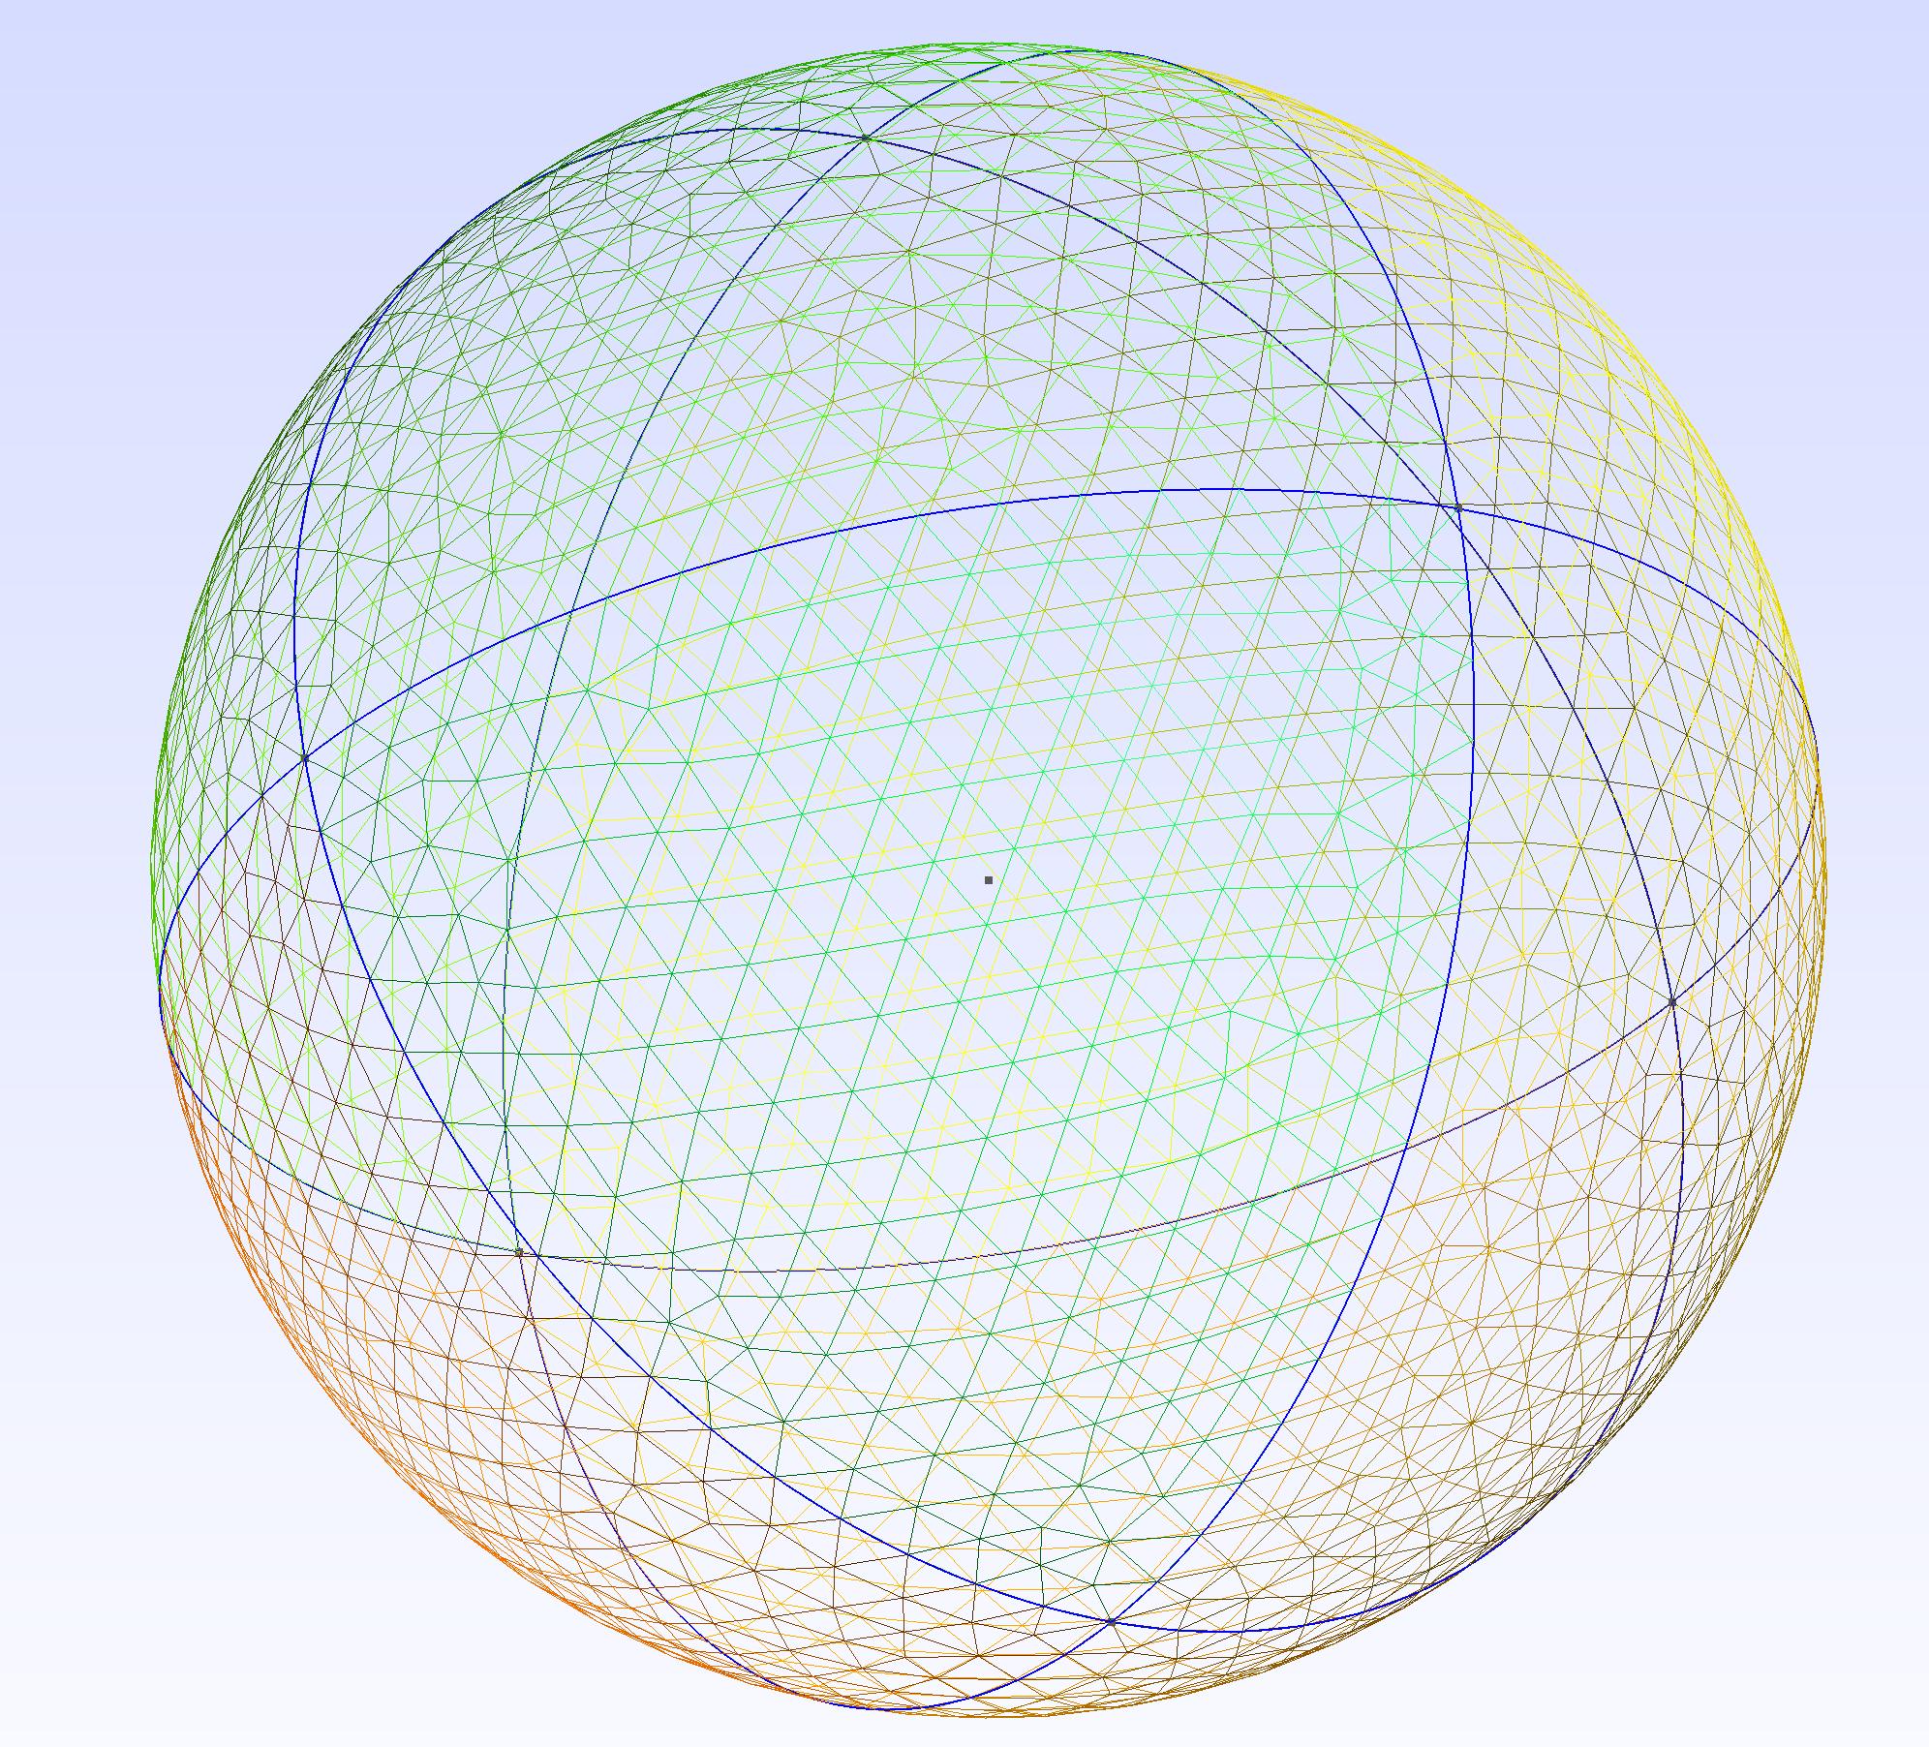
Step 1: Define Vertices
Step 2: Define Circles
Step 3: Define Surface and Mesh

Slide 3

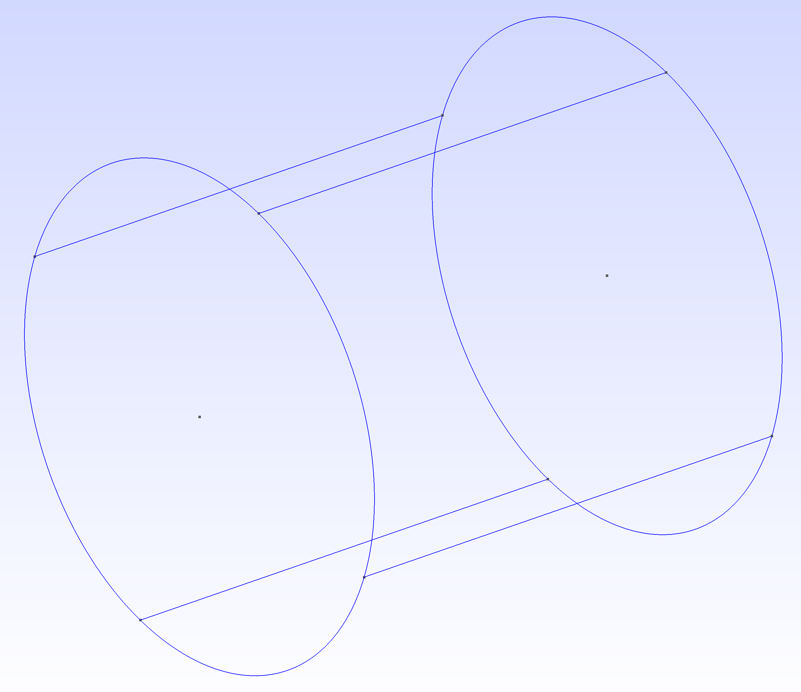
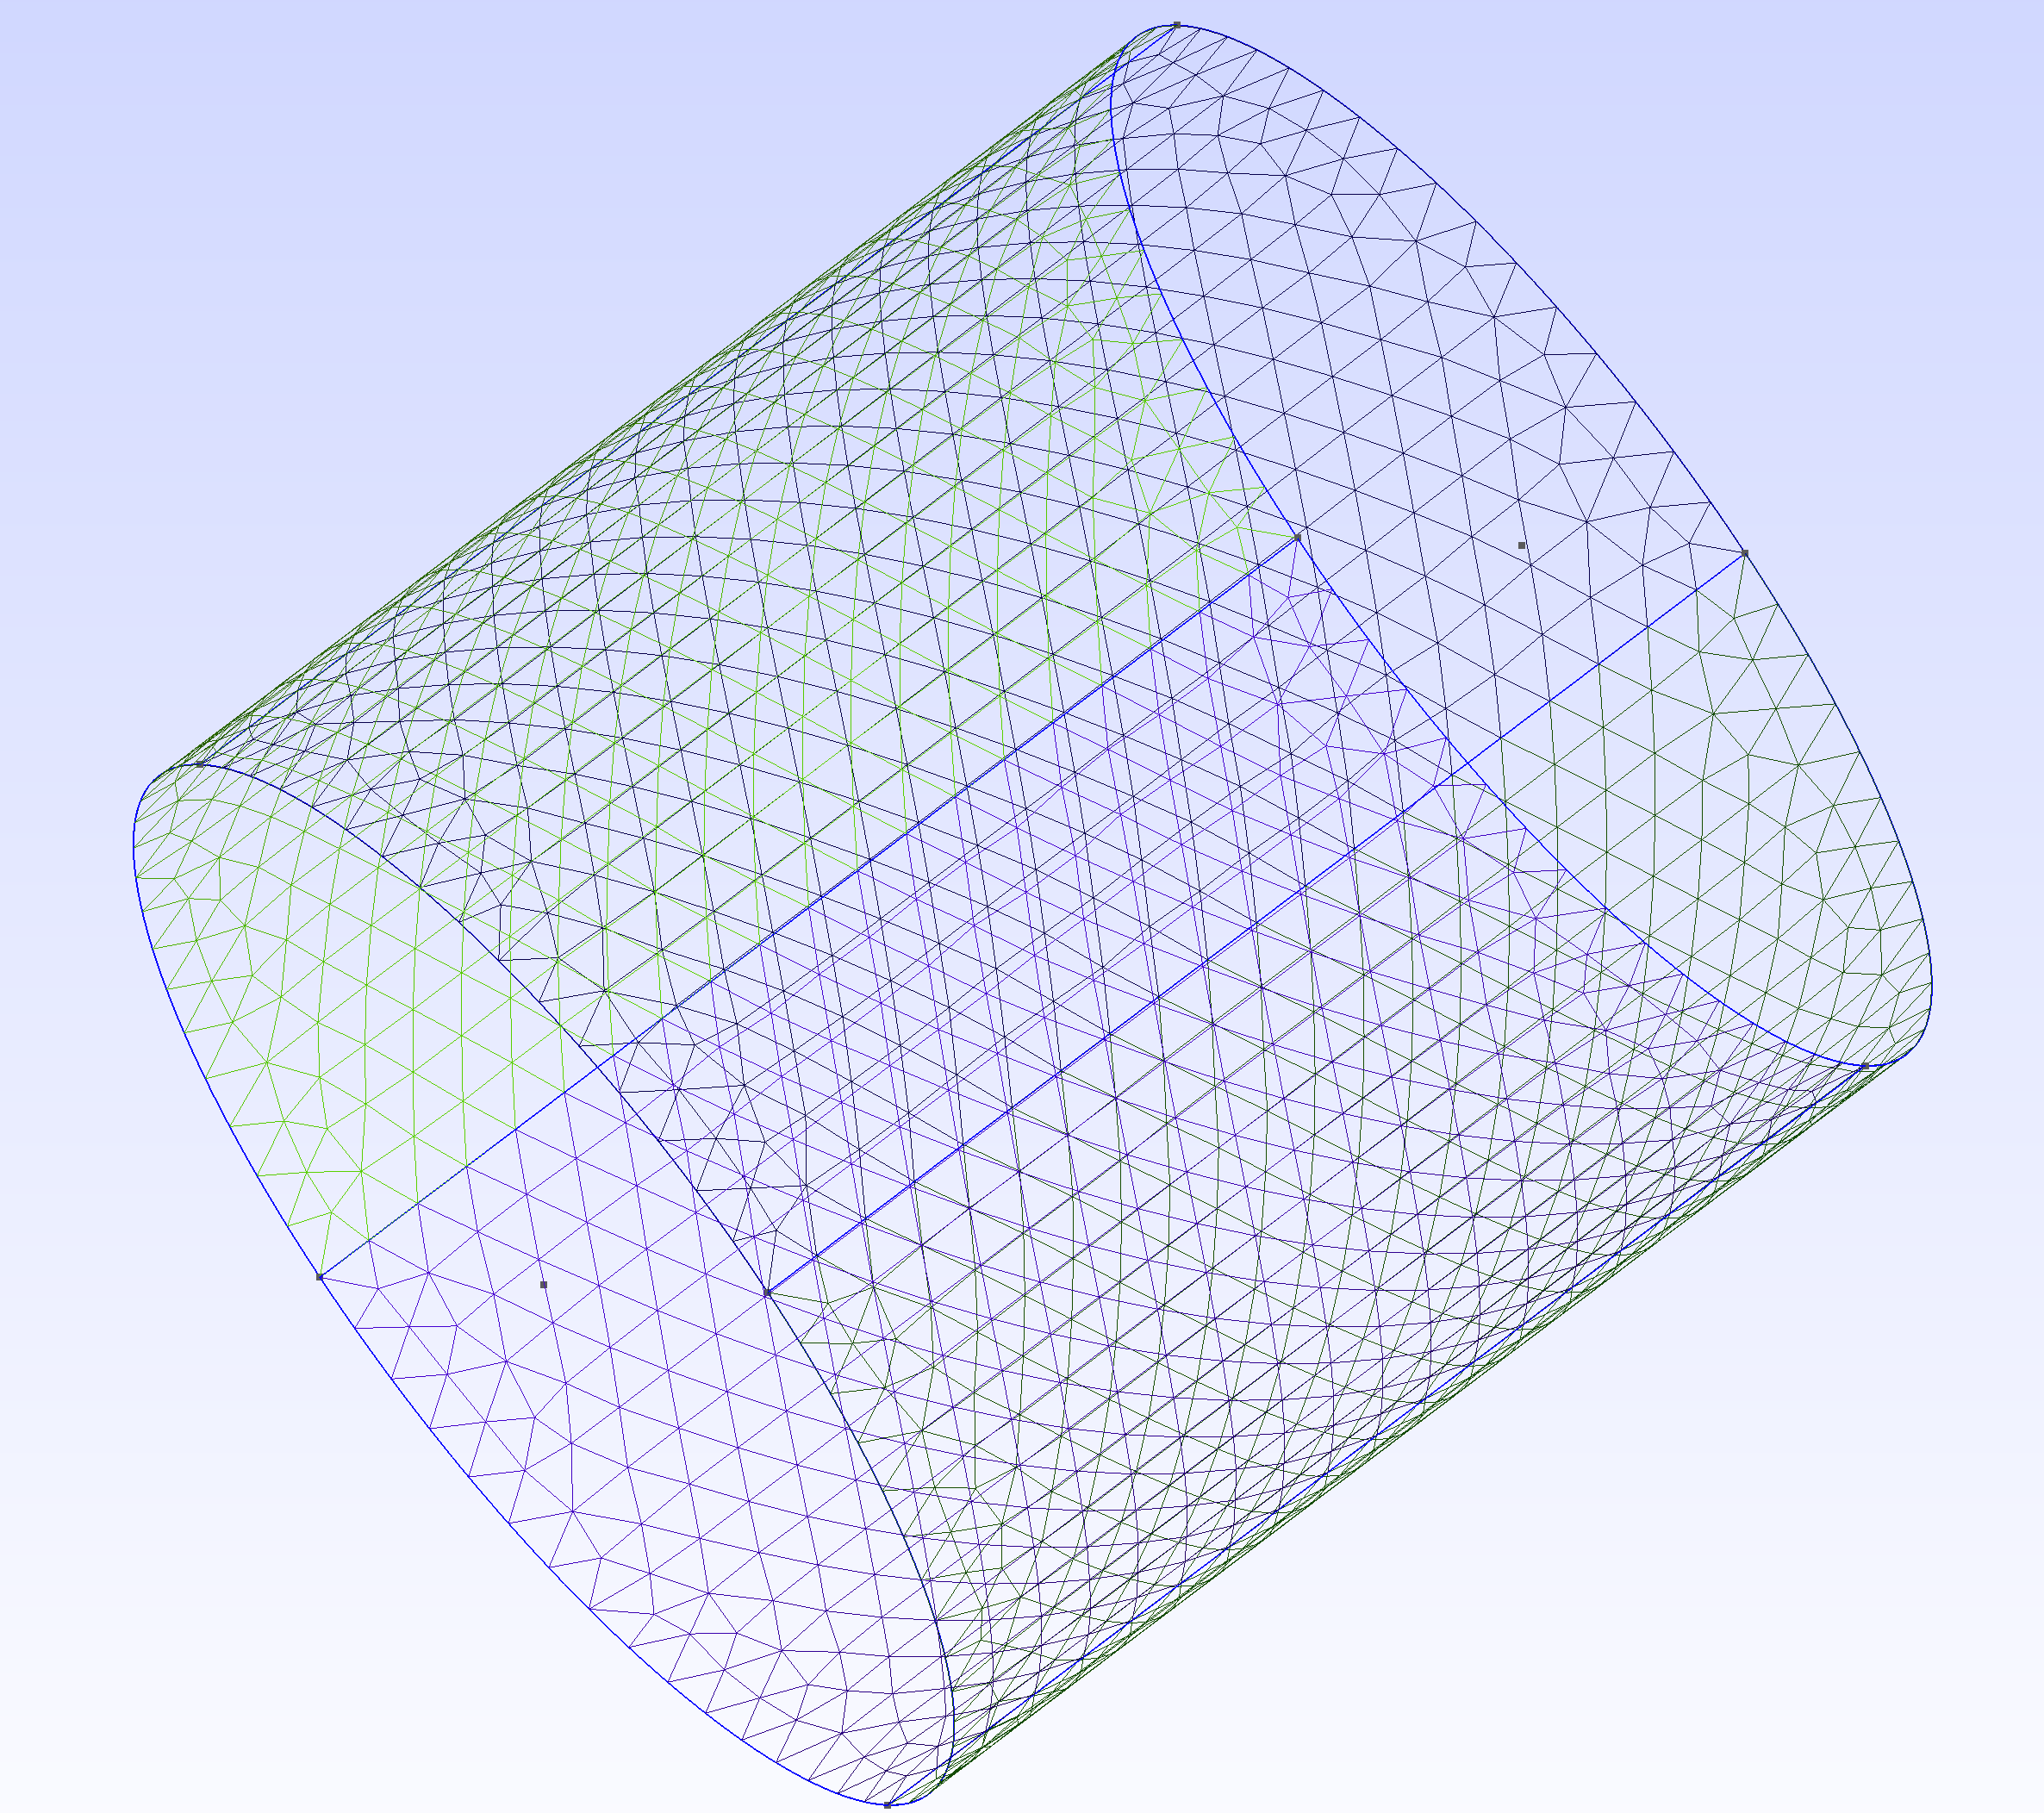
Step 1: Define Vertices of two circles
Step 2: Connect Lines and Arcs
Step 3: Mesh Surface of Cylinder

Slide 4
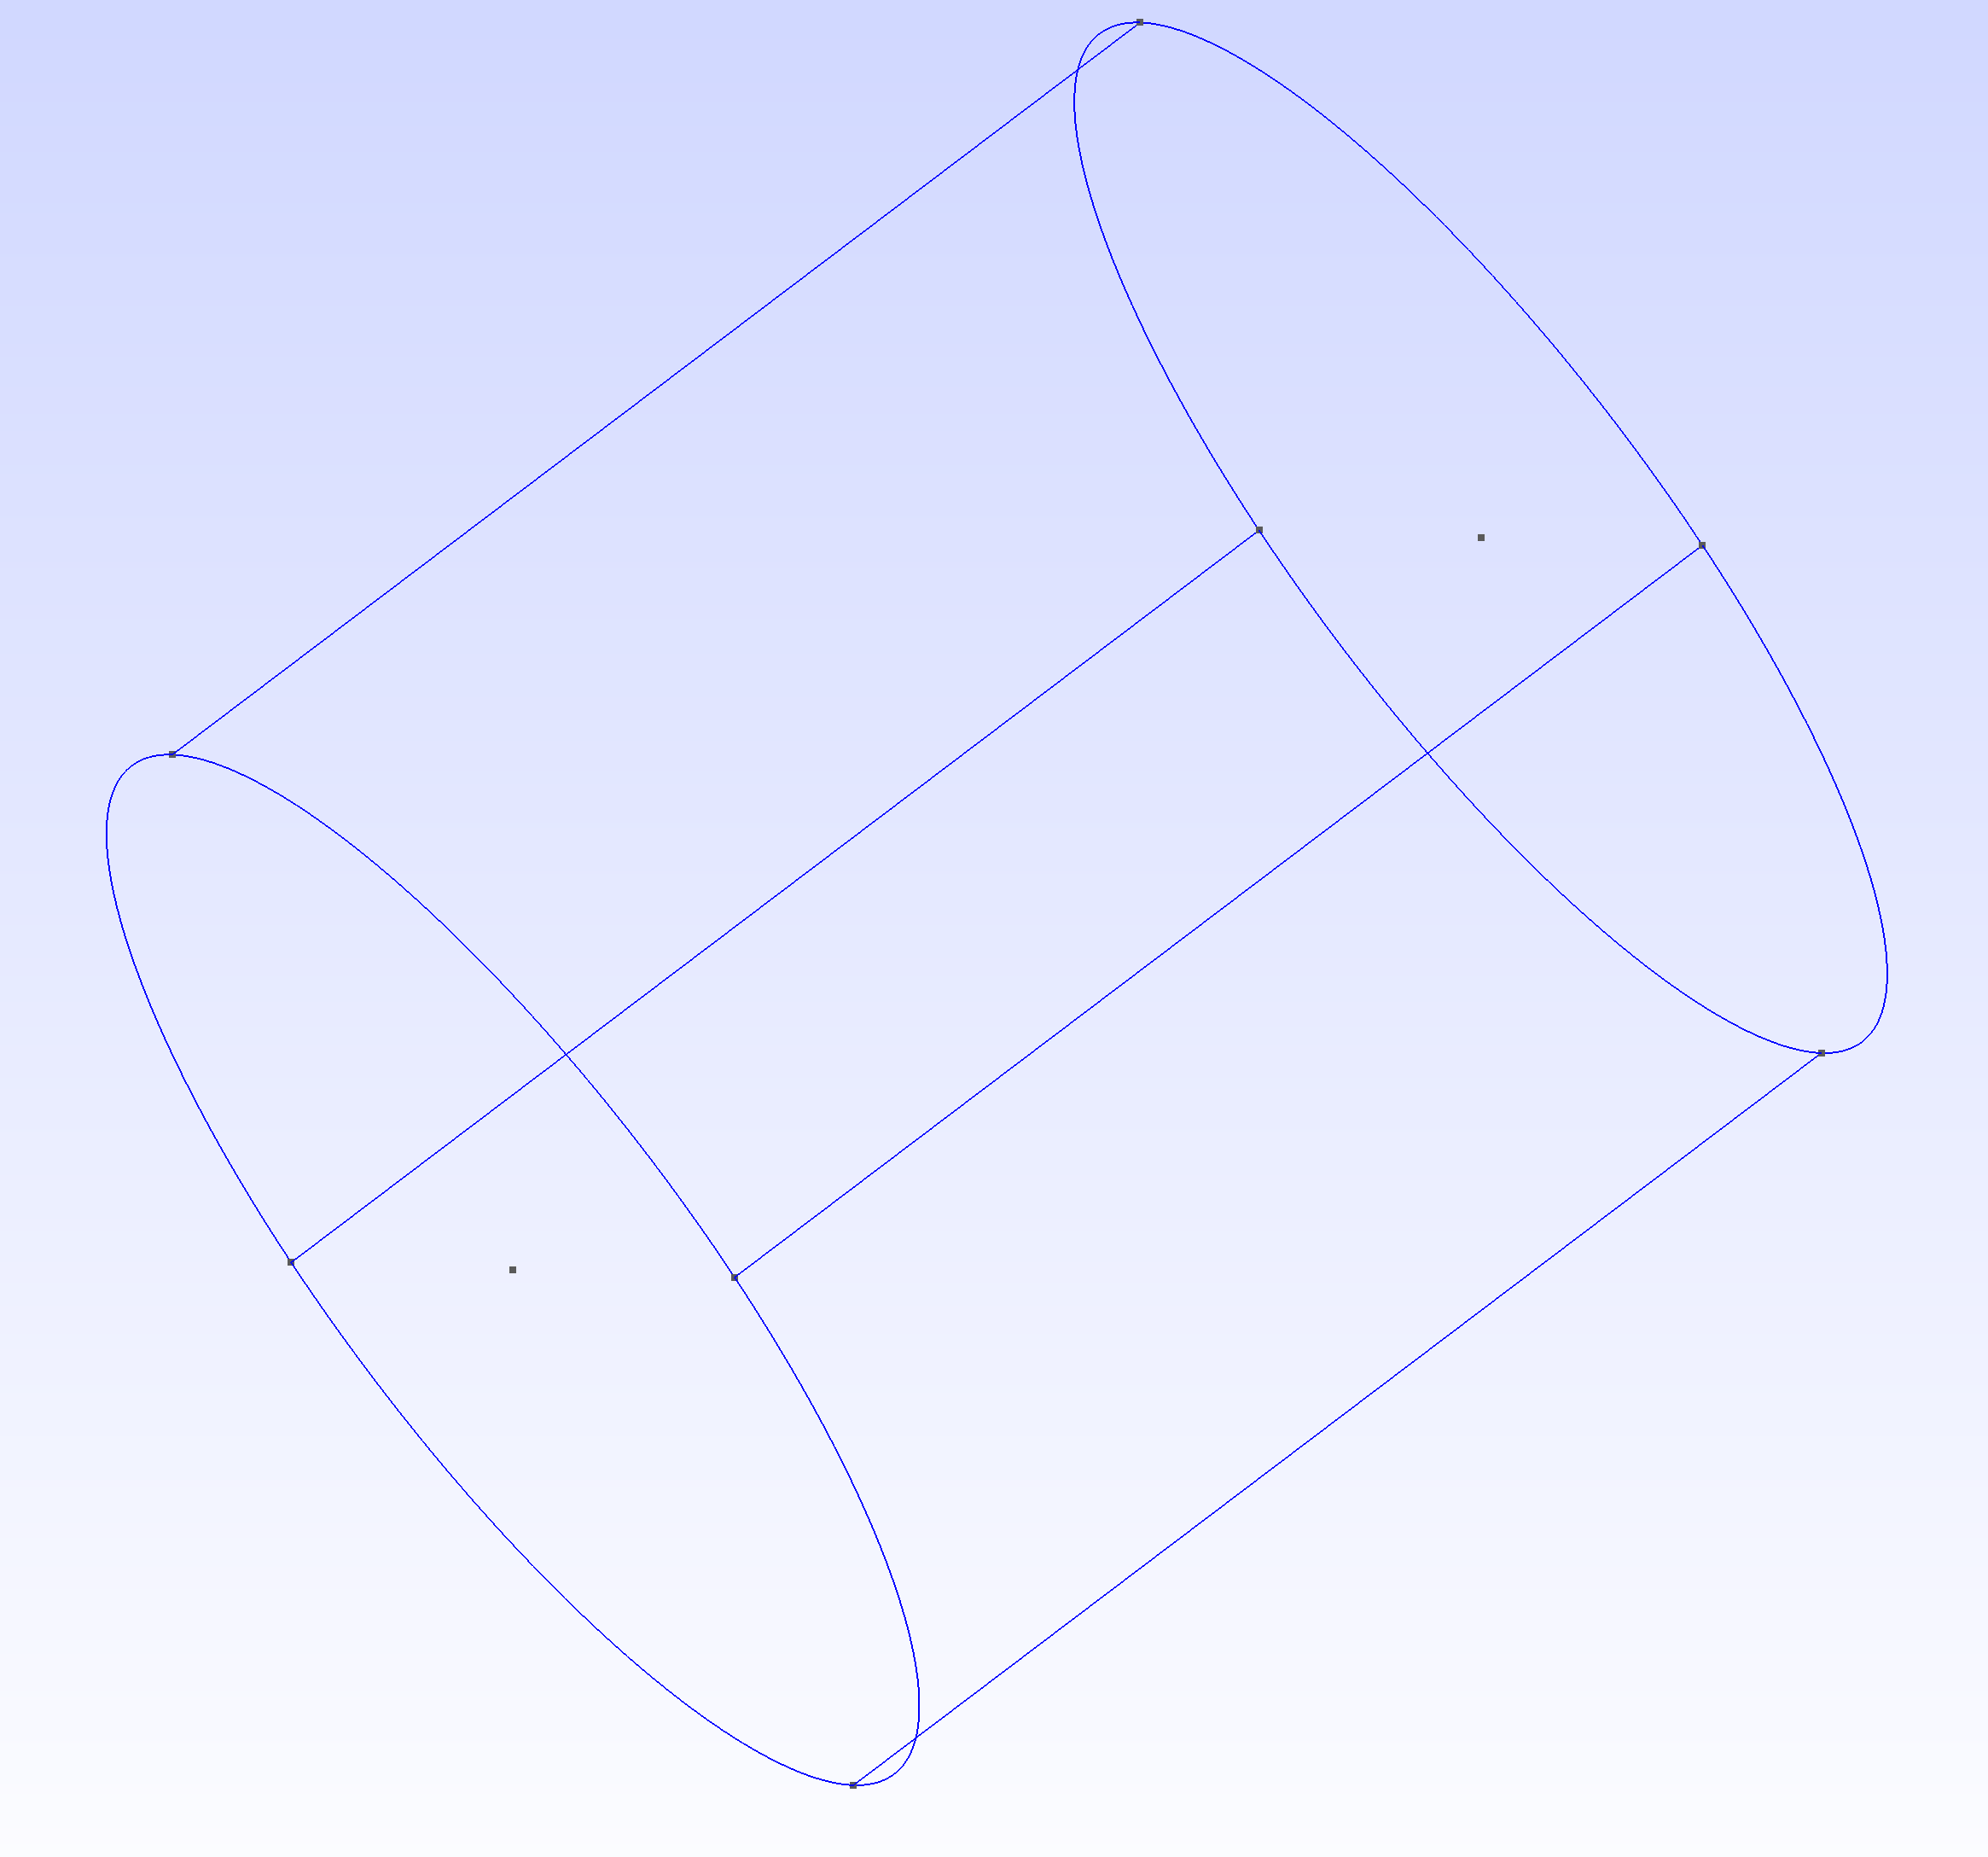
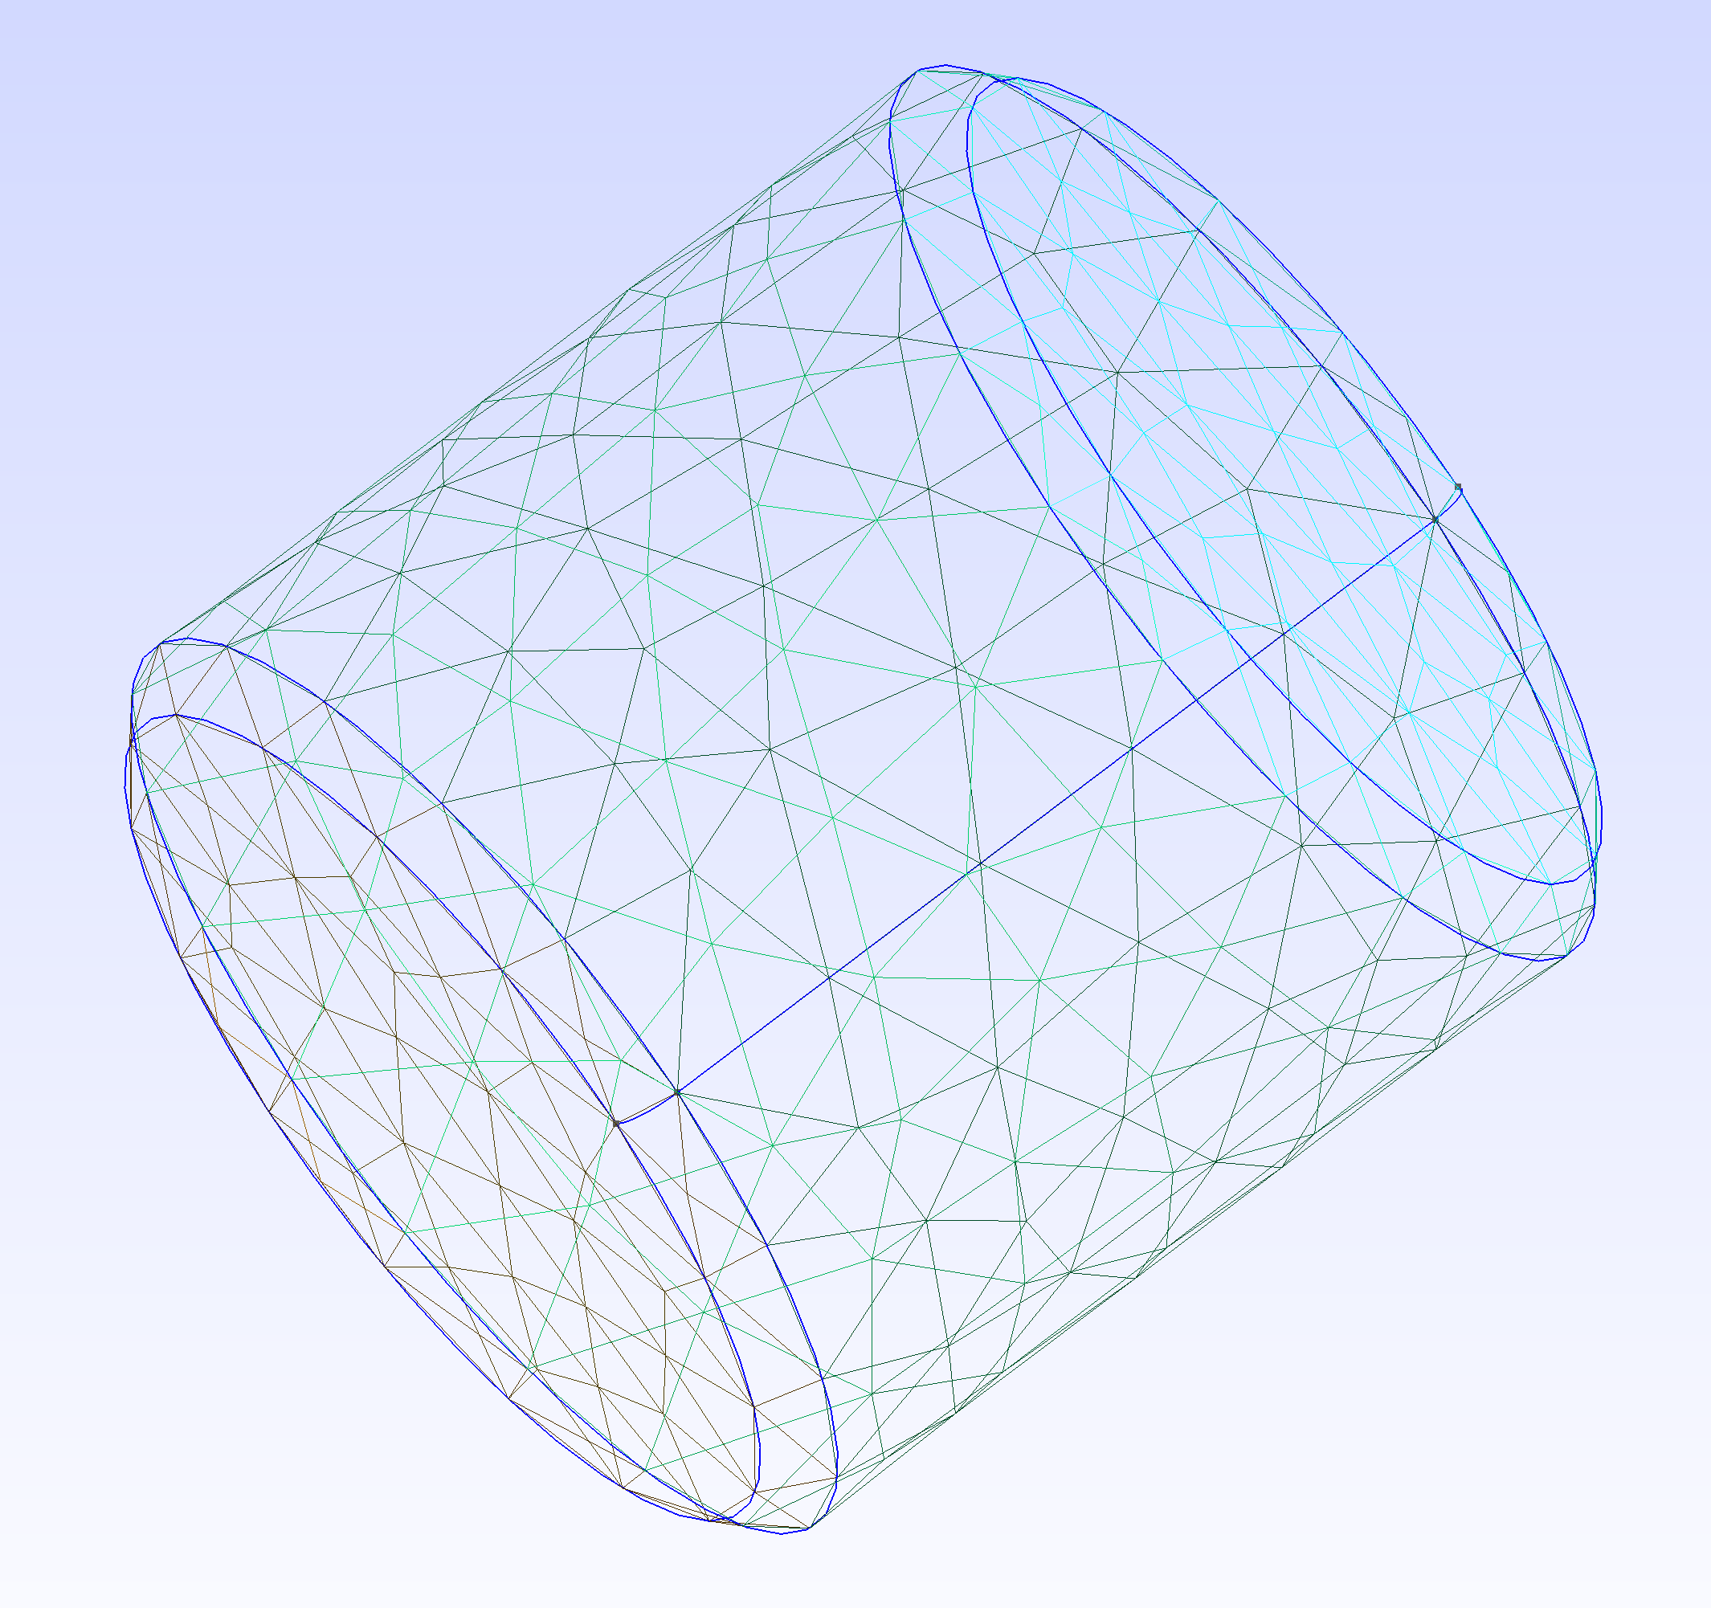
Cylinder
Round Cylinder

