Slide 1
The DIDs application based on Aptos network
WGQ GROUP

Slide 2
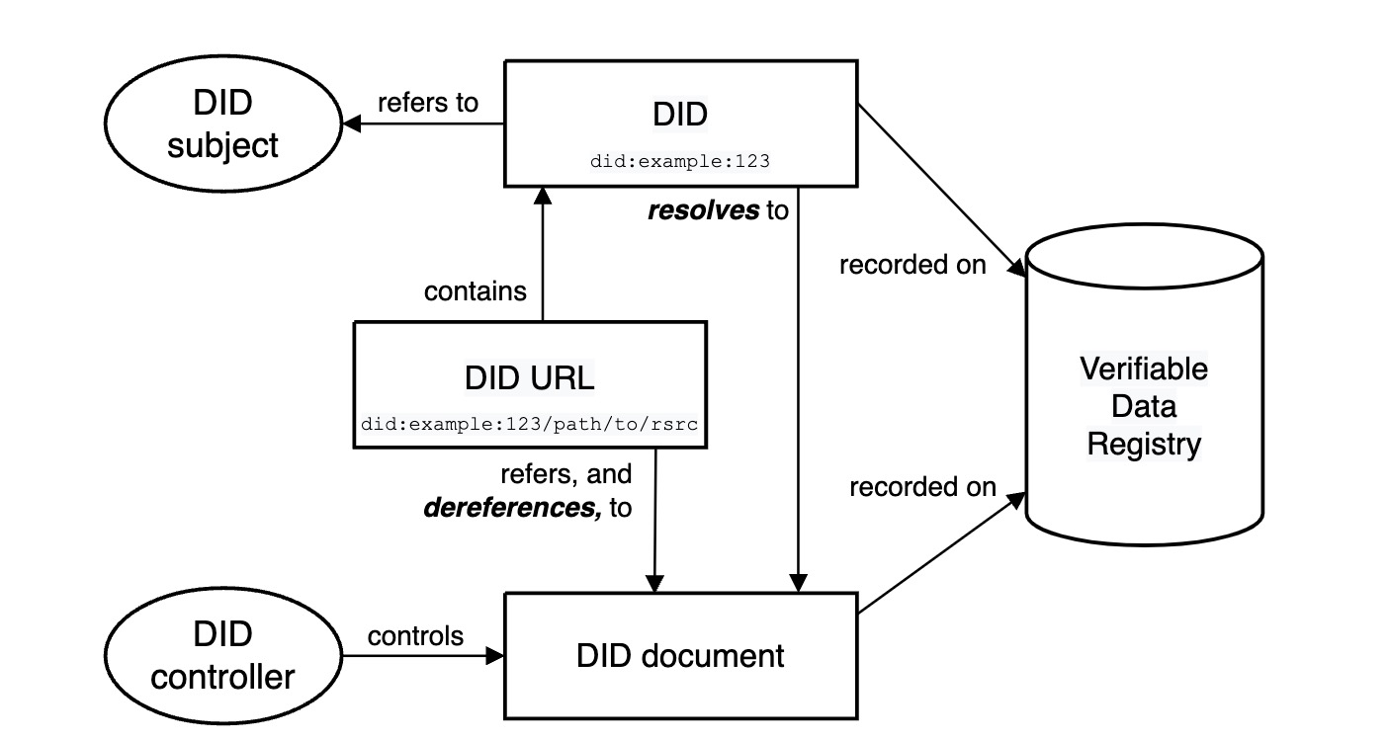
What is DIDs
Decentralized identifiers (DIDs) are a new type of identifier that enables verifiable, decentralized digital identity.
In contrast to typical, federated identifiers, DIDs have been designed so that they may be decoupled from centralized registries, identity providers, and certificate authorities.

Slide 3
Why DIDs
1. Using DIDs can facilitate users to verify most Dapps and reduce the risk of illegality.
2. Using DIDs can protect user information from being stolen.
Ex: Dapps can obtain verification information but not the details.

Slide 4
How to protect users
1. Important information of users is only encrypted and stored locally. Non-sensitive information of users will be encrypted and stored in IPFS.
2. The user’s information verification process will be based on zero-knowledge proof technology.

Slide 5
Some DIDs usage scenarios
1. In the decentralized launchpad platform, DIDs can help the platform to complete the identity verification of users. DIDs can help users and platforms avoid legal risks.
2. DIDs can be used in WEB3 social applications. Social applications can obtain users' non-sensitive information for social matching, while users can still protect their privacy.
3. In our project, DIDs can be used to create soul-bound NFTs. In the future, DIDs and soul-bound NFTs will become the core elements of our project.

Slide 6

The Waga project
1 WAGA DIDs
The DIDs application based on Aptos network.
2 WAGA Wallet
An Aptos wallet support DIDs application. And also support for verified NFT projects.
3 WAGA NFT
Soul-bound NFTs will be minted for free to all users of DIDs.

Slide 7
The Waga project
Our goal is to create a Web3 identity standard.
We hope to solve the privacy protection problem of the future Web3
We hope to build an open and diverse web3 world with more Web3 projects.

Slide 8
Demo session

