Slide 1
GhostNFT Protocol
更安全和高效的NFT租赁
YJ@ghostnft ghostnft2022@gmail.com
Notes:
Hey guys, this is YJ from ghostnft protocol.
Now let me introduce our project.

Slide 2
NFT应用爆发的前夕
NFT不只是PFP
NFT可以是GameFi中的人物和道具
NFT可以是X to Earn中的道具
NFT可以是线上/线下组织/俱乐部的门票
…
Notes:
And I believe there could be other use case of NFTs that beyond our imagination

Slide 3
持有NFT有时并不是一个好主意
NFT可能比较昂贵
NFT的流动性问题
在你真正了解一个GameFi/X to Earn项目前，你可能并不想买
时间/资源限制导致你的NFT闲置
NFT租赁应运而生
Notes:
Sometime NFTs are expensive to buy
When you own an NFT, you may concern about the liqudity
Or before you try some gamefi or x2earn project, you are not sure about you interests at the very beginning
If you have many NFT of a collection, you may not have enough time to play with it
As for these reasons, NFT rentals is now in business

Slide 4
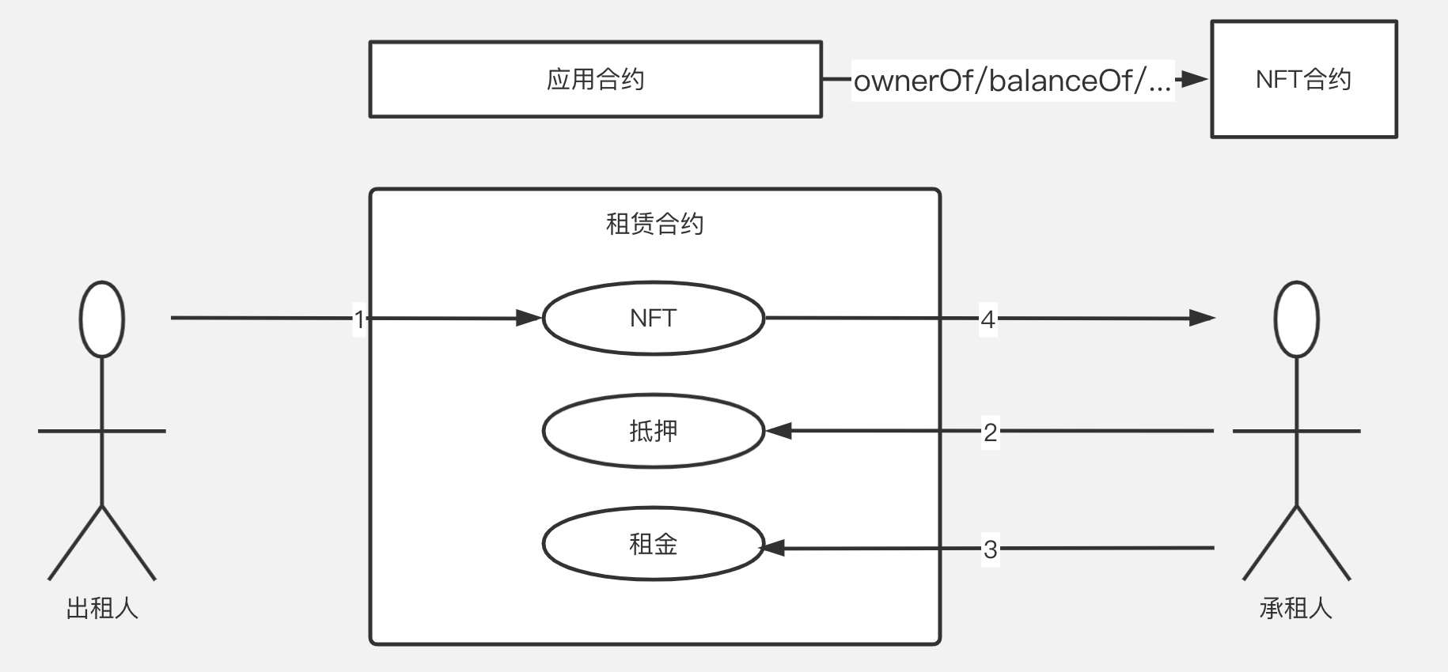
现有的NFT租赁市场
所有权转移/超额抵押
Notes:
Most existing NFT rental markets is collateral-based and ownership-transfered.
Let's see a process of traditional NFT rental in a gamefi case.
First the lessor transfer the NFT to the rental platform.
Then borrower pay collateral and rent to borrow the NFT.
When the rental period ends, the borrower return the NFT to the platform and get back the collateral.
On the dapp side, the game contract only need to interact with the NFT contract to check out ownership or other infomation

Slide 5
基于所有权转移的NFT租赁市场的缺陷
不安全
NFT和抵押物需要转移
资金利用率低下
抵押物需要比原有NFT价值更高
可能错失潜在的空投
NFT在租赁期间暂时不属于原所有者
Notes:
From the previous process, we can easily see some disadvanteges.
First, Both the lessor and borrower side need to transfer their asset to the rental platform. If something bad happened to the platform, the asset could loss
Secondly, the borrowers have to lock collateral, which is more valueable than the NFT, that is finacially inefficient
Also, if the owner transfer the NFT, he could miss some airdrops

Slide 6
我们的想法和实现
不转移所有权
NFT的所有者在租赁平台发布出租使用权的意愿，不需要真正转移所有权给平台或租户。租户在平台中锁定租金后，即在平台中获得该NFT的虚拟使用权。
出租人锁定违约金，而非租户锁定抵押物
租期内出租人不得转移NFT，否则不能拿回违约金。租户不再需要锁定超额抵押物。
监督者
当一个出租人违约时，除了出租人以外的任何用户可以发起请求，从违约金中得到部分奖励，同时剩余违约金支付给租户和应用方以补偿损失。
应用方需做一定的集成
应用方合约除了访问原NFT合约获取所有权信息，还需从平台租赁合约获取租赁信息。
Notes:
So here's our idea and implementations
We introduce a non-ownership-transfer protocol
Since the lessors no longer have to transfer the NFTs, they are required to pay guarantees for keeping their promises, that is not to transfer the NFT during rental period
But what if the lessors break their promises? We introduce the supervisors, that is literally any account except the lessors. When a supervisor found out that any lessor transfered the lending NFT, he could call the platform contract to get a portion of the guarantee as a reward. Remaining
Only extra work need to be done is for the dapp dev team. Besides the origin NFT contract, they also need to query the rental contract for extra information. But compare to the tremendous increament of NFT utilization, the integration cost is totally worth it.

Slide 7
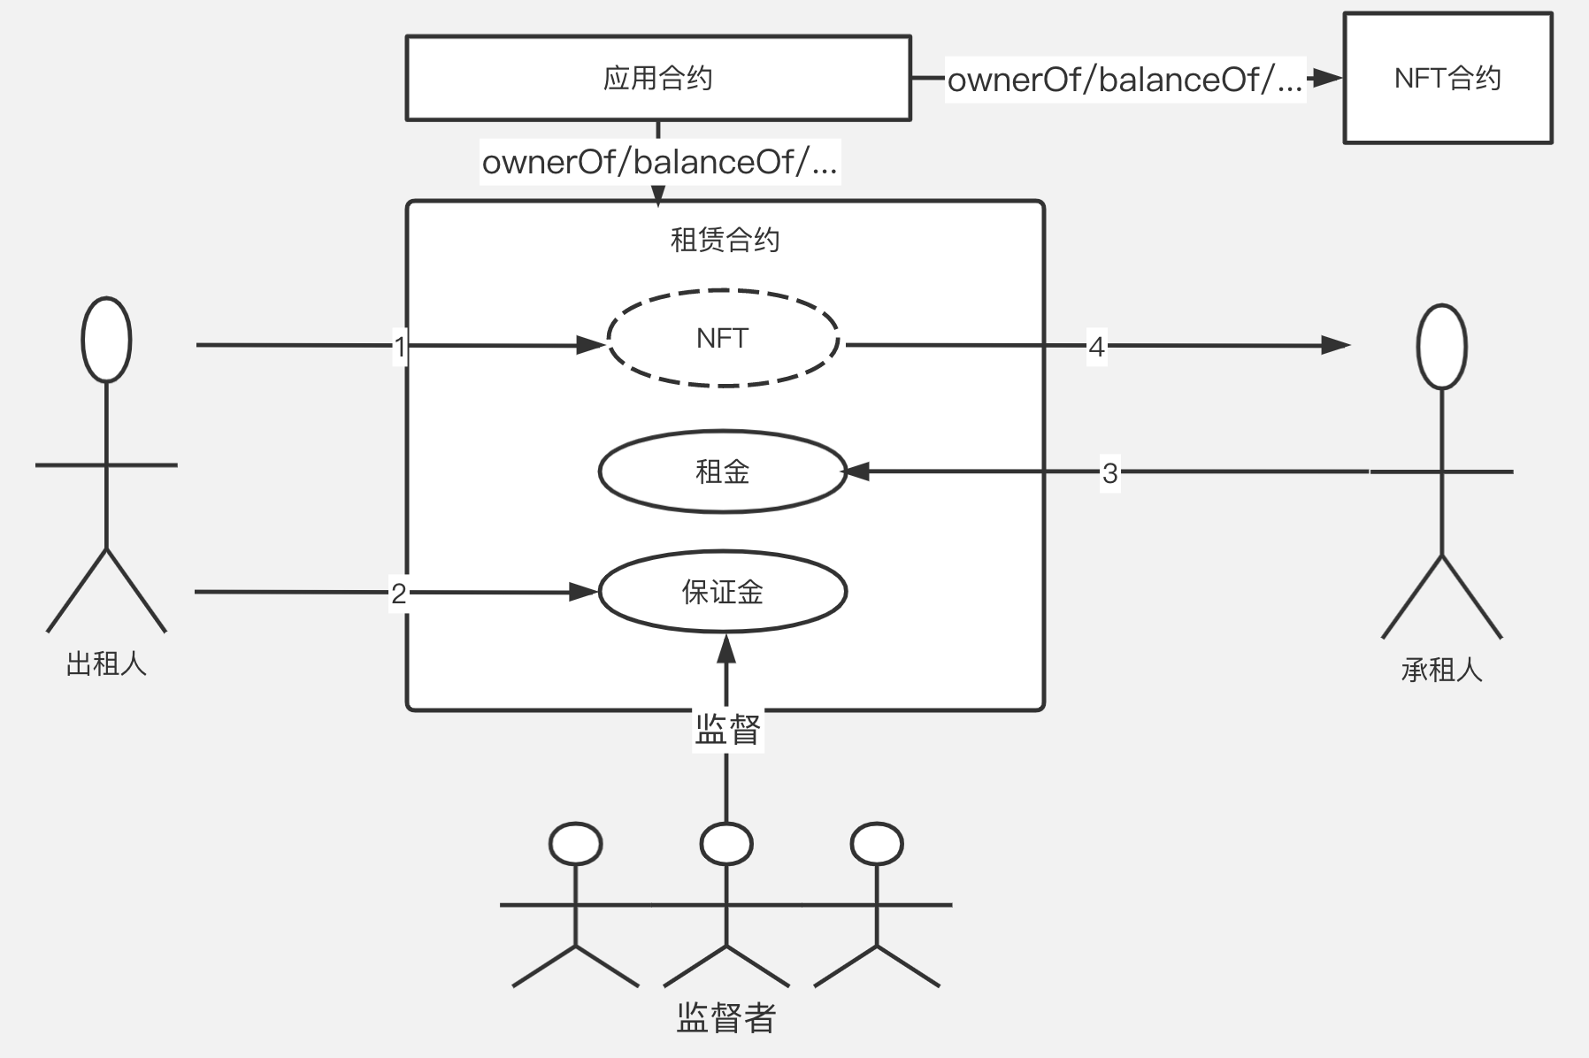
我们的NFT租赁市场
无需所有权转移/无需超额抵押
Notes:
Most existing NFT rental markets is collateral-based and ownership-transfered.
Let's see a process of traditional NFT rental in a gamefi case.
First the lessor transfer the NFT to the rental platform.
Then borrower pay collateral and rent to borrow the NFT.
When the rental period ends, the borrower return the NFT to the platform and get back the collateral.
On the dapp side, the game contract only need to interact with the NFT contract to check out ownership or other infomation

Slide 8
各方收益
出租方
无须担忧NFT资产的安全，不会错过空投
承租方
无须锁定超额抵押，资金利用率提高
监督者/租赁平台
监督出租方，从违约出租方获取收益的同时，客观上保证平台的正常运转。
应用方
ROI？？？
Notes:
So here's our idea and implementations
We introduce a non-ownership-transfer protocol
Since the lessors no longer have to transfer the NFTs, they are required to pay guarantees for keeping their promises, that is not to transfer the NFT during rental period
But what if the lessors break their promises? We introduce the supervisors, that is literally any account except the lessors. When a supervisor found out that any lessor transfered the lending NFT, he could call the platform contract to get a portion of the guarantee as a reward. Remaining
Only extra work need to be done is for the dapp dev team. Besides the origin NFT contract, they also need to query the rental contract for extra information. But compare to the tremendous increament of NFT utilization, the integration cost is totally worth it.

Slide 9
应用方收益
提升各种运营指标
NFT资产闲置率降低，提高用户活跃率，进而提高收入。
突破限制
项目受到某种用户限制时，通过租赁NFT资产给不受限用户来突破限制。
模糊NFT和应用方的边界，提供更多组合的可能
现有的应用方大多在应用内使用自己的NFT，是为了促进自己的NFT销售。
在不转移所有权的租赁模式下，NFT项目和应用项目可以组合，相互促进。
Notes:
So here's our idea and implementations
We introduce a non-ownership-transfer protocol
Since the lessors no longer have to transfer the NFTs, they are required to pay guarantees for keeping their promises, that is not to transfer the NFT during rental period
But what if the lessors break their promises? We introduce the supervisors, that is literally any account except the lessors. When a supervisor found out that any lessor transfered the lending NFT, he could call the platform contract to get a portion of the guarantee as a reward. Remaining
Only extra work need to be done is for the dapp dev team. Besides the origin NFT contract, they also need to query the rental contract for extra information. But compare to the tremendous increament of NFT utilization, the integration cost is totally worth it.

Slide 10
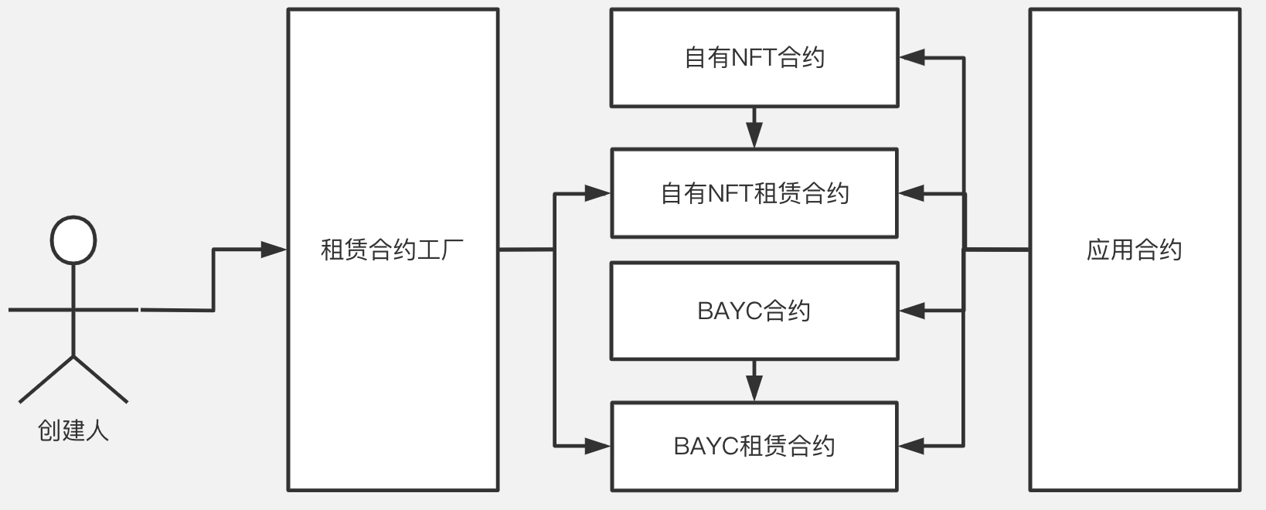
应用方收益
所有权和使用权的分离
Notes:
So here's our idea and implementations
We introduce a non-ownership-transfer protocol
Since the lessors no longer have to transfer the NFTs, they are required to pay guarantees for keeping their promises, that is not to transfer the NFT during rental period
But what if the lessors break their promises? We introduce the supervisors, that is literally any account except the lessors. When a supervisor found out that any lessor transfered the lending NFT, he could call the platform contract to get a portion of the guarantee as a reward. Remaining
Only extra work need to be done is for the dapp dev team. Besides the origin NFT contract, they also need to query the rental contract for extra information. But compare to the tremendous increament of NFT utilization, the integration cost is totally worth it.

Slide 11
应用方成本
合约集成
租赁合约提供
1.和访问NFT相同的balanceOf, ownerOf, tokenOfOwnerByIndex等ERC721及其衍生合约的接口。
2.获取出租列表，租期，租金token种类，租金金额等的额外信息。
3.可在应用合约中添加开关，方便随时开启和关闭租赁功能。
Notes:
So here's our idea and implementations
We introduce a non-ownership-transfer protocol
Since the lessors no longer have to transfer the NFTs, they are required to pay guarantees for keeping their promises, that is not to transfer the NFT during rental period
But what if the lessors break their promises? We introduce the supervisors, that is literally any account except the lessors. When a supervisor found out that any lessor transfered the lending NFT, he could call the platform contract to get a portion of the guarantee as a reward. Remaining
Only extra work need to be done is for the dapp dev team. Besides the origin NFT contract, they also need to query the rental contract for extra information. But compare to the tremendous increament of NFT utilization, the integration cost is totally worth it.

Slide 12
演示视频

Slide 13
总结
安全
无需NFT和抵押物资产的所有权转移
资金效率更高
超额抵押 v.s. 小额违约金，不会错失空投
利用监督者获益的副作用惩罚违约，保证系统自我平衡
监督者获利惩罚违约 v.s. 套利者套利保持DEX之间汇率稳定
所有权和使用权分离，提供更多的可能性
Notes:
So to summarize, our model of rental protocol has following advantages:
First is Safety, neither ownership transfer nor collateral transfer is needed.
Second is capital efficiency. The amount of lessor guarantee has not to be too large. An amount larger than the benifit you could get from one round of the game is enough for a guarantee
The third advantage is that the system is self-governing,
And also, if you don't transfer ownership, you won't miss any airdrops

Slide 14
未来计划
完成更多的功能
完善和丰富的接入文档和示例代码
支持ERC-1155
希望租到物品的需求提交
出租人信誉系统
…
寻求合作
欢迎任何GameFi/X to Earn/NFT PASS 团队与我们合作
Notes:
In the next weeks, we plan many features to implement

Slide 15
联系
ghostnft2022@gmail.com
Notes:
If there are any collaborations/investors/discussions, you can contact us through this email

Slide 16
为NFT的应用带来更多的可能性！

Slide 17
Q&A

