Slide 1
Ponzi Scheme Detector and Predictor on Ethereum
Team PowerOwl

Slide 2
PowerOwl Team
Steven Fan
Ph.D. in Computer Science from HKUST, software analysis expert, entrepreneur.
Ph.D. Candidate from Zhejiang University, Research Interests include artificial intelligence & big data, published over 10 SCI papers, owned over 30 patents.
Ph.D. in Database from HKUST, many years’experience of using data science technique to evaluate and estimate productivity, software quality and project ROI.
Ph.D. Candidate from HKUST, Research Interests include software analysis, big data and artificial intelligence.
M.Sc. in Artificial Intelligence from Edinburgh. Industrial experience from Alibaba and Huawei.
Maxwell Cao
Molly Xie
Chris Wang
Fruit Zi

Slide 3
Contents
01
Background
02
Workflow
03
Model Performance
04
Future Perspective

Slide 4
01
Background

Slide 5
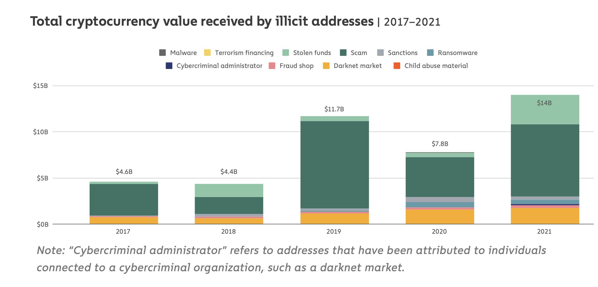
Motivation: Why we choose a Ponzi-detector
According to Chainanalysis, DeFi users lost over $10.5 Billion in Ponzi projects in 2021
Ponzi smart contracts have obvious patterns in bytecodes and chain data
We leverage AI and PL techniques to detect Ponzi contracts and forcast their collapse.

Slide 6

Definition of Ponzi Scheme on Ethereum
The contract distributes money among investors
The contract receives money only from investors
Each investor makes a profit if enough investors invest enough money in the contract afterwards
The later an investor joins the contract, the greater the risk of losing his investment.

Slide 7
02
Workflow & Model

Slide 8
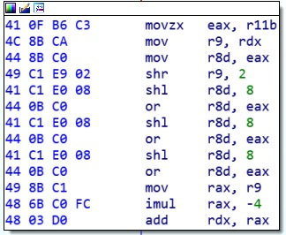
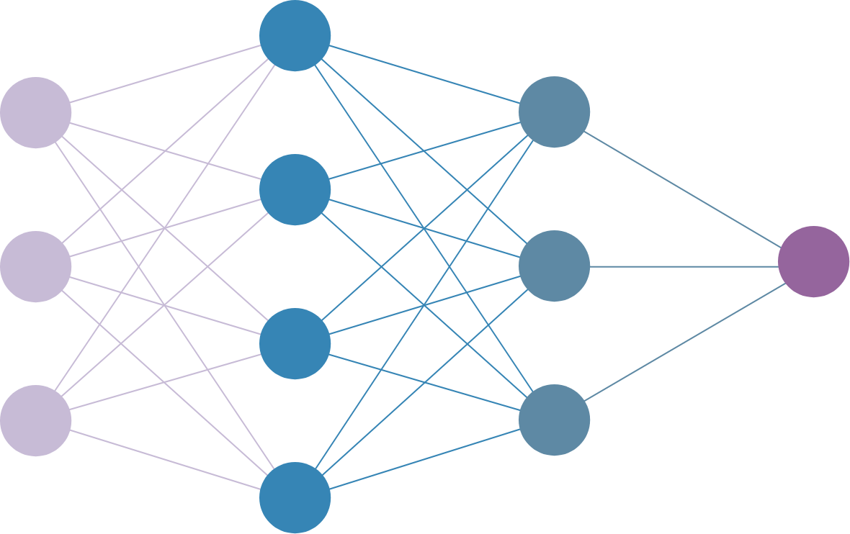
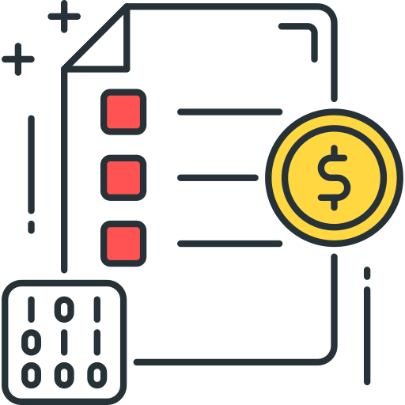
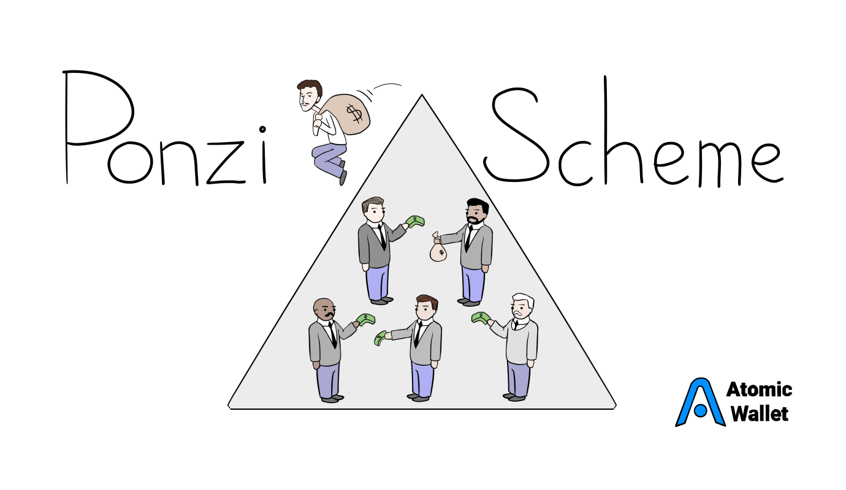

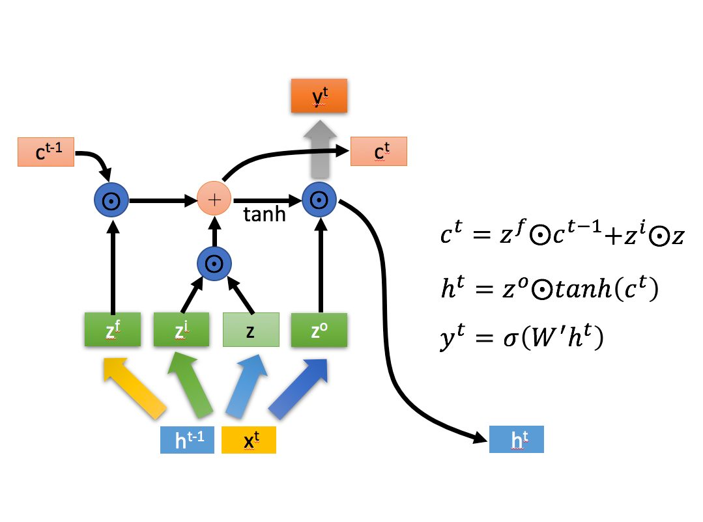
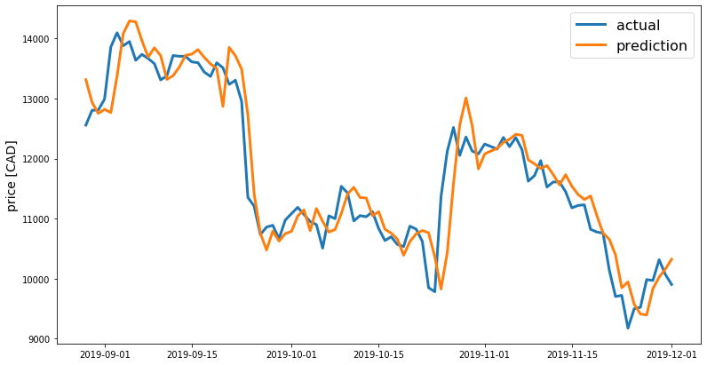
Workflow
Decompile
AI Analysis
Smart Contract
Opcode
Multilayer Perceptron (MLP)
Ponzi Scheme Identification
Pattern Recognition
Transactions History
Long short-term memory (LSTM)
Burst Time Prediction

Slide 9
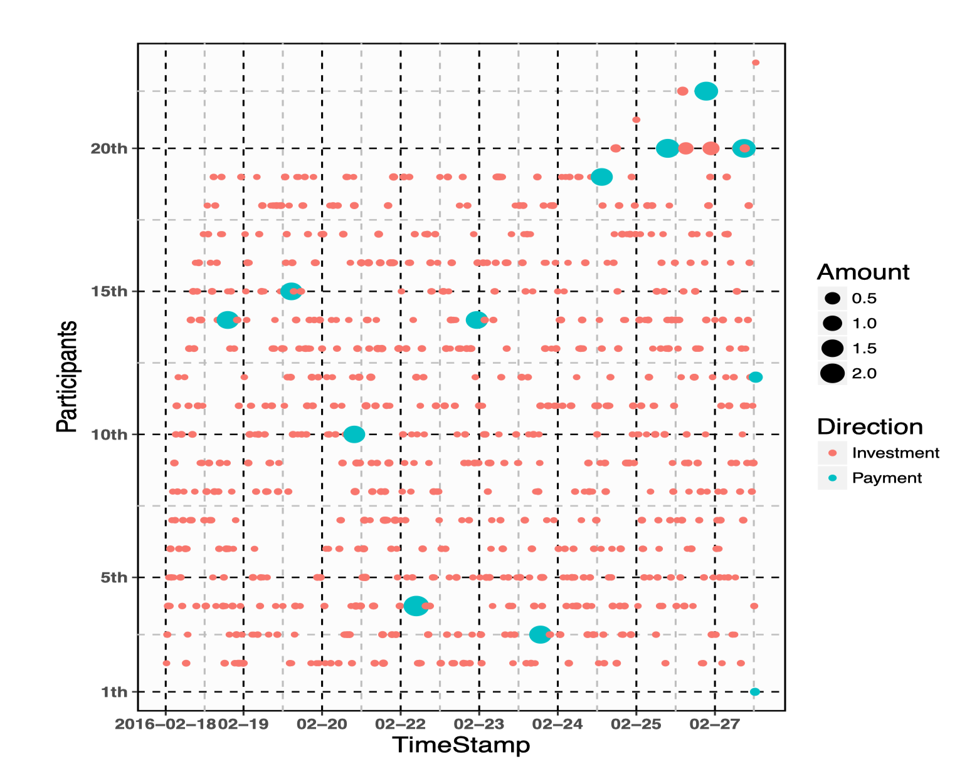
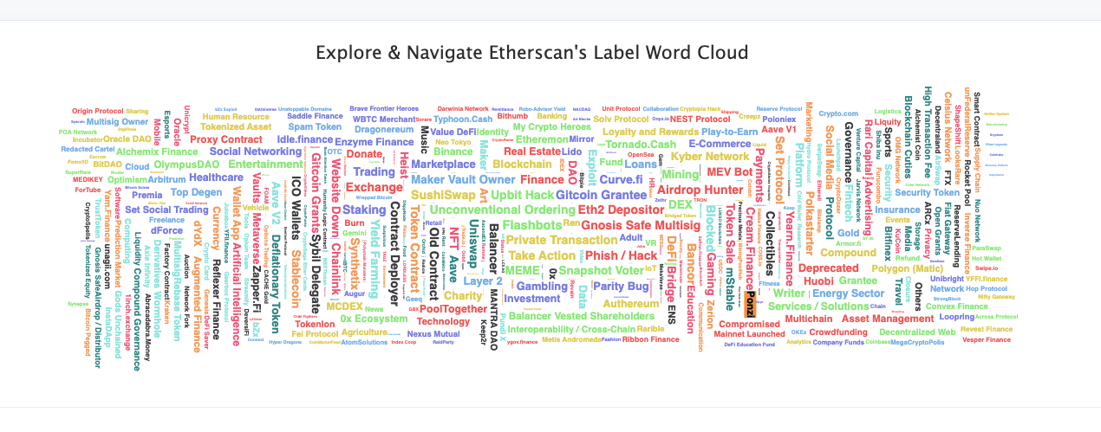
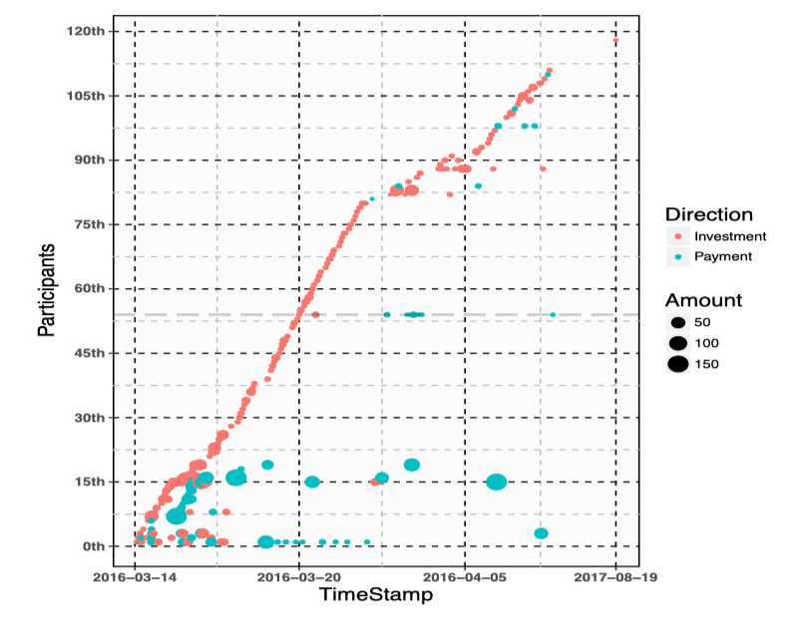
Data Collection
Etherscan Ponzi Tag List (50)
WWW 2018 Paper Ponzi Contracts (400)
GitHub Collection (150)
Normal Contract Address (600)

Slide 10
03
Model Performance

Slide 11
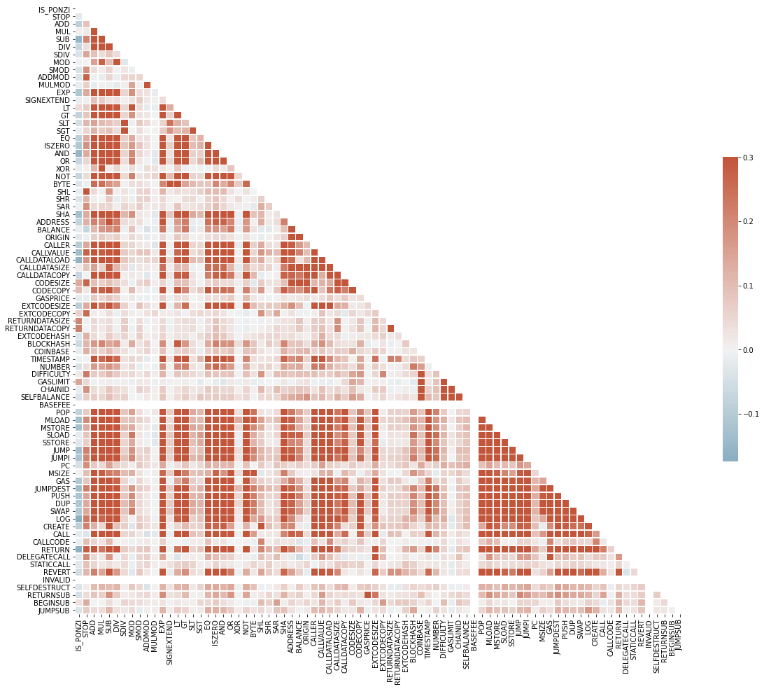
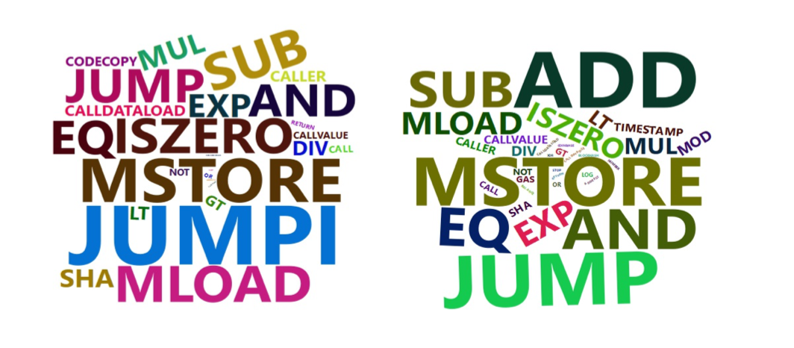
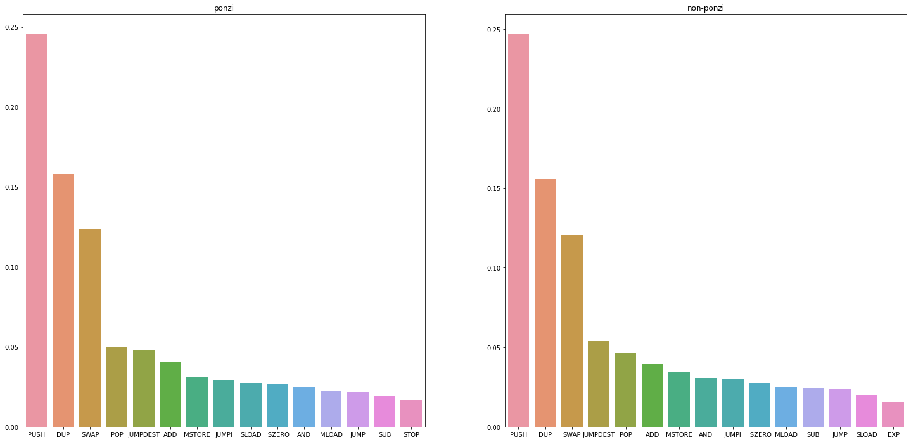
Pairwise Correlation of Opcode Patterns
Opcode List
STOP ADD MUL SUB DIV SDIV MOD SMOD ADDMOD MULMOD EXP SIGNEXTEND LT GT SLT SGT EQ ISZERO AND OR XOR NOT BYTE SHL SHR SAR SHA ADDRESS BALANCE ORIGIN CALLER CALLVALUE CALLDATALOAD CALLDATASIZE CALLDATACOPY CODESIZE CODECOPY GASPRICE EXTCODESIZE EXTCODECOPY RETURNDATASIZE RETURNDATACOPY EXTCODEHASH BLOCKHASH COINBASE TIMESTAMP NUMBER DIFFICULTY GASLIMIT CHAINID SELFBALANCE BASEFEE POP MLOAD MSTORE SLOAD SSTORE JUMP JUMPI PC MSIZE GAS JUMPDEST PUSH DUP SWAP LOG CREATE CALL CALLCODE RETURN DELEGATECALL STATICCALL REVERT INVALID SELFDESTRUCT RETURNSUB BEGINSUB JUMPSUB

Slide 12
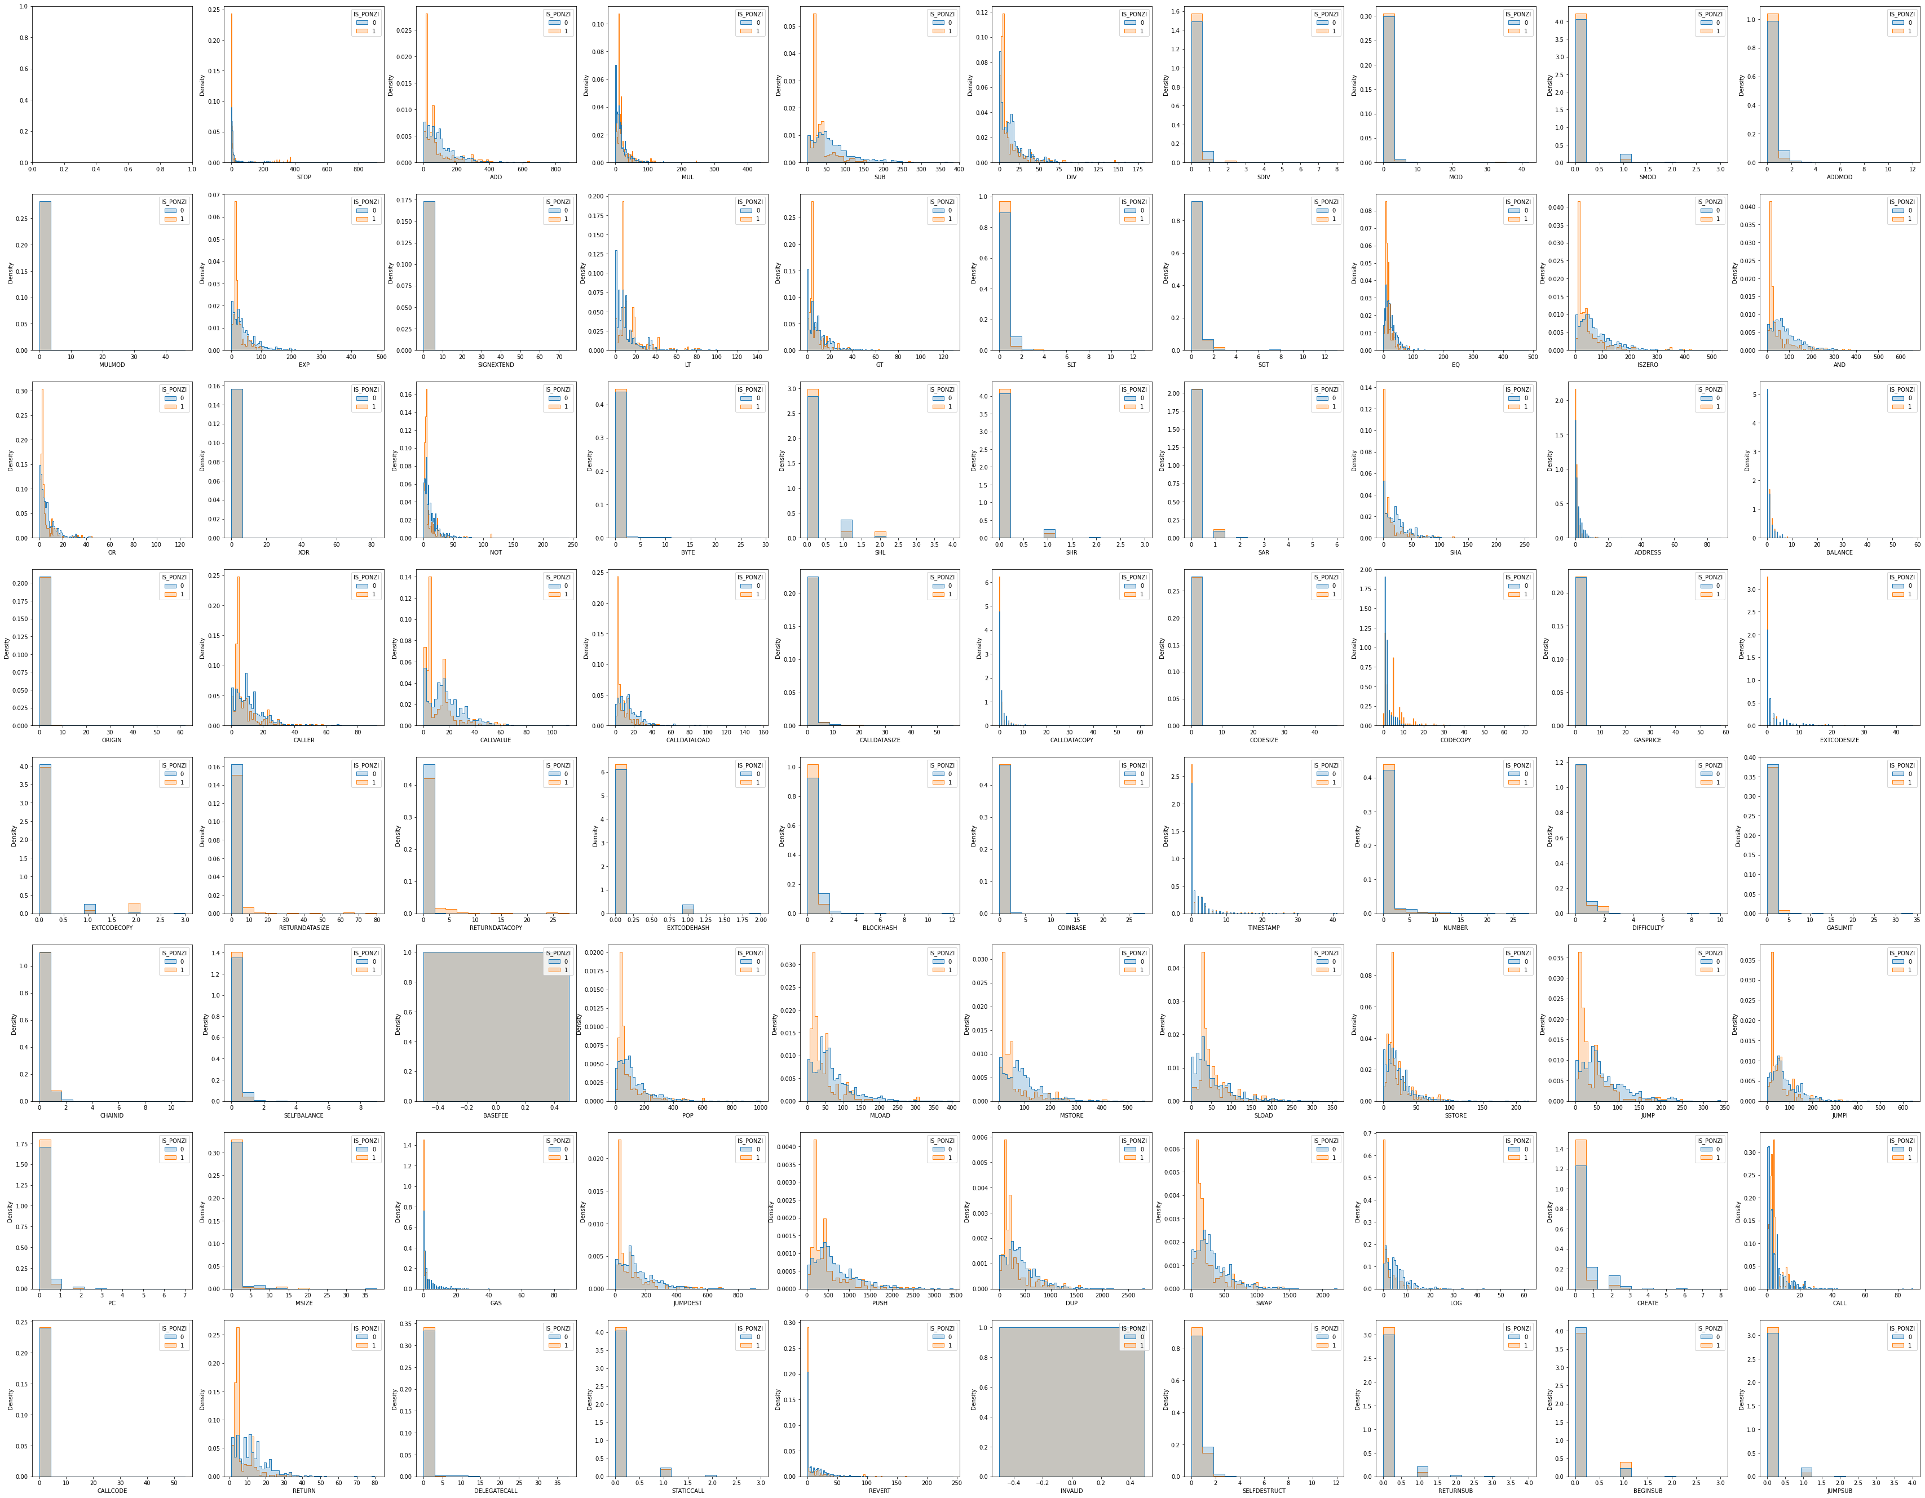
Opcode Distribution Analysis

Slide 13
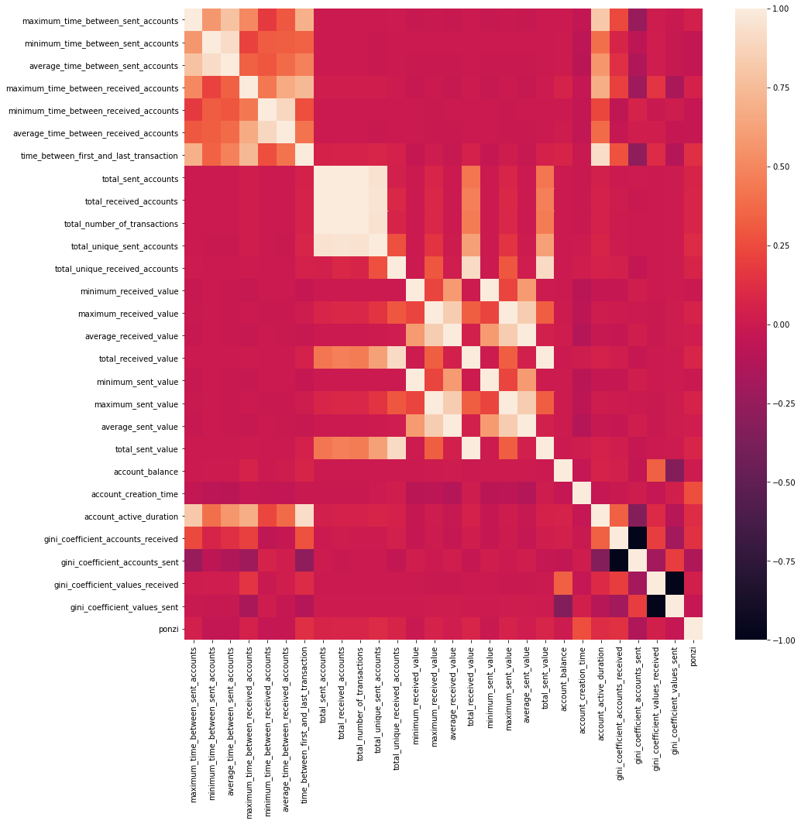
Pairwise Correlation of Transaction Patterns
minimum_time_between_sent_accounts
average_time_between_sent_accounts
maximum_time_between_received_accounts
minimum_time_between_received_accounts
average_time_between_received_accounts
time_between_first_and_last_transaction
total_sent_accounts
total_received_accounts
total_number_of_transactions
total_unique_sent_accounts
total_unique_received_accounts
minimum_received_value
maximum_received_value
average_received_value
total_received_value
minimum_sent_value
maximum_sent_value
average_sent_value
total_sent_value
account_balance
account_creation_time
account_active_duration
gini_coefficient_accounts_received
gini_coefficient_accounts_sent
gini_coefficient_values_received
gini_coefficient_values_sent

Slide 14
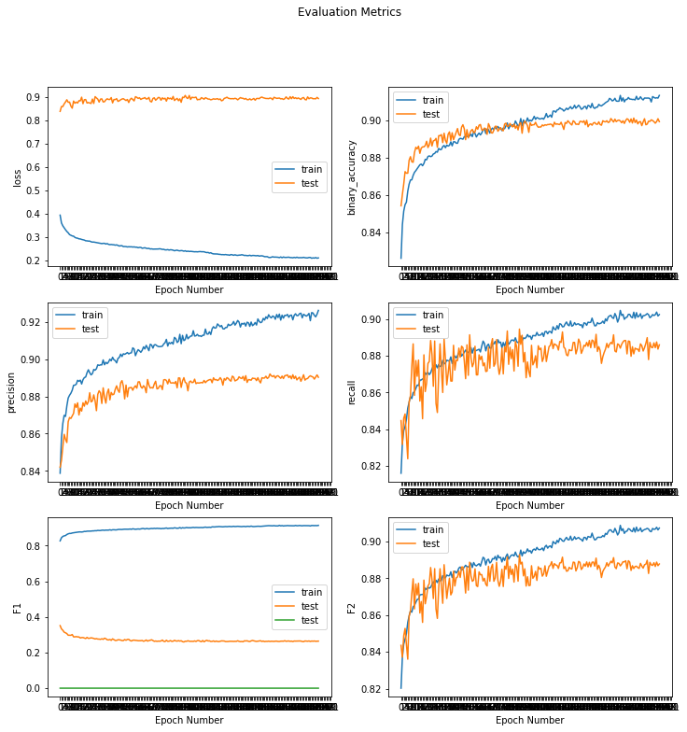
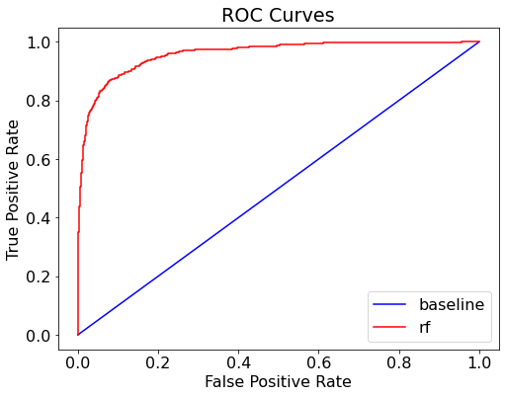
Training Results
Accuracy 0.9034
Specificity 0.9064
Precision non-fraud 0.9850
Precision fraud 0.5098
Recall non-fraud 0.9064
Recall fraud 0.8760
F2 non-fraud 0.9211
F2 fraud 0.7660
F1 0.6446
AUC 0.9591

Slide 15
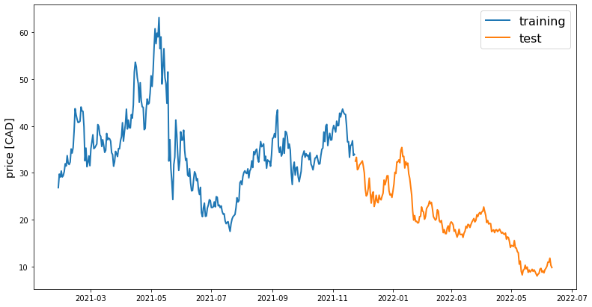
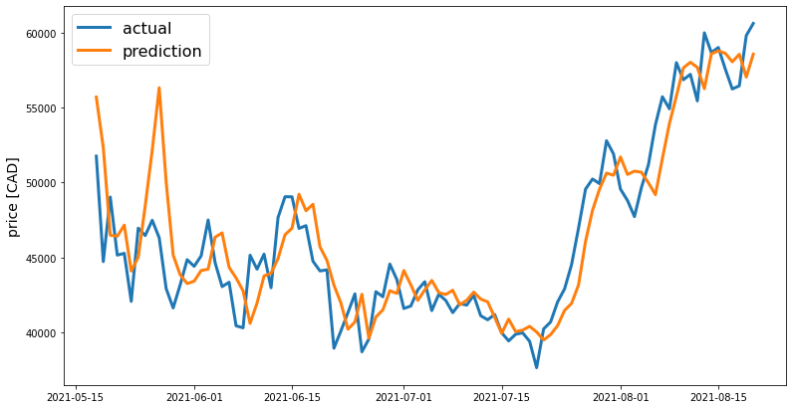
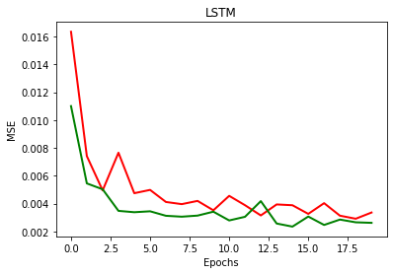
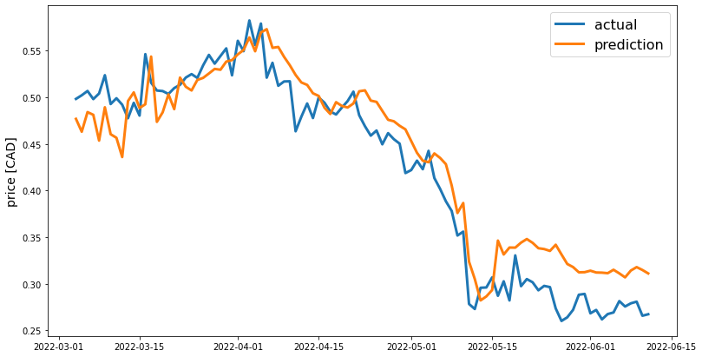
Burst Prediction Results
Training Data
Test Data
MAE: 0.0280
R²: 0.6655
MSE: 0.0429
Training Loss

Slide 16
04
Future Perspective

Slide 17
Future Perspective
Q1 Data Collection
We only collect 2k samples in this work, 600 positive sample
Prepare some
Q2 Method Generalization
Test more cases
Try more ML models, e.g. GNN/Transformer
Q3 Future Application
Apply the ML model in quantitive research
Develop an automatic program to monitor the new smart contract

Slide 18
Thank you
Q&A

