Slide 1
This is your Block & This is your Store

Slide 2

Hello!
I AM ZHU JUNCHENG
I am here because I love to give cool Ideas.
You can find me at github:
@Feo-0134

Slide 3
Vintage
Let’s start with the first concept

Slide 4
消費の究極の意味は、より充実した人生を送る方法です。 より虚栄心のある消費習慣を放棄し、消費する適切な方法を選択します。

Slide 5
This is a slide title
Here you have a list of items
And some text
But remember not to overload your slides with content
Your audience will listen to you or read the content, but won’t do both.

Slide 6
BIG CONCEPT
Bring the attention of your audience over a key concept using icons or illustrations

Slide 7
In two or three columns
In two or three columns
YELLOW
Is the color of gold, butter and ripe lemons. In the spectrum of visible light, yellow is found between green and orange.
BLUE
Is the colour of the clear sky and the deep sea. It is located between violet and green on the optical spectrum.
RED
Is the color of blood, and because of this it has historically been associated with sacrifice, danger and courage.

Slide 8
Maps

Slide 9
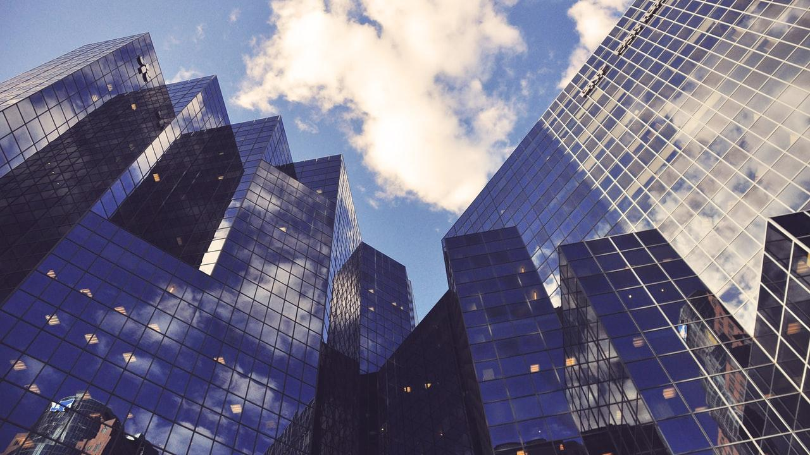
Want big impact?
Use big image.

Slide 10
Use charts to explain your ideas
Use charts to explain your ideas
Gray
White
Black

Slide 11
89,526,124
Whoa! That’s a big number, aren’t you proud?

Slide 12
89,526,124$
185,244 users
100%
That’s a lot of money
And a lot of users
Total success!

Slide 13
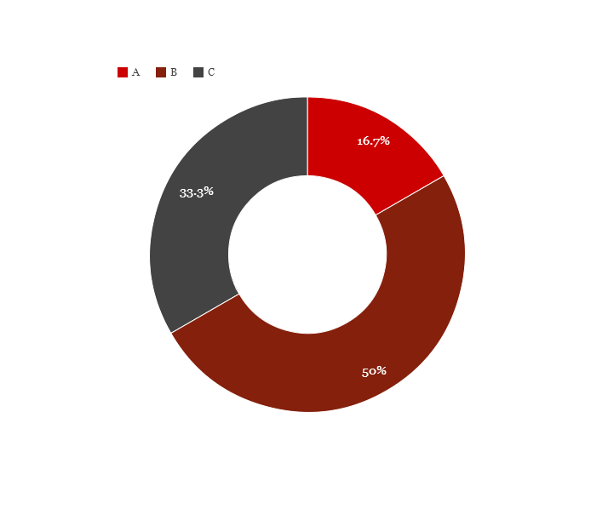
You can copy&paste graphs from Excel or Google Sheets

Slide 14
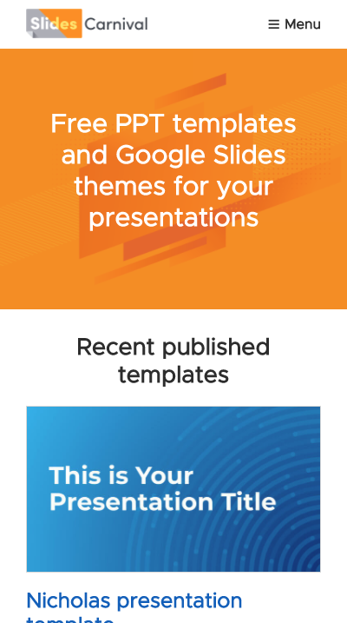

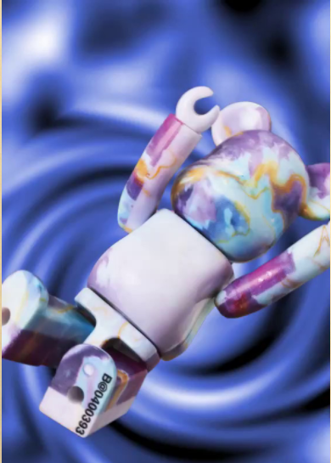
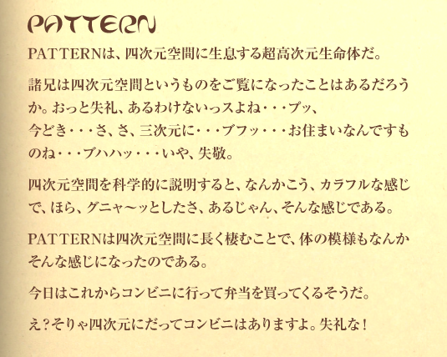

Mobile project demo
Show and explain my web, app or software projects.

Slide 15
Thanks!
ANY QUESTIONS?
You can find me at:
@Feo-0134
zhujuncheng1021@gmail.com

Slide 16
Now you can use any emoji as an icon!
And of course it resizes without losing quality and you can change the color.
How? Follow Google instructions https://twitter.com/googledocs/status/730087240156643328
✋👆👉👍👤👦👧👨👩👪💃🏃💑❤😂😉😋😒😭👶😸🐟🍒🍔💣📌📖🔨🎃🎈🎨🏈🏰🌏🔌🔑 and many more...

