Slide 15
Lenovo starter presentation template
Speaker name | Date

Slide 16
Section header
Subhead here

Slide 17


Where to find the latest templates
Option 1:
Log-in to AEM
Visit Brand Portal to download both
the Lenovo starter presentation template
and the Lenovo presentation slide library
Option 2:
Open PowerPoint
Open PowerPoint and find both the
IT-loaded Lenovo starter presentation template and the Lenovo presentation
slide library
Notes:
File > New > Lenovo tab to find the pre-loaded template
Follow the instructions provided in the Lenovo presentation slide library to insert your desired slides into this deck

Slide 18


Getting started
Begin with the Lenovo starter presentation template and use it in conjunction with the Lenovo presentation slide library
The Lenovo presentation slide library includes slide examples and elements to help further customize and enhance your Lenovo presentations

Slide 19
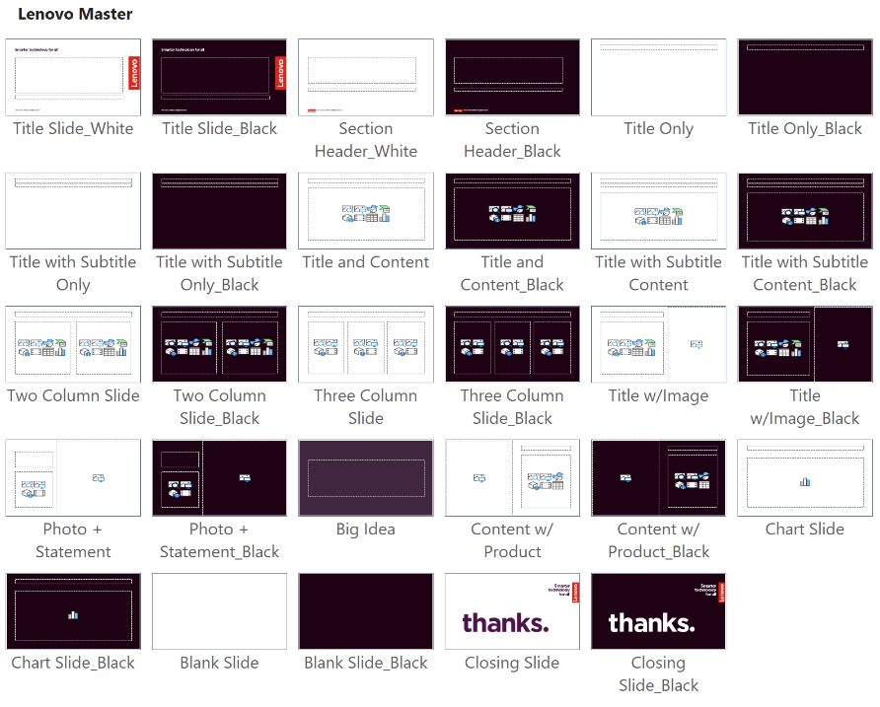
Slide master layouts
Discover all available slide layouts by following these instructions:
  In the slide panel on the left, right-click on a thumbnail and select “Layout” to choose an option based on your content needs OR
  From the “Home” tab, choose the “Slide Layout” dropdown
Layout options between “Title Slide_White” and “Closing Slide_Black” are considered part of the current template

Slide 20
Template best practices
For every slide layout option, there is an alternative dark option:
  For slides that will be printed, use white slide layouts to conserve toner
  Dark slides are a dramatic alternative for formal presentations that will be projected on screen
Bold color is your highlight text, text, text, text, text, text
Try not to exceed six bullet points per slide
Tips for transferring content from other templates:
  Paste the slide in the desired location and then from "Paste Options" box, choose "Use Destination Theme“
  You may still have to copy-paste or cut-paste content into the correct content placeholder on the slide, depending on how the source file was created
  Copy-paste the content within the slide instead of copying and pasting entire slides from the side pane
  Delete any layout options that appear after "Closing Slide_Black"; these are legacy artifacts from older templates and should not be used

Slide 21
Installing theme files
1
Go to the Brand World Templates page
2
Download the Lenovo theme file (.thmx) and the Lenovo starter template/slide library (.potx) using the instructions near the top of the page
3
Open “File Explorer” and click “View” > “Show” > “Hidden items”
4
Navigate to: “C:\Users\<YourUsername>\AppData\Roaming\Microsoft\Templates”
5
Copy your .potx file (Lenovo Starter Template or Lenovo Slide Library) into the Templates folder
6
Open the “Document Themes” subfolder inside Templates, then copy your .thmx file (Lenovo Theme) into this folder.

Slide 22


Update footer with correct information classification
Select “Home” tab and “Replace” button. Put current footer text in “Find” field and type the appropriate footer content from the options below. Click “Replace All” to update all Title and Section Header slides.
  Lenovo Internal: Information generally intended for use within Lenovo without restrictions. Much of Lenovo's internal information can use this template.
  Lenovo Unclassified (no protection required): Does not include any Lenovo Internal, Lenovo Confidential or Lenovo Restricted content. Information is in the public domain or is approved for disclosure outside of Lenovo.
  Lenovo Confidential (additional protection required): Confidential within Lenovo, with distribution limited to individuals with a specific business need to know.
2026 Lenovo Internal. All rights reserved.
2026 Lenovo
2026 Lenovo Confidential. All rights reserved.

Slide 23

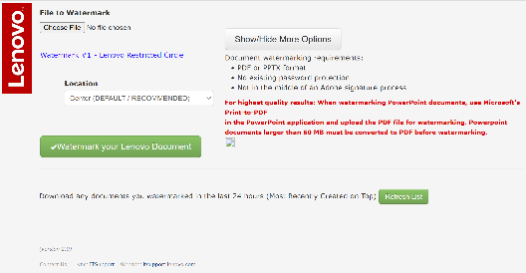
Restricted presentations
For presentations that require maximum protection, there are two options for protecting your sensitive presentations. Either option will work for confidential information:
  Lenovo Restricted (PPT template):
  Confidential within Lenovo, with distribution limited to designated individuals or positions.
Download Restricted Template Here
  Lenovo Restricted (Watermark):
  Upload any presentation file to watermark.lenovo.com to auto-populate the restricted watermark for protection. This only works with PDF or PPTX formats.

Slide 24
Titles are Arial, bold, 32 pt, sentence case
Subtitles are Arial, regular, 22 pt, sentence case
Level one bullet style is Arial, regular, 20 pt
  Level two style is Arial, regular, 18 pt
    Level three style is Arial, regular, 18 pt
Bulleted copy has initial cap on first word only with no period at the end
If bulleted copy is more than one sentence, use a period at the end
Use periods for all bulleted copy in the list if one requires a period

Slide 25
Two column layout
Two-column level one bullet style is
Arial, regular, 20 pt
  Level two style is Arial, regular, 18 pt
    Level three style is Arial, regular, 18 pt
Level one style
Level one style
Level one style
Two-column level one bullets are
Arial, regular, 20 pt
  Level two style is Arial, regular, 18 pt
    Level three style is Arial, regular, 18 pt
Level one style
Level one style
Level one style

Slide 26
Color scheme
Red
225.37.27
#E1251B
Deep Red 1
100.19.30
#64131E
Deep Purple 1
77.20.74
#4D144A
Deep Blue 1
17.24.79
#11184F
Black
30.01.19
#1E0013
Mid Red 1
184.37.46
#B8252E
Deep Purple 2
122.18.107
#7A126B
Deep Blue 2
41.78.149
#294E95
Deep Gray
78.68.78
#4E444E
Lenovo signature red should be used to elevate the brand but should not be overused. Always use the signature red for the Lenovo logo.
Mid Red 2
242.106.82
#F26A52
Mid Gray
171.168.177
#ABA8B1
Colors built into the template (theme colors)
Pale Red 1
240.199.191
#F0C7BF
Pale Purple 1
217.193. 216
#D9C1D8
Pale Blue 1
201.208.240
#C9D0F0
Pale Gray
230.226.228
#E6E2E4
SMARTER
Passion
Ambition
Knowledge
Curious
Wonder
Creative
SMARTER
& LINEAR
GRADIENTS:
LINEAR

Slide 27

Colors for light slides
Use deep and bold colors that contrast with the white background
Theme colors
Avoid the paler tones that do not allow enough contrast with the white background

Slide 28

Colors for dark slides
Use light and bold colors that contrast
with the dark background
Theme colors
Avoid the darker tones that do not allow enough contrast with the dark background

Slide 29
Thanks

