Slide 1
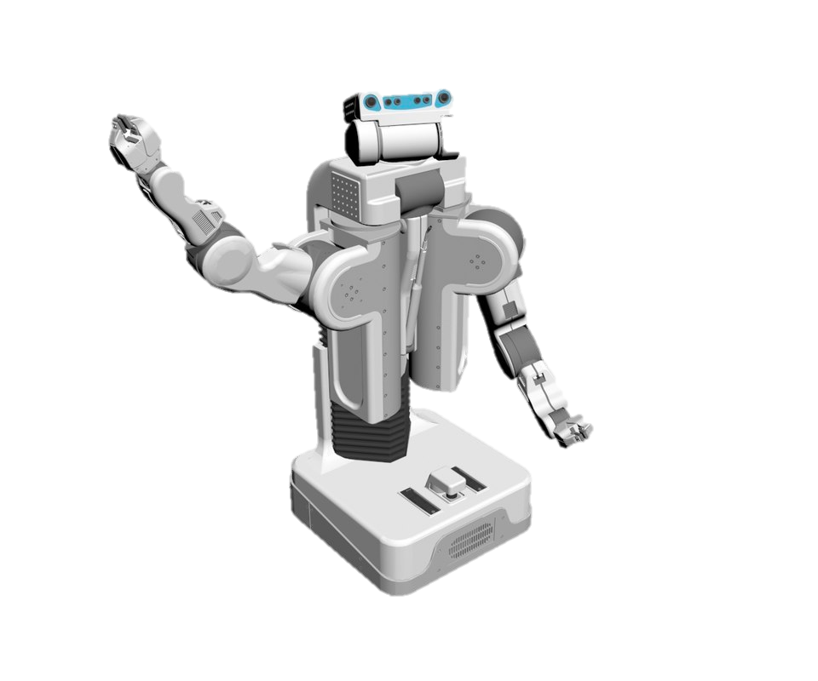
Goal
waypoint 4
Obstacles
Obstacles
waypoint 1
waypoint 3
Obstacles
waypoint 2

