Slide 1
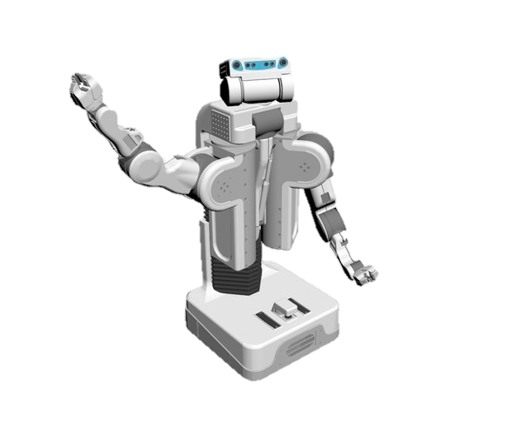
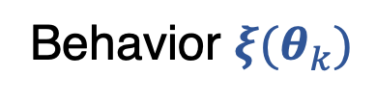
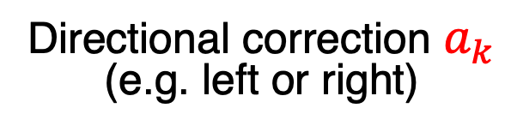
Behavior $ξ(θ_{k})$
Directional correction $a_{k}$
(e.g. left or right)

