Slide 1

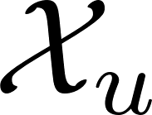

trajectory
-- unsafe
-- goal
-- initial

