Slide 1
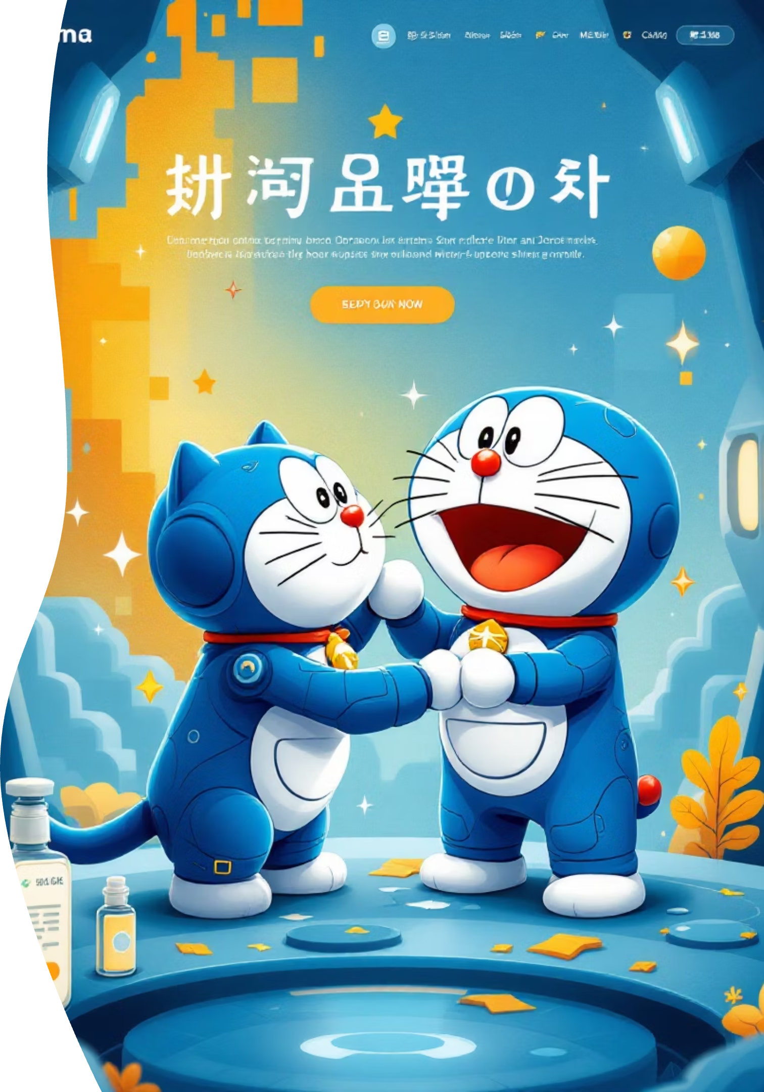
DoraBlog: Unleashing Gadget-Powered Storytelling - Final Project Presentation
Presented by Team Blue Cat Four

Slide 2
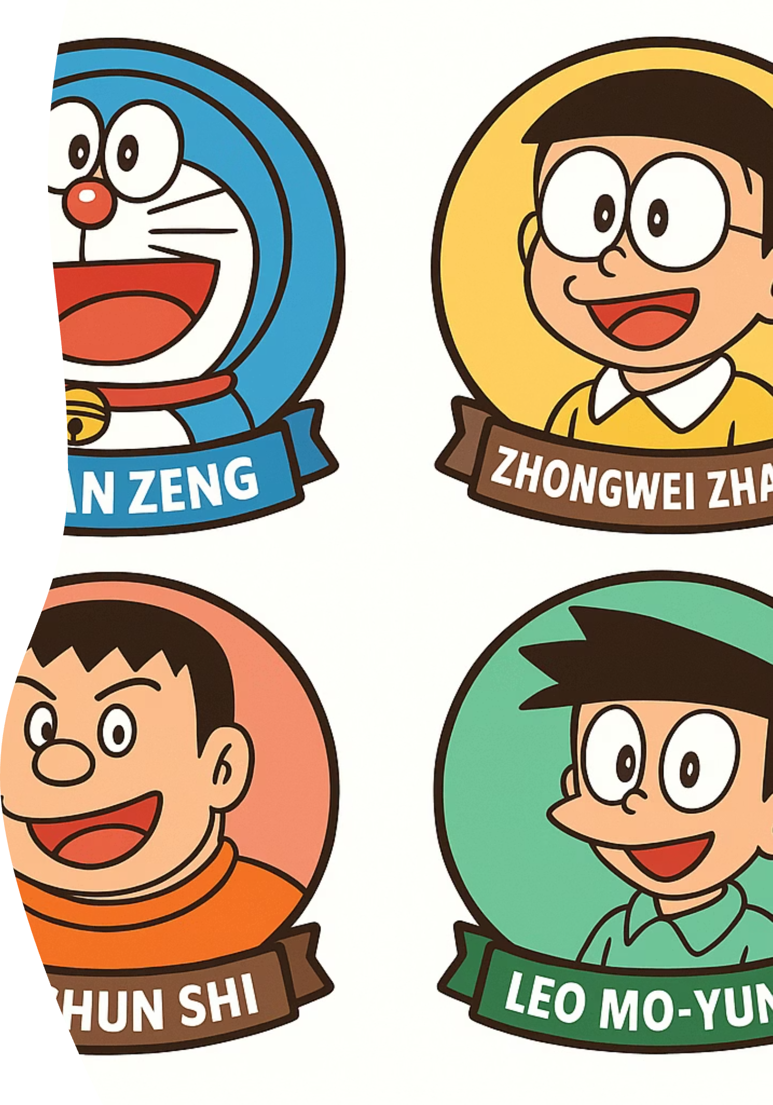
Team members
Team leader & architecture: Leo Mo-yung
UI & developer: Yushun Shi
Developer & test: Xuan Zeng
Developer & test: Zhongwei Zhang
Notes:
Team leader&architecture: Leo Mo-yung
UI & developer: Yushun Shi
Developer&test: Xuan Zeng
Developer&test: Zhongwei Zhang

Slide 3

DoraBlog: Unveiling Doraemon's Blogging Wonderland!
Discover a revolutionary platform where classic Doraemon gadgets transform blogging into an imaginative adventure. Share your stories with extraordinary tools, making every post a magical experience, powered by innovation and creativity.

Slide 4
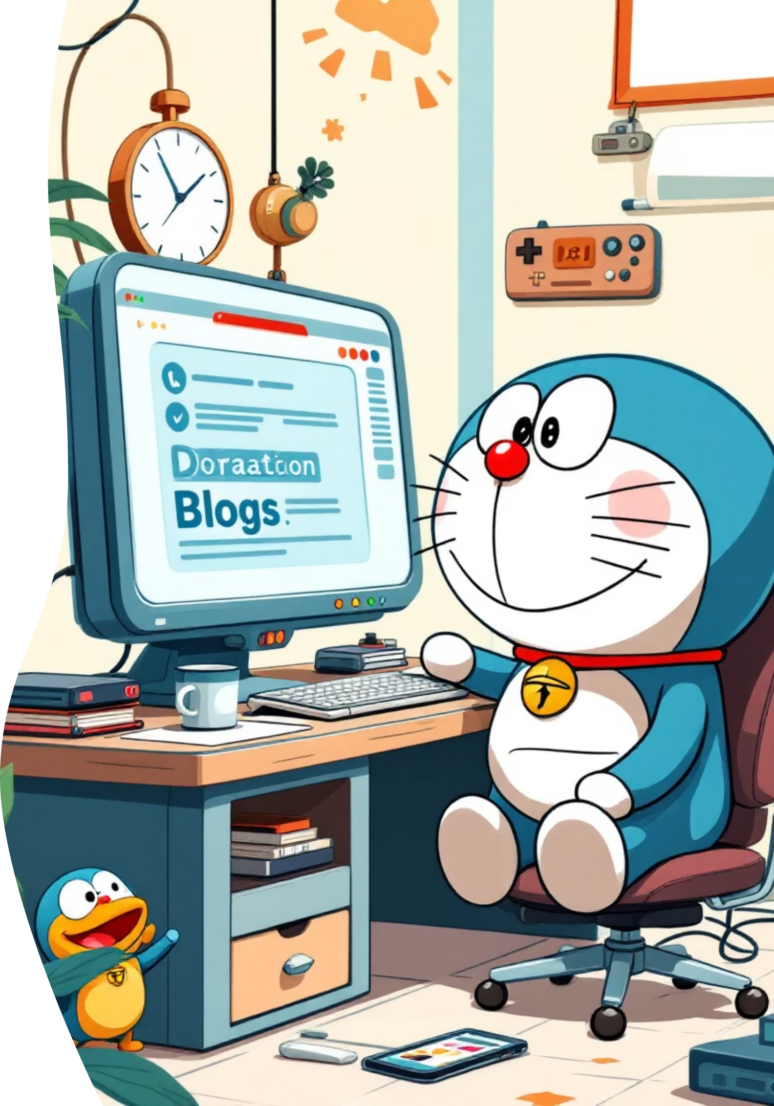
DoraBlog: Unveiling Doraemon's Blogging Wonderland!
Doraemon's Everywhere Pocket Platform
We've engineered a complete full-stack blogging platform, like Doraemon's Everywhere Pocket, featuring a user-friendly front-end interface, a robust back-end service, and an independent management system for seamless operations.
Gadget-Powered Core Features
Experience super-powered features: Identification Camera for user registration/authentication, Word-Processor Pencil for rich-text article creation, a hierarchical comment system (like a tiny Thought-Reading Microphone network), Detective Hat for article search & discovery, and fun Mood Changer like/unlike functionality.
Future-Proof User Experience
Enhance your blog with multi-theme options (light/dark/Doraemon blue, using a Color-Changing Cloak metaphor), a Truth Mirror-like password strength indicator, and daily motivational quotes from our Motivation Machine!
Advanced Gadgetry for Admins
Unleash powerful features: Categorization Chips for tag-based article organization, Friendship Caller for related article recommendations, and a dedicated Java administrator dashboard, acting as our very own Control Panel of the Future.

Slide 5
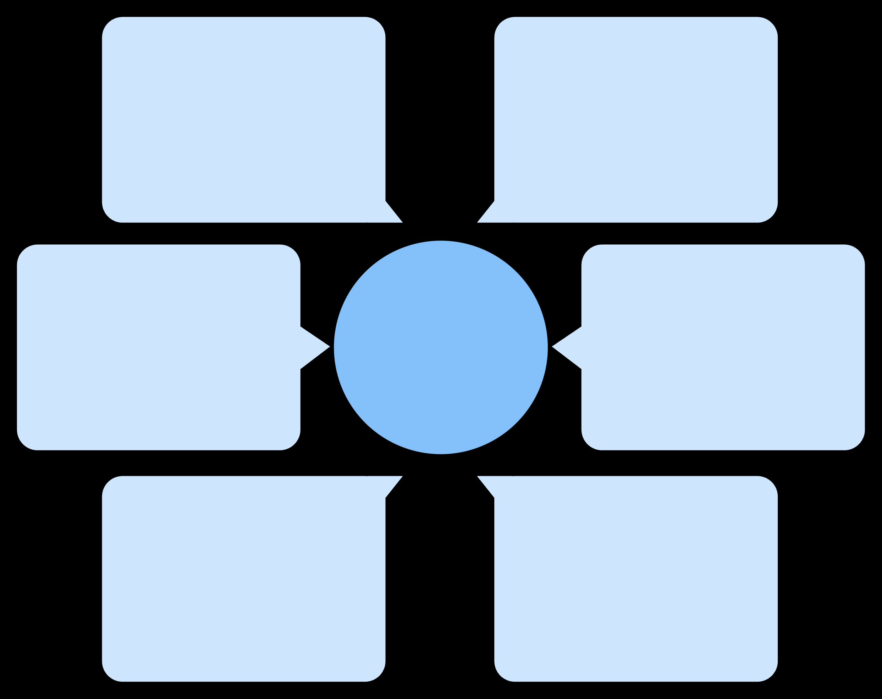
DoraBlog's Gadget Blueprint: System Architecture
Time Machine Admin Console
Anywhere Door UI
Java Client & Jackson
SvelteKit & Vite
DoraBlog's Super-Powered Gadget Workflow!
4D Pocket Storage
Future-Proof Communication
SQLite Database
RESTful API Calls
Secret Identity Badges
Gadget Control Center
JWT Authentication
Node.js & Express Logic
Essential Gadgets & Tools!
Doraemon's Safety Protocols & Blueprint Creation!
Anywhere Door Frontend: SvelteKit (speedy as a rocket!), Vite (quick build-up), TinyMCE (message pen for rich text), Responsive Design (fits any situation, like Doraemon's adaptability!).
Secret Identity Badges: Bcrypt Password Hashing (super secure code lock), JWT Token Authentication (personal ID pass), CORS Configuration (friendship ring for connections!).
Gadget Control Center (Backend): Node.js (our energy source), Express (fast travel routes), RESTful API (Anywhere Door endpoints!), SQLite Database (our 4D Pocket for memories!).
Blueprint Quality Tools: Git (Time Machine for version control & PR workflow), Prettier (neat-freak for code formatting), ESLint (check-up robot for code quality!).
Time Machine Admin Console: Java Swing (sturdy control panel), Jackson (gadget translator for JSON), HTTP Client (time-travel communication!).

Slide 6
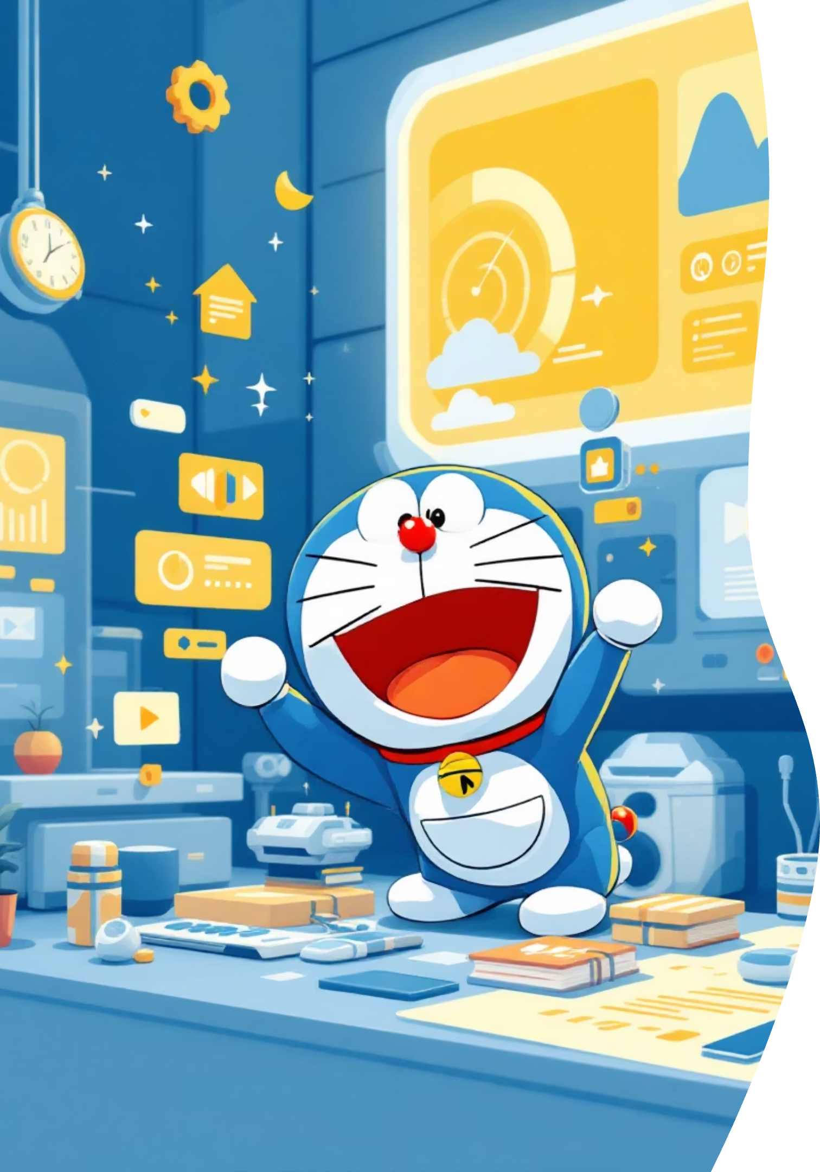

Doraemon's Core Gadgets for an Excellent User Experience
Gadget-Proof User Management
With security as tight as Doraemon's secret pocket, we feature gadget-proof registration, robust password validation, customizable profiles (choose your favorite robotic cat avatar!), and persistent session authentication – keeping your data safe and sound.
"Copying Toaster" Content Creation
Unleash your inner inventor with our full-featured rich text editor, as versatile as a "Copying Toaster"! It includes seamless image uploads, smart article tagging for organization (keeping your ideas tidy, just like Doraemon's pocket), and smooth draft-to-publish workflows for your brilliant posts.
"Anywhere Door" Social Interaction
Connect with fellow adventurers using our multi-level comment threads (like opening an "Anywhere Door" to conversation!), intuitive like/unlike functionality, and user profiles that proudly display all your published articles. It's like a virtual gathering with Nobita and friends!
"Searchlight" Article Discovery
Find your next great read with ease using our powerful "Searchlight" tools! Supports keyword search across titles, content, and authors, provides smart related article recommendations, and offers flexible tag-based filtering to guide you through the universe of DoraBlog posts.

Slide 7
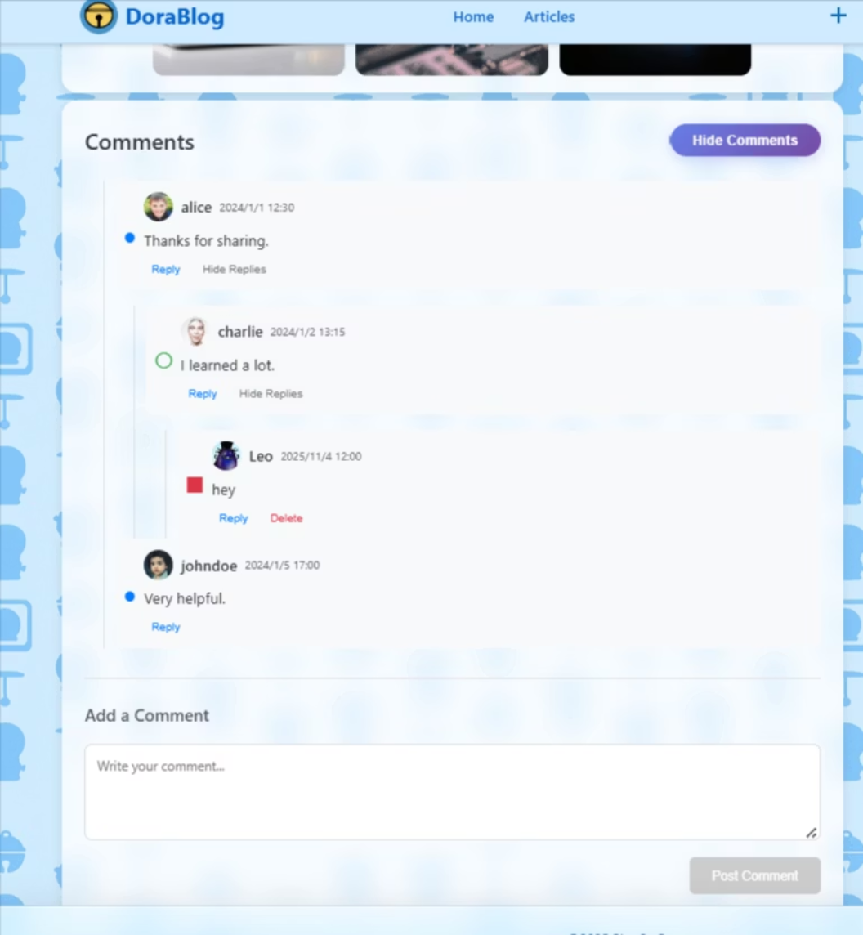
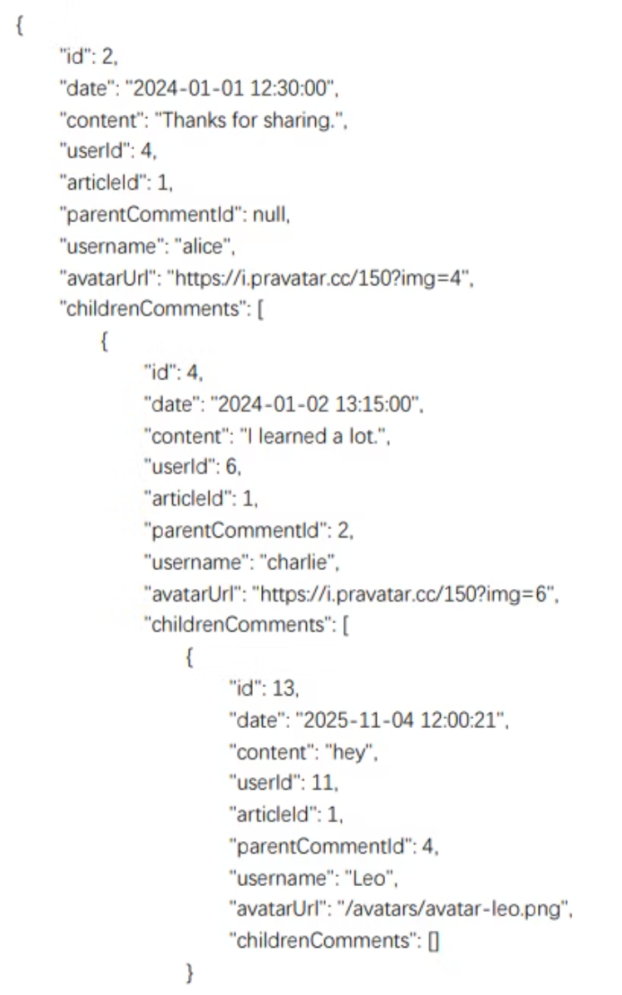
Comments components(Leo)
Graphic UI
API response
CommentsList → CommentItem : svelte:self
parentCommentId & childrenComments contribute to different depth

Slide 8
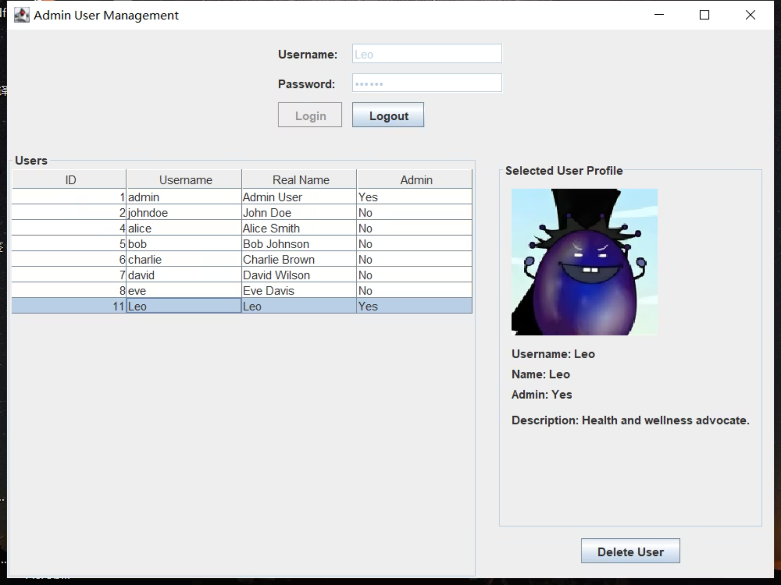
JAVA management system(Leo)
Main file: User(pojos), AdminFrame(view), AdminController, UserModel(TableModel & observer), API
AdminFrame with BorderLayout
AdminController deals with click action
UserModel extends AbstractTableModel, notify observer (adapter and observer)

Slide 9
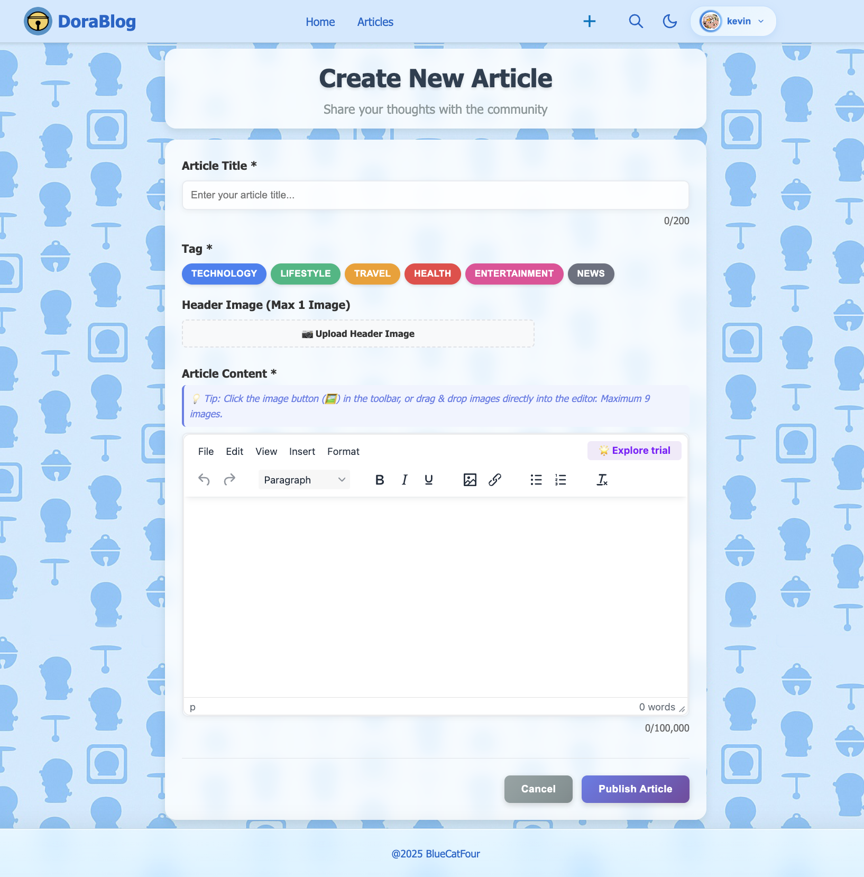
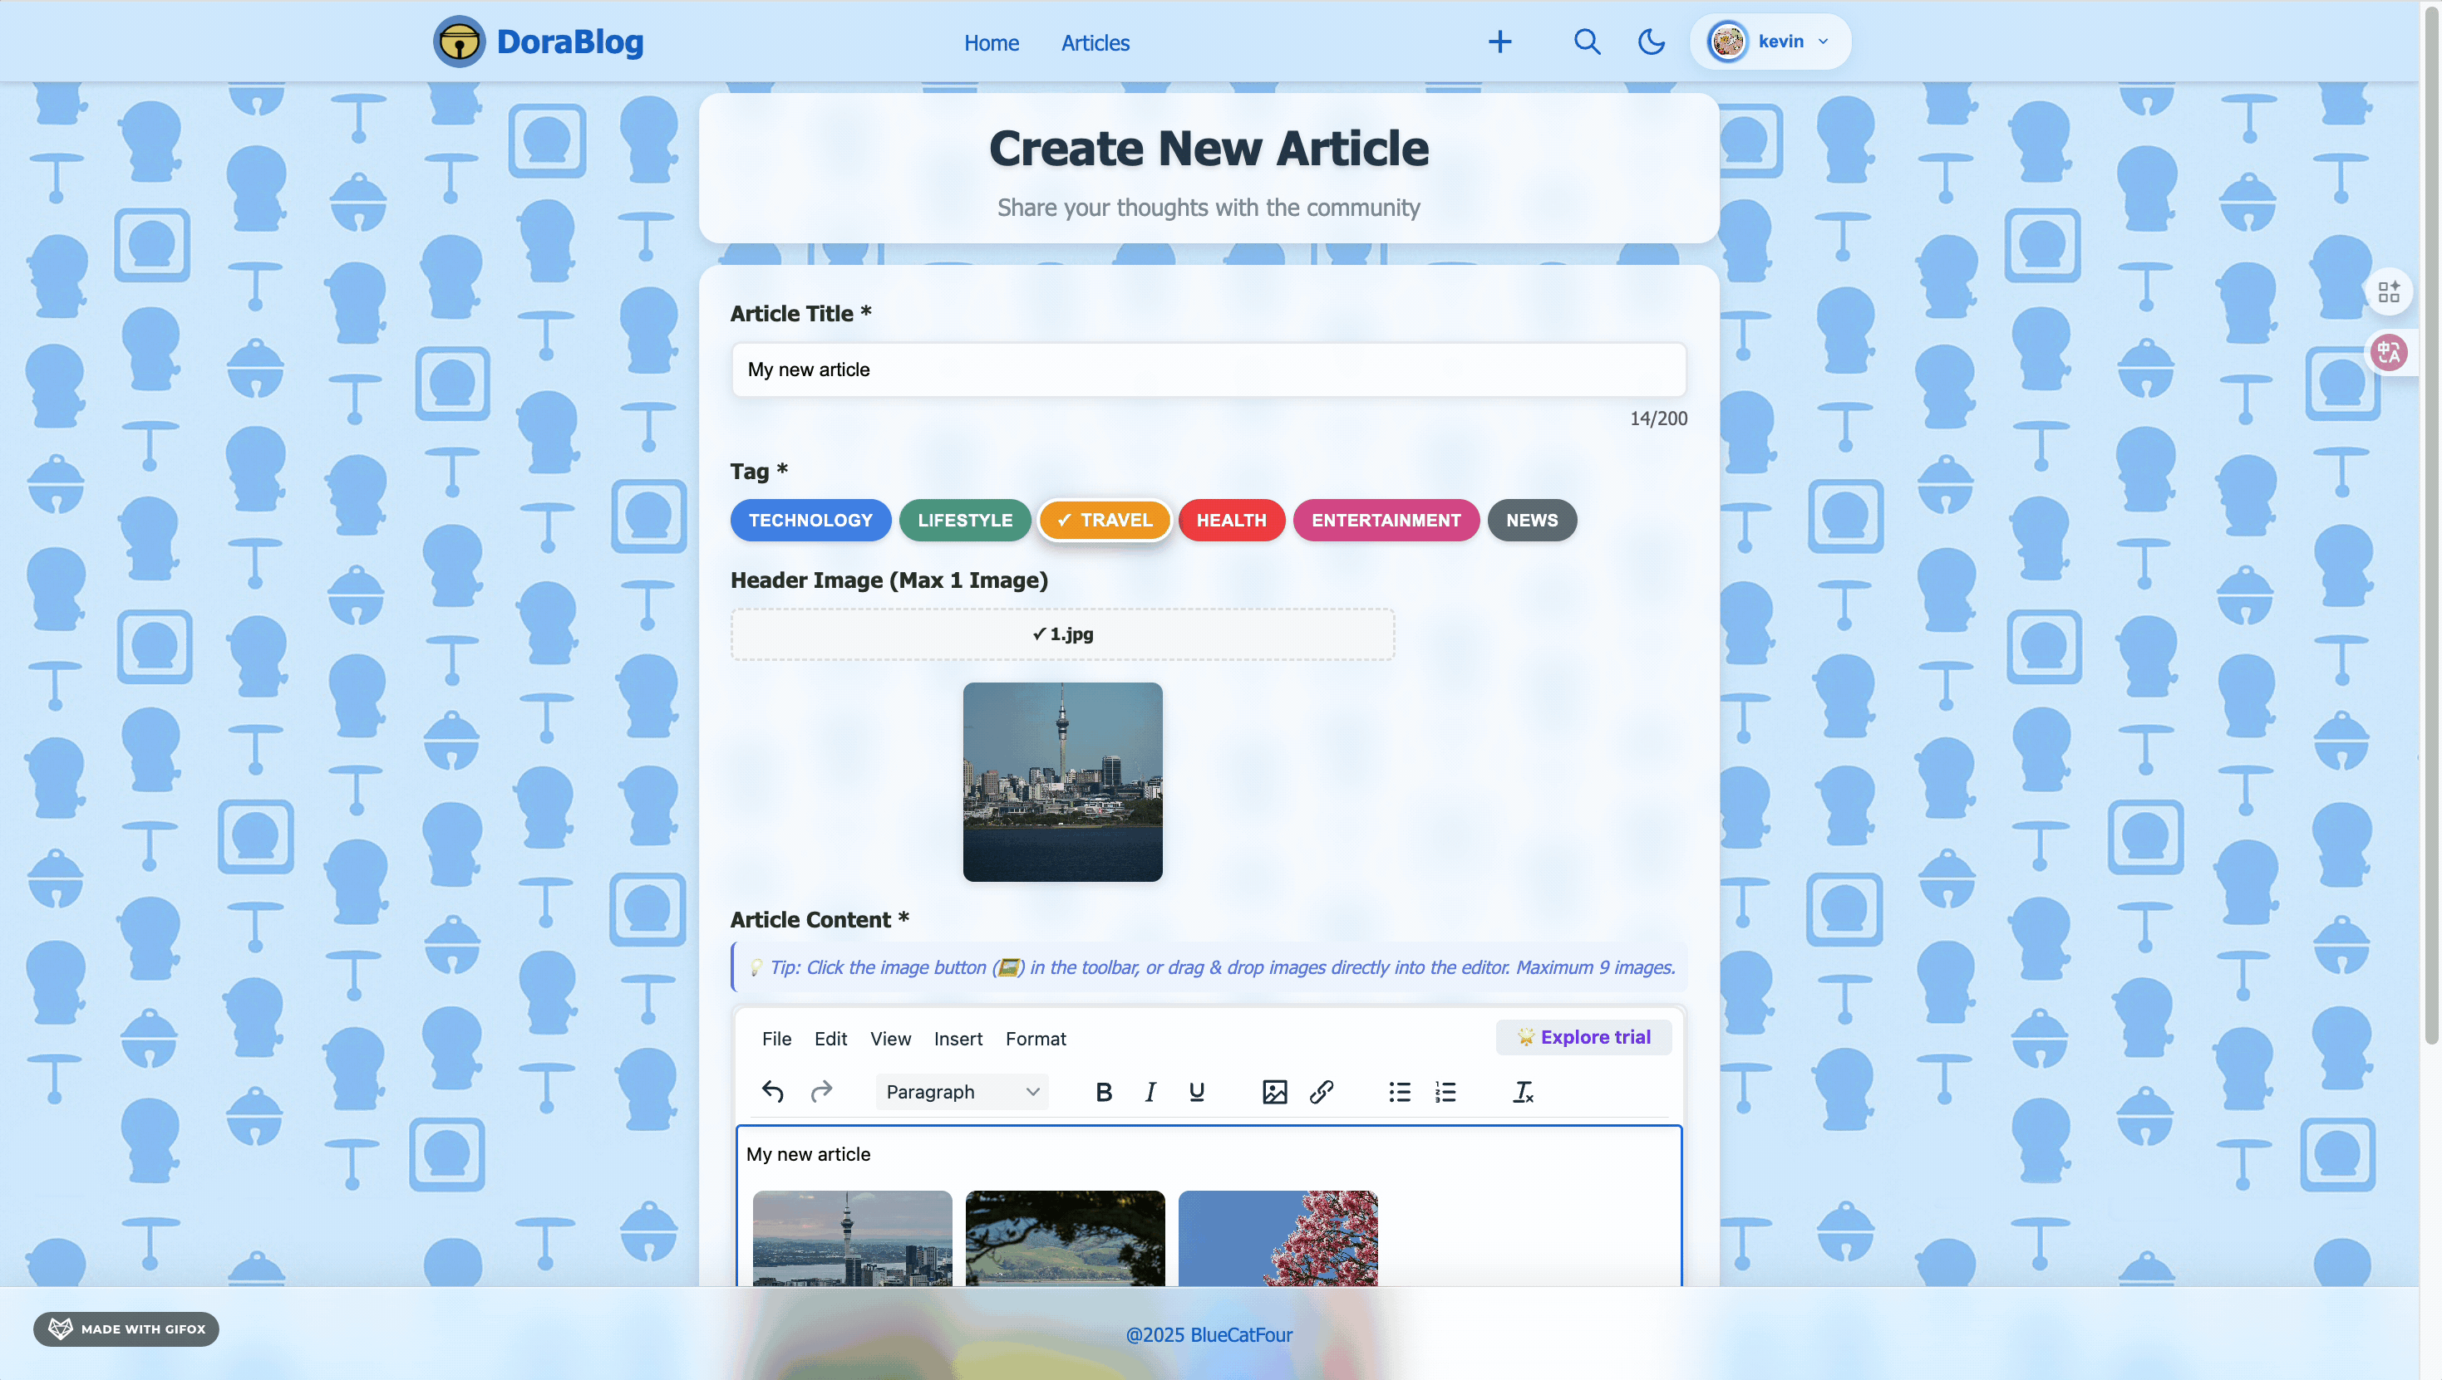
New article page(kevin)
Core Features:
📝Rich Text Editor (TinyMCE)
Formatting support including bold, italic, underline.
🖼️Multi-Image Upload System(1Header+up to 9 Content)
Flexible image management for rich media content.
🏷️Tag-Based Categorization
6 predefined categories for easy organization
✨One-Click Publishing
Instant publish with automatic redirect
Login required to access this page

Slide 10
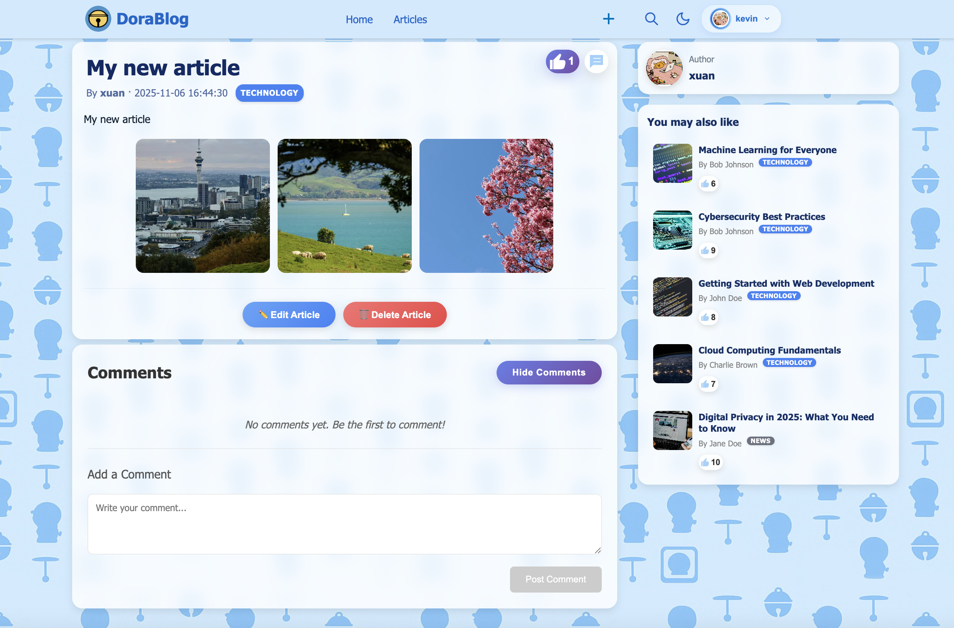
Core Features:
📖Complete Article Content Display
Rich text, images, author information, publication date and tags
💬Interactive Features
• Like system
Users can like articles with real-time counter updates.
• Comment section (collapsible)
View and post comments
🎯Smart Recommendations Sidebar(Two-Stage)
Stage 1: Tag matching + Newest first
Finds same-tag articles, sorted by date only
Stage 2: Popularity ranking (if insufficient)
Score = Likes × 1 + Comments × 2
Fills remaining slots with popular articles
🔐Role-Based Three Tiers Access Control
Read articles : All users
Like/Comment : Logged-in users
Edit/Delete articles : Author or Admin
Article detail page(kevin)

Slide 11

Doraemon's Gadget Workshop: Teamwork & Tech Magic!
Here at Doraemon's Tech Team, we embrace agile development with the enthusiasm of a robotic cat discovering a new gadget! We ensure successful project delivery through stellar code quality and super collaborative processes, just like Doraemon and friends working together to help Nobita.
The Time Machine of Version Control
Anywhere Door for API Standards
We harness the power of version control, much like Doraemon's Time Machine! Utilizing Git Pull Requests (PRs) and peer code reviews, we ensure every change is perfectly recorded and reviewed, preventing any temporal paradoxes in our code and keeping our team synchronized.
Our code quality and standards are as sturdy as Doraemon's robotic frame! We maintain consistent code formatting with Prettier, adhere to clear branch naming conventions, and use "Anywhere Door" level API documentation standards, making sure our connections are always seamless and accessible.
Cross-Dimensional Contributions
Gadget-Powered Challenge Resolution
Just as Doraemon can pull out any gadget from his pocket, our team members are multi-talented! Everyone contributes across front-end, back-end, and integration tasks, fostering full-stack skill development. It's like everyone has their own mini-pocket of helpful gadgets!
No challenge is too big for Doraemon's Tech Team! We've successfully navigated complex technical puzzles, including intricate comment thread logic, secure JWT token management, efficient image uploads, and even multi-theme persistence – finding the perfect gadget for every tricky situation!

Slide 12

DoraBlog's Grand Adventures: Gadget-Powered Triumphs!
Amazing Deliverables, Doraemon Style!
Core Gadget Skills Acquired
A fully functional blog platform with over 15 Anywhere Door API endpoints, connecting users to data in a flash!
100%
A sleek, responsive SvelteKit frontend for Noby and friends, and a dedicated Java admin client, like Doraemon's own personal control panel.
Full-Stack Mastery
Mastered Node.js and SvelteKit to implement a decoupled frontend and backend architecture, just like Doraemon's multi-functional toolkit!
Comprehensive technical documentation, including API blueprints and Entity Relationship Diagrams (ERD) – our secret guide to the Dora-verse of data.
We didn't just build an application, we journeyed through the full-stack development lifecycle, powered by Doraemon's Tech Team!
95%
Agile & Time Travel Collaboration
Utilized Git workflow and peer code reviews, ensuring our project evolves smoothly, much like a Time Machine for version control and teamwork!
90%
Security Shield Best Practices
Proficiently used JWT authentication and Bcrypt hashing, building a strong security shield around DoraBlog's precious data.
Future Outlook: DoraBlog has boundless potential for expansion, easily integrating new features like email notifications, advanced analytics, and social sharing—imagine what other amazing gadgets we can integrate!

Slide 13
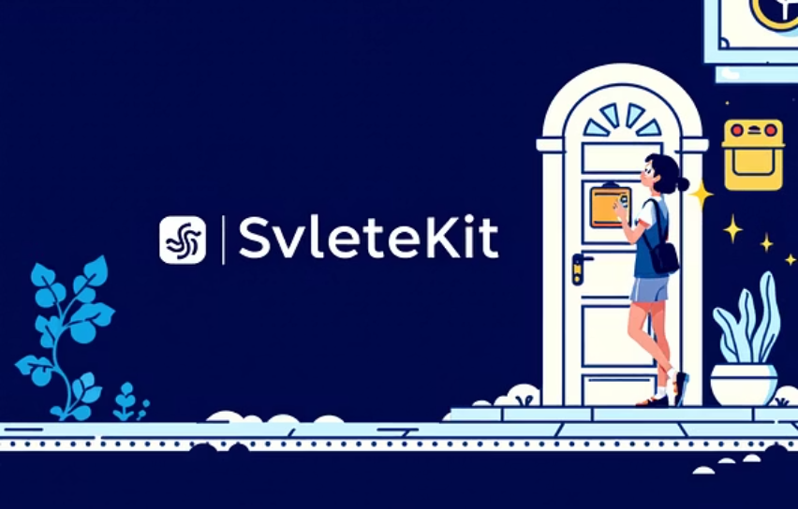

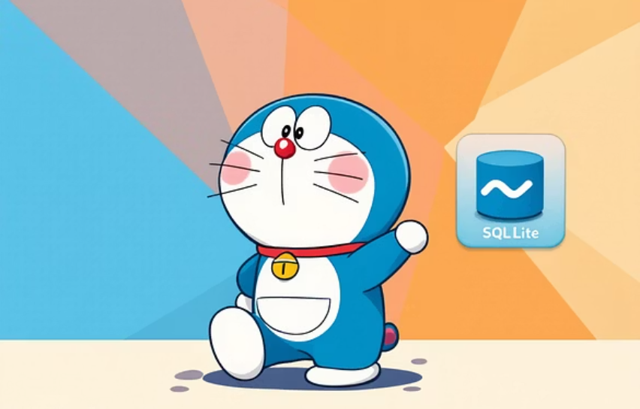
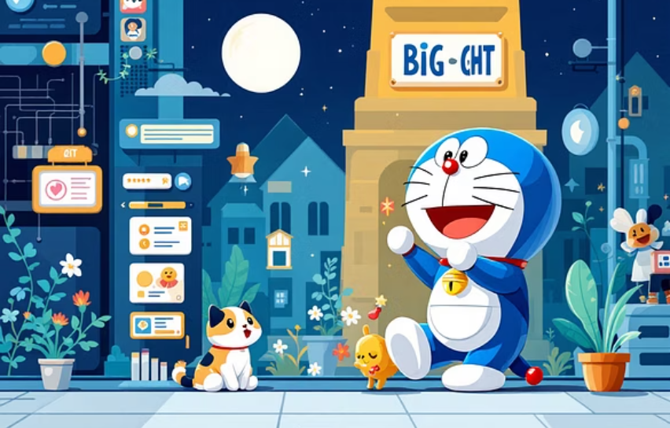
Thank you for joining Doraemon's Tech Team Adventure!
Noby and friends are now happy to answer any questions about our incredible DoraBlog project. Get ready for some gadget-powered insights!
Gadget Blueprint Archives (Project Repository)
Core Gadgets & Tools (Core Technologies)
Our project's very own Time Machine for version control: pgcit-final-project-Doraemon's Tech Team
SvelteKit (our Anywhere Door for the frontend) • Node.js/Express (our backend Hopter) • SQLite (our data Memory Bread) • JWT (our secure Invisible Cape) • Java Swing (our handy admin Big Light)

