Slide 1
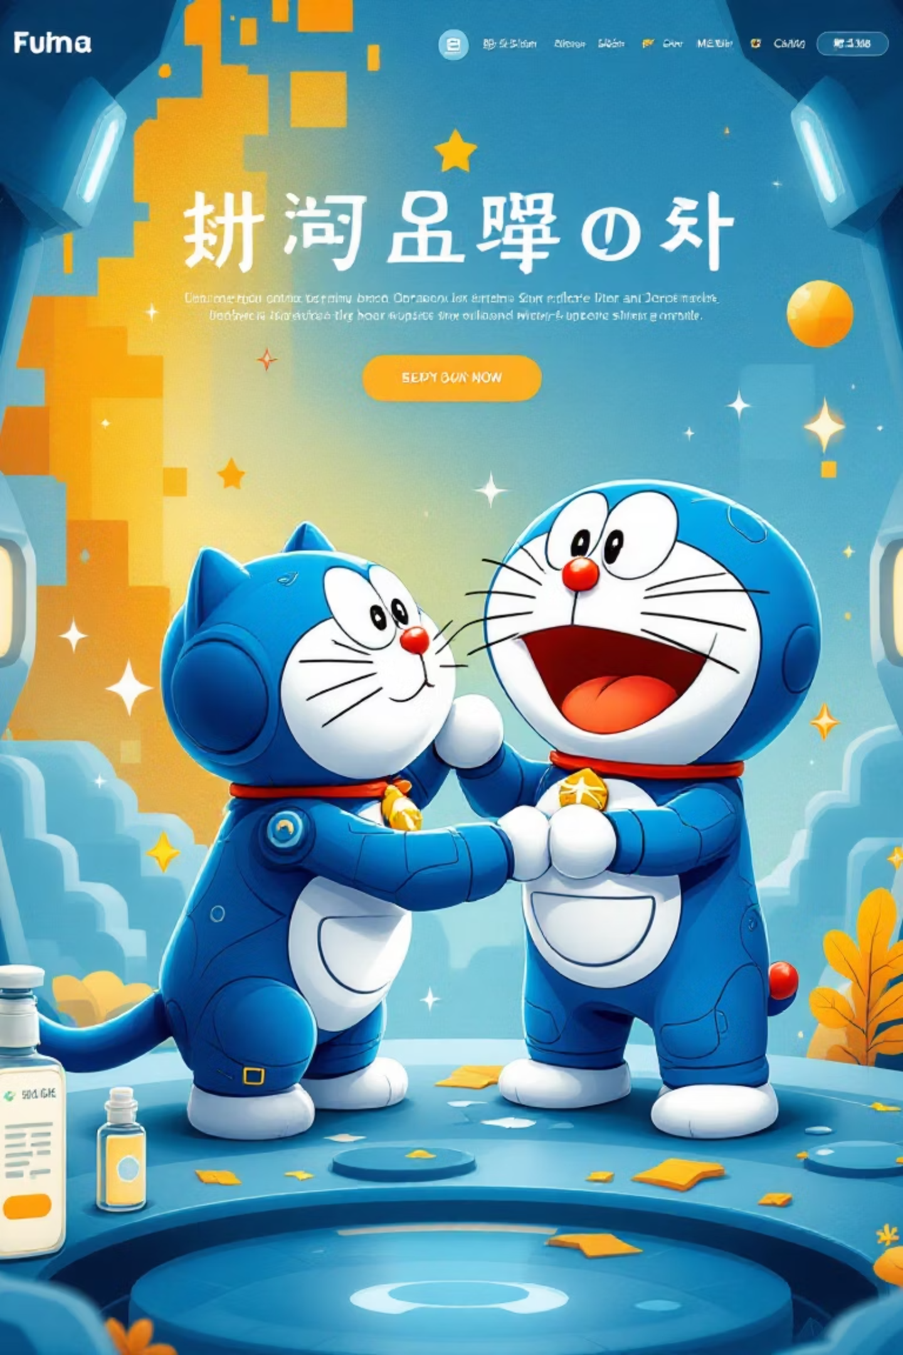
DoraBlog: Unleashing Gadget-Powered Storytelling - Final Project Presentation
Presented by Team Blue Cat Four

Slide 2
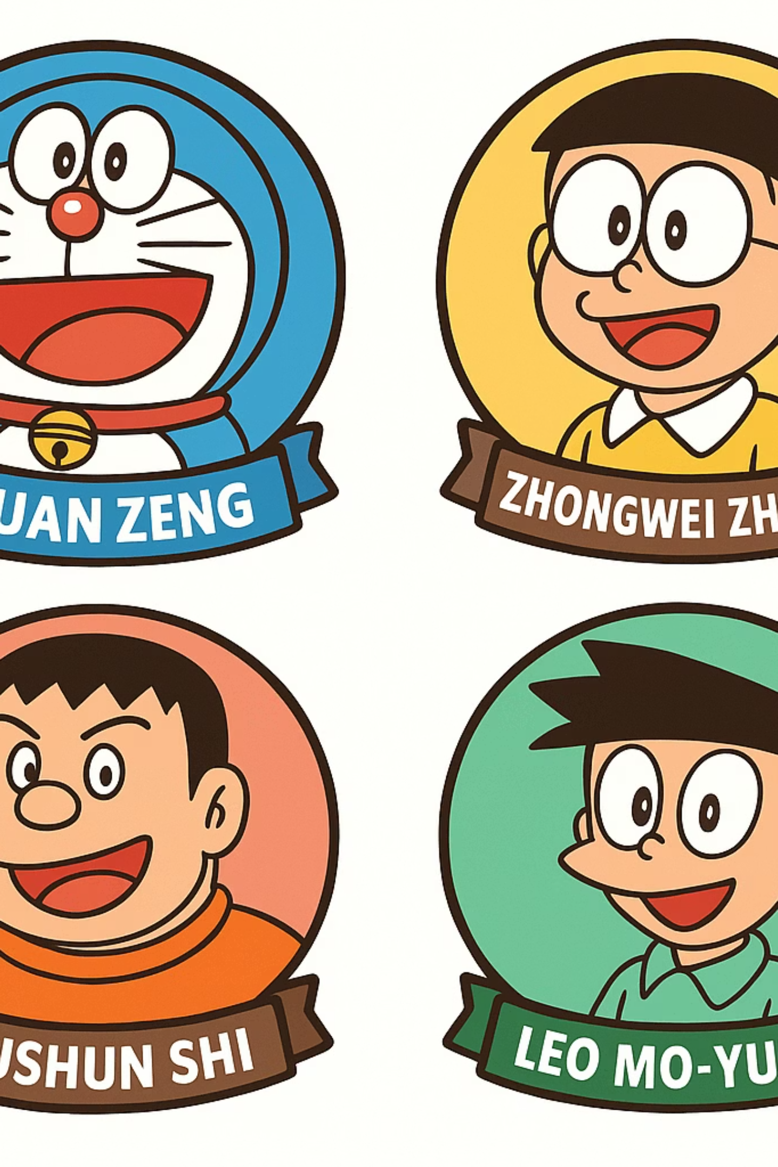
Team members
Team leader & architecture: Leo Mo-yung
UI & developer: Yushun Shi
Developer & test: Xuan Zeng
Developer & test: Zhongwei Zhang
Notes:
Team leader&architecture: Leo Mo-yung
UI & developer: Yushun Shi
Developer&test: Xuan Zeng
Developer&test: Zhongwei Zhang

Slide 3

DoraBlog: Unveiling Doraemon's Blogging Wonderland!
Discover a revolutionary platform where classic Doraemon gadgets transform blogging into an imaginative adventure. Share your stories with extraordinary tools, making every post a magical experience, powered by innovation and creativity.

Slide 4
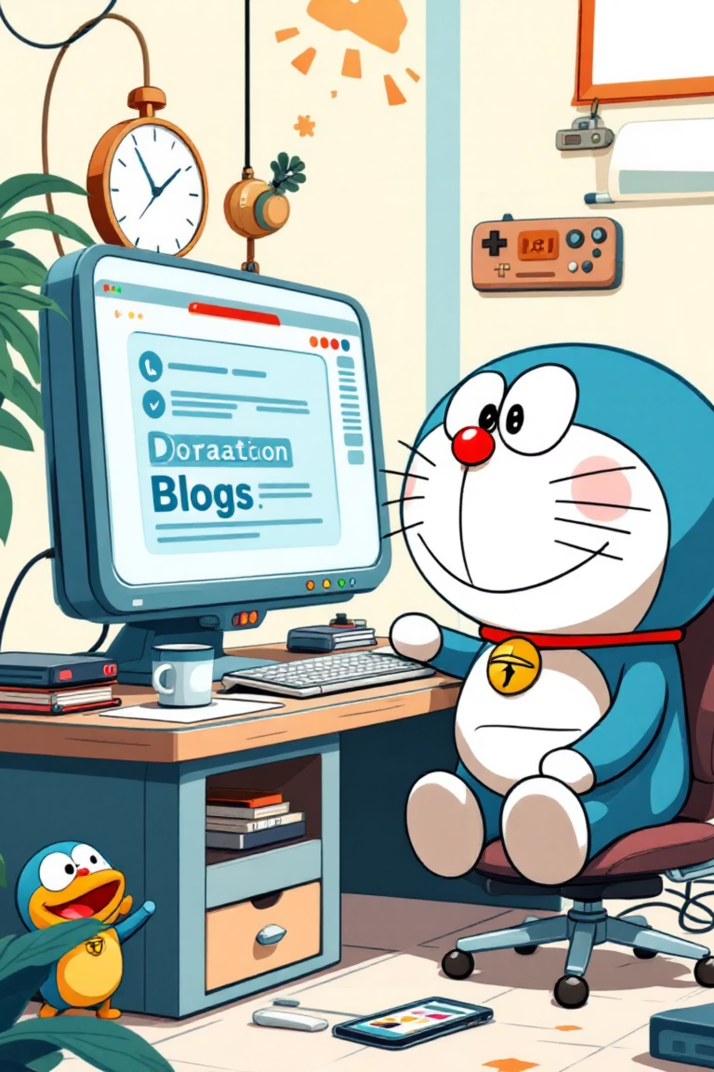
DoraBlog: Unveiling Doraemon's Blogging Wonderland!
Doraemon's Everywhere Pocket Platform
We've engineered a complete full-stack blogging platform, like Doraemon's Everywhere Pocket, featuring a user-friendly front-end interface, a robust back-end service, and an independent management system for seamless operations.
Gadget-Powered Core Features
Experience super-powered features: Identification Camera for user registration/authentication, Word-Processor Pencil for rich-text article creation, a hierarchical comment system (like a tiny Thought-Reading Microphone network), Detective Hat for article search & discovery, and fun Mood Changer like/unlike functionality.
Future-Proof User Experience
Enhance your blog with multi-theme options (light/dark/Doraemon blue, using a Color-Changing Cloak metaphor), a Truth Mirror-like password strength indicator, and daily motivational quotes from our Motivation Machine!
Advanced Gadgetry for Admins
Unleash powerful features: Categorization Chips for tag-based article organization, Friendship Caller for related article recommendations, and a dedicated Java administrator dashboard, acting as our very own Control Panel of the Future.

Slide 5





DoraBlog: Key Features
Imaginative Content Creation
Unleash your creativity with our rich-text editor, inspired by Doraemon's Word-Processor Pencil. Craft engaging articles, seamlessly upload images.
Secure & Seamless Access
Our robust JSON Web Token (JWT) system ensures secure and persistent authentication, guarding your DoraBlog account like Doraemon's secret vault. Enjoy a reliable and gadget-proof login experience every time.
Dynamic Interactive Comments
Engage with your audience through a hierarchical, nesting comment system, much like a tiny Thought-Reading Microphone network. Foster vibrant discussions and build a strong community around your captivating content.
Smart Content Discovery
Navigate the DoraBlog universe with ease. Benefit from intelligent article recommendations, comprehensive tagging for seamless organisation, and powerful search capabilities that help you find exactly what you're looking for.
Personalised User Experience
Tailor your DoraBlog journey with multi-theme options, a visual password strength indicator for enhanced security, and daily motivational quotes to inspire your storytelling adventures.

Slide 6
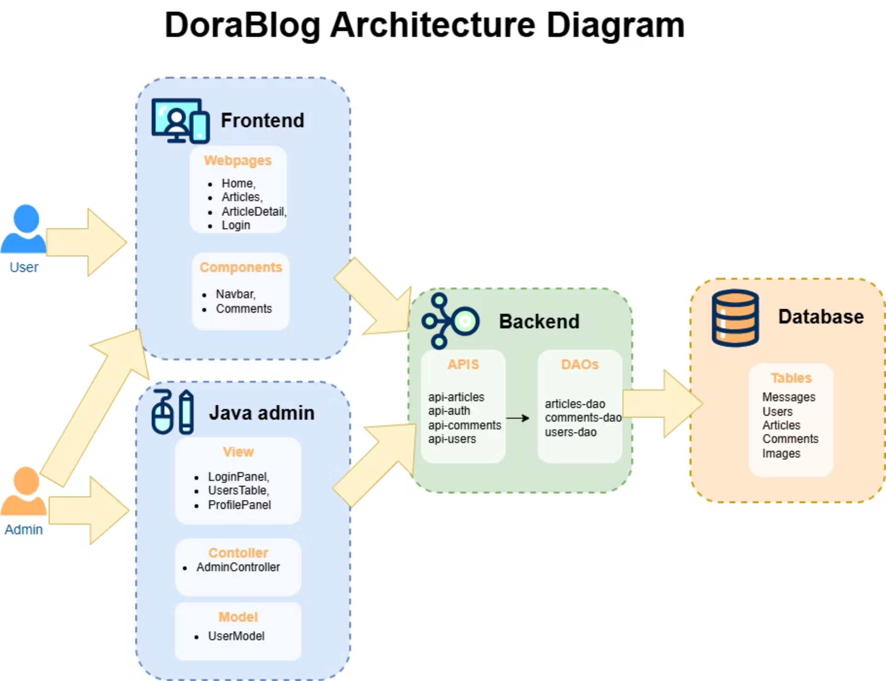
DoraBlog Architecture Overview
Just like Doraemon's complex internal wiring, our DoraBlog has a cleverly designed architecture! This diagram is your "Time Machine" to understanding how all the magic happens. It clearly illustrates the interconnected components of our blogging platform: the front end is designed into home, articles, articleDetail and login, 4 main part. The Java admin follows MVC design pattern. The APIs consist of 4 part and get data by DAOs and pack the data up to front end. The Database is designed to 5 main tables and 3 relation tables, ArticleImg, ArticleLike and ArticleTag

Slide 7
Doraemon's Time Machine: Project Timeline & Agile Adventure!
Our team developed the whole project using agile development methods. There is a short meeting to discuss current progress and problems every morning. Besides, Kanban board is used to assign and record our tasks, which is divided into small pieces.
Days 1-2: Blueprint & Design Phase 🎨
Designed UI and decided the whole visual style (like choosing the perfect gadget design!)
Created ER diagram and API architecture
Days 3-4: Foundation Building 🔧
Developed comprehensive development plan and time management strategy
Developed SQL database structure (our 4D Pocket storage system!)
Built most APIs (our Anywhere Door endpoints!)
Days 5-7: Magic Integration ✨
Created static web pages: home, login, and article details
Rendered pages with APIs (bringing our gadgets to life!)
Added router jumping and navigation
Implemented article editing features
Days 8-10: Advanced Gadgetry 🚀
Added password hashing security
Developed nesting comments system
Added additional features and enhancements
Developed Java admin panel (our Control Panel of the Future!)
Final Days: Quality Assurance 🔍
Debugging and comprehensive testing
Final polish and optimization
This agile approach ensured smooth collaboration and timely delivery, just like Doraemon's perfectly timed gadget solutions!

Slide 8
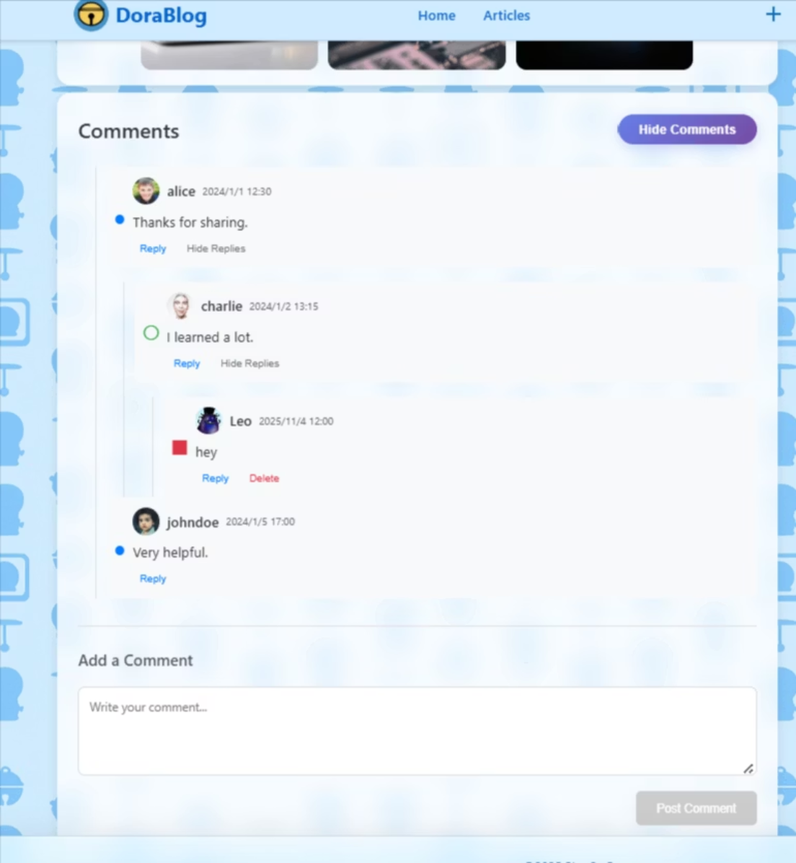
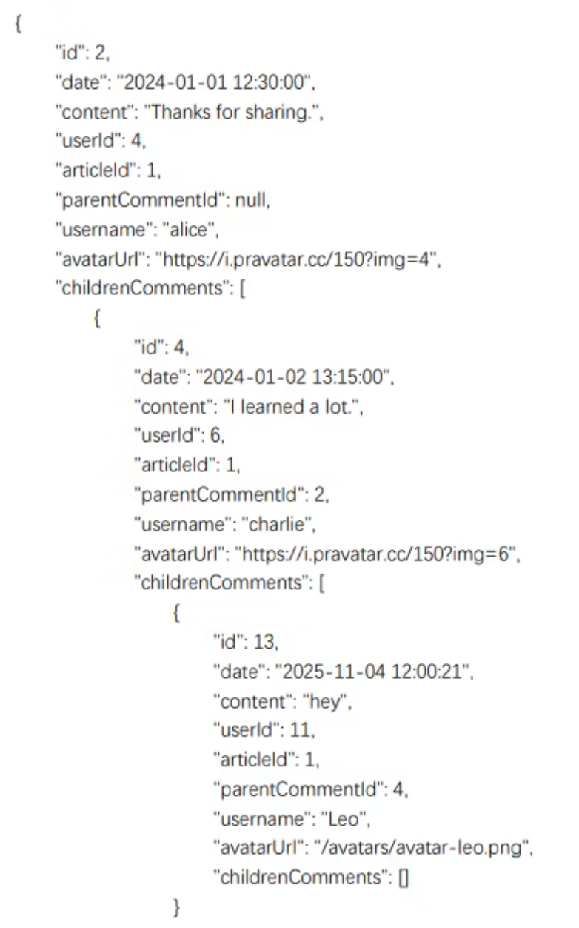
Comments components(Leo)
Graphic UI
API response
CommentsList → CommentItem : svelte:self
parentCommentId & childrenComments contribute to different depth

Slide 9
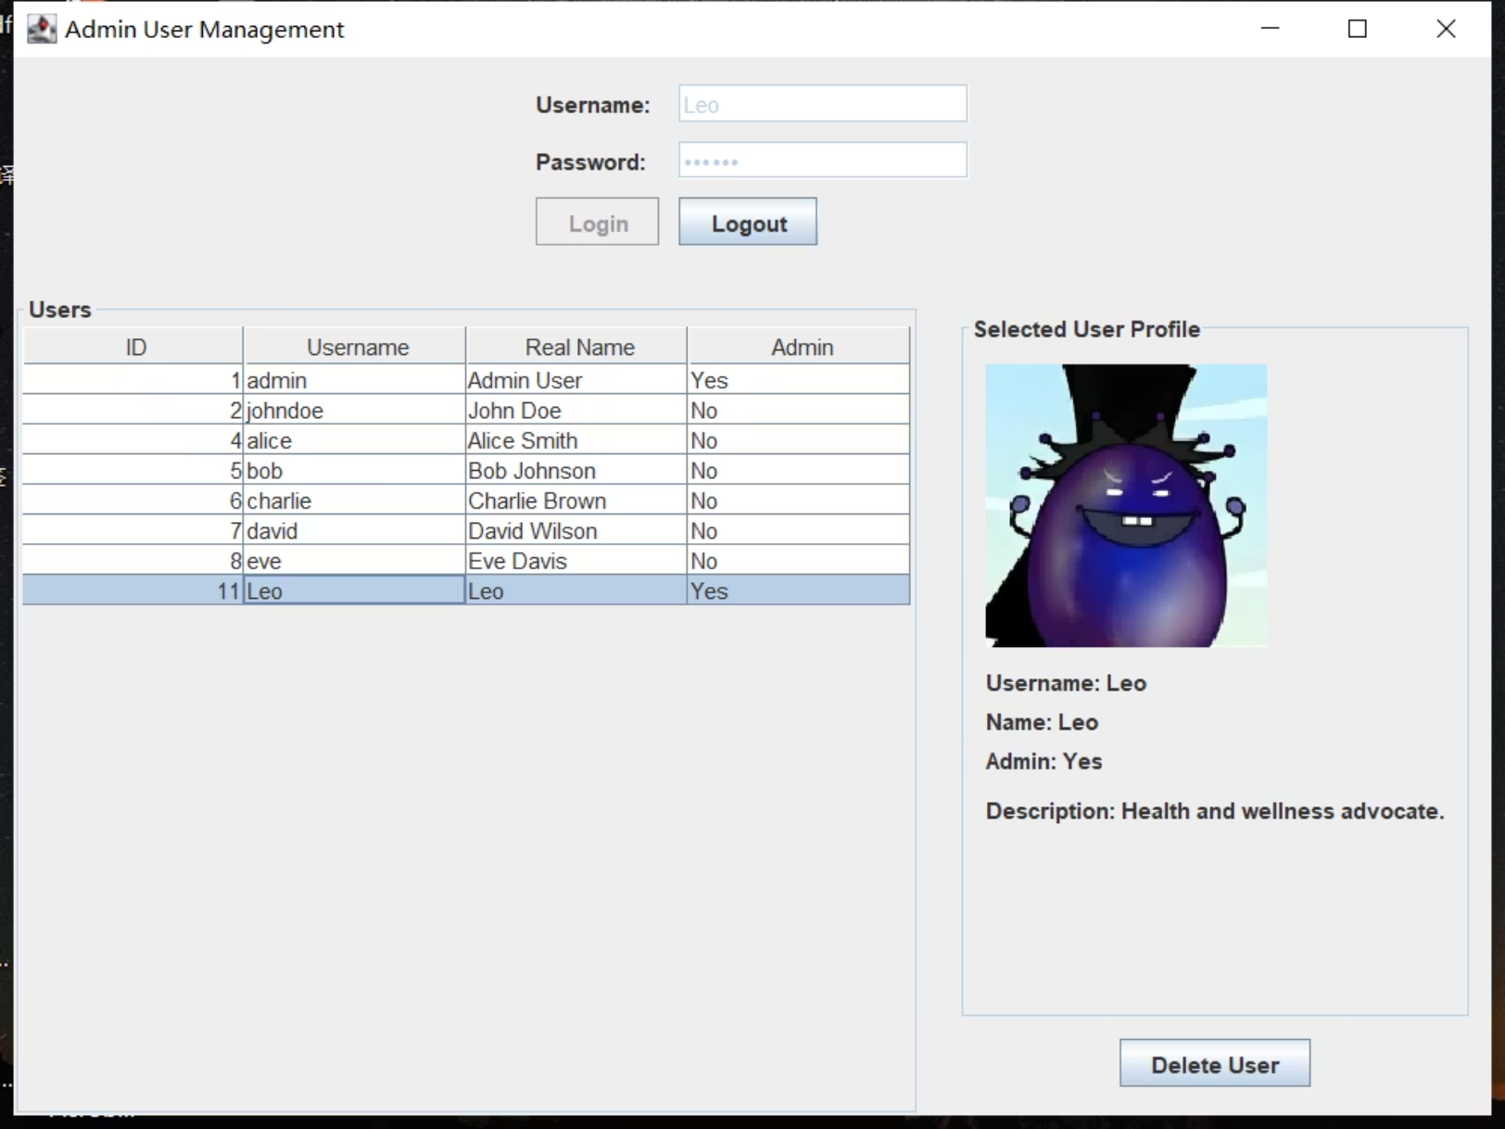
JAVA swing admin interface(Leo)
Main file: User(pojos), AdminFrame(view), AdminController, UserModel(TableModel & observer), API
AdminFrame with BorderLayout
AdminController deals with click action
UserModel extends AbstractTableModel, notify observer (adapter and observer)

Slide 10

Doraemon's Gadget Workshop: Teamwork & Tech Magic!
Here at Doraemon's Tech Team, we embrace agile development with the enthusiasm of a robotic cat discovering a new gadget! We ensure successful project delivery through stellar code quality and super collaborative processes, just like Doraemon and friends working together to help Nobita.
The Time Machine of Version Control
Anywhere Door for API Standards
We harness the power of version control, much like Doraemon's Time Machine! Utilizing Git Pull Requests (PRs) and peer code reviews, we ensure every change is perfectly recorded and reviewed, preventing any temporal paradoxes in our code and keeping our team synchronized.
Our code quality and standards are as sturdy as Doraemon's robotic frame! We maintain consistent code formatting with Prettier, adhere to clear branch naming conventions, and use "Anywhere Door" level API documentation standards, making sure our connections are always seamless and accessible.
Cross-Dimensional Contributions
Gadget-Powered Challenge Resolution
Just as Doraemon can pull out any gadget from his pocket, our team members are multi-talented! Everyone contributes across front-end, back-end, and integration tasks, fostering full-stack skill development. It's like everyone has their own mini-pocket of helpful gadgets!
No challenge is too big for Doraemon's Tech Team! We've successfully navigated complex technical puzzles, including intricate comment thread logic, secure JWT token management, efficient image uploads, and even multi-theme persistence – finding the perfect gadget for every tricky situation!

Slide 11

DoraBlog's Grand Adventures: Gadget-Powered Triumphs!
Amazing Deliverables, Doraemon Style!
Core Gadget Skills Acquired
A fully functional blog platform with over 15 Anywhere Door API endpoints, connecting users to data in a flash!
100%
A sleek, responsive SvelteKit frontend for Noby and friends, and a dedicated Java admin client, like Doraemon's own personal control panel.
Full-Stack Mastery
Mastered Node.js and SvelteKit to implement a decoupled frontend and backend architecture, just like Doraemon's multi-functional toolkit!
Comprehensive technical documentation, including API blueprints and Entity Relationship Diagrams (ERD) – our secret guide to the Dora-verse of data.
We didn't just build an application, we journeyed through the full-stack development lifecycle, powered by Doraemon's Tech Team!
95%
Agile & Time Travel Collaboration
Utilized Git workflow and peer code reviews, ensuring our project evolves smoothly, much like a Time Machine for version control and teamwork!
90%
Security Shield Best Practices
Proficiently used JWT authentication and Bcrypt hashing, building a strong security shield around DoraBlog's precious data.
Future Outlook: DoraBlog has boundless potential for expansion, easily integrating new features like email notifications, advanced analytics, and social sharing—imagine what other amazing gadgets we can integrate!

Slide 12
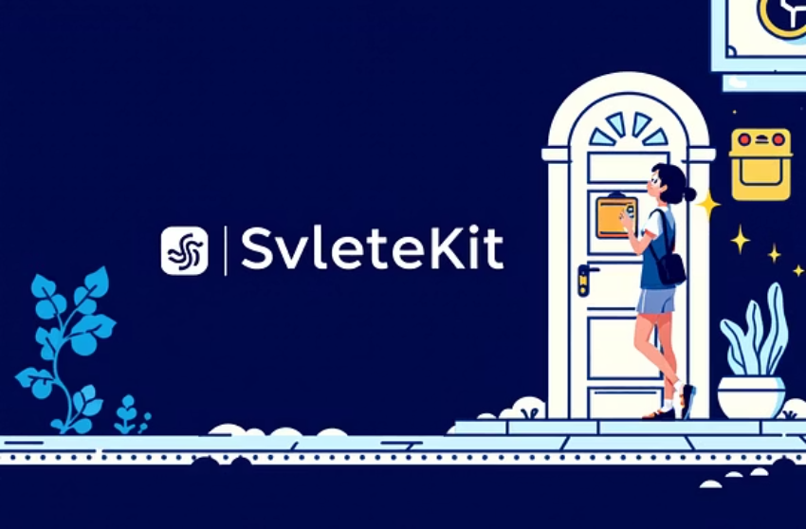

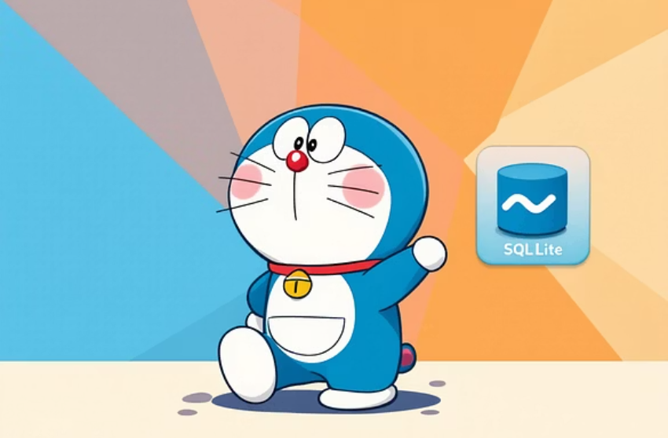

Thank you for joining Doraemon's Tech Team Adventure!
Noby and friends are now happy to answer any questions about our incredible DoraBlog project. Get ready for some gadget-powered insights!
Gadget Blueprint Archives (Project Repository)
Core Gadgets & Tools (Core Technologies)
Our project's very own Time Machine for version control: pgcit-final-project-Doraemon's Tech Team
SvelteKit (our Anywhere Door for the frontend) • Node.js/Express (our backend Hopter) • SQLite (our data Memory Bread) • JWT (our secure Invisible Cape) • Java Swing (our handy admin Big Light)

