Slide 1
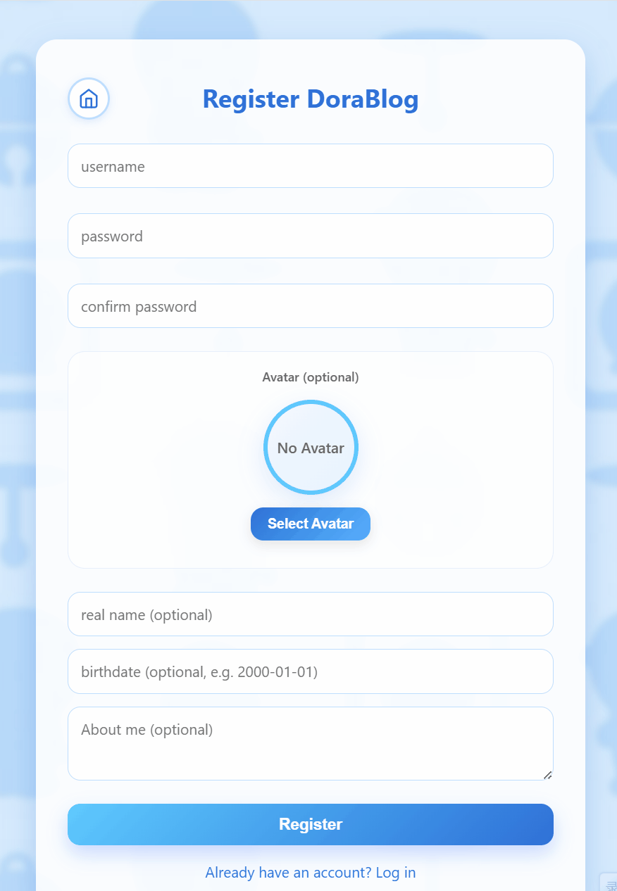
Login & Registration (Zac)
A comprehensive sign-up system with real-time validation, strength indicators,
and customizable user avatar.
Smart Validation
Real-time username availability checks (green = available, red = taken)
Password strength meter progresses from red to yellow to green
Password match verification before form submission
Personalization
Avatar selection with preview: choose from library or upload custom image
Optional profile fields: real name, birthdate, and bio
Confirmation message with automatic redirect to login upon success

Slide 2
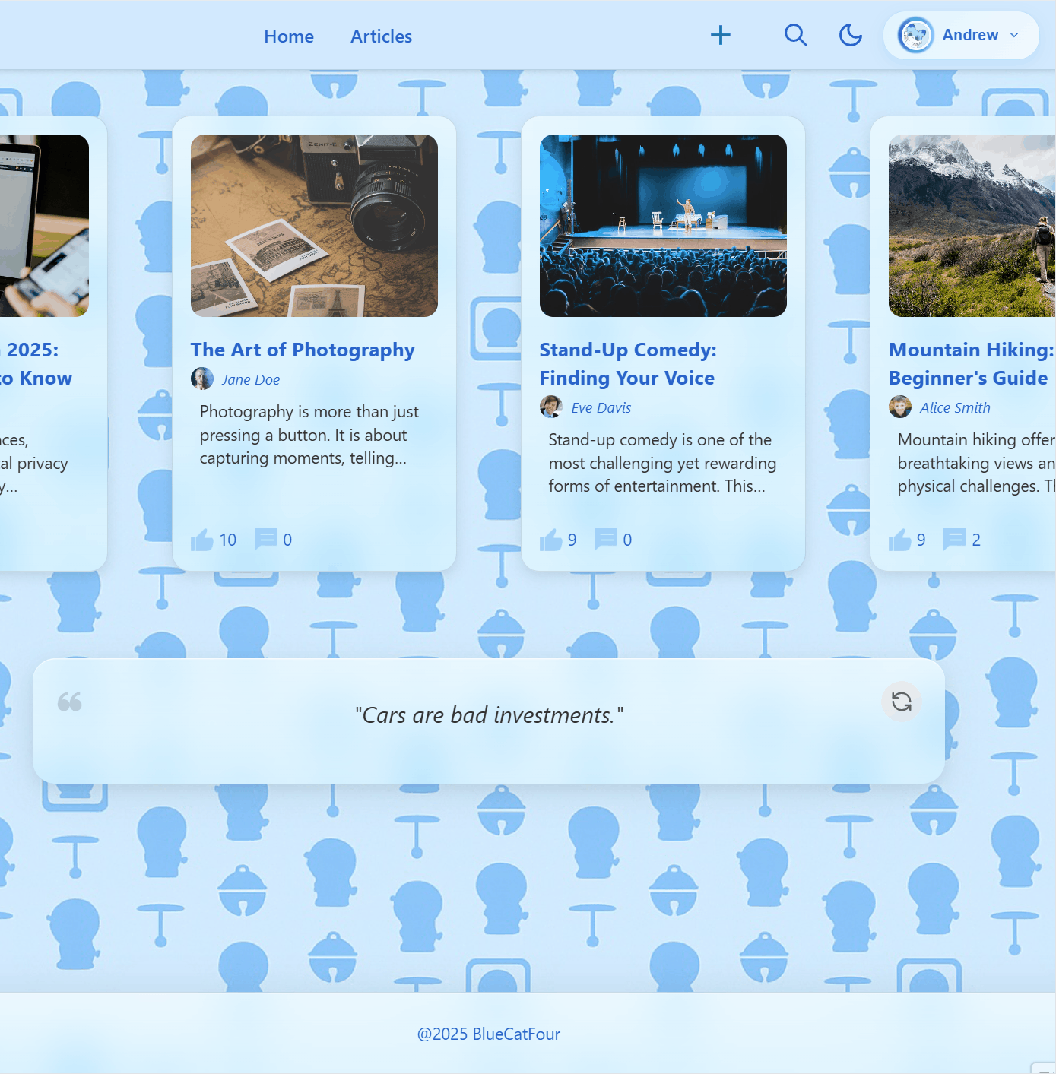
Profile Management (Zac)
Secure, authenticated profile hub where users control their
information, settings, and account status.
Core Features
View and manage complete user profile (avatar, username, real name,
birthdate, bio)
Accessible only to logged-in users for enhanced security
Edit Profile mode enables password changes and avatar updates
Account Control
Danger Zone: Delete Account option requires username verification to
prevent accidental deletion.
Users are warned that all articles and comments will be permanently removed
from DoraBlog.

