Slide 1

Silver Oaks Cooperative School
Information System
Changnan Jing, Jiading Chen, Kaho Ip, Wanyun Yang, Wenzhe Wu
12/3/2019

Slide 2
Background
User:
Silver Oaks Cooperative School administrators
Data/sources:
Information of students, staffs, members, tasks and classes
All information is from Silver Oaks Cooperative School Official Site
(https://www.silveroakscooperative.org/)

Slide 3
Introduction
1. Silver Oaks Cooperative School Information System is a system that helps the school to manage all the students’ and members’ information and allocate those students to different classes and staff (teachers).
2. Apart from those, school can also manage the information of the enrolled students and award the top students by sorting the grades.
3. Besides, by building relationships among the tables, school can deal with staff resignation, student transfer and etc..
4. Finally, we can use different queries to get interesting statistics such as the most popular course, number of students of different statuses and etc..
5. School administrators can use the system to inquire about the students’ tuition fees information and their cooperation ways.

Slide 4
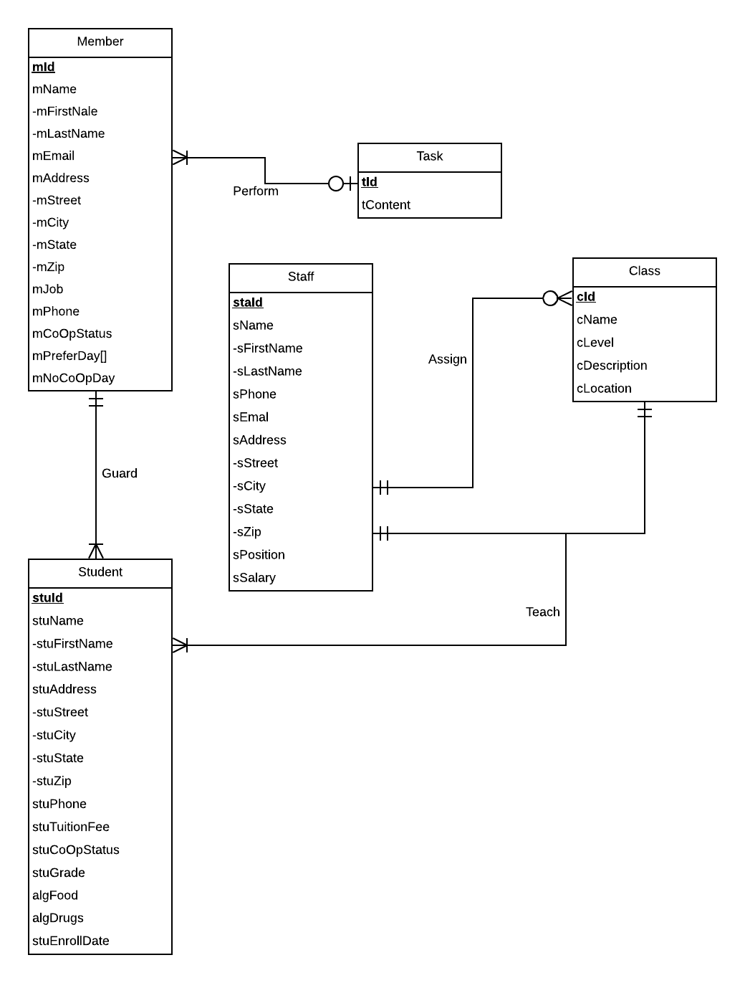
Conceptual
Database
Design

Slide 5
Logical Database Design
Student(stuId, stuFirstName, stuLastName, stuStreet, stuCity, stuState, stuZip, stuPhone, stuTuitionFee, stuCoOpStatus, stuGrade, algFood, algDrugs, stuEnrollDate, mId)
Staff(staId, sFirstName, sLastName, sPhone, sEmail, sStreet, sCity, sState, sZip, sPosition, sSalary)
Member(mId, mFirstName, mLastName, mEmail, mStreet, mCity, mState, mZip, mJob, mPhone,mCoOpStatus, mPreferDay, mNoCoOpDay )
Class(cId, cName, cLevel, cDescription, cLocation, staId)
Task(tId, mId , tContent)
Teach(cId, staId, stuId)

Slide 6
Physical Database Design -- Student
CREATE TABLE [Student] (
stuId CHAR(9) NOT NULL,
mId CHAR(9),
stuFirstName VARCHAR(20),
stuLastName VARCHAR(20),
stuStreet VARCHAR(40),
stuCity VARCHAR(20),
stuState CHAR(2),
stuZip CHAR(5),
stuPhone CHAR(12),
stuTuitionFee DECIMAL(10,2),
stuCoOpStatus VARCHAR(20),
stuGrade VARCHAR(20),
algFood VARCHAR(100),
algDrugs VARCHAR(100),
stuEnrollDate DATE,
CONSTRAINT pk_Student_stuId PRIMARY KEY (stuId),
CONSTRAINT fk_Student_mId FOREIGN KEY (mId)
REFERENCES [Member] (mId)
ON UPDATE CASCADE
ON DELETE SET NULL
);

Slide 7
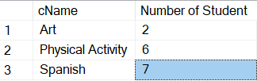
Use Case & Application 1
Which is the most popular class according to the number of students registered?
SELECT s.cName, MAX(s.nStudent) AS 'Number of Student'
FROM (SELECT c.cName , COUNT(t.stuId) AS 'nStudent'
FROM Class c, Teach t
WHERE c.cId = t.cId
GROUP BY c.cName) s
GROUP BY s.cName;

Slide 8

Use Case & Application 2
What percent of students are Halfcooper or Fullcooper?
SELECT stuCoOpStatus, COUNT(stuId)*100/(SELECT COUNT(stuId) FROM Student) AS 'Percentage of Student'
FROM Student
GROUP BY stuCoOpStatus;

Slide 9
Front-end
http://128.8.127.120/Front-end/Member.php#

Slide 10
Thank you
Notes:
The next one is to find out the percentage of students of Halfcooper or Fullcooper.

