Slide 1
Application of Data Mining on the Classification of Vehicle Loan Lending Risk
STA 5703 Data Mining--Project Presentation
Bingran Chen
04/09/2018

Slide 2
Outline
Introduction
Objective
Method
Results
Conclusion

Slide 3
Introduction

Slide 4
Lending Analytics
Loan Portfolio: one of a financial institution primary revenue generators
Underwriting process : when a member of bank applies for a loan, bank utilizes many data points to determine the risk that bank would undertake if the bank approved the loan.
Charge off: unable to meet their financial obligation which causes the loan to charge off.
Chaffer and Weinberg, 2011; Greco and Hainsworth, 2006; Gupta and Massagué, 2006; Hodi, et al., 2010; Joyce and Pollard, 2009; Daugaard, et al., 2009

Slide 5
Effects
Loan charge off rate is one of the most important statistics to track in the consumer lending industry.
Mitigate Risk??
Loan Charge Off
Massive Loss
Higher rates
Stringent lending practices
Lenders
Customers

Slide 6
Techniques
Artificial Neural Network
Decision Tree
Support Vector Machine
Random Forest (RF)
Bagging
Logistic Regression
Y Jin & Y Zhu, 2015; Akkoç, 2012 ; (Vinod Kumar L, Natarajan S, Keerthana S, Chinmayi K M, & Lakshmi N, 2016

Slide 7
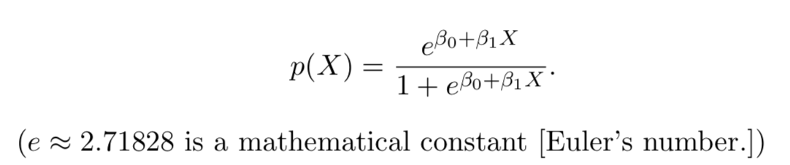
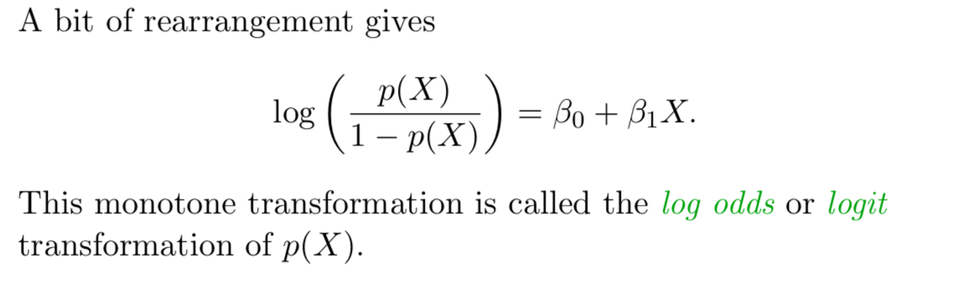
Logistic Regression

Slide 8
Objective

Slide 9
Objective
Select important features related to loan charge off
Classify whether loan charge off occurs using Logistic Regression
Assess the model accuracy

Slide 10
Methods

Slide 11
Dataset
CFE dataset from UCF WebCourse
 | Observations | Attributes
Total Dataset | 19658 | 87
Vehicle Loan | 13217 | 87
Basic Loan Information (21)
Borrowers (12)
Co-Borrowers (10)
Borrowers Combined (5)
Account Information (17)
Vehicle Information (19)
Charge off (3)

Slide 12
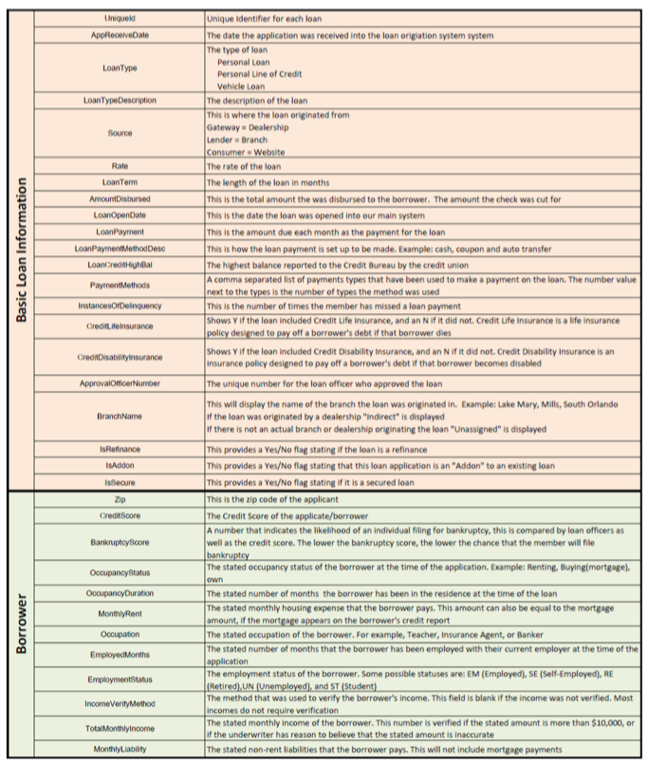
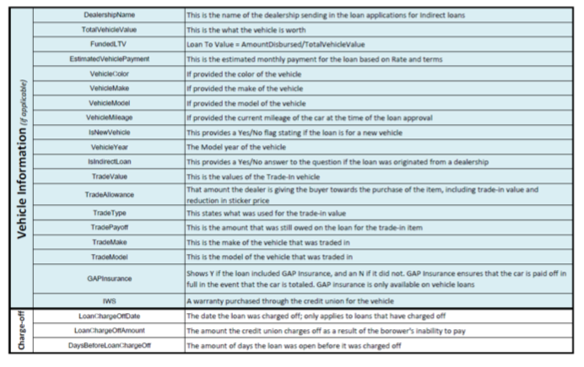
Dataset --- Continue

Slide 13
Data Preprocessing
Missing values
Removing attributes which have more than 70% missing value.
The result of the missing values are omitted.
Check inconsistent data
Removing rows of Total Monthly income with 0
Check outliers
Creating dummy variables
The categorical attributes selected were created dummy variables (i.e. 0 and 1).

Slide 14
Feather Selection
Removing redundant attributes
The attributes that carried same or similar information.
Example: "IsNewVehicle", "TradeValue", "LoanTypeDescription","Loantype","Occupation"
Number of removed: 11
Removing excessive attributes
Some attributes are counted only when the house had been sold.
Example: "LoanOpenDate", "LoanPaymentMethodDesc", "PaymentMethods", "InstancesOfDelinquency"
Number of removed: 11
Using domain knowledge
An intuitive approach was taken, with an objective to eliminate the least important ones.
Example: "AvgTotalDeposits","CoEmployedMonths", "EmployedMonths","LoanTerm",
"AvgDirectDeposit", "DirectDepositsReceived”, "VehicleModel","TradeMake","TradeModel",
"TradePayoff", "TradeAllowance"
Number of removed : 38

Slide 15
Feather Construction
Average credit score
average = (credit score + Cocredit score)/2
LoanChargeOff --- Target variable
According to LoanChargeOffAmount coding 0/1
Recalculating "TotalDebtToIncomeFund"
New TotalDebtToIncomeFund = (TotalMonthlyDebt+Rent+CoRent)/(TotalMonthlyIncome + CoTotalMonIn)

Slide 16
Prediction and Model Accuracy
Build classifier by Logistic Regression
Prediction
Model Evaluation

Slide 17
Results

Slide 18
Exploratory Data Analysis
Total Removed Features: 73
Total Removed inconsistent and missing observations: 84
Dummy variables created: 5
Remain datasets dimensions: 13133 rows and 14 features

Slide 19
Training set and Testing set
Training dataset: 75%
Testing dataset: 25%
 | Training dataset | Testing dataset
Rows | 9849 | 3824
Columns | 14 | 14

Slide 20
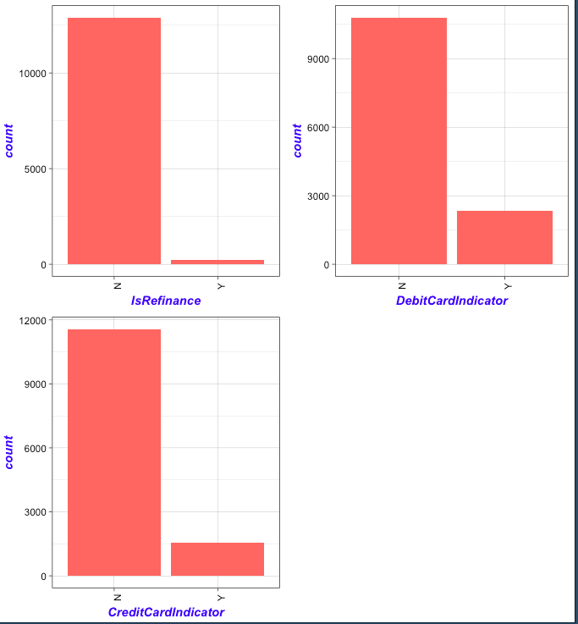
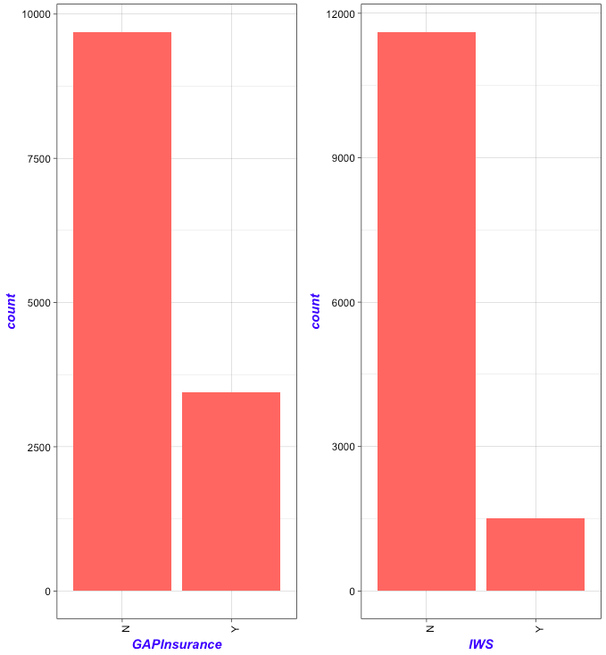
Bar plots

Slide 21
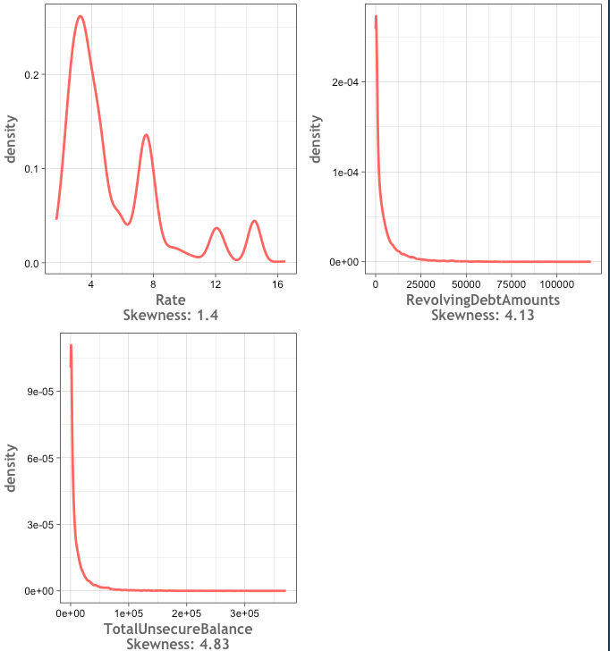
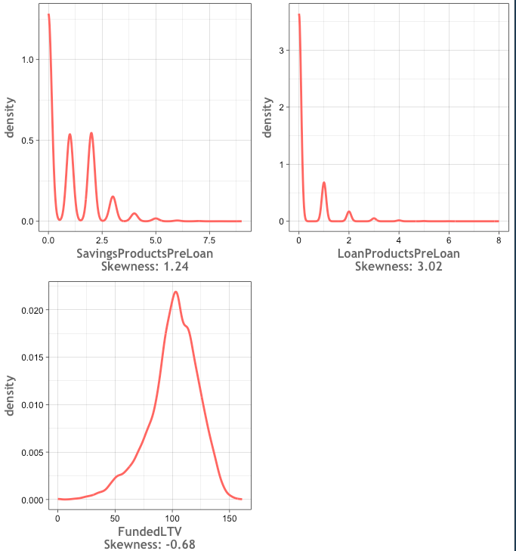
Density Plots

Slide 22
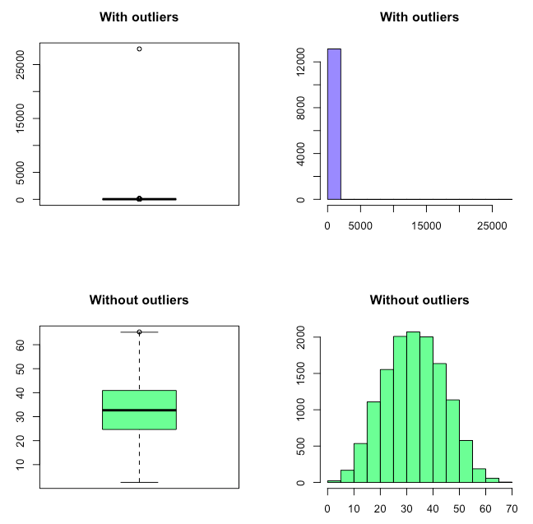
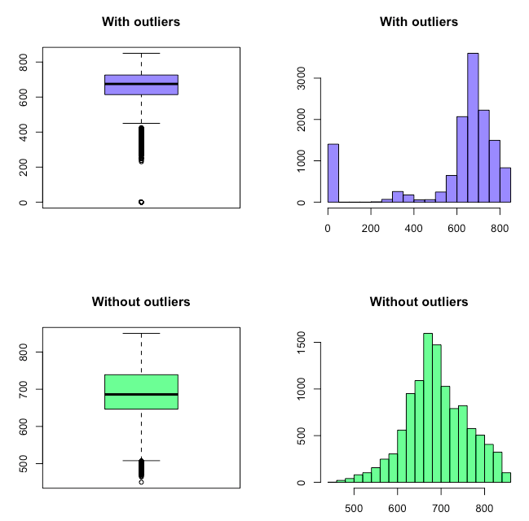
Outliers
Total Debt To Income Fund
Average Credit Score

Slide 23
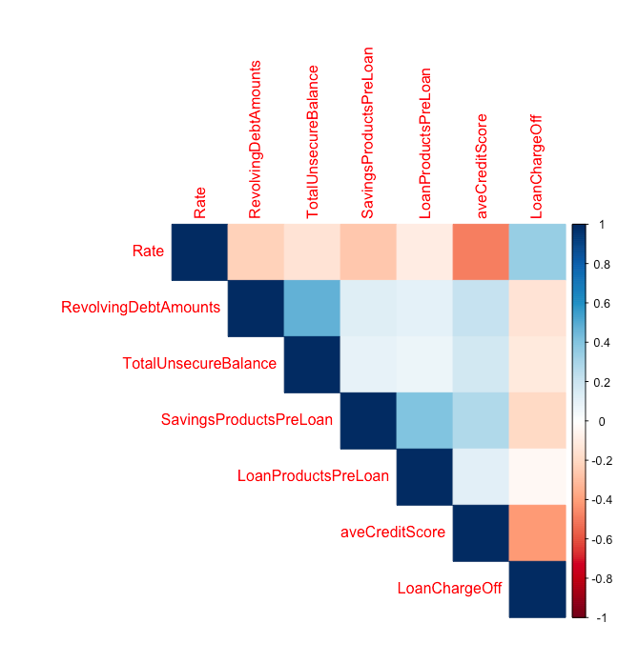
Correlation

Slide 24
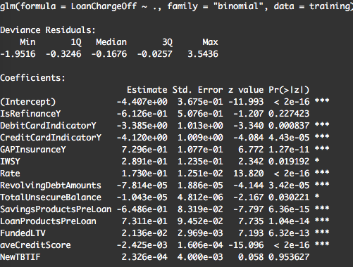
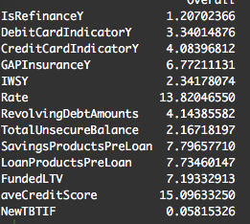
Coefficients

Slide 25
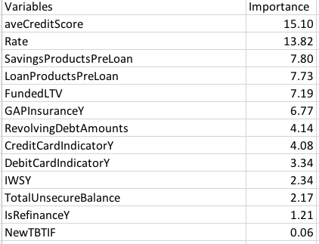
Coefficients Importance

Slide 26
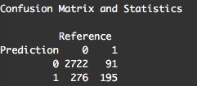


Model Evaluation and Diagnostics
Confusion matrix
Accuracy calculation

Slide 27
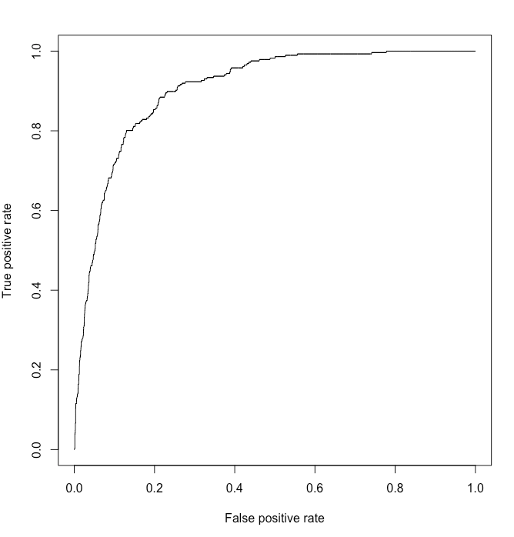

ROC Curve

Slide 28
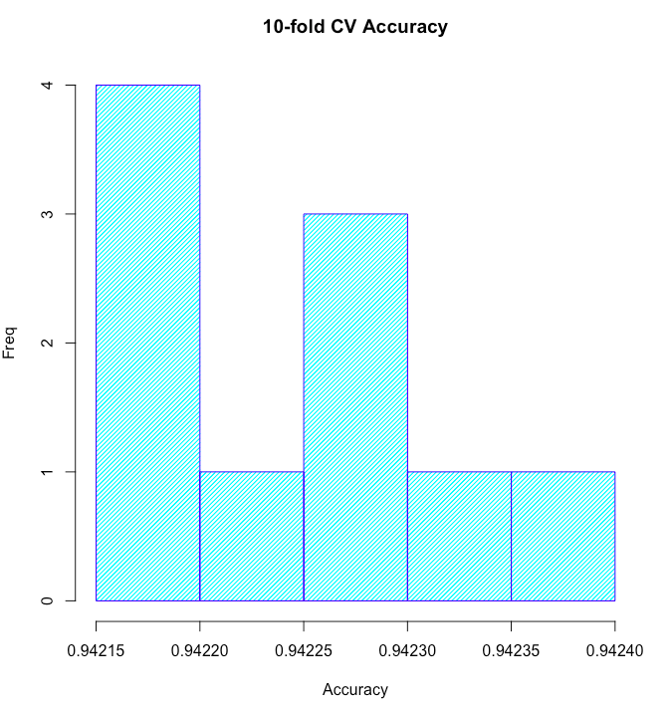
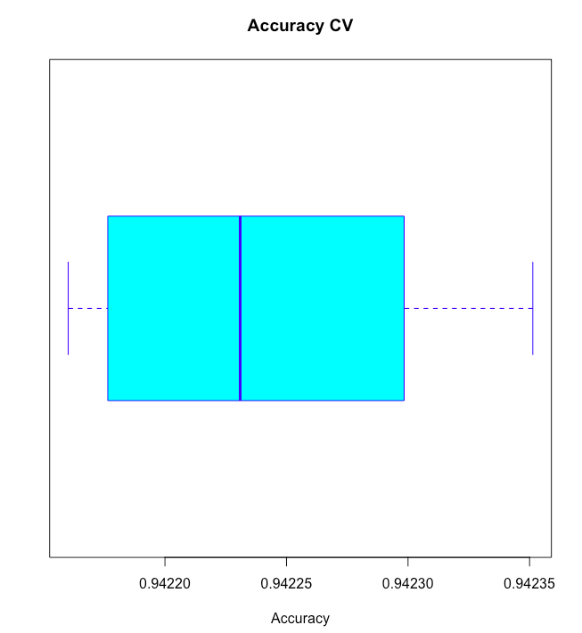

10-Fold Cross Validation for Whole Dataset
Mean Accuracy : 94.22%
Cross Validation Error Rate
0.05783765 0.05774156 0.05772752 0.05781743 0.05770162 0.05769343 0.05782352 0.05764867 0.05783978 0.05779654

Slide 29
Conclusion & Future work
The accuracy of testing dataset is 88.82%.
The sensitivity of testing dataset is 0.9079. The specificity is 0.6818.
The AUC is 0.9.
The mean accuracy of whole dataset is 94.22% according to 10-fold crossing validation.
The accuracy seems to be high. More classifier needs to be try, like SVM, RF.
Feature selection still needs to done.
Outliers needs to be done.

Slide 30
Reference
Alfiyatin, A., Ema, R., Taufiq, H., & Mahmudy, W.Modeling house price prediction using regression analysis and particle swarm optimization case study : Malang, east java, indonesia.8
ATIF, M., AMIR, S., & FRANCESCO, T.Foreclosures, house prices, and the real economy. The Journal of Finance, 70(6), 2587-2634. 10.1111/jofi.12310 Retrieved from https://doi.org/10.1111/jofi.12310
Azadeh, A., Ziaei, B., & Moghaddam, M. (2012). A hybrid fuzzy regression-fuzzy cognitive map algorithm for forecasting and optimization of housing market fluctuations. Expert Syst.Appl., 39(1), 298-315. 10.1016/j.eswa.2011.07.020 Retrieved from http://dx.doi.org/10.1016/j.eswa.2011.07.020
Boser, B. E., Guyon, I. M., & Vapnik, V. N. (1992). (1992). A training algorithm for optimal margin classifiers. Paper presented at the Proceedings of the Fifth Annual Workshop on Computational Learning Theory, Pittsburgh, Pennsylvania, USA. 144-152. 10.1145/130385.130401 Retrieved from http://doi.acm.org/10.1145/130385.130401
Calhoun, C. A.Property valuation methods and data in the united states. Housing Finance International, 16(2), 12-23. Retrieved from https://search.proquest.com/docview/216195180?accountid=2909
Coakley, J. R., & Brown, C. E.Artificial neural networks in accounting and finance: Modeling issues. Intelligent Systems in Accounting, Finance and Management, 9(2), 119-144. AID-ISAF182>3.0.CO;2-Y Retrieved from https://doi.org/10.1002/1099-1174(200006)9:2<119::AID-ISAF182>3.0.CO;2-Y
Fan, G., Ong, S. E., & Koh, H. C. (2006). Determinants of house price: A decision tree approach. Urban Studies, 43(12), 2301-2315. 10.1080/00420980600990928 Retrieved from https://doi.org/10.1080/00420980600990928
Lenk, M. M., Worzala, E. M., & Silva, A.High‐tech valuation: Should artificial neural networks bypass the human valuer? Jnl of Property Val & Invest, 15(1), 8-26. 10.1108/14635789710163775 Retrieved from https://doi.org/10.1108/14635789710163775
Limsombunchai, V. (2004). House price prediction: Hedonic price model vs. artificial neural network Retrieved from http://ageconsearch.umn.edu/record/97781/files/2004-9-house%20price%20prediction.pdf;
McGreal, S., Adair, A., McBurney, D., & Patterson, D.Neural networks: The prediction of residential values. Jnl of Property Val & Invest, 16(1), 57-70. 10.1108/14635789810205128 Retrieved from https://doi.org/10.1108/14635789810205128
Mullainathan, S., & Spiess, J. (2017). Machine learning: An applied econometric approach. Journal of Economic Perspectives, 31(2), 87-106. 10.1257/jep.31.2.87 Retrieved from http://www.aeaweb.org/articles?id=10.1257/jep.31.2.87
Park, B., & Bae, J. K. (2015a). Using machine learning algorithms for housing price prediction. Expert Syst.Appl., 42(6), 2928-2934. 10.1016/j.eswa.2014.11.040 Retrieved from http://dx.doi.org/10.1016/j.eswa.2014.11.040
Park, B., & Bae, J. K. (2015b). Using machine learning algorithms for housing price prediction: The case of fairfax county, virginia housing data//doi.org/10.1016/j.eswa.2014.11.040 Retrieved from http://www.sciencedirect.com/science/article/pii/S0957417414007325
Plakandaras, V., Gupta, R., Gogas, P., & Papadimitriou, T.Forecasting the U.S. real house price index//doi.org/10.1016/j.econmod.2014.10.050 Retrieved from http://www.sciencedirect.com/science/article/pii/S0264999314004143
A review of real estate valuation and optimal pricing techniques. (2014). Asian Economic and Financial Review, 4(12), 1878-1893. Retrieved from http://www.pakinsight.com/archive/3/12-2014/12

Slide 31
Thank you

