Slide 1

DARK WEB

Slide 2
whoami
I’m Sarath
From Alappuzha, Kerala
Currently Working as a Cyber Security Consultant and Trainer at Technovalley Software India pvt. Ltd
Other than technical domain I am a soft skill trainer and a public speaker

Slide 3
What are we going to discuss today
Introducing the whole Internet
Surface Web
Deep Web
Dark Web
Exploring dark web
Tor Project
Onion services
What is the purpose?
Conclusion

Slide 4
INTERNET – The world of Information
Internet is nothing but an interconnection of different networks around the globe.
The whole internet can be divided into three different categories
Surface Web
Deep Web
Dark Web

Slide 5
Surface Web – Owned by search engines
The surface web is the place where anyone can explore with an internet connection.
The reality is only 4% of the whole internet is exposed in the surface web.

Slide 6
Deep Web – Only for Authorized users
Deep web is the place where we need some kind of authorization to access.
Gmail is a part of deep web, Because we need to give our username and password to access our inbox

Slide 7
Dark Web – World of Anonymous users
Dark web is the place where PRIVACY becomes important to the users.
The Dark Web is invented by US Naval Research Laboratory for data exchange between spies, The technology behind dark web is known as Tor (The Onion Router).

Slide 8
Tor Project
US Naval Research Laboratory released the source code to the public. After this the project is developed under “The Tor Project”
Tor uses onion protocol for communication between users and the servers.

Slide 9
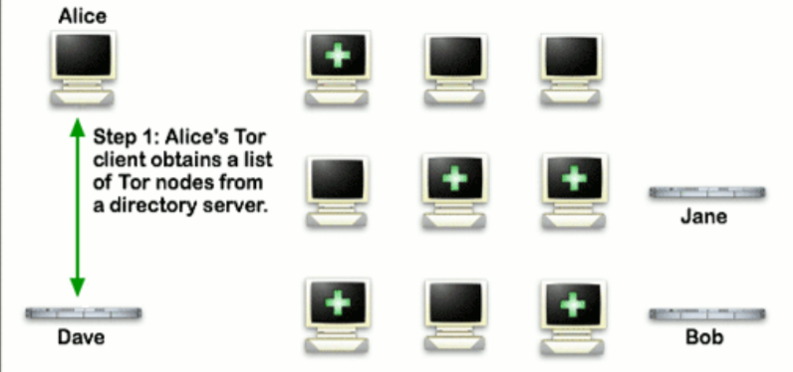
How it works..

Slide 10
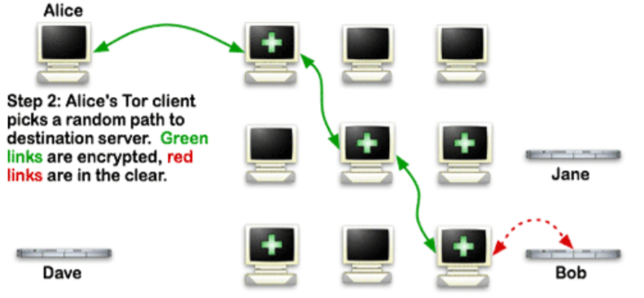

Slide 11
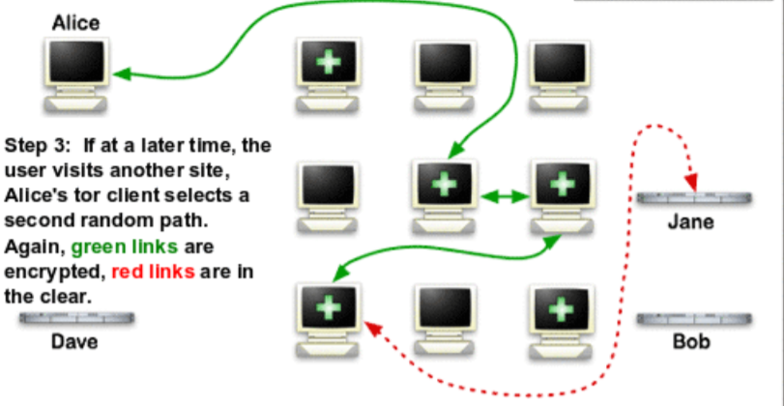

Slide 12
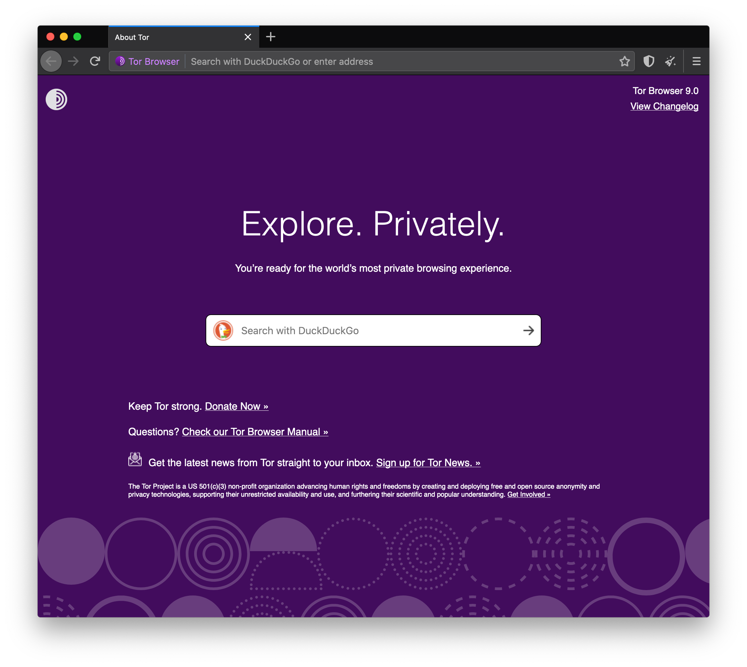
Tor Browser

Slide 13

DuckDuckGo
DuckDuckGo is the default search engine in Tor Browser
Using Tor Browser prevents DDG from tracking users, even if they wanted to (they claim not to)
Duckduckgo.com or https://3g2upl4pq6kufc4m.onion/

Slide 14
Things to know about mobile Tor
The design of mobile devices makes full privacy impossible
Mobile Tor is best for censorship prevention
Can also provide better privacy for some threat models
We’re making it better all the time and better options for mobile devices are coming out soon

Slide 15
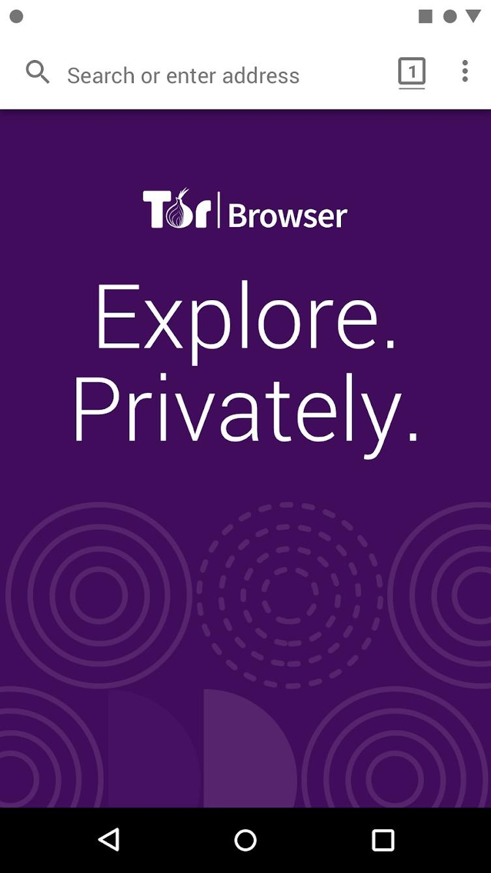
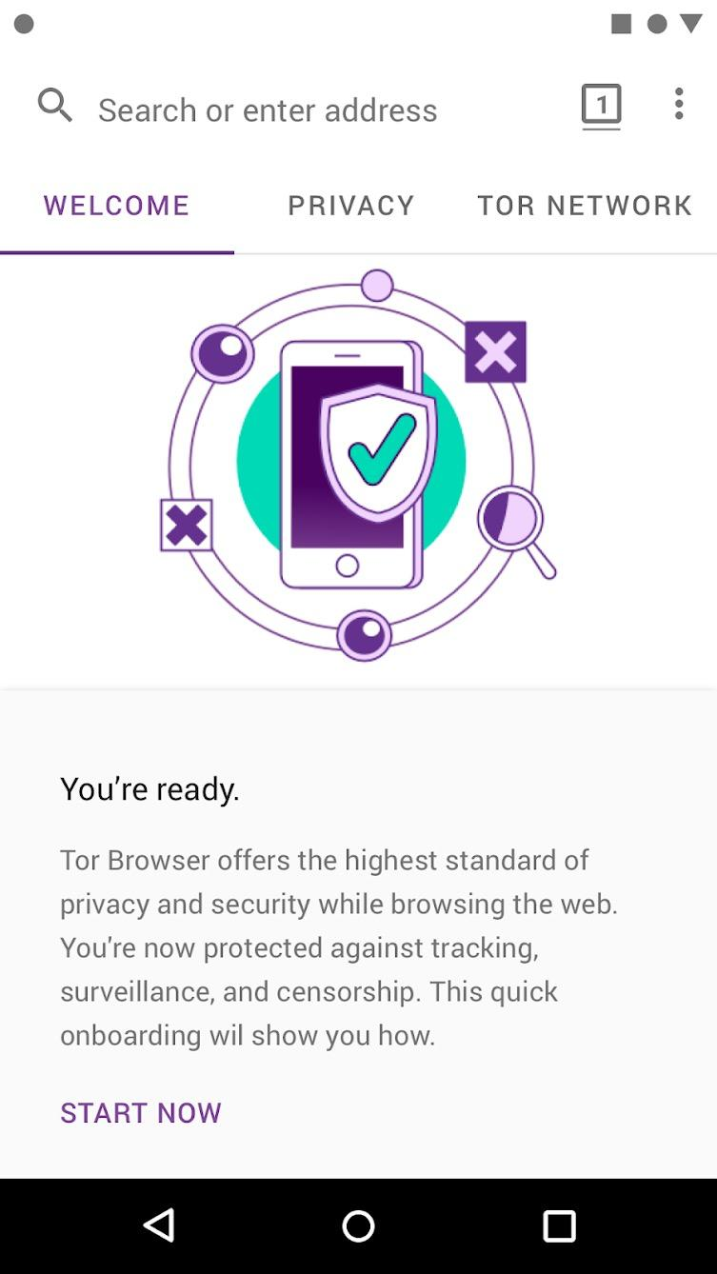

Tor Browser for Android

Slide 16
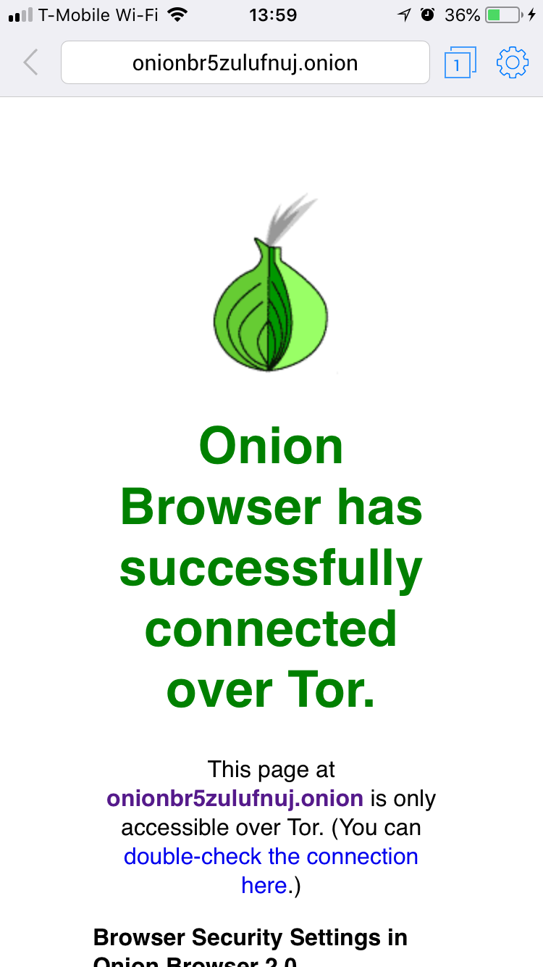
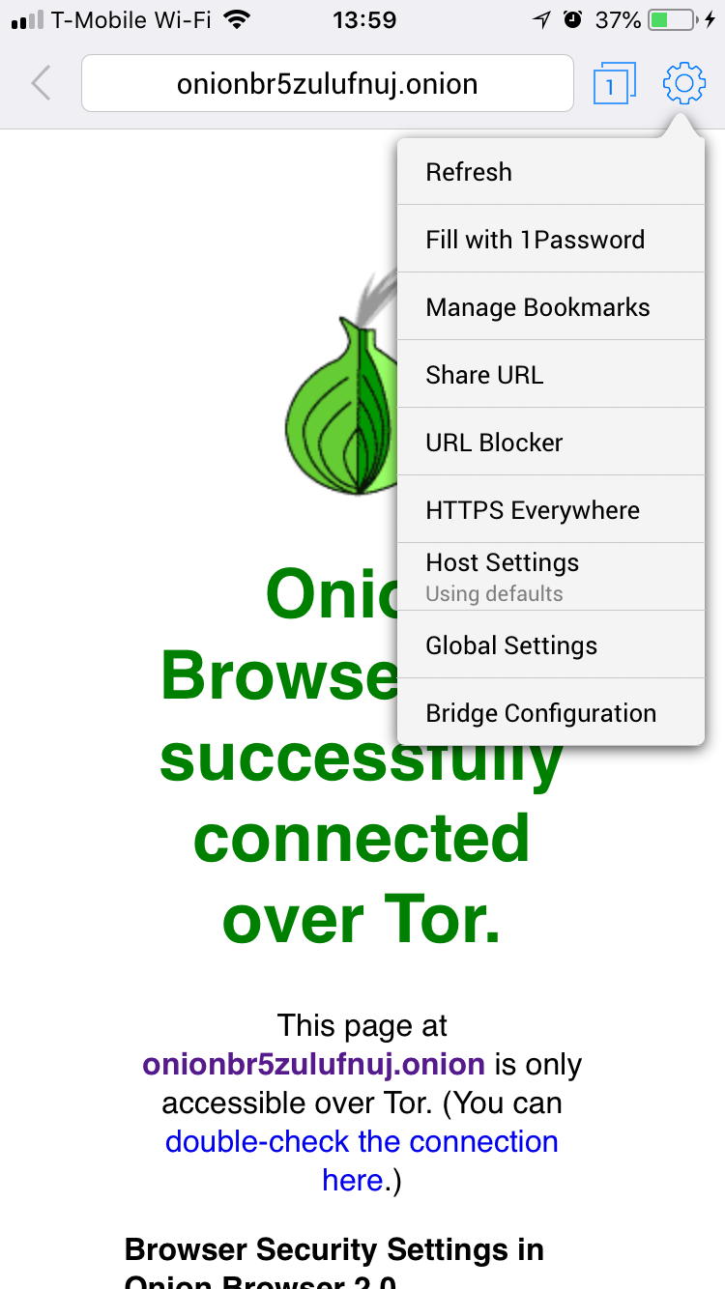
Onion Browser
Tor Browser for iOS

Slide 17
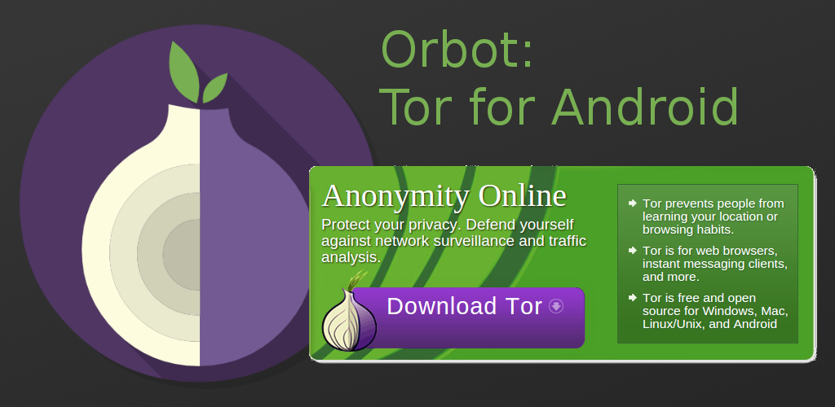

Slide 18
What are onion services?
The regular internet allows adversaries to see what you are sharing and with whom, whether you're using Dropbox etc., downloading it from email or through your browser...

Slide 19
...so Tor devised a sneaky way to hide both the file data and the related metadata!

Slide 20
Onion Services..
Dark web links are special links having .onion as the extension
.onion websites can’t be opened using normal web browsers. We need to use a special browser “Tor” for accessing these websites.
Tor directs Internet traffic through a free, worldwide, volunteer overlay network consisting of more than seven thousand relays to conceal a user's location and usage from anyone conducting network surveillance or traffic analysis.

Slide 21
.onion communications are end to end encrypted without HTTPS

Slide 22
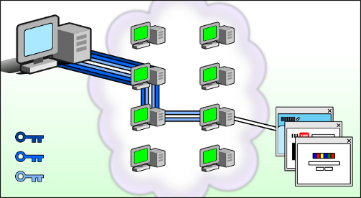
Working of Tor Relays

Slide 23
What is the purpose
First and foremost “PRIVACY”
Whistleblowing
Protection from Censorship
Protection from Surveillance

Slide 24
Conclusion
Introduction of internet given us a lot of opportunities to enhance our efficiency and time management, along with these benefits internet do have a bad side like child pornography. Like wise dark net or dark web giving us a great way to manage our privacy and block surveillances, so use your brain....

Slide 25
Thanks You

Slide 26
QUESTIONS ?

Slide 27

Sarath G Personal Blog : https://www.rootseclabs.com/ My company :Technovalley Software consulting website : https://www.technovalley.co.in/
CONTACT ME

