Slide 1
Intranet Penetration Testing
Speaker : Shameel Uddin

Slide 2
Disclaimer
The information in the presentation/webinar has the goal to teach you the techniques used by hackers in order to avoid them.
This knowledge is not intended to be used maliciously. It is your responsibility if you decide to use this information to make illegal and/or unethical choices/actions.
The ideas/concepts/techniques/tricks mentioned in the presentation are not developed by me but by others and I’ve accumulated the material from different sources to convey it to the audience.
Always obtain the permission first before utilizing the knowledge of penetration testing.

Slide 3
Introduction
Penetration testing is an exercise to identify vulnerabilities which could be present in network, system or application of an organization.
Penetration tests are authorized tests and are carried by professionals who use same techniques that real attackers may use.
Penetration Testing demonstrates the weaknesses/vulnerabilities and most importantly, the remedies for the demonstrated weaknesses.

Slide 4
Reasons :
Evaluate current “Security Profile”.
Highlight the affects of weakness.
Create Security Measures.
Documentation.
Notes:
Simulate an attack to find out what malicious attacker could exploit.
Not just highlight the vulnerability but the danger that it poses to the company as well.
Provide Remedies for it.
Documentation!!!

Slide 5
How to do it?
Follow a methodology.
Define proper objectives and limits to the scope of Penetration Test.
Use right tools to complete the tasks.

Slide 6
Types of penetration tests
There are three types of penetration tests :
White Box
Black Box
Gray Box
Notes:
Pentster has complete knowledge of infrastructure.
When company want the complete security audit.
Pentester gives complete posture of the company.
It is further broken down into two types of tests → (i) Blind (ii) Double-Blind
Pentester will go for reconnaissance, scanning and public available information and the internal employees will be aware that a test is being conducted.
It’s also called as zero-knowledge testing. Neither the penetester know about the target nor the target knows about the scope of the pentest. [most popular today]
3. Attacker has a partial knowledge. It saves some time. It also provides Dual Prespective. From developer’s as well as attacker’s prespective. I.e. We can attack from outside or inside.

Slide 7
Methodologies
OSSTMM : Open Source Security Testing Methodology Manual.
OWASP : Open Web Application Security Project.
ISSAF : Information System Security Assessment Framework.
NIST : National Institute of Standards and Technology.
LPT : Licensed Penetration Tester (by EC-Council)
Notes:
PT Methodology is a comprehensive methodological approach that is used in penetration testing to identify vulnerabilities in overall security posture of an organization.
Ensures that tests are reliable, accurate & consistent across the board.
PT is only as comprehensive as the methodology that was used.
Both proprietary and open source methodologies exist

Slide 8
Types of penetration tests
External Penetration Testing
Internal Penetration Testing
Firewall / IDS Penetration Testing
IoT Devices Penetration Testing
Password Cracking Penetration Testing
Social Engineering Penetration Testing
Web App Penetration Testing
Database Penetration Testing
Wireless Penetration Testing
Cloud Penetration Testing
… And many more.

Slide 9
Common types of penetration tests:
“External network pen test — A black box test designed to use footprint analysis to identify publicly available information about the network and organization, including IP addresses, ranges, and key personal information (email addresses, passwords, etc.) Using this information, an expert will locate potential vulnerabilities.
Internal network pen test — A white or grey box test designed to simulate what could happen if a user’s account is compromised.”
Reference : bitsight

Slide 10
Internal Penetration Testing
It is also known as Intranet Penetration Testing.
It is a test of internal networks which simulates what an attacker could do once he has breached into the network. This test emulates the action of actual attacker by exploiting weaknesses in network security.
Internal Attack could also come from rogue employee.
This test examines internal IT systems for any weakness that could be used to disrupt the confidentiality, availability or integrity of the network
Notes:
Why should we perform an Internal Penetration Test?
Internal Penetration testing allows organisations to test, if an attacker had the equivalent of internal access how they may they may have access to perform unauthorised data disclosure, misuse, alteration or destruction of confidential information, including Non-Public Personal Information (NPPI).
The internal network, (file servers, workstations, etc.), of the organisation is exposed to threats such as external intruders, after breaching perimeter defences, or malicious insiders attempting to access or damage sensitive information or IT resources. Therefore organisations are encouraged to test the internal network at least as frequently as they do the external perimeter.
Best Practice recommends that each organisation perform an Internal Penetration Test as part of their regular Security Program in order to ensure the security of their internal network defenses.

Slide 11
Phases of pentesting
Reconnaissance
Scanning
Exploitation
Maintaining Access
Covering Tracks
Reference : pentaroot

Slide 12
Reconnaissance / Information Gathering
Collect Basic Information to build foundation.
Discover Operating Systems and Web Servers.
Performing Queries [to find underlying network infrastructure]
Types
Passive : No direct interaction with the target.
Active : Direct interaction with target.
Notes:
Reason :
Understand the Security Posture
Reduce the Attack Area
Build Information Database
Layout a Network Map

Slide 13
Goal
Create Blue Print
Network Information
Domain Names
IP Addresses
Unmonitored/Private Webs
TCP/UDP Services
IDS/Access Controls
VPN Info
Phone Numbers / VoIP
Organization Information
Organization Website
Employee Details
Location Details
Addresses/Phone Numbers
Web Server Links
Background of Organization
News/Press Release
Notes:
Hundreds of tools : - Search Engines
Websites
Applications & Built-in Commands.
Whois | Ping | DNS

Slide 14
Scanning
It’s a process involving probing a target network with a goal to find out as much information as we can about those systems.
Looking for Live Systems
Identifying those systems
Discover “open” or “close” ports
Identify “services” running on the systems.
Notes:
From Recon, we found our targets’ basic knowledge like range of IP addresses and ownership etc.
→ A good attacker keeps on scanning to identify if a new node/sercurity-device enters into the network.

Slide 15
Note:
When reviewing the output from scanning, always make special notes of Internet protocol (IP) addresses that include some type of remote access service because gaining access to these services often results in the complete compromise (or “owning”) of that target. Upon discovery of one of these services, hackers typically turn to an “online password cracker”.
Secure shell (SSH) / Telnet
File Transfer Protocol (FTP)
PCAnywhere
Virtual Network Computing (VNC)
Remote Desktop Protocol (RDP)
Notes:
Ncrack
Medusa
Hydra

Slide 16
Goal
Live Hosts.
All IP Addresses must be gathered.
Identifying open and closed ports
OS Identification
Vulnerabilities and Threats

Slide 17
Exploitation
Exploitation is the process of gaining control over a system. However, it is important to understand that not every exploit leads to total system compromise.
More accurately defined, an exploit is a way to bypass a security flaw or circumvent security controls.
This process can take many different forms, the end goal always remains the same: administrative-level access to the computer.
Notes:
Mention Post-Exploitation too.

Slide 18
Common Issues :
Outdated Softwares / Operating Systems / Networking Devices
Misconfigured Softwares / Operating Systems / Networking Devices
Insecure Protocols

Slide 19
Maintaining Access
Maintaining access in a target machine is a necessary phase in order to further escalate the attack in the network and to steal important information from the system.
It can be done by using backdoors and/or rootkits

Slide 20
Covering Tracks
Disable auditing.
Clearing logs.
Modifying logs, registry files.
Removing all files, folders created.
Notes:
There are two types of attackers.
The one everybody knows
The one nobody knows
Rootkit : Mask his precense or the presence of malware [in a form of driver and appear as a port of OS]

Slide 21
Intrapenetesting
It is said that 90-95% fortune 500 companies use Active Directory.
We will be focusing on SOHO (Small Office / Home Office ) network.

Slide 22
Llmnr Posioning
Used to identify hosts when DNS failed to do so.
Previously it was NBT-NS
Flaw : Service utilizes a user’s username and NTLMv2 hash when appropriately responded to.

Slide 23
Let’s get some basics straight first
DNS
NBT-NS

Slide 24
DNS : Domain name system
Humans are tend to easily memorize names rather than some random numbers
Computers understands IPs (which are random numbers for humans)
So, we need a bridge → DNS
Google.com → 172.217.19.14

Slide 25
netbios
Abbreviated as Network Basic Input/Output System
Also called as NBT-NS
Made in 1983
When it was made so security wasn’t kept in check.
Allows Operating Systems and Applications to communicate with other hosts on LAN by performing name resolution without requiring a DNS server.

Slide 26
llmnr
Link-Local Multicast Name Resolution
Released in 2006
Replased NETBIOS
Enabled by default

Slide 27
Password hashes
It is a one-way process to convert a password into some non-understandable string.
shameel → a036a362c3cd76c8a9c0e1220d109173
Dictionary Attacks / Hybrid Attacks / Brute-Forcing Attacks.

Slide 28
Scenario 1
Attacker is an internal employee
Attacker physically connects something like ruber-ducky / raspberry pi and then enters into the network and compromise someone’s PC to launch the attack.
Attacker sends malicious file to the employee and infects it.

Slide 29
Order of operations for name resolution
Suppose a victim wants to access file sharing server → \\sharing
So it follows the following order :
It asks itself whether it is \\sharing.
Then it looks for static record in → C:\Windows\System32\drivers\etc\hosts
It asks from DNS Server
Then it broadcasts in the network to look for \\sharing. [problem]

Slide 30
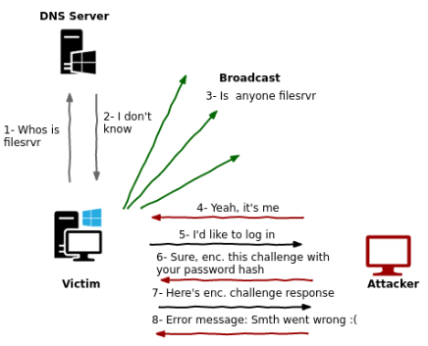
Graphical Representation :
Reference: pentest.blog

Slide 31
Tools:
Responder
MITMF
LLMNR_RESPONSE module in MSF

Slide 32
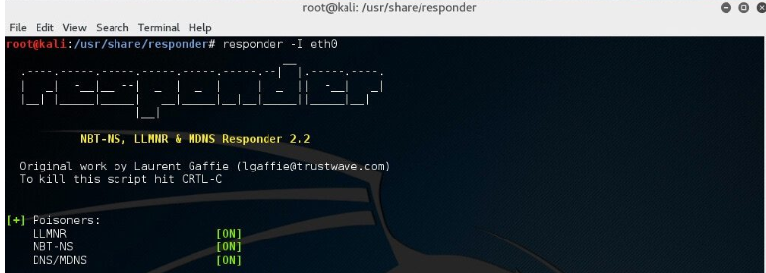
Responder
respnder -I eth0
Notes:
With this running, if a client now tries to resolve a name not in the DNS, our instance of Responder should poison the LLMNR and NBT-NS requests that are sent out.

Slide 33
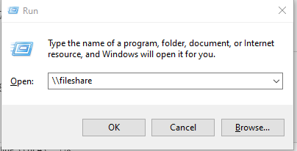
Victim:
Notes:
Now on a Windows 7 machine, we will request a network resource that does not exist within our DNS. For this example, we will use the file explorer and request access to a network resource “\\fielshare”.
If a user accidentally typed this instead of a legitimate hostname in the DNS which could be “\\fileshare” Responder should say that its IP is the location of “fielshare”. The Windows 7 machine will then try to connect to “\\fielshare” using SMB which it believes is located on the Kali host. The SMB process will send the Windows 7 username and hashed password to the Kali host.

Slide 34
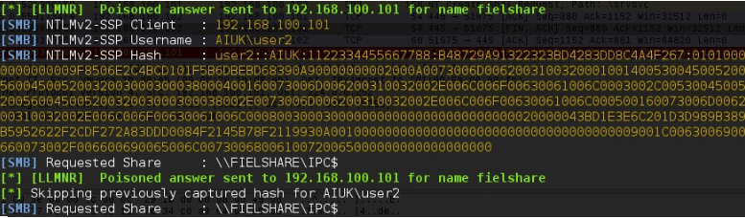
Responder’s Response:
Reference : 4armed

Slide 35
Cracking begins
Since hash has been obtained so now the attacker can begin the cracking process.
Some of the common tools are :
Hashcat
John The Ripper

Slide 36
WPAD - Web Proxy Autodiscovery Protocol
WPAD is used in some corporate environments to automatically provide the Internet proxy for web browsers.
Many Internet browsers have “enable system proxy” set by default in their internet settings, so they will seek out a WPAD server for a proxy address.
If a browser is configured to automatically detect proxy settings, then it will make use of WPAD protocol to try and locate and download the wpad.dat Proxy Auto-Config (PAC) file.
A PAC file defines proxy servers that a web browser should use for different URLs.
Notes:
Explanation : https://nakedsecurity.sophos.com/2016/05/25/when-domain-names-attack-the-wpad-name-collision-vulnerability/

Slide 37
WPAD Attack
Responder -I eth0 –wbF
“-w” Starts the WPAD Server
“-b” Enables basic HTTP authentication
“-F” Forces authentication for WPAD (a login prompt)
Now when a user on the local network uses IE/ Chrome, the browser should fetch the wpad.dat file from Responder. Because we supplied the argument –F
Note: Firefox prompts the user to manually enter their credentials

Slide 38
Pass the hash
What if the password is a really long string and you’re unable to crack it in short amount of time with various wordlists ?
This sort of attack comes in handy in such scenarios.

Slide 39
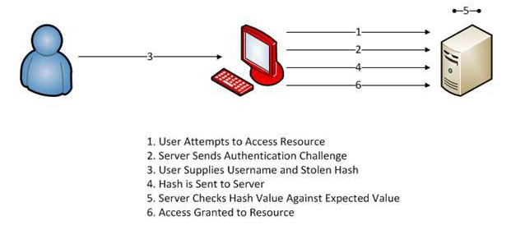
Graphical Representation
Rederence : techgenix
Notes:
psexec module of MSF
Remedies :
Isolation of Sensitive Systems
Two Factor Authentication
Intrusion Detection System Monitoring - From an IDS perspective you most likely won't be able to catch an attacker performing the pass the hash attack itself because it typically looks like a normal authentication sequence. However, you may have success in catching the attacker based upon the actions they perform after they've gained access. For instance, in our example scenario you probably wouldn't see an IDS alert on the passing of the hash to the victim machine, but you probably would see an alert once psexec creates a shell and sends it back across the network. This would allow you to detect the attack when it happens and respond to the incident appropriately.

Slide 40
MULTIRELAY
It is used along with Responder and sends authentication requests to the target impersonating the victim’s machine.
If the compromised account has “atleast” local administrative privileges then we can :
Dump local password hashes
Launch shells
Pivot to other devices
Conditon : SMB Signing must be off. So, first step is to identify the machine which don’t require SMB signing using “RunFinger”

Slide 41
Scope
Responder’s scope is within the local subnet.
BUT
MultiRelay can relay the hashes anywhere in the network which the requests can be reached.

Slide 42
Other loopholes to look for?
DHCP Attacks
ARP Spoofing
STP
DTP/VTP
Other critical vulnerabilities like EternalBlue, BlueKeep
Most importantly : Misconfiguration
Notes:
Mention about password sessions misconfiguration like only first 3 host will be authenticated and no other.
ONVIF Protocol activated but not known.
Ports in IoT Devices which are enabled but are nothing but backdoors.

Slide 43
The End
Thank You
☺

