Slide 1
Instructor: Rakesh Shrestha Group 5: Sovichea Cheth Aaron Gezai James Alituhikya Samuel Tesfabruk Project URL: https://github.com/wap-group5/Hotel
MAHARISHI UNIVERSITY OF MANAGEMENT
CS-472: Web Application Programming
Project: Hotel Management System

Slide 2
Project Introduction
Hotel Management System is the web application use for managing various hotel processes such as booking the room, check in/check out the room, room payment, etc.
We use the tools and technologies through out the course including:
HTML
CSS
JavaScript, jQuery, AJAX
Servlet
JSP
JSTL
GSON
etc..

Slide 3
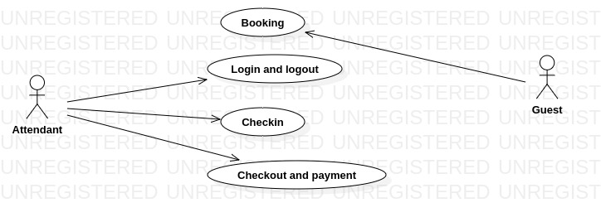
Use Case Diagram
Our project contains 4 different use cases, so all the team are assigned to work on each of the use case through the project.

Slide 4
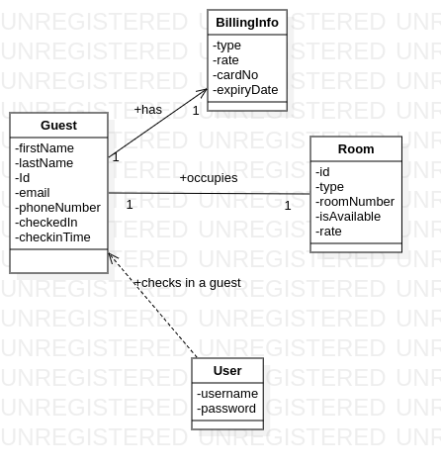
Class Diagram

Slide 5
Project Demonstration
Demonstration
Q&A

Slide 6
Thank you for your attention!

