Slide 1




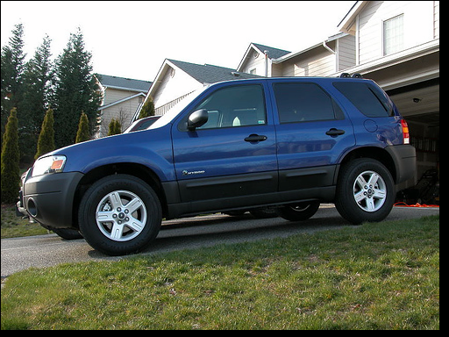
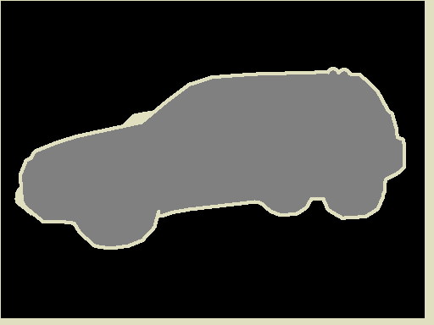
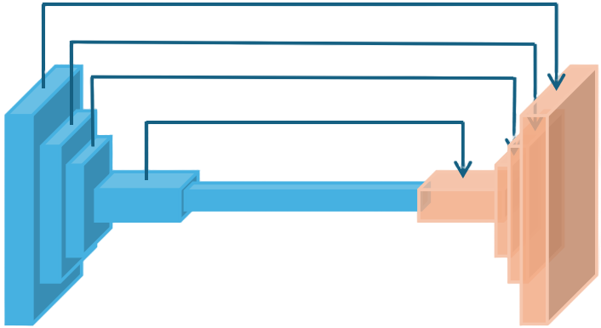
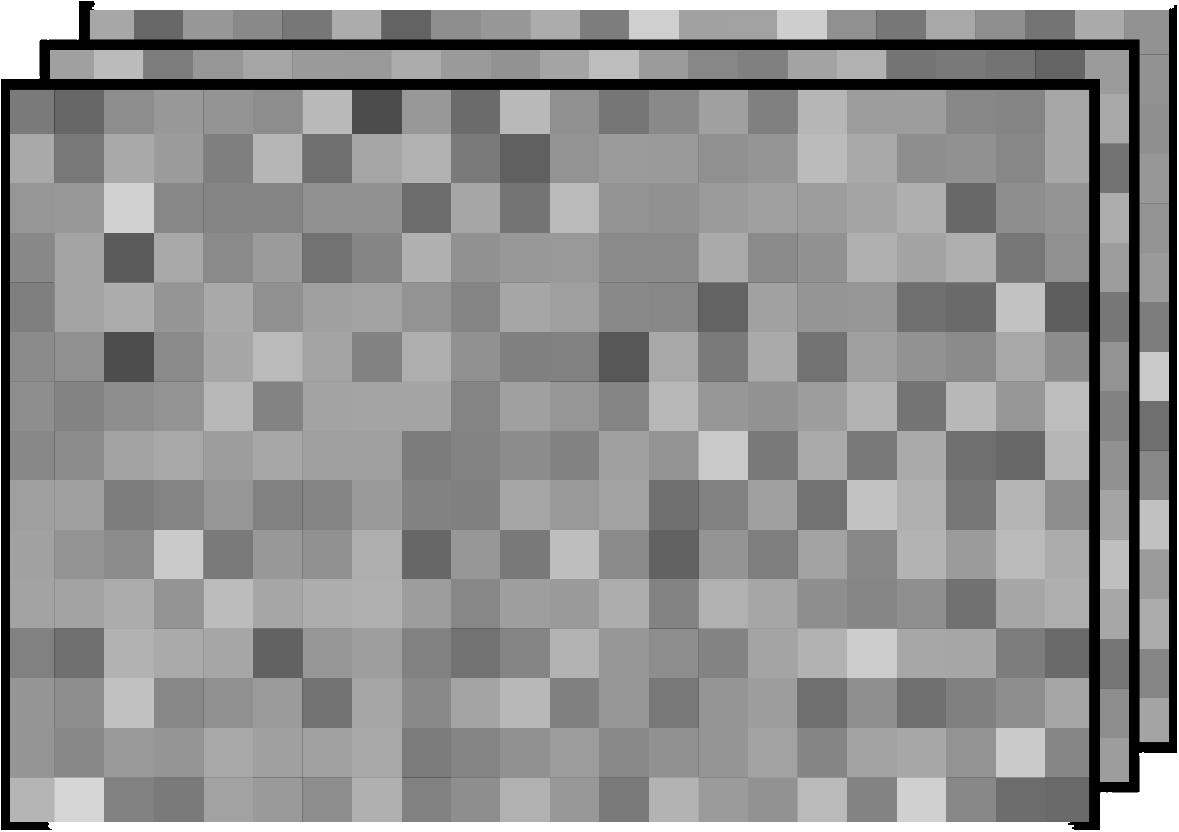
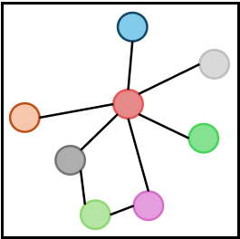
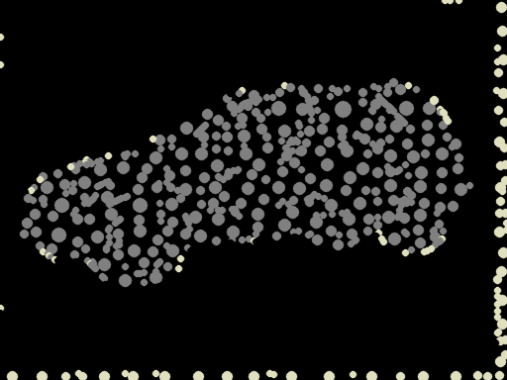
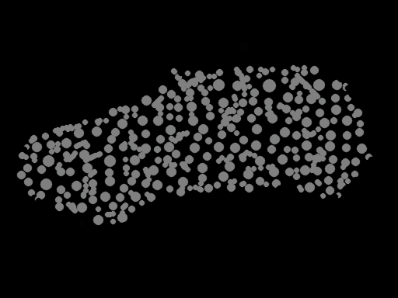


Encoding
Pixel Domain
Prediction
Pixel-Wise Prediction
Pixel-Level
Features
DisAggregated
GNN Features
Feature-Fusion Decoder
^
Y
L_{sp}(·)
Input Image
F_{p}
F_{g}
Ground Truth
CNN Backbone
X
Pixel-to-Superpixel Affinity Matrix
Y
Q
SpiexelFCN
Class Distribution
in Superpixels
Y_{sp}
G
: DATA FLOW
L_{sp}(·)
: GRADIENT FLOW
Node-Wise Prediction
: SUPERVISION FLOW
FC
F_{sp}
F_{n}
^
Y_{sp}
GCN
Superpixel Domain

